Slide 1


CMPE 135: Object-Oriented Analysis and Design October 24 Class Meeting
Department of Computer Engineering San Jose State University Fall 2017 Instructor: Ron Mak
www.cs.sjsu.edu/~mak

Slide 2
Review
Object-oriented design basics
Abstraction
Encapsulation
Inheritance
Polymorphism
Object-oriented design principles
Encapsulate what varies.
Favor composition over inheritance.
Program to interfaces, not to implementations.

Slide 3
Other Principles
Open-Closed Principle (OCP)
Classes should be open for extension but closed for modification.
Don’t Repeat Yourself (DRY) Principle
Abstract out things that are common and place them in a single location.
Single Responsibility Principle (SRP)
Make every object cohesive by giving it a single responsibility that all its services should focus on carrying out.

Slide 4
Other Principles, cont’d
The Liskov Substitution Principle (LSP)
Any object should be substitutable by an object of its base (super) class.
To maintain the LSP in your code, use delegation, composition, or aggregation instead of inheritance.
Code reuse
Use delegation, composition, and aggregation to use behavior from other classes.

Slide 5
Goal: Better Software!
Well designed
Implement object-oriented design basics.
Follow object-oriented design principles.
Results
More reliable software done sooner.
Flexible enough to handle change.
Easy to maintain.
It’s time to move up to an even higher level.

Slide 6
Design Patterns
A general reusable solution to a commonly occurring software design problem.
A template for how to solve a problem that can be used in many different situations.
Formalized best practices that can be used to solve common software design problems.
A shared vocabulary for discussing solutions to software design problems.

Slide 7
Design Patterns, cont’d
Not cut and paste code that can be inserted into an application.
Discovered, not created from scratch.
Found after many years of real-world programming experience by many top programmers.
Originated as a concept for designing buildings by architect Christopher Alexander.
Popularized in computer science by the “Gang of Four” (GOF) and their design patterns book.

Slide 8
Shared Pattern Vocabulary
Powerful
A design pattern communicates not just its name, but the entire set of its qualities, characteristics, and constraints.
Say more with less
Describe a design pattern and other developers quickly know precisely the design you have in mind.
Stay “in the design” longer
Design pattern discussions stay at a high level without diving into implementation details.

Slide 9
Shared Pattern Vocabulary, cont’d
Accelerate the design team
A team well versed in design patterns can move more quickly with fewer misunderstandings.
Accelerate junior programmers
Senior programmers who use design patterns serve as strong role models for junior programmers.

Slide 10
How to Use Design Patterns
Unlike library code that gets inserted into your code, design patterns go into your brain.
Framework and library code provide specific implementations of solutions.
Design patterns are at a higher level.
They tell us how to structure classes to solve certain software design problems.
We must adapt the design patterns to fit each application.

Slide 11
The Strategy Pattern
We used the Strategy Design Pattern to create the SimUDuck application.

Slide 12
The Strategy Pattern, cont’d
Define a family of algorithms.
Encapsulate each algorithm.
Make them interchangeable within the family.
Vary which algorithm to use independently from the clients that use it.
https://en.wikipedia.org/wiki/Strategy_pattern

Slide 13
Example: Weather Monitoring Station
WeatherData object tracks current conditions
temperature, humidity, barometric pressure
An app must provide three display elements updated in real time as the WeatherData object obtains the most recent measurements:
current conditions
weather statistics
simple forecast
Design an API for developers to create their own weather displays.
This example and its images are from
Head First Design Patterns
by Eric & Elizabeth Freeman
O’Reilly, 2004

Slide 14
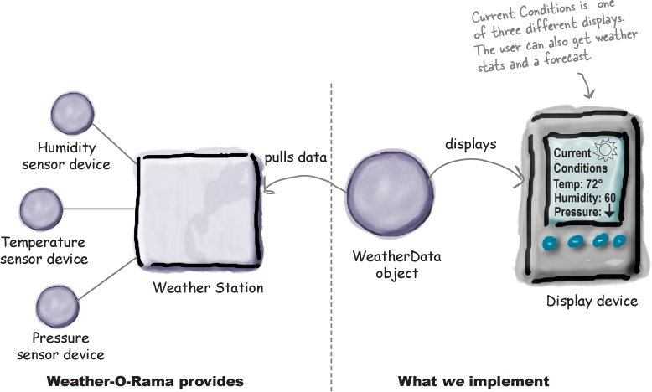
Weather Monitoring Station, cont’d

Slide 15
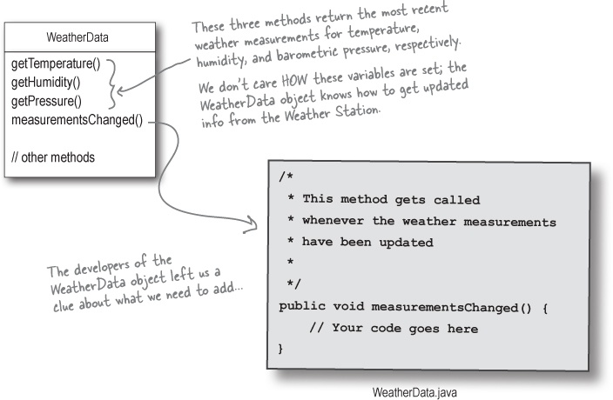
Obtaining Weather Data

Slide 16
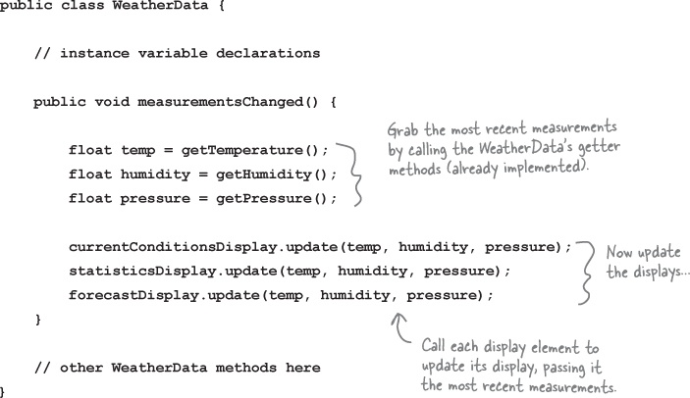
First Implementation

Slide 17
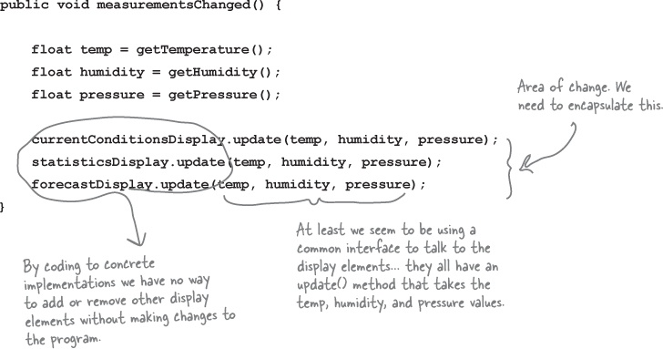
First Implementation: What’s Wrong

Slide 18
Newspaper Subscriptions
A newspaper publisher goes into business and begins publishing newspapers.
You subscribe to a particular publisher, and every time there’s a new edition it gets delivered to you. As long as you remain a subscriber, you get new newspapers.
You unsubscribe when you don’t want papers anymore, and they stop being delivered.
While the publisher remains in business, people, hotels, airlines, and other businesses constantly subscribe and unsubscribe to the newspaper.

Slide 19
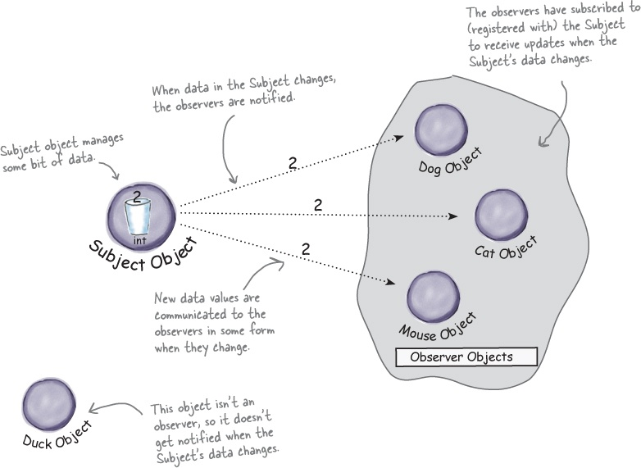
Publishers + Subscribers = Observer Pattern
Observer objects
can come and go.

Slide 20
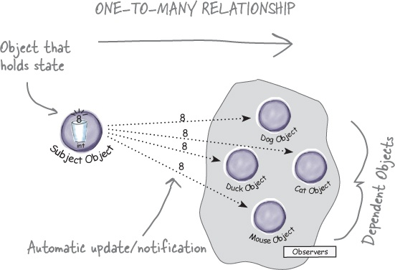
Observer Pattern Defined
Define a one-to-many dependency between objects.
When one object changes state, all of its dependents are notified and updated automatically.

Slide 21
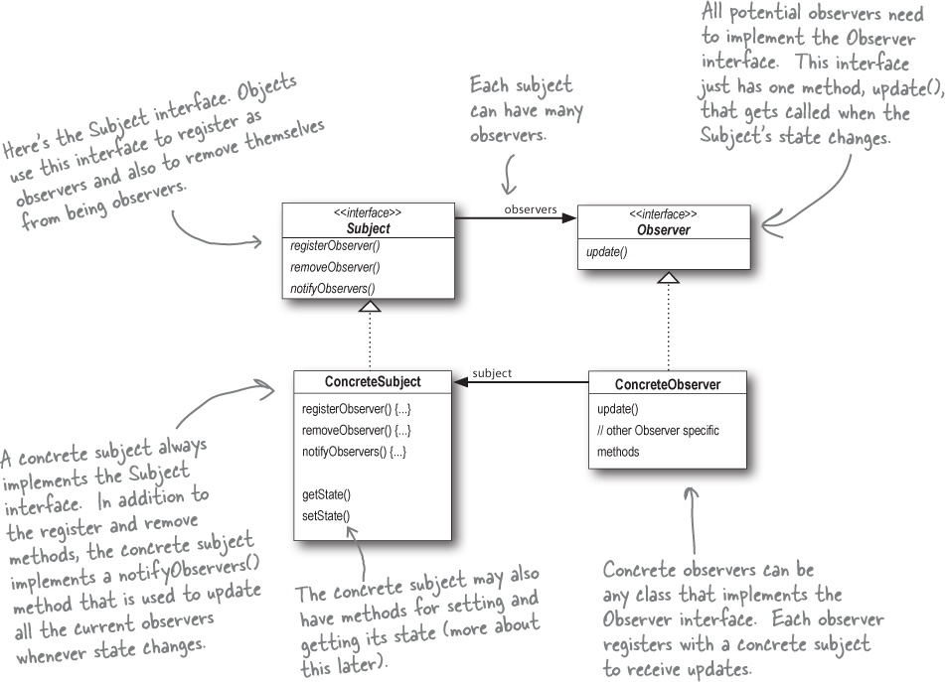
Observer Pattern UML

Slide 22
Loose Coupling
All the subject knows about an observer is that it implements the Observer interface.
The subject doesn’t care who the observer is or what it does with the data the subject provides.
We can add new observers at any time.
We never need to modify the subject to add new types of observers.
We can reuse subjects or observers independently of each other.
Changes to either the subject or an observer will not affect the other.

Slide 23
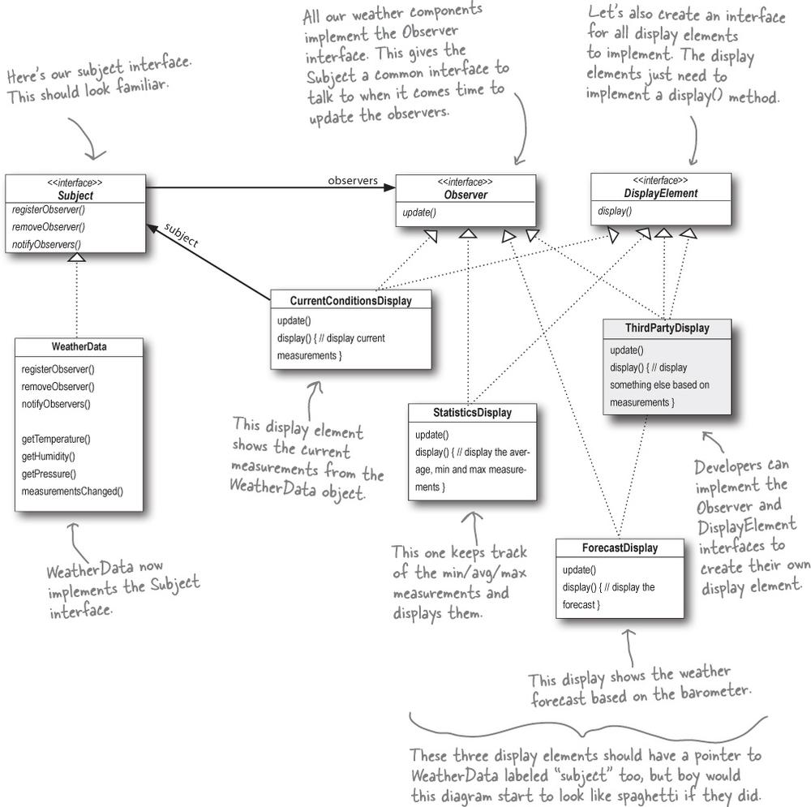
Weather Station Design

Slide 24
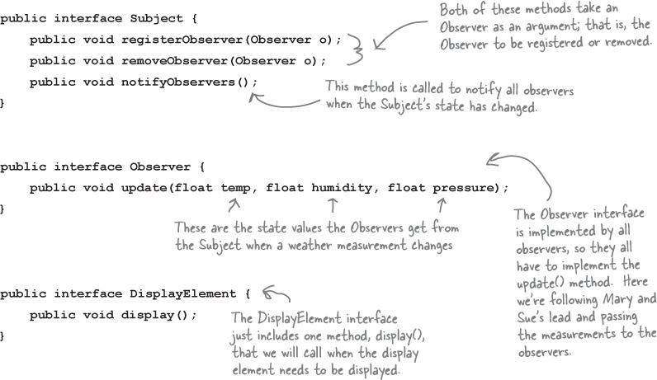
Weather Station Implementation

Slide 25
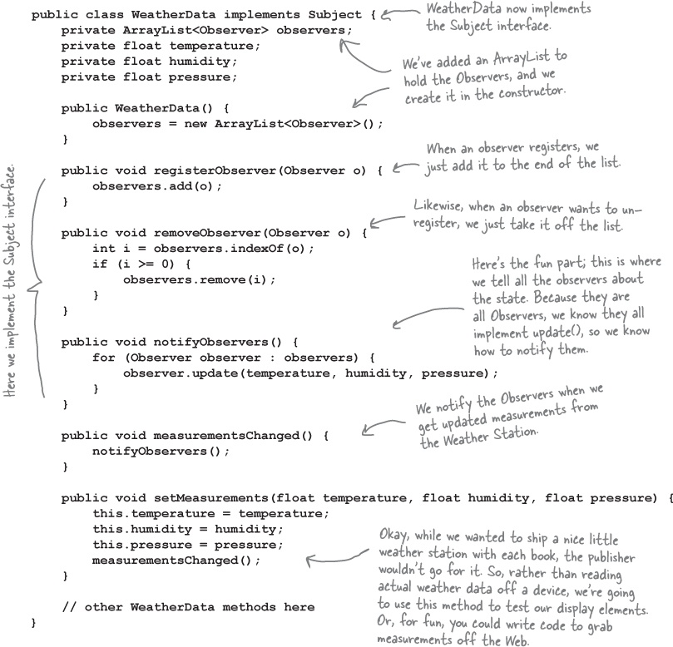
WeatherData Implementation

Slide 26
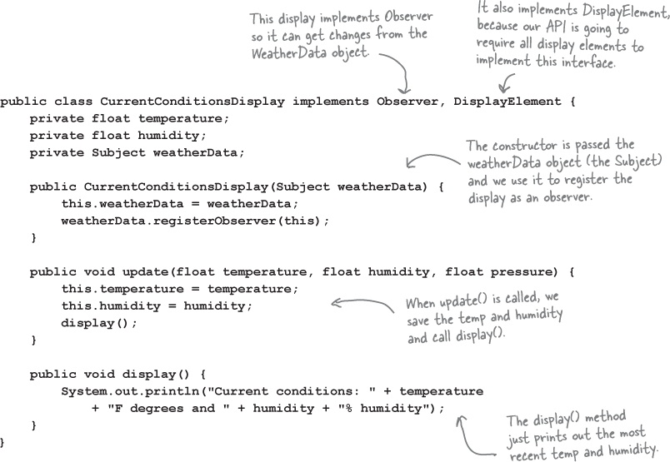
Display Elements Implementation

Slide 27
Observer Pattern Summary
Design principle: Separate what varies from what stays the same.
What varies: The state of the subject and the number and types of observers.
Design principle: Program to an interface, not to an implementation.
Both the subject and the observer use interfaces.
The subject keeps track of objects that implement the Observer interface.
Observers register and are notified by the Subject interface.

Slide 28
Observer Pattern Summary, cont’d
Design principle: Favor composition over inheritance.
The Observer Pattern composes any number of observers with their subjects.
These relationships are not part of an inheritance hierarchy.
They are established at run time by composition.

