Slide 1


Increased expression of inflammatory mediators in small-airway epithelium from tobacco smokers
Authors:Ajime Takizawa, Mitsuru Tanaka, Kazutaka Takami, Takayuki Ohtoshi, Koji Ito, Masaru Satoh, Yasumasa Okada, Fumihiro Yamasawa, and Akira Umeda
Presented by : Timothy Ongaba 2021/HD17/2680U
Suubi Ivy Grace Chimulwa 2021/HD17/2686U

Slide 2
Background
Methodology
Results
Discussion
Conclusion
Airway epithelial cells activated by tobacco smoke express chemokines (IL-8) and adhesion molecules (ICAM)
IL-8 is a potent neutrophil chemotactic factor
ICAM-1 is believed to be an important adhesion molecule for neutrophil accumulation, adhesion to the epithelium, activation, and transepithelial migration
Recruited neutrophils express Mac-1, which binds to its counter-molecule, intercellular adhesion molecule (ICAM)

Slide 3
Background
Methodology
Results
Discussion
Conclusion
These inflammatory processes in the small airways are involved in the initial steps for development of Chronic Obstructive Pulmonary disease
However, the precise functional changes in small airways from tobacco smokers have not yet been clarified because of the lack of the technology

Slide 4
Background
Methodology
Results
Discussion
Conclusion
Therefore:
Utilized a new large-size brush for harvesting a larger number of epithelial cells
Evaluated the mRNA levels of inflammatory mediators of IL-8 and ICAM-1 with the RT-PCR technique
In some samples, epithelial cells from small airways were cultured until confluence and evaluated the secretion of IL-8 and the soluble form of ICAM-1 (sICAM-1) with ELISA

Slide 5
Study participants
Background
Methodology
Results
Discussion
Conclusion
The criteria below were observed and recorded for 39 subjects (22 smokers and 17 never smoked):
Free of respiratory diseases(3months)
Normal chest X-ray films
No respiratory symptoms for at least 3 months before this study
Results of percent forced vital capacity and percent forced expiratory volume in 1s (Normal)
Maximum flow rate at 50% and 25% lung volumes
For smokers: mean pack/yr

Slide 6
Background
Methodology
Results
Discussion
Conclusion
Bronchoscopy for cell isolation
Cell culture & monitoring of morphological changes
RT PCR for IL-8 & ICAM mRNAs
Centrifugation and washing
Total RNA extraction
Evaluation of IL-8 and s-ICAM release by cultured cells
Cell counting and viability testing
Differential cell counting
NOTE: mRNA levels were corrected by Beta-actin transcripts

Slide 7
Background
Methodology
Results
Discussion
Conclusion
Clinical data for subjects
 | n | Age | Gender | Smoking History pack.yr | %FVC | %FEVC | %V₅₀ | %V₂₅
Smokers | 22 | 59±2 | 17 Men | 41.3±4.12 | 94.4±2.0 | 83.2±1.4 | 81.0±3.1 | 34±2.0
 |  |  | 5 Women
Nonsmokers | 17 | 55±2 | 12 Men |  | 84.7±1.6 | 84.7±1.6 | 88.0±3.1 | 62.0±4.2
 |  |  | 5 women
Total | 39 | 57±2 | 29men |  | 83.9±1.0 | 83.9±1.0 | 84.1±2.2 | 46.2±3.1
 |  |  | 10 Women

Slide 8
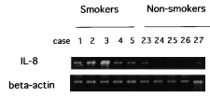
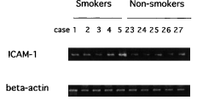
Background
Methodology
Results
Discussion
Conclusion
Characteristics of Epithelial cells from small airways (truncated)
 | Neutrophils, % | Eosinophils,% | Macrophages, %
Smokers (22) | 2.25±0.82 | 0.05±0.04 | 1.02±0.70
Non-smokers (17 | 1.50±1.00 | 0.03±0.02 | 0.85±0.35
Total (39) | 1.92±1.02 | 0.04±0.03 | 0.94±0.88
Smokers had more contaminating cells than non-smokers
Representative result of RT-PCR gel showing that magnitude of IL-8 signals from smokers was higher than of those from nonsmokers

Slide 9
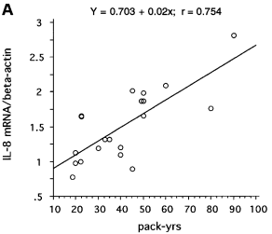
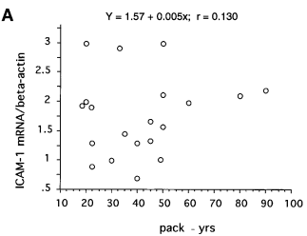
Background
Methodology
Results
Discussion
Conclusion
Correlation between gene expression of IL-8 and ICAM and smoking history
There was a significant positive correlation between IL-8 gene expression and pack·yr (packs/day 3 no. of yr of smoking; A) and current amount of cigarettes by
Spearman’s rank correlation analysis, P , 0.001
There was no significant correlation between ICAM-1 gene expression and pack·yr (A) and current amount of cigarettes (B) by Spearman’s rank correlation analysis, P . 0.05.

Slide 10
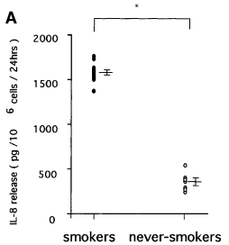
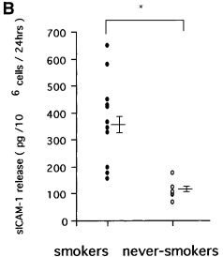
Release of IL-8 (A) and soluble ICAM-1 (sICAM-1; (B)) by small-airway epithelial cells
Background
Methodology
Results
Discussion
Conclusion
Small-airway epithelial cells from smokers released more IL-8 and sICAM-1 into medium than those from non-smokers.

Slide 11
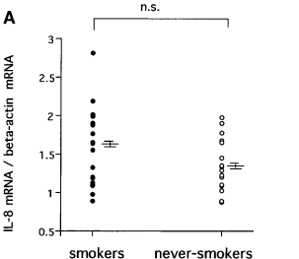
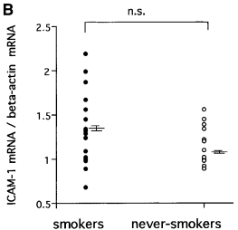
Comparison of IL-8 (A) and ICAM-1 (B) expression between proximal and peripheral airway epithelial cells
Background
Methodology
Results
Discussion
Conclusion
IL-8 (A) and ICAM-1 (B) mRNA levels in proximal airway epithelial cells as assessed by RT-PCR. There was no significant difference (ns) in IL-8 and ICAM-1 levels between smokers and nonsmokers.

Slide 12
Background
Methodology
Results
Discussion
Conclusion
The present study highlighted a close link between smoking and IL-8 gene expression in small-airway epithelial cells
The expression levels of IL-8, which is a potent neutrophil chemotactic factor, were significantly increased in smokers
The magnitude of IL-8 signals corrected by β-actin transcripts showed a positive correlation with the amount of cigarette smoking. ICAM-1 mRNA levels were also increased in smokers, and spontaneously released IL-8 and sICAM-1 were again statistically increased in smokers than in nonsmokers

Slide 13
Background
Methodology
Results
Discussion
Conclusion
Cigarette smoking causes neutrophil migration and accumulation in the lung
ICAM-1 is believed to be an important adhesion molecule for neutrophil accumulation, adhesion to the epithelium, activation, and trans-epithelial migration
Recent data suggest that cigarette smoke stimulates airway epithelial cells to release chemotactic activities such as IL-8 for neutrophils
Neutrophil-derived products such as elastases destroy the bronchiolar and alveolar structures, followed by remodeling of the airway and parenchymal tissues
IL-8 is believed to play an important role in the pathogenesis of various airway inflammatory diseases
It was also interesting to note that such increased levels of IL-8 and ICAM-1 did not show any correlation to small air way obstruction as assessed by V25

Slide 14
Background
Methodology
Results
Discussion
Conclusion
Findings suggested potential mechanism by which tobacco smoke activates small airway epithelial cells to release IL-8 and ICAM which sequester neutrophils
Larger brush used was able to obtain enough cells for cell and molecular biological analyses (Good approach technique together with new ultrathin bronchoﬁberscope)

Slide 15
Background
Methodology
Results
Discussion
Conclusion
Limitations of the study/ critiques
Increased levels of IL-8 and ICAM-1 did not show any correlation to small air way obstruction as assessed by V25 yet other factors acting on airway ﬁbroblasts, such as transforming growth factor-b, might be involved in the airway obstruction frequently found among heavy smokers.
Il-8 and ICAM-1 don’t account for all inflammatory mediators (too few)
Use matched age/sex case and control participants
Longitudinal study better representation of study compared to cross-sectional study
There was increased expression of IL-8 and ICAM-1 in small-airway epithelium but not in proximal bronchial epithelium from smokers which remained unclear

Slide 16


