Slide 1
Expeditions in the Himalayas
Tim

Slide 2
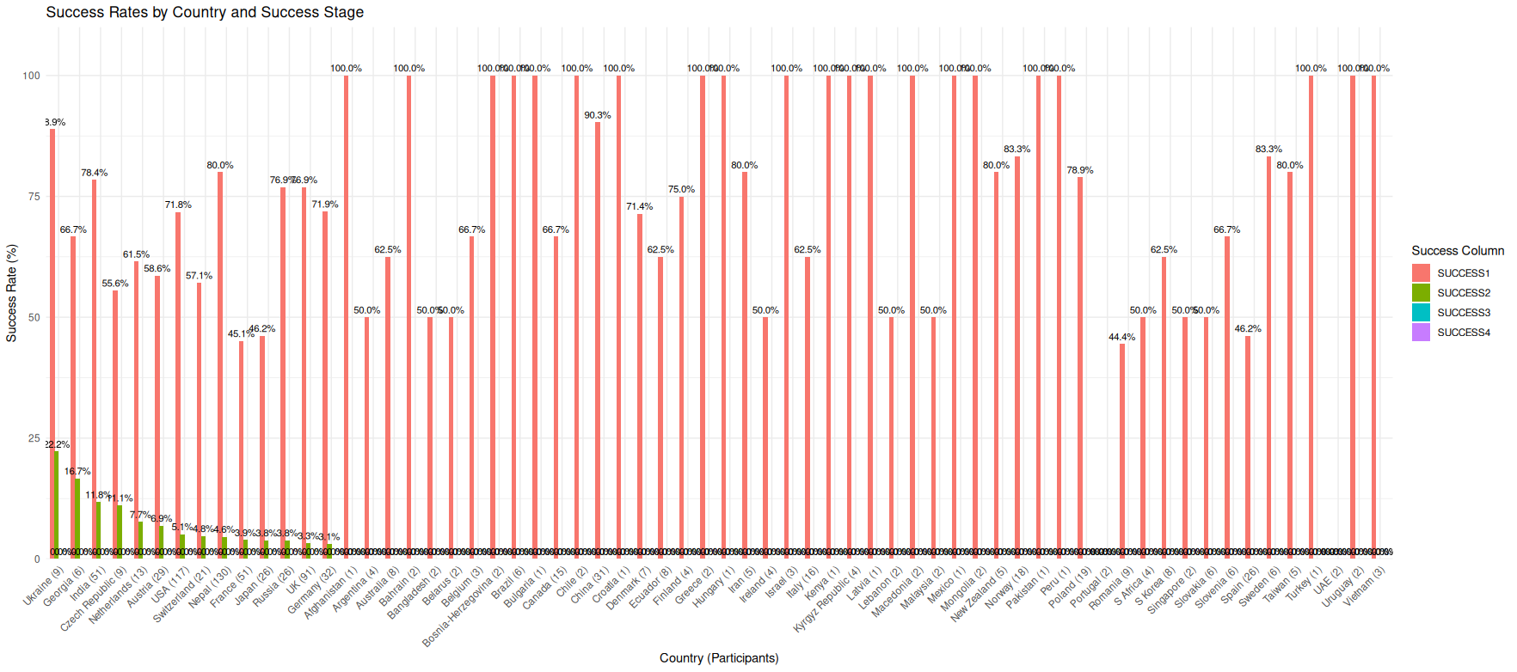
Number of expedition members and success rate of different countries?
Fig 1| Nepal had the most No. members, Ukrain had more success rates

Slide 3
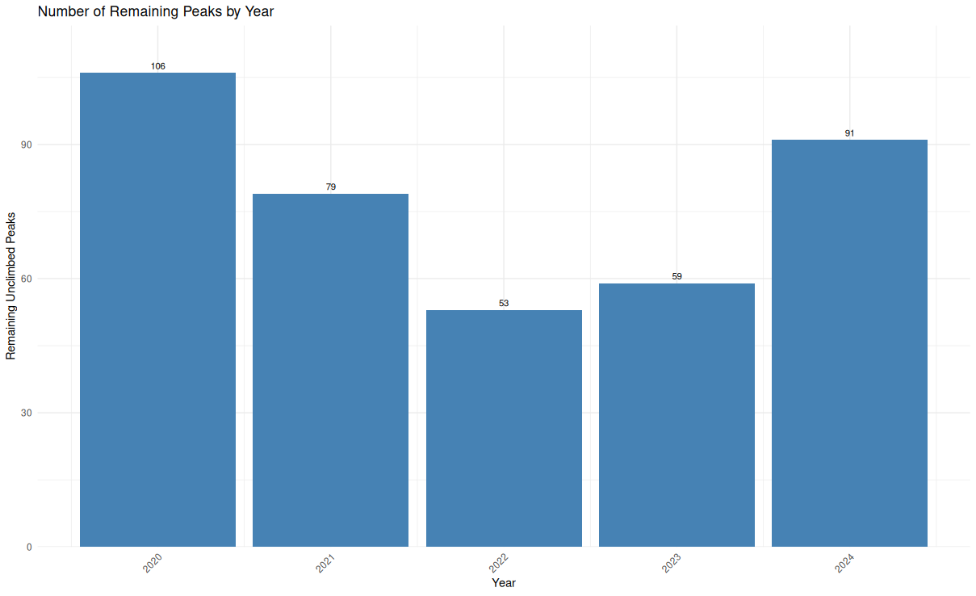
Number of remaining peaks with year
Fig 2| More peaks were climbed in 2022

Slide 4
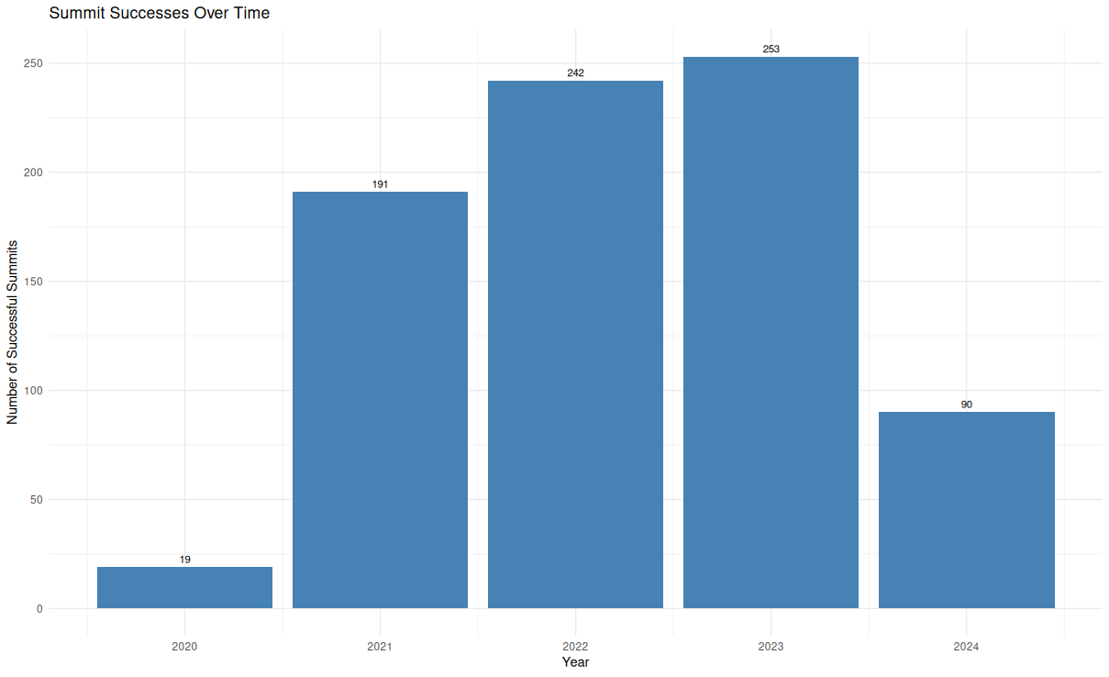
Success rate changed over time
Fig 3| More peaks were summited in 2023

Slide 5
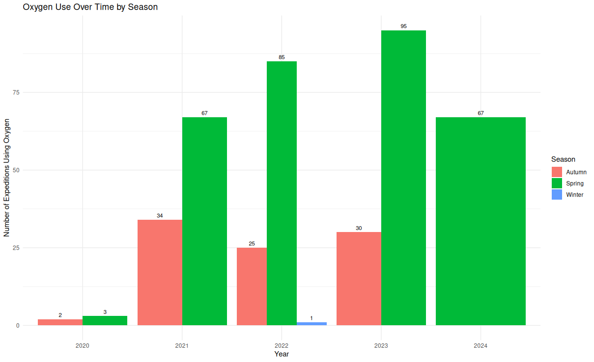
Oxygen usage change over time
Fig 4| More oxygen was used in the spring of 2023

Slide 6
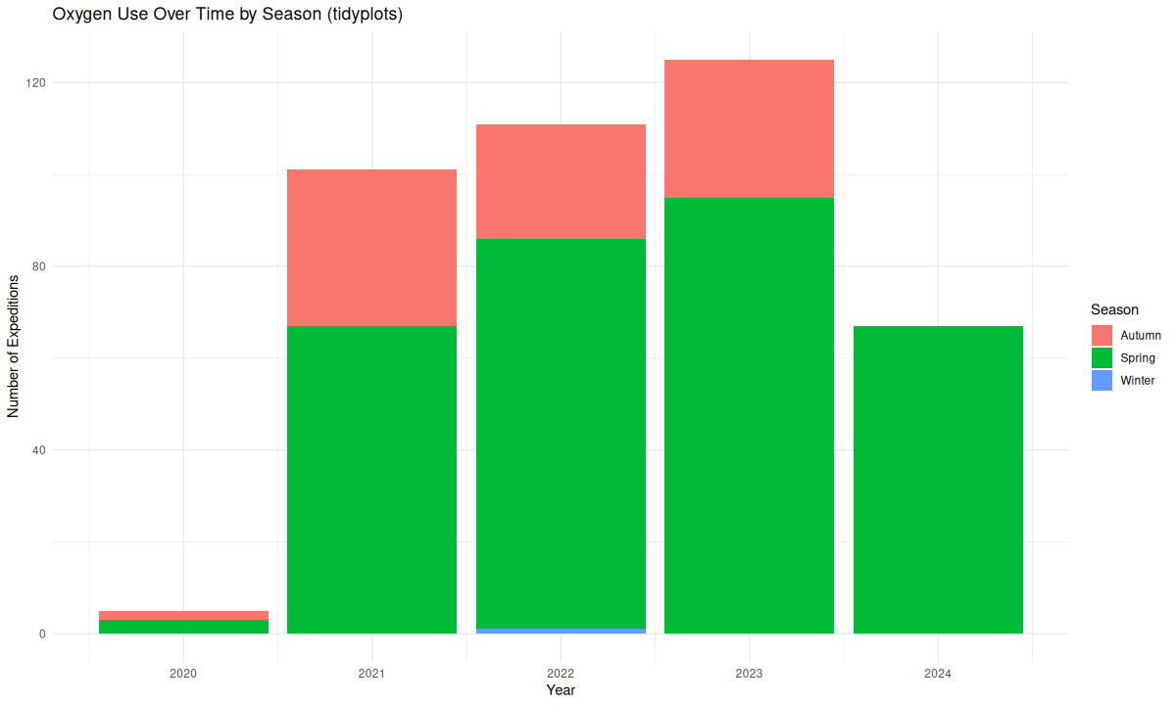
Oxygen usage change over time
More spring>summer climbs due to
Favourable weather
Reduced wind speeds(Monsoon winds)
Clearer skies
Milder temps
Fig 4| More oxygen was used in the spring of 2023

