Slide 1

BrainFuck Interpreter

Slide 2

BrainFuck Interpreter
Has ~ 30,000 memory cells
Each can store a single 8-bit value,can hold an integer 0 to 255.
Each cell contains a single unsigned 8-bit integer
Integer can represent;
Numbers:The raw numeric value stored in the cell.
Text Letters (ASCII Characters):
The numeric value can also represent an ASCII character when interpreted as such.
32 corresponds to a space ( ).Commands like . (output) and , (input) interpret the cell value as ASCII characters.
Symbols: The ASCII table includes symbols like punctuation (!, @, #, etc.) and control characters, so these can also be represented.

Slide 3
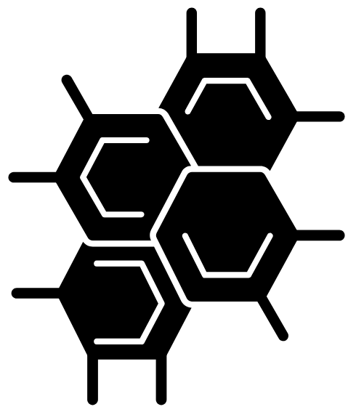
Brain fuck cells
All 30,000 memory cells start at 0 by default.
The Brainfuck pointer (starting at cell 0) moves between cells using the > and < commands.
The values in the cells are modified using + (increment) and - (decrement):
+ and - add and subtract 1 to the value in the current cell resp.
If value > 255, it wraps around to 0 (like modular arithmetic).
If value < 0, it wraps around to 255.
Eg: If first cell contains 65, the raw value is just the number 65.
Text Letters:If cell contains 65, it could also represent the letter A in ASCII.
This is particularly useful when using the . command, which outputs the ASCII character corresponding to the value.
Symbols:If a cell contains 33, it corresponds to ! in ASCII.

Slide 4
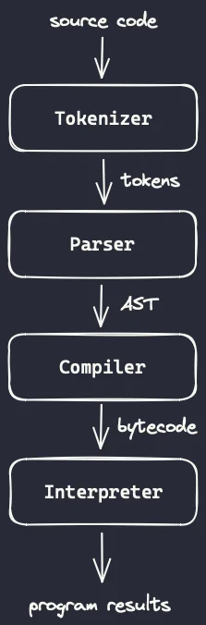
How it works
Input source code is in the brainfuck syntax (<>+[].,) commands
Tokeniser breaks the source code into induvdual commands (tokens)
The parser then coverts these tokens into an abstract syntax tree(AST) that is a more structured representation
of the commands in hierarchy of commands, sequences and loops
More like adding milk to the cornflakes or getting the bown just becore that.
The compiler then transaltes the AST into a lower level computer undertandable format
The interprester executes the compiled code stepwwise and recursively and produces a result which is printed in the console
You can type your code so to generator brain fuck syntax here; https://andrew.hedges.name/experiments/brainf_cker/

