Slide 1
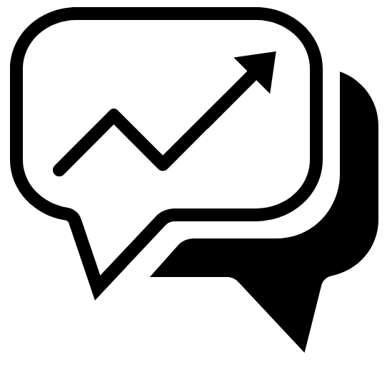
Chat tool usage performace

Slide 2
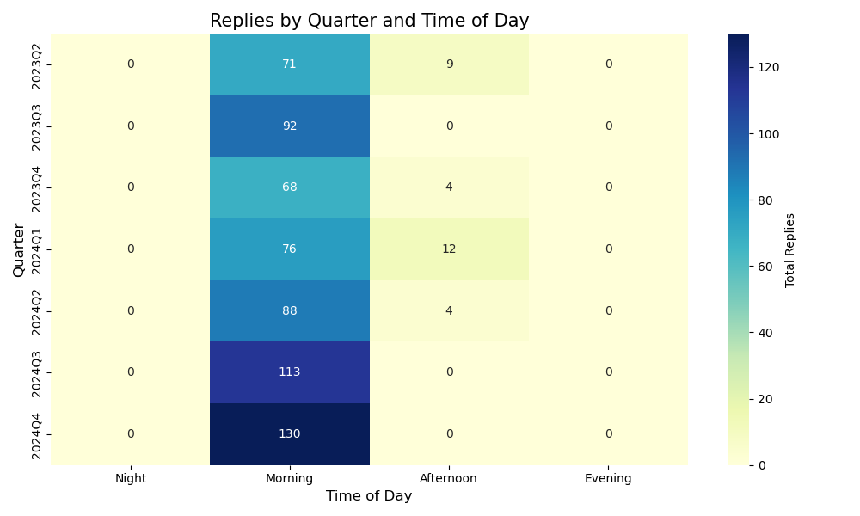
Fig1| Increasing chat tool usage YoY mostly used in the morning

Slide 3
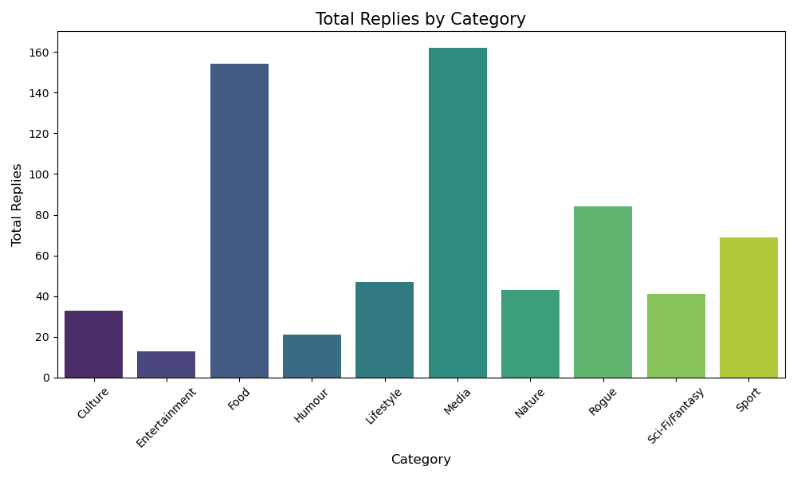
Fig2| Media and Food had the highest replies, humour and entertainment had the least

Slide 4
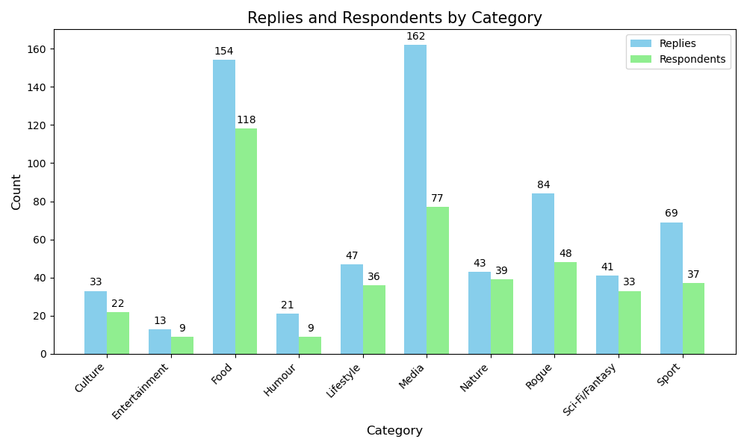
Fig3| More people engagement on food. More passion/influencers for media

Slide 5
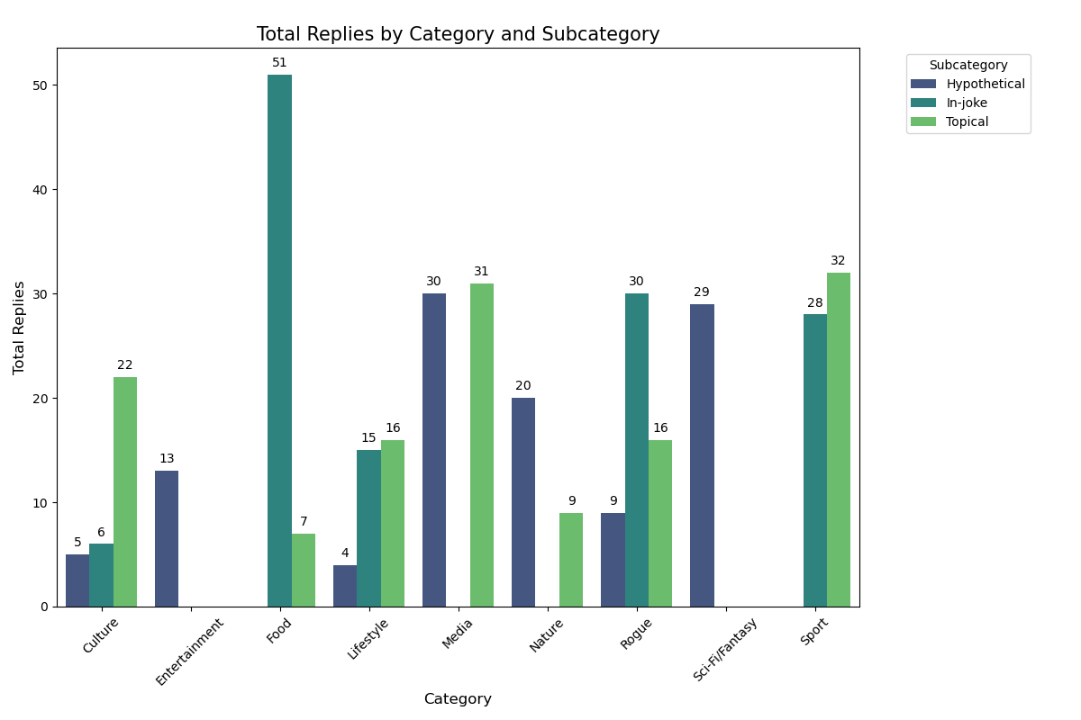
Fig4| In-jokes attracted more food engagement.

Slide 6
Take homes
KPIs which might best predict user engagement.
Number of respondents YoY
Number of replies
Recommendations

