Slide 1
Chessgames Challenge
By me alongside R and VS studio copilots

Slide 2
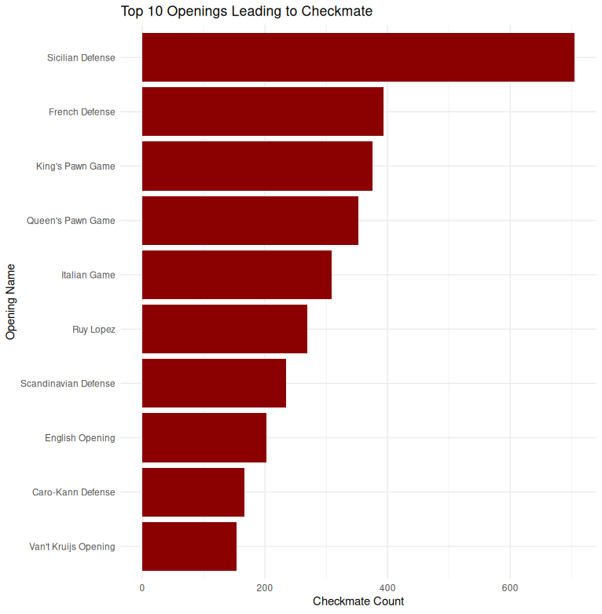
What the common opening moves? By ranks?
opening_name n
<chr> <int>
1 Sicilian Defense 705
2 French Defense 394
3 King's Pawn Game 376
4 Queen's Pawn Game 352
5 Italian Game 309
6 Ruy Lopez 269
7 Scandinavian Defense 234
8 English Opening 202
9 Caro-Kann Defense 166
10 Van't Kruijs Opening 154
Fig1| Common player opening moves ranked by number of games used

Slide 3
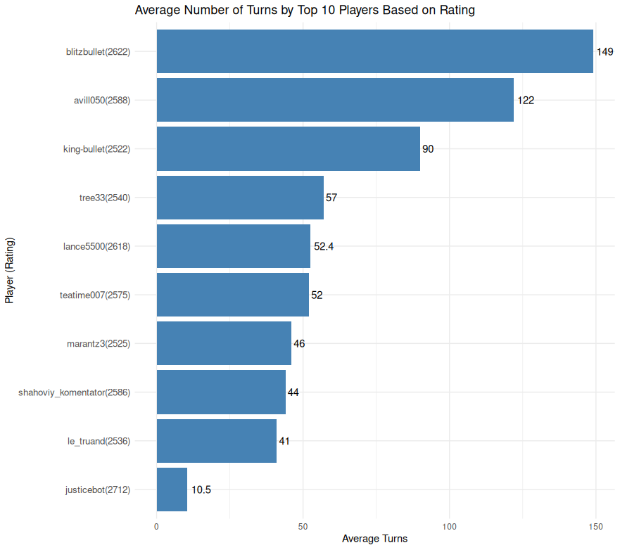
How many turns does a game last based on player ranking?
Fig2| Average number of turns for top 10 ranked players

Slide 4
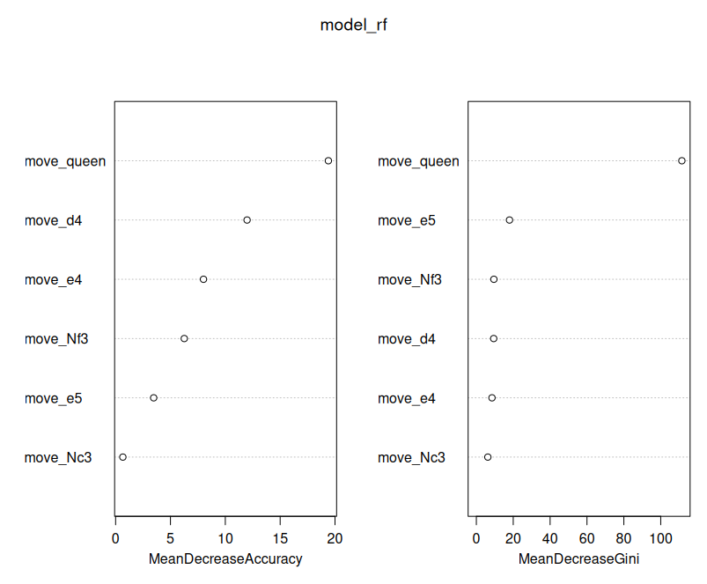
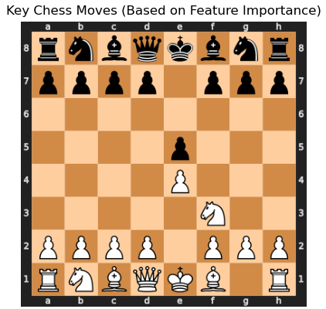
What move patterns explain the game outcome?
Moving the queen was a more predictive move of the outcome than any other move on the chessboard followed by the pawn to D4, E4, Knight to f3, pawn to e5 and lastly night to c3
Fig3| Moving the queen was a better predictor of the game outcome

