Slide 1

Inventory Management System (IMS)
Timothy Owen
21 Jan Salesforce Enable

Slide 2
Introduction
Objective:
To create a functional application, using supporting tools, methodologies, and technologies, that encapsulates all fundamental modules covered during training.
Key concepts from core training modules:
Agile & Project Management
Databases & Cloud Fundamentals
Programming & Testing Fundamentals
Continuous Integration & Build Tools
The individual project must encapsulate all aspects of the aforementioned modules, to achieve the specification outlined in the Domain section.
JIRA
JDBC, MySQL
Java, JUnit, Mockito, Sonarqube
Git, Maven

Slide 3
Requirements
Domain:
The domain requirement was to build an application that allows an end-user to have CRUD (Create/Read/Update/Delete) functionality for a system of customers, items and orders.
Add/View All/Update/Delete a customer in the system.
Add/View All/Update/Delete an item in the system.
Add/View All/Update/Delete an order to the system.
Minimum requirements for project:
Code fully integrated into a Version Control System using the feature branch model.
A project management board.
A risk assessment.
A relational database.
A functional application ‘back-end’.
A build of your application.
Unit tests (80% coverage).

Slide 4
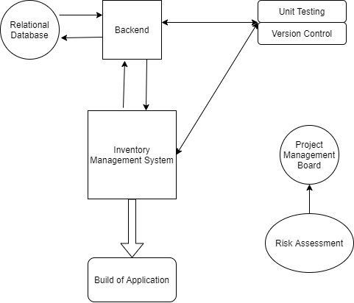
Minimum Viable Product (30th January)

Slide 5
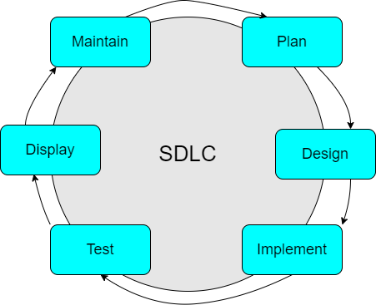
Agile
The software development life cycle is the steps necessary to create any piece of software and is used by both Agile and Waterfall methodologies.
Agile is a flexible software development methodology. It allows companies to adapt quickly to changes meaning that they can have a competitive edge by delivering the most relevant product needs. It involves discovering requirements and developing solutions through the collaborative effort of self-organizing and cross-functional teams and their end-users.
The values and principles of the Agile manifesto were derived from and underpin a broad range of software development frameworks, including Scrum and Kanban.
Most agile development methods break product development work into small increments that minimize the amount of up-front planning and design.

Slide 6
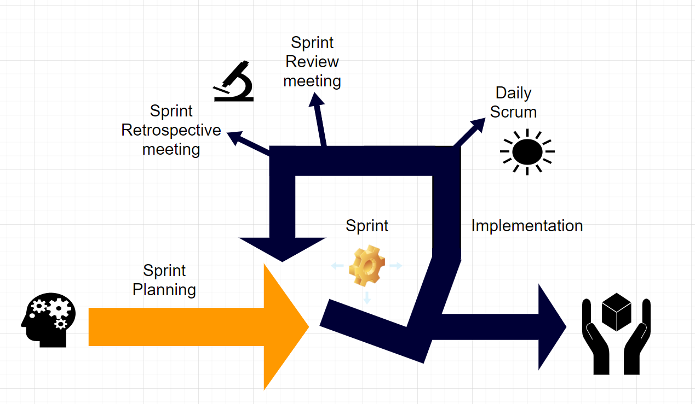
My Agile Approach (Scrum)
Scope and Project Vision
Product Backlog
Sprint
Sprint Planning
Implementation (including a daily Scrum)
Sprint Review
Sprint Retrospective
Deployment
JIRA

Slide 7
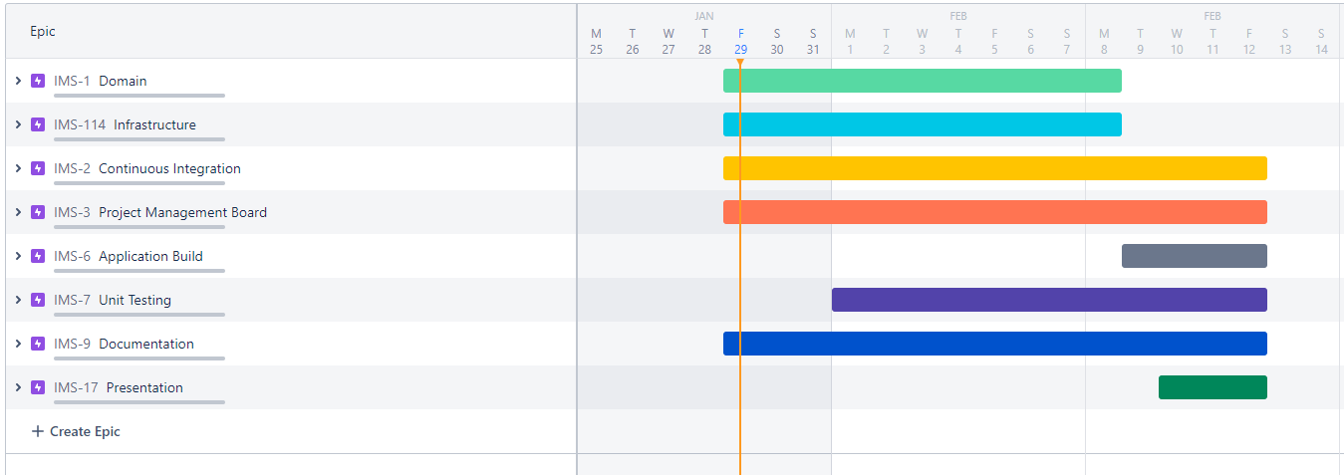
Project Management Board JIRA

Slide 8
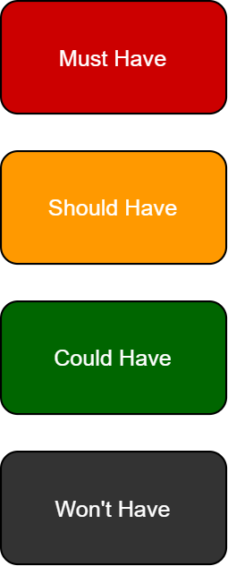
MoSCoW Prioritisation
The minimum requirements. CRUD functionality for customer, order and item entities.
Access restriction. So that customers are not able change item information, other customers information or other customers orders.
Separation of end-user interface into sub-interfaces for customers and system developers.
Images for each item.

Slide 9
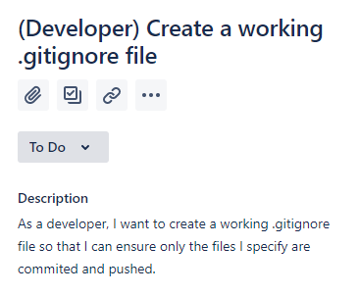
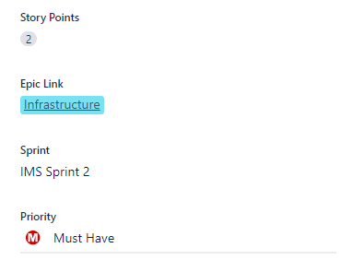
MoSCoW Prioritisation

Slide 10
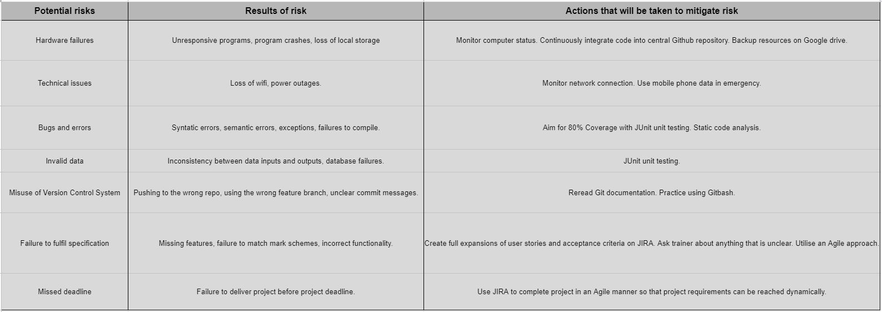
Risk Assessment (29th January)

Slide 11
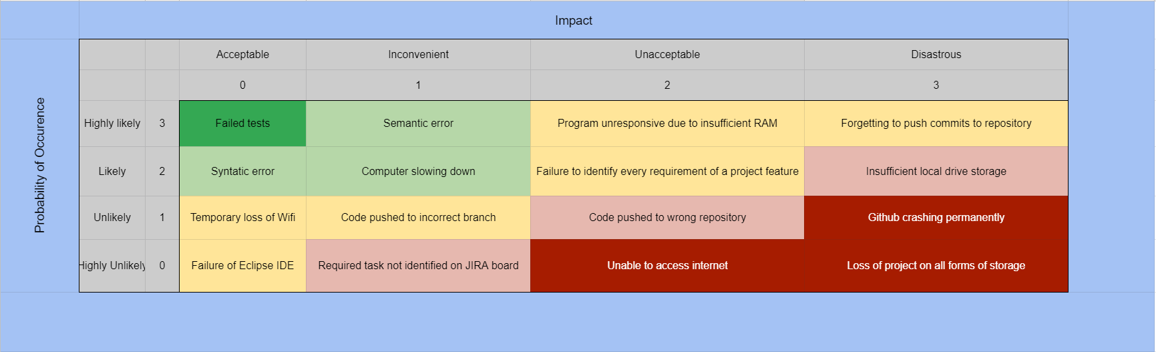
Risk Matrix (29th January)

Slide 12
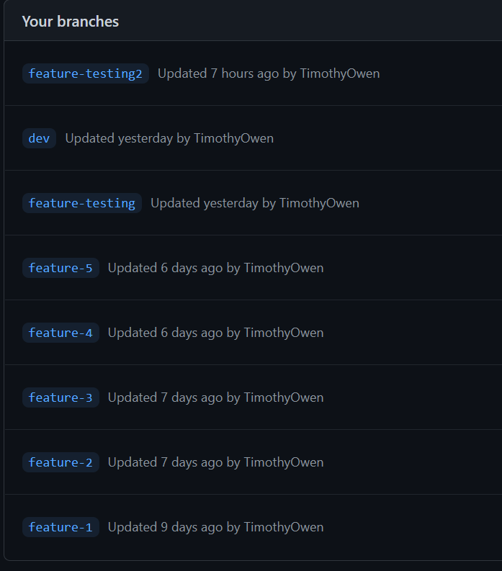
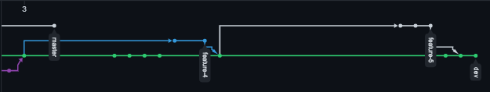
Version Control System

Slide 13
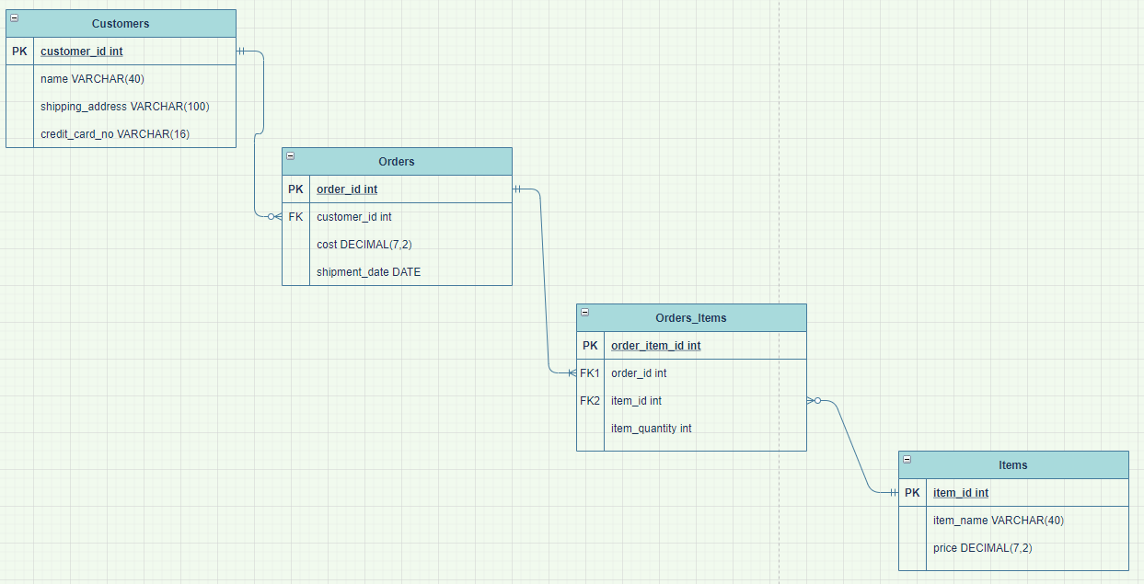
Entity Relationships

Slide 14
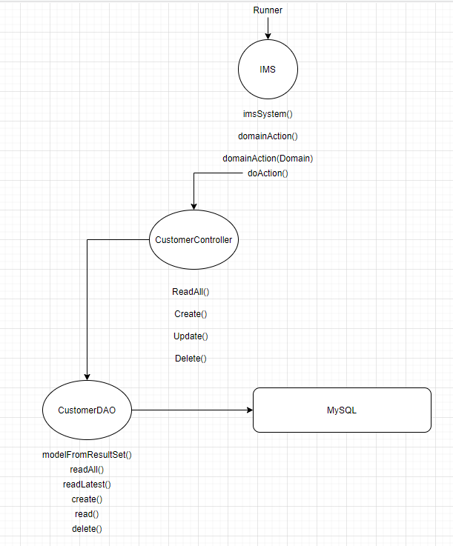
Starting Point

Slide 15
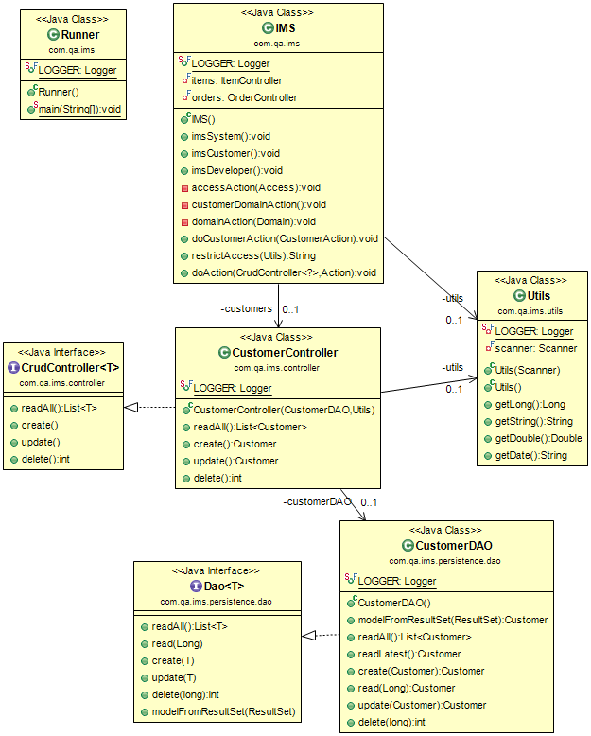
Starting Point UML
(29th January)

Slide 16
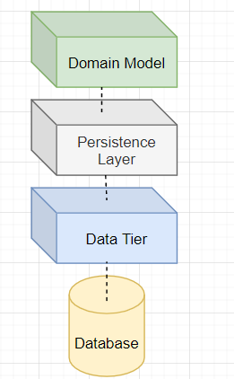
Domain-Driven-Design
Order, OrderController
OrderDAO
Order table in MySQL

Slide 17
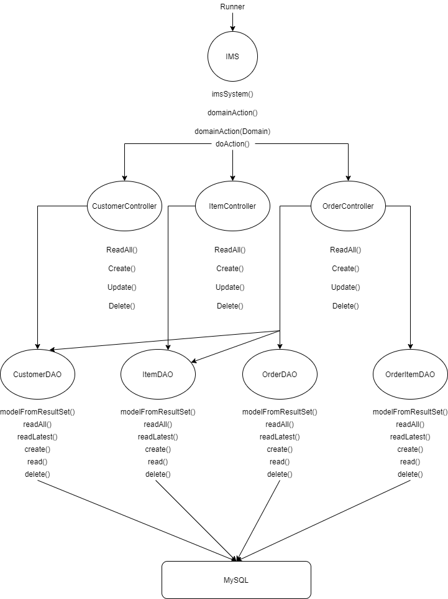
Extended structure to fulfil Project requirements

Slide 18
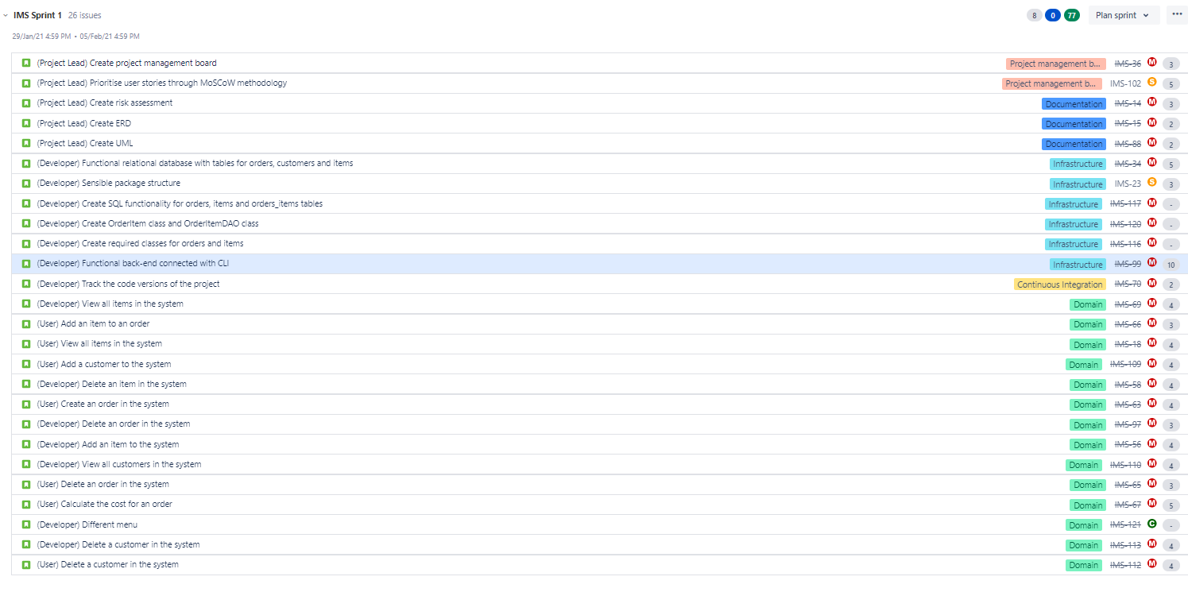
Sprint 1 (29th January - 5th February)

Slide 19
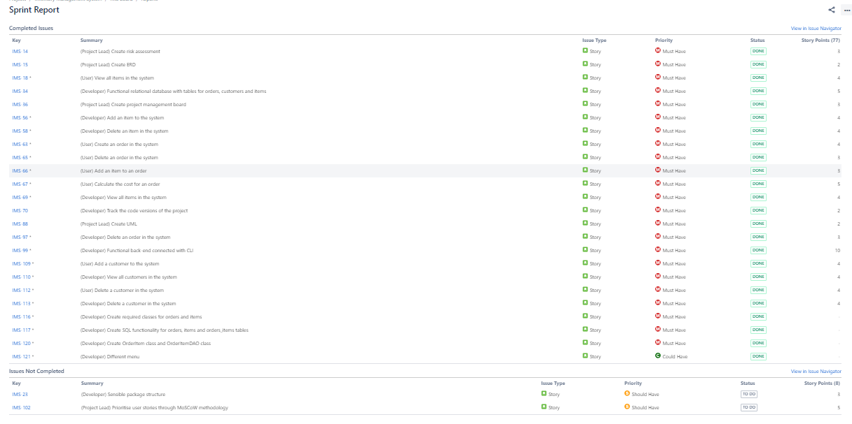
Sprint 1 (29th January - 5th February)

Slide 20
Sprint 1 (29th January - 5th February)
Sprint review (What was done?)
The domain requirements were fulfilled. CRUD functionality was achieved for the 3 entities.
The command line was able to communicate with the backend and perform updates and queries on the MySQL instance.
Access levels were implemented, meaning an end-user would have to input a password in order to access the applications full functionality.
Minimal testing was conducted.
Minimal optimisation of code was conducted.
Sprint retrospective (What went well?)
Daily scrum gave me an opportunity to consider what I had done yesterday and consider what I was going to do that day.
JIRA enabled me to efficiently keep track of my product backlog.
I discovered requirements of the project which I had not previously planned for (eg. OrderSubController class), this is one of the key concepts of Agile methodologies.
I did not utilise JIRA efficiently as is shown in the Sprint report. I did not keep an accurate log of completed user stories.

Slide 21
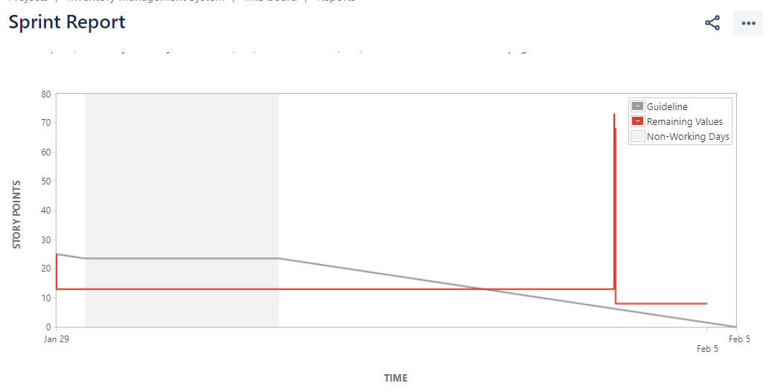
Sprint 1 (29th January - 5th February)

Slide 22
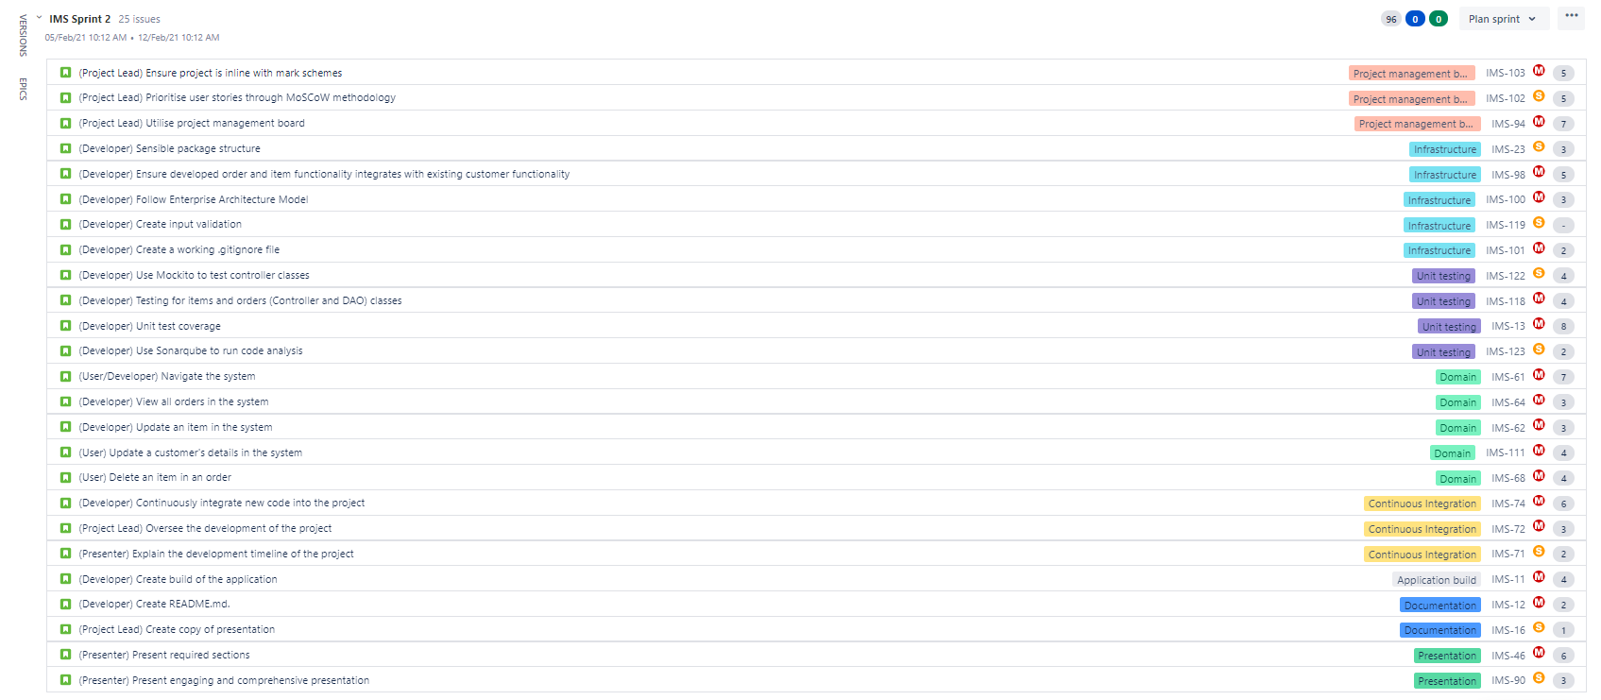
Sprint 2 (5th February- 12th February)

Slide 23
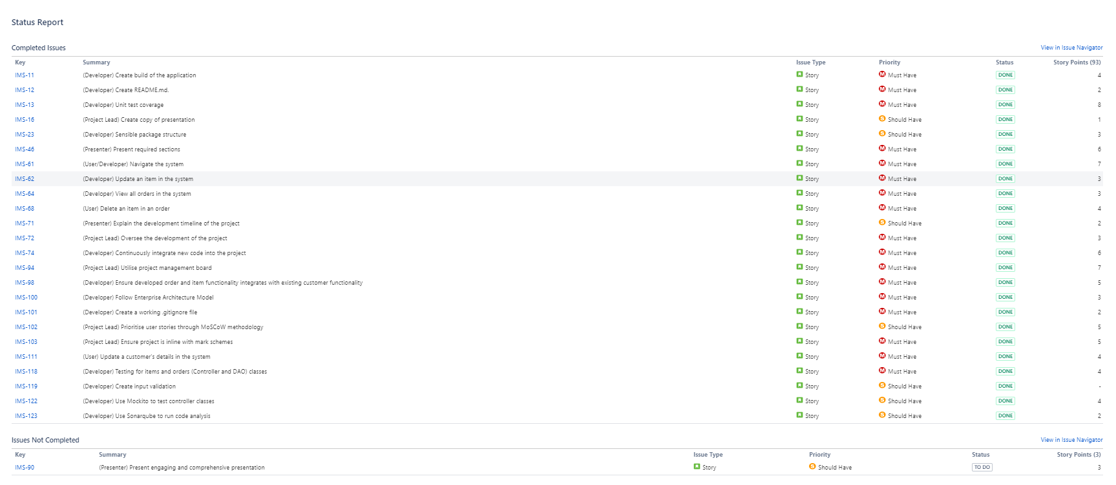
Sprint 2 (5th February- 12th February)

Slide 24
Sprint 2 (5th February- 12th February)
Sprint review (What was done?)
83% coverage was achieved in unit testing through JUnit and Mockito.
Documentation was produced (READme.md, presentation).
Intensive optimisation was carried out with Sonarqube.
Refactoring of code was carried out.
Ensured code adhered to industry standards and best practices (SOLID & OOP).
Sprint retrospective (What went well?)
More experienced with JIRA and GitHub.
Better understanding of the importance of iterative development.
Sonarqube and JUnit helped develop my understanding of best practices.

Slide 25
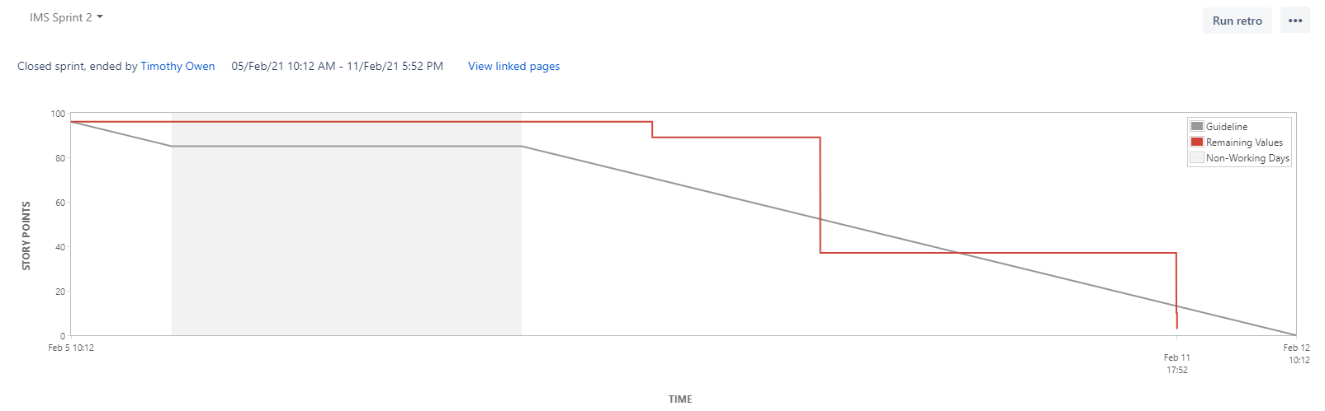
Sprint 2 (5th February- 12th February)

Slide 26
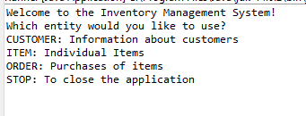
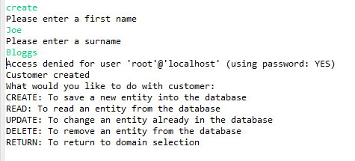
Starting Point Interface (29/01)

Slide 27
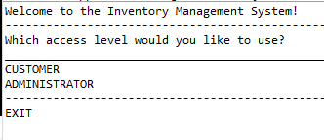
Delivered Product (12/02)

Slide 28
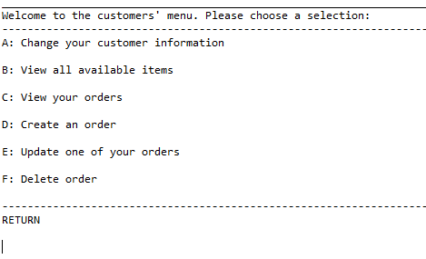
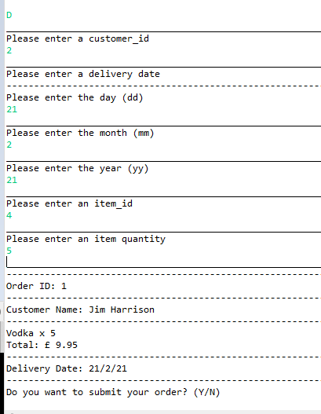
Customers’ Interface (12/02)

Slide 29
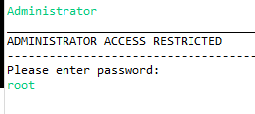
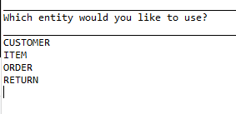
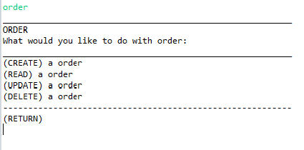
Administrators’ Interface (12/02)

Slide 30
Unit Testing in relation to extended structure of project

Slide 31
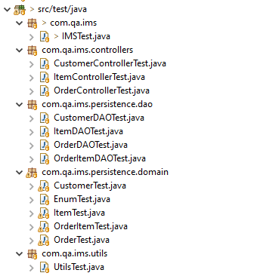
Testing

Slide 32
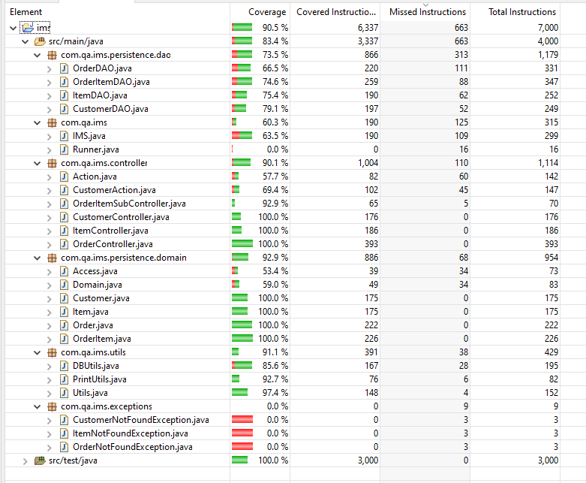
Testing

Slide 33
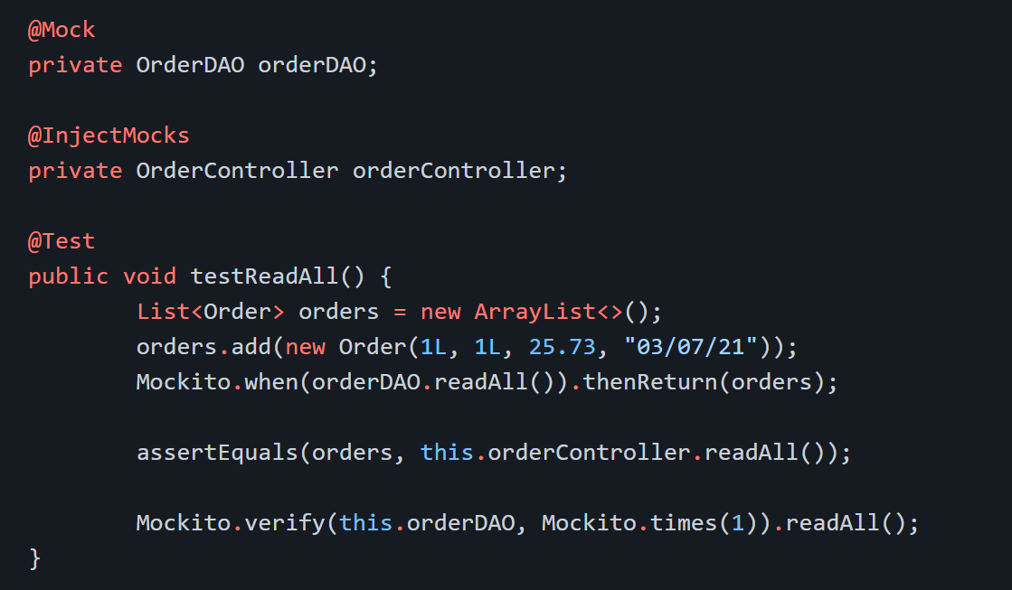
Testing

Slide 34
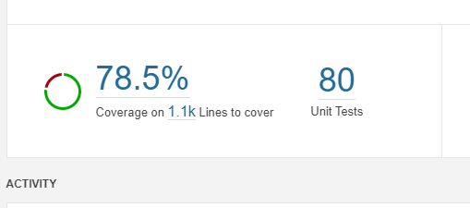
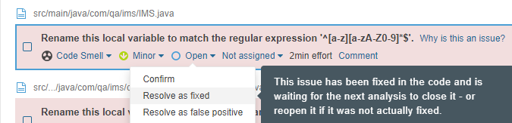
Static Testing

Slide 35
Conclusion
Minimum requirements for project:
Code fully integrated into a Version Control System using the feature branch model.
A project management board.
A risk assessment.
A relational database.
A functional application ‘back-end’.
A build of your application.
Unit tests (80% coverage).

Slide 36
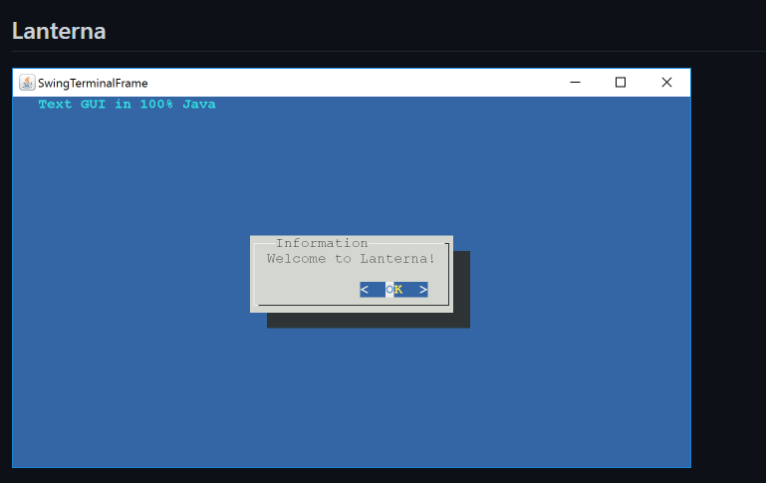
Future Improvements

Slide 37
Thank you for listening.

