Slide 1
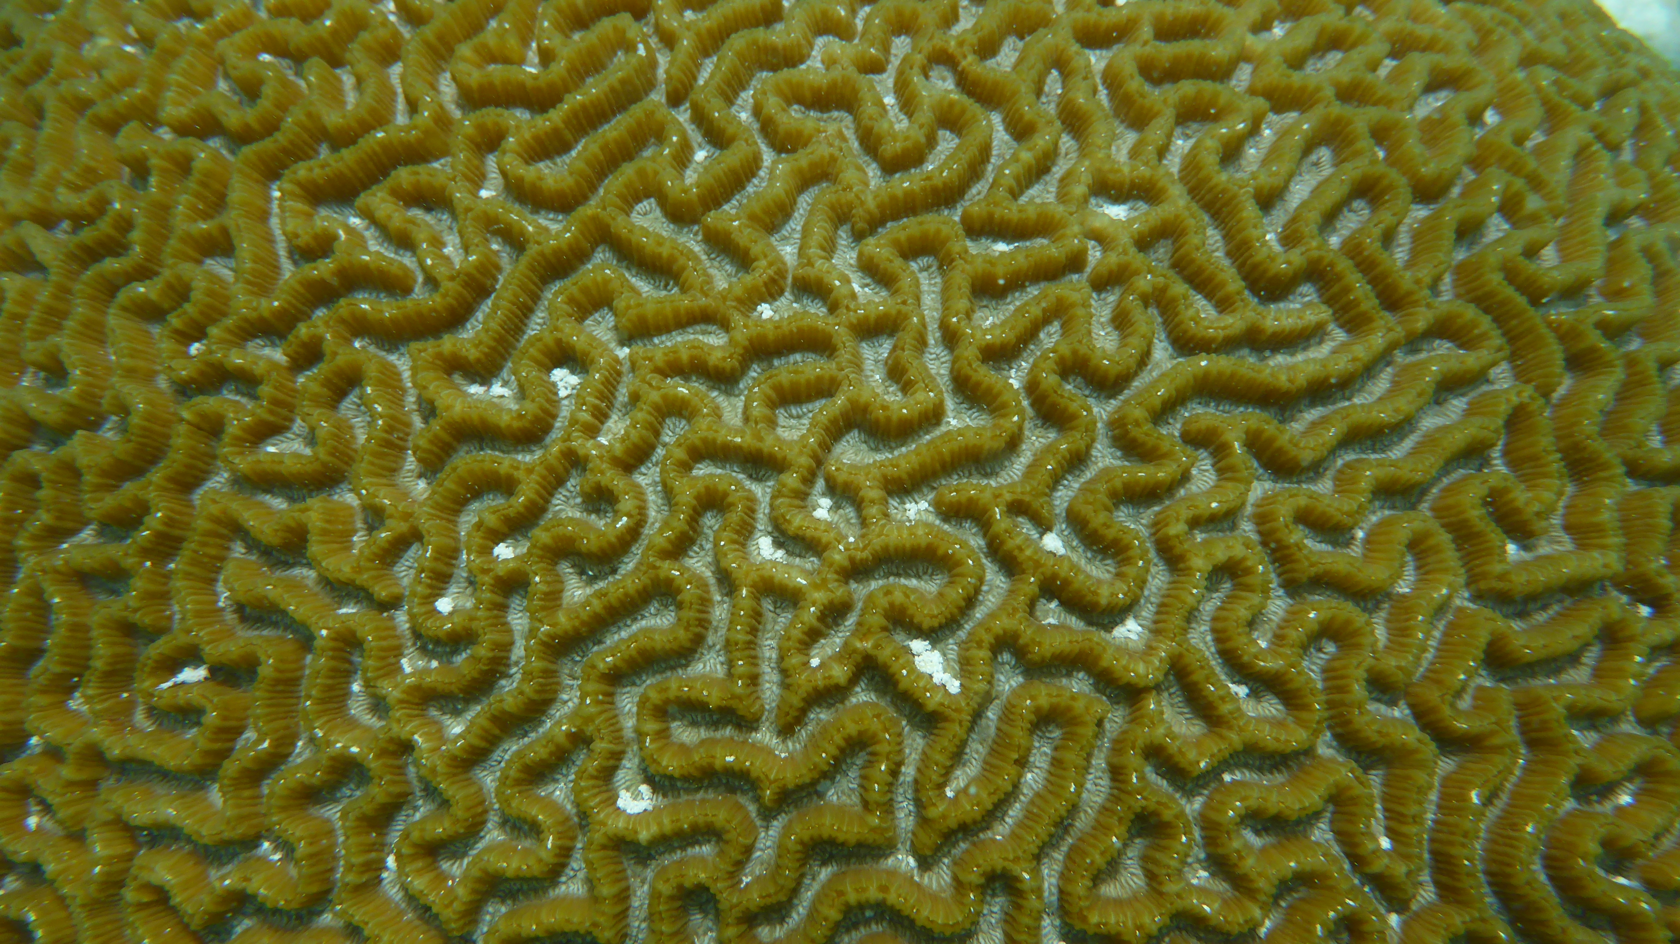

Photo: Nataly Gutierrez Isaza

Slide 2
Marine Threats
Bleaching shot
Algal phase shift
Overfishing

Slide 3
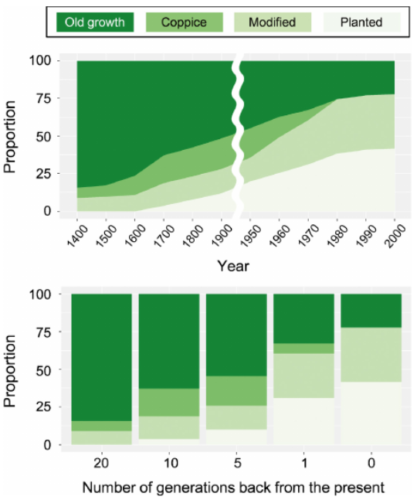
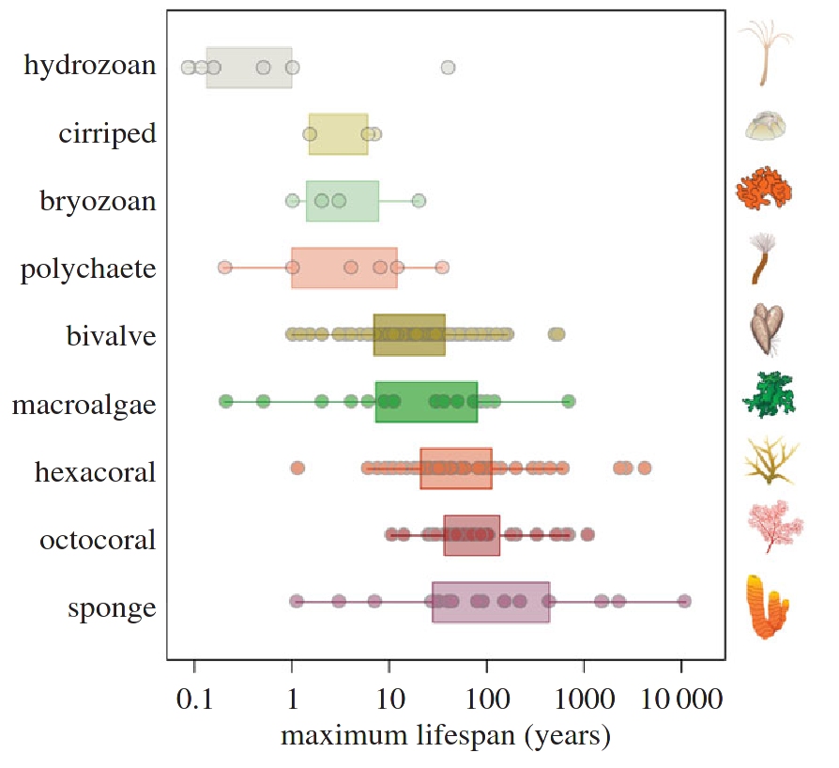
Soga, M. and Gaston, K.J. (2018) Shifting baseline syndrome: causes, consequences, and implications. Front. Ecol. Environ. 16, 222–230
Montero-Serra, I. et al. (2018) Strong linkages between depth, longevity and demographic stability across marine sessile species. Proc. R. Soc. B Biol. Sci. 285, 20172688

Slide 4
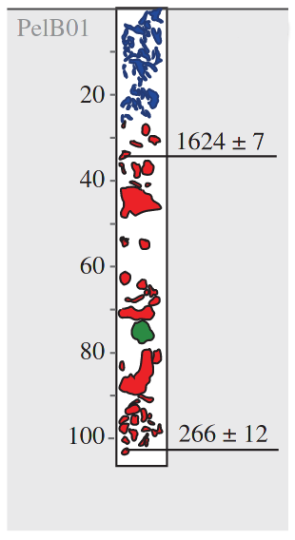
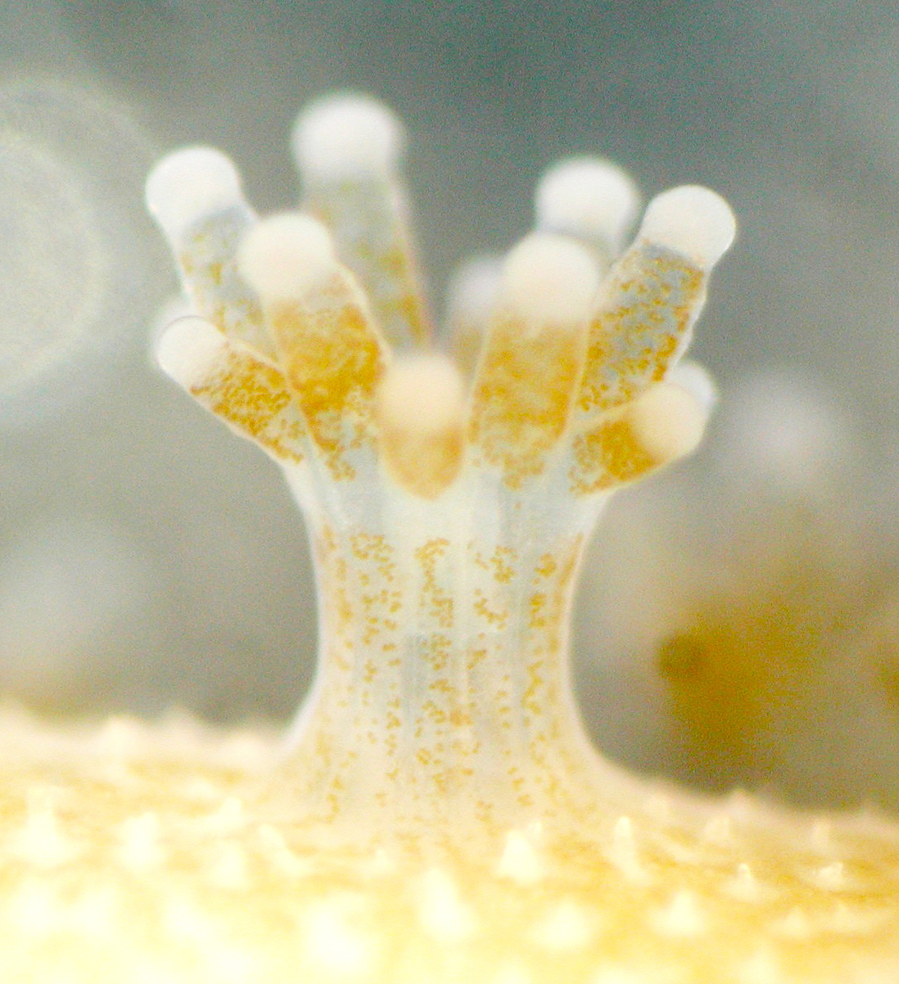
Shifting baselines
Life history unknowns
Preservation
Roff, G., et al. (2013). Proceedings of the Royal Society B: Biological Sciences, 280(1750), 20122100.

Slide 5
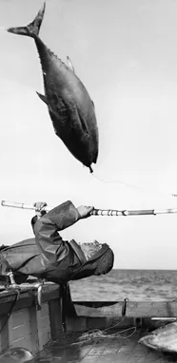
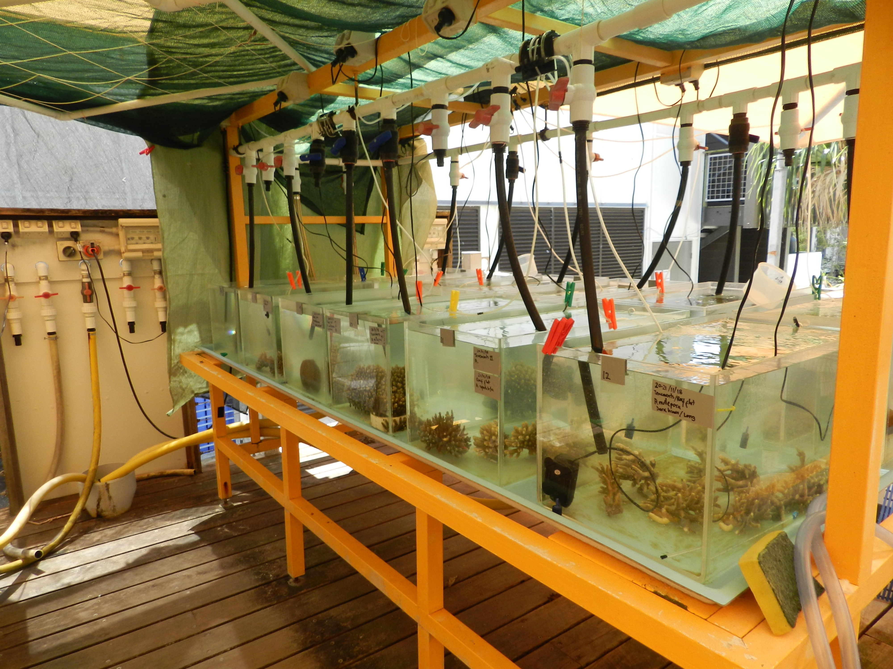
Historical ecology
Global change biology
Fundamental ecology
Palaeoecology
1
https://timothystaples.github.io/labnetwork/labNetwork.html

