Slide 1
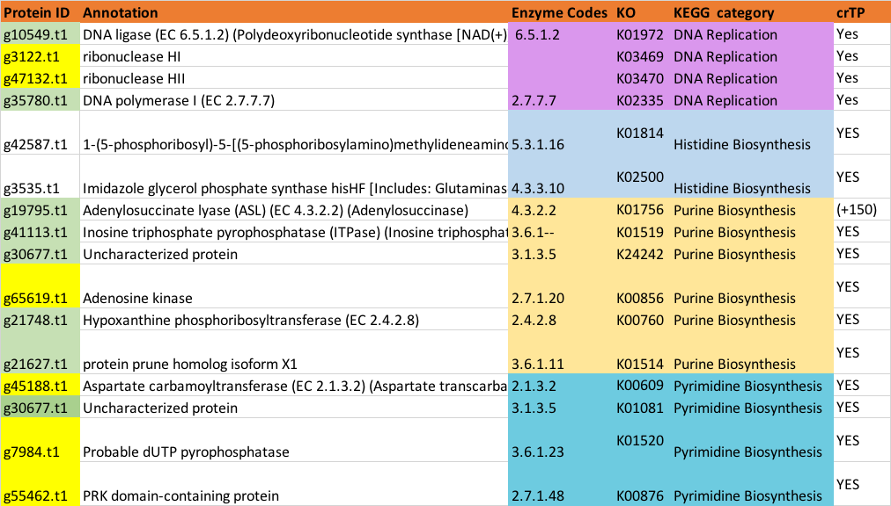
Notes:
I looked into the proteins that contain crTP and play an important role in three pathways.
All the green highlighted are those that do not seem to have a 5’end issue and that have a good KEGG hit coverage.
All the yellow highlighted ones are those that don’t have a great KEGG hit coverage. I blasted all of these and they all seem to have the correct conserved domain (see attached ppt.)

Slide 2
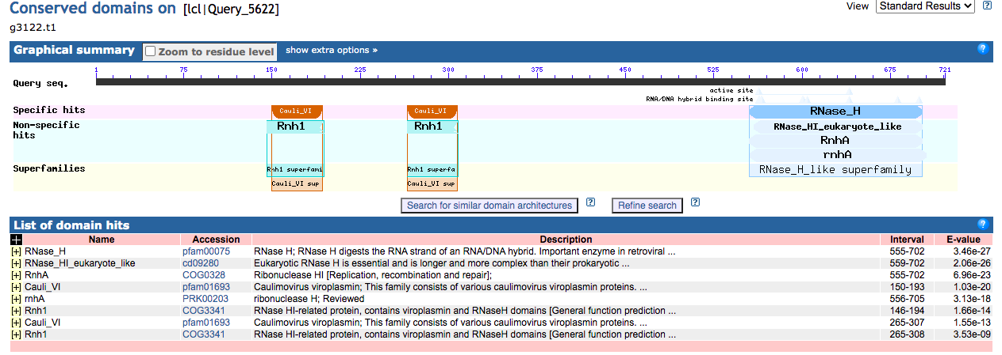
~47% identity to a bacteria

Slide 3
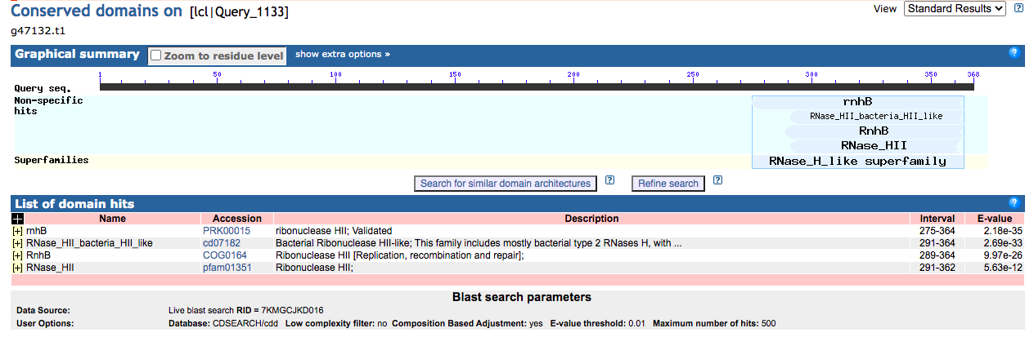
~57% identity to green algae

Slide 4
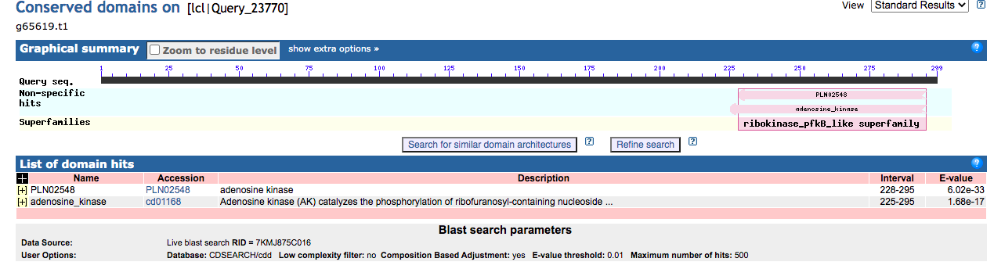
~70% identity to plant

Slide 5
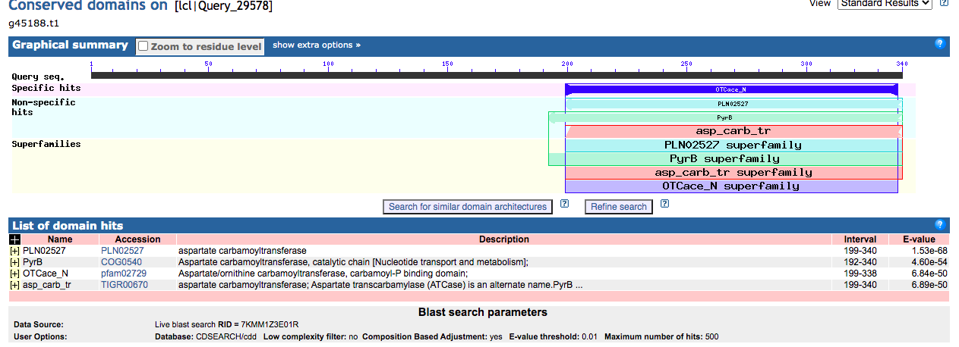
~66 identity to bacteria

Slide 6
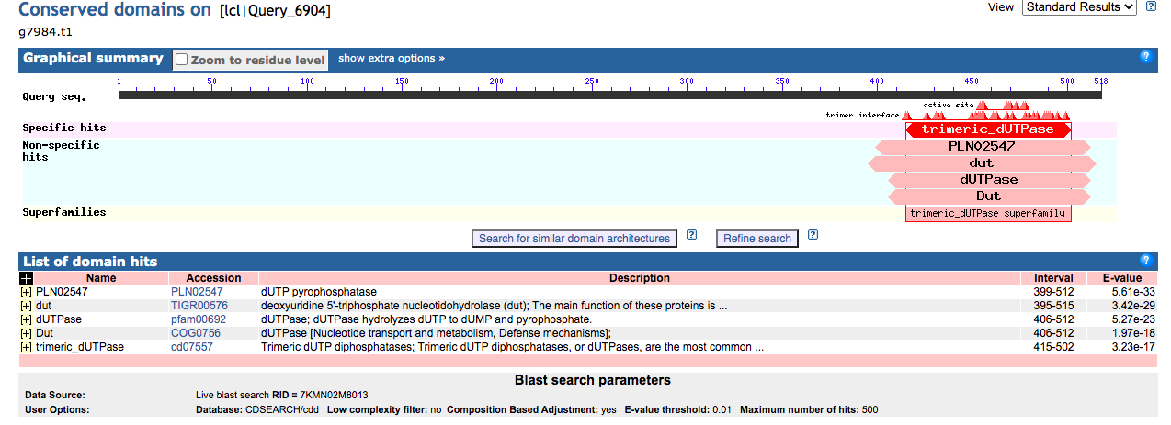
49% identity to fungi

Slide 7
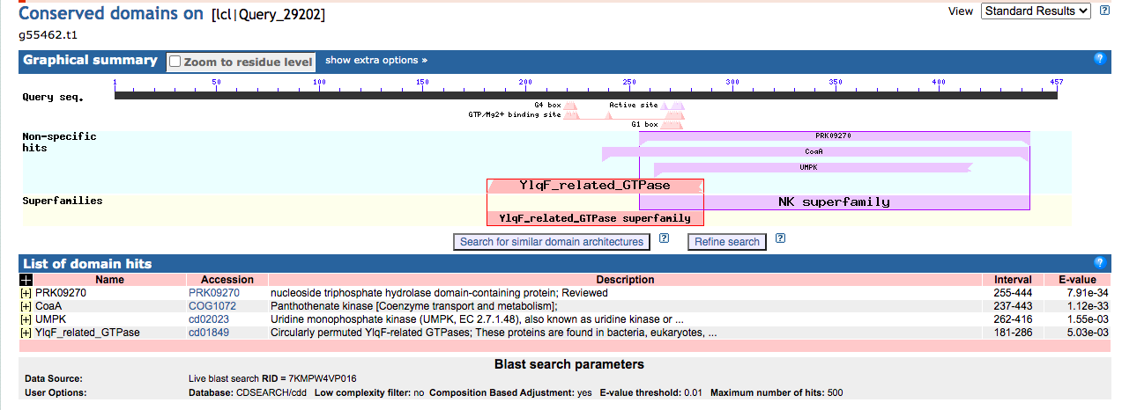
45% identity to fungi

