Slide 1
DNA Replication

Slide 2
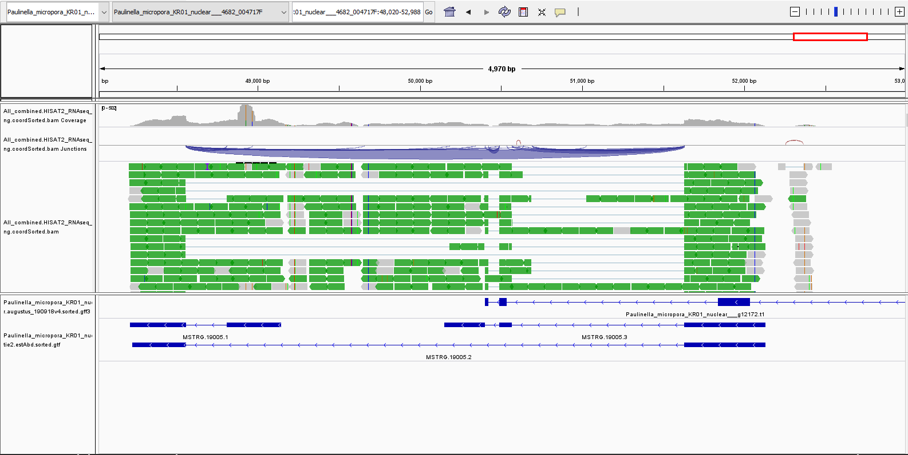
g12172.t1
Notes:
MSTRG.19005.3

Slide 3
Purine

Slide 4
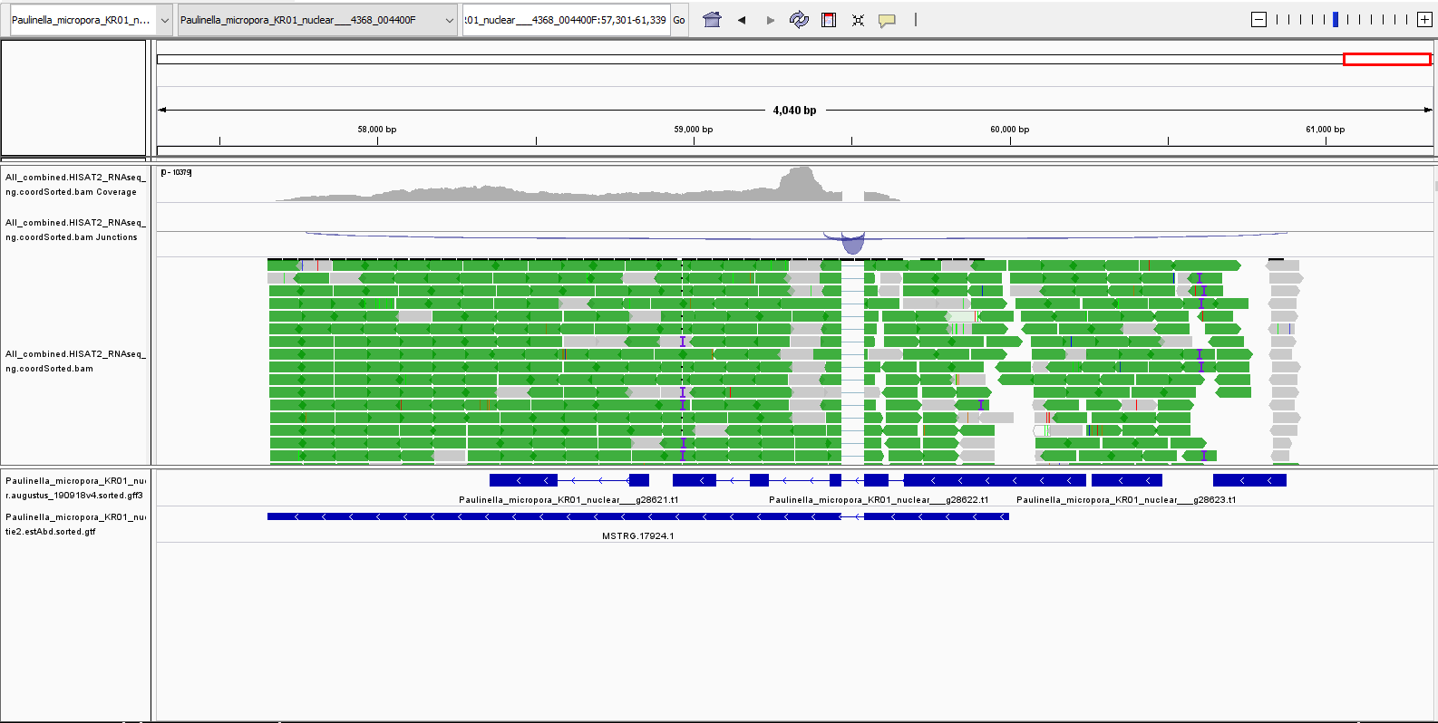
g28623.t1
g28623.t1
~50x coverage
Notes:
Large region expressed. Closest gene model is MSTRG.17924.1 but it doesn’t overlap with original gene (g28623.t1). Psudogene?

Slide 5
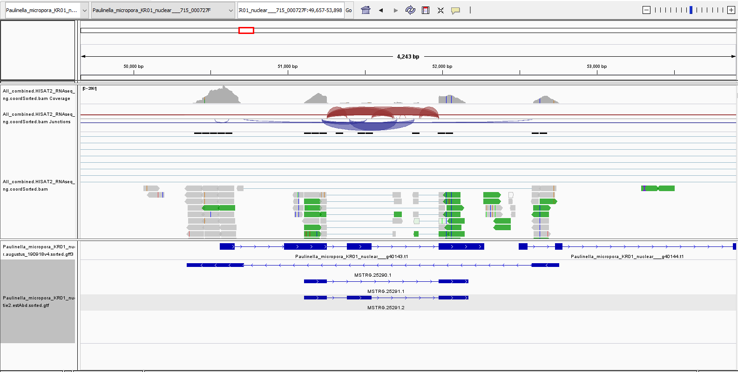
g40143.t1
585x coverage
105x coverage

Slide 6
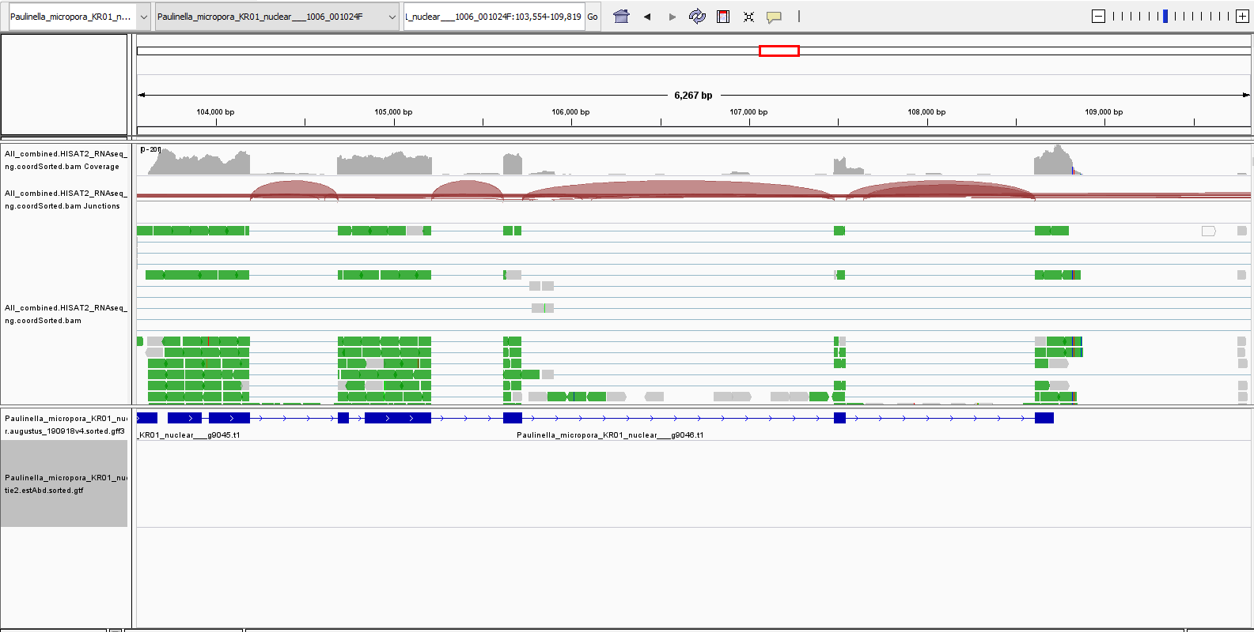
g9046.t1
Alternative splice site (shorter version used)
Notes:
No transcript model for some reason??

Slide 7
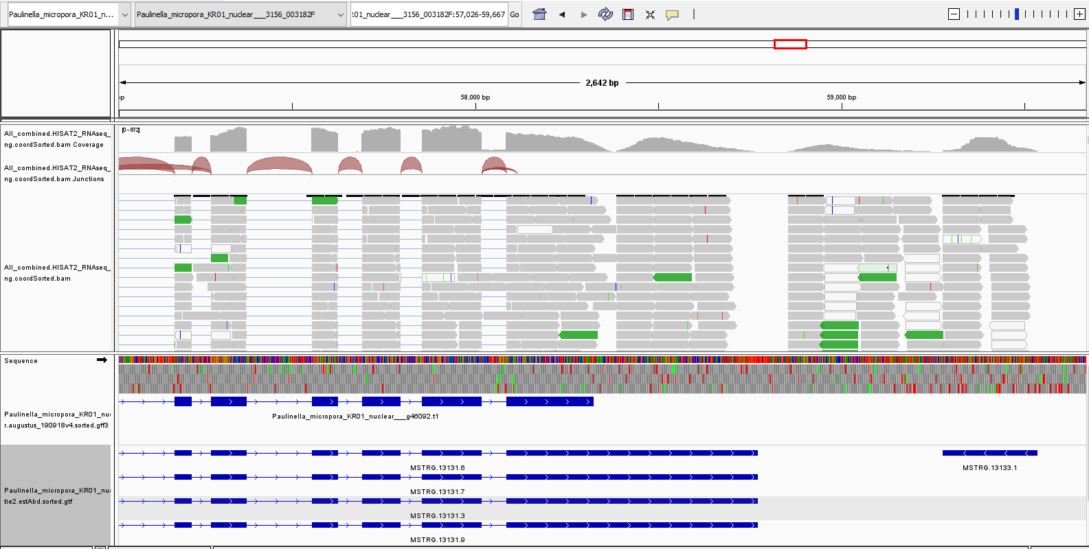
g46092.t1
Sharp cutoff in read mapping. Some soft clipping in the reads to the right. Maybe misassemblely?

Slide 8
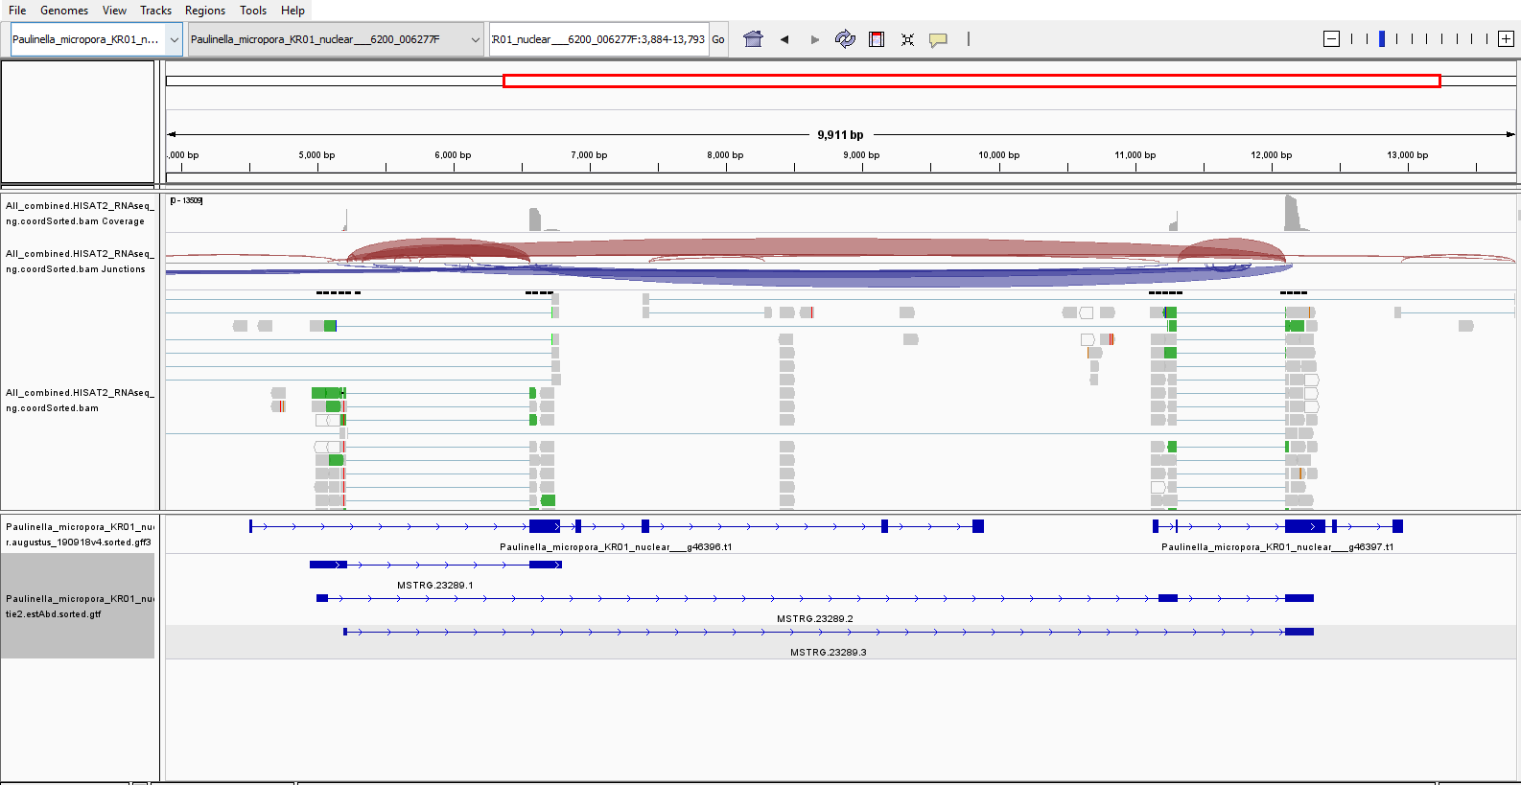
g46396.t1 + g46397.t1
Likely part of the same gene. Not super clear cut

Slide 9
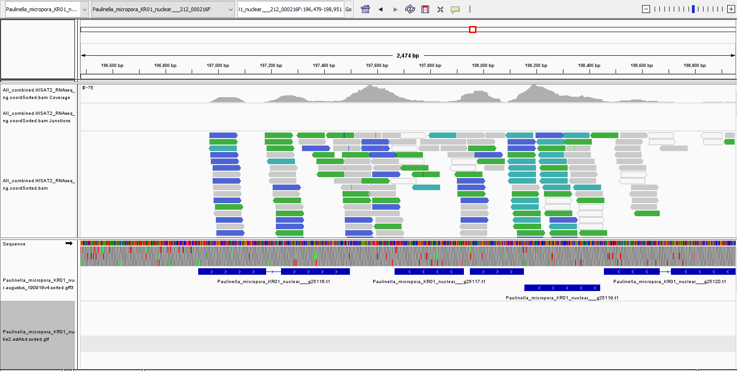
g25116.t1

Slide 10
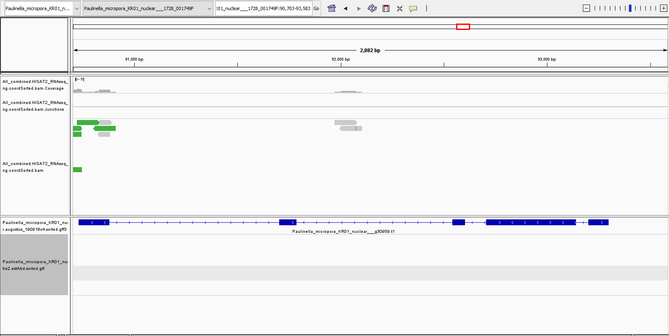
g30959.t1

Slide 11
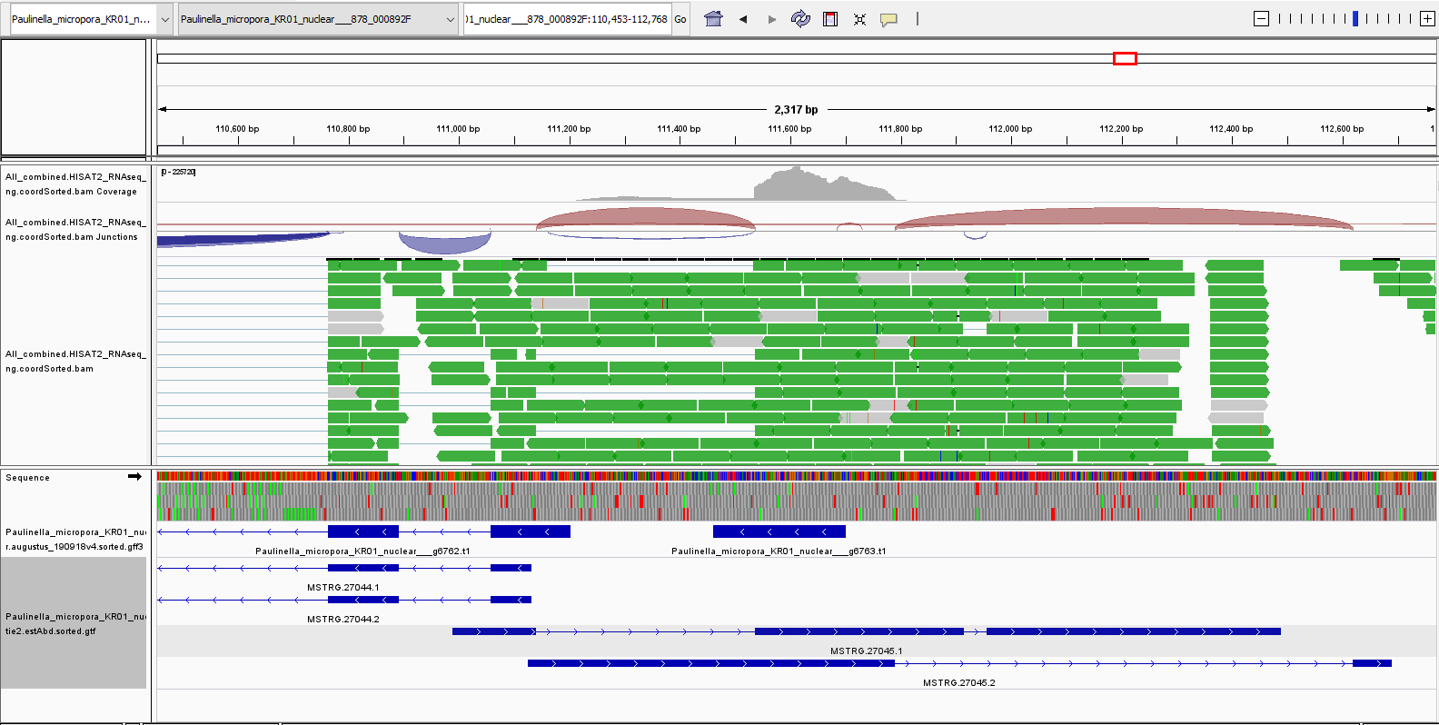
g6763.t1

Slide 12
Pyrimidine

Slide 13
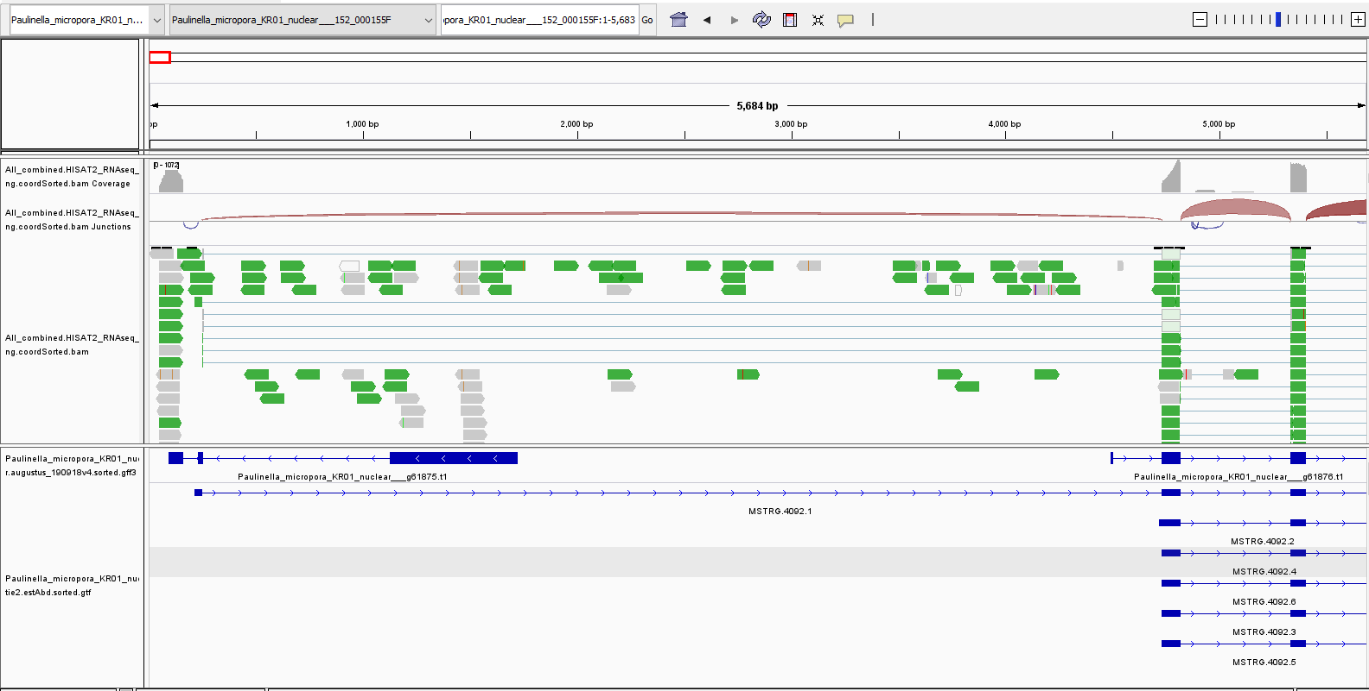
g61875.t1

Slide 14
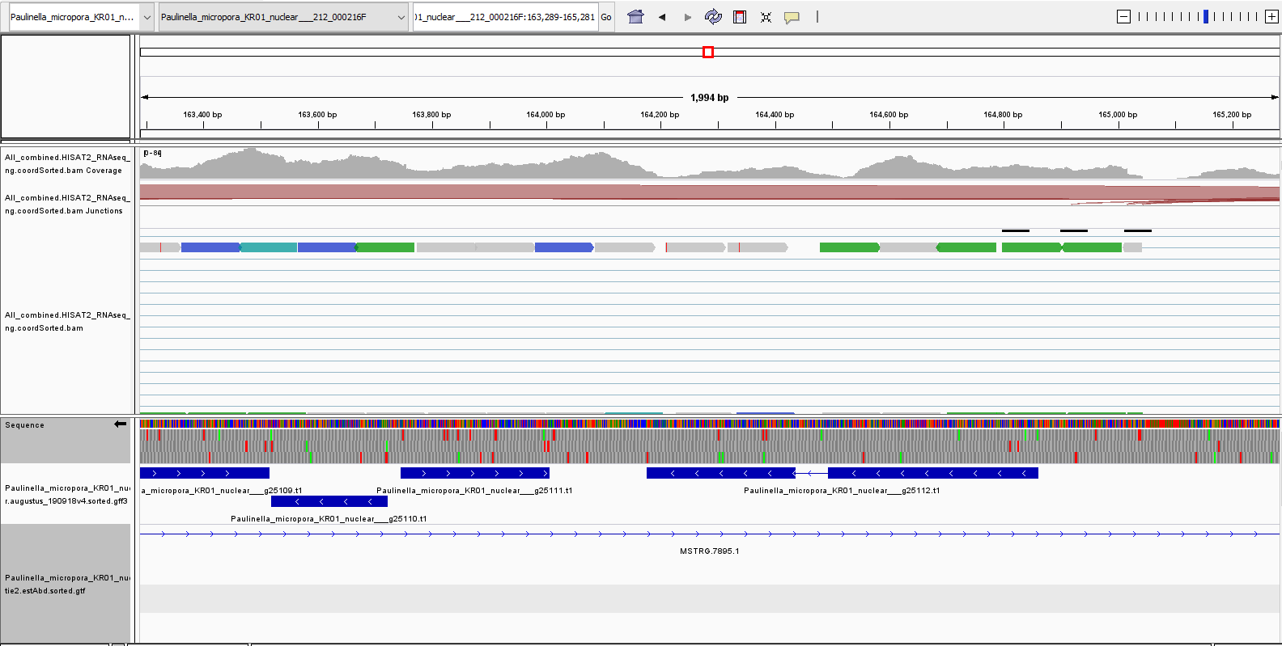
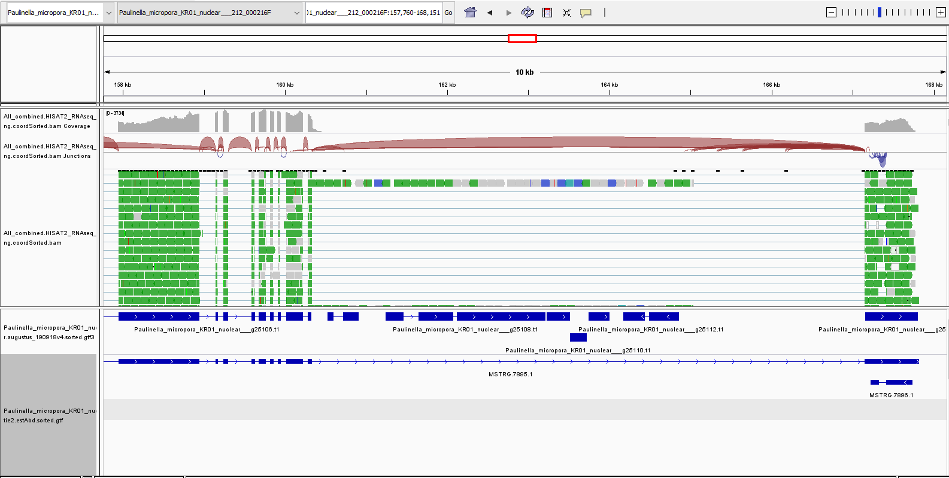
g25112.t1

Slide 15
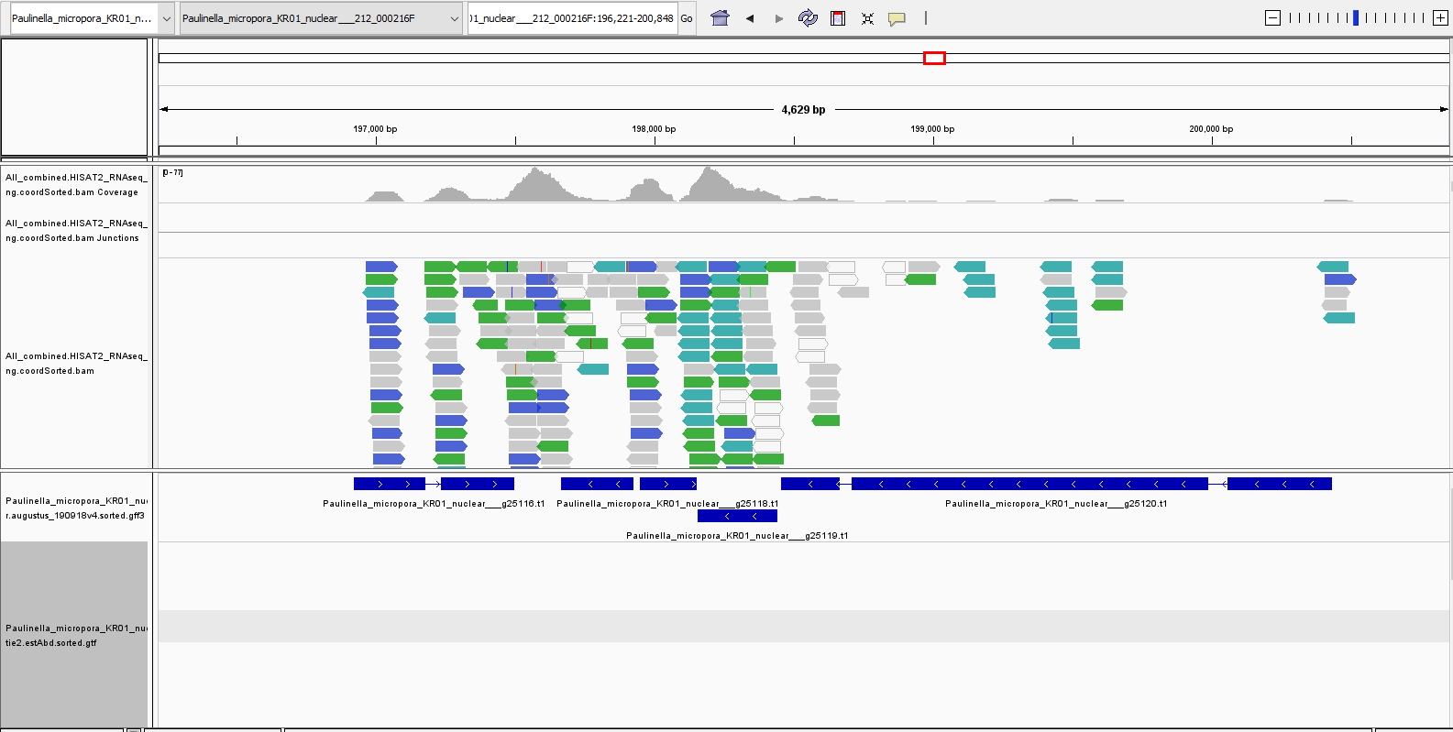
g25116.t1

Slide 16
g30959.t1

