Slide 1
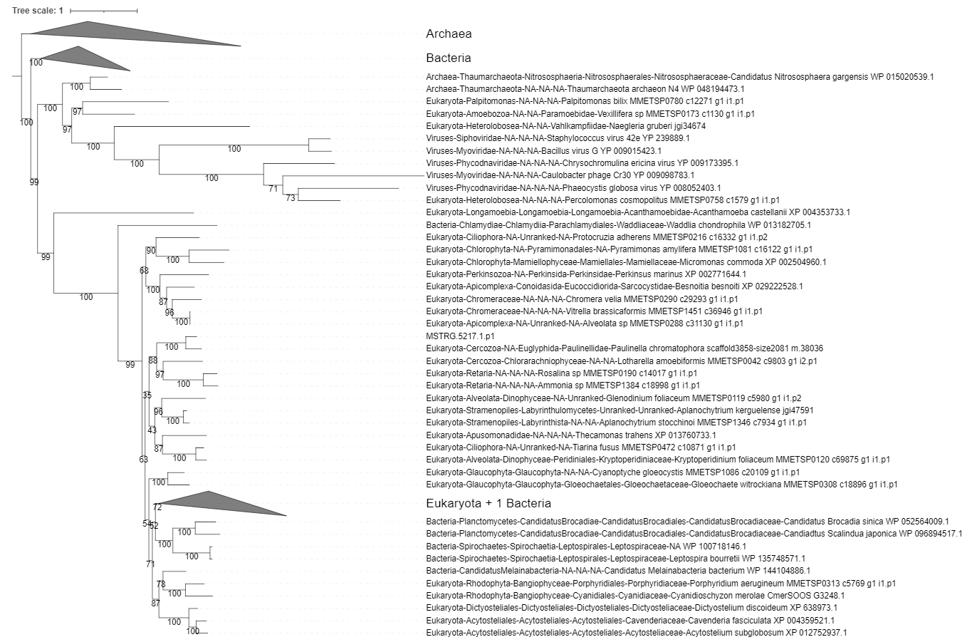
K00088 IMPDH,guaB;IMPdehydrogenase[EC:1.1.1.205]

Slide 2
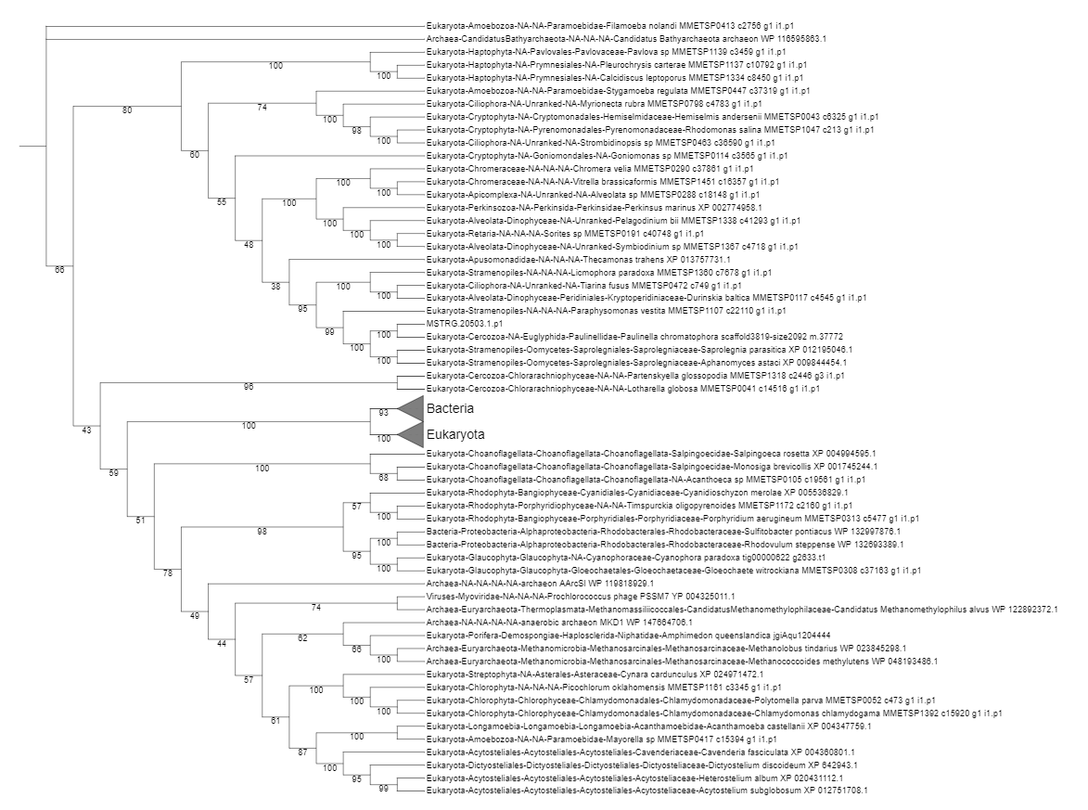
K00602 purH;phosphoribosylaminoimidazolecarboxamideformyltransferase/IMPcyclohydrolase[EC:2.1.2.33.5.4.10]

Slide 3
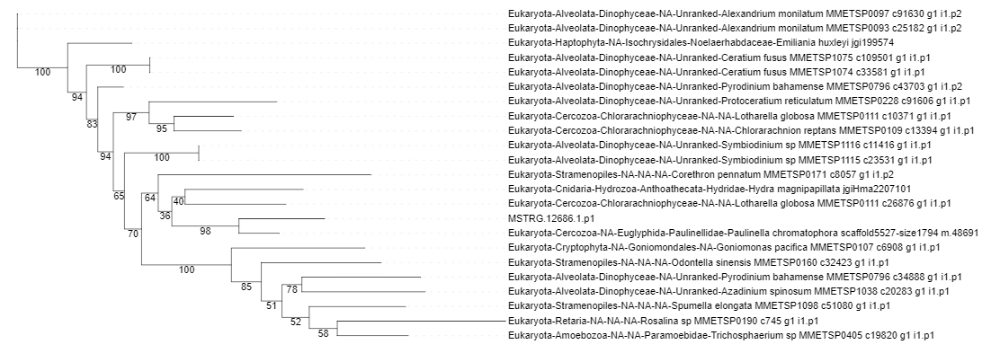
K00860 cysC;adenylylsulfatekinase[EC:2.7.1.25]

Slide 4
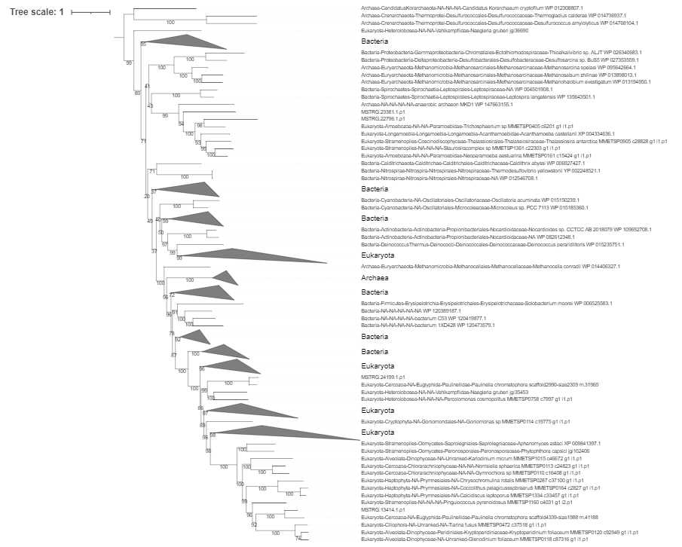
K00873 PK,pyk;pyruvatekinase[EC:2.7.1.40]

Slide 5
K00939 adk,AK;adenylatekinase[EC:2.7.4.3]

Slide 6
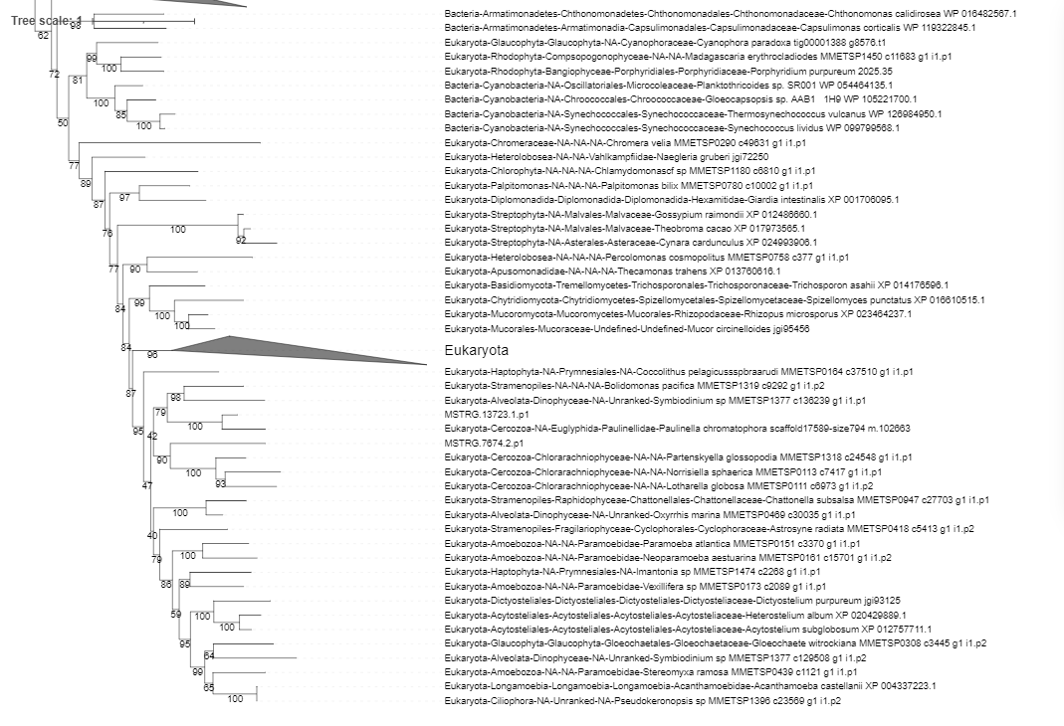
K00940 ndk,NME;nucleoside-diphosphatekinase[EC:2.7.4.6]

Slide 7
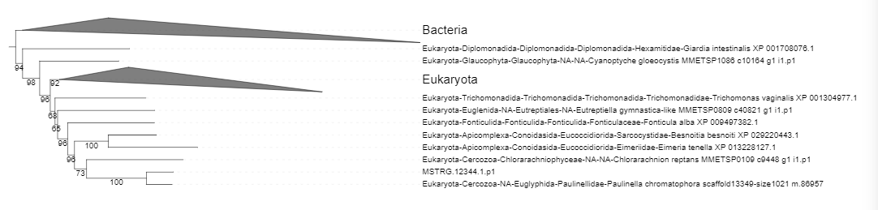
K00942 E2.7.4.8,gmk;guanylatekinase[EC:2.7.4.8]

Slide 8
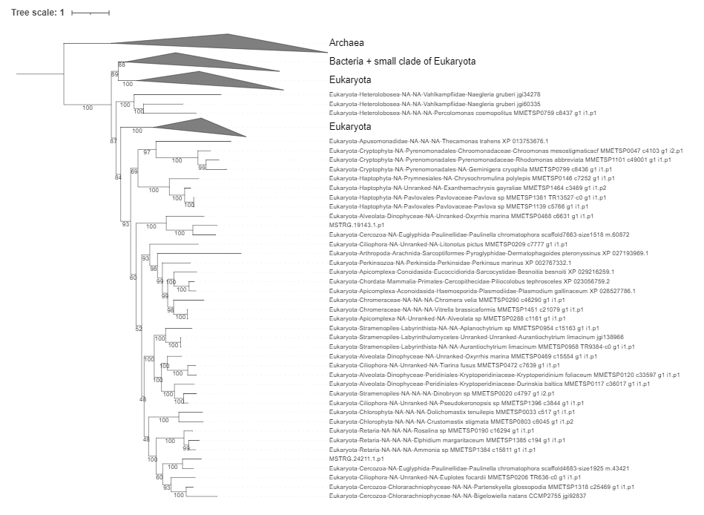
K00948 PRPS,prsA;ribose-phosphatepyrophosphokinase[EC:2.7.6.1]

Slide 9
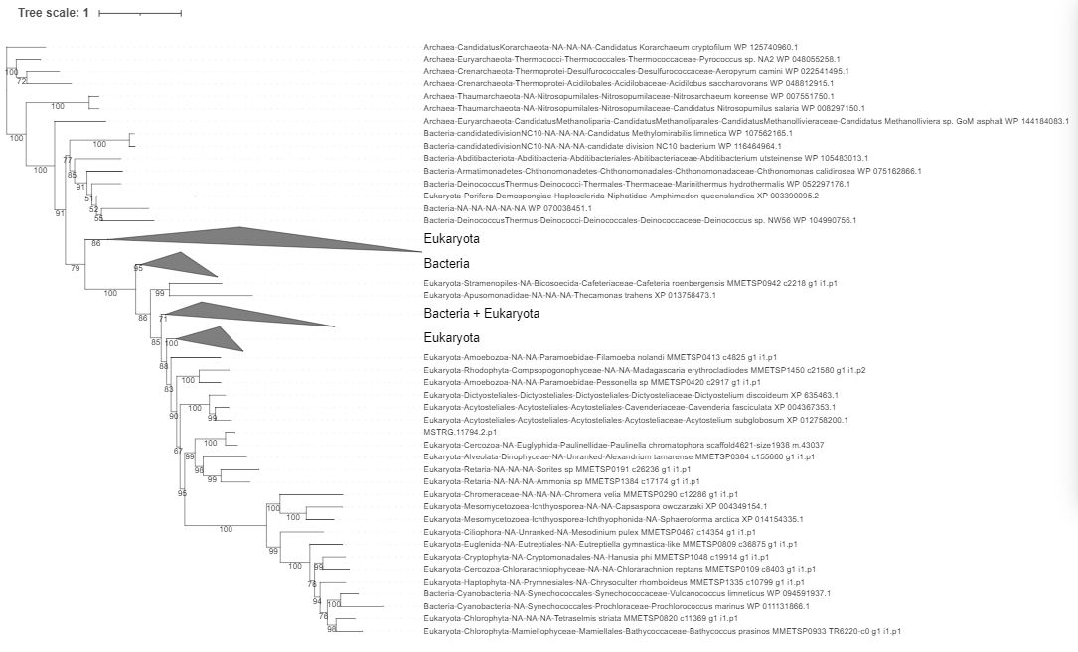
K00958 sat,met3;sulfateadenylyltransferase[EC:2.7.7.4]

Slide 10
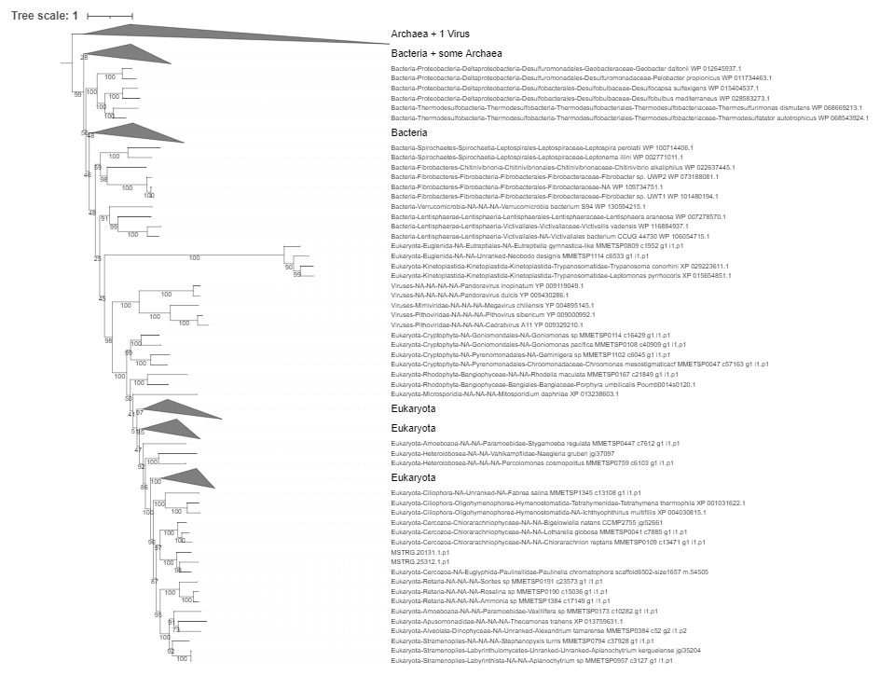
K01939 purA,ADSS;adenylosuccinatesynthase[EC:6.3.4.4]

Slide 11
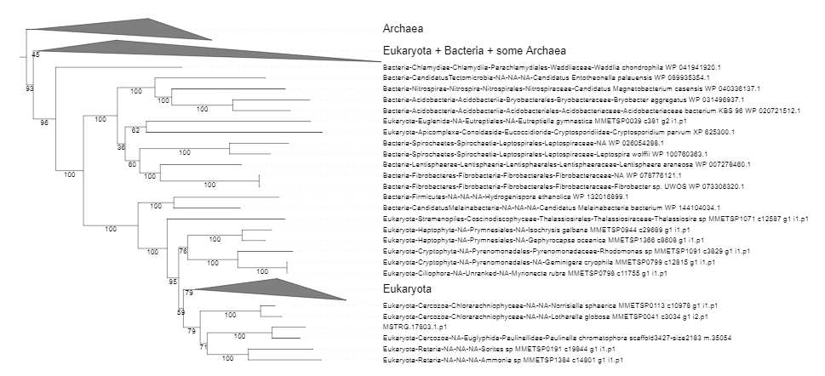
K01951 guaA,GMPS;GMPsynthase(glutamine-hydrolysing)[EC:6.3.5.2]

Slide 12
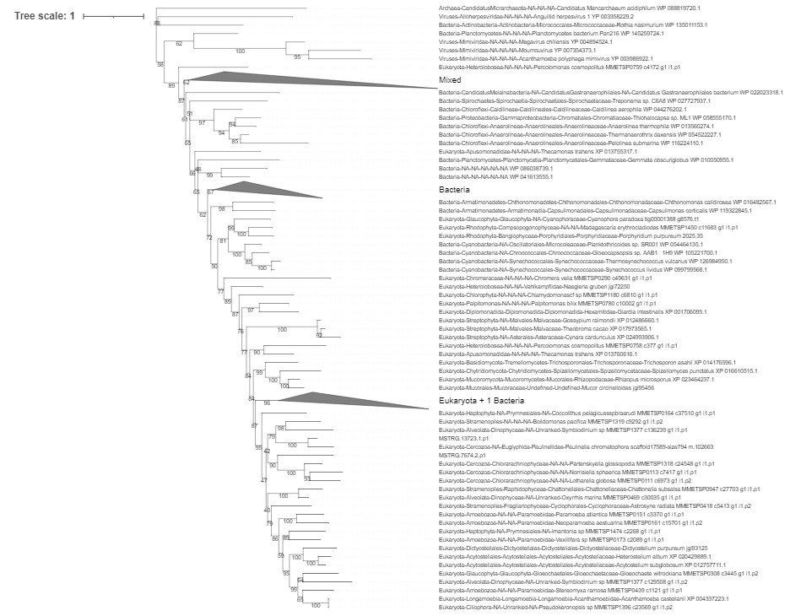
K00940 ndk, NME; nucleoside-diphosphate kinase [EC:2.7.4.6]

Slide 13
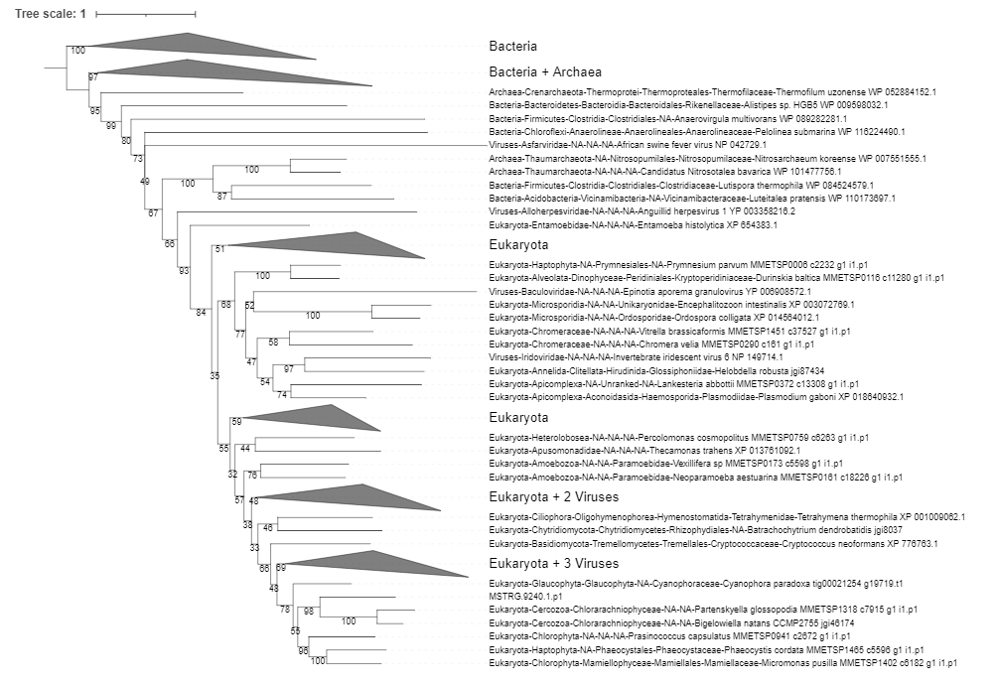
K00943 tmk, DTYMK; dTMP kinase [EC:2.7.4.9]

Slide 14
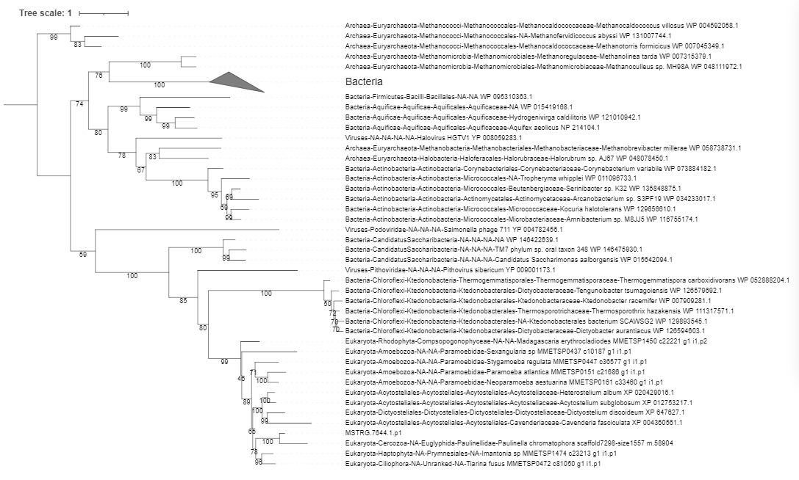
K01494 dcd; dCTP deaminase [EC:3.5.4.13]

Slide 15
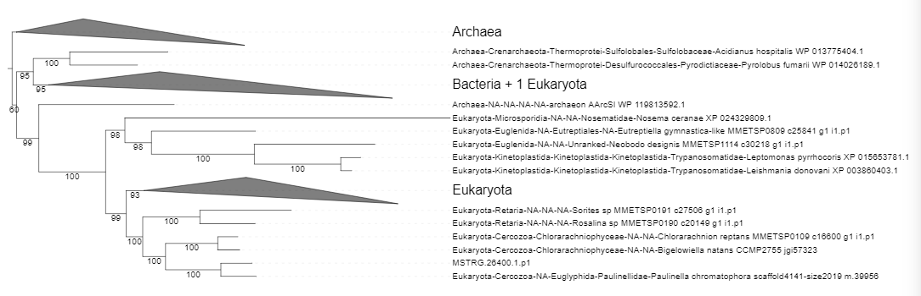
K01937 pyrG, CTPS; CTP synthase [EC:6.3.4.2]

