Slide 1


Starting Git and GITHUB
Let’s Get Started

Slide 2
What is Git?
An Organized Way To Track Changes in Documents
Git is a tool to record changes in files.
Revision control system.
Was made by Linus Torvalds
Made the Linux Kernel.
You can recover from your code being deleted!
You can have multiple people and multiple versions.
You can collaborate with off-site individuals.

Slide 3
Let’s Install Git
☑ Install git
☑ git config --global user.name “John Doe”
☑ git config --global user.email you@broadinstitue.org
☑ git config --list

Slide 4
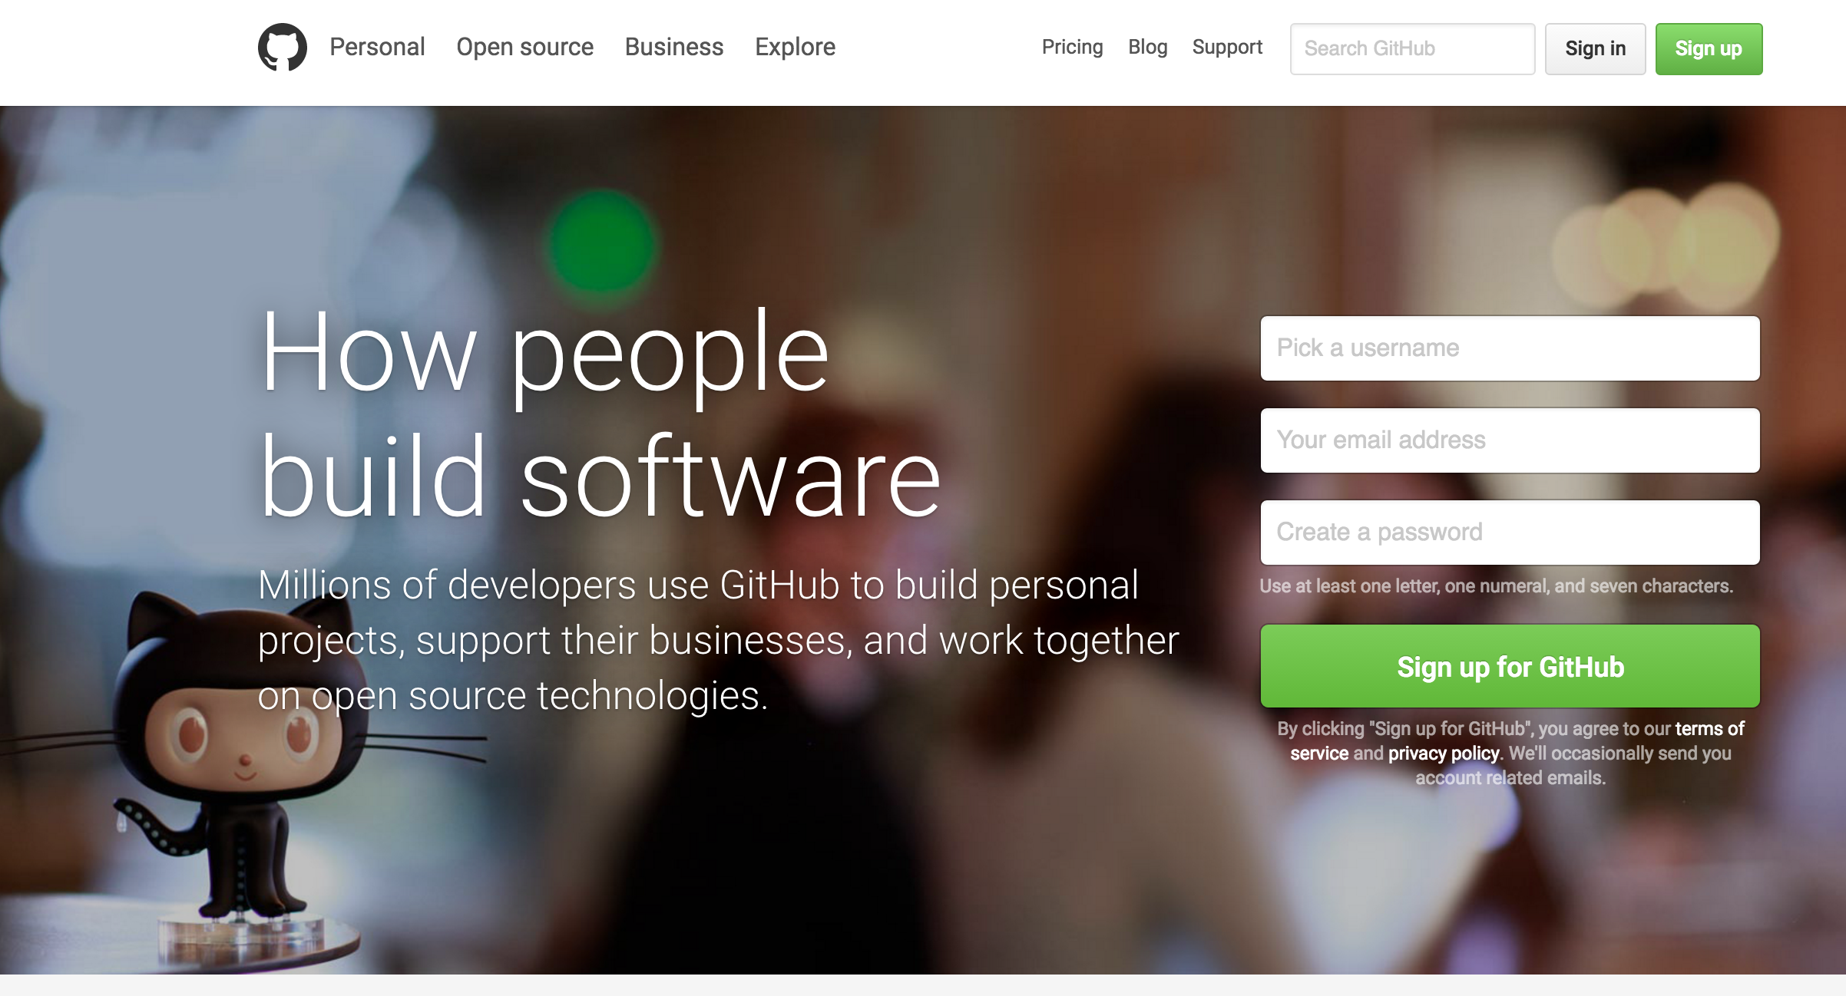
GitHub
https://github.com/

Slide 5

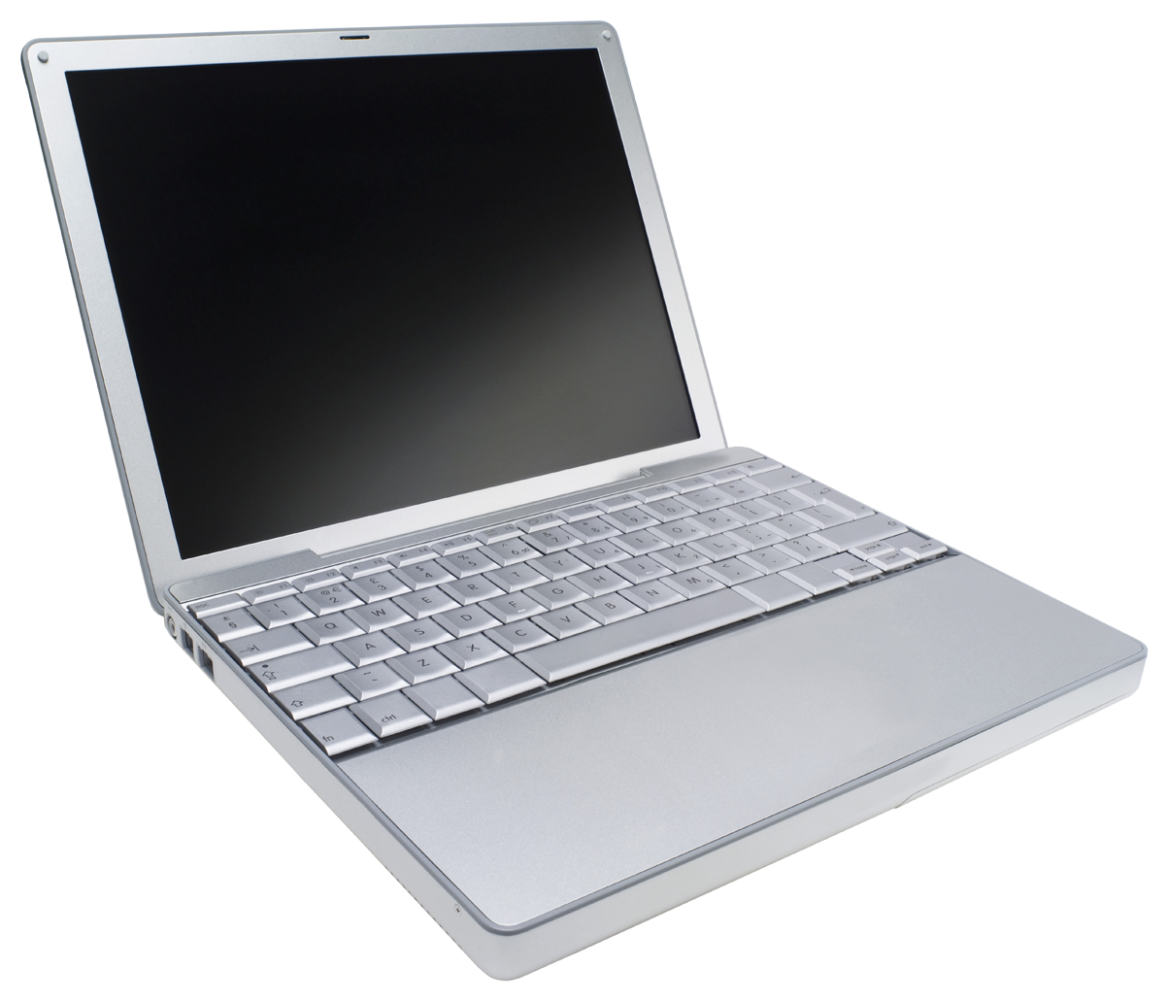
git clone
Command:
git clone https://……..
GitHub
Git Repo
Staging
Local Working
Directory

Slide 6

git status
Command:
git status
GitHub
Git Repo
Staging
Local Working
Directory

Slide 7
git add
Command:
git add filename.txt
git add directory
GitHub
Git Repo
Staging
Local Working
Directory

Slide 8
git add
Command:
git add filename.txt
git add directory
GitHub
Git Repo
Staging
Local Working
Directory

Slide 9
git commit
Command:
git commit –m “Message describing commit.”
GitHub
Git Repo
Staging
Local Working
Directory

Slide 10
git push
Command:
git push
GitHub
Git Repo
Staging
Local Working
Directory

Slide 11
git pull
Command:
git pull
GitHub
Git Repo
Staging
Local Working
Directory

Slide 12
Git History
(Current Branch)
Head
Initial commit

Slide 13
Git History
Modify
git add
git commit
git push
Hello World!
Head
8dfd8fsq
Initial commit

Slide 14
Git History
Modify
git add
git commit
git push
Hello World!
Hello to you too!
Head
98d3l43g
8dfd8fsq
Initial commit

Slide 15
Git History
Modify
git add
git commit
git push
Hello World!
Hello to you too!
Wait…am I talking to myself?
Head
9dke9cde
98d3l43g
8dfd8fsq
Initial commit

Slide 16
Git History
qit checkout 8dfd8fsq
Hello World!
9dke9cde
98d3l43g
Head
8dfd8fsq
Initial commit

Slide 17
Git History
qit checkout master
Hello World!
Hello to you too!
Wait…am I talking to myself?
Head
9dke9cde
98d3l43g
8dfd8fsq
Initial commit

Slide 18
Branching
git checkout –b dev
dev
Master
Head
ffdf8fs8f9
9dke9cde
98d3l43g
Locally
8dfd8fsq
Initial commit

Slide 19
Branching
dev
git add filename1.txt
git add filename2.txt
Head
5kjl4jl4k
Master
ffdf8fs8f9
9dke9cde
98d3l43g
Locally
8dfd8fsq
Initial commit

Slide 20
The Dreaded Merge
dev
git checkout master
5kjl4jl4k
Master
ffdf8fs8f9
Head
9dke9cde
98d3l43g
Locally
8dfd8fsq
Initial commit

Slide 21
Branching
dev
git merge dev
Master
Head
5kjl4jl4k
98d0fdf0
ffdf8fs8f9
9dke9cde
98d3l43g
Locally
8dfd8fsq
Initial commit

Slide 22
Branching
git branch -d dev
Master
Head
98d0fdf0
9dke9cde
98d3l43g
Locally
8dfd8fsq
Initial commit

Slide 23
Branching
git checkout 9dke9cde
Master
98d0fdf0
Head
9dke9cde
98d3l43g
Locally
8dfd8fsq
Initial commit

Slide 24
Branching
Master
Feature 1
Feature 2
Feature 1
Update

Slide 25
A Note on Branches
The commands before assume you are working with local branches not interacting with github (or your remote server).
When you make a branch locally and try to push it to github it does not know it should exist and gets confused. To tell it the branch should be made on the github site use:
git push --set-upstream origin branch_name
Normally the command for deleting branches deletes local branches only, this is safer. When you need to delete a branch on github, switch to the master branch and use this command:
git push origin --delete branch_name

Slide 26
Submodules
Why make this complicated?
Super Cool Repo 1
(Automated Cat Picture Search)
Super Cool Repo 2
(Corgi Video Website)
Picture Utility

Slide 27
Submodules
Solution 1: Copy in code.
Super Cool Repo 1
(Automated Cat Picture Search)
Super Cool Repo 2
(Corgi Video Website)
Copy
Copy
Picture Utility

Slide 28
Submodules
Solution 1: Copy in code.
Super Cool Repo 1
(Automated Cat Picture Search)
Super Cool Repo 2
(Corgi Video Website)
Picture Utility
Need to update the code for Repo1

Slide 29
Submodules
Solution 1: Copy in code.
☑
☒
Broken!
Fixed!
Super Cool Repo 1
(Automated Cat Picture Search)
Super Cool Repo 2
(Corgi Video Website)
Picture Utility
Need to update the code for Repo1

Slide 30
Submodules
Solution 1: Copy in code.
☑
☑
Fixed!
Fixed!
Super Cool Repo 1
(Automated Cat Picture Search)
Super Cool Repo 2
(Corgi Video Website)

Slide 31
Submodules
Solution 1: Copy in code.
☑
☑
Fixed!
Fixed!
Super Cool Repo 1
(Automated Cat Picture Search)
Super Cool Repo 2
(Corgi Video Website)
Need to add a new functionality to the Picture Utility.

Slide 32
Submodules
Solution 1: Copy in code.
Which to update?
Super Cool Repo 1
(Automated Cat Picture Search)
Super Cool Repo 2
(Corgi Video Website)
Need to add a new functionality to the Picture Utility.

Slide 33
Submodules
Solution 1: Copy in code.
☑
☑
Fixed!
Fixed!
Super Cool Repo 1
(Automated Cat Picture Search)
Super Cool Repo 2
(Corgi Video Website)

Slide 34
Submodules
Solution 1: Copy in code.
Where is the bug?
Super Cool Repo 1
(Automated Cat Picture Search)
Super Cool Repo 2
(Corgi Video Website)
Picture Utility
Found a bug!

Slide 35
Submodules
Copying Code is almost NEVER the solution
Adds unnecessary work and more chances for mistakes.
Super Cool Repo 1
(Automated Cat Picture Search)
Super Cool Repo 2
(Corgi Video Website)
X
X
Picture Utility

Slide 36
Submodules
Solution 2: Git Submodule.
Cat Repo 1
Corgi Repo 2
Picture Utility

Slide 37
Submodules
Solution 2: Git Submodule.
Add and Commit Repo
as submodule
Cat Repo 1
Corgi Repo 2
Picture Utility

Slide 38
Submodules
Solution 2: Git Submodule.
Cat Repo 1
Corgi Repo 2
Need to update the code for Repo1
Picture Utility

Slide 39
Submodules
Solution 2: Git Submodule.
☑
Fixed!
Unchanged!
Cat Repo 1
Corgi Repo 2
Need to update the code for Repo1
Picture Utility

Slide 40
Submodules
Solution 2: Git Submodule.
Unchanged!
Unchanged!
Cat Repo 1
Corgi Repo 2
Need to add a new functionality
to the Picture Utility.
Picture Utility

Slide 41
Submodules
Solution 2: Git Submodule.
☑
☑
Fixed!
Fixed!
Cat Repo 1
Corgi Repo 2
Need to add a new functionality
to the Picture Utility.
Picture Utility

Slide 42
Submodules
Solution 2: Git Submodule.
☑
Unchanged!
Fixed!
Cat Repo 1
Corgi Repo 2
Need to add a new functionality
to the Picture Utility.
Picture Utility

Slide 43
Submodules
Solution 2: Git Submodule.
Cat Repo 1
Corgi Repo 2
Found a bug!
Picture Utility

Slide 44
Submodules
Submodules allow shared code that can be:
Developed without breaking repos that depend on them
Differently versioned for different repos that depend on them
Versioning code is used instead of duplicating.
Still have the power of the commit history
Cat Repo 1
Corgi Repo 2
Picture Utility

Slide 45
Command for Submodules
Working with the repo is no different than other repos.
clone, add, commit, pull, push

Slide 46
Using a Repo with Submodules
Cloning a repo with submodules
git clone --recursive https://……
To add a submodule to a project (the first time)
git submodule add https://…
When submodules are changed, add (normal add) and commit them in the parent repo.
git status will indicate with (modified content)
Need to add the submodule to the parent repo.
Repos added this way are at a “detached head”
This means they will not update on their own but you have to update them as needed…which is what you want.

Slide 47
How is this Implemented?
Cloned submodules do NOT have .git directories.
They are just links to the parent directory.
The parent .git controls the submodule.
Let’s look at a real example!

Slide 48
How to Use It?
Cat Repo 1
git clone --recursive https://cat.repo
Picture Utility
git clone https://picture.repo

Slide 49
How to Use It?
Cat Repo 1
git clone --recursive https://cat.repo
Picture Utility
git clone https://picture.repo
(Make changes)
git add changed.txt
git commit --m “snazzy message”
git push

Slide 50
How to Use It?
Cat Repo 1
git clone --recursive https://cat.repo
(go to submodule picture.repo)
git pull
Picture Utility
git clone https://picture.repo
(Make changes)
git add changed.txt
git commit --m “snazzy message”
git push

Slide 51
How to Use It?
Cat Repo 1
git clone --recursive https://cat.repo
(go to submodule picture.repo)
git pull
(go up into Cat Repo)
git add picture.repo
git add commit –m “Updated submodule”
git push
Picture Utility
git clone https://picture.repo
(Make changes)
git add changed.txt
git commit --m “snazzy message”
Git push

Slide 52
How to Use It?
Cat Repo 1
git clone --recursive https://cat.repo
(go to submodule picture.repo)
git pull
Cat Repo
Dev Environment
(go up into Cat Repo)
git add picture.repo
git add commit –m “Updated submodule”
git push
Picture Utility
git clone https://picture.repo
(Make changes)
git add changed.txt
git commit --m “snazzy message”
Git push
Picture Util Repo
Dev Environment

Slide 53
How to Use It?
Cat Repo 1
git clone --recursive https://cat.repo
(go to submodule picture.repo)
git pull
NOT Picture Util
Dev Environment
(go up into Cat Repo)
git add picture.repo
git add commit –m “Updated submodule”
git push
Picture Utility
git clone https://picture.repo
(Make changes)
git add changed.txt
git commit --m “snazzy message”
Git push
Picture Util Repo
Dev Environment

Slide 54

How Can This Help Me?
No Really, Why Do I care?
You can work on multiple
computers (home and work).
Easily see differences in projects
or files (git diff / github).
Record all tasks in one place
(github issues).
Changes can be rolled back if it breaks things (git checkout).
If your computer dies you can recover code (git clone).
You are provided with an easy editor to make online material (github editor).

Slide 55
Make Life Easier
Now you can be lazy!
☑Users get code from a website.
☑Users can update new versions
with git pull.
☑Users can use git status to
indicate the version.
☑Users can get a working copy of
code while you develop the code.
☑Code is always online to be
viewed.
☑Issues can be reported and
managed online.
☑You are provided with an easy
editor to make online material.
☒Each user emails you.
☒Each user emails you.
☒You email the user an updated
version just incase.
☒You always keep a separate code
base for others.
☒Email / drop box code.
☒Users email you.
☒You create your own website.

Slide 56
Thank You
Learn more:
https://www.atlassian.com/git/tutorials
Slack Channel:
coding-club

