Slide 1


Slide 2

Regev Group Python Club
Welcome!

Slide 3
Club Organization
Meet once every 2 weeks
Organizer: Asma Bankapur (bankapur@broadinstitute.org)
Instructors: Timothy Tickle (ttickle@broadinstitute.org)
and YOU?!
Join the coding_club slack channel.
Github repo for materials
https://github.com/TimothyTickle/python_club
https://www.codecademy.com/learn/python
https://www.python.org

Slide 4

Instructor Background
Senior Software Engineer in the Regev and KCO.
Steering Committee Member of Broad SoftEng.
BS in Computer Science, PhD in Bioinformatics and Computational Biology, PostDoc working with Inference in Metagenomics Studies
16 years of experience in programming focused on: C/C++/C#, Java, Perl, Python, R
This is not a tyranny!
A conversation, not a dictatorship.

Slide 5
Why Python?
Python is NOT a perfect language…there are none.
So why Python?
Perl?
Both come out of Unix based systems scripting focused on text files.
In this context Perl is faster and more succinct.
Perl is not as readable and is becoming less embraced in the community.
C/C++?
Fast.
Efficient.
Large Learning Curve.
I love these languages but the devil is in the details.

Slide 6
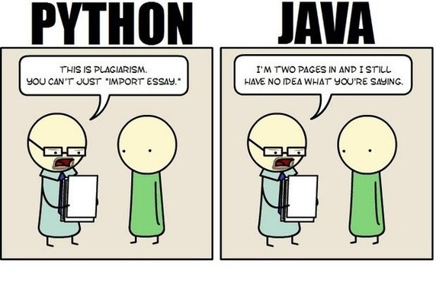
Why Python?
Java?
May be slightly faster than Python.
Verbose.
Complicated object hierarchies (design can fix this).
R?
Awesome for math / data science (but this is it’s only niche).
Matlab?
Not open source solution.
Python?
Weaknesses
R is better at math
No Mobile
JS is a better web platform

Slide 7
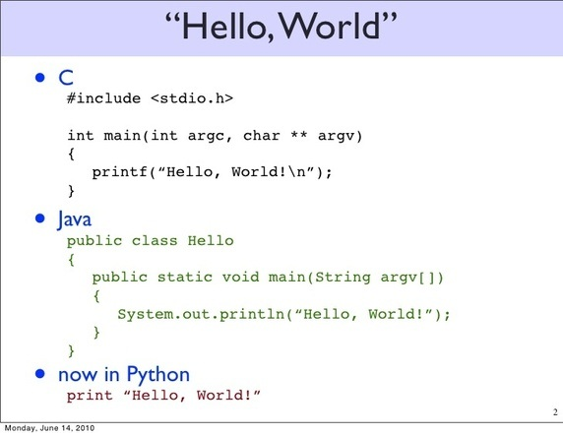
Why Python?
Python is readable
Popular in science for this reason
You can still be a scientist!
Maintainable
Nice first language.
Scientific Libraries are written by scientists.
Has collected a large library.
Python can make blazing fast solutions with C++.
Most the things you will write will not require blazing speeds.
A lot of work has gone into and continues to go into Python’s speed.
This does not mean it is fast but it can be with C/C++.
As a first language this is not really the point…

Slide 8

Who Uses Python?
Google
Compments of spider / search engines
RedHat
Uses it for their installer / configuration utilities (Anaconda)
IBM
Factory Tool Control Automation
Disney!
Animation production scripts.
Industrial Light and Magic
Scripts used in making The Mummy, The Phantom Menace.
Eve-online
Massively Multiplayer Online RPG (MMORPG).
NASA
The standard for Johnson Space Center (being adopted in Mission Control).
The Broad Institute!

Slide 9
Goals of the Club
Initially focusing on syntax and procedural language.
Milestone to make a tested script that can be called from command line.
Good Programming Practices and Agile Development in Science
Github Repo with continuous integration.
Object Oriented Language Elements
Create a website with Django Flask?
Trinotate Web?
BioPython?
Functional Programming
Milestone?
Data Science
Milestone? iPython Notebook

Slide 10

Best Practices for Science!
Readability
Coding standards
Auto-documentation
Linting
Maintainability
Code Versioning
Testing
Continuous Integration Techniques
Online user support with minimal effort
Reproducibility
Open source, public code repositories
Jupyter Notebooks
Collaboration
Web-based social code development

Slide 11
Online Courses
Code Academy:
https://www.codecademy.com/learn/python
EdX (MIT):
https://www.edx.org/course/introduction-computer-science-mitx-6-00-1x-8#!
Preferences?

Slide 12
Setting Up for Next Steps
Integrated Development Environment.
For local machines
Vim or Emacs on server
Can get syntax highlighting and other goodies also.
Suggestions?
Get a github account.
Account on instruction platform
Cousera, code-academy
Slack channel
neumann@broadinstitute.org

Slide 13


