Slide 1

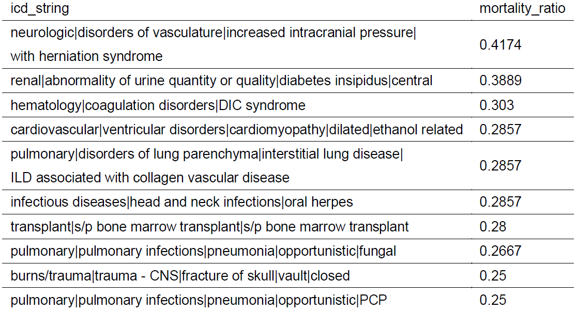
Few-Shot Learning with Similar Tasks via
MOE for Mortality Prediction of Diverse Rare Diseases
Wu Haoxian (A0225199W), Chen Nan (A0224882Y), Wang Ruixiao (A0225545E), Ye Ruizhe (A0225250U)
Abstract
With the vast volume of Electronic Health Records(EHR) available online, the past few years have witnessed the profound impact of DL applying in healthcare application. EHR systems store data associated with each individual patients' medical chronological journey, including demographic information, diagnoses, medications, laboratory tests and results, medical images, clinical notes, and so on.
Considering the high dimensionality and temporality of medical journey, deep sequential model have been widely used for diverse applications, such as medical concept extraction, patient trajectory modelling, disease prediction, mortality prediction, to name a few.
Mortality prediction of diverse rare diseases using electronic health record (EHR) data is a crucial task for intelligent healthcare. However, data insufficiency and the clinical diversity of rare diseases make it hard for directly training deep learning models on individual data. Mortality prediction for these different diseases with insufficient samples can be viewed as a few-shot multi-task learning problem. Though different diseases have distinct medical inherence, common properties may be shared among some of them which can be considered as task similarity. By modeling both the task specificity and similarity, data insufficiency problem can be mitigated to make a more accurate prediction for patients with certain disease.
In our project, we leverage Mixture of Experts(MOE) to capture task similarity and specificity on deep sequential model for 24-hour earlier mortality prediction.
Methodology
We take LSTM as both gates and experts model. Individual chronological events are used by gated-LSTM to determine the latent disease property. Each expert-LSTM is a specific model for mortality prediction of one task. The weighted-sum of outputs of each expert are fed to the final output layer to generate the mortality signal in the next 24 hour.
The Overall model architecture is shown as the figure below.
Gated
LSTM
Expert
LSTM-1
Expert
LSTM-2
output
layer
Expert
LSTM-3
24-hour earlier Mortality Prediction
events embedding
……
Patients medical
chronological Journey
Expert
LSTM-n
Dataset
eICU is populated with data from a combination of many critical care units throughout the continental United States between 2014 and 2015. For each patient, we select events occurred 24 hours earlier before unit discharge with counterpart features and arrange the events in the temporal order. We computed the frequency of each event among unit charging, remaining events with frequency more than 80%. The type of the events is listed below.
lab event: MCHC, WBC x 1000, Hct, MCH, platelets x 1000, RBC, Hgb, RDW, MCV, bicarbonate, glucose, BUN, potassium, creatinine, calcium, sodium, chloride,
vital sign: systolic, diastolic, noninvasivemean, sao2, heartrate, respiration
For each ICD (International Classification of Diagnose x) code in eICU, we calculate its sample size (i.e. the number of patients with this code). Then we select 251 ICD codes with less than 200 samples in eICU as rare diseases.
The description of 10 icdcodes with highest mortality ratio is summarized as the table below.
Experiment
Within each icdcode, split train, test with ratio 4:1 for alive and expired samples respectively, 1/3 of train samples are further separated into validation.
The overall dataset is the combination of samples of all icdcodes for train, validation, test
Set learning-rate=0.0005, epoch_num=15, ran 5 times(seed 1024, 2048, 4096, 8192, 16384), dropout=0.3
For resource limitation, we set 200 as window size, and pad 0 at last if the length of chronological journey is shorter than 200.
Baseline model: treat all icds as one single task
LSTM, Transformer
MOE(10-experts) – LSTM
Assume there are 10 inherences among diseases, 10 tasks
Model | Metrics seed - [Test_loss, ROC_AUC, PRC_AUC] | Cost
MOE(10)-LSTM | 1024 - [0.3029, 0.7640, 0.3341] 2048 - [0.2973, 0.7842, 0.3673] 4096 - [0.3047, 0.7641, 0.3732] 8192 - [0.3026, 0.7519, 0.3543] 16384 - [0.2949, 0.7712, 0.3829] | 5s/step
Transformer | 1024 - [0.3113, 0.7432, 0.2934] 2048 - [0.3193, 0.7478, 0.3053] 4096 - [0.3182, 0.7259, 0.2983] 8192 - [0.3113, 0.7292, 0.2841] 16384 - [0.3102, 0.7522, 0.3318] | 230ms/step
LSTM | - [0.3482, 0.6022, 0.1598] - [0.3443, 0.6536, 0.1792] - [0.3323, 0.6722, 0.2446] 8192 - [0.3388, 0.6405, 0.1843] 16384 - [0.3423, 0.6301, 0.1870] | 610ms/step

