Slide 1
Simple Machines
Team: Never lose
Hao Qin
Kaiyu Lin
Juehan Fu

Slide 2
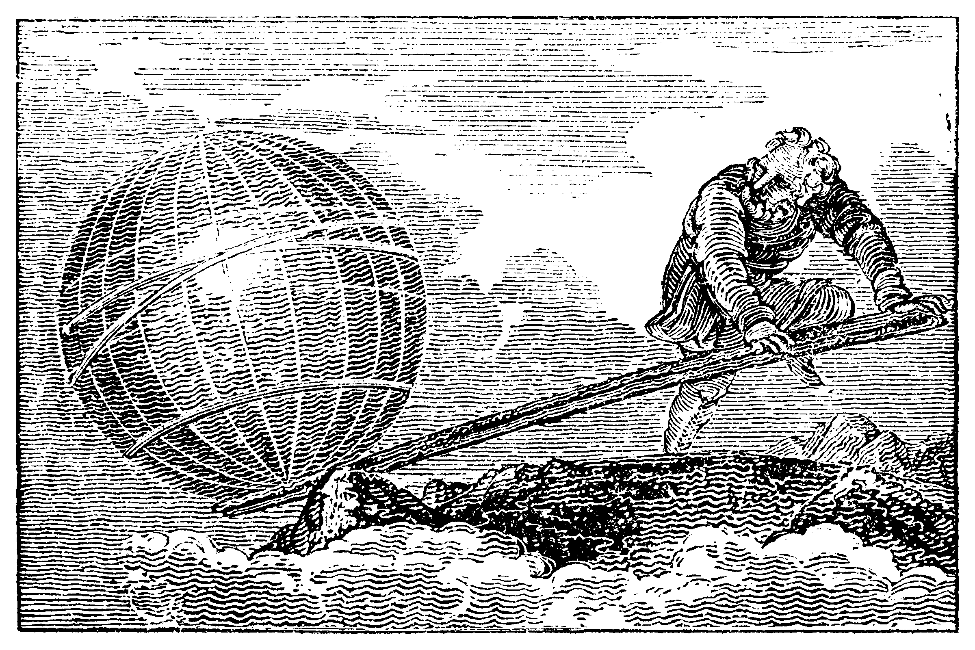
Lever:
Archimedes said: “Give me a place to stand, and I shall move the world.”

Slide 3
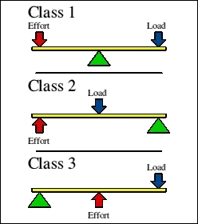
Lever:

Slide 4
The inclined plane

