Slide 2
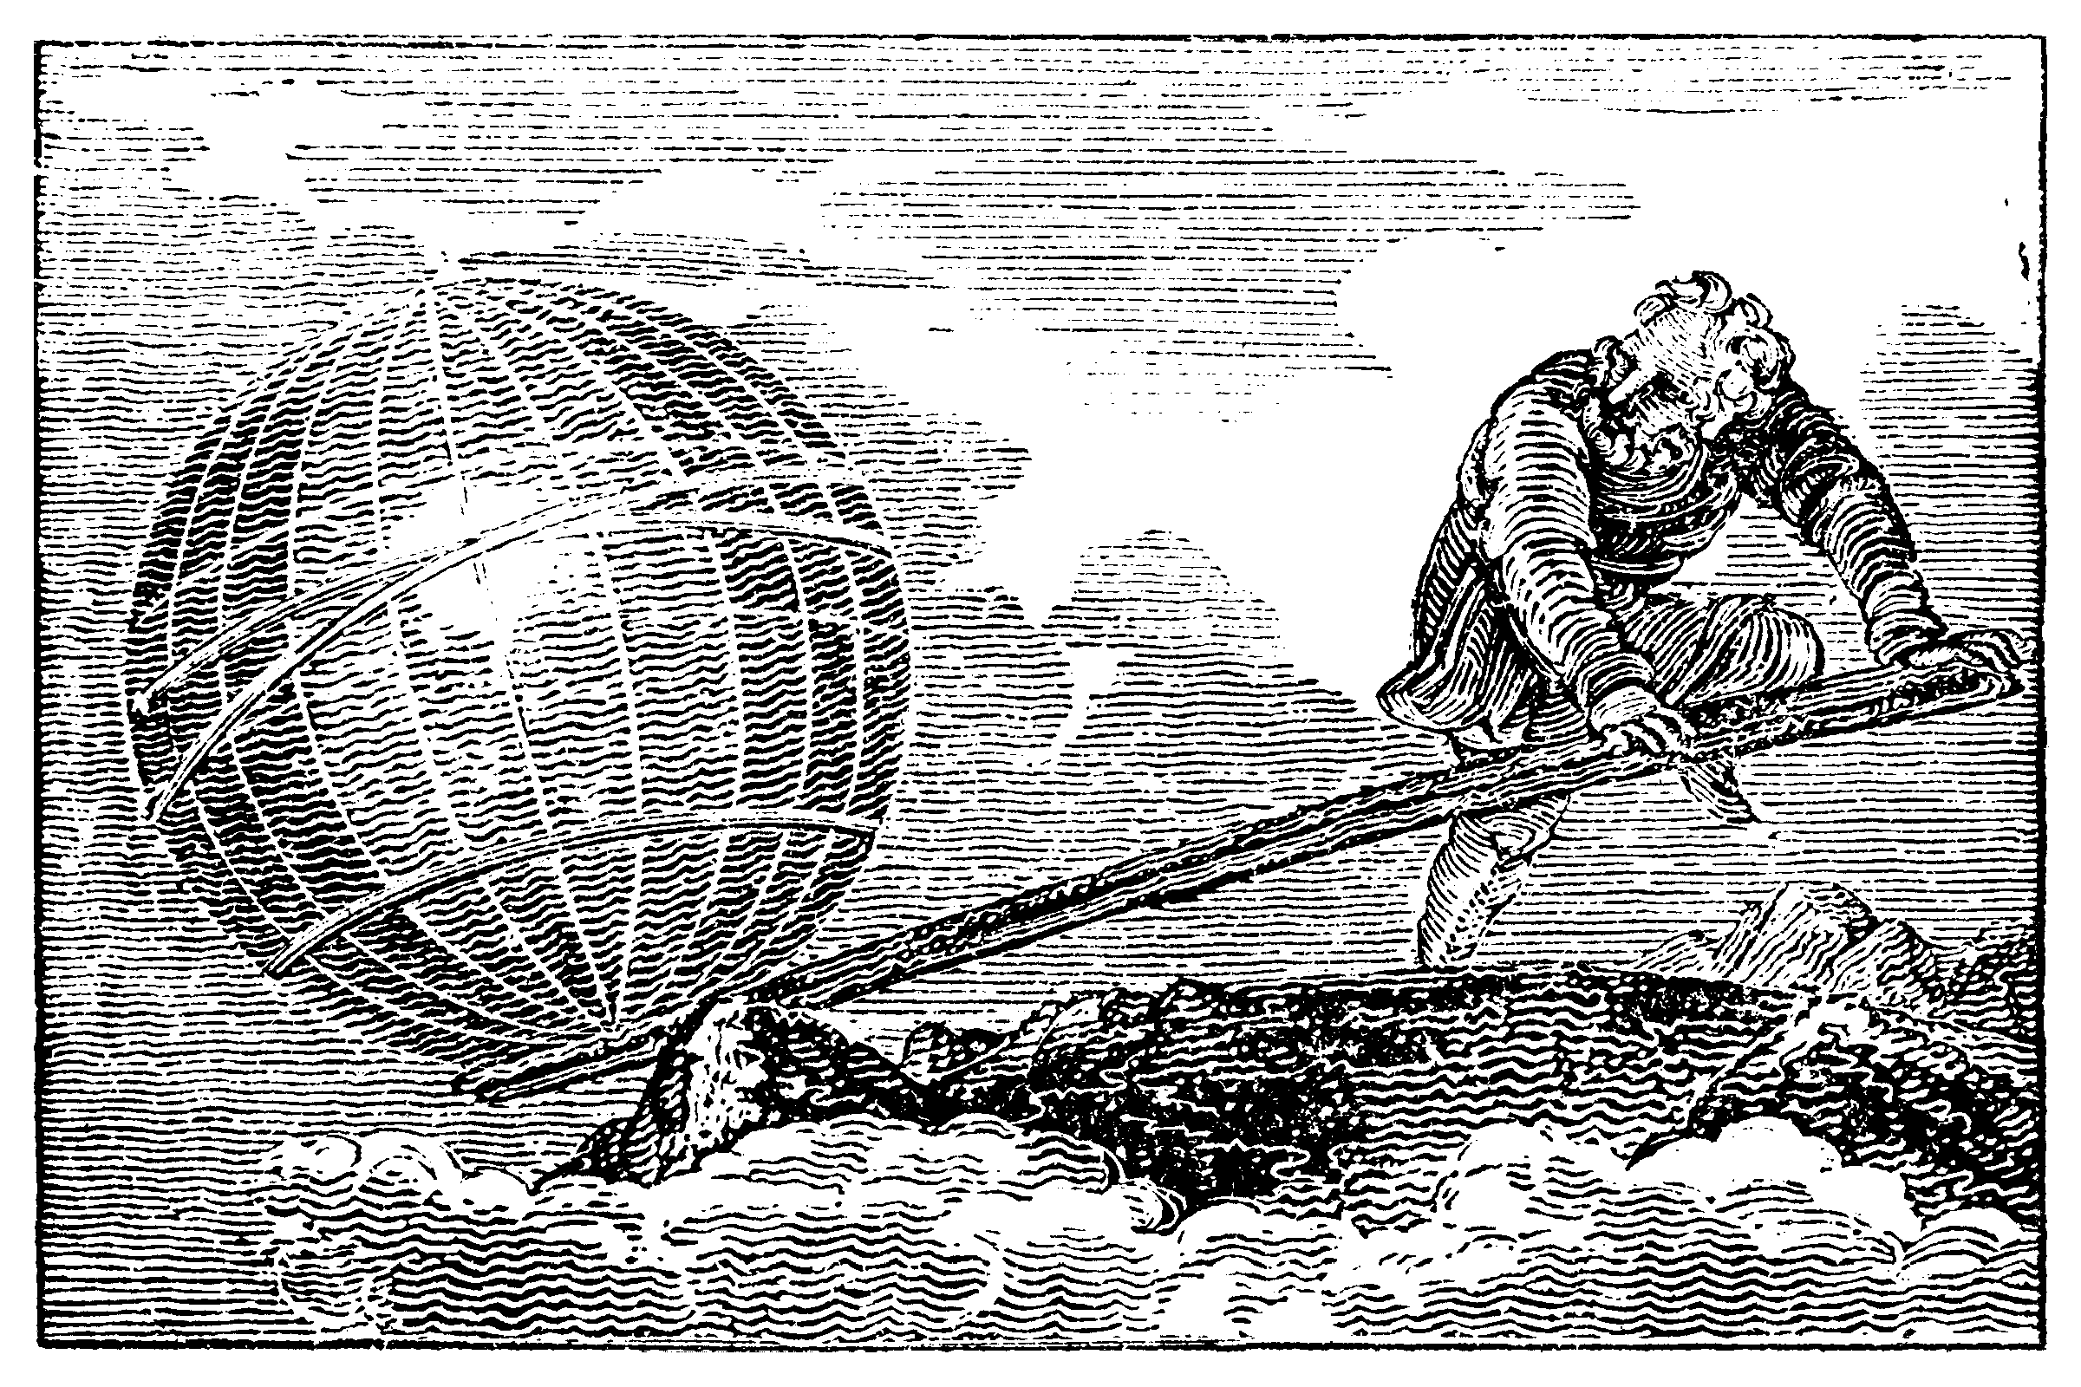
Lever:
Archimedes said: “Give me a place to stand, and I shall move the world.”

Slide 3
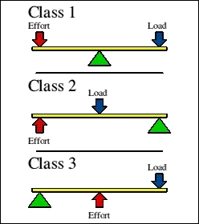
Lever:

