Slide 1
Operation: Escape
The Escapey Boys

Slide 2
Agenda
Design Challenge
Analysis
Design
Realization
Validation
Conclusion & Recommendations

Slide 3

Introduction
Active Floor is a company that provides a device that offers games that combine physical movement with education.
We were tasked to create a game
Cooperative
Educational
For kids in grades 7 & 8

Slide 4
Design Challenge

Slide 5
Design Challenge
We want to design an...
interactive game environment
that enables students from group 7 & 8 during active school hours
to solve educational puzzles in an escape room-like environment
with teamwork as its main focus

Slide 6
Analysis

Slide 7
Analysis
What’s important for the target users?
Are there specific calculations that we should focus on?
Comprehensive reading (Begrijpend lezen)
Calculations (Rekenen)
Basic calculations
Metric system
Fractions
Percentages
How can we make it a fun cooperative experience?

Slide 8
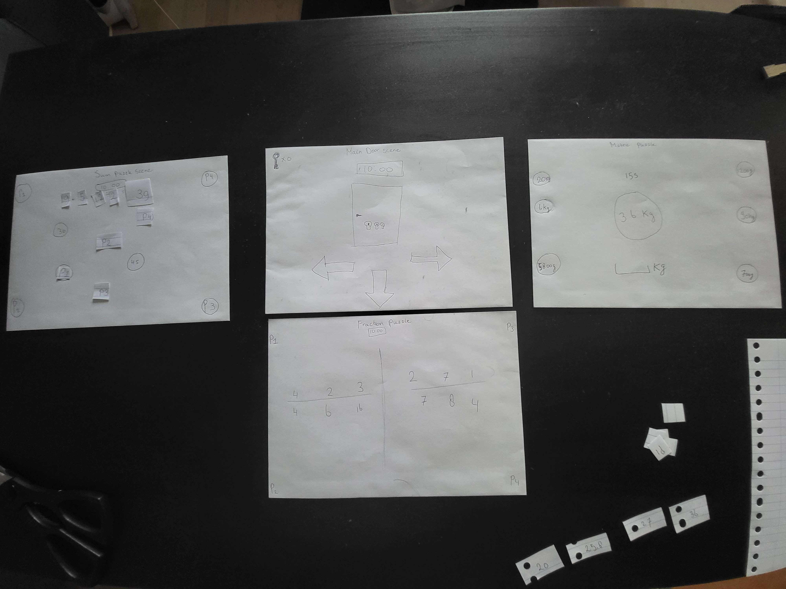
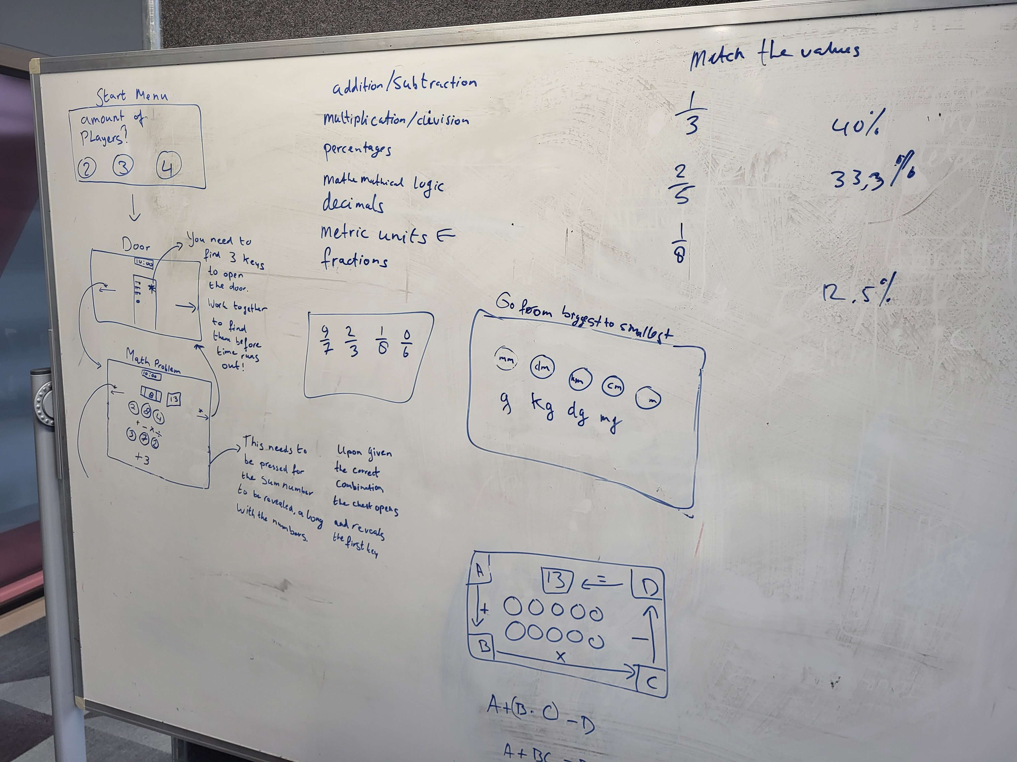
Analysis: Rapid & Paper Prototype

Slide 9
Design

Slide 10

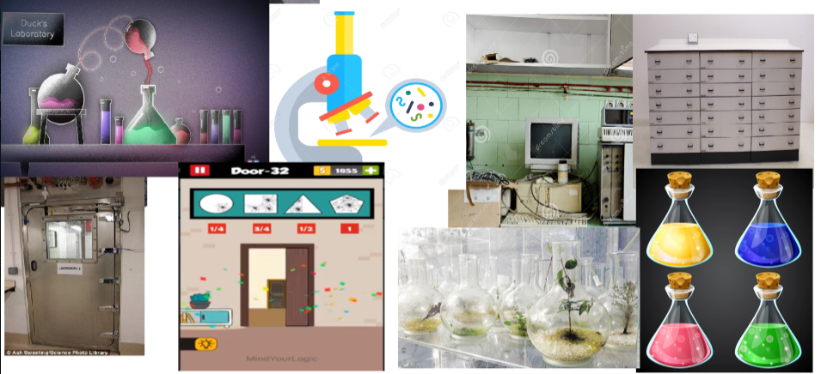
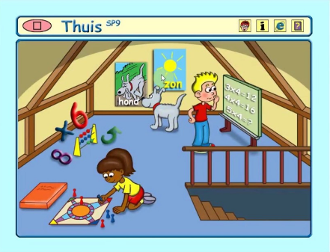
Design

Slide 11
Realization

Slide 12
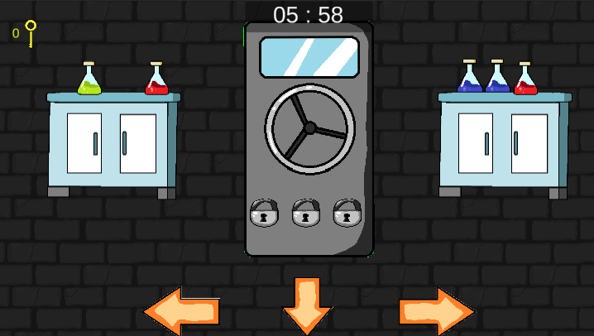
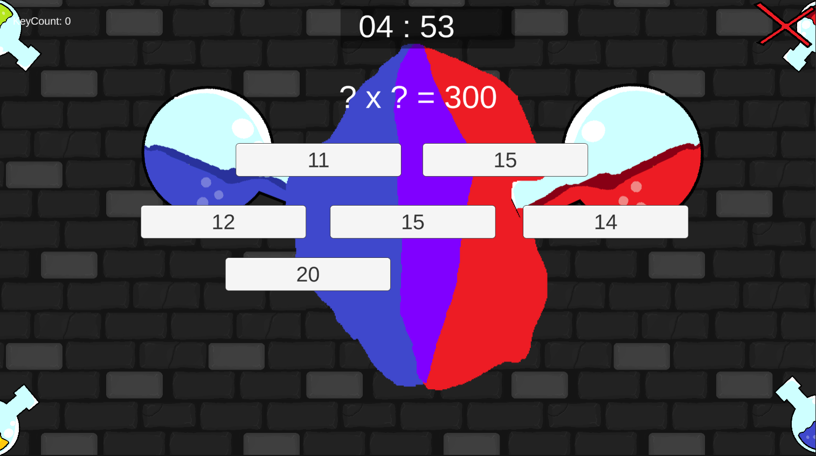
Realization

Slide 13
Validation

Slide 14
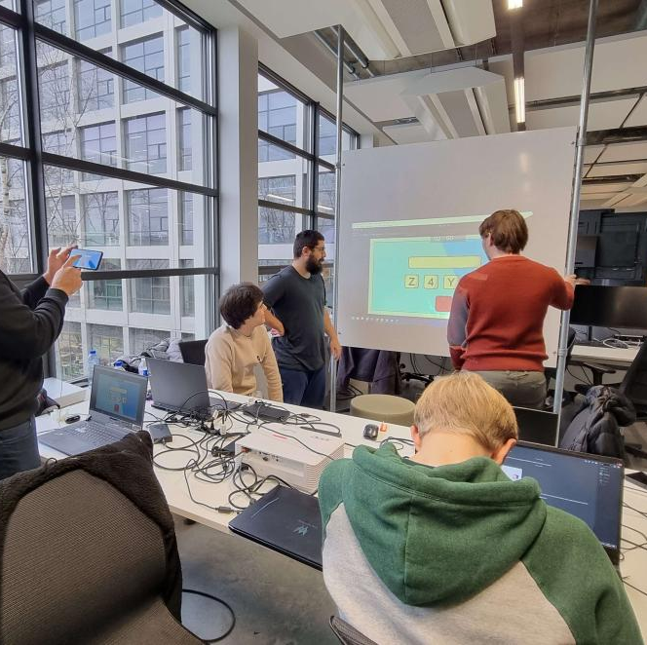
Validation
We held a grand play test at Fontys TQ on 12/01/23.
We did not have access to the Active Floor beamer.
We asked participants to be pretend they are around 10 years old, and to only use 1 hand to “interact”.

Slide 15
Validation
What did we want to validate?
Cooperative experience
Did participants communicate with each other
Did the cooperative aspect feel natural
Immersion (escape room elements)
Were they fun
If they actually added to immersion
Difficulty
Time limit
Difficulty of the math puzzles

Slide 16
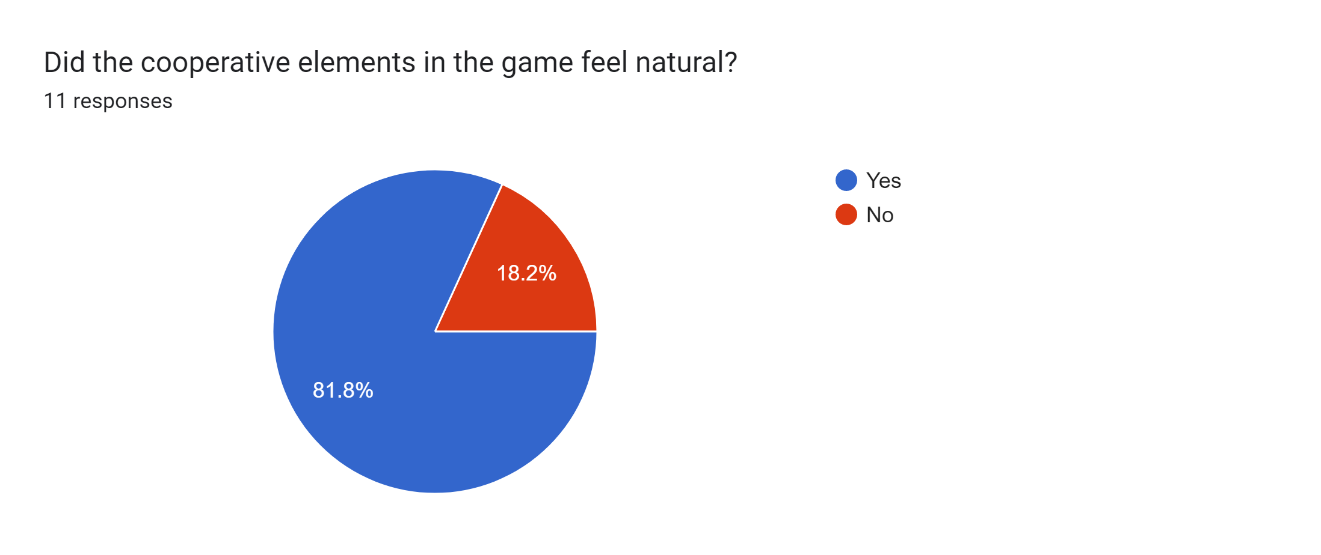
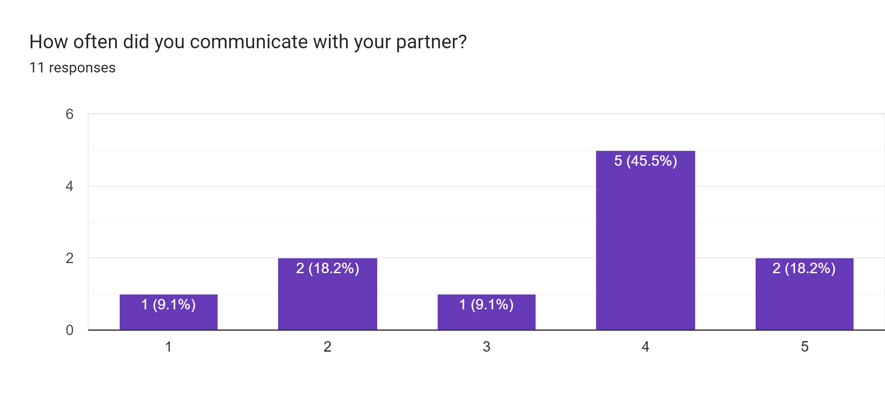
Validation: Cooperative experience

Slide 17
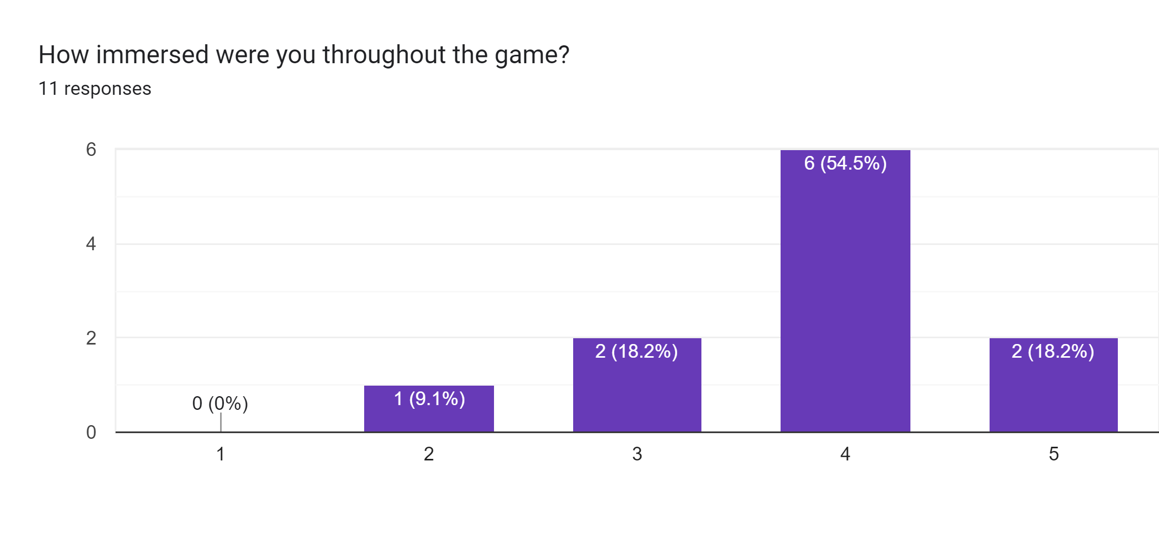
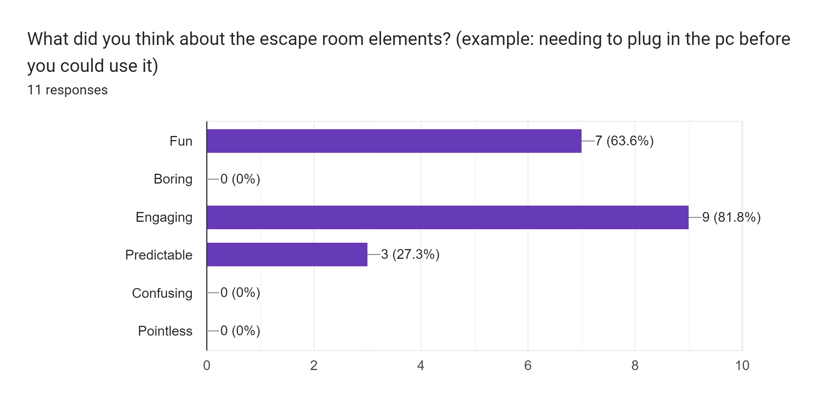
Validation: Immersion

Slide 18
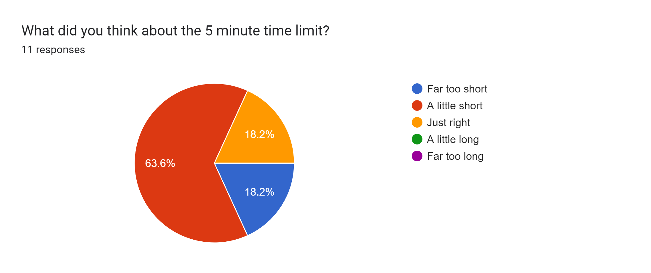
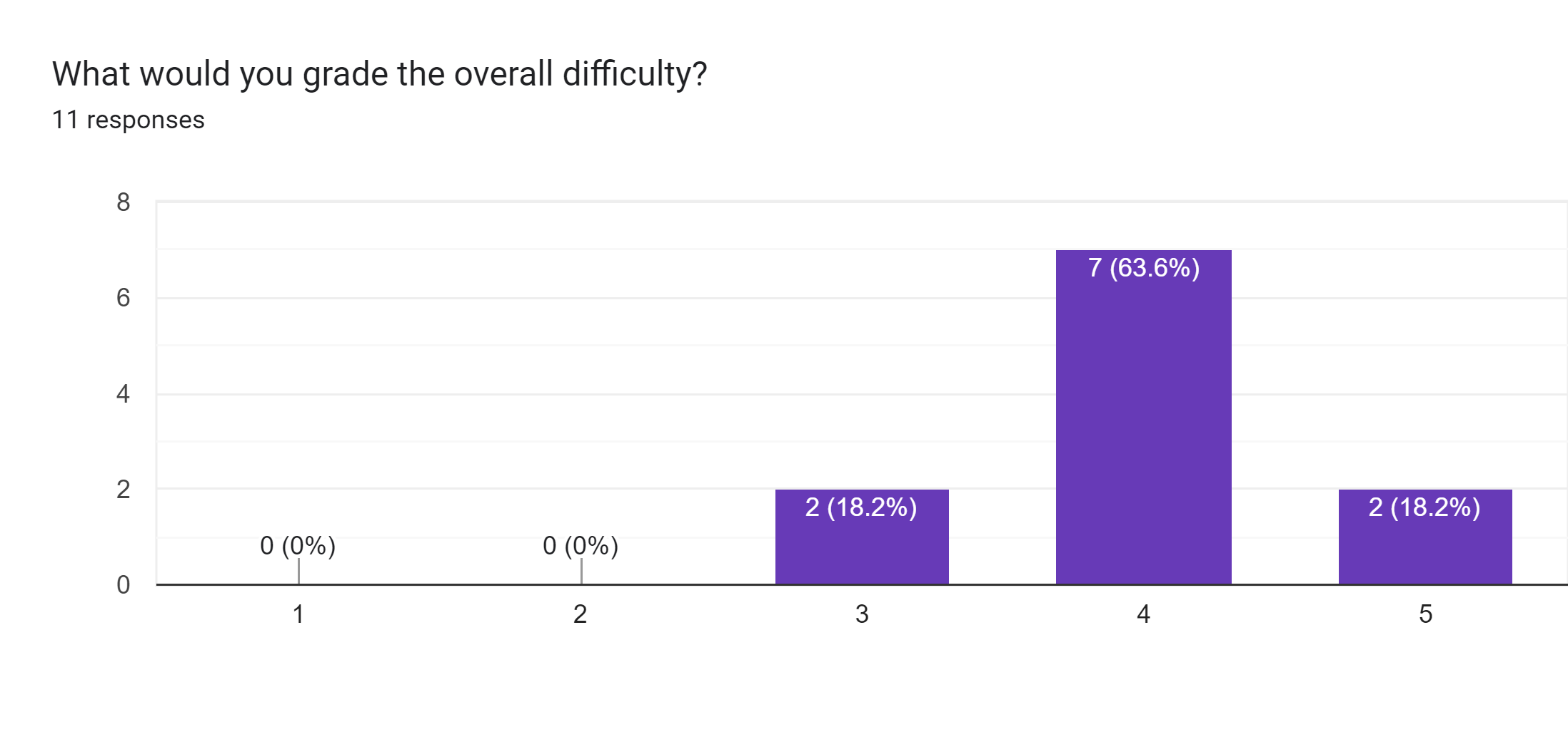
Validation: Difficulty

Slide 19
Validation
We asked a teacher to take a look at our game
“Escape room: leuke coöperatieve vorm waarbij de leerlingen verschillende sommen in 2-tallen moeten oplossen. De sommen sluiten aan bij de SLO doelen voor rekenen van leerlingen in groep 7/8.”
“Het spel zal de leerlingen zeker motiveren en als de leerkracht 2-tallen maakt is het handig om leerlingen van een laag en hoog niveau samen te laten spelen zodat beide leerlingen een positief gevoel krijgen.”
- Angelique Willemsen, teacher at Willem de Zwijger elementary school in Roermond

Slide 20
Conclusion & Recommendations

Slide 21
Conclusion
If we look at our design challenge again
We want to design an interactive game environment...
that enables students from group 7 & 8 to solve educational puzzles in an escape room-like environment...
with teamwork as a main focus.
Looking at the results of our Validation, we believe we achieved the challenge goal.

Slide 22
Recommendations
While the Active Floor is an interesting device and we do feel that there are a lot of creative things to achieve with it, due to the constant blocks and hurdles we had to overcome, it made it a bit frustrating to work on this project from time to time.
If the idea is to seriously pursue potential innovations on this device, future students should have access to “under the hood” of the device.
Alternatively another project could be started to reverse engineer the Active Floor that students could use to develop games for it.

Slide 23
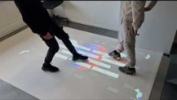
Demo video
https://youtu.be/RbvYzPDa_8k

Slide 24
Thank you

