Slide 1
SHOP
Customer Segmentation Using RFM Analysis In E-Commerce
By- Timsy Singh

Slide 2
Problem Statement And Objectives
PAY
Problem Statement
E-commerce businesses need a structured approach to turn vast transactional data into actionable insights for effective customer segmentation and targeted marketing
Objective 1
Using different segment techniques like RFM to perform customer segmentation
Objective 2
Performing analysis to determine high paying segment as well as at risk segment
Objective 3
Suggesting implementable actions for different segments to ensure better customer retention and statsifaction

Slide 3
Data Set Overview
General Information:
Key Variables:
InvoiceNo: Unique transaction ID
StockCode: Unique product identifier
Description: Product description
Quantity: Number of items purchased
InvoiceDate: Timestamp of purchase
UnitPrice: Price per unit in GBP
CustomerID: Unique customer identifier
Country: Location of the customer
Source: Kaggle
Size: 541909 Rows and 8 Columns
Timeframe: 01/12/2010 to 09/12/2011

Slide 4
Data Cleaning Process
02
03
01
04
Duplicate Values
Cancelled Orders
SHOP
Missing Values
Non-Product Stock Codes And Invoice Date

Slide 5
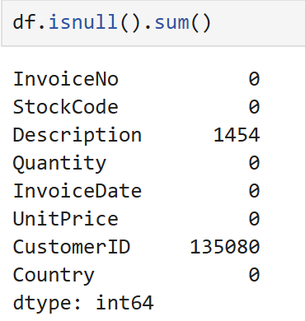
01
Missing Values
We identified the different columns along with the total number of null values present in each
As Description has 1454 null values
SHOP
And CustomerID has 135080 null values
Since our analysis is primarily focused on customer-related data, and ‘CustomerID' accounts for 24.93% of the total null values, we've decided to remove these records to maintain relevance and accuracy

Slide 6
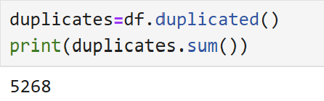
02
Duplicate Values
We identified a total of 5,268 duplicate records with exact matching data points
SHOP
These duplicate entries will be removed to ensure data integrity

Slide 7
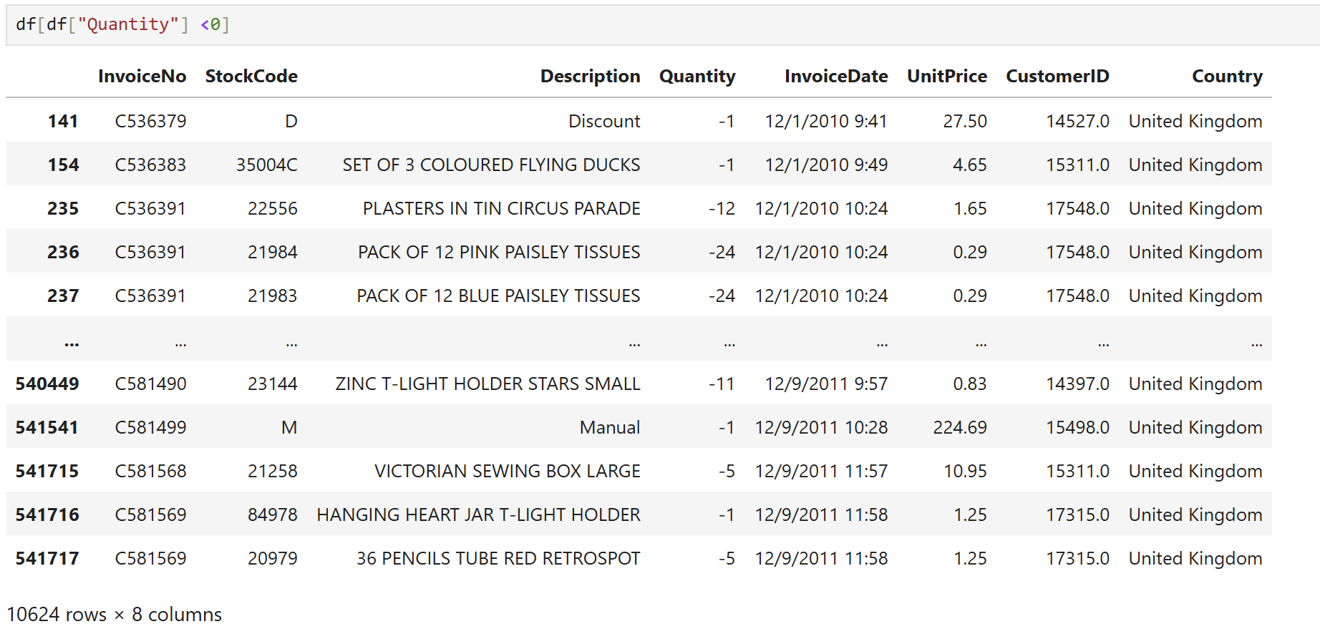
03
Cancelled Orders
We observed 10,624 records with negative ‘Quantity' values, likely reflecting cancellations, returns, or potential input errors
SHOP
Upon review, all records with negative quantities are linked to invoices starting with 'C', which likely indicates cancelled orders. As a result, these records will also be removed from the dataset

Slide 8
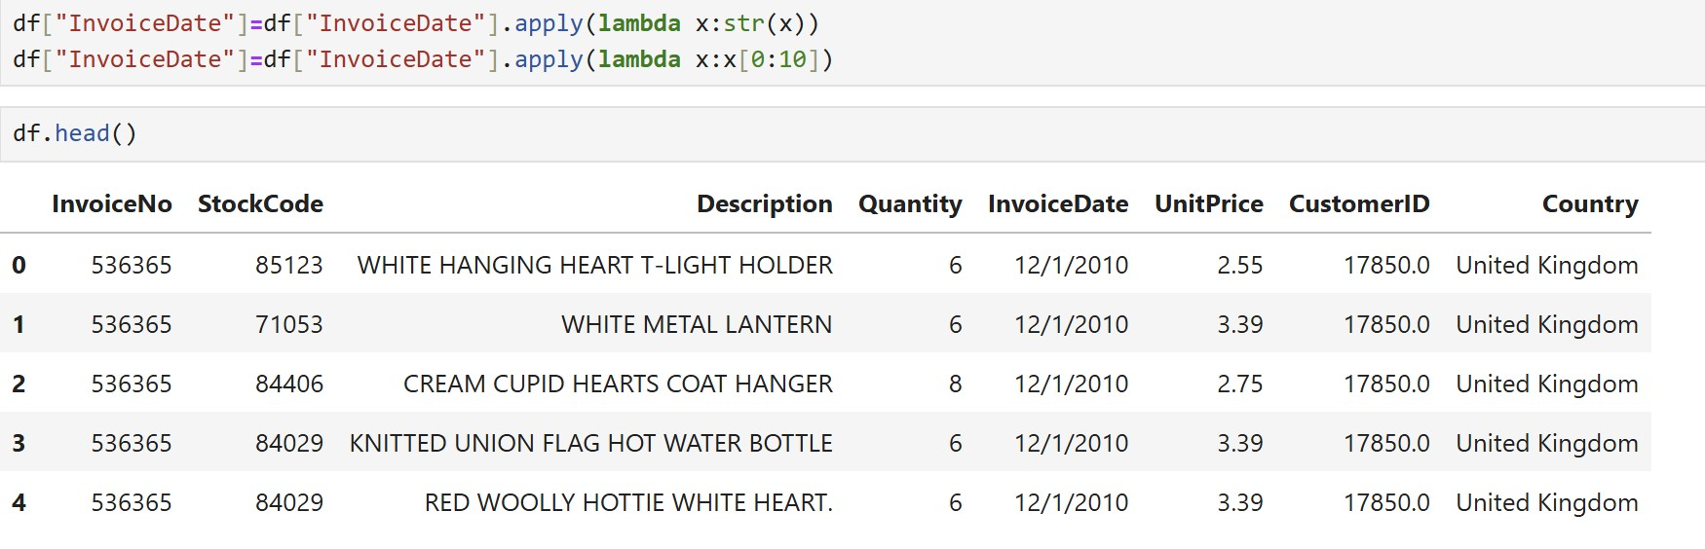
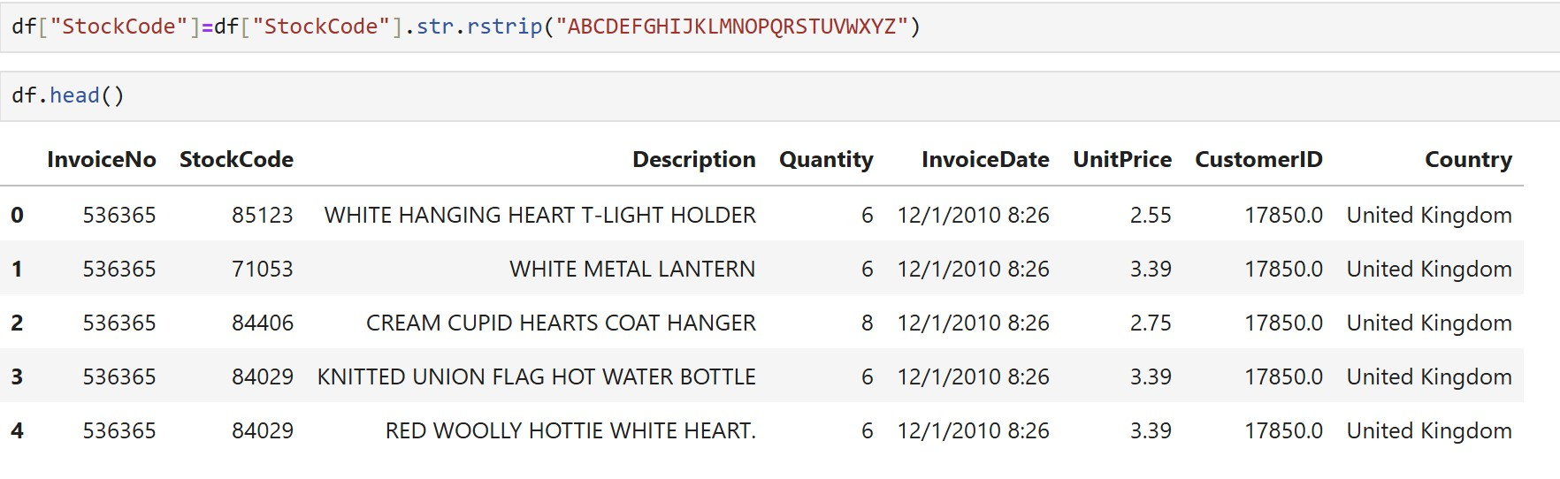
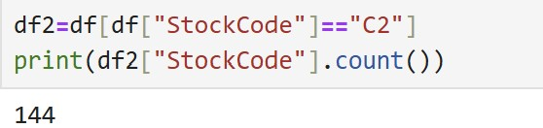
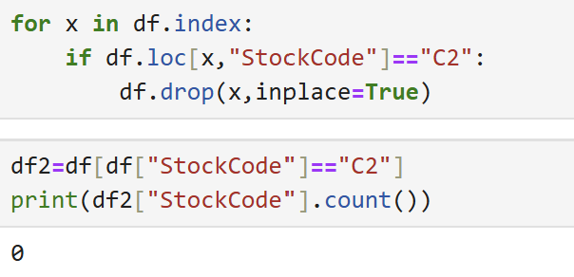
04
Non-Product Stock-Code And Invoice Date
Since the 'InvoiceDate' column includes both date and timestamp, we’ve separated the date component to streamline and improve the accuracy of our analysis
SHOP
Additionally, we standardized the 'StockCode' column by stripping any trailing text—whether attached to numbers or standalone—to ensure consistency in product codes
Finally, we identified 144 records with the value 'C2', which is not associated with any known product. These records will be removed from the dataset

Slide 9
Exploratory Data Analysis (EDA)

Slide 10
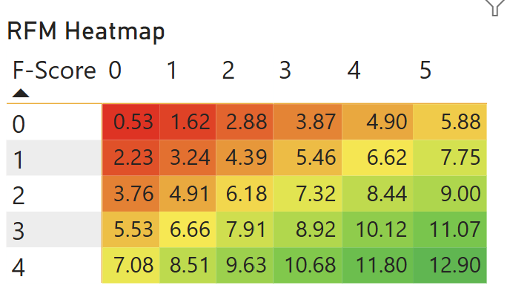
Dormant
Loyal Customer
At Risk
Champion

Slide 11
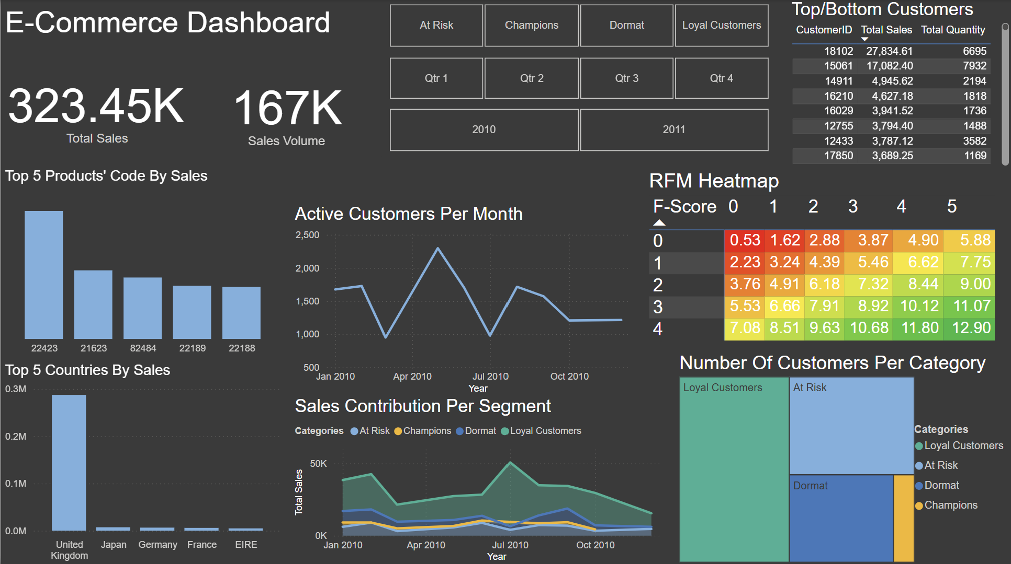


Slide 12
Analysis With Action Plan
Heatmap Zone | Characteristics | Segment | Recommended Action
Bottom-Right | High F, High R, High RFM score | Champions | Retain, First access to sale items, Special discounts and reward, upsell
Bottom-Mid | High F, High R | Loyal Customers | Re-engage with personalized offers, cross-sell
Middle-Middle | Moderate F & R | At Risk (Potential Loyalists) | Encourage repeat purchases, Points-based discounts
Top-Left | Low F, Low R | Dormant (Lost Customers) | Consider win-back or pause outreach
High RFM Score (>10) | High value overall | High-Value Segments | Focus investment and retention efforts
Low RFM Score (<5) | Low value overall | Low-Value Segments | Minimal investment, cleanup

Slide 13

Thank You
A
B
C
Timsy Singh
singhtimsy33@gmail.com

