Slide 1
FlogSOG BPMN Model & BPEL Implementation
BPM Labs – Group 6
Tim Ebner, Matthias Meissler, Sascha Tränkle
22.12.2016

Slide 2
Prerequisites
Existing FlowSOG Services
Inventory, Order, Payment, Shipment provided through web services
Definition can be derived from given WSDL file
“Conduct order” workflow
To be modelled using BPMN
Implementation in BPEL, executing on given workflow environment

Slide 3
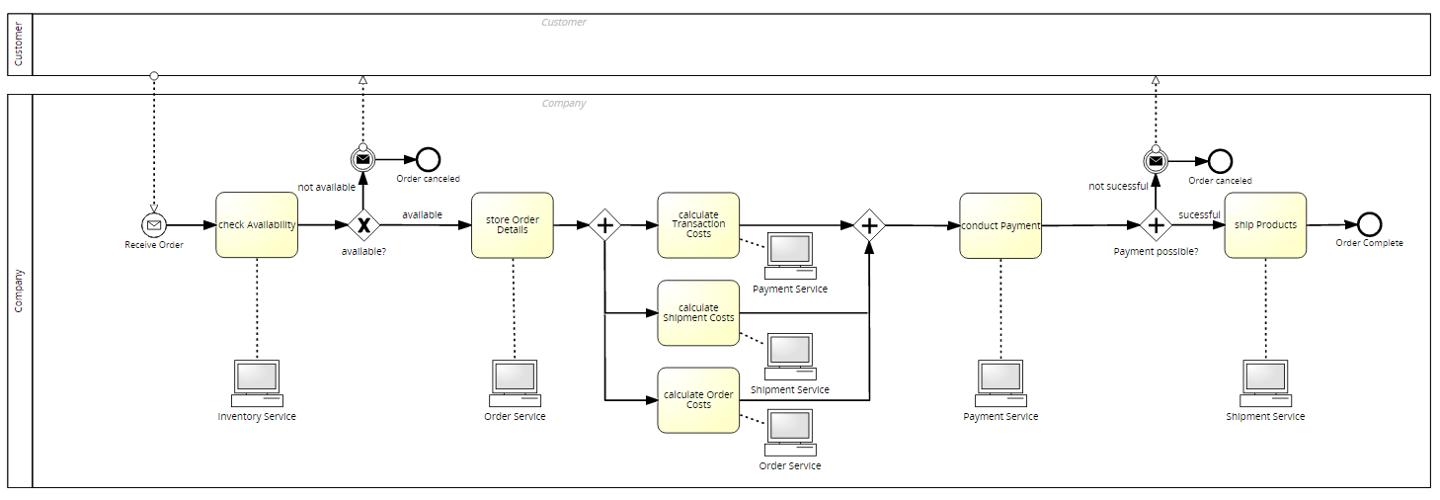
BPMN of the synchronous flow

Slide 4
BPMN of the synchronous flow

Slide 5
Synchronous BPEL Flow
Live Demo

Slide 6
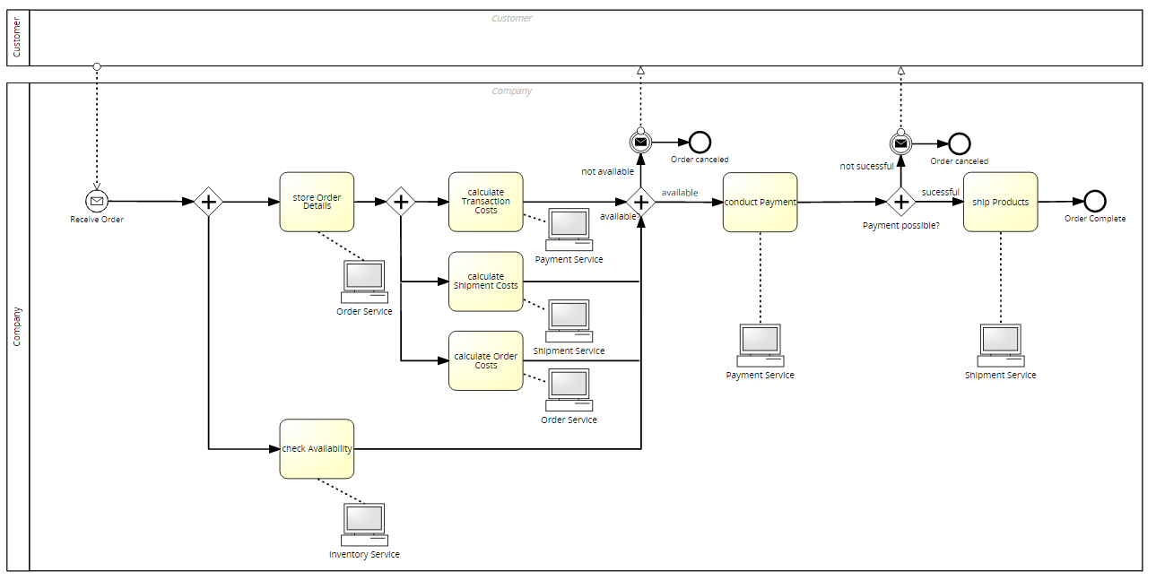
BPMN of the asynchronous flow

Slide 7
Asynchronous BPEL Flow
Live Demo

Slide 8
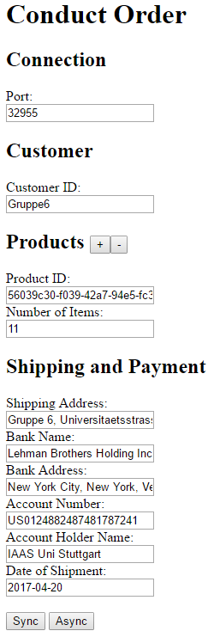
Web UI Implementation
Cross domain call to invoke service via Web UI
CORS Plugin in Browser is needed to send requests to server via browser

Slide 9
Web UI Implementation
Live Demo

Slide 10
Lessons Learned
There a few thinks you can’t to with GUI and have to do in xml which was confusing at the beginning
Some features which are supported by BPEL aren’t supported by the APACHE ODE (at least in the version we were using)
Like <bpel:copy ignoreMissingFromData=“yes"> which suppresses bpel: selectionFailure and thus allows to assign data of optional fields without using if branching (Patch for the ODE: https://issues.apache.org/jira/browse/ODE-141)
The counter variable of the for-each-loop has to be rounded and delivers varying values
It costs a lot of time and nerves to master the tooling

