Slide 1
One-Step Diffusion for Real-World Video Super-Resolution
SeedVR2 (arXiv 2506.05301) · FlashVSR (arXiv 2510.12747)
Timur Iakshibaev · Lab reading group · July 2026
Notes:
Two 2025 papers that take diffusion-based video super-resolution from ~50 sampling steps to a single step, with two different bets: SeedVR2 bets on scale plus adversarial post-training for maximum quality; FlashVSR bets on sparsity, causal streaming and a tiny decoder for real-time throughput. FlashVSR uses SeedVR2-3B as its strongest baseline, so they read naturally as a pair.

Slide 2
Why these two papers
▪ Real-world VSR: recover HQ video from LQ input with unknown, mixed degradations — diffusion priors give realistic textures where regression models (BasicVSR-style) over-smooth.
▪ The problem is cost: 15–50 denoising steps per output. For 100 frames at 768×1344: Upscale-A-Video ≈ 1285 s, STAR ≈ 2326 s, SeedVR-7B (50 steps) ≈ 1285 s.
▪ Both papers collapse sampling to 1 step, but optimize different objectives:
– SeedVR2 (ByteDance Seed + NTU, Jun 2025): keep the big 7B DiT, replace step-by-step sampling with adversarial post-training against real data → quality first.
– FlashVSR (Tsinghua + Shanghai AI Lab, Oct 2025): 1.3B causal DiT with block-sparse attention, KV-cache streaming, tiny decoder → 17 FPS, constant memory.
▪ Shared technical themes: distillation from a flow-matching teacher, attention locality as the key to resolution generalization (RoPE range mismatch), and the VAE/decoder becoming the bottleneck once the DiT is one-step.
Notes:
Frame the session: same goal (one-step diffusion VSR), opposite design points. Highlight the three shared themes now so the audience tracks them through both papers: (1) how you distill, (2) attention locality vs RoPE generalization, (3) after one-step distillation the VAE dominates runtime — both papers hit this wall and respond differently.

Slide 3
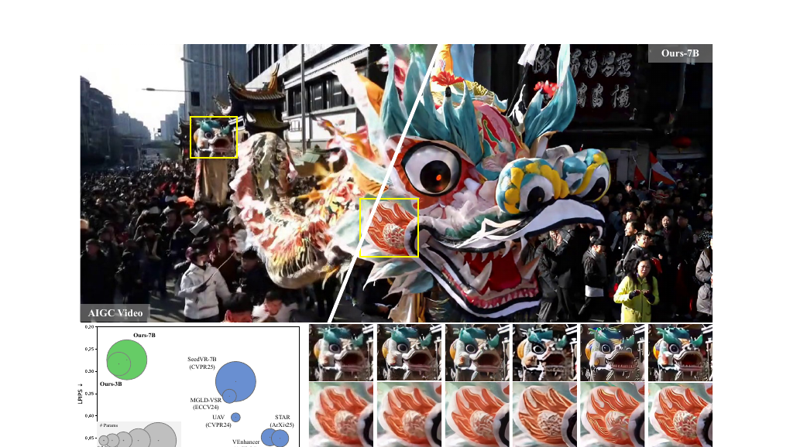
SeedVR2 — problem and core idea
Wang et al., NTU + ByteDance Seed
▪ Starting point — SeedVR: Swin-MMDiT diffusion restorer (7B), strong quality but 50 sampling steps.
▪ Why not standard one-step distillation?
– Student quality is upper-bounded by the multi-step teacher; pre-computing teacher outputs is expensive; image methods lack temporal design.
▪ Core idea — Adversarial Post-Training (APT) against real data: initialize from the diffusion model, then train GAN-style vs. ground-truth videos with no frozen teacher → the one-step student can surpass its initialization.
▪ Contributions:
– Adaptive window attention — fixes boundary artifacts + RoPE generalization at 1080p/2K.
– Stabilized GAN recipe — RpGAN + approximated R1/R2 regularization.
– Feature-matching loss on discriminator features — replaces LPIPS (no pixel decode).
– Progressive distillation init (64→1 steps) before adversarial training.
▪ Largest VR GAN trained to date: generator + discriminator ≈ 16B params (3B & 7B generator variants).
Fig. 1 — quality vs. speed; ≥4× faster than 50-step baselines
Notes:
Key conceptual point: adversarial training against REAL data removes the teacher ceiling that limits classic distillation. VR is easier to GAN-train than text-to-video because the LQ condition anchors the output — they observed no mode collapse even with a single adversarial stage. The 3B is distilled from the 7B and humans actually preferred the 3B.

Slide 4
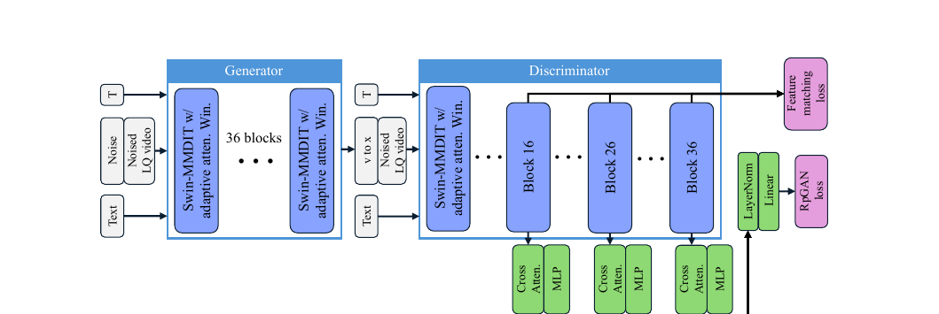
SeedVR2 — architecture
Fig. 2 — generator + DiT discriminator with taps at blocks 16/26/36 (feature-matching + RpGAN heads)
▪ Generator: SeedVR's Swin-MMDiT, 36 blocks; inputs = noise + noised LQ latent + text + timestep; trained on the velocity field (flow matching, v-prediction).
▪ VAE: SeedVR's causal video VAE (8× spatial compression) — reused unchanged; later shown to be the runtime bottleneck.
▪ Discriminator = a second pre-trained DiT (APT recipe): cross-attention-only blocks + MLPs tap features after backbone blocks 16 / 26 / 36 → LayerNorm + Linear → GAN logits.
– Same taps double as a perceptual feature extractor for the feature-matching loss.
▪ Model sizes: Ours-7B = 8 240 M (same as SeedVR-7B), Ours-3B = 3 391 M, distilled from the 7B.
Notes:
Emphasize the discriminator design: it's not a small CNN — it is another full pre-trained diffusion transformer, so discriminator features are strong video representations. That's what makes the feature-matching loss a viable LPIPS substitute in latent space: LPIPS would need decoding to pixels every step, unaffordable for HR video.

Slide 5
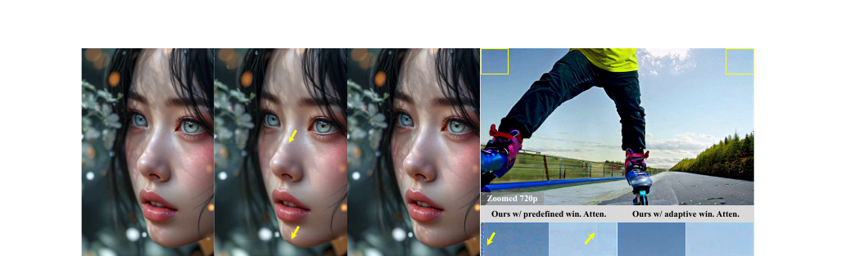
SeedVR2 — adaptive window attention
▪ Failure mode of SeedVR: predefined 64×64-latent shifted windows → visible seams at >2K output; 3D RoPE inside windows generalizes poorly to unseen resolutions.
– At 720p training resolution, fixed windows almost never create overlap/shift cases → the model is undertrained on exactly what high-res inference needs.
▪ Training: partition the feature map into a fixed 3×3 grid of spatial windows (window size adapts to input); temporal window capped at 30 latent frames. Varying aspect ratios in the data → the model sees many window sizes.
▪ Inference: compute a proxy resolution with the test aspect ratio but the *training area* (45×80 latent at 720p): d̃ₕ = √(dₕ·d𝓌 · ĥ/ŵ). Window sizes then match training statistics at any output resolution.
▪ Effect: boundary artifacts eliminated at 1080p/2K; RoPE robust because it was trained over a *distribution* of window sizes rather than one.
Fig. 4 — predefined windows (left of each pair) show seams and detail loss; adaptive windows fix both
Notes:
This is the slide most relevant to our thesis work: their diagnosis is that positional encodings fail when test-time geometry leaves the training distribution — the same phenomenon we probe temporally in FlashVSR with the RoPE probe. Their fix is to keep test statistics inside the training distribution (interpolation), not to extrapolate. Note they cap temporal windows at 30 latent frames — they sidestep temporal extrapolation entirely.

Slide 6
SeedVR2 — training pipeline and losses
G loss: RpGAN + L1 + feat-match · D loss: RpGAN + aR1 + aR2
▪ Stage 0: retrain SeedVR-7B from scratch with adaptive window attention.
▪ Stage 1 — progressive distillation (Salimans & Ho): halve sampling steps 64→32→…→1, ~10k iters per halving, plain MSE on the velocity field.
– Needed to preserve restoration under heavy degradation; jumping straight to one-step adversarial training loses it. Clip length grows progressively (images → variable-length videos).
▪ Stage 2 — adversarial post-training against real data, with three stabilizers:
– RpGAN (relativistic pairing, from R3GAN) instead of non-saturating GAN → avoids mode dropping.
– Approximated R1 + R2 gradient penalties (weight 1000): penalize discriminator sensitivity to Gaussian perturbations of real/fake inputs — a finite-difference proxy, no double backprop.
– Feature-matching loss: L1 between discriminator features (blocks 16/26/36) of prediction vs. GT — LPIPS-like supervision without decoding latents.
▪ Perception–distortion knob: final model lowers L1 + feature-matching weights to 0.1 (high weights raise PSNR but over-smooth).
▪ Scale: 72× H100-80G; ~10 M image + 5 M video pairs, UAV-style degradation synthesis.
Notes:
The ablation ordering to remember: swapping non-saturating GAN for RpGAN+R2 is the single biggest jump (LPIPS 0.310→0.278) and prevents collapse after ~20k iters; adding L1 then feature matching brings LPIPS to 0.244; progressive-distillation init adds fidelity (PSNR 22.9→24.0). Loss weights: G-side 1.0 each by default; final release uses 0.1 on the reconstruction terms — an explicit perception-distortion trade.

Slide 7
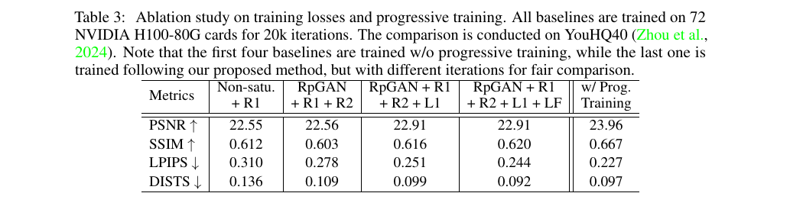
SeedVR2 — results
▪ Quality (1 step vs. 50-step baselines): best or 2nd-best perceptual metrics nearly everywhere. UDM10: LPIPS 0.203 / DISTS 0.101 vs. SeedVR-7B-50step 0.264 / 0.124. Best DOVER on real (VideoLQ) and AIGC sets.
▪ Speed: 100 frames at 768×1344 — Ours-3B 269 s, Ours-7B 299 s vs. 1285 s (UAV, SeedVR-50) and 2326 s (STAR) → >4× faster with ≥4× more parameters.
▪ User study (GSB): 3B preferred over 7B (+16%); all multi-step baselines strongly rejected (VEnhancer −94%).
▪ But: PSNR is not SOTA (RealViformer/MGLD-VSR lead — both trained on REDS); bicubic wins warping error, which the authors use to argue E*warp is a broken metric for generative VR.
▪ Hidden caveat: with a 1-step DiT, the causal video VAE now takes >95% of runtime.
Table 3 — loss ablation on YouHQ40 (20k iters): RpGAN+R2 is the biggest jump; feature matching and progressive training add fidelity
Notes:
If asked about temporal consistency: they report VMAF (leads on 3/4 synthetic sets) and DOVER plus temporal profiles, and explicitly argue warping error rewards blur — bicubic wins it. The >95% VAE share means the headline 4x speedup is VAE-limited, not DiT-limited; this is exactly the gap FlashVSR's tiny conditional decoder attacks.

Slide 8
SeedVR2 — takeaways and limitations
▪ Takeaways
– Adversarial post-training against real data removes the distillation ceiling: the 1-step student beats its 50-step initialization on perceptual metrics, and beats pure progressive distillation at equal iterations (VideoLQ: DOVER 8.18 vs. 6.61).
– Positional-encoding robustness comes from *training-time diversity* of window geometry — a data/statistics fix, not an architecture fix.
– Multi-step baselines collapse below ~25 steps — one-step cannot be reached by simply reducing steps; the training recipe is essential.
▪ Limitations (authors')
– Causal video VAE is >4× slower than baselines' VAEs → dominates runtime.
– Not robust to heavy degradation and large motions.
– Over-sharpens lightly-degraded input (e.g., clean AIGC video); no performance lower bound.
▪ Our reading: temporal attention is still windowed (≤30 latent frames) — no global temporal memory, and chunked offline inference; nothing here addresses minute-long consistency.
Notes:
Transition to FlashVSR: SeedVR2 answers 'how good can one step be' but ignores latency structure — it is still an offline, chunked, 52 GB-class model. FlashVSR asks the complementary question: what does one-step diffusion VSR look like as a streaming system.

Slide 9
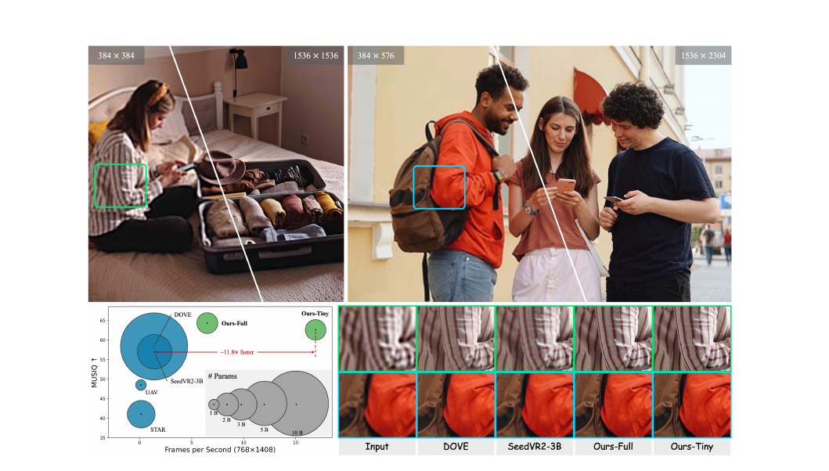
FlashVSR — problem and core idea
Zhuang et al., Tsinghua + Shanghai AI Lab
▪ Three obstacles to practical diffusion VSR:
– Lookahead latency: chunk-based methods emit nothing until the whole 80–101-frame chunk finishes.
– Quadratic dense 3D attention over long high-res sequences.
– Train–test resolution gap: models trained at ~720p produce repeated patterns / blur at 1440p+.
▪ Key insight: VSR is strongly conditioned on the LR stream — plausible motion comes from the input, so the model does not need its own past predictions as input.
– → no teacher/self forcing; fully parallel training that exactly matches causal streaming inference (inputs are only LR + noise in both).
▪ Result: one-step, causal, streaming DiT — ~17 FPS at 768×1408 on one A100, 8-frame lookahead, constant memory; 11.8× faster than SeedVR2-3B.
Fig. 1 — quality vs. FPS at 768×1408; scales to 1440p
Notes:
The LR-conditioning insight is the intellectual core: autoregressive video *generation* needs clean history (teacher forcing vs self-forcing dilemma, serial training). VSR doesn't — the LR frames carry the motion. That single observation unlocks parallel training with zero train-infer gap. Worth discussing when it breaks: heavy degradation where LR is uninformative.

Slide 10
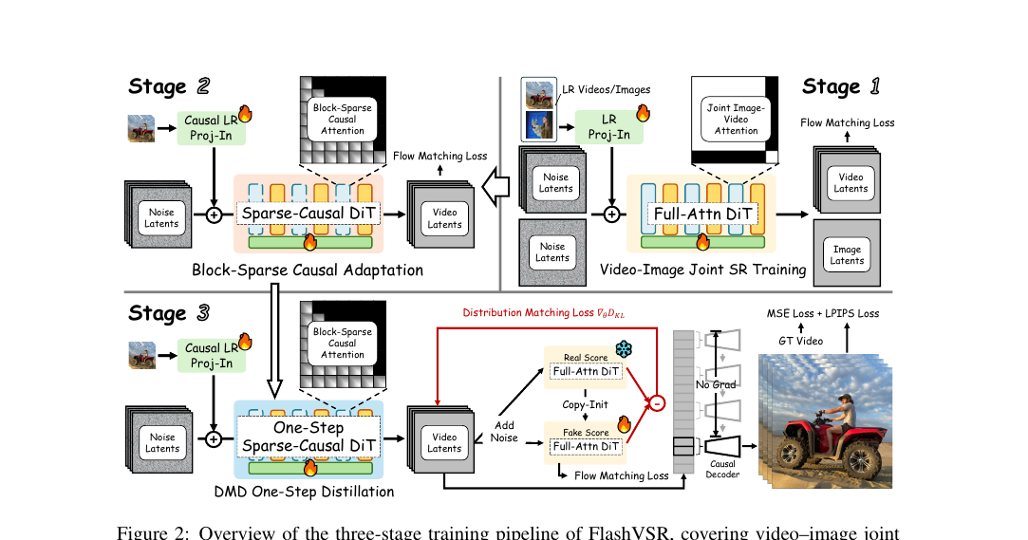
FlashVSR — three-stage training pipeline
▪ Base: Wan 2.1–1.3B video DiT + LoRA (rank 384). LR enters via a causal LR Projection-In layer (pixel-shuffle 8× + causal 3D convs + MLP, added to latent tokens) — no VAE encoding of the input; a fixed quality prompt makes cross-attention K/V a one-time cost.
▪ Stage 1 — joint image+video SR teacher: full attention, flow matching; images packed with videos via a block-diagonal segment mask.
▪ Stage 2 — block-sparse causal adaptation: convert to causal masking + block-sparse attention, keep training with flow matching.
▪ Stage 3 — one-step distillation (DMD): Stage-1 model = frozen real-score teacher; loss = DMD + flow-matching (fake-score net) + pixel MSE + 2·LPIPS. All frames trained in parallel at a unified timestep.
▪ Data — VSR-120K: 120k videos (avg >350 frames) + 180k images, filtered by LAION-Aesthetic + MUSIQ + RAFT motion; RealBasicVSR degradations. 32× A100, ~5 days total.
Fig. 2 — Stage 1 full-attention teacher → Stage 2 sparse-causal adaptation → Stage 3 DMD one-step distillation
Notes:
Contrast the distillation choice with SeedVR2: DMD (distribution matching against a frozen teacher score) vs adversarial post-training against real data. FlashVSR keeps a teacher, so in principle inherits a teacher ceiling — but the teacher here is their own Stage-1 model trained on 120k videos. Also note ordering: sparsify FIRST, then distill, so the one-step student is trained under the exact inference-time mask.

Slide 11
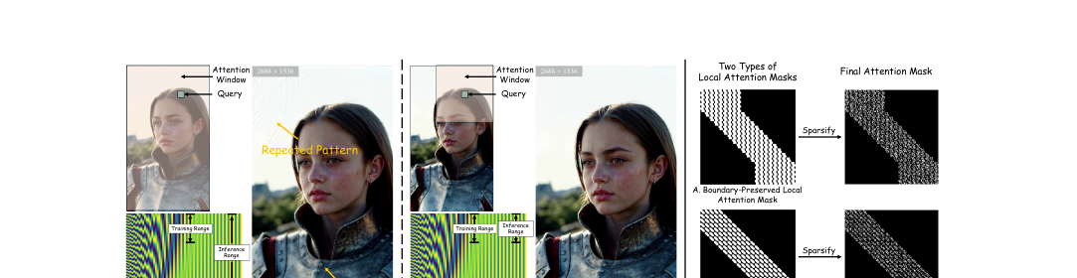
FlashVSR — sparse + locality-constrained attention
▪ Block-sparse attention: partition latents into (2, 8, 8) blocks of 128 tokens; average-pool each block → coarse block-to-block attention → keep top-k pairs → run dense 128×128 attention only there.
– ~13.6% of dense cost; attention time per 8-frame step 1.105 s → 0.355 s (3.1×); PSNR −0.5 dB but MUSIQ *better*. Same mask in training and inference → consistent.
▪ Resolution-gap diagnosis: RoPE is periodic — positions beyond the trained range make some dimensions repeat → repeated textures / blur at 1440p+.
▪ Fix — locality-constrained attention: restrict each query to a local spatial window (ablation: 1152×1152 receptive field) so *relative* positions stay inside the trained range; final mask = local ∩ top-k.
– At 1536×2688 (305-frame videos): both window variants beat global attention on every metric — boundary-preserved best fidelity (PSNR 24.87 vs. 24.21), boundary-truncated best perceptual (MUSIQ 67.47 vs. global).
Fig. 3 — out-of-range RoPE causes repeated patterns (left); local attention windows restore training-range statistics (middle); the two mask variants (right)
Notes:
Same disease as SeedVR2's window story, different organ: SeedVR2 fixes window-size statistics, FlashVSR fixes relative-position range. Both are interpolation strategies — keep inference inside the training distribution. Neither touches the temporal axis, which is where our RoPE-probe work on FlashVSR sits.

Slide 12
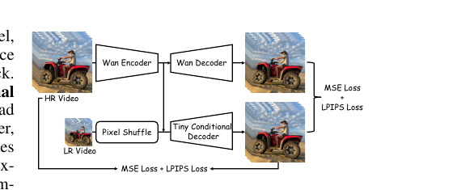
FlashVSR — streaming KV-cache and the Tiny Conditional decoder
▪ Streaming: sliding-window KV-cache over the most recent ~85 frames, all layers; constant memory, 8-frame lookahead. No past predictions are fed back — history lives only in the cache.
– Their account of why this preserves consistency: early-layer KV carries LR-aligned structure/motion; late-layer KV carries progressively cleaner latents that stabilize texture.
– Eviction ablation: sliding window ≈ importance-based; head-wise eviction fails — attention-sink heads keep stale first-frame KVs → blur.
▪ Tiny Conditional decoder: after one-step distillation the VAE decoder is ~70% of runtime.
– Replace it with a small decoder conditioned on latents + pixel-shuffled LR frames — LR supplies low-frequency structure, decoder only adds detail.
– Trained with pixel loss + distillation from the Wan decoder. ~7× faster decode (11.13 s → 1.60 s per 101 frames); −1.5 dB reconstruction PSNR vs. Wan decoder, but beats an unconditional tiny decoder by +1.1 dB.
Fig. 4 — TC decoder training: supervised by GT pixels and the Wan decoder output
Notes:
Two things to stress. First, the KV-cache IS the temporal memory — there is no recurrence and no clean-latent feedback; the sink-attention failure shows cache management is unsolved beyond ~85 frames. Second, the TC decoder answers the exact bottleneck SeedVR2 complained about (VAE >95% of runtime): condition the decoder on the LR pixels you already have and it can be tiny.

Slide 13
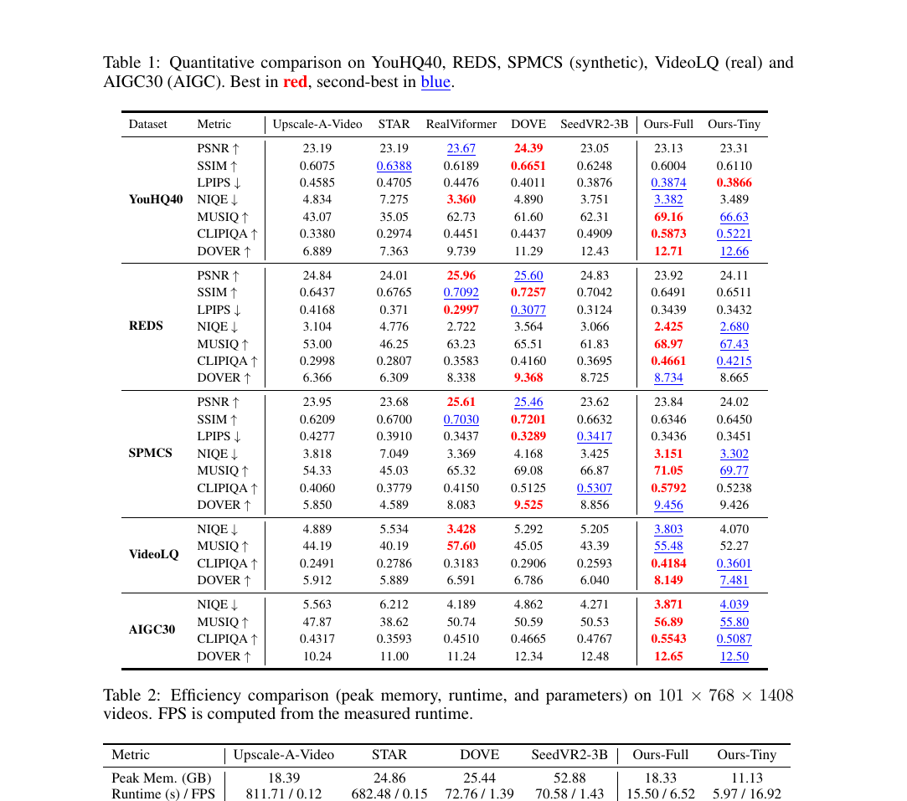
FlashVSR — results
▪ Efficiency (101 frames @ 768×1408, A100): Ours-Tiny 5.97 s (16.9 FPS), 11.1 GB vs. SeedVR2-3B 70.6 s / 52.9 GB → 11.8× faster, ~4.8× less memory; 136× vs. Upscale-A-Video; 1.78 B params.
▪ Quality: wins nearly all no-reference/perceptual metrics (NIQE, MUSIQ, CLIP-IQA, DOVER) across YouHQ40 / REDS / SPMCS / VideoLQ / AIGC30; PSNR/SSIM competitive, not best.
– Caveat they flag: RealViformer's REDS numbers are inflated (REDS is in its training set).
▪ User study (20 CV researchers, GSB vs. Ours-Tiny): SeedVR2-3B −33%, DOVE −30%; Ours-Full ≈ Ours-Tiny (+2%).
▪ Ablations: sparsity costs 0.5 dB PSNR, nothing perceptually; locality windows beat global at 1536×2688 on all metrics; TC decoder −1.5 dB reconstruction for 7× decode speed.
Tables 1–2 — quality across 5 benchmarks; efficiency at 768×1408
Notes:
Pattern to note: like SeedVR2, the one-step model optimizes the perceptual/no-reference end of the perception-distortion trade-off — PSNR/SSIM go to regression-style or teacher-forced models. No tOF or warping-error temporal metric is reported; temporal quality evidence is DOVER, the user study, and qualitative videos.

Slide 14
Head-to-head
 | SeedVR2 (3B / 7B) | FlashVSR (1.3B base)
Goal | Max quality at 1 step | Real-time streaming at 1 step
Backbone | Swin-MMDiT (36 blocks), full finetune | Wan 2.1–1.3B + LoRA r384, causal
One-step recipe | Progressive distillation 64→1, then adversarial post-training vs. real data (RpGAN + aR1/aR2 + feature matching) | 3-stage: FM teacher → sparse-causal adaptation → DMD + MSE + LPIPS
Teacher ceiling? | No frozen teacher — can surpass init | Frozen Stage-1 teacher (own model)
Attention | Adaptive 3×3 windows; ≤30-frame temporal window | Block-sparse top-k (13.6%) ∩ local window; causal + KV-cache (~85 frames)
Resolution scaling | Window-size statistics matched to training | Relative RoPE range kept in training range
Inference mode | Offline, chunked | Streaming, 8-frame lookahead, constant memory
101 fr @ 768×1408 | ≈70 s, 52.9 GB (3B) | 5.97 s, 11.1 GB (Tiny) — 11.8× faster
Decoder | Causal video VAE (>95% of runtime) | Tiny Conditional decoder (7× faster decode)
Quality profile | Best detail/texture; wins user study vs. everything multi-step | Wins NR metrics + user study vs. SeedVR2-3B; PSNR/SSIM mid-pack
Notes:
Fair-comparison caveats: the 70.6 s / 52.9 GB SeedVR2-3B numbers are FlashVSR's measurement at 768×1408; SeedVR2's own paper reports 269 s for 100 frames at 768×1344 including its slow VAE. Quality-wise the two papers' user studies point in opposite directions on SeedVR2-3B vs FlashVSR — different test sets and protocols; treat both as self-reported wins.

Slide 15
What this means for long-video SR (>1 min)
▪ Streaming beats chunking for long videos: FlashVSR's KV-cache gives constant memory and no chunk seams — but the longest evaluated sequences average ~305 frames (~12 s). Behavior over thousands of frames is untested; head-wise eviction already fails from attention sinks.
▪ Positional encoding is the recurring failure point: both papers fix *spatial* RoPE/window mismatch by keeping inference statistics inside the training range. The *temporal* analogue — extending beyond the trained temporal window — is untouched (SeedVR2 caps at 30 latent frames; FlashVSR's cache is 85 frames). This is exactly where our RoPE probe / position-interpolation work on FlashVSR operates.
▪ After one-step distillation, the VAE/decoder is the wall: >95% of SeedVR2's runtime; ~70% of FlashVSR's before the TC decoder. Any long-video system needs a cheap (causal) decoder.
▪ Temporal-memory design space is open: sliding KV-cache is the only working option shown; smarter eviction failed → constant-state alternatives (SSM-style, à la Po et al. long-context world models) are a natural next step for minute-scale consistency.
▪ Evaluation caution: warping error rewards blur (bicubic wins it); both papers lean on DOVER/VMAF/user studies. Long-video eval likely needs consistency metrics over much longer horizons.
▪ Discussion: when does the 'LR carries the motion' assumption break — heavy degradation, large motion, generative hallucination drift over minutes?
Notes:
Closing pitch tying to the thesis: FlashVSR is the natural experimental platform (code + weights + streaming design), SeedVR2 supplies the quality-side recipe and the evidence that PE robustness comes from training-range alignment. The open problem in between: temporal extrapolation and long-horizon memory for minute-plus videos — SSM state or learned cache management instead of a sliding window.

