Slide 1

JavaScript
Lecture 2. Functions & Array

Slide 2

Functions
Function Declaration
Function Expression
Parameters
Return
Self Execution Functions
Scope
Scope Chaining
Clousers
Array overview
Arguments
Arrow Functions
Functions Strict Mode

Slide 3
Functions
One of the fundamental building blocks
A set of statements that performs a task or calculates a value

Slide 4
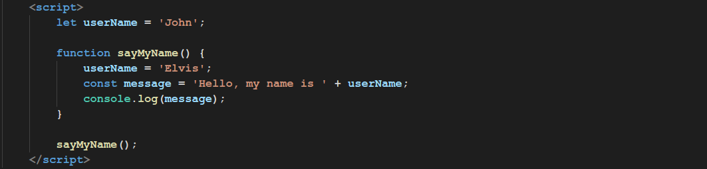
Functions Declaration

Slide 5
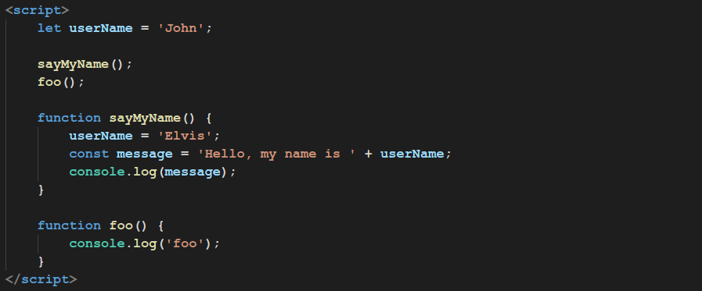
Functions Declaration
All declared functions are available from everywhere.

Slide 6
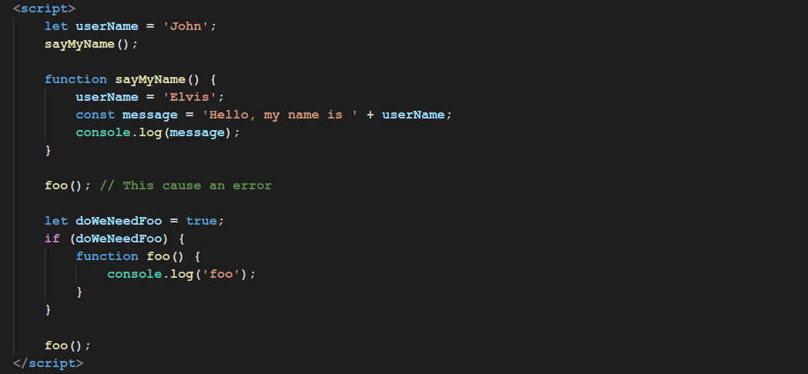
Functions Declaration
But be aware!

Slide 7
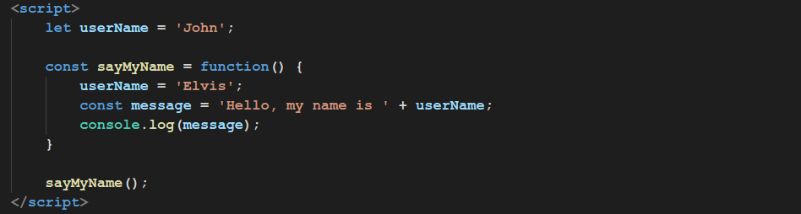
Functions Expression

Slide 8
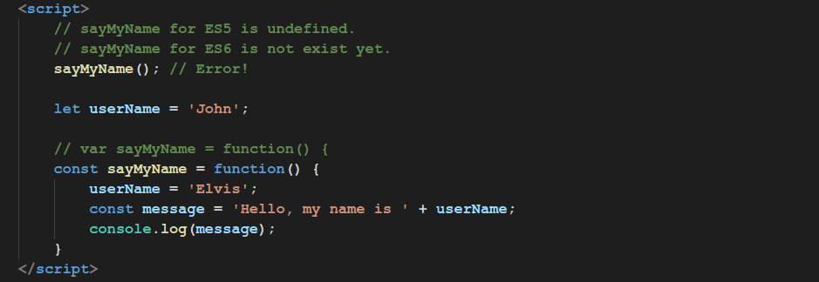
Functions Expression

Slide 9
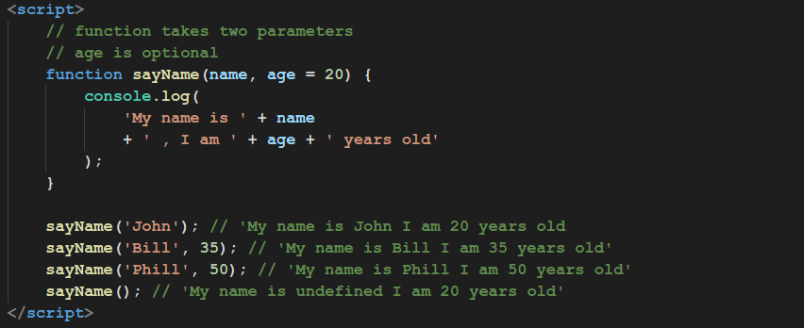
Functions Parameters

Slide 10
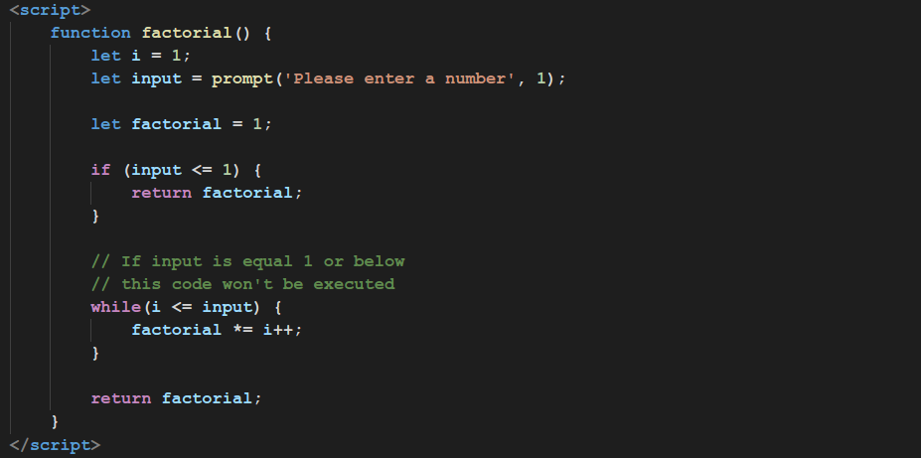
Return

Slide 11
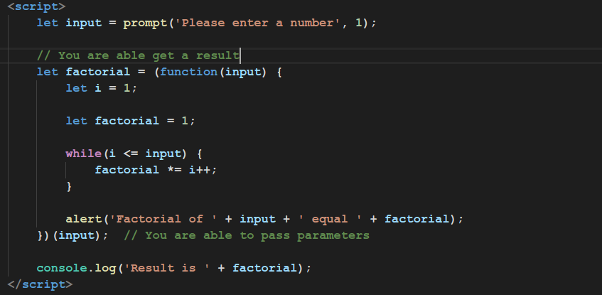
Self Execution Functions

Slide 12
Scope
Scope determines accessibility of functions and variables
In JavaScript there are two types of scopes:
Global Scope
Local Scope

Slide 13
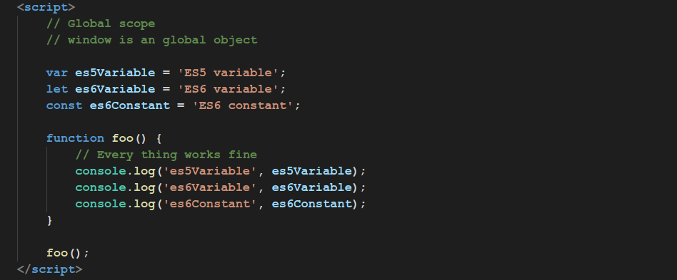
Scope
Scope determines accessibility of functions and variables

Slide 14
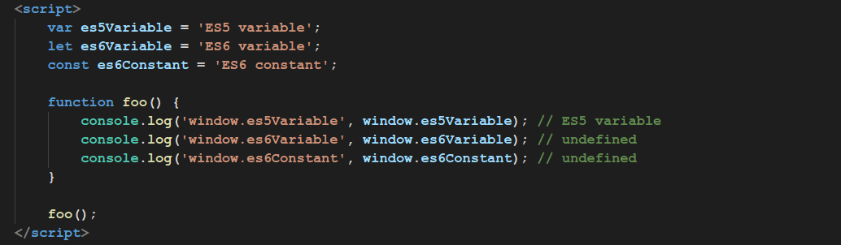
Scope
All ES5 global variables are members of window object, but not ES6

Slide 15
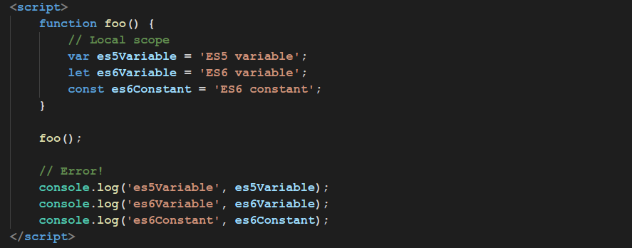
Scope
There is no way to access local variable

Slide 16
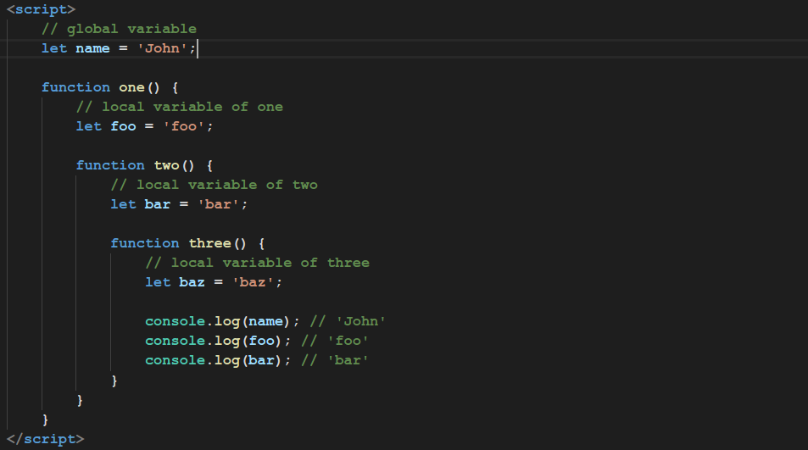
Scope Chaining

Slide 17
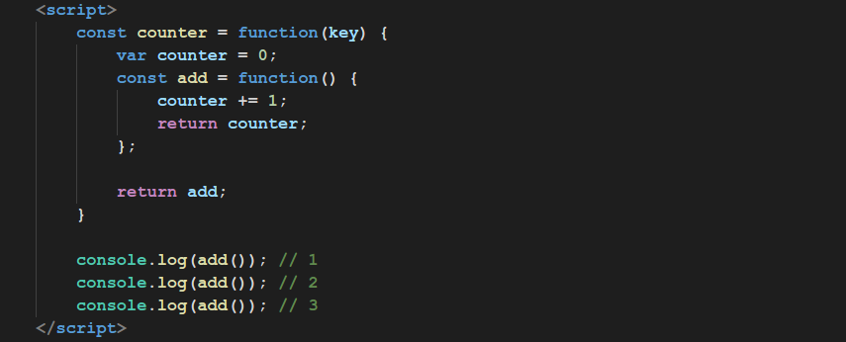
Closures

Slide 18
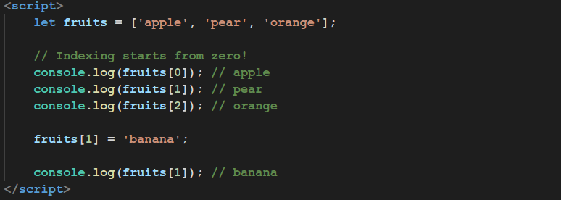
Array
Brief overview

Slide 19
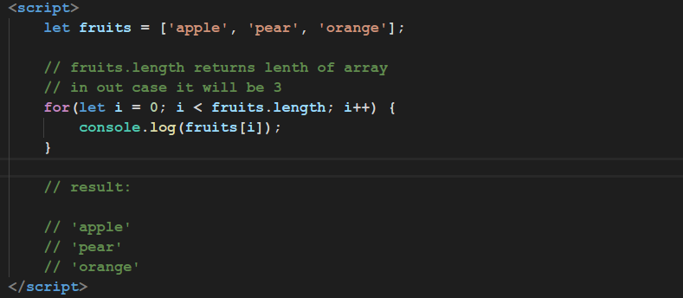
Array Length

Slide 20
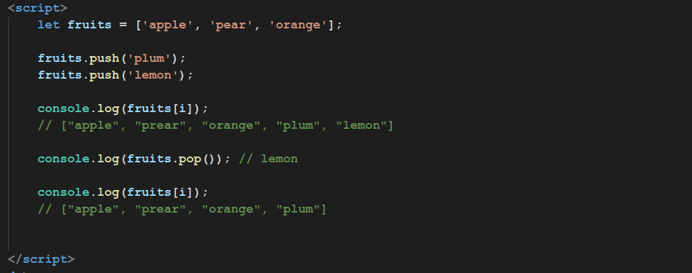
Operations with array

Slide 21
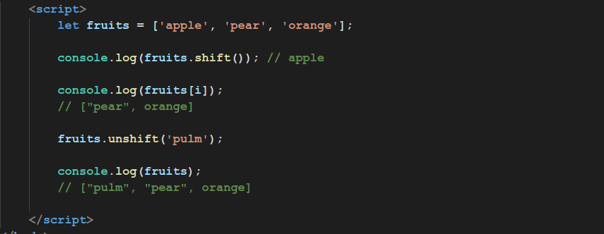
Operations with array

Slide 22
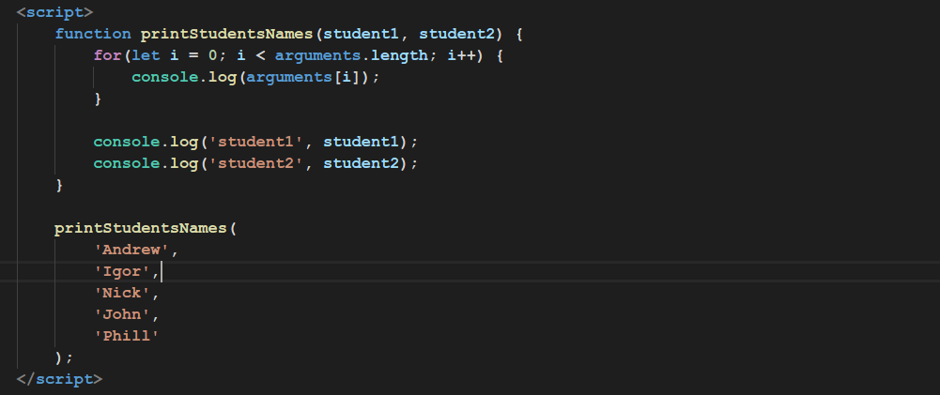
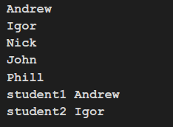
Arguments

Slide 23
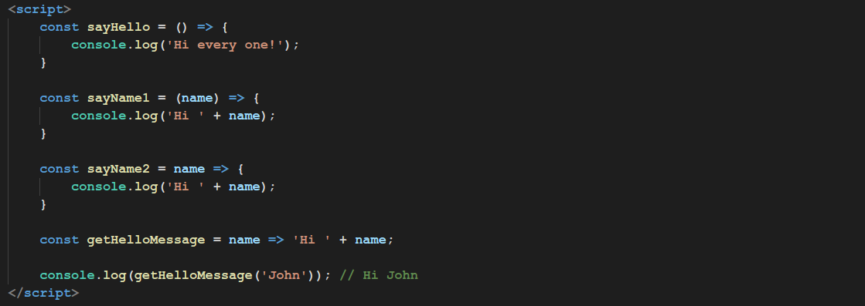
Arrow Functions

Slide 24
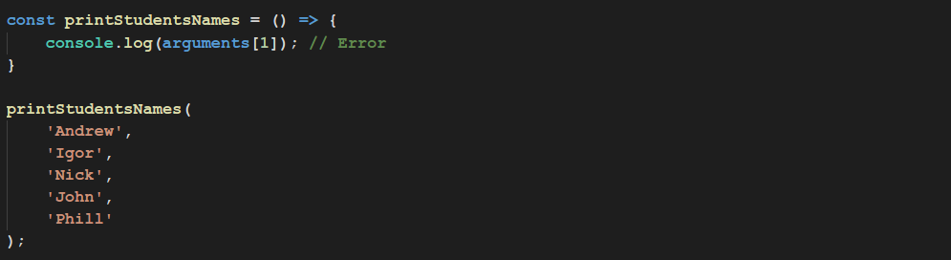

Arrow Functions
This is new in ES6. Arrow functions have couple differences with ES5 functions.
Arrow Functions don’t have arguments object.
Arrow Functions don’t have own context. They use context of a parent. (see in next episodes)

Slide 25
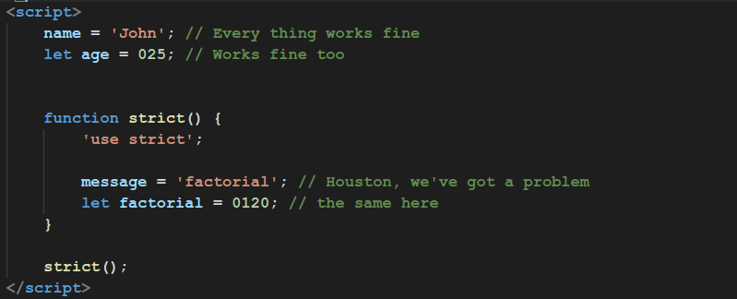
Functions Strict Mode

Slide 26
Thanks for watching

