Slide 1

JavaScript
Lecture 1. Basics

Slide 2

ECMAScript
Scripting-language specification
Was created to standardize JavaScript
ECMA-262

Slide 3
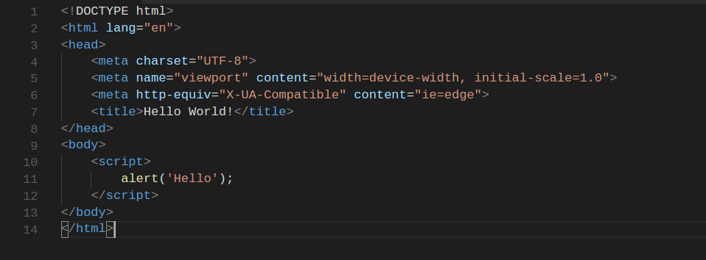
First JavaScript Application

Slide 4
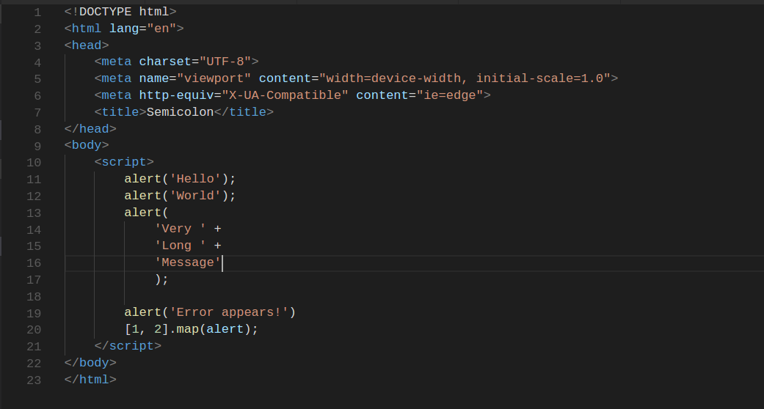
Line break and semicolon

Slide 5
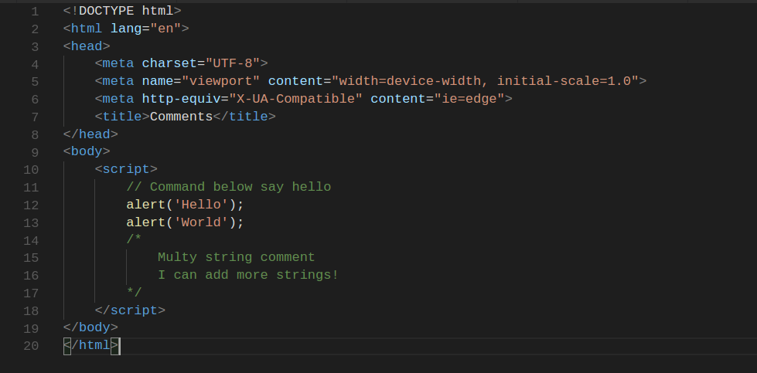
Comments

Slide 6
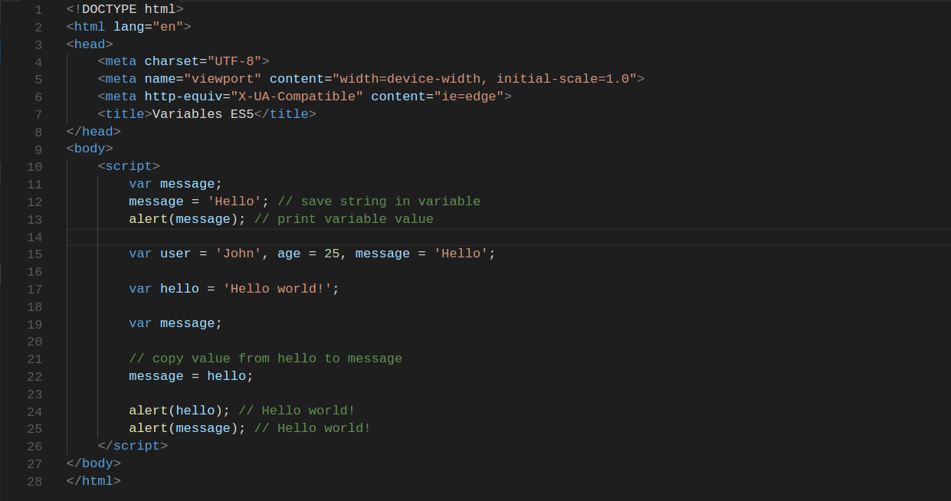
Variables in ES5

Slide 7
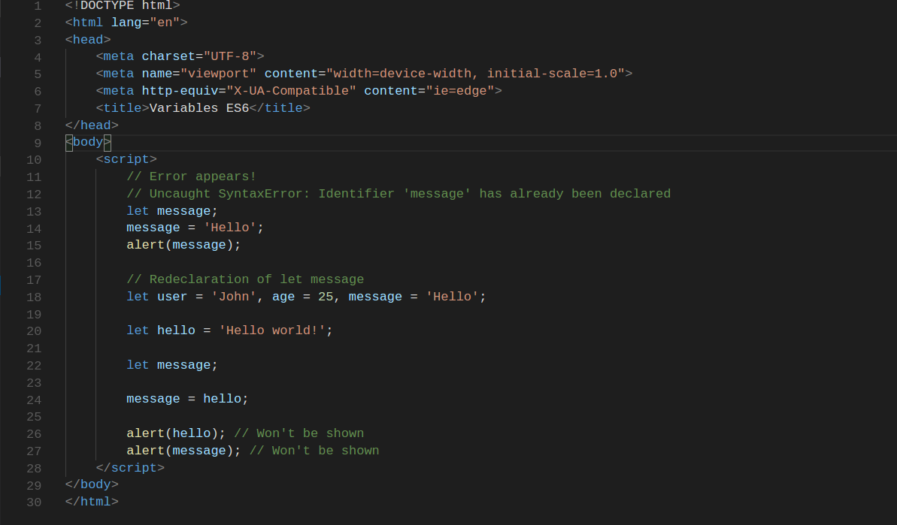
Variables in ES6

Slide 8
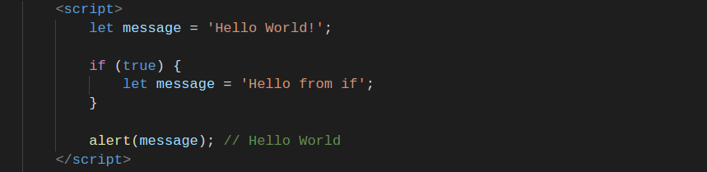
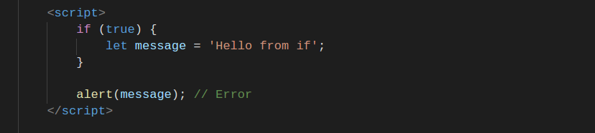
Variables in ES6

Slide 9
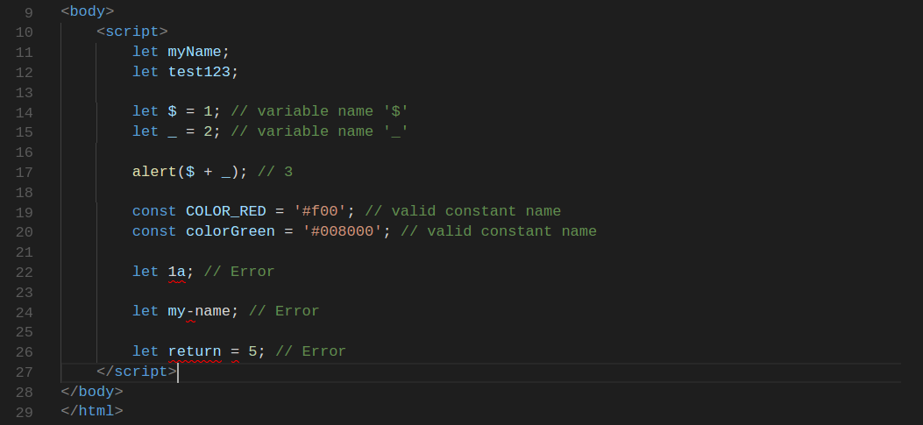
Variables naming

Slide 10
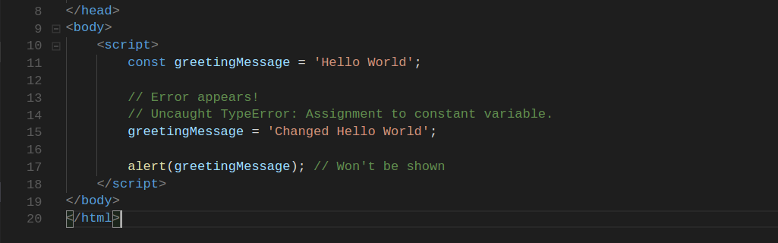
Constants

Slide 11
Data Types
The latest ECMAScript standard defines seven data types:
Six primitive types:
Boolean
Null
Undefined
Number
String
Symbol (new in ECMAScript 6)
and Object

Slide 12
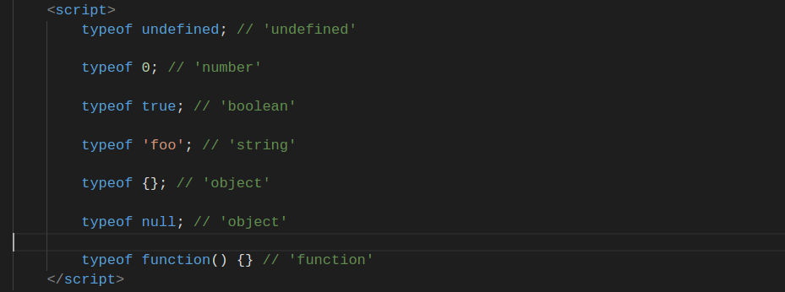
typeof

Slide 13
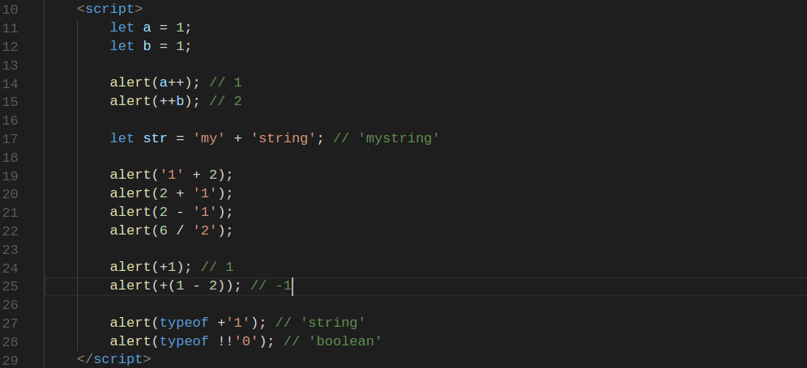
Operators

Slide 14
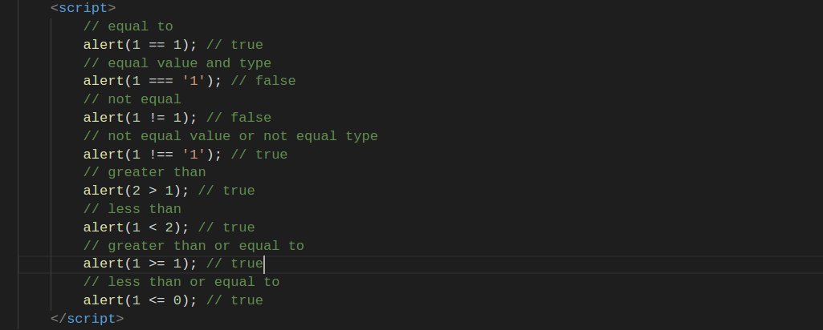
Logical Operators

Slide 15
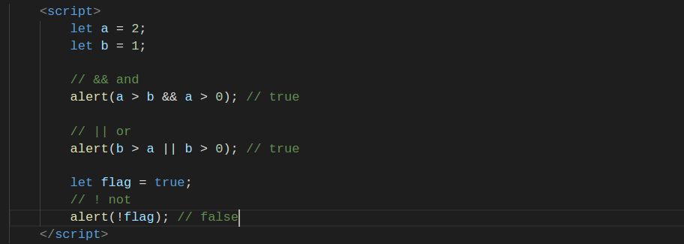
Logical Operators

Slide 16
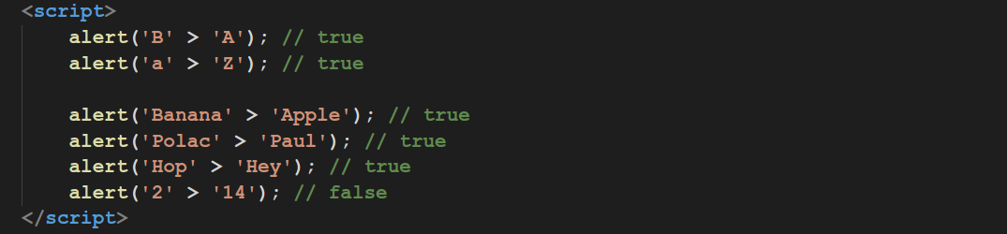
Strings Comparison

Slide 17
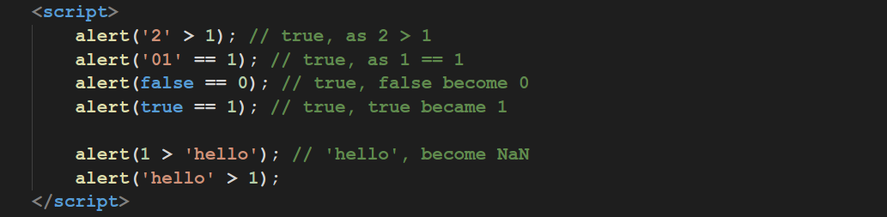
Types Comparison

Slide 18
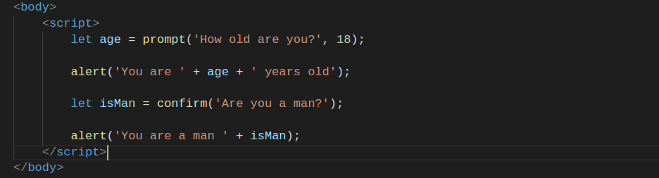
Alert, Prompt, Confirm

Slide 19
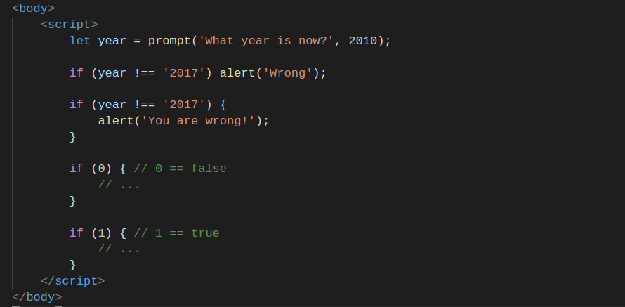
If Statement

Slide 20
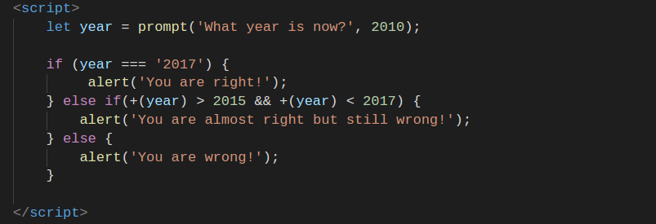
Else Statement

Slide 21
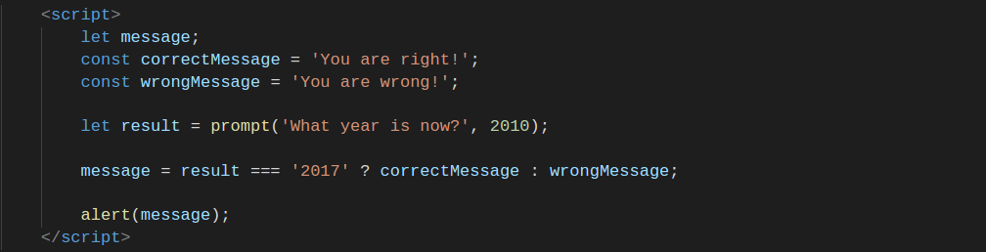
Conditional (ternary) Operator

Slide 22
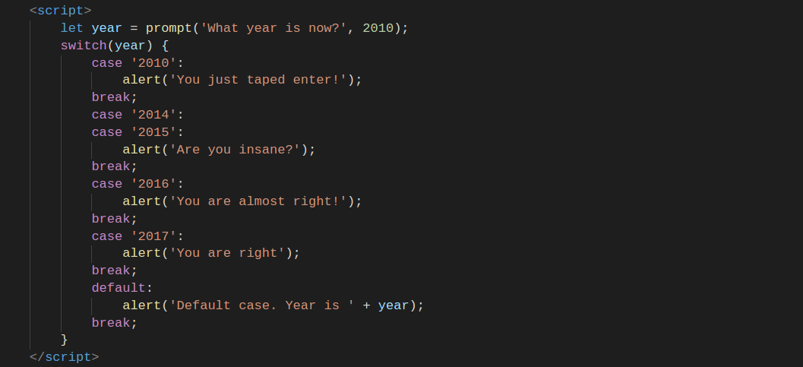
Switch Statement

Slide 23
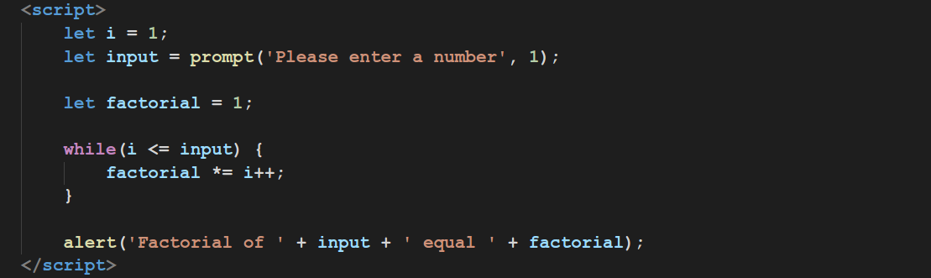
Loop While

Slide 24
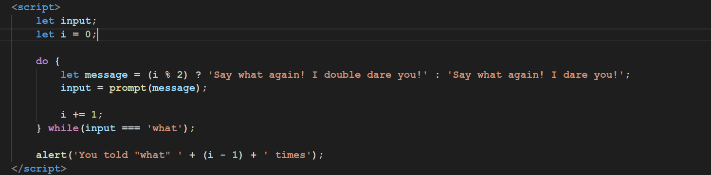
Loop Do While

Slide 25
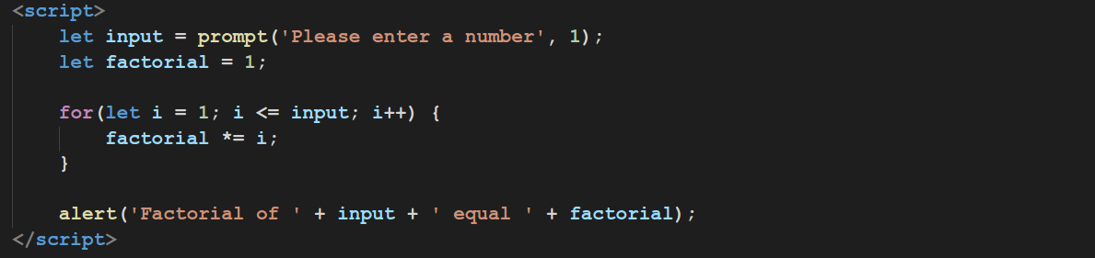
Loop For

Slide 26
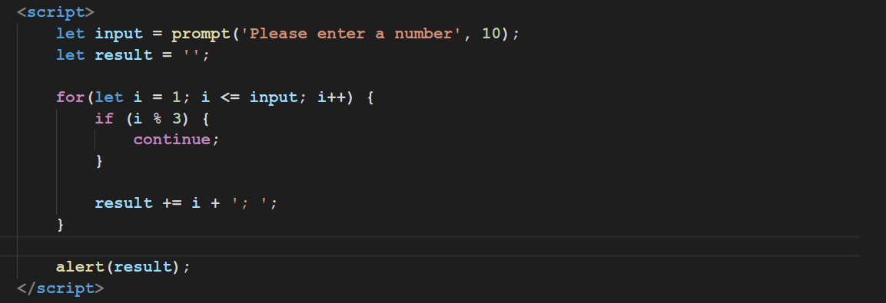
Break and Continue

Slide 27
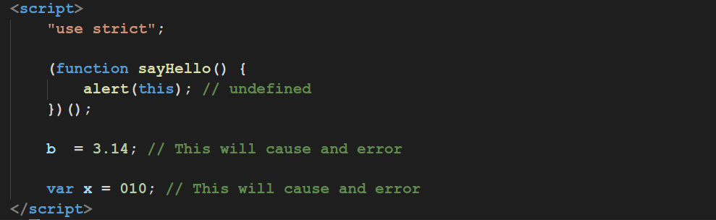
Strict Mode

Slide 28
Thanks for watching

