Slide 1

Capstone Project – Exploring Greater Metropolitan Sydney
IBM – Data Science Professional Certificate

Slide 2
Introduction and problem
Being a first generation migrant myself, moving to new country brings a lot of challenges with it
The first dilemma we all face is where to live! To Rent or Buy, how many amenities nearby, how safe an area is, what is population and so on...
The best way to solve this riddle was to make use of data to understand the economic and social landscape of the area we are moving
Hence, using personal experience (and lot of Data of course!) we will explore Greater Metropolitan Sydney region of Australia

Slide 3
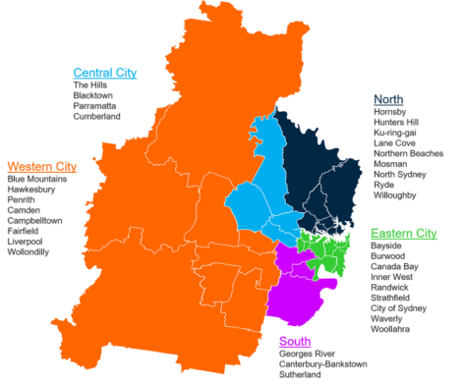
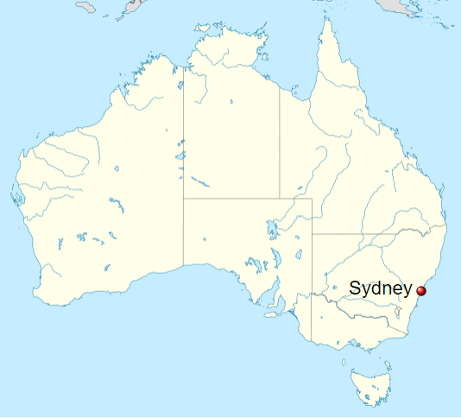
Greater Metropolitan Sydney
The Greater Metropolitan Sydney comprise of various Local Government Areas (LGAs), which we will refer to as Neighbourhoods/LGA interchangeably;
It is one of the most populous and vibrant area in the state of New South Wales and hosts LGAs like Sydney (known of Opera house and NYE fireworks of course!)
Different regions within this area has varied geographic and socio-economic landscape. From busy business district of Sydney to calm suburbs of The Hills Shire and picturesque Blue Mountains, there is something for everyone!
Image source: https://sport.nsw.gov.au/
Image source: Wikipedia

Slide 4
Data source
In order to explore various LGAs within the Sydney Region we have used following data sources:
Dwellings rental data by LGA/neighbourhood for September quarter 2019 (Source: www.facs.gov.au)
Dwellings sales data by LGA/neighbourhood for June quarter 2019 (Source: www.facs.gov.au)
Shape file of Sydney region (to plot geo maps and get co-ordinates of neighbourhoods)
Population data based on 2016 census (Source: http://stat.data.abs.gov.au/)
Crime data by LGA/neighbourhood for Year to date Sep 2019 (Source: https://www.bocsar.nsw.gov.au)
First we will clean the data by using Python to bring it in the format that can help us visualize the data as follows:
Rental cost per dwelling per neighbourhood
Median sale price per neighbourhood
Population per neighbourhood
Crime rate per neighbourhood
We will use a range of bar plots, scatter graphs, heat maps and Geo Spatial analysis to understand various factors that can impact a decision on the best place to live based on user preference
We will then use Four Square API to explore these neighbourhoods and through k-mean clustering analyse pros and cons of living in various neighbourhoods
All data is in AUD

Slide 5
Methodology
The analysis performed comprised of following sections with lot of foocus on rental since new migrants would probably rent as opposed to buying right away:
Property Rental analysis
Created Box plot to evaluate statistical range of rent per dwelling (per week rental)
Bar chart to view avg rental per suburb and total properties on rent at the end of Q2 2019
Scattered visualization of avg rent and total properties based on number of bedrooms for every neighbourhood
Heat map to evaluate distribution of rental by neighbourhood
Property Sales analysis
Bar graph to compare Median house price per neighbourhood
Understand Correlation between Avg rent and Median price
Choropleth map using Sydney’s shape file to visualize geospatially median prices and Number of dwellings sold
Population distribution analysis
Use of shape file to create Choropleth map of population distribution
Crime statistics analysis
Visualized relative number of crimes on Folium using Bubble map. Obtained co-ordinates from shape file and superimposed crime data over Folium Open street map
Four Square API venue exploration
- Finally explored all neighbourhoods using FourSquare API and the carried out k-mean clustering machine learning algortithm to create groups of neighbourhoods sharing similar amenities. This will help us decide on making a move to new country by gathering some understanding of the area.

Slide 6
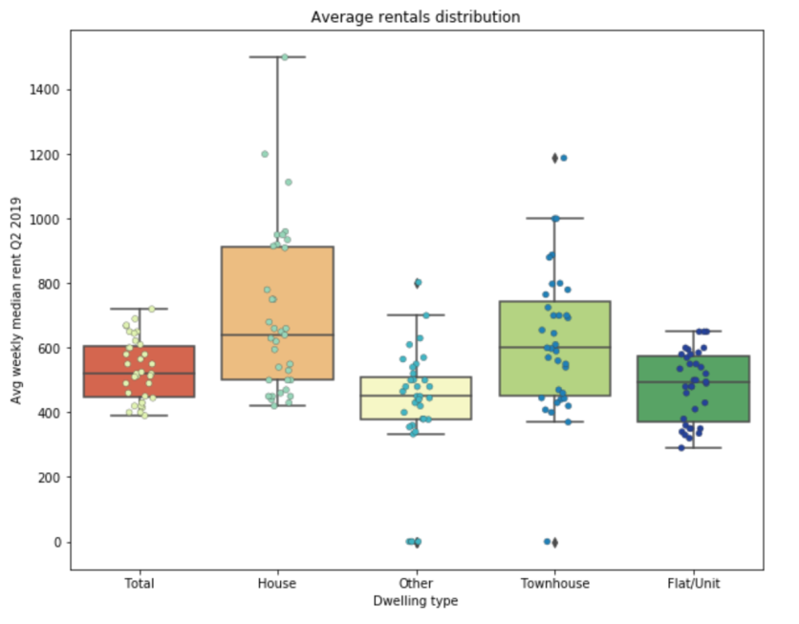
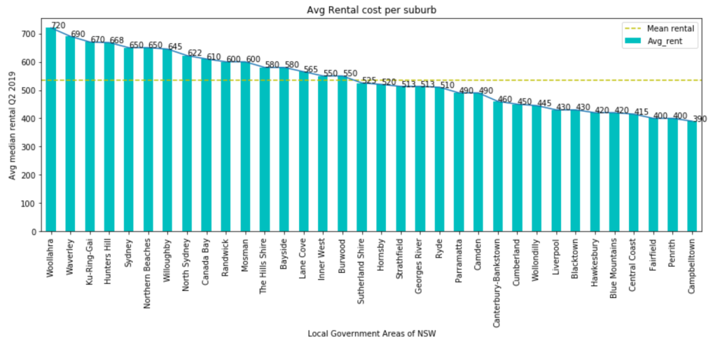
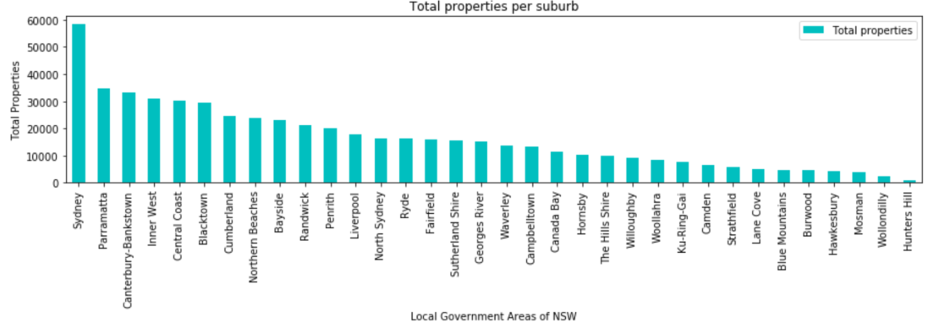
Results: Property Rental analysis
The Box plot on the right gives us a 5 point range of min, 1st quartile, median, 3rd quartile and max rental per dwelling type. For instance, we can see House rent can range from $400 pw to >$1400 pw. The scatter superimposed on it shows the number of properties on rent within that range. For example in Houses we can most of the properties within min to median rental range.
Bar plots above show a simplistic view of median rental per LGA along with number of properties available. Sydney being a metropolis has highest number of dwellings with avg. rental of $650 pw. The overall avg rental is somewhere near $530.

Slide 7
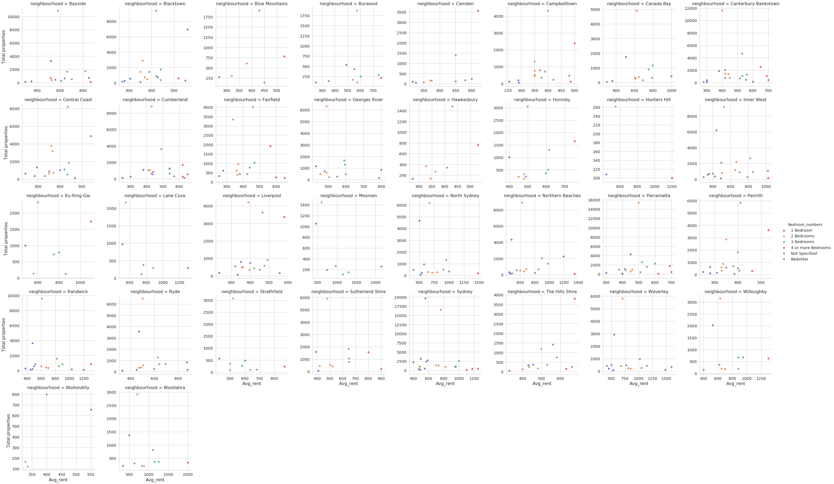
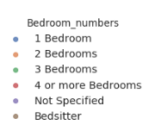
Results: Property Rental analysis (cont’d)
This shows a detailed rental distribution by number of bedrooms per neighbourhood. Taking Sydney again as an example we can see the 4 bedroom houses are all >$1100pw with less than 2500 properties. The 1 bedrooms on the other hand are in abundance and are in range <$600pw.

Slide 8
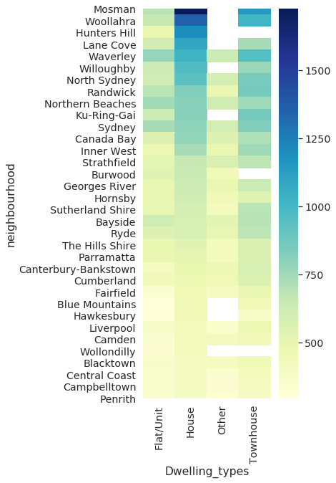
Results: Property Rental analysis (cont’d)
Next we created a heatmap to visulize the rental cost range for all suburbs by type of dwelling. This tells us Mosman is most expensive neighbourhood by individual dwelling type followed by Woollahra and so on.
Now based on all the above analysis if we add a factor of individual needs, family size, dwelling type preference and budget we can decide with reasonable certainty on whereabouts one would like to live.
In the next slides we will continue to explore these neighbourhoods and look at sales, population and crime data.

Slide 9
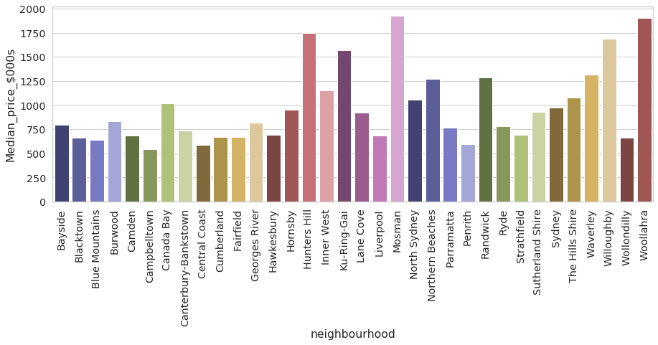
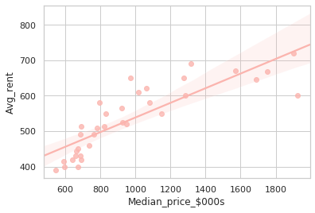
Results: Property Sale analysis
The bar plots above give us the sky scrapper of Median price distribution during Q2 2019 by each neighbourhood under review. The theme remains the same with neighbourhoods like Mosman, Woollahra, Hunters Hill being most expensive. Now this cover all property types’ median price. This would vary by type and size which is out of our scope at this stage.
The scatter plot on the right shows a strong correlation (0.84) between Avg rent and Median prices. This is consistent with what we have seen so far.

Slide 10
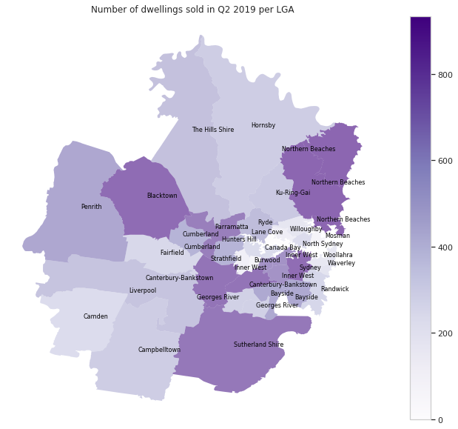
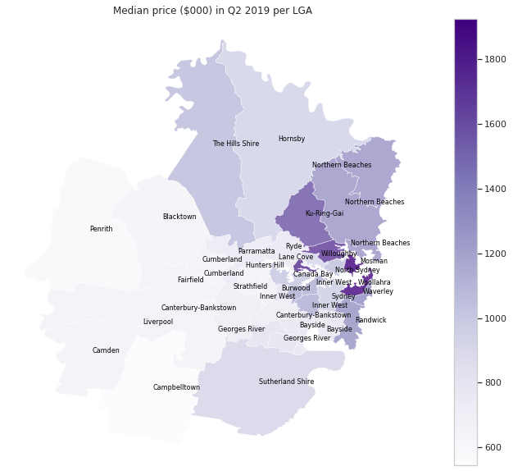
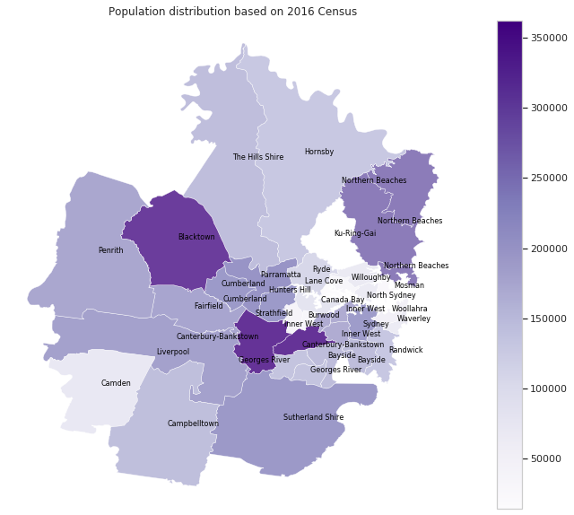
Results: Geospatial visualization
Next we decided to look at the geospatial distribution of various data sets by creating Choropleth maps.
The first one from left shows the number of dwelling sold during Q2 2019. We can see somewhat similar colour scheme on population distribution as well (the 3rd map). This indicates the economic activity happening somewhat in proportion to population size and not just entirely based on location of neighbourhood.
The map in the middle shows a visual distribution of median prices we observed earlier. This indicates that the most expensive properties are located within the circled area which is somewhere near Sydney’s Central Business District as we move up towards Northern beaches.

Slide 11
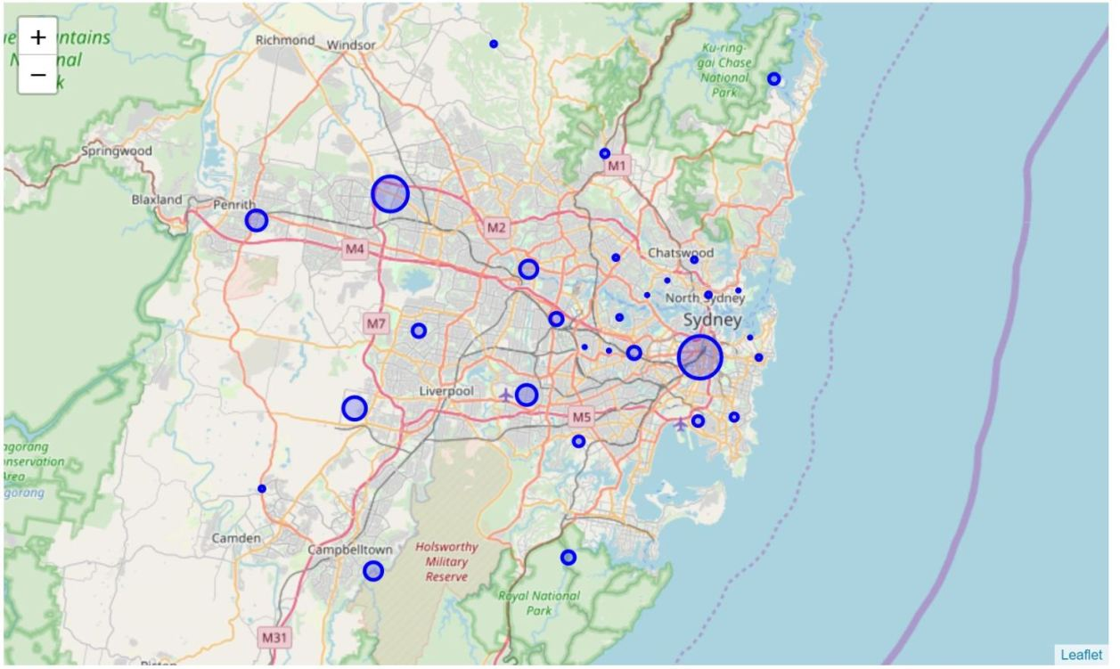
Results: Crimes per neighbourhood
Next we downloaded Sep 2019 Year to date crime related incidents data from NSW Bureau of Crime Statistics and mapped in on top of Folium Open street map. We used bubble map to illustrate the number of incidents happening in the neighbourhood as a proportion to the size of the bubble.
The above gives us a good indication of which areas have higher crimes e.g. the area near Sydney’s CBD seems to record quite a high number of crimes.

Slide 12
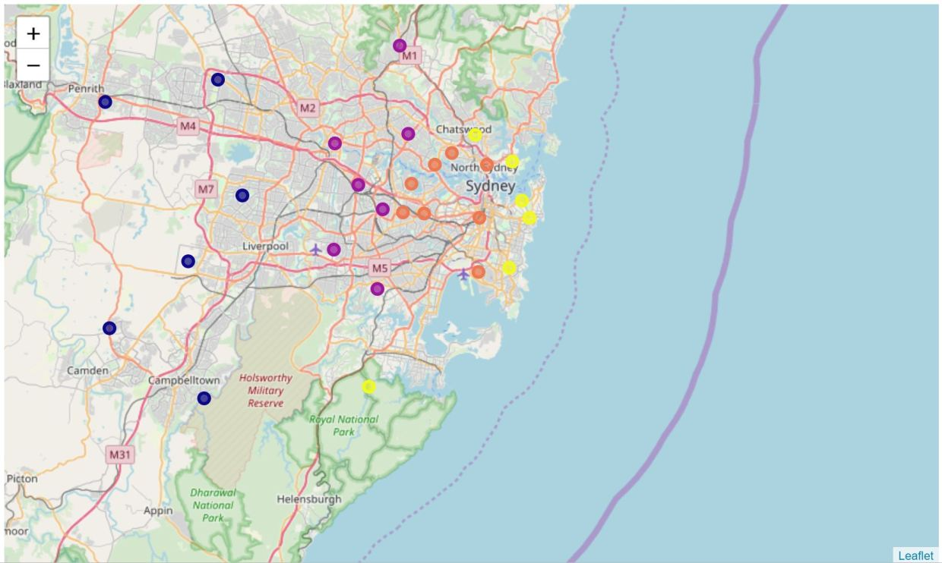
Results: k-mean clustering
Now comes the part where we apply machine learning algorithm on all neighbourhoods’ venues. We used Foursquare API to explore all the venues (cafes, gyms, bars, parks etc) in the neighbourhoods and then created data frame based on those venues.
On the resulting dataframe we applied a popular unsupervised machine learning algorithm, known as k-mean clustering.
We divided the neighbourhoods in 4 different clusters based on the venues data explored. This is illustrated with 4 different colours. We will examine the venues in detail in next slide. But for now we can see the clusters actually fit in geographically as well. This indicates a more similar lifestyle/venues offering by geography. Let’s analyse these in detail on next slide.
 | Cluster 1
 | Cluster 2
 | Cluster 3
 | Cluster 4

Slide 13
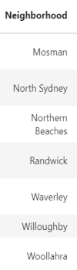
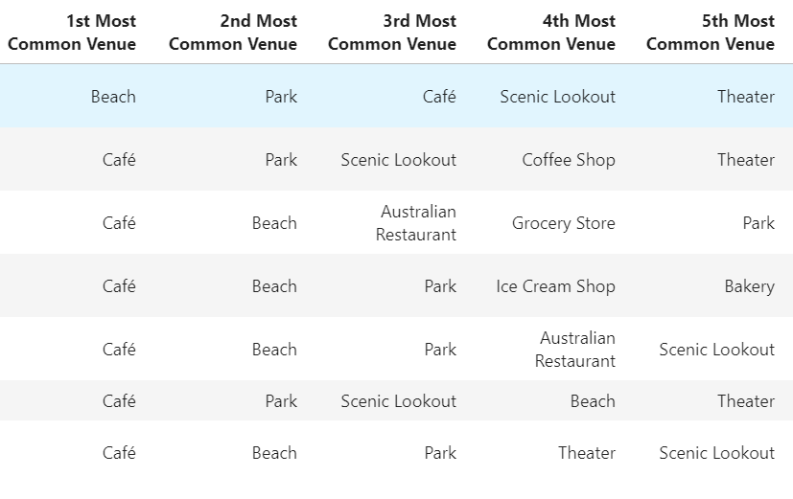
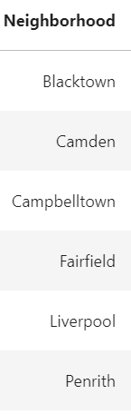
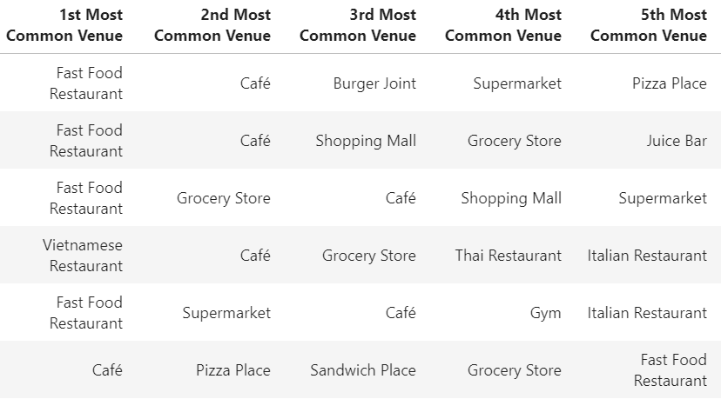

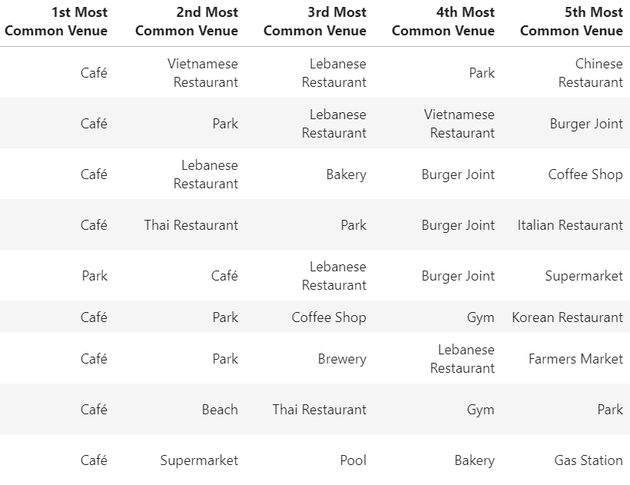
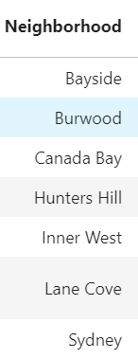
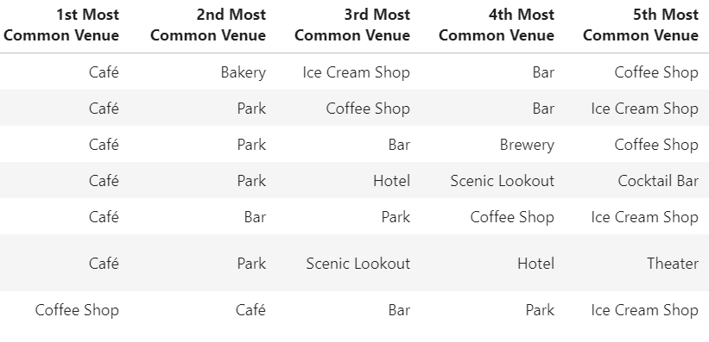

Results: k-mean clustering
Our cluster 1 comprises of neighbourhoods on the left. This cluster comprises mostly of Cafes, Beaches and Parks. On map as we could see this area being close to beaches to naturally Cafe, parks and beaches are the most common venues here.
The clustering algorithm grouped mostly the Western and South Western areas under Cluster2. Farther from CBD, it mostly has restaurants, cafe, shopping malls to offer as common venues for families.
The 3rd Cluster runs from The Hills shire Council to Parramatta and Bankstown area. Again this area is dominated by Cafes, Parks, restaurants, Burger joints as the most common venues.
Our 4th and final cluster is much closer (geographically and venue wise) to Cluster 1 as this area is known for its Cafes, Parks, Bars etc.

Slide 14
Conclusion
As we discussed earlier, it is not an easy decision for one to relocate in to an entirely new country. However, living in the age of technology has its perks! We get loads of information available over internet and then using data analysis tools we can make reasonable decisions based on our individual preferences.
Our analysis of rental costs has given us a good insight into one of the biggest cost for a new migrant i.e. Rent based on neighbourhood. If one chooses to buy a property outright, the sales analysis gives an understanding of how much that would cost (in terms of mortgages) based on that neighbourhood.
The population and crime data gives us a further insight on how the neighbourhoods stack up against each other.
Finally the k-mean clustering algorithm gives us insight into the most common venues available in a given cluster since that can impact one’s decision to choose a neighbourhood. For instance, we can use below decision table as an indication based on the rental, sale and venue data we analysed *:
* we are ignoring dwelling size and type for now

Slide 15
Caveats!
Scrapping data from various sources over the internet is one of the biggest challenge we face. There are number of factors to consider while reviewing the analysis:
Data was downloaded in various different formats and joined together which resulted in some loss of data e.g. certain neighbourhoods data being not available in one data set resulting in keeping only the valid values in new data frame;
The purpose of this analysis is educational only and cannot be used for any other purposes
The boundaries of LGAs keep on changing over various years e.g. merged more than one LGA to form a new one. In various data set (mostly that pertained to 2016 and beyond), a number of these changes happened, hence we had to take various averages and additions of data to make it comparable with other, more newer, data sets containing new LGAs.
Decision to live in a certain area depends on a number of factors and vary by individual requirements and the stage of life they are in. We have only used limited data as per previous slide to understand the compositions of different neighbourhoods.

