Slide 1
Speak Please
The Gamified Social Engine Built in Rust

Slide 2
The Idea
The Problem: Social media makes us lonely; real-world interaction feels like a "boss fight."
The Solution: Speak Please – A gamified platform that turns social interactions into XP.
The Goal: Enhance interpersonal skills and self-esteem through structured real-world challenges.
Philosophy: Built with Rust/Tauri for maximum performance and reliability.

Slide 3
Tech Stack
Real Engineering for a "Simple" App
The Core: 100% Rust-driven ecosystem.
Frontend: Tauri + React + TailwindCSS + TypeScript.
Why? Native performance without the Chromium bloat. (Also, I don’t like Electron)
Backend: Axum (High-performance web framework) + SeaORM (Async ORM).
The Bridge: Tauri Specta. Eliminating the "Type Gap" between Rust and TypeScript. No : any allowed here.
Target: Android & Linux (The OS of choice).

Slide 4
Technical Deep Dive: Security & Auth
Argon2 Hashing: Using the winner of the Password Hashing Competition for user security.
Dual-Token System: Robust JWT implementation with Refresh Tokens and static salting.
Refresh tokens rotation
ULID for ids

Slide 5
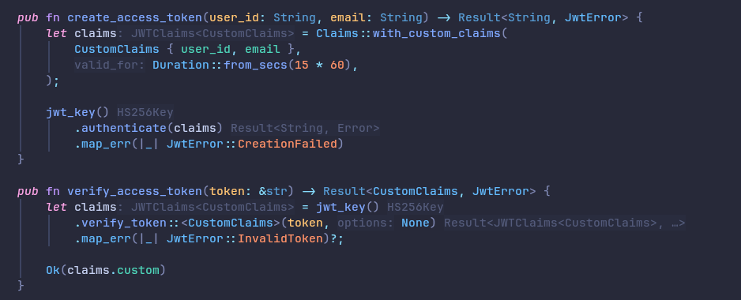

Slide 6
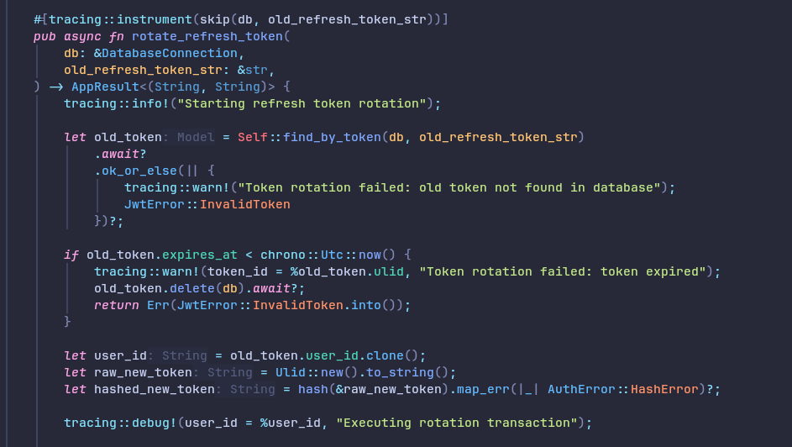

Slide 7
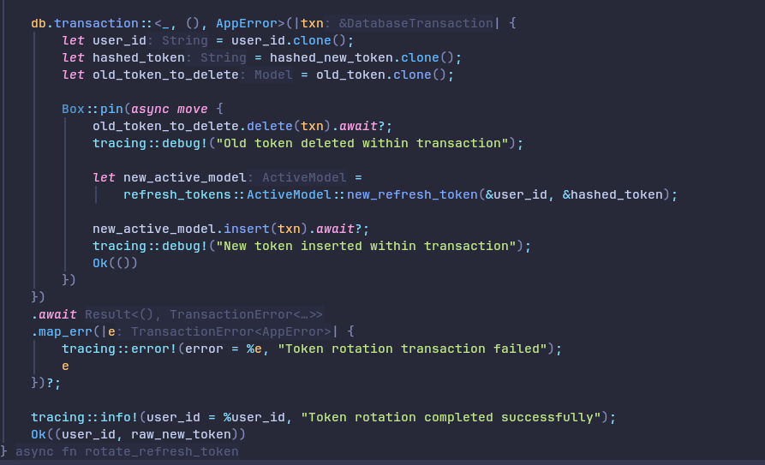

Slide 8
The Features
Quest System: Fully implemented logic for social missions.
The Arena and Chat: A real-time hub for users (80% complete, built on async streams and Web sockets).
Quest Archive: A persistent history of personal growth powered by SeaORM.
Multi-Platform: True cross-platform potential (Android/Linux) from a single codebase.
Error handling
Very good scalability

Slide 9
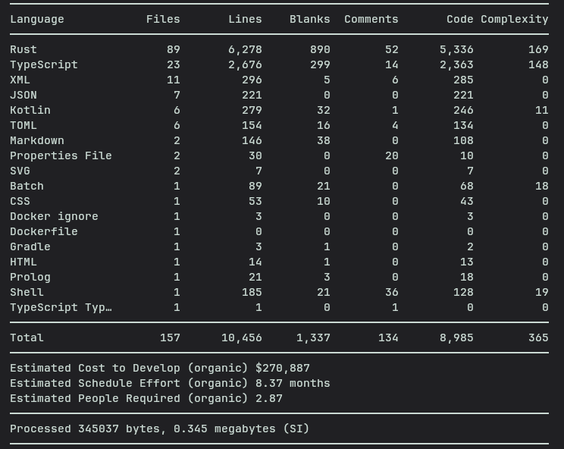

scc(Sloc Cloc and Code)
Rust is heavy(or project is big?)

Slide 10
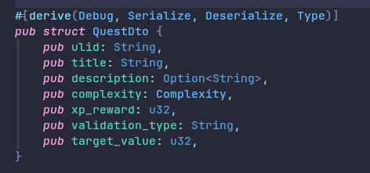
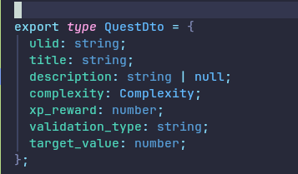
Tauri Specta – Best thing ever
From Rust struct
We get this

Slide 11
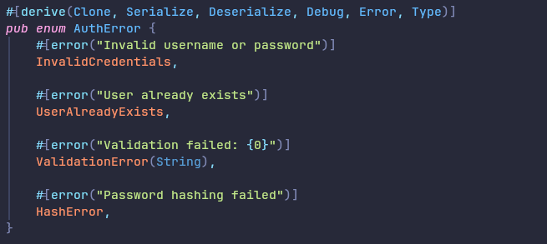
Error handling is very important!

Slide 12
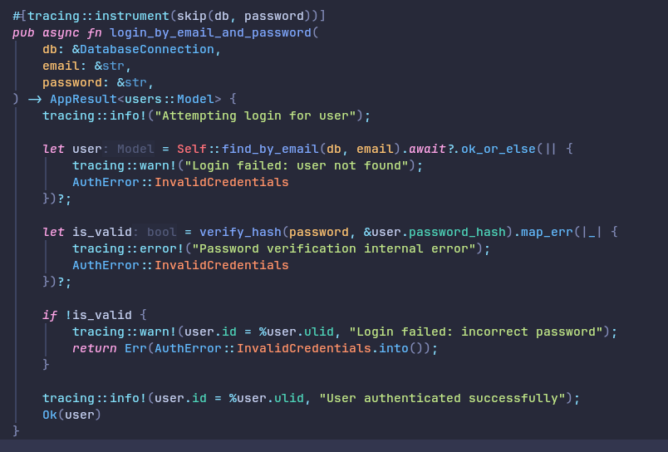

Slide 13
Performance & Architecture
Why Rust?
Concurrency: Axum handles thousands of requests with a minimal memory footprint.
Safety: The "Borrow Checker" ensures the server doesn't crash.
Async Everything: From database queries with SeaORM to the Tauri IPC bridge.
S3 Integration: Integrated Synology C2 storage for scalable media handling.
And… I just love Rust!

Slide 14
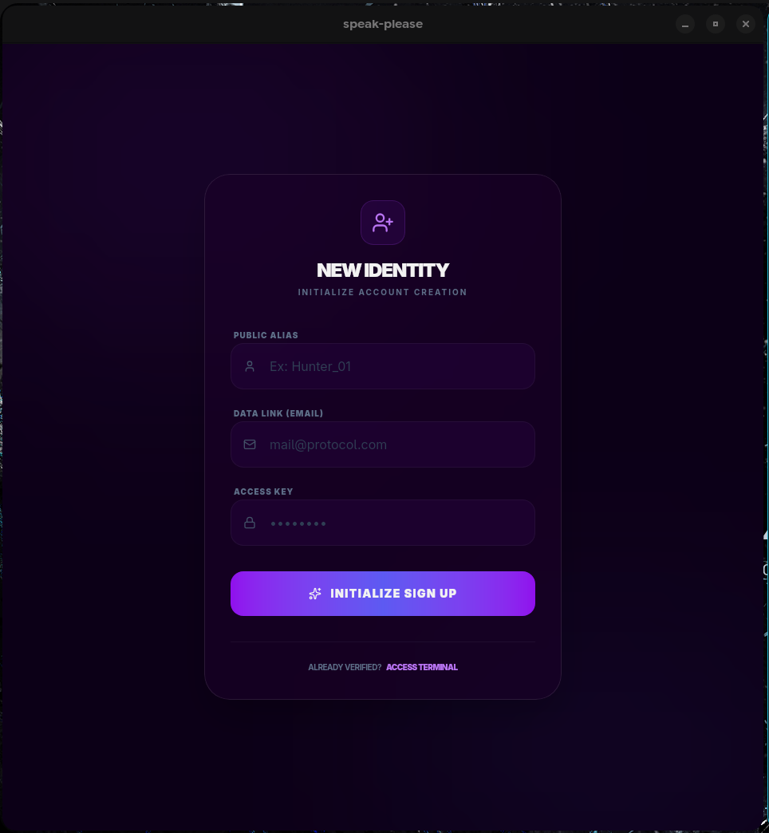
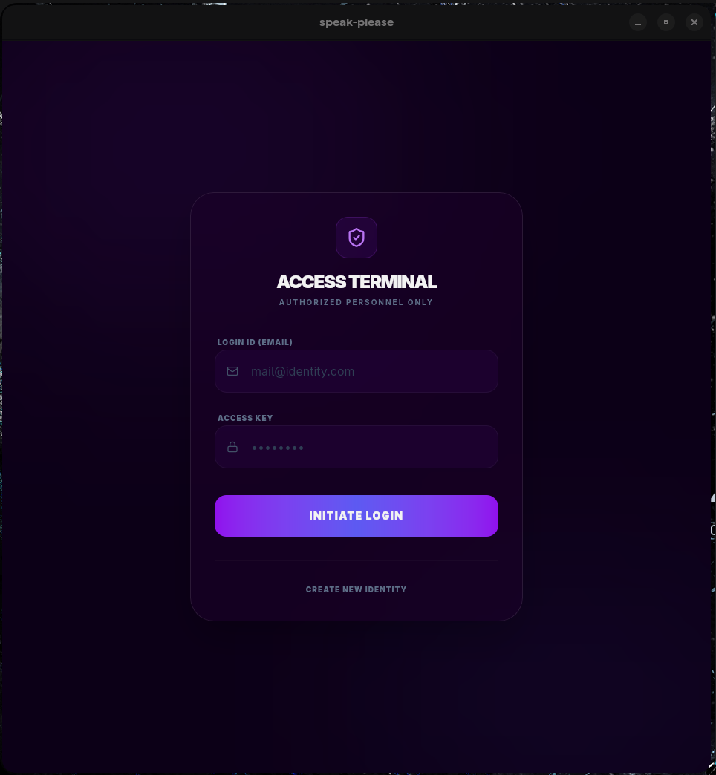

Slide 15
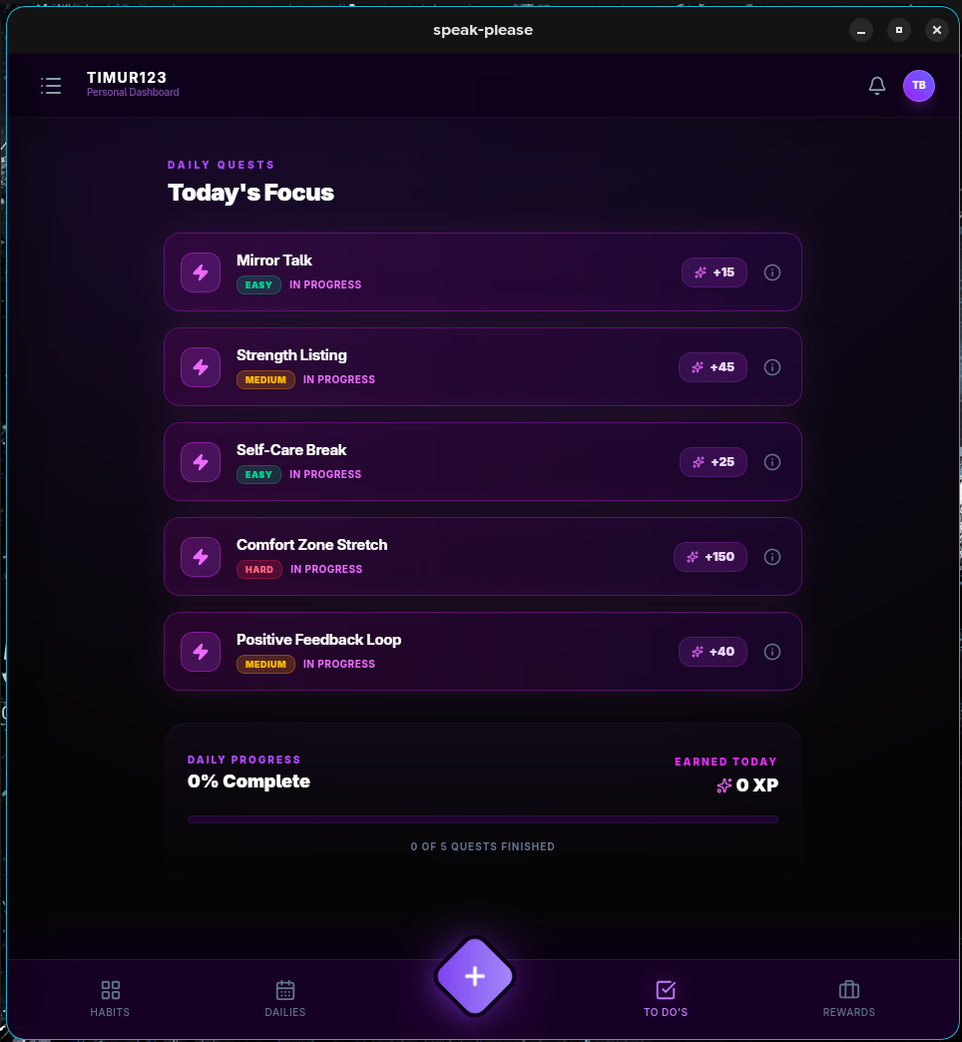
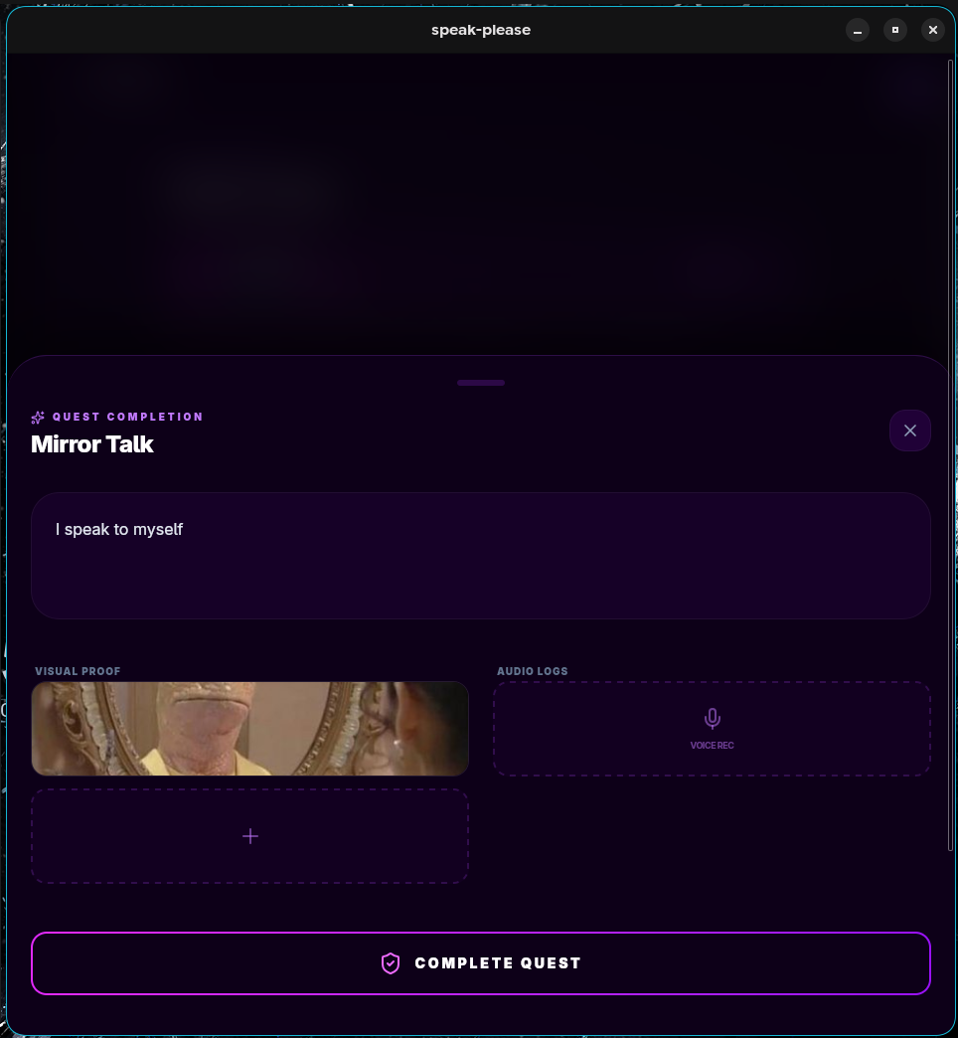

Slide 16
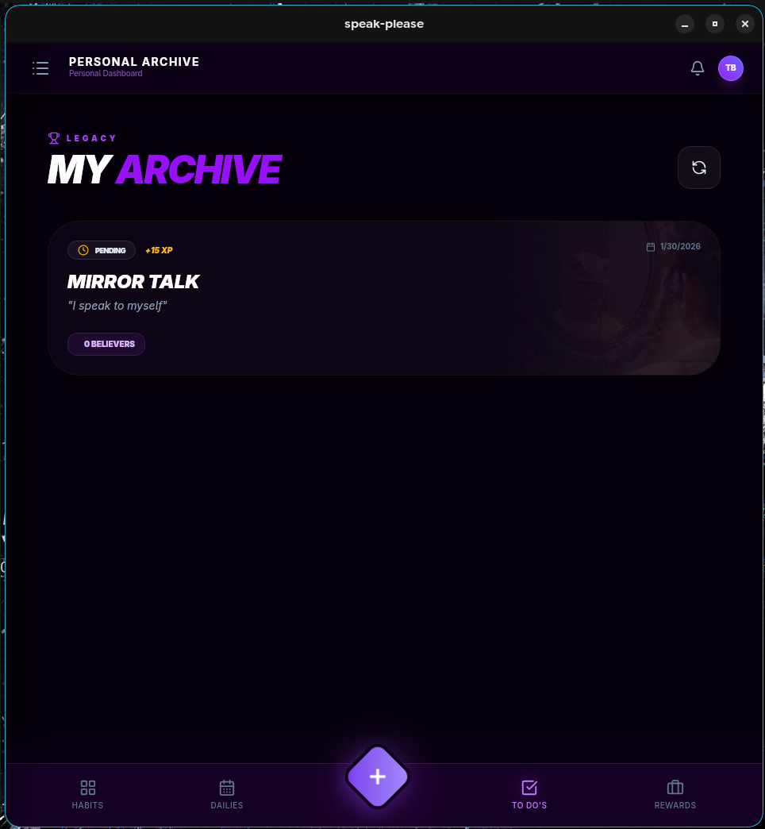
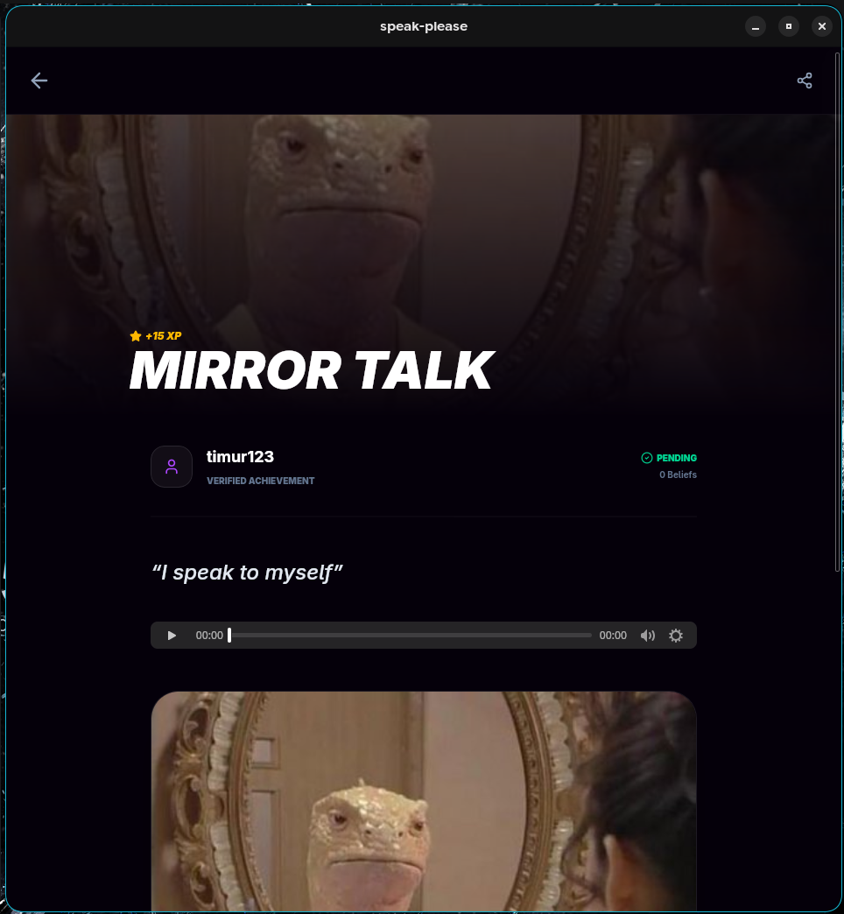

Slide 17
Thanks for attention!
Questions?

