Slide 1

KNN algorithm
Final project
COSC4345
Timur Musaev

Slide 2
KNN
Lazy learner
Steps:
Gather all training and testing data
Calculate distance and store it into max-priority heap
Get k nearest neighbors
Gather information about labels about nearest neighbors
Predict
Calculate accuracy

Slide 3


Euclidian distance

Slide 4
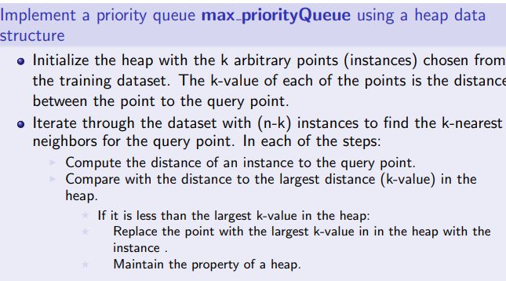
Heap

Slide 5
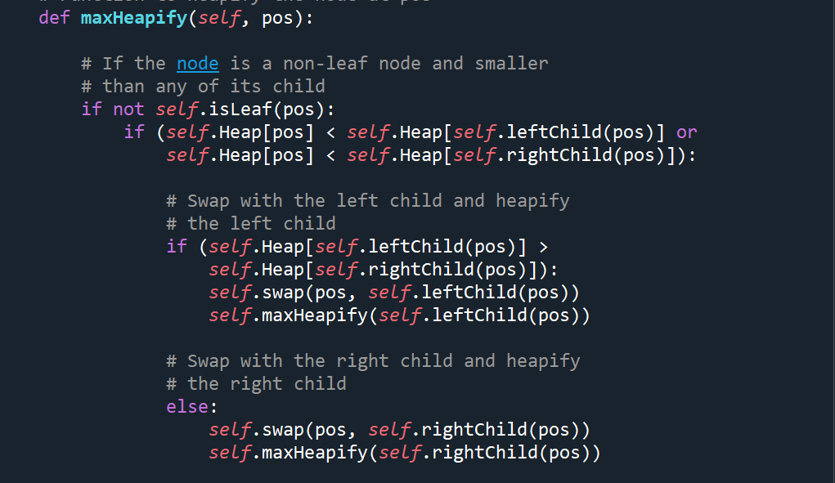
Heap

Slide 6

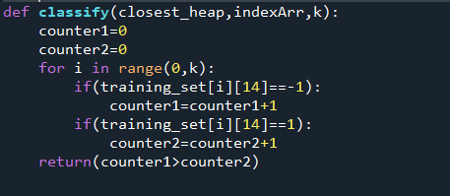
Prediction

Slide 7


Accuracy test

Slide 8
Results
K=10 Ntst=NTrn=100 Accuracy=74% time ~2s
K=10 Ntst=NTrn =200 Accuracy=76% time ~4s
K=10 Ntst=NTrn =400 Accuracy=77.5% time ~9s
K=20 Ntst=NTrn =200 Accuracy=76.8% time ~5s
K=200 Ntst=NTrn =10000 Accuracy=82.4% time ~20 min
K=1000 Ntst=NTrn =15000 Accuracy=~81.3% time ~35min

Slide 9
Q&A
????????????????????????????????????????????????????????????????????????????????????????????????????????????????????????????????????????????????????????????????????????????????????????????????????????????????????????????????????????????????????????????????????????????????????????????????????????????????????????????????????????????????????????????????????????????????????????????????????????????????????????????????????????????????????????????????????????????????????????????????????????????????????????????????????????????????????????????????????????????????????????????????????????????????????????????????????????????????????????????????????????

