Slide 1
OneTech
Team members:
Aziz 20152772
Jakhongirmirzo 20152781
Timur (team leader) 20152783

Slide 2
Content
Introduction
Outline
Academic Objectives
Motivation
Plan vs. Progress
Program languages
Result
Learning from the project
Future works
Conclusion

Slide 3
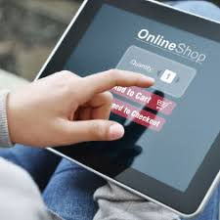
Introduction
E-Pharm – it is an e-commerce website mainly operates for selling, buying and browsing pharmacy items.
Goal :
Compare remedy prices
between pharmacy companies.
Save time.
Be aware of new remedies.
More accuracy.
Intended clients: pharmacies and
Companies.

Slide 4
Outline of the project
Project name is E-Pharm. We wanted to create a website that is so necessary to medicine field in today's world. Our website can be used by pharmacies and pharmacy companies. And they can buy and sell their remedies with profitable prices. Because, E-Pharm gives a chance to differentiate medicine prices between companies. There are some troubleshot without our product in Uzbekistan:
Confusing remedies
Too much paper work
Time loose
Connection

Slide 5
Academic Objective
Learn the process of the E-commerce website development.
Understand how E-commerce website work in our country.
Design and develop the website that can be easy to use.
Learning Search engine, databases, user preferences.
Develop an e-payment system for our website.

Slide 6
Motivation
To learn whole website development (back end, database ...).
Make a new and useful website for business in Uzbekistan.
Necessity of E-commerce in Pharmacy field.

Slide 7
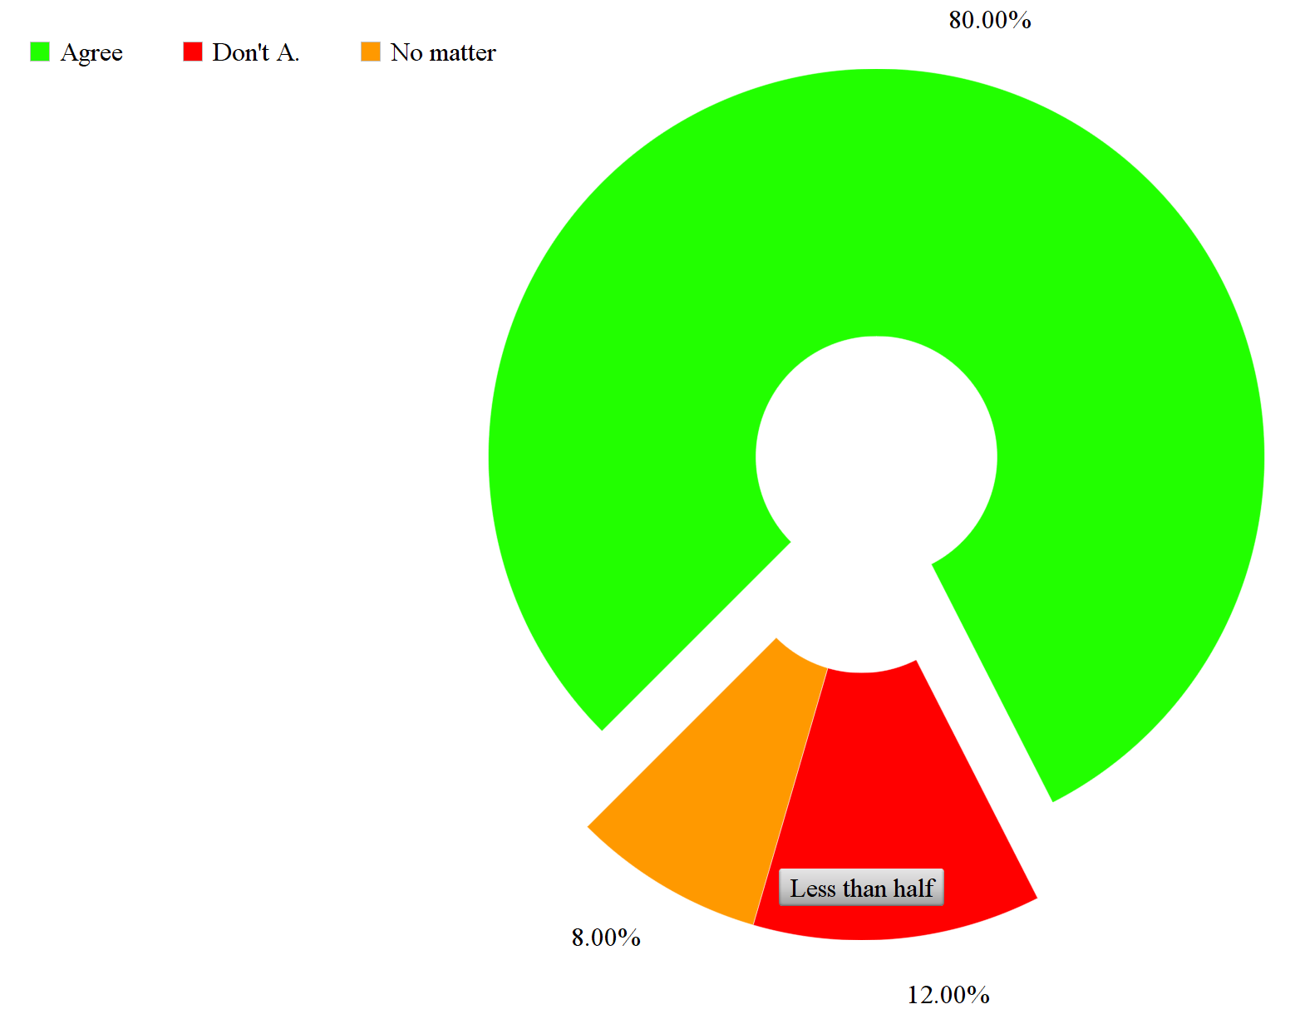
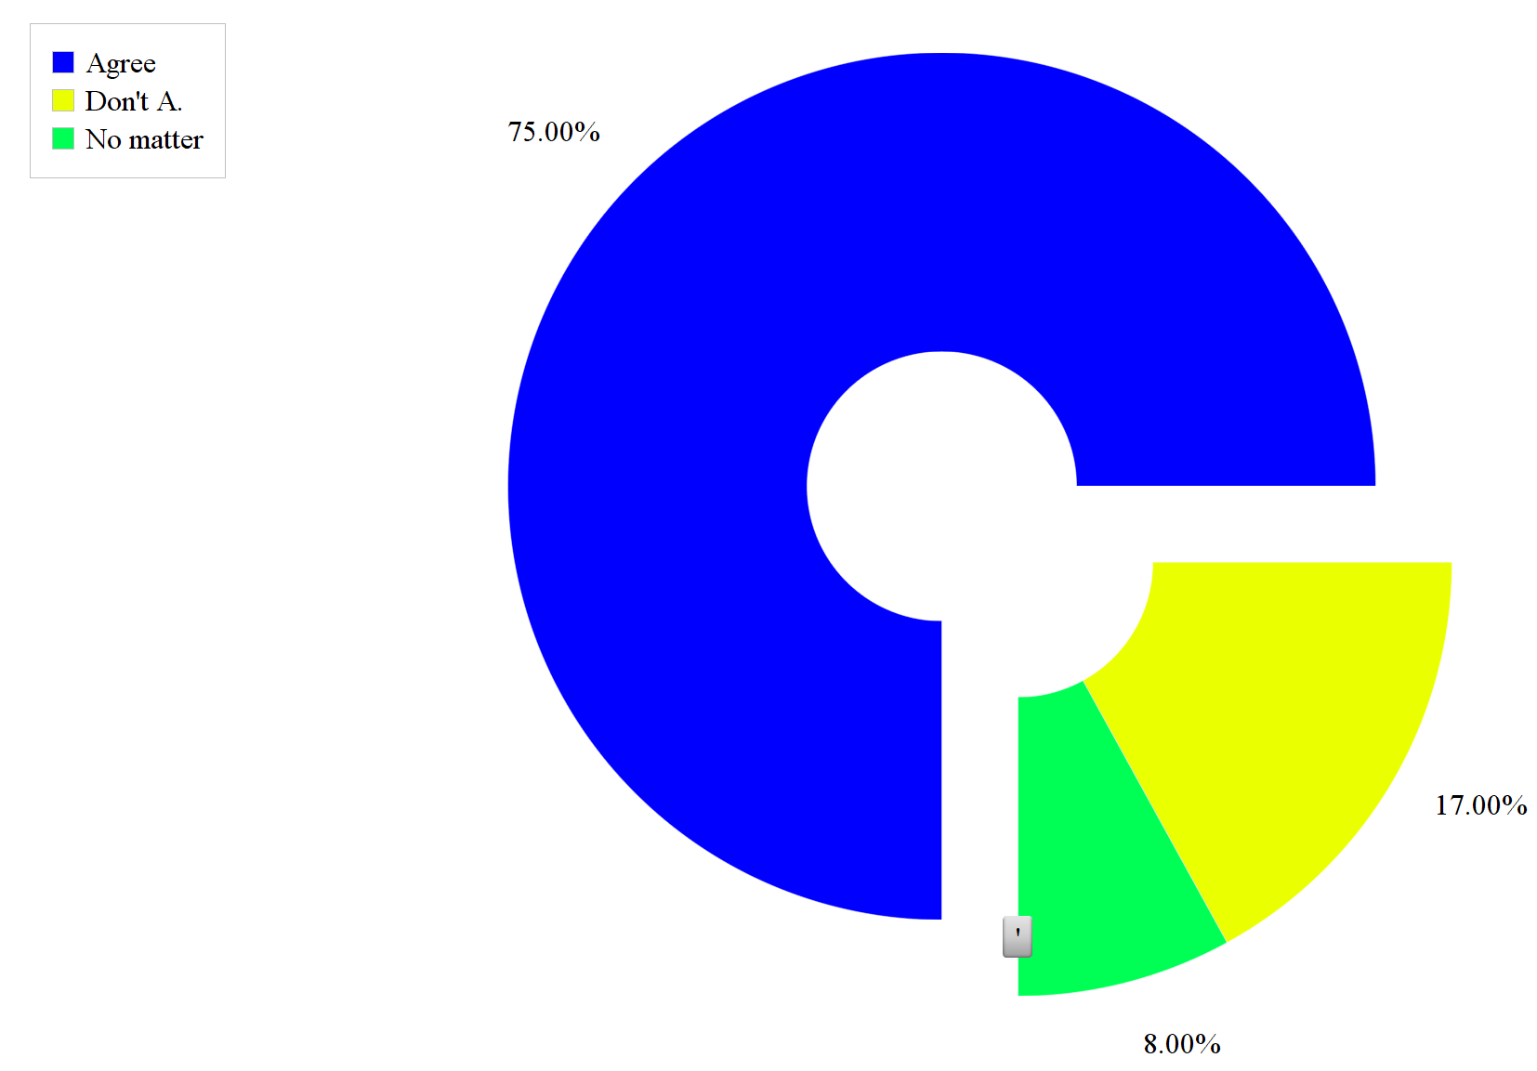
Motivation (survey)
Figure 1. Survey between Pharmacies
Figure 2. Survey between Firms

Slide 8
Plans vs. Progress
Week Task |  | 4 | 5 | 6 | 7 | 8 | 9 | 10 | 11 | 12 | 13 | 14 | 15 | 16 (12/21)
R&D | P
 | D
Front end | P
 | D
Data-base | P
 | D
Back end | P
 | D

Slide 9
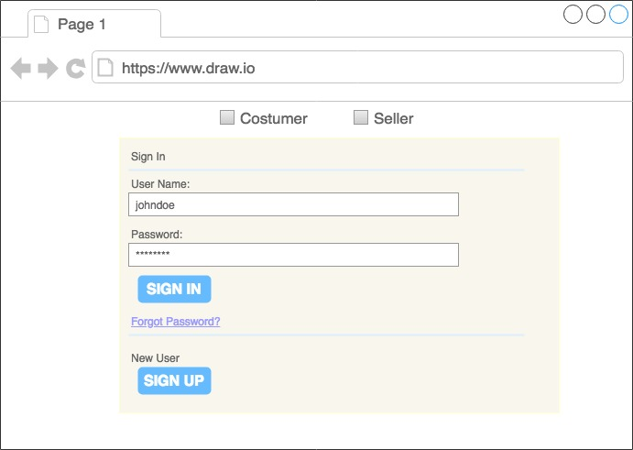
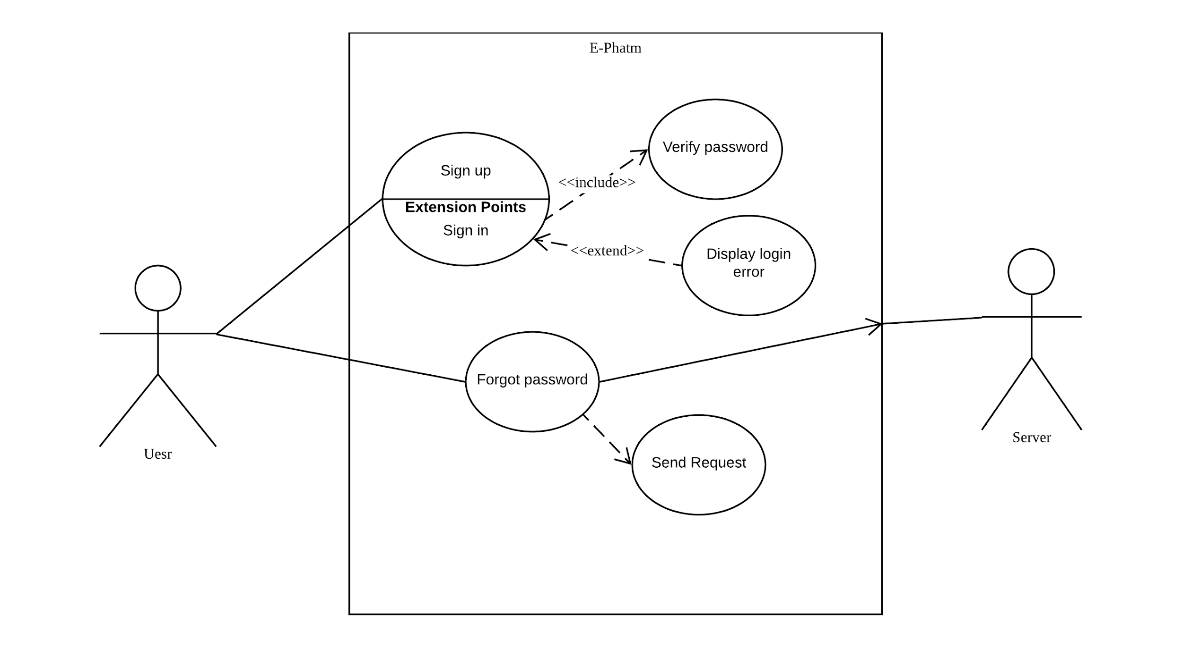
Mockup and Use Case Diagram

Slide 10
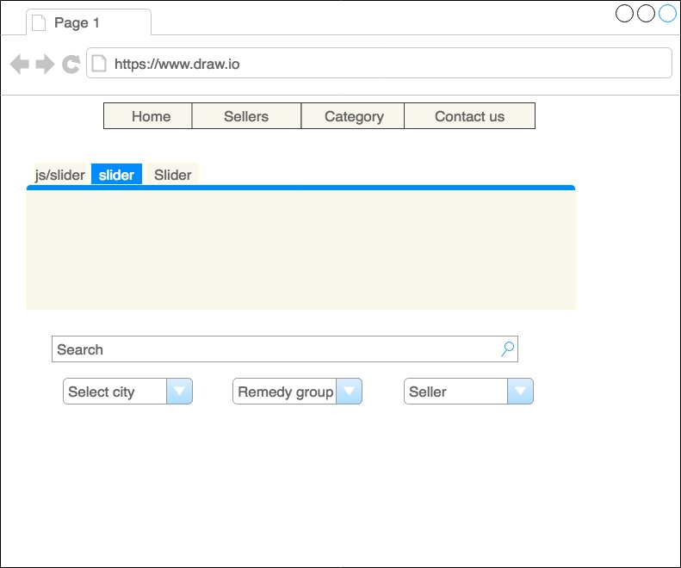
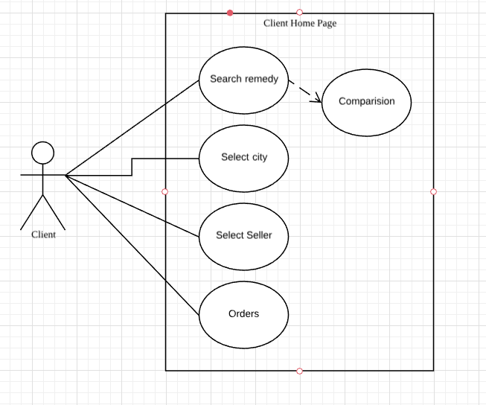
Mockup and Use Case Diagram

Slide 11
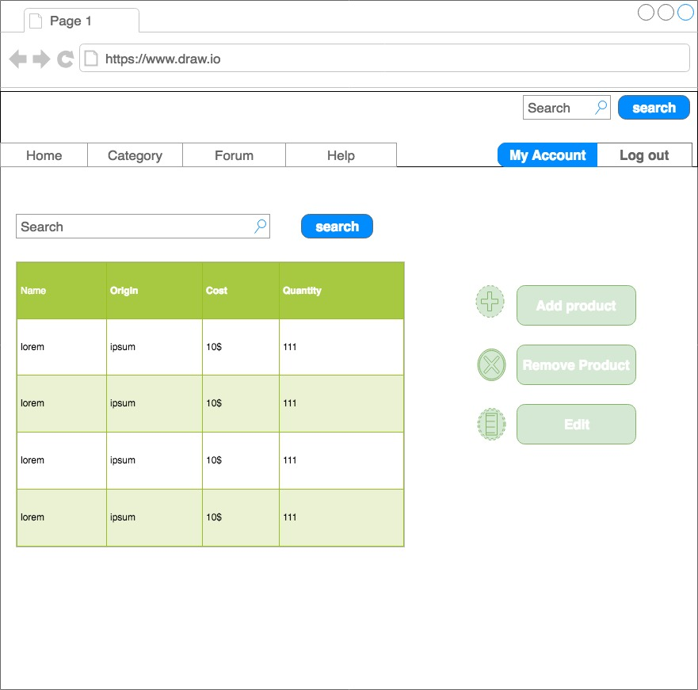
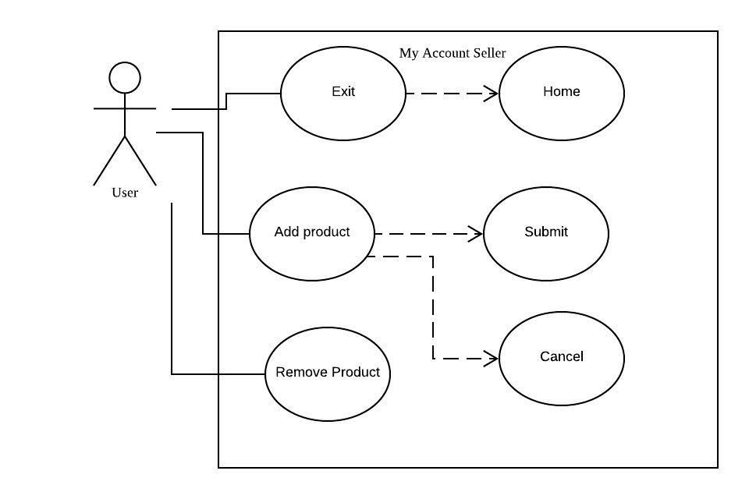
Mockup and Use Case Diagram

Slide 12
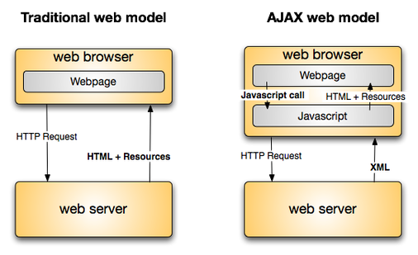


Program languages
Database: MongoDB (NoSQL)
Front-End
HTML, CSS, JS (jQuery), Bootstrap,
Back-end
Node.js, Express framework
stripe framework(for payments)

Slide 13
NPM packages
Express - generator
Passport
Bcrypt
handlebars
mongoose
stripe

Slide 14
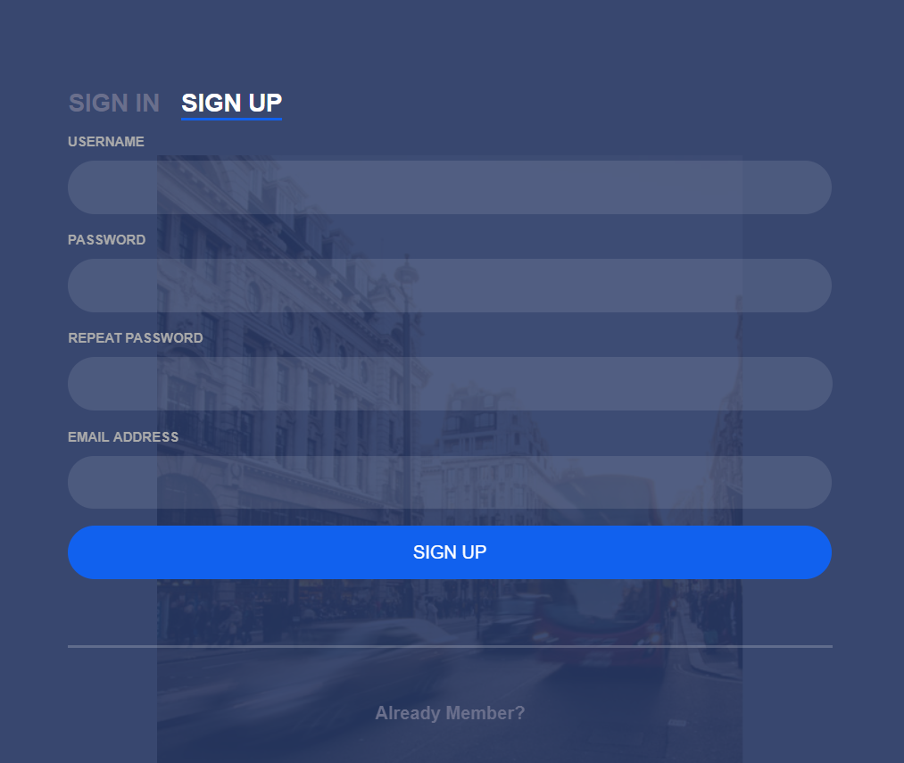
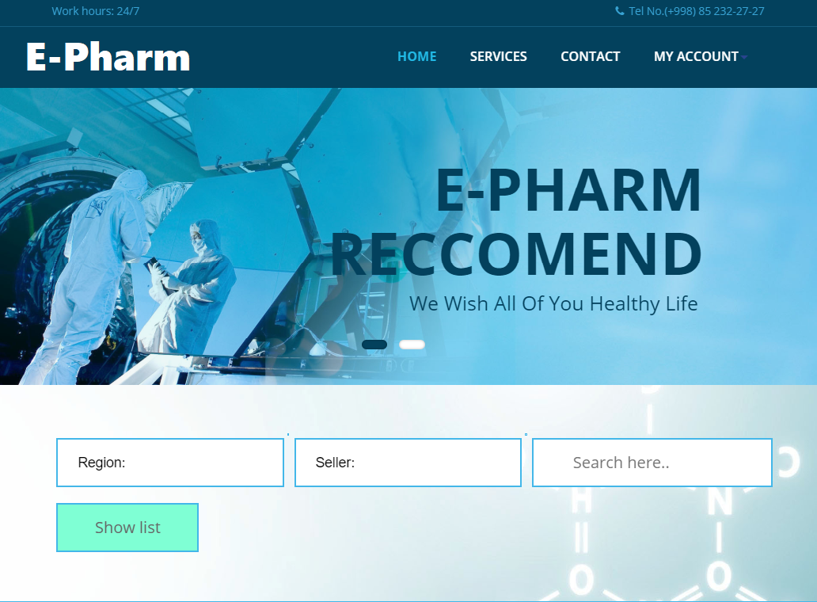
Result

Slide 15
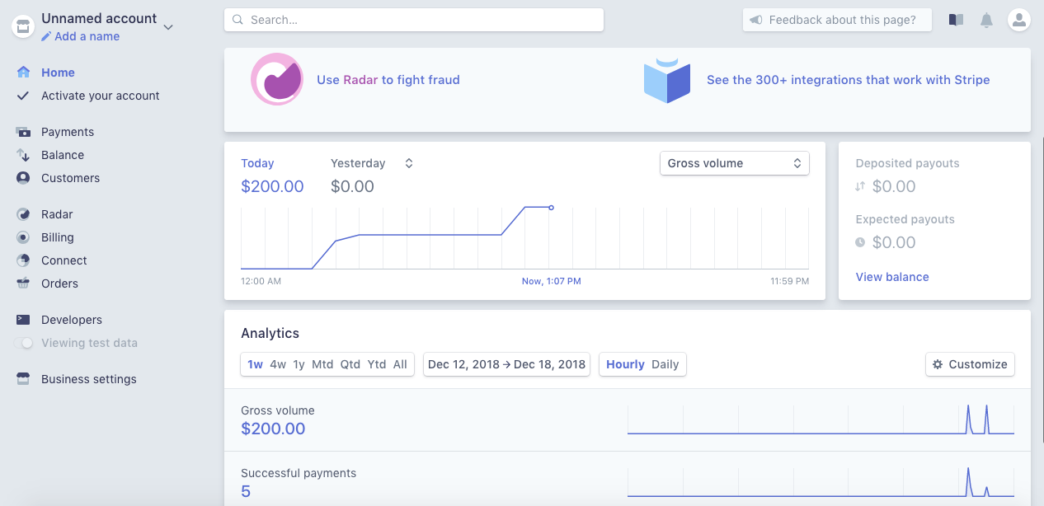
Stripe

Slide 16
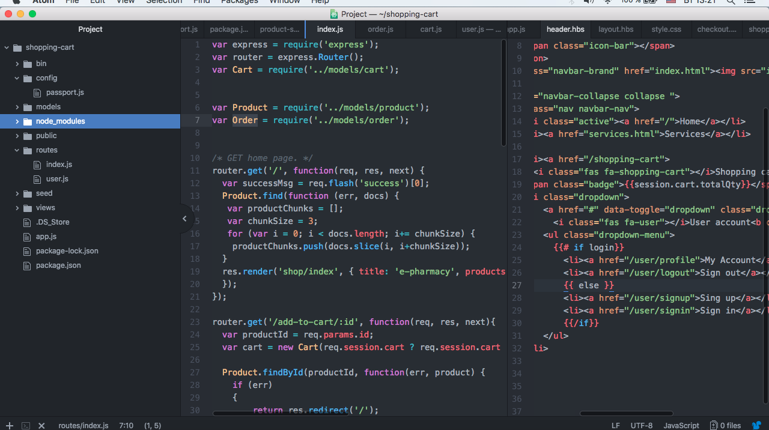

Slide 17
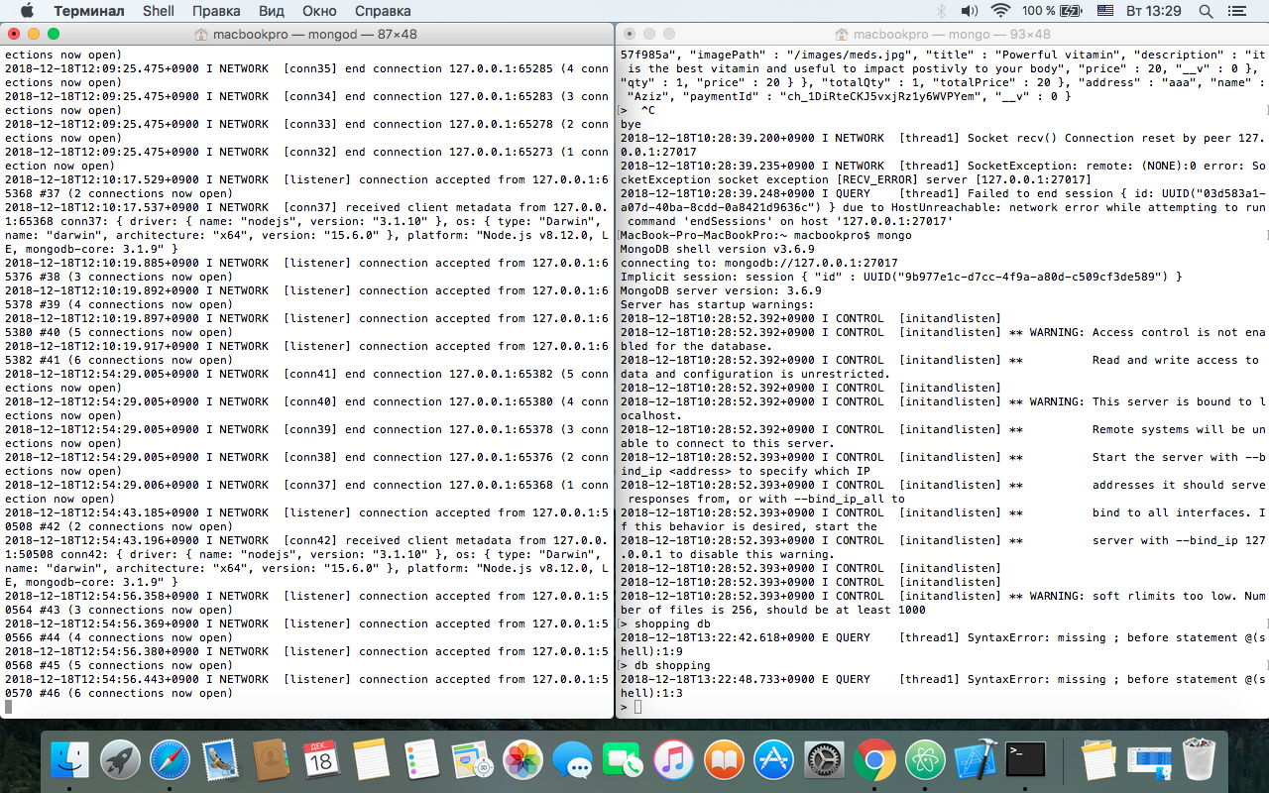

Slide 18
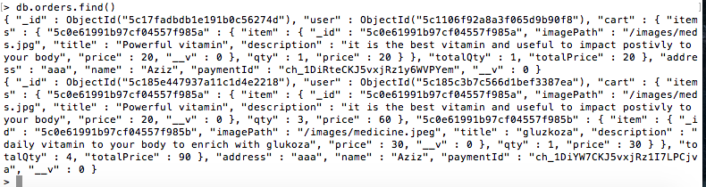

Slide 19
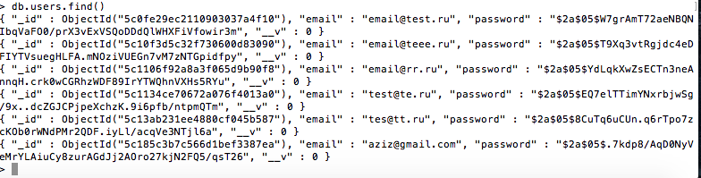

Slide 20
Learning from the project
Using JS libraries, Bootstrap, Templating Engines
How to work with MongoDB, Node.js for backend
Learning Stripe for payment usage
How to write research paper
Knowledge about class, use case and sequential diagrams

Slide 21
Future Plans
Make a single page website
Using Aws for hosting website
Adding more payment options

Slide 22
Conclusion
Make many possibilities to see the distinguish of products with their price, company, country, and brief instruction.
We have learned some libraries, frameworks, and programming languages and made an ecommerce website for Pharmacy field.
We have achieved how to differentiate remedy prices by one searching remedy name.

