Slide 1
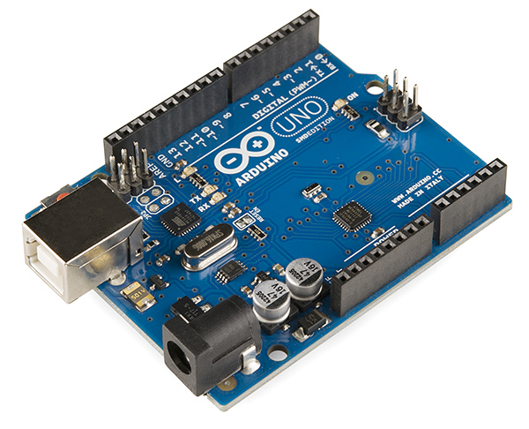

Arduino
Freek Pols

Slide 2
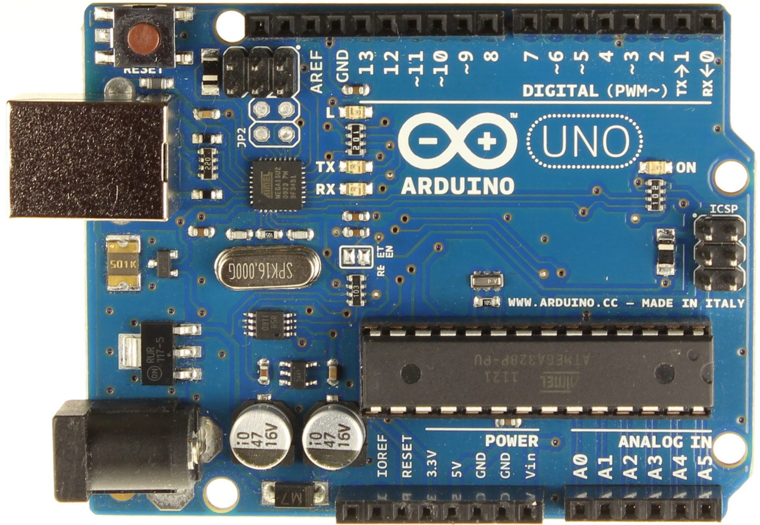
The Arduino
Pin in or out
usb
microcontroller
Power
supply
Voltage and 0 V
Analog in

Slide 3
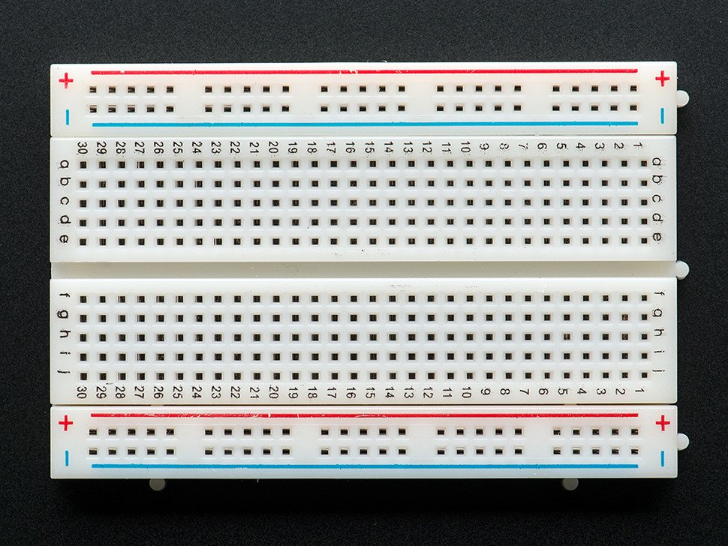
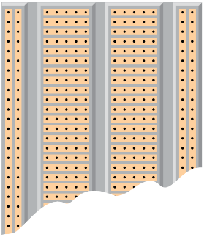
The breadboard
Row connected
Colom connected

Slide 4
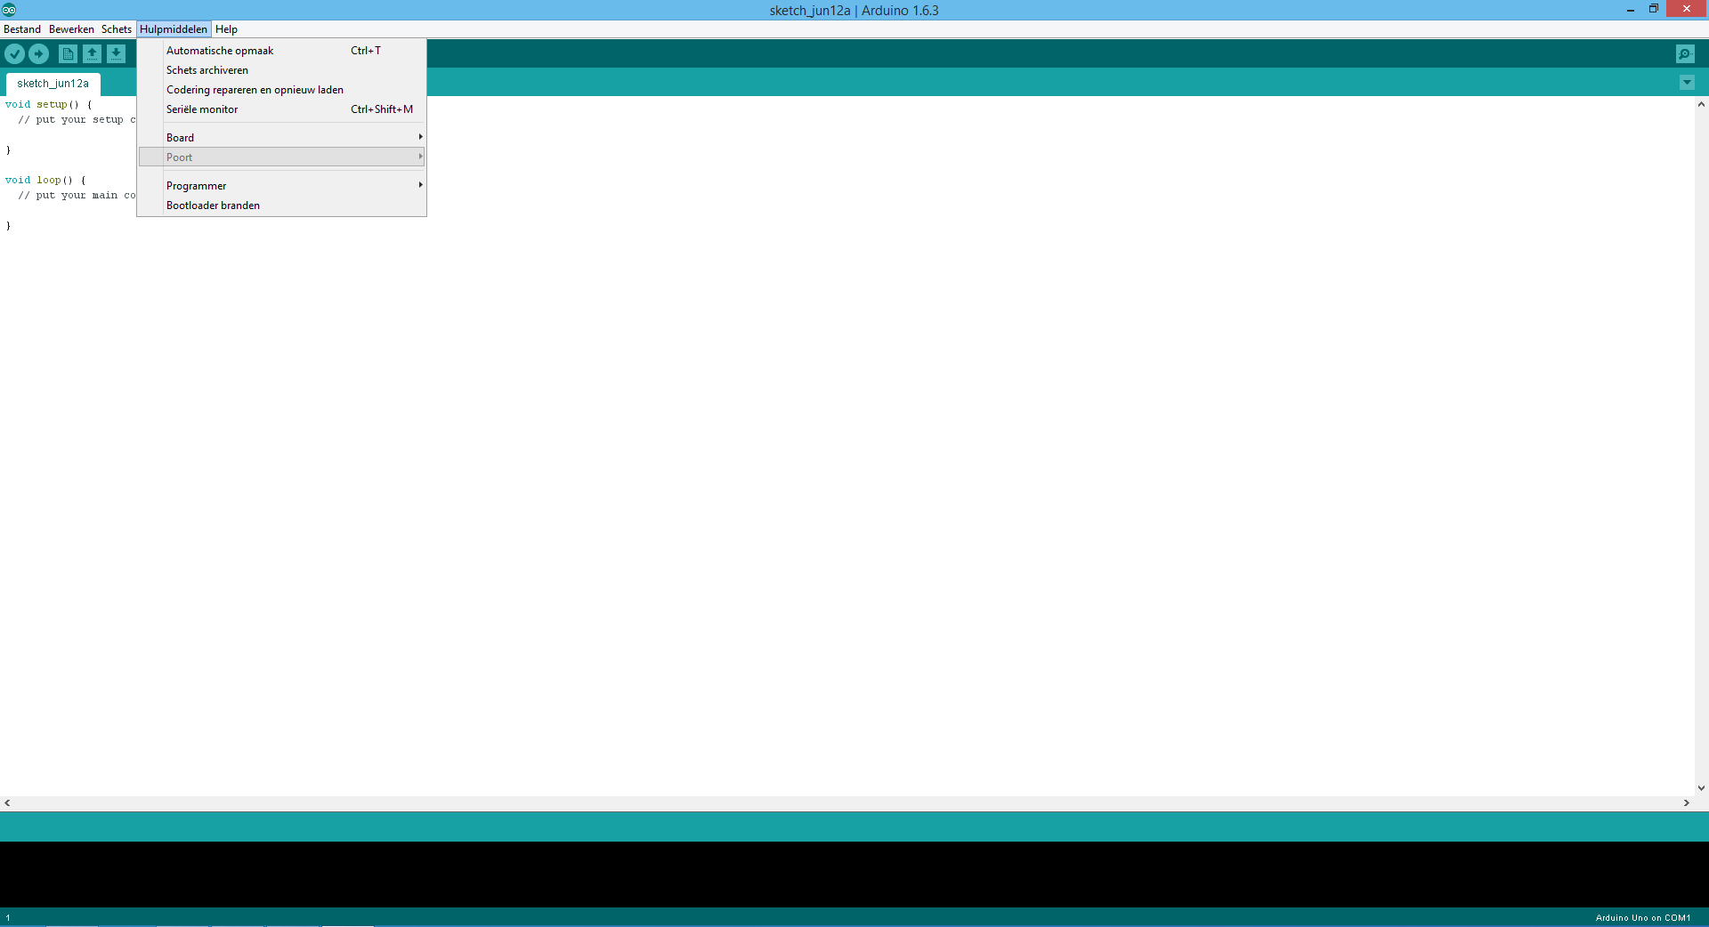
The coding environment
upload
compiling
Serial monitor
Com-poort

Slide 5
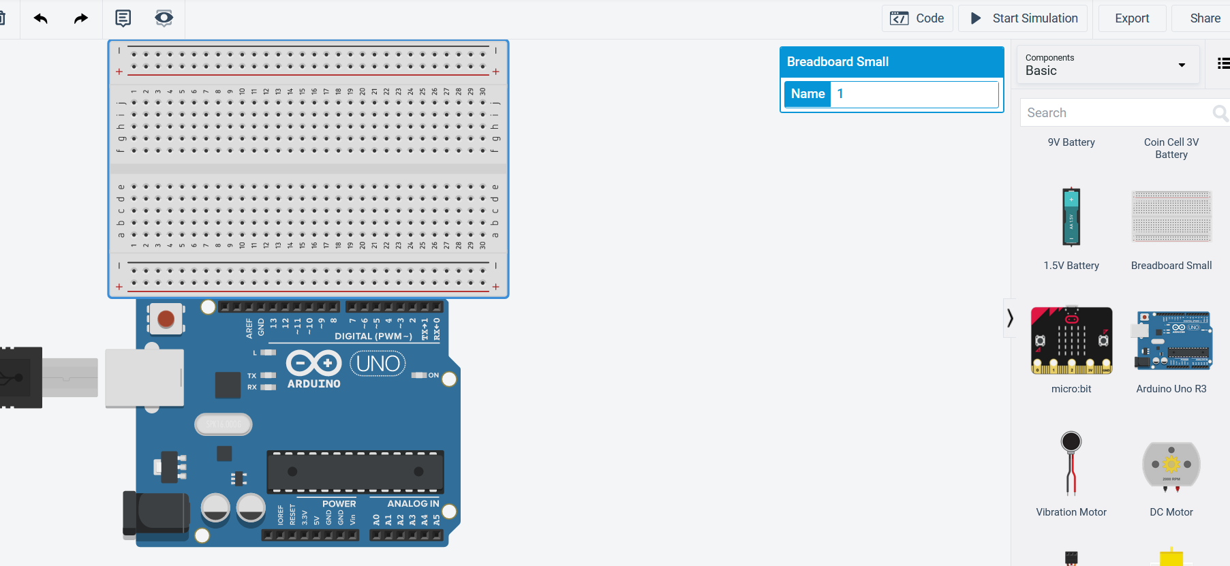
Tinkercad coding environment

Slide 6
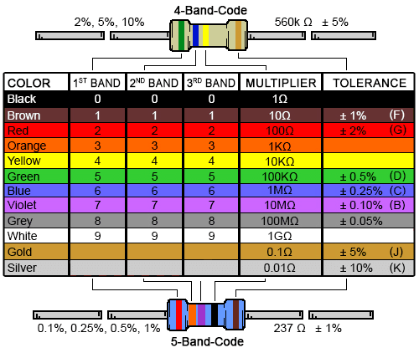
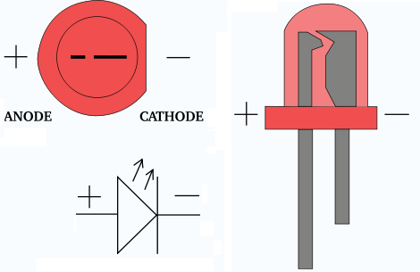
LED and resistors
A LED draws 20 mA (2,0V).
The applied voltage is 5,0 V.
So…

Slide 7
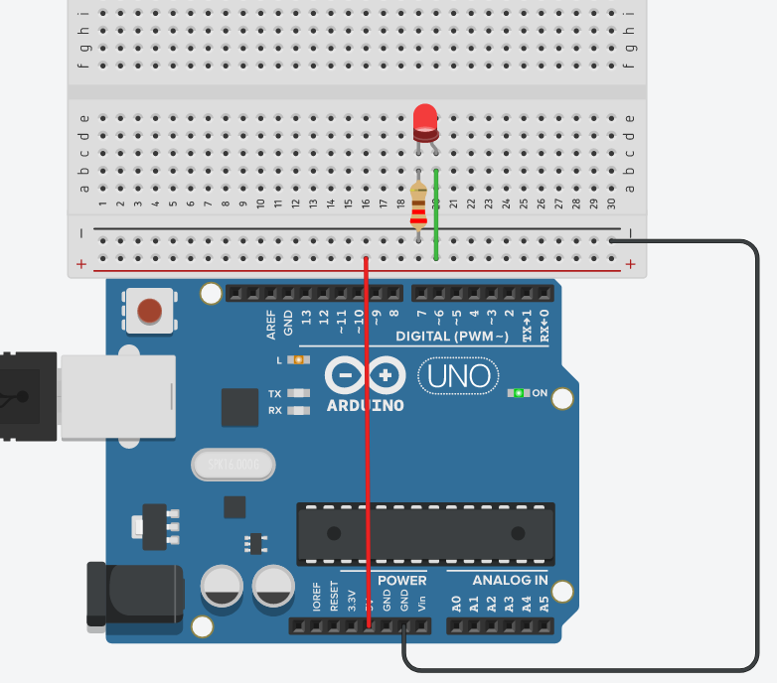
Assignment 1
Build the circuit.
Set the resistor to 220 Ω
Start the simulation (no code required)
Explain what is happening.

Slide 8
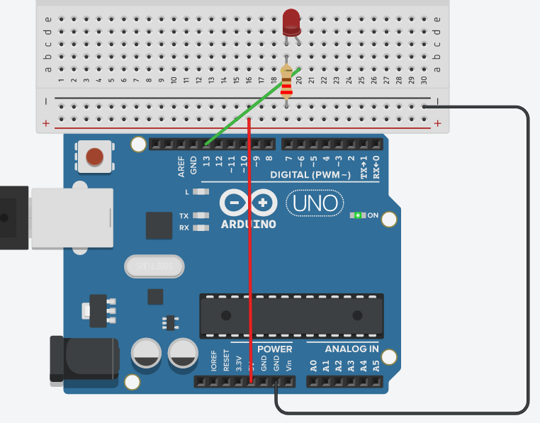
Assignment 2
Build the circuit.
See that the 5V is not used!
Copy + paste the Blink code in the code environment
Start the simulation.
Change the code so the LED blinks faster.

Slide 9
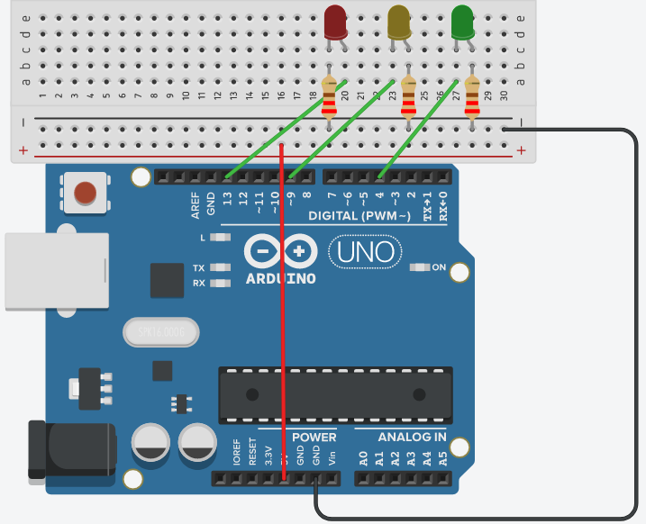
Assignment 3
Expand the existing circuit to the one you see here.
Write your code so all three LEDs can be controlled.
Make a trafficlight.

Slide 10
Code
Arduino code consist of three / four parts
Define variables before the setup
Setup which runs a single time
An infinite loop
Functions
Code explained
int rodeled = 13;
void setup() {
// initialize digital pin 13 as an output.
pinMode(rodeled, OUTPUT);
}
void loop() {
digitalWrite(rodeled, HIGH);
delay(1000);
digitalWrite(rodeled, LOW);
delay(1000);
}

Slide 11

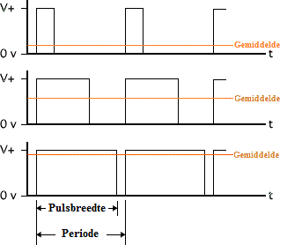
PWM ~
Pin 3, 5, 6, 9, 10 & 11 are PWM pins
PWM stands for Pulse Width Modulation
The output voltage is controlled by PWM

Slide 12
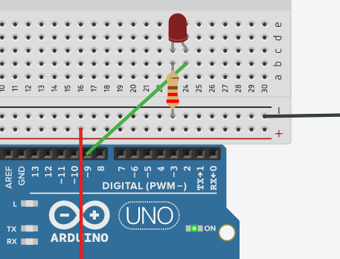
Assignment 4
Copy the Fade code.
Connect the LED to pin 9.
Change your code so the cycle is shorter.
Why do we use analogWrite()?

Slide 13
Code
int led = 11;
int brightness = 0;
int fadeAmount = 5;
void setup() {
pinMode(led, OUTPUT);
}
void loop() {
analogWrite(led, brightness);
brightness = brightness + fadeAmount;
if (brightness == 0 || brightness == 255) {
fadeAmount = -fadeAmount ;
}
delay(30);
}
int is an integer and refers to pin (11) or to a variable which is used.
This variable can be used throughout your code.
In the setup we define whether our variable is an out/input pin.
Explaining the code.

Slide 14
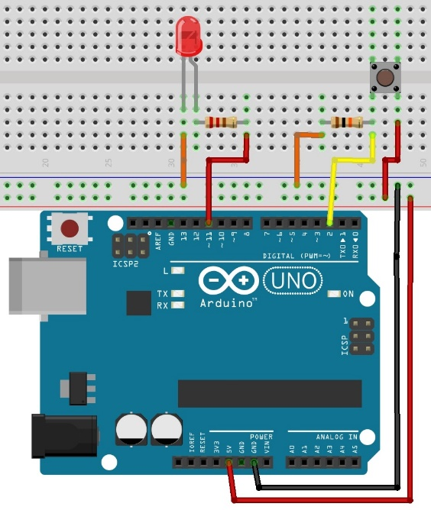
Assignment 5
Build the circuit.
Copy & paste the script Button.
Explain the code and what is happening when you push the button.

