Slide 1
Summer 2026
Tim Zhao

Slide 2
HSX Goal
From the previous experiment
The Hall-effect sensor produced output aligned with the plasma dynamics and energy
But, we don’t know anything else (magnetic field value, orientation, temperature noise, offset)
Next experiment
A 3D magnetic field sensing cube (3 Hall-effect sensors)
Three current-spinning and amplification readout circuit for a bandwidth of 10 kHz
Dynamic biasing current source

Slide 3
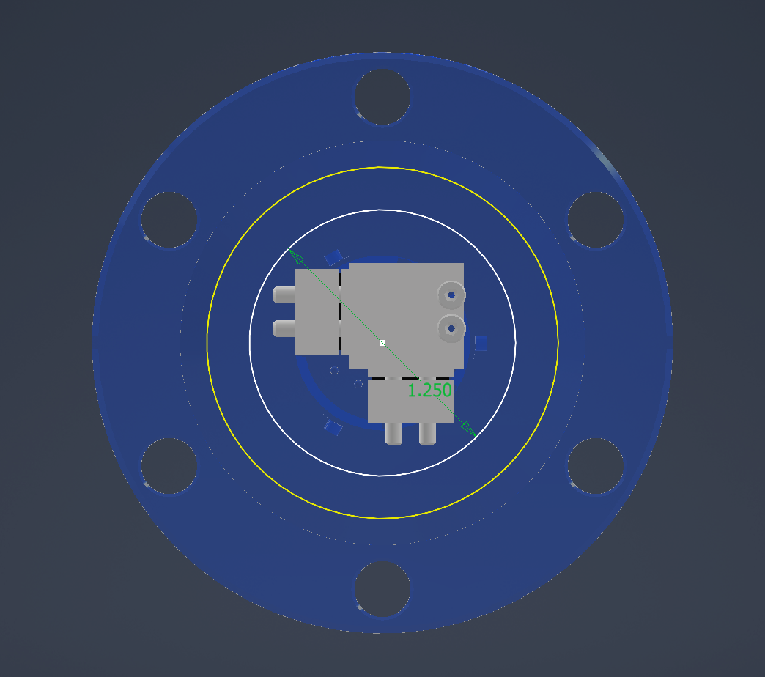
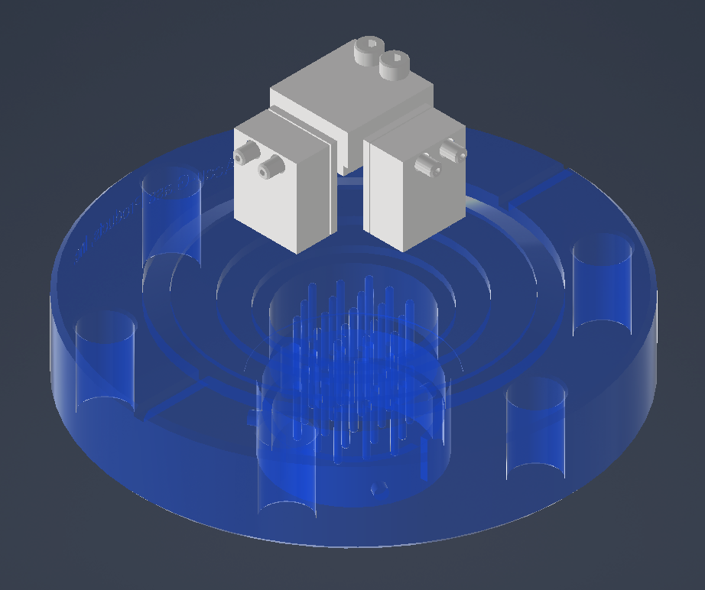
Another 3D package design (still in progress)

Slide 4
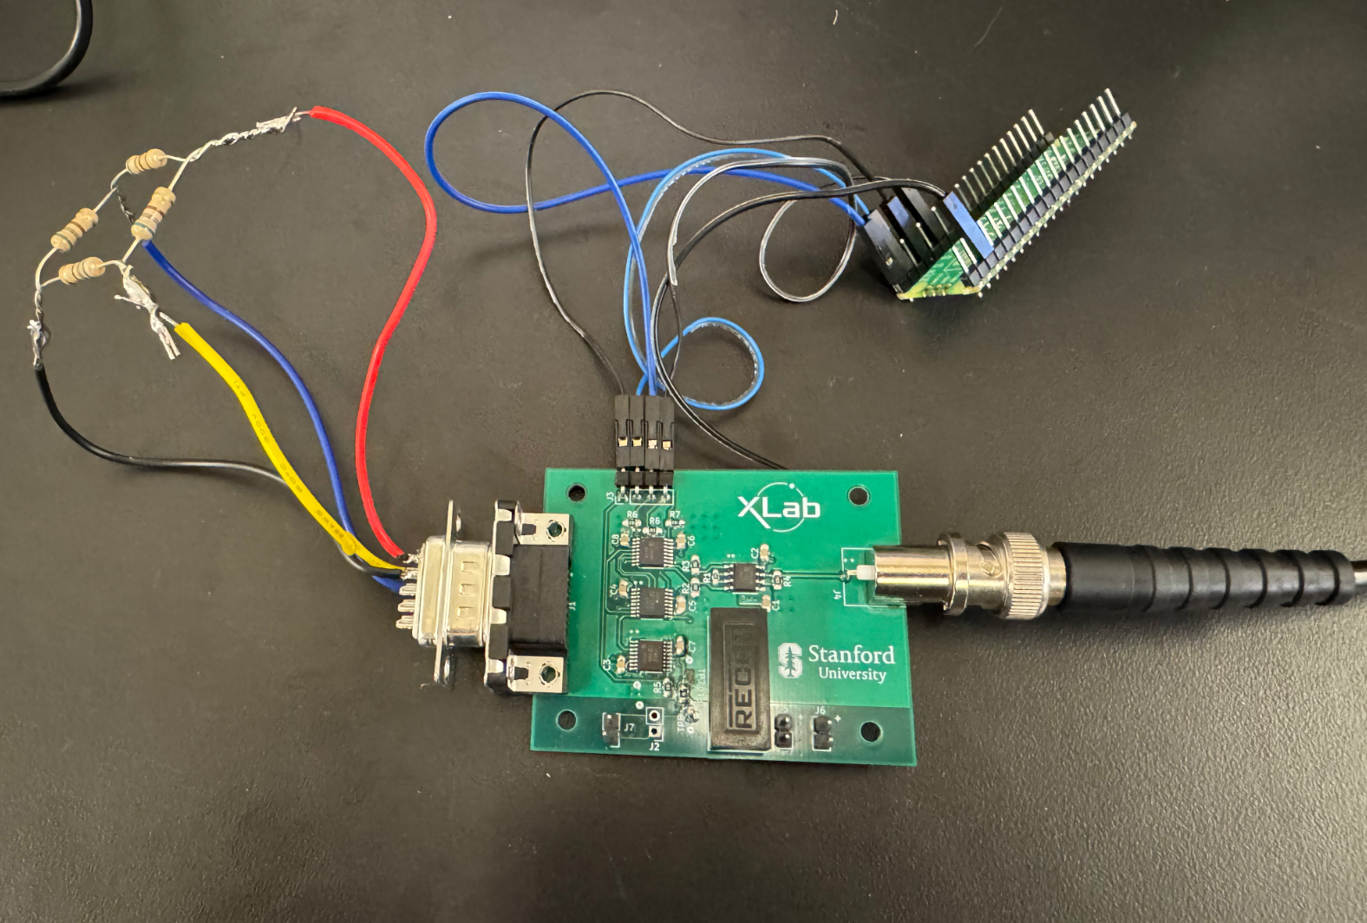
Current Spinning
Resistor bridge
Switching network
Amplifier

Slide 5
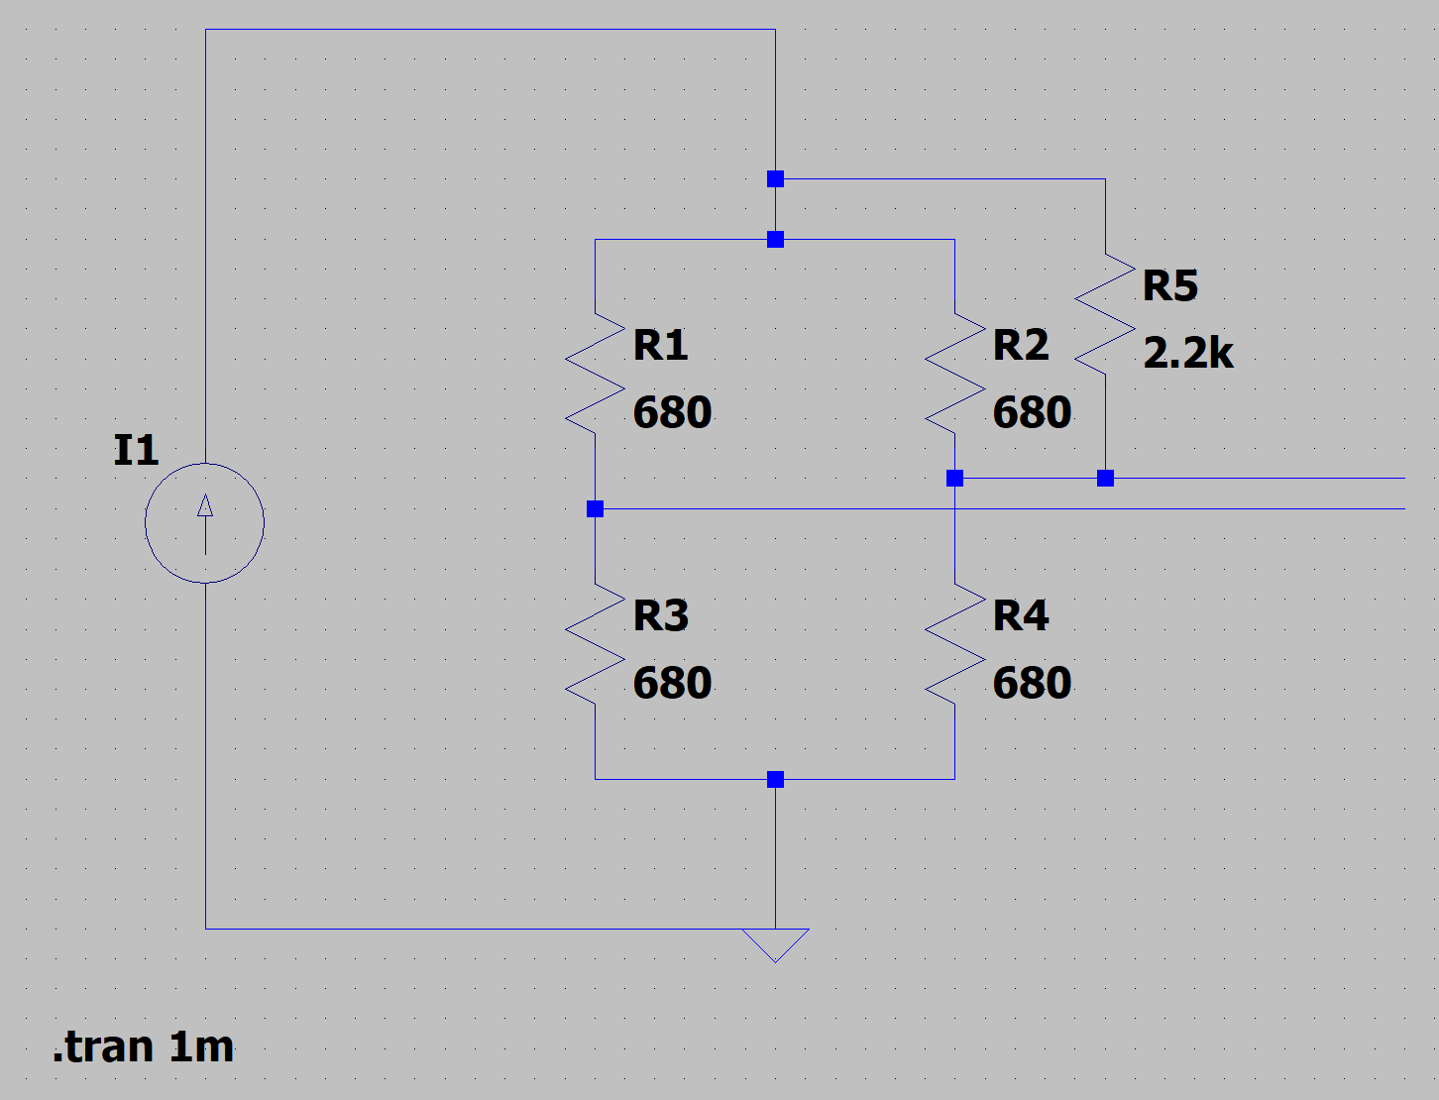
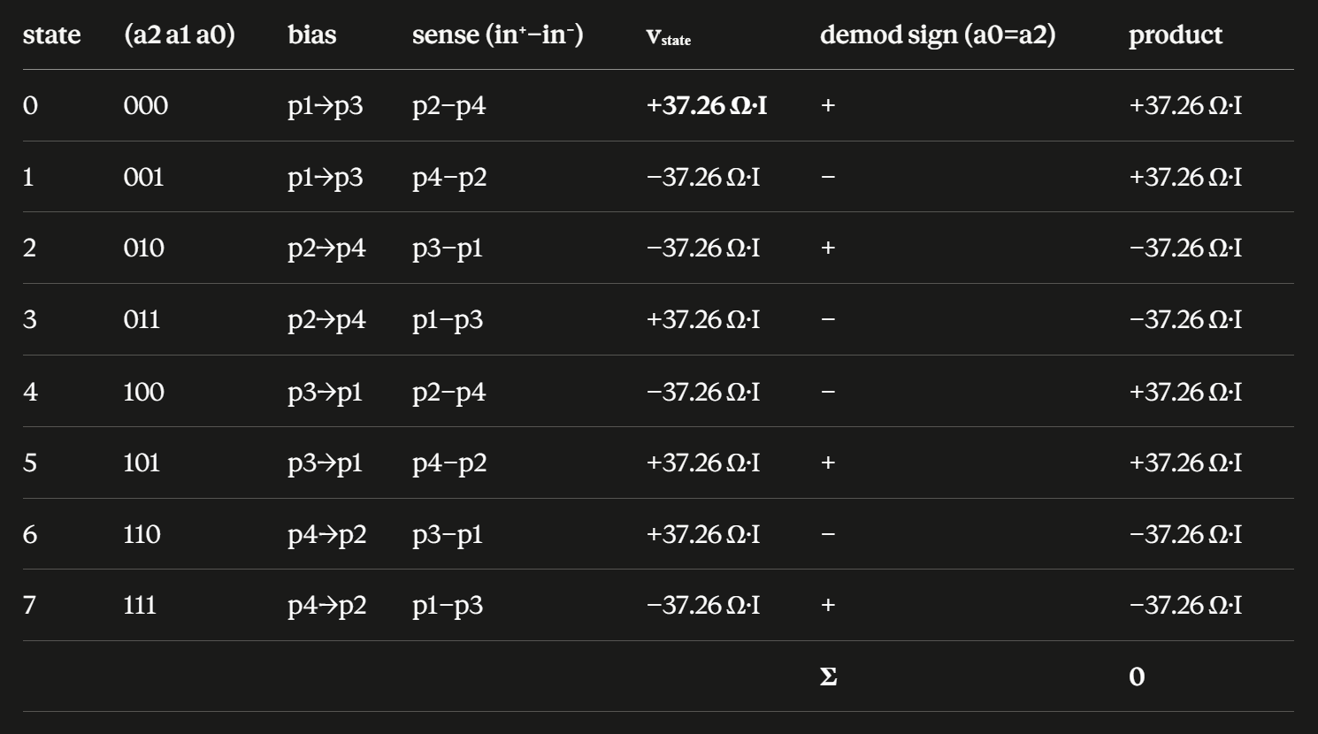
Resistor bridge

Slide 6
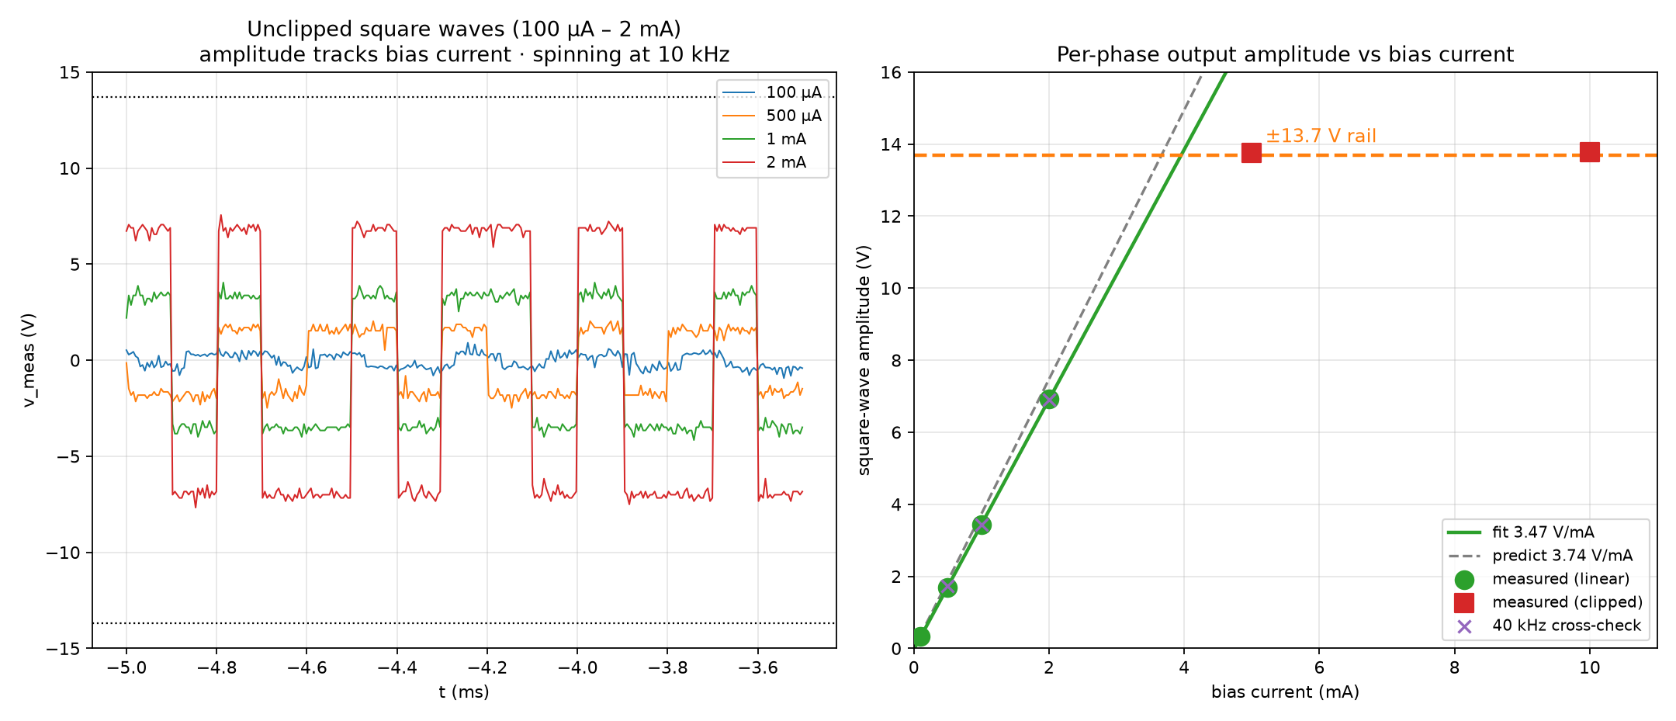
Results — bias sweep at 10 kHz spinning

Slide 7
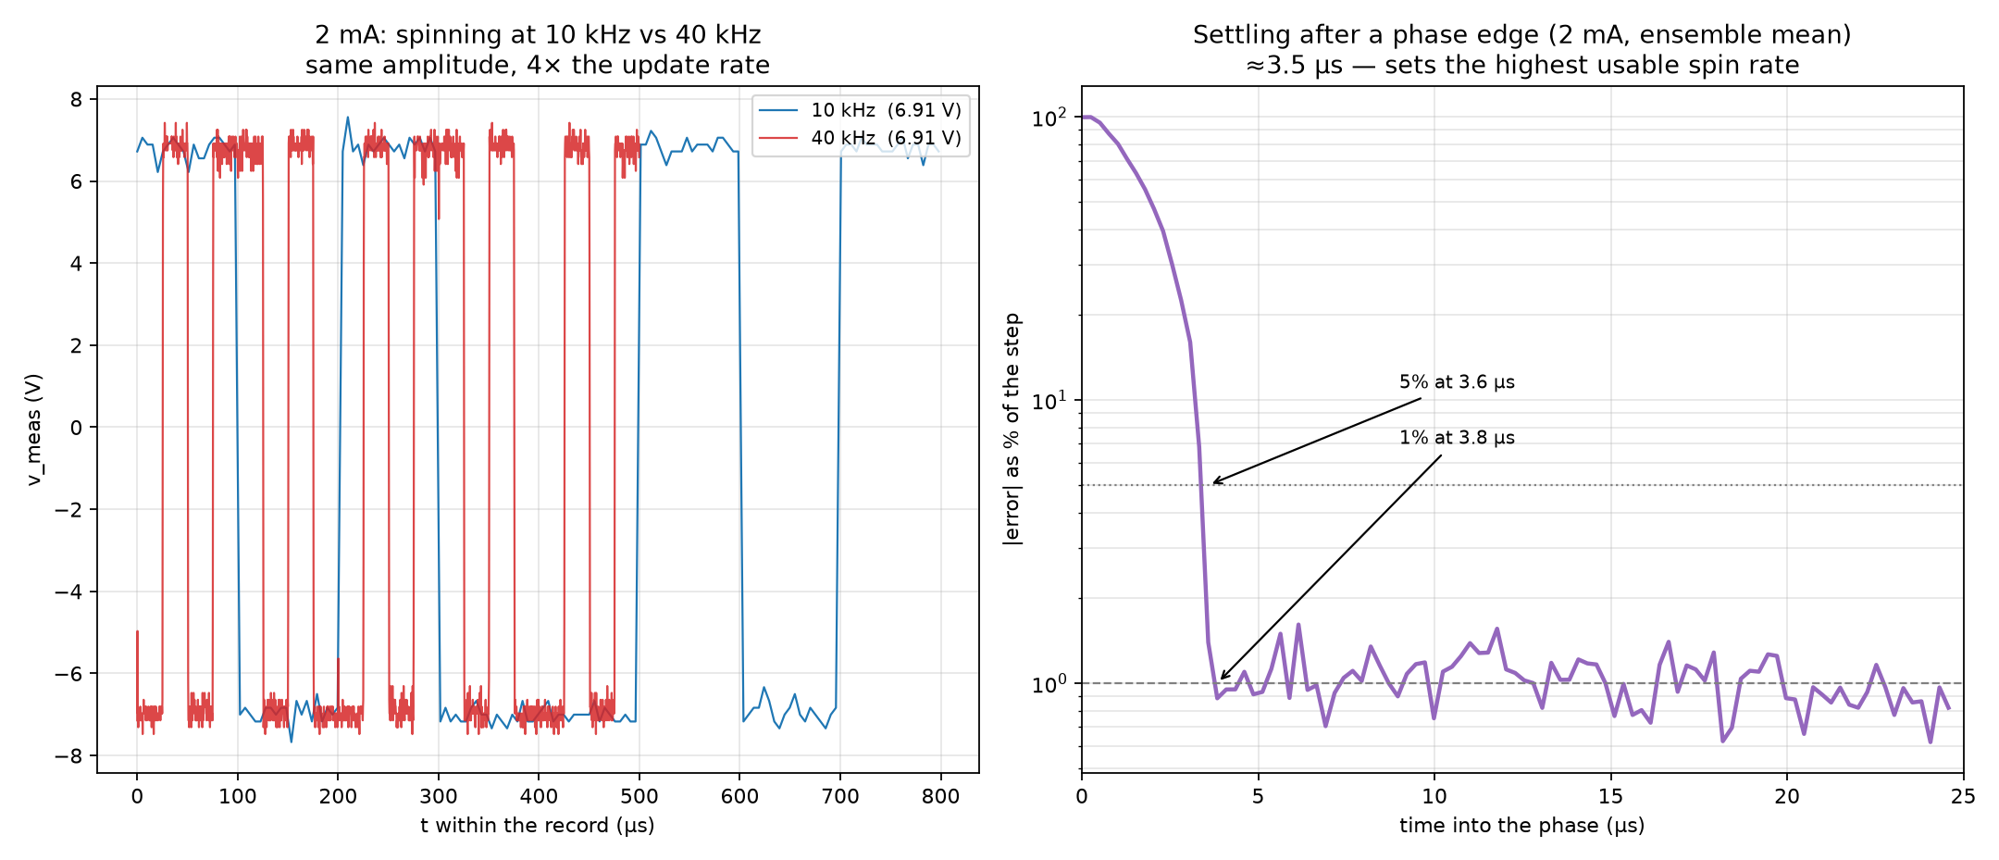
Spinning frequency: 10 kHz vs 40 kHz

Slide 8
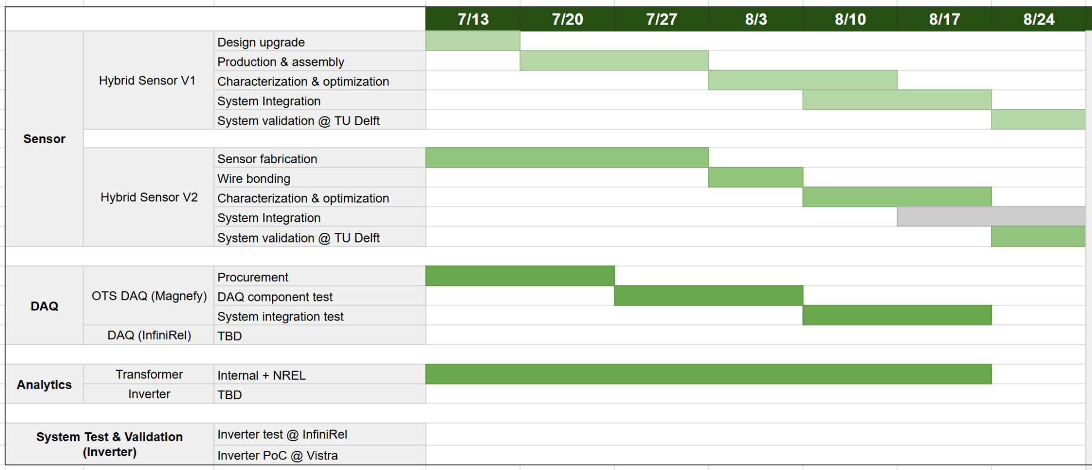
Magnify
I will have the RTA Training on Friday

Slide 9
Thank you

