Slide 1
CAPSTONE SYSTEM IT AUDIT ENGAGEMENT
IT Audit of the MCST Library Management System (MCST LMS)
Final Integrated Professional IT Audit Report - Labs 7-12
Evidence cutoff 2026-10-10 | Audited builds BLD-04/BLD-05 | Report 1.0 Final, 2026-10-20
404NotFound
Justin C. Batlangao
Glenn Patrick B. Darriguez
Ma. Jenifer L. Labag
Findings and Report Lead
Evidence and Root-Cause Analyst
Recommendation and Action-Plan Analyst
Notes:
[Justin C. Batlangao]
Good day, everyone. We are 404NotFound — Justin Batlangao, Glenn Darriguez, and Jenifer Labag. For our capstone, we audited our own system: the MCST Library Management System, which we built for the MCST Library under Head Librarian Calixto Nicolas Camangeg, the system owner.
We tested our own capstone the way an external audit team would — with written criteria, sampled tests, and dated evidence. This is our Final Integrated Professional IT Audit Report, covering Labs 7 to 12. Our evidence closes on October 10, 2026; it covers audited builds BLD-04 and BLD-05; and the report is version 1.0 Final, dated October 20.
Over the next fifteen minutes we will show you what we audited, what we tested, what we found, and what we recommend. Let us begin with how the engagement came together.

Slide 2
Our Audit Journey - and Who Presents What
Six laboratory milestones built one continuous engagement from scope to conclusion
7
8
9
10
11
12
Lab 7
Lab 8
Lab 9
Lab 10
Lab 11
Lab 12
Scope + objectives + criteria
Assets + flows + accounts
Risks + compliance
Controls + tests + gaps
Findings + actions
Final integration
2026-09-19
2026-09-26
2026-10-03
2026-10-03
2026-10-10
2026-10-20
Justin
Glenn
Justin
Glenn
Ma.
Ma.
One continuous engagement: every lab shares the same system, build records, and ID families (OBJ / RSK / CTL / TEST / GAP / FND).
This deck covers: what we audited, what we tested, what we found, what we recommend, and our conclusion.
Every claim traces to evidence we collected - we will show the chain, not the paperwork.
Presenter: Justin C. Batlangao
Notes:
[Justin C. Batlangao]
Our audit was not six separate homework pieces — it is one continuous engagement across six labs, each dated, each building on the last. Lab 7 set scope, objectives, and criteria on September 19 — that is mine. Lab 8 mapped assets, data flows, and accounts on September 26 — Glenn. Lab 9 scored risks and compliance on October 3 — Justin again. Lab 10 evaluated controls, tests, and gaps, also October 3 — Glenn. Lab 11 produced findings and action plans on October 10 — and Jenifer, who also presents today's final integration from Lab 12.
One thread holds it all together: every lab shares the same system, the same build records, and the same ID families — OBJ, RSK, CTL, TEST, GAP, FND. When you hear a number today, it traces to that same family in the final report.
One last point: everyone built and cross-checked in every lab. Today we divided the telling, not the doing.
Q&A cue: 'who did what' — each member created their own content, cross-reviewed another member's work, and contributed to every lab.

Slide 3
The System We Audited
Client: MCST Library (Head Librarian Calixto Nicolas Camangeg) | Our own capstone build - audited like an external team would
Flask 3.1 web app: catalog, borrowing, fines, requests, buying, stock check, reports (MOD-01..08)
Real library workflow: request -> buy -> add -> borrow/return -> fines -> stock take
PostgreSQL on Render + timed pg_dump backups
Key data: book catalog + copies, borrower records, loans and fines, audit trail
Google school-email login (@mcst.edu.ph) with role checks per page
Runs on local demo + Render test site - demo evidence only, honestly stated
Users: students / faculty borrow; desk staff circulate; admins manage
That is why we could show every code path transparently
Build lineage - real git history, frozen before every lab
BLD-01 @ 71e0d30
>
BLD-02 @ 82075e8
>
BLD-04 @ 7b9b680
>
BLD-05 @ 5ca2c79
>
BLD-06 @ c20f98e
Sep 19
Sep 26
tests, Oct 3
confirmations, Oct 10
POST-CUTOFF - excluded
Presenter: Justin C. Batlangao
Notes:
[Justin C. Batlangao]
What exactly did we audit? The MCST LMS is our own Flask 3.1 web application — catalog, borrowing and returns, fines, requests, buying, stock count, and reports, modules MOD-01 to MOD-08 — running PostgreSQL on Render with timed pg_dump backups, and Google school-email login restricted to @mcst.edu.ph, with role checks on every page. Students and faculty borrow; desk staff circulate; admins manage.
Because we own the code, we could give the audit full transparency — every code path, every screen. But we deliberately treated it like any external client: written criteria, sampled tests, dated evidence.
The build lineage on the right is real git history, frozen before every lab — BLD-01 through BLD-05. And note BLD-06, build c20f98e: it came after our October 10 evidence cutoff. It is excluded from our conclusions and disclosed separately, as you will see later.
Q&A cue: 'why audit your own system?' — the partner benefit is real findings before live use; integrity is handled by evidence anyone can re-open (screenshots, git, logs).

Slide 4




Audit Objectives and Scope (Lab 7)
Four objectives supported by criteria CRT-01..04; scope approved with the library owner
OBJ-01
OBJ-02
Access control - only the right people reach the right pages
Build truth - the build really supports the library work we claim
SCP-01/05/06 | CRT-01
SCP-02/05/07 | CRT-02
OBJ-03
OBJ-04
Traceability - every borrow and change leaves a named record
Data safety - backup, settings, reports protect and hide secrets
SCP-02/04/05 | CRT-03
SCP-02/03/04 | CRT-04
In scope (safe procedures)
Out of scope / limits (SCP-03/04)
Records + code inspection, config review, walkthroughs, small demo tests - nothing changed or harmed
No attack testing, no live restore, no real student data - demo environment only, stated in every conclusion
Presenter: Justin C. Batlangao
Notes:
[Justin C. Batlangao]
Our four objectives came from Lab 7 and were approved with the library. OBJ-01: access control — only the right people reach the right pages, with rights granted by the Access Approver, ORG-02. OBJ-02: build truth — the frozen build really supports the library work we claim. OBJ-03: traceability — every borrow, fine, and change leaves a named record. OBJ-04: data safety — backup, settings, and reports protect data and hide secrets.
Each objective anchors to written criteria, CRT-01 to CRT-04. For example, CRT-01 requires role rules in code, a roles table, and school approvals; CRT-03 requires thin pages, POST-only writes, and audit-trail rows.
Our procedures stay inside safe boundaries: records and code inspection, configuration review, walkthroughs, and small demo tests — nothing changed, nothing harmed. We did not do attack testing, live restores, or touch real student data. Demo environment only — and that limit is stated in every conclusion we make.
Q&A cue: 'why no attack test?' — outside the approved procedures; we promised no over-claim and kept that promise.

Slide 5




How We Worked - Evidence First
Same method through Labs 7-12; every result carries an ID chain
1
2
3
4
Inspect
>
Walk through
>
Test
>
Review
records, code paths, configuration
real screens in the demo build
10/10 pages, CSV file, loan cycle, backup log
each member cross-checked + challenged
EVD-09/10/12/13 series
clean screenshots - no names
TEST-01..06 samples
REV-01..14 rows
AI used only for wording fixes, count double-checks, task clarifications - every suggestion validated against real records; never an evidence source (Portfolio AIV-01..06)
Presenter: Justin C. Batlangao
Notes:
[Justin C. Batlangao]
How did we work? The same four-step method through Labs 7 to 12, with every result carrying an ID chain. First, inspect — records, code paths, configuration, forming the EVD-09 and EVD-10 evidence series. Second, walk through — real screens in the demo build, screenshotted only after names are cleaned. Third, test — the TEST-01 to TEST-06 samples. Fourth — the discipline layer — every increment was cross-reviewed by another team member with a written challenge and a recorded resolution: the REV-01 to REV-14 log.
On AI: we used it only for wording fixes, count double-checks, and task clarification. Every suggestion was validated against real records, and it was never an evidence source. All six AI rows are disclosed in the portfolio, AIV-01 to AIV-06, with what we verified and what we revised.
Q&A cue: 'did AI write your audit?' — no; it shortened sentences and re-checked math; every AI row carries Accept/Revise plus what was verified.

Slide 6
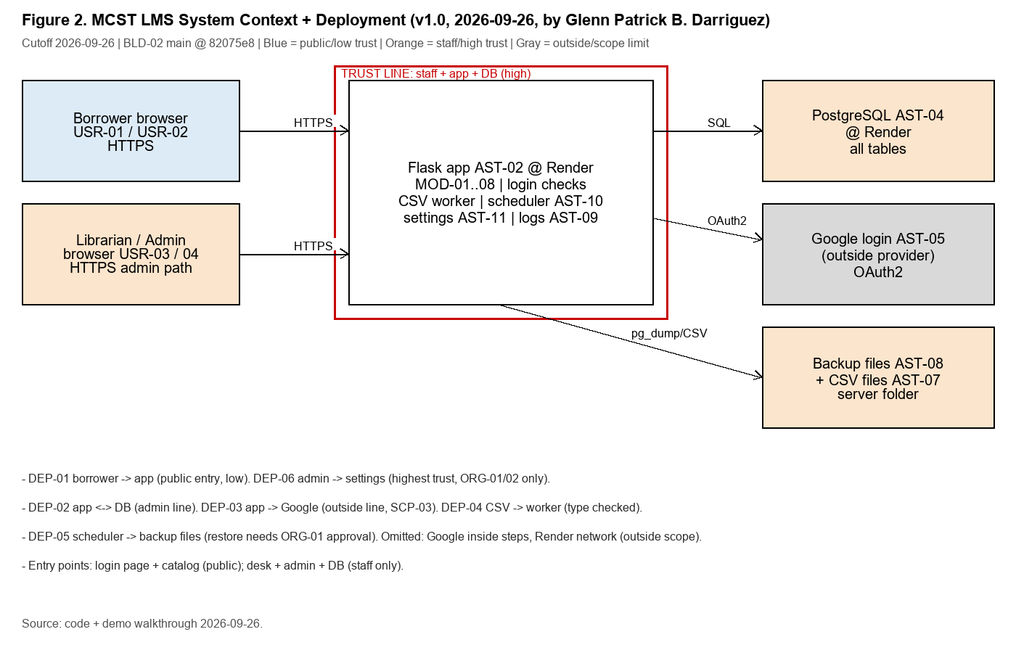
Architecture and Trust Boundaries
Figure 2 from the report: Flask app, PostgreSQL, Google OAuth, Render (DEP-01..06)
6
trust boundaries mapped: public entry, DB line, Google line, staff upload path, backup path, admin path
7
account types registered; one-time bootstrap admin was closed and verified (ACC-07)
Secrets live in environment config - never in the app, never in this report
Each line names its evidence source (DEP-01..06)
Presenter: Glenn Patrick B. Darriguez
Notes:
[Glenn Patrick B. Darriguez]
Now the system underneath — Figure 2 of our report. Walk the picture with me. A borrower connects over HTTPS to the Flask application. Behind the app, it talks SQL only to PostgreSQL. Google sits outside as an identity provider — it proves who you are; it never touches library data. On the platform side, a scheduler copies the database on a timed pg_dump, and administrators change settings through the highest-trust path.
That is six trust boundaries mapped and named, DEP-01 to DEP-06: public entry, the database line, the Google line, the staff upload path, the backup path, and the admin path.
Three points to hold. There are seven registered account types, and the one-time bootstrap admin used for first setup was closed and verified — that is ACC-07. Secrets — database URLs, OAuth keys — live only in environment configuration: never in the app code, never inside this report. And every line on this map names its evidence source.
Q&A cue: 'what protects the database?' — env-held credentials plus the admin-only path (DEP-02); provider-side access follows school/provider rules.

Slide 7
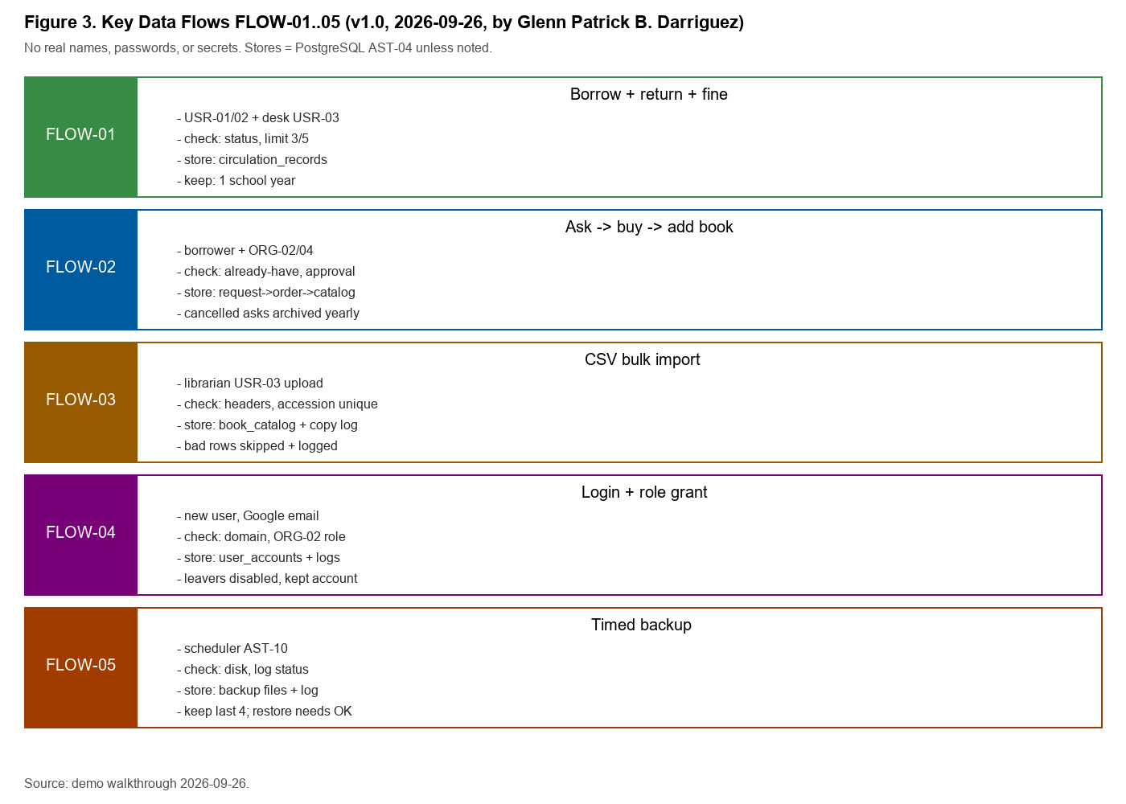
How Data Moves Through the Library
Figure 3 from the report: five flows with validation, storage, and retention rules (FLOW-01..05)
FLOW-01
borrow/return/fine: limits (3/5), fine = rate x days late, archive-before-delete
FLOW-03
CSV import: header map + required fields; bad rows skipped + logged
FLOW-04
login: school email only; first-login admin closed after setup
Every flow has validation, store, channel, and a written retention rule
Presenter: Glenn Patrick B. Darriguez
Notes:
[Glenn Patrick B. Darriguez]
Figure 3 shows how data moves through the library, across five flows, FLOW-01 to FLOW-05. FLOW-01 is the heart: borrow, return, and fines — borrowing honors the limits of three books for students and five for faculty, the fine is the rate times days late, and deletion is archive-before-delete, never a hard erase of an active record. FLOW-03 is the CSV import: headers must map, and bad rows are skipped — not half-inserted — with every skip logged. FLOW-04 is login: school email only through Google, and the first-login bootstrap admin closes after setup.
Every flow carries written rules for validation at entry, where data is stored, which channel it moves over, and how long it may be kept. And notice the in-line checks: a can-borrow check before a loan, unique accession numbers before a copy is added, approval before a purchase is bought.
One flow to remember: borrower data sits in PostgreSQL, and its views should be role-limited under CMP-01 and CMP-02. The weak part of that picture is Finding FND-03 — coming up.
Q&A cue: 'where does borrower data sit?' — PostgreSQL (AST-04); views should be role-limited per CMP-01/02 — the weakness is FND-03.

Slide 8
What Could Go Wrong - Risk Profile (Lab 9)
8 risks scored Likelihood x Impact; 3 High priorities drive our findings
Residual score (Inherent x Impact, after safeguards)
3
High priorities: RSK-01, RSK-04, RSK-07 - they become our three findings
Residuals only drop for safeguards proven in the build (e.g., backup log proves RSK-04 impact drops 5 -> 4); unmatched safeguards change nothing. Compliance base: Data Privacy Act + school access rules (CMP-01..07).
Presenter: Justin C. Batlangao
Notes:
[Justin C. Batlangao]
What could go wrong? Lab 9 scored eight risk scenarios — likelihood times impact — adjusted for the safeguards we could actually see in the build. Three are High priority. RSK-01: account takeover — a leaked staff password meets no second check; residual sixteen of twenty-five. RSK-04: recovery unproven — backups are logged, but a restore was never demonstrated; residual eight. RSK-07: borrower data exposed through wide staff views and an open export path. Those three drive our three findings.
Two principles in our scoring. First: residuals only drop when a safeguard is proven in the build — the backup log is real, so RSK-04's impact drops from five to four. Second: unmatched safeguards change nothing — RSK-05, a single-provider outage, has no verified safeguard, so nothing drops, and the owner accepts it with a paper control: manual desk steps for outage days.
Our compliance base is the Data Privacy Act of 2012 plus school access rules — CMP-01 to CMP-07.
Q&A cue: 'why is RSK-01 a 16?' — likelihood 4 x impact 4: passwords leak often and no second check exists; the mitigation is the second factor, aiming for 8.

Slide 9
Controls We Evaluated and What the Tests Showed (Lab 10)
8 controls CTL-01..08; 6 tests TEST-01..06 on build BLD-04 (Oct 3) - 4 Effective, 2 Partially Effective
TEST-01
Effective
TEST-02
Effective
Wrong-role entry on 10 pages
CSV upload with 2 bad rows
10 / 10 blocked - 0 exceptions
6 added, 2 skipped + logged
TEST-03
Effective
TEST-04
Effective
Borrow -> return -> fine cycle
Delete active vs archived book
Fine matched + 3 log rows
Active refused; archived allowed
TEST-05
Partially Effective
TEST-06
Partially Effective
Backup log Sep-Oct (14 runs)
Settings change + log
14/14 logged - NO restore proof
Logged with name - no approval step
All 6 tests: real procedures on the demo build, full populations where small (10 pages, 14 log rows, whole files); evidence EVD-12-01..05 saved clean.
Presenter: Glenn Patrick B. Darriguez
Notes:
[Glenn Patrick B. Darriguez]
With risks named, we looked for the controls that address them — eight controls, CTL-01 to CTL-08 — and tested six under TEST-01 to TEST-06 on build BLD-04, on October 3. Four came back Effective; two came back Partially Effective.
TEST-01, wrong-role entry: all ten role-gated pages blocked the intruder — ten out of ten, zero exceptions. TEST-02, CSV upload with two bad rows: six good books added, both bad rows skipped and logged. TEST-03, a full borrow-return-fine cycle: the fine matched the rate-times-days formula, and the audit trail logged the events. TEST-04, delete discipline: a delete on an active book was refused; the archived one was allowed.
Then the two partials. TEST-05, the backup log: fourteen runs, fourteen logged — perfect logs, but zero proof any of them restore. TEST-06, settings changes: the change is logged with a name — but there is no approval step before it takes effect.
A word on honesty: these are real populations, not cherry-picked samples — all ten pages, the whole fourteen-row log, the entire CSV. Small system, full coverage. The two partials line up with gaps GAP-02 and GAP-05 — and those gaps are exactly where two of our three findings come from.
Q&A cue: 'does Partially Effective = failed?' — no: the control partly works (backups run and are logged) but misses the objective — restore proof, approval step.

Slide 10
Key Findings - Three High Items
From Lab 11 screening: 5 candidates -> 3 formal findings + 1 observation + 1 close (evidence-checked)
FC-01
FC-02
FC-03
FC-04
FC-05
Finding -> FND-01
Finding -> FND-02
Observation (OBS-01)
Finding -> FND-03
Close (compensated)
FND-01
HIGH
FND-02
HIGH
FND-03
HIGH
Staff Login Without Second Check Allows Full Account Takeover
Restore Never Tested, So Recovery Is Unproven
Wide Staff Views and Open Export Path Expose Borrower Data
Not every gap became a finding - FC-03 is fixable small (backlog); FC-05 is compensated by logging + monthly review. Honest screening, not finding inflation.
Presenter: Ma. Jenifer L. Labag
Notes:
[Ma. Jenifer L. Labag]
From all that evidence, five finding candidates crossed our desk in Lab 11, and we screened each with four questions: is the evidence sufficient, is it material, is it inside our scope, and what exactly happened? Here are the honest answers.
FC-01 and FC-02 became findings FND-01 and FND-02. FC-03 is an observation, OBS-01 — a small fix backlog; not a finding, because it is fixable small and tracked, not hidden. FC-04 became FND-03. FC-05 is closed and compensated: the risk it described is already offset by logging plus a monthly owner review.
The result: three formal findings, all High. And we want to be explicit — not every candidate became a finding, because inflating the register would dilute the real ones. Materiality disciplined this list, and every one of the five screening decisions carries its evidence IDs.
Q&A cue: 'why not more findings?' — materiality: small items would dilute; they are tracked (OBS-01 backlog, FC-05 control note), not hidden.

Slide 11
Finding 1 - Staff Login Without Second Check
FND-01 | HIGH | RSK-01 residual 16 | evidence EVD-12-01 + EVD-13-01
Condition
No staff/admin login asks for a second check (screens confirm; BLD-05, Oct 10)
Why HIGH (severity rationale)
Residual risk 16 of 25; full loan + fine data at stake; single control failure on the main gate; affected: all borrowers + library staff
Criteria
CRT-01 + CMP-03 - access fits role AND login stops outsiders (approver ORG-02)
Cause
Second step never built (code read); small team, demo stage
Recommendation REC-01
Effect
One leaked password = full borrower/loan control - exposure, no breach seen
Access Approver (ORG-02) turns on a second check for staff/admin logins; target: stolen password alone fails - re-run TEST-01 + login tries
Limitation
No attack test allowed; stated on the workpaper
Presenter: Ma. Jenifer L. Labag
Notes:
[Ma. Jenifer L. Labag]
Finding one, FND-01 — and word care matters here, so follow the five steps. Condition: on BLD-05, no staff or admin login asks for a second check — the screens confirm it. TEST-01 was ten-for-ten on blocking the wrong role, but blocking the wrong role is not the same as stopping a stolen password. Criteria: CRT-01 and CMP-03 say access must fit the role and login must stop outsiders — ORG-02 is the approver in that line. Cause: the second step was never built; the code read shows no second step. Effect: one leaked staff password can read and change all borrower, loan, and fine data. We say exposure, not breach — nothing was lost or seen broken.
Why High: residual risk sixteen of twenty-five, full loan and fine data at stake, a single point of failure on the main gate, and every borrower and staff member affected. The limitation, stated on the workpaper: no attack testing was allowed.
The recommendation, REC-01: the Access Approver turns on a second check for staff and admin logins — the target is that a stolen password alone fails, and we re-run TEST-01 plus login attempts to prove it.
Q&A cue: '10/10 role tests passed — why still a finding?' — role checks stop the wrong people, not a thief with the right password; challenged in REV-13-02.

Slide 12
Finding 2 - Restore Never Tested
FND-02 | HIGH | RSK-04 intrinsic 10 -> residual 8 | evidence EVD-12-04
Condition
14/14 backup runs logged (Sep-Oct) - but ZERO restore demonstrations exist
Why HIGH - severity rationale
A backup log proves copies exist, NOT that they work. If recovery fails once, the loss is total - all loans + catalog. Team challenged: kept High on effect, not score alone (REV-13-01)
Criteria
CMP-05 + CRT-04 - copies exist AND recovery is possible with approval
Cause
Restore needs live approval; never scheduled (owner inquiry + no record)
Recommendation REC-02
Effect
If the database is lost, desk work may stop for days; loans/catalog may be unrecoverable
System Admin (ORG-03) runs ONE witnessed restore on a test copy + files approved restore steps; verified by reading the restore log
Limitation
Restore itself was out of scope (SCP-03) - our conclusion: identify it, not test it
Presenter: Ma. Jenifer L. Labag
Notes:
[Ma. Jenifer L. Labag]
Finding two, FND-02 — the restore provability point. Condition: fourteen of fourteen backup runs are logged for September and October, completed status — and zero restore demonstrations exist anywhere. Criteria: CMP-05 with CRT-04 requires more than copies; it requires that recovery is actually possible with approval. Cause: a restore needs owner approval and test data, and it was never scheduled — the owner confirmed that, and our search found no record. Effect: if the database dies, desk work may stop for days, and loans and the catalog may be unrecoverable.
Why High: because a backup log proves copies exist — it proves nothing about them coming back. If recovery fails once, the loss is total: every loan, every catalog record. This was the item our cross-review challenged hardest — REV-13-01 — and we kept it High on effect, not on the score alone.
And the safety point: restoring the live database was outside our approved scope — that is SCP-03 — so the remedy itself stays safe. REC-02: the System Admin runs one witnessed restore onto a test copy, files the approved steps, and verification is simply reading the restore log. One admin hour: the cheapest fix in this report, and the largest single step in assurance gained.
Q&A cue: 'why not restore the real DB?' — out of approved scope; the test-copy exercise gives the proof without touching live data.

Slide 13
Finding 3 - Borrower Data Exposure
FND-03 | HIGH | RSK-07 + CMP-01/02 (Data Privacy Act context) | EVD-10-02/03 + EVD-13-02
Condition
Staff roles open FULL borrower rows (name, school ID, fines); reports show names; export path has no extra rule
Why HIGH
Many students affected + real privacy-law obligations; passing TEST-01 does not clear it: getting IN vs seeing WIDE are different questions
Criteria
CMP-01/02 + CRT-01 - private data only for need-to-know roles; names hidden in reports
Cause
Views built for desk speed; export path never fenced (code read)
Recommendation REC-03
Effect
Curious or rogue staff could read/copy many student records - exposure; no misuse seen
Privacy role (ORG-05) narrows views to need-to-know, hides names in reports/exports, turns on an export log
Limitation
Full export was never tested (not allowed); conclusion rests on views seen + missing rule
Presenter: Ma. Jenifer L. Labag
Notes:
[Ma. Jenifer L. Labag]
Finding three, FND-03 — borrower data exposure. Condition: staff roles open full borrower rows — name, school ID, fines — on desk screens; reports show names; and the export path has no extra rule between the staff role and the file. Criteria: CMP-01 and CMP-02 — the Data Privacy Act line and the school borrower-privacy practice — with CRT-01: private data only for roles with a genuine need to know, and names hidden in reports. Cause: the views were built for desk speed, and the export path was never fenced — the code read found no rule. Effect: a curious or rogue staff member could read or copy many student records. Again — exposure; we saw no misuse.
Why High has a two-part answer: many students are affected, and real privacy-law obligations attach. And note this does not conflict with TEST-01 passing — getting in and seeing wide are different questions. Role checks close the door; they do not narrow the room. Limitation: full export was never tested — we had no right to try.
REC-03: the Privacy role narrows views to need-to-know, hides names in reports and exports, and turns on an export log.
Q&A cue: 'can staff export everything today?' — we did not test export (SCP); the finding rests on wide views seen plus no export rule found; wording softened accordingly.

Slide 14
How Conclusions Stand on Evidence - The Chain
Example: FND-01 traced end-to-end; every finding has the same chain in the report
1
2
3
4
5
TEST-01
>
EVD-12-01 / EVD-13-01
>
GAP-01
>
FND-01
>
REC-01 / MAP-01
10/10 wrong-role blocked; no second step visible
clean screenshots, dated, sanitized
missing control identified (CTL-01/CTL-02)
condition + criteria + cause + effect + severity
rule-focused action, owner + target set
Same chain for FND-02 (TEST-05 -> EVD-12-04 -> GAP-02) and FND-03 (TEST-01/EVD-10/13 -> GAP-04).
20 evidence items indexed in the final report (EVD-09-01 .. EVD-13-02) - each with source, date, privacy treatment, and written limitation.
Evidence protection: names hidden, counts only, secrets excluded - nothing sensitive leaves the controlled folder.
Presenter: Glenn Patrick B. Darriguez
Notes:
[Glenn Patrick B. Darriguez]
So how do our conclusions stand on evidence? Here is FND-01 traced end to end — and every finding carries the same chain. Step one, TEST-01: ten out of ten wrong-role visits blocked, and no second step visible on any login screen. Step two, that behavior is locked into evidence — EVD-12-01 and EVD-13-01 — clean, sanitized, dated screenshots tied to the build. Step three, the gap is identified as GAP-01 against controls CTL-01 and CTL-02. Step four, FND-01 is written up in full: condition, criteria, cause, effect, severity. Step five, the response is set — REC-01 with owner and result target — tracked as MAP-01.
FND-02's chain runs TEST-05 to EVD-12-04 to GAP-02. FND-03's runs through TEST-01 and the EVD-10 and EVD-13 series to GAP-04.
In total, twenty evidence items are indexed — EVD-09-01 through EVD-13-02 — each with its source, date, privacy treatment, and written limitation. And one more thing: evidence protection. No names, counts only, secrets excluded — nothing sensitive ever left the controlled group folder. Ask us for any ID, and we can show you exactly the condition we saw.
Q&A cue: 'could screenshots be faked?' — screenshots are only part; the role test uses live behavior, the backup log comes from the system itself, and dates/git tie everything to builds.

Slide 15
What We Recommend - and Honestly, What It Is Not Yet
Roadmap: 3 actions, owners, priorities, target results - status: Proposed (library not yet confirmed)
REC-01 | MAP-01
High
REC-02 | MAP-02
High
REC-03 | MAP-03
High
Second login check for staff + admin accounts
One witnessed restore on a test copy + filed steps
Narrow staff views, hide names, log exports
Owner
Access Approver (ORG-02)
Owner
System Admin (ORG-03)
Owner
Privacy role (ORG-05)
Target
Next release
Target
Before final defense
Target
Next release
Result
Stolen password alone fails
Result
Recovery becomes demonstrable
Result
Borrower rows visible only to need-to-know roles
All three are OUR PROPOSALS - no action is claimed as management-approved unless the owner confirms it. That honesty is part of the audit standard we followed.
Presenter: Ma. Jenifer L. Labag
Notes:
[Ma. Jenifer L. Labag]
So what do we recommend — and honestly, what it is not yet. Three recommendations, each with a named owner, a priority, a target, and a verifiable result.
REC-01 — High, next release: a second login check for staff and admin accounts, owned by the Access Approver; the result must be that a stolen password alone fails. REC-02 — High, before our final defense: one witnessed restore on a test copy plus filed restore steps, owned by the System Admin; the result is that recovery becomes demonstrable, verified by reading the restore log. REC-03 — High, next release: narrow staff views to need-to-know, hide names in reports and exports, and log every export, owned by the Privacy role.
Now the honest part: all three are our proposals — proposed, not confirmed. No action is claimed as management-approved unless the library owner confirms it. The good news is the price tag: REC-02 is roughly one admin hour; REC-01 and REC-03 are small development tasks for the next release. Each has a verifiable target, so at follow-up we simply re-run the tests. And if the library declines any of these, the residual risk stays — and the report records that acceptance explicitly. Our job is disclosure, then follow-up; theirs is the decision.
Q&A cue: 'what if the library says no?' — the residual stays; the report records owner acceptance explicitly; our job is disclosure, then follow-up.

Slide 16


What This Audit DOES NOT Say (professional honesty)
Balanced assurance language - conclusions cover only what was tested
Environment: evidence from demo build + test site only - not live production data
Change after cutoff - handled correctly
No attack testing, no live restore, no real student records (approved scope limits)
BLD-06 @ c20f98e (Oct 11-20): inventory shared-session fixes + set-based reconcile + condition modal + Philippine-time timestamps
Compliance items CMP-05 (restore) and CMP-07 (Google terms) stay NOT DETERMINED
NOT tested - arrives after the 2026-10-10 cutoff, so it is DISCLOSED, not absorbed into results
Samples are small because the system is small - populations honestly listed
Flag: re-run TEST-03 (fine/due-date math) after deploy - timestamps could shift fine displays
Conclusion: needs improvement, NOT 'system is broken' - 4/6 controls fully effective
Presenter: Justin C. Batlangao
Notes:
[Justin C. Batlangao]
Now the professional-honesty slide: what this audit does not say. Read our limitations plainly. All evidence comes from the demo build and the test site — never live production data. No attack testing, no live restore, no real student records — those are the approved scope limits. Two compliance items stay not determined: CMP-05, because a restore needs approval we could not obtain unilaterally, and CMP-07 on Google's terms. Our samples are small because the system is small, and the populations are honestly listed. So our conclusion is that the system needs improvement — not that it is broken: four of the six tested controls are fully effective.
Finally, change after the cutoff. BLD-06, build c20f98e, landed October 11 to 20 — inventory shared-session fixes, set-based reconcile, a condition modal, and Philippine-time timestamps. None of that was tested: it arrived after the cutoff, so it is disclosed — not absorbed into results. That is the Lab 12 manual rule, applied word for word. One flag for follow-up: once deployed, re-run TEST-03, because timestamps could shift fine displays.
Q&A cue: 'does the timestamp commit break your conclusion?' — no; conclusions cover BLD-04/05 up to cutoff; BLD-06 gets its own follow-up test after deploy.

Slide 17


Overall Conclusion - Needs Improvement
Pending remediation - built on effective tests + honest gaps + unconfirmed actions
VERDICT
What WORKS (tested, 0 exceptions)
What must improve (3 High, all Proposed)
Needs Improvement
Wrong-role access blocked 10/10 - CTL-01
Second login check (FND-01 / REC-01 / ORG-02)
CSV checks add-good / skip-bad with logs
One witnessed restore (FND-02 / REC-02 / ORG-03)
Conclusion covers tested builds BLD-04/05 up to cutoff 2026-10-10. 6/8 controls designed adequate-or-partial; 4/6 tests fully effective; 3 High findings open with no confirmed response yet.
Full audit trail on desk work + delete guards
Narrow views + export control (FND-03 / REC-03 / ORG-05)
Backups run on schedule, 14/14 logged
Then: follow-up review + BLD-06 re-test - before live borrower data
Presenter: Justin C. Batlangao
Notes:
[Justin C. Batlangao]
Our overall conclusion: the MCST LMS needs improvement, pending remediation — a fair verdict, and here is why.
What works, with evidence we showed today: wrong-role access blocked ten out of ten — control CTL-01; CSV checks that add good rows and skip bad ones, with logs; a full audit trail on desk work with guard rails on deletes; and backups running on schedule — fourteen of fourteen logged.
What must improve — the three High findings, all still Proposed: a second login check under FND-01, one witnessed restore under FND-02, and narrower views with export control under FND-03. Then — before live borrower data ever touches this system — a follow-up review and a BLD-06 re-test.
We debated whether a different verdict fits — that was a real cross-review argument — but three High findings and no confirmed management response mean improvement must come first. A system that holds student data should not go live with an unproven restore and a single-factor gate.
Q&A cue: 'why not Satisfactory instead?' — we debated it in REV cross-review; three High findings plus no confirmed management response means improvement is required first.

Slide 18
Thank You - Questions?
Anyone may direct a question to any member - all three of us reviewed the whole engagement.
Justin
Glenn
Jenifer
scope, risks, conclusion
system, controls, tests
findings, actions
Evidence on request: EVD index (20 items), test workpapers, REV/AI logs, build lineage - all in the final report.
404NotFound | Justin C. Batlangao | Glenn Patrick B. Darriguez | Ma. Jenifer L. Labag | MCST Library (Head Librarian Calixto Nicolas Camangeg)
Notes:
[All]
Justin: Thank you for your time. Anyone may direct a question to any of us — all three of us reviewed the whole engagement, so no question has to wait for one person. A quick map: Justin owns scope, risks, and the conclusion; Glenn owns the system, controls, and tests; Jenifer owns findings and action plans.
Jenifer: If you ask for evidence, we can bring the report on screen — the twenty-item EVD index, the test workpapers, the review and AI logs, and the build lineage.
Glenn: Prepared answers, in case: the fine formula is rate times days late under settings control TEST-06; the Data Privacy Act basis is CMP-01; the post-cutoff build is BLD-06 — disclosed and excluded; and the action plan is verified by re-running TEST-01 and TEST-03, reading the restore log, and reviewing the export log once they exist.
Q&A cue: about 3 minutes of Q&A; use the report if asked to show evidence — sections and IDs on request.

