Slide 1
CAPSTONE SYSTEM IT AUDIT ENGAGEMENT
IT Audit of the MCST Library Management System (MCST LMS)
Final Integrated Professional IT Audit Report - Labs 7-12
Evidence cutoff 2026-10-10 | Audited builds BLD-04/BLD-05 | Report 1.0 Final, 2026-10-20
404NotFound
Justin C. Batlangao
Glenn Patrick B. Darriguez
Ma. Jenifer L. Labag
Findings and Report Lead
Evidence and Root-Cause Analyst
Recommendation and Action-Plan Analyst
Notes:
[Justin C. Batlangao]
Good day, everyone. We are 404NotFound — Justin Batlangao, Glenn Darriguez, and Jenifer Labag. We audited our own capstone system, the MCST Library Management System, built for the MCST Library under Head Librarian Calixto Nicolas Camangeg — and we tested it the way an external audit team would: written criteria, sampled tests, dated evidence. This is our final integrated report from Labs 7 to 12; evidence closes October 10, audited builds BLD-04 and BLD-05. Today: what we audited, what we tested, what we found, and what we recommend.

Slide 2
Our Audit Journey - and Who Presents What
Six laboratory milestones built one continuous engagement from scope to conclusion
7
8
9
10
11
12
Lab 7
Lab 8
Lab 9
Lab 10
Lab 11
Lab 12
Scope + objectives + criteria
Assets + flows + accounts
Risks + compliance
Controls + tests + gaps
Findings + actions
Final integration
2026-09-19
2026-09-26
2026-10-03
2026-10-03
2026-10-10
2026-10-20
Justin
Glenn
Justin
Glenn
Ma.
Ma.
One continuous engagement: every lab shares the same system, build records, and ID families (OBJ / RSK / CTL / TEST / GAP / FND).
This deck covers: what we audited, what we tested, what we found, what we recommend, and our conclusion.
Every claim traces to evidence we collected - we will show the chain, not the paperwork.
Presenter: Justin C. Batlangao
Notes:
[Justin C. Batlangao]
It was one continuous engagement across six labs, each dated. Lab 7 set scope and criteria; Lab 8, assets and flows; Lab 9, risks and compliance; Lab 10, controls and tests; Lab 11, findings and actions; Lab 12 integrated the final report. Every lab shares the same system, build records, and ID families — OBJ, RSK, CTL, TEST, GAP, FND — so every claim traces. And everyone built and cross-checked in every lab — today we divided the telling, not the doing.
Q&A cue: 'who did what' — each member created their own content, cross-reviewed another member's work, and contributed to every lab.

Slide 3
The System We Audited
Client: MCST Library (Head Librarian Calixto Nicolas Camangeg) | Our own capstone build - audited like an external team would
Flask 3.1 web app: catalog, borrowing, fines, requests, buying, stock check, reports (MOD-01..08)
Real library workflow: request -> buy -> add -> borrow/return -> fines -> stock take
PostgreSQL on Render + timed pg_dump backups
Key data: book catalog + copies, borrower records, loans and fines, audit trail
Google school-email login (@mcst.edu.ph) with role checks per page
Runs on local demo + Render test site - demo evidence only, honestly stated
Users: students / faculty borrow; desk staff circulate; admins manage
That is why we could show every code path transparently
Build lineage - real git history, frozen before every lab
BLD-01 @ 71e0d30
>
BLD-02 @ 82075e8
>
BLD-04 @ 7b9b680
>
BLD-05 @ 5ca2c79
>
BLD-06 @ c20f98e
Sep 19
Sep 26
tests, Oct 3
confirmations, Oct 10
POST-CUTOFF - excluded
Presenter: Justin C. Batlangao
Notes:
[Justin C. Batlangao]
We audited our Flask 3.1 app — catalog, borrowing, fines, requests, buying, stock count, reports: modules MOD-01 to MOD-08 — on PostgreSQL with timed backups, and school-email login with per-page role checks. Because we own the code, we had full transparency, but we audited it like any client: criteria, samples, dated evidence. The build lineage on the right is real git history, frozen every lab — BLD-01 to BLD-05. BLD-06 came after the cutoff — excluded from conclusions, and disclosed later.
Q&A cue: 'why audit your own system?' — the partner benefit is real findings before live use; integrity is handled by evidence anyone can re-open.

Slide 4




Audit Objectives and Scope (Lab 7)
Four objectives supported by criteria CRT-01..04; scope approved with the library owner
OBJ-01
OBJ-02
Access control - only the right people reach the right pages
Build truth - the build really supports the library work we claim
SCP-01/05/06 | CRT-01
SCP-02/05/07 | CRT-02
OBJ-03
OBJ-04
Traceability - every borrow and change leaves a named record
Data safety - backup, settings, reports protect and hide secrets
SCP-02/04/05 | CRT-03
SCP-02/03/04 | CRT-04
In scope (safe procedures)
Out of scope / limits (SCP-03/04)
Records + code inspection, config review, walkthroughs, small demo tests - nothing changed or harmed
No attack testing, no live restore, no real student data - demo environment only, stated in every conclusion
Presenter: Justin C. Batlangao
Notes:
[Justin C. Batlangao]
Four approved objectives, OBJ-01 to OBJ-04: access control, build truth, traceability, and data safety — each anchored to written criteria CRT-01 to CRT-04. For example, CRT-01 requires role rules in code plus approver ORG-02; CRT-03 requires audited, POST-only desk actions. Our procedures were deliberately safe: record and code inspection, configuration review, walkthroughs, and small demo tests — nothing changed or harmed. No attack testing, no live restore, no real student data — and those limits are stated in every conclusion.
Q&A cue: 'why no attack test?' — outside the approved procedures; we promised no over-claim and kept that promise.

Slide 5




How We Worked - Evidence First
Same method through Labs 7-12; every result carries an ID chain
1
2
3
4
Inspect
>
Walk through
>
Test
>
Review
records, code paths, configuration
real screens in the demo build
10/10 pages, CSV file, loan cycle, backup log
each member cross-checked + challenged
EVD-09/10/12/13 series
clean screenshots - no names
TEST-01..06 samples
REV-01..14 rows
AI used only for wording fixes, count double-checks, task clarifications - every suggestion validated against real records; never an evidence source (Portfolio AIV-01..06)
Presenter: Justin C. Batlangao
Notes:
[Justin C. Batlangao]
One four-step method across Labs 7 to 12. First, inspect records, code, and configuration — the EVD-09 and EVD-10 series. Second, walk through real demo screens with names cleaned. Third, test — full populations where small. Fourth, cross-review: a written challenge and resolution for every increment, REV-01 to 14. On AI: wording fixes, counts, and clarification only — every suggestion validated, never an evidence source; all six uses are disclosed in the portfolio.
Q&A cue: 'did AI write your audit?' — no; wording and math only; every AI row carries Accept/Revise plus what was verified.

Slide 6
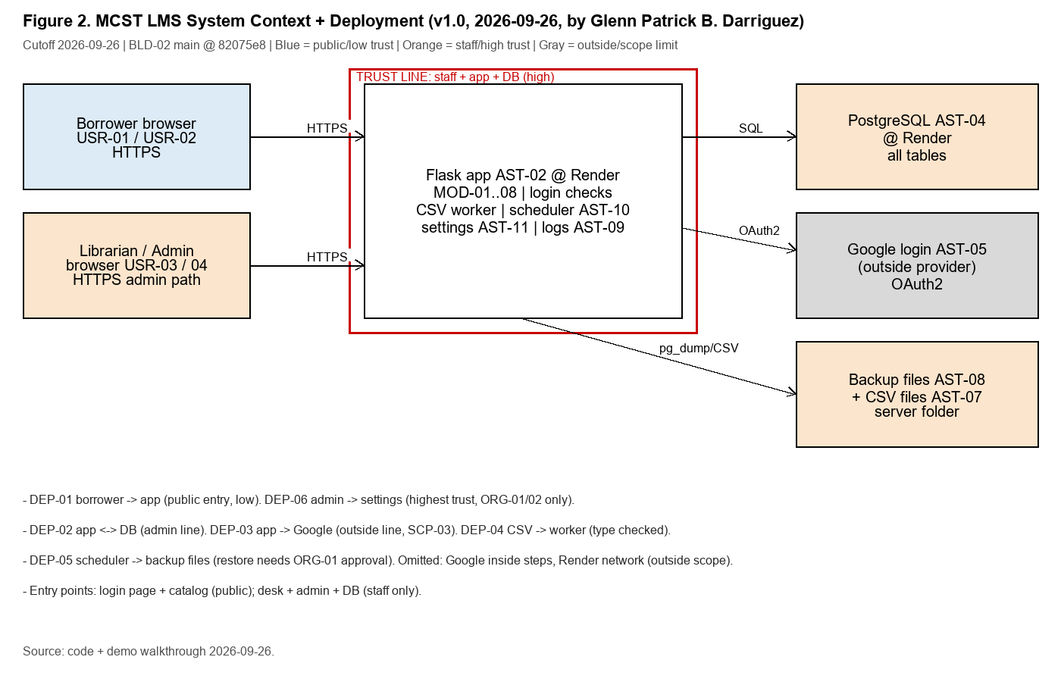
Architecture and Trust Boundaries
Figure 2 from the report: Flask app, PostgreSQL, Google OAuth, Render (DEP-01..06)
6
trust boundaries mapped: public entry, DB line, Google line, staff upload path, backup path, admin path
7
account types registered; one-time bootstrap admin was closed and verified (ACC-07)
Secrets live in environment config - never in the app, never in this report
Each line names its evidence source (DEP-01..06)
Presenter: Glenn Patrick B. Darriguez
Notes:
[Glenn Patrick B. Darriguez]
Figure 2: a borrower connects over HTTPS to Flask, which talks SQL only to PostgreSQL. Google only proves identity — it never touches library data. A scheduler runs the timed backup, and admins use the highest-trust path. Six trust boundaries, DEP-01 to DEP-06, each with a named evidence source. Seven account types — and the one-time bootstrap admin was closed and verified, ACC-07. Secrets live only in environment config: never in the code, never in this report.
Q&A cue: 'what protects the database?' — env-held credentials plus the admin-only path (DEP-02).

Slide 7
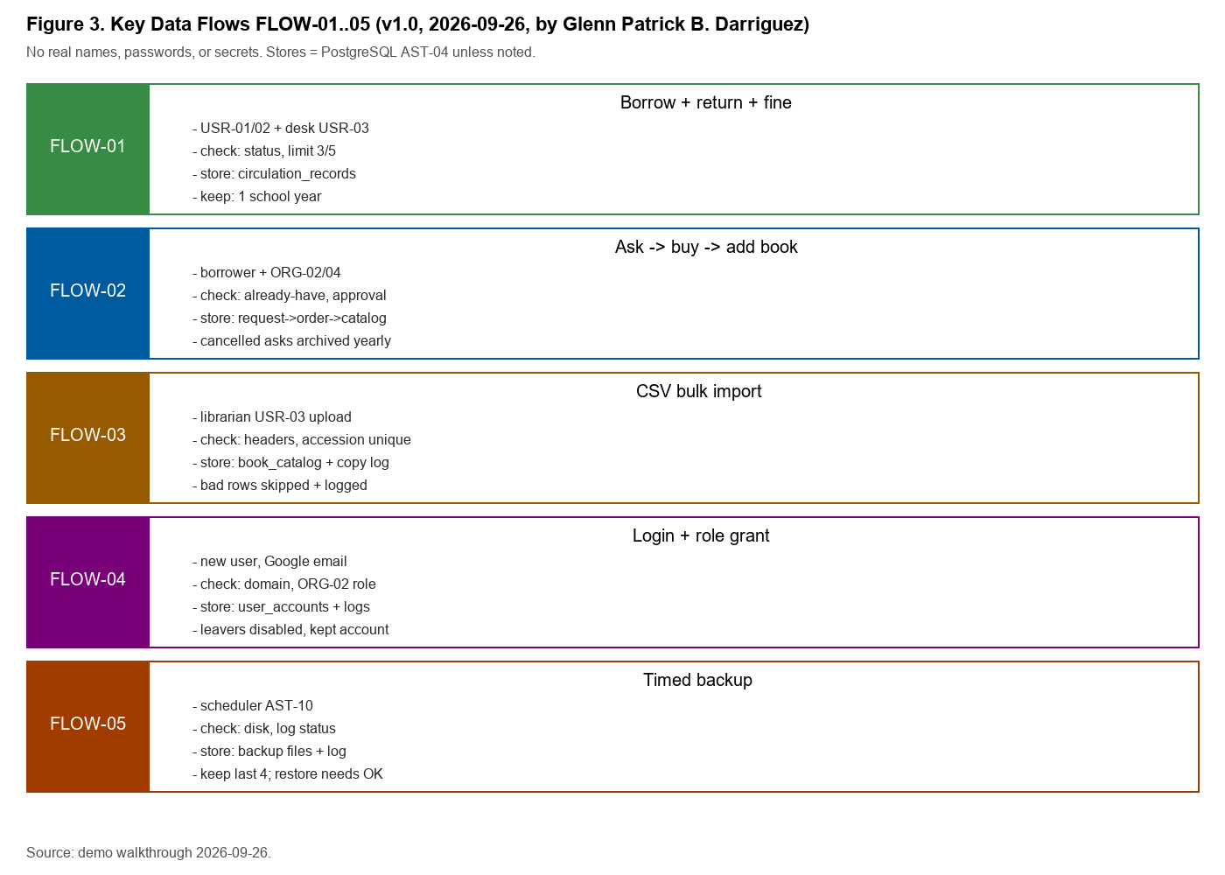
How Data Moves Through the Library
Figure 3 from the report: five flows with validation, storage, and retention rules (FLOW-01..05)
FLOW-01
borrow/return/fine: limits (3/5), fine = rate x days late, archive-before-delete
FLOW-03
CSV import: header map + required fields; bad rows skipped + logged
FLOW-04
login: school email only; first-login admin closed after setup
Every flow has validation, store, channel, and a written retention rule
Presenter: Glenn Patrick B. Darriguez
Notes:
[Glenn Patrick B. Darriguez]
Figure 3 shows five data flows, FLOW-01 to 05. Borrowing honors the three-and-five-book limits; fines are rate times days late; deletion is archive-before-delete. The CSV import requires headers and skips bad rows — logged. Login is school email only, with the bootstrap admin closed after setup. Every flow has written validation, storage, channel, and retention rules. Remember one thing: borrower data sits in PostgreSQL, and its views should be role-limited — the weak part is Finding FND-03.
Q&A cue: 'where does borrower data sit?' — PostgreSQL (AST-04); views should be role-limited per CMP-01/02 — the weakness is FND-03.

Slide 8
What Could Go Wrong - Risk Profile (Lab 9)
8 risks scored Likelihood x Impact; 3 High priorities drive our findings
Residual score (Inherent x Impact, after safeguards)
3
High priorities: RSK-01, RSK-04, RSK-07 - they become our three findings
Residuals only drop for safeguards proven in the build (e.g., backup log proves RSK-04 impact drops 5 -> 4); unmatched safeguards change nothing. Compliance base: Data Privacy Act + school access rules (CMP-01..07).
Presenter: Justin C. Batlangao
Notes:
[Justin C. Batlangao]
Lab 9 scored eight risks — likelihood times impact, adjusted only for safeguards proven in the build. Three are High. RSK-01: account takeover — a leaked password meets no second check; residual sixteen of twenty-five. RSK-04: recovery unproven — backups logged, restore never demonstrated; residual eight. RSK-07: borrower data exposed through wide views and an open export path. Those three become our findings. One example of adjustment: RSK-04's backup log is real, so its impact drops five to four. Single-provider outage, RSK-05, is accepted with a paper control. Compliance base: the Data Privacy Act plus school rules.
Q&A cue: 'why is RSK-01 a 16?' — likelihood 4 x impact 4: passwords leak often and no second check exists; mitigating aims for 8.

Slide 9
Controls We Evaluated and What the Tests Showed (Lab 10)
8 controls CTL-01..08; 6 tests TEST-01..06 on build BLD-04 (Oct 3) - 4 Effective, 2 Partially Effective
TEST-01
Effective
TEST-02
Effective
Wrong-role entry on 10 pages
CSV upload with 2 bad rows
10 / 10 blocked - 0 exceptions
6 added, 2 skipped + logged
TEST-03
Effective
TEST-04
Effective
Borrow -> return -> fine cycle
Delete active vs archived book
Fine matched + 3 log rows
Active refused; archived allowed
TEST-05
Partially Effective
TEST-06
Partially Effective
Backup log Sep-Oct (14 runs)
Settings change + log
14/14 logged - NO restore proof
Logged with name - no approval step
All 6 tests: real procedures on the demo build, full populations where small (10 pages, 14 log rows, whole files); evidence EVD-12-01..05 saved clean.
Presenter: Glenn Patrick B. Darriguez
Notes:
[Glenn Patrick B. Darriguez]
Eight controls, CTL-01 to 08; six tests on BLD-04. Four came back Effective. TEST-01: wrong-role entry blocked on all ten pages — ten for ten, zero exceptions. TEST-02: CSV upload — six good rows added, two bad rows skipped and logged. TEST-03: a full borrow-return-fine cycle — the fine matched the formula. TEST-04: deleting an active book refused; archived allowed. Two came back Partially Effective. TEST-05: fourteen of fourteen backups logged — but zero proof any restores. TEST-06: settings changes logged with a name — no approval step. These were full populations, not cherry-picked samples. The two partials spill into our findings.
Q&A cue: 'does Partially Effective = failed?' — no: the control partly works but misses the objective — restore proof, approval step.

Slide 10
Key Findings - Three High Items
From Lab 11 screening: 5 candidates -> 3 formal findings + 1 observation + 1 close (evidence-checked)
FC-01
FC-02
FC-03
FC-04
FC-05
Finding -> FND-01
Finding -> FND-02
Observation (OBS-01)
Finding -> FND-03
Close (compensated)
FND-01
HIGH
FND-02
HIGH
FND-03
HIGH
Staff Login Without Second Check Allows Full Account Takeover
Restore Never Tested, So Recovery Is Unproven
Wide Staff Views and Open Export Path Expose Borrower Data
Not every gap became a finding - FC-03 is fixable small (backlog); FC-05 is compensated by logging + monthly review. Honest screening, not finding inflation.
Presenter: Ma. Jenifer L. Labag
Notes:
[Ma. Jenifer L. Labag]
Five finding candidates, screened against evidence, materiality, and scope. FC-01 and FC-02 became findings FND-01 and FND-02. FC-03 became OBS-01 — a small, tracked backlog, not worth a finding. FC-04 became FND-03. FC-05 is closed — its risk is already compensated by logging plus a monthly review. Result: three formal findings, all High. We did not inflate the register — materiality disciplined the list, and every screening decision carries its evidence IDs.
Q&A cue: 'why not more findings?' — materiality: small items would dilute; they are tracked, not hidden.

Slide 11
Finding 1 - Staff Login Without Second Check
FND-01 | HIGH | RSK-01 residual 16 | evidence EVD-12-01 + EVD-13-01
Condition
No staff/admin login asks for a second check (screens confirm; BLD-05, Oct 10)
Why HIGH (severity rationale)
Residual risk 16 of 25; full loan + fine data at stake; single control failure on the main gate; affected: all borrowers + library staff
Criteria
CRT-01 + CMP-03 - access fits role AND login stops outsiders (approver ORG-02)
Cause
Second step never built (code read); small team, demo stage
Recommendation REC-01
Effect
One leaked password = full borrower/loan control - exposure, no breach seen
Access Approver (ORG-02) turns on a second check for staff/admin logins; target: stolen password alone fails - re-run TEST-01 + login tries
Limitation
No attack test allowed; stated on the workpaper
Presenter: Ma. Jenifer L. Labag
Notes:
[Ma. Jenifer L. Labag]
Finding one, FND-01. Condition: no staff or admin login asks for a second check on BLD-05. TEST-01 blocked the wrong role ten for ten — but that stops the wrong people, not a thief with the right password. Criteria, CRT-01 and CMP-03: login must stop outsiders. Cause: the second step was never built. Effect: one leaked password could read and change all borrower, loan, and fine data — we say exposure, not breach; nothing was lost. Severity: residual sixteen of twenty-five. REC-01 — ORG-02 turns on a second check; target: a stolen password alone fails.
Q&A cue: '10/10 role tests passed — why still a finding?' — role checks stop the wrong people, not a thief with the right password; challenged in REV-13-02.

Slide 12
Finding 2 - Restore Never Tested
FND-02 | HIGH | RSK-04 intrinsic 10 -> residual 8 | evidence EVD-12-04
Condition
14/14 backup runs logged (Sep-Oct) - but ZERO restore demonstrations exist
Why HIGH - severity rationale
A backup log proves copies exist, NOT that they work. If recovery fails once, the loss is total - all loans + catalog. Team challenged: kept High on effect, not score alone (REV-13-01)
Criteria
CMP-05 + CRT-04 - copies exist AND recovery is possible with approval
Cause
Restore needs live approval; never scheduled (owner inquiry + no record)
Recommendation REC-02
Effect
If the database is lost, desk work may stop for days; loans/catalog may be unrecoverable
System Admin (ORG-03) runs ONE witnessed restore on a test copy + files approved restore steps; verified by reading the restore log
Limitation
Restore itself was out of scope (SCP-03) - our conclusion: identify it, not test it
Presenter: Ma. Jenifer L. Labag
Notes:
[Ma. Jenifer L. Labag]
Finding two, FND-02 — recovery provability. Condition: fourteen of fourteen backups logged, zero restore demonstrations. CMP-05 with CRT-04 requires not just copies but provable recovery. Cause: a restore needs owner approval and was never scheduled. Effect: if the database died, desk work could stop for days. Why High: a backup log proves copies exist — nothing about them coming back; one failed recovery means total loss. Our cross-review kept it High on effect, not score alone. REC-02 — one witnessed restore on a test copy plus filed steps: one admin hour, the cheapest fix, the biggest assurance gain.
Q&A cue: 'why not restore the real DB?' — out of approved scope; the test-copy exercise gives the proof without touching live data.

Slide 13
Finding 3 - Borrower Data Exposure
FND-03 | HIGH | RSK-07 + CMP-01/02 (Data Privacy Act context) | EVD-10-02/03 + EVD-13-02
Condition
Staff roles open FULL borrower rows (name, school ID, fines); reports show names; export path has no extra rule
Why HIGH
Many students affected + real privacy-law obligations; passing TEST-01 does not clear it: getting IN vs seeing WIDE are different questions
Criteria
CMP-01/02 + CRT-01 - private data only for need-to-know roles; names hidden in reports
Cause
Views built for desk speed; export path never fenced (code read)
Recommendation REC-03
Effect
Curious or rogue staff could read/copy many student records - exposure; no misuse seen
Privacy role (ORG-05) narrows views to need-to-know, hides names in reports/exports, turns on an export log
Limitation
Full export was never tested (not allowed); conclusion rests on views seen + missing rule
Presenter: Ma. Jenifer L. Labag
Notes:
[Ma. Jenifer L. Labag]
Finding three, FND-03 — borrower data exposure. Staff roles open full borrower rows — name, school ID, fines; reports show names; and the export path has no extra rule. Criteria: the Data Privacy Act line plus CRT-01 — private data only for need-to-know roles. Cause: views built for desk speed; export never fenced. Effect: a curious or rogue staff member could copy many student records — exposure, no misuse seen. And this stands despite TEST-01 passing, because getting in and seeing wide are different questions. REC-03 — narrow views to need-to-know, hide names, log exports.
Q&A cue: 'can staff export everything today?' — export was not tested (SCP); the finding rests on wide views seen plus no export rule found.

Slide 14
How Conclusions Stand on Evidence - The Chain
Example: FND-01 traced end-to-end; every finding has the same chain in the report
1
2
3
4
5
TEST-01
>
EVD-12-01 / EVD-13-01
>
GAP-01
>
FND-01
>
REC-01 / MAP-01
10/10 wrong-role blocked; no second step visible
clean screenshots, dated, sanitized
missing control identified (CTL-01/CTL-02)
condition + criteria + cause + effect + severity
rule-focused action, owner + target set
Same chain for FND-02 (TEST-05 -> EVD-12-04 -> GAP-02) and FND-03 (TEST-01/EVD-10/13 -> GAP-04).
20 evidence items indexed in the final report (EVD-09-01 .. EVD-13-02) - each with source, date, privacy treatment, and written limitation.
Evidence protection: names hidden, counts only, secrets excluded - nothing sensitive leaves the controlled folder.
Presenter: Glenn Patrick B. Darriguez
Notes:
[Glenn Patrick B. Darriguez]
Is our conclusion supported? FND-01, traced end to end. TEST-01: ten for ten blocked, no second step visible. Locked into dated, sanitized evidence — EVD-12-01 and 13-01. The gap is GAP-01 against CTL-01 and 02. Then FND-01 written in full, and REC-01 with a named owner, tracked as MAP-01. FND-02 and FND-03 carry the same chain. Twenty evidence items are indexed, each with source, date, privacy treatment, and limitation. And nothing sensitive ever left the controlled folder — no names, counts only, secrets excluded.
Q&A cue: 'could screenshots be faked?' — screenshots are only part; the role test is live behavior, logs come from the system, dates/git tie to builds.

Slide 15
What We Recommend - and Honestly, What It Is Not Yet
Roadmap: 3 actions, owners, priorities, target results - status: Proposed (library not yet confirmed)
REC-01 | MAP-01
High
REC-02 | MAP-02
High
REC-03 | MAP-03
High
Second login check for staff + admin accounts
One witnessed restore on a test copy + filed steps
Narrow staff views, hide names, log exports
Owner
Access Approver (ORG-02)
Owner
System Admin (ORG-03)
Owner
Privacy role (ORG-05)
Target
Next release
Target
Before final defense
Target
Next release
Result
Stolen password alone fails
Result
Recovery becomes demonstrable
Result
Borrower rows visible only to need-to-know roles
All three are OUR PROPOSALS - no action is claimed as management-approved unless the owner confirms it. That honesty is part of the audit standard we followed.
Presenter: Ma. Jenifer L. Labag
Notes:
[Ma. Jenifer L. Labag]
Three recommendations — each with an owner, a target, and a verifiable result. REC-01, High, next release: a second login check, owned by the Access Approver; result — a stolen password alone fails. REC-02, High, before our final defense: one witnessed restore plus filed steps, owned by the System Admin; result — recovery demonstrable. REC-03, High, next release: narrow views, hide names, log exports, owned by the Privacy role. The honest part: all three are our proposals, not confirmed. If the library declines any, the residual risk stays — and the report records that acceptance.
Q&A cue: 'what if the library says no?' — the residual stays; owner acceptance recorded explicitly; disclosure, then follow-up.

Slide 16


What This Audit DOES NOT Say (professional honesty)
Balanced assurance language - conclusions cover only what was tested
Environment: evidence from demo build + test site only - not live production data
Change after cutoff - handled correctly
No attack testing, no live restore, no real student records (approved scope limits)
BLD-06 @ c20f98e (Oct 11-20): inventory shared-session fixes + set-based reconcile + condition modal + Philippine-time timestamps
Compliance items CMP-05 (restore) and CMP-07 (Google terms) stay NOT DETERMINED
NOT tested - arrives after the 2026-10-10 cutoff, so it is DISCLOSED, not absorbed into results
Samples are small because the system is small - populations honestly listed
Flag: re-run TEST-03 (fine/due-date math) after deploy - timestamps could shift fine displays
Conclusion: needs improvement, NOT 'system is broken' - 4/6 controls fully effective
Presenter: Justin C. Batlangao
Notes:
[Justin C. Batlangao]
What this audit does not say. All evidence is from the demo build and test site — never live production data. No attack testing, no live restore, no real student records — the approved scope limits. CMP-05 and CMP-07 stay not determined. Samples are small because the system is small, and populations are honestly listed. And BLD-06, the October 11-to-20 build, arrived after the cutoff: untested — disclosed, not absorbed into results. One flag: re-run TEST-03 after deploy, because timestamps could shift fine displays.
Q&A cue: 'does the timestamp commit break your conclusion?' — no; conclusions cover BLD-04/05 up to cutoff; BLD-06 gets its own follow-up test.

Slide 17


Overall Conclusion - Needs Improvement
Pending remediation - built on effective tests + honest gaps + unconfirmed actions
VERDICT
What WORKS (tested, 0 exceptions)
What must improve (3 High, all Proposed)
Needs Improvement
Wrong-role access blocked 10/10 - CTL-01
Second login check (FND-01 / REC-01 / ORG-02)
CSV checks add-good / skip-bad with logs
One witnessed restore (FND-02 / REC-02 / ORG-03)
Conclusion covers tested builds BLD-04/05 up to cutoff 2026-10-10. 6/8 controls designed adequate-or-partial; 4/6 tests fully effective; 3 High findings open with no confirmed response yet.
Full audit trail on desk work + delete guards
Narrow views + export control (FND-03 / REC-03 / ORG-05)
Backups run on schedule, 14/14 logged
Then: follow-up review + BLD-06 re-test - before live borrower data
Presenter: Justin C. Batlangao
Notes:
[Justin C. Batlangao]
Our verdict: Needs Improvement, pending remediation — a fair call. What works, tested: wrong-role access blocked ten for ten, CSV checks with logs, a full audit trail, and fourteen of fourteen backups on schedule. What must improve — the three High findings, all still Proposed: the second login check, one witnessed restore, and narrowed views with export control. Then a follow-up review and a BLD-06 re-test before any live borrower data. A system holding student data should not go live with an unproven restore and a single-factor gate.
Q&A cue: 'why not Satisfactory instead?' — debated in REV cross-review; three High findings plus no confirmed management response means improvement comes first.

Slide 18
Thank You - Questions?
Anyone may direct a question to any member - all three of us reviewed the whole engagement.
Justin
Glenn
Jenifer
scope, risks, conclusion
system, controls, tests
findings, actions
Evidence on request: EVD index (20 items), test workpapers, REV/AI logs, build lineage - all in the final report.
404NotFound | Justin C. Batlangao | Glenn Patrick B. Darriguez | Ma. Jenifer L. Labag | MCST Library (Head Librarian Calixto Nicolas Camangeg)
Notes:
[All]
Thank you. Any question can go to any of us — all three reviewed the whole engagement. Justin: scope, risks, conclusion. Glenn: system, controls, tests. Jenifer: findings and actions. Evidence on request: the twenty-item EVD index, test workpapers, and logs. Prepared answers: the fine formula is rate times days late under TEST-06; the privacy basis is CMP-01; BLD-06 is post-cutoff and excluded; and the plan is verified by re-running TEST-01 and TEST-03 plus reading the new logs.
Q&A cue: keep about 3 minutes of Q&A; use the report if asked to show evidence.

