Slide 1

Business Intelligence-Enabled Web-Based Library Management System for Academic Resource Planning
Research Colloquium
Mandaluyong College of Science and Technology
Bachelor of Science in Information Systems - Research Team | October 2026
MCST Library Management System - Research Colloquium
1
Notes:
Good day. We present our capstone: a Business Intelligence-Enabled Web-Based Library Management System for Academic Resource Planning at MCST. The main highlight of this talk is the features of the system: what it can do, how it was tested, and what it can give the school.

Slide 2
CONTEXT
Background of the Study
• Academic libraries are shifting from record-keeping automation to analytics-based resource management - turning everyday transactions into figures that support collection decisions (Roy, 2025; Sukula et al., 2023; Wan Abas & Mustapha, 2025).
• Web-based systems make library services accessible beyond the library walls, supporting remote work and self-service (Chavan & Hase, 2025).
• This shift matters most for small to mid-sized institutions, where technology infrastructure and data capabilities are limited.
• MCST keeps growing - enrollment, borrowing activity, and collection volume increase year after year.
• The study responds with a web-based Library Management System with Business Intelligence embedded in its operations.
• Aligned with SDG 4 (Quality Education) and SDG 9 (Industry, Innovation, and Infrastructure).
MCST Library Management System - Research Colloquium
2
Notes:
Macro context only - no MCST problems on this slide. Academic libraries globally are moving from mere automation to analytics-based management; BI turns transactions into decision support; web-based systems extend services beyond library walls. This matters most for small/mid-sized schools like MCST, which keeps growing. The study responds with a web-based LMS with embedded BI, aligned with SDG 4 and SDG 9.

Slide 3
CONTEXT
Current System at MCST: KOHA + Paper Sheets
• The library's system is KOHA - but its complex user interface makes it too difficult for the librarian to use day to day.
• KOHA has no integrated Business Intelligence - it stores records but does not analyze them.
• Daily borrowing bypasses the system entirely - it runs on paper:
Student borrows (in-library / overnight)
Paper log sheet: book + program + name
Sheets re-encoded into KOHA later
Manual tallies & reports
Result: a fragmented system - the paper record is the real one, KOHA lags behind, and nothing is analyzed.
• Koha's catalog is kept, but borrowing habits live on paper and are never aggregated.
• Program-level demand, borrowing trends, and utilization - the data exists, but no tool reads it.
MCST Library Management System - Research Colloquium
3
Notes:
The scene-setting slide. The honest picture: KOHA is installed, but it is way too difficult for the librarian to use because of its complex interface, and it does not have an integrated Business Intelligence. For borrowings, in-library borrowing is still manual - students log onto a sheet of what book they borrowed, their program, and their name. Same with overnight borrowing: it is written on a sheet, which is later inputted into KOHA. That makes the current system fragmented, and it lacks analytics.

Slide 4
CONTEXT
Issues Found Out
Gathered from interviews with library staff and a walkthrough of their current workflow - KOHA and the paper borrowing logs.
• KOHA's complex interface is too difficult for the librarian to use for daily work (rated 'Serious to Very Serious' by users of such systems - Padilla, 2022).
• KOHA has no integrated Business Intelligence - records are stored, never analyzed.
• In-library borrowing is still manual - students log the book title, their program, and their name on a sheet.
• Overnight borrowing is also written on a sheet, then inputted into KOHA only later - KOHA lags behind real activity.
• Fragmented workflow - the paper record is effectively the system of record; data is scattered between sheets and KOHA.
• No borrowing trends, program-level usage, or demand visibility - collection decisions rely on intuition.
• Inadequate authentication and access control; no audit trail for accountability.
• This is also the research gap: most existing LMS automate record-keeping, but few turn records into analytical insights (Ch. 2).
MCST Library Management System - Research Colloquium
4
Notes:
One combined slide: what the interviews and walkthrough found, stated plainly, closing with the literature gap. Say aloud: 'these were not assumptions - we asked the staff about their week.' KOHA is way too difficult for the librarian to use because of its complex interface, and it does not have an integrated Business Intelligence; in-library borrowing is still manual via a sheet, and overnight borrowing is written on a sheet and inputted into KOHA later. Hence: fragmented, and lacking analytics - which matches the gap documented in Chapter 2.

Slide 5
THE SOLUTION
Proposed System - How It Mitigates the Issues
Issue found out | How the proposed system mitigates it
KOHA's complex interface | Simplified, consistent UI - workable with little training
No integrated BI in KOHA | Reporting Dashboard with 4 analytics tabs built into the same platform
Paper log sheets for borrowing | Borrowing/return processed in the system, on or off campus, with automatic due dates and fines
Fragmented workflow (sheets re-encoded later) | One integrated platform: requests, cataloging, circulation, inventory, reservations, reporting
Weak authentication and access control | Google OAuth @mcst.edu.ph, 4-role access control, HTTPS sessions, audit trail
No quality baseline | Evaluated against ISO/IEC 25010:2011 + UAT with 87 users
MCST Library Management System - Research Colloquium
5
Notes:
This slide maps each issue from the interviews to what the built system does about it. Read left to right. Note the paper-sheet row: the biggest mitigation is that borrowing itself becomes a system transaction instead of a sheet re-encoded later. Keep this brief - the features that follow prove each row.

Slide 6
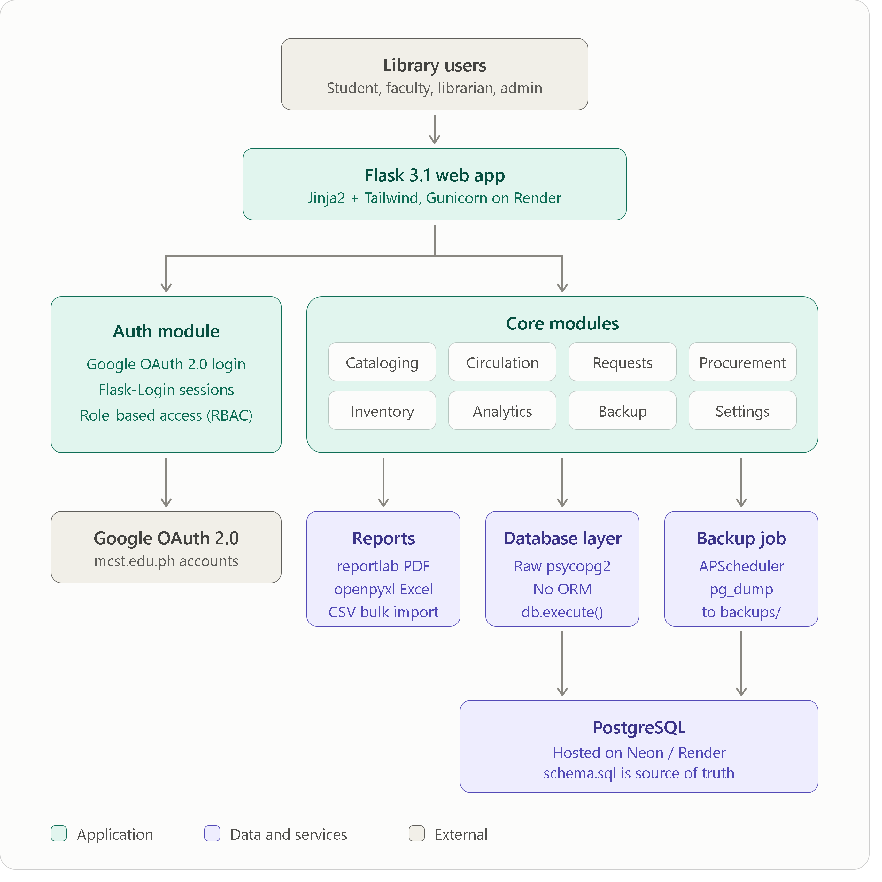
THE SOLUTION
System Architecture
• Presentation layer - what you see: the site in any web browser, for students, faculty, librarian, and admin.
• Application layer - the brain: the Flask web app on Render checks your login, enforces roles, and runs cataloging, circulation, requests, inventory, and analytics.
• Data layer - the memory: PostgreSQL on Neon stores all records; backup jobs keep them safe.
Sign-in is Google School Account only (@mcst.edu.ph) - verified by the app before anything is shown.
Every action travels over HTTPS, is allowed or blocked by role, and is recorded in the audit trail.
MCST Library Management System - Research Colloquium
6
Notes:
Keep it simple: imagine an online form (the browser), the staff office that approves everything (the Flask app on Render), and the filing cabinet (the PostgreSQL database on Neon). A user clicks something in the browser, the app checks who you are and what your role is allowed to do, it reads or updates the database, then sends the result back to the browser. Google handles the sign-in with school accounts, and every critical action is logged.

Slide 7
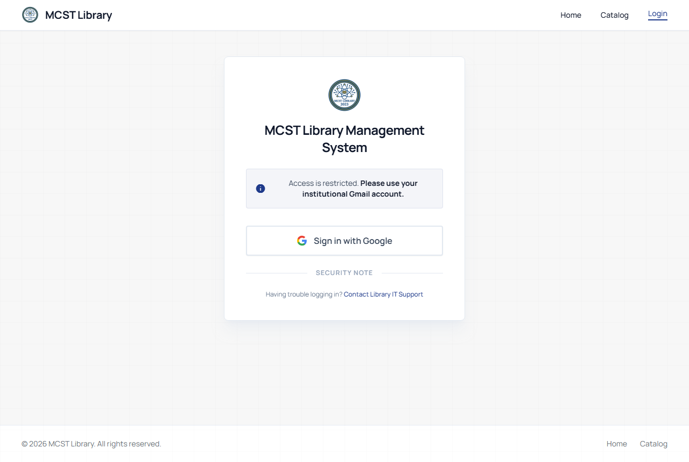
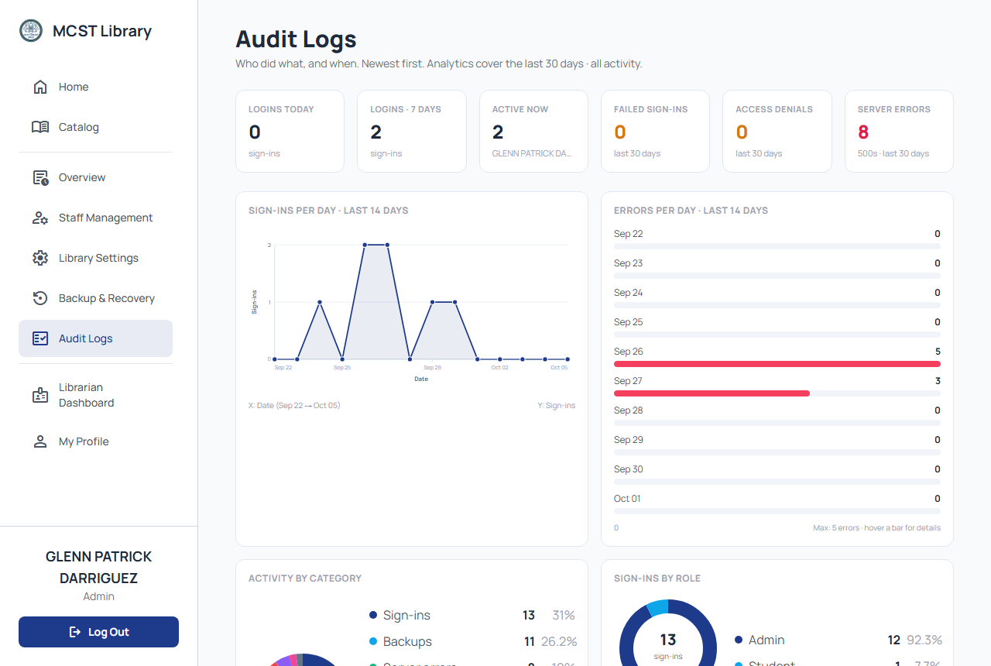
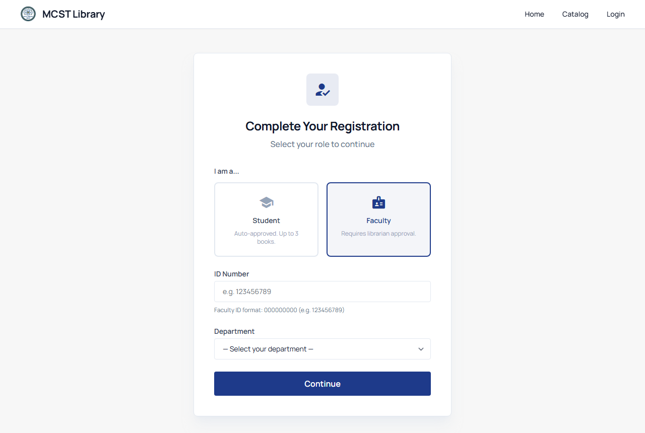
FEATURES
Sign-in, Roles, and Accountability
• Sign in with Google - only @mcst.edu.ph accounts can enter.
• Students/Faculty: role selection + ID/department, then pending approval.
• Four roles: Admin, Librarian, Faculty, Student - each sees only what their role allows.
• Audit trail every write action.
Institutional sign-in
Audit trail
Role selection
MCST Library Management System - Research Colloquium
7
Notes:
Access begins with Google school-account sign-in restricted to mcst.edu.ph. New students and faculty choose their role and wait for approval. Once in, four roles control what each person sees. Every critical action is recorded in the audit trail, so accountability is now defined by role.

Slide 8
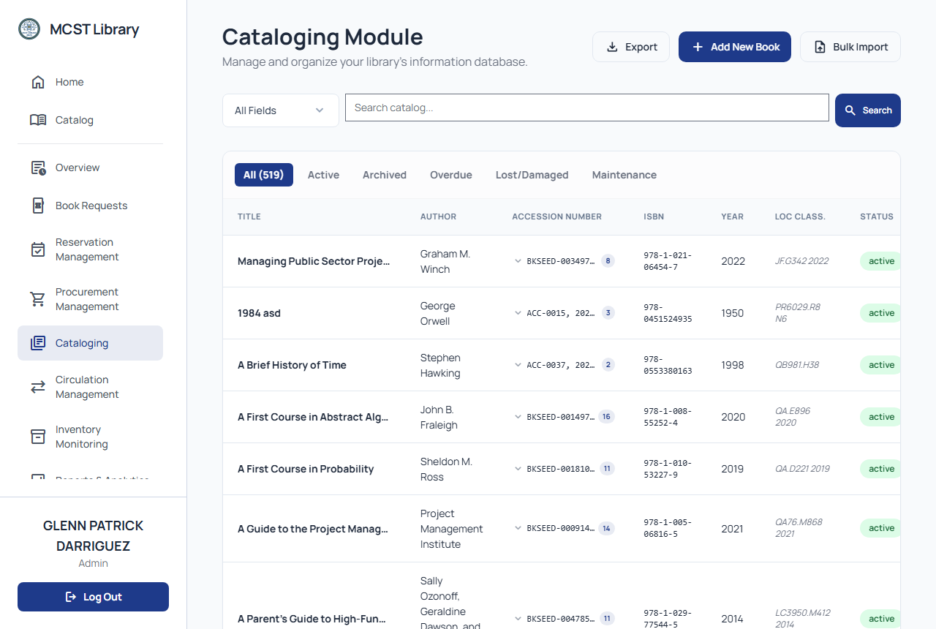
FEATURES
Cataloging and Accessioning
• Add, edit, and archive book records with full bibliographic details.
• Accession management: unique control numbers, automatic copy numbering per title.
• Bulk CSV import - up to 1,000 records per file, processed in the background.
• Per-row validation: duplicates and invalid rows are reported before they enter the catalog.
• Archive-then-delete policy - records are never hard-deleted while active.
Cataloging page, accessed remotely
MCST Library Management System - Research Colloquium
8
Notes:
Cataloging is on the browser - the librarian can encode from any authorized location. Accession numbers are managed automatically. For large collections, a CSV bulk import handles up to a thousand records with per-row validation, running in the background so the librarian does not wait - a workaround for periods of weak connectivity.

Slide 9
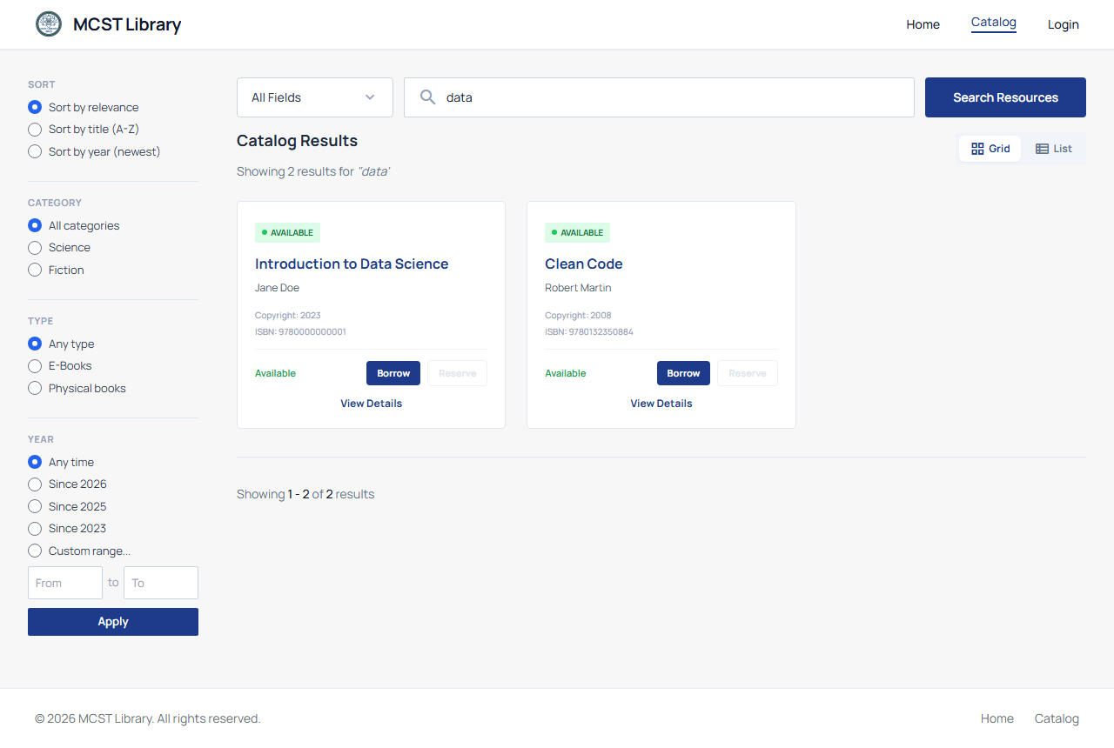
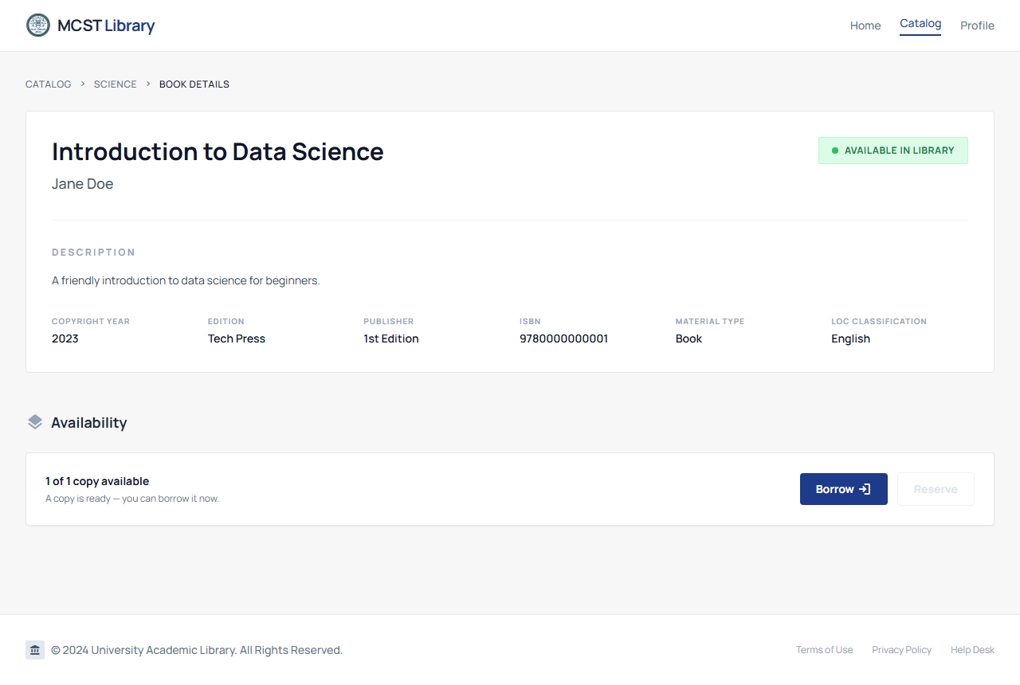
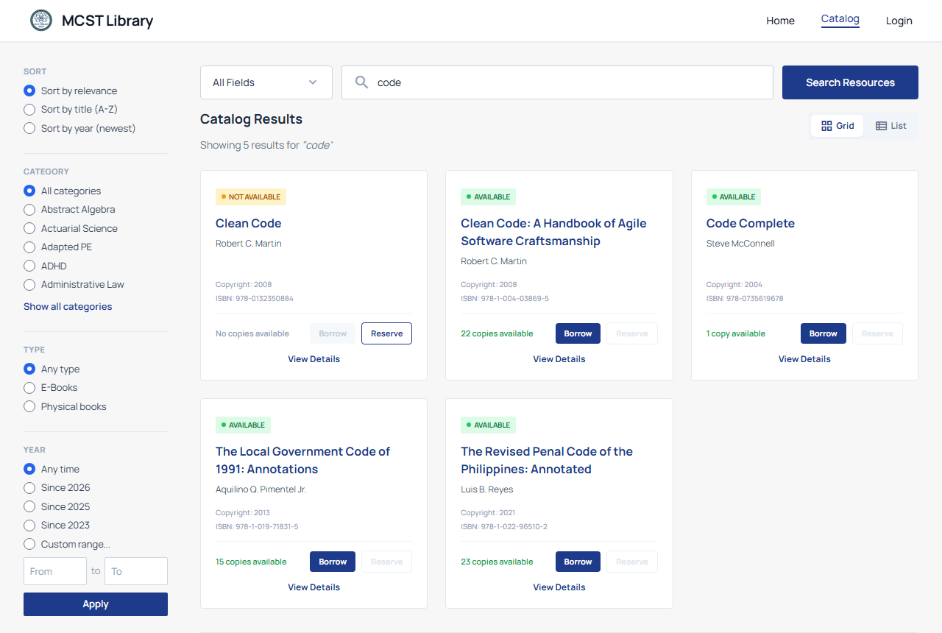
FEATURES
Public Catalog and Search
• Search by title, author, ISBN, or category.
• Google Scholar-style filter sidebar: sort, category, type, availability, year presets.
• Active filter chips - remove individually or clear all.
• Availability badges on every result.
• Book details page: copies, availability, related titles; favorites list.
Catalog search
Book details
Filters and availability badges
MCST Library Management System - Research Colloquium
9
Notes:
The public catalog is what students and faculty see. Search across fields, filter like a scholar search, and read availability at a glance. Search performance held up in testing even with a few thousand accession records thanks to indexed, parameterized queries.

Slide 10
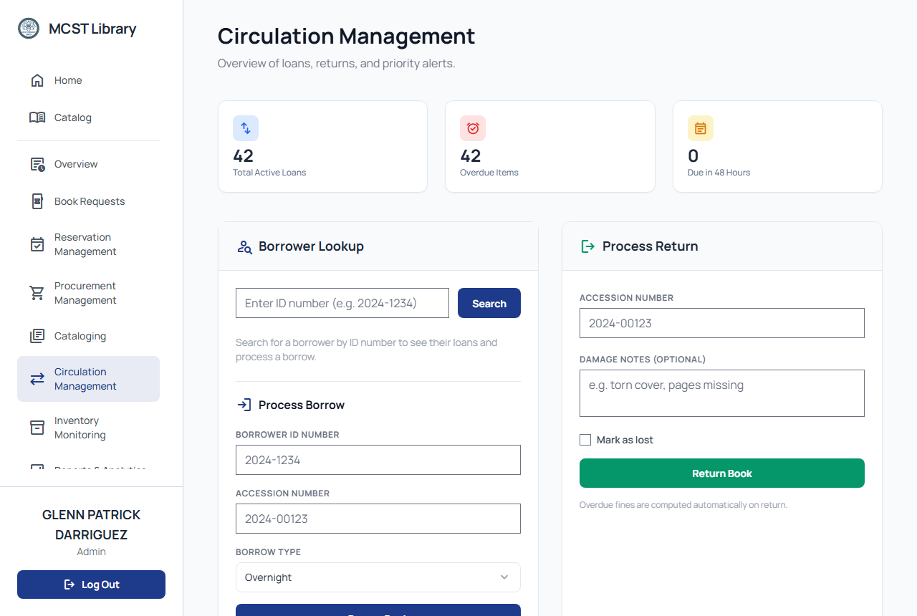
FEATURES
Circulation Management
• Borrow and return processed in the browser, on or off campus.
• Replaces the paper log sheet - the system record is the real record.
• Due dates follow library policy and user role automatically.
• Computed fines shown as part of the transaction.
• Overdue status monitoring + reminders to users.
Circulation page, accessed remotely
MCST Library Management System - Research Colloquium
10
Notes:
Circulation directly answers the paper-sheet problem: borrowing and returning are processed in the browser, so the system record is the real record - no re-encoding later. Due dates and fines are computed automatically, and overdue reminders go out in-system.

Slide 11
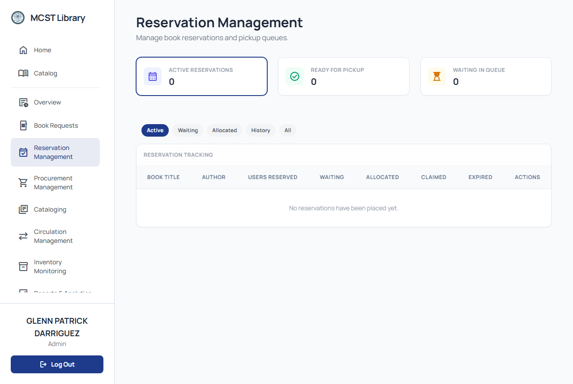
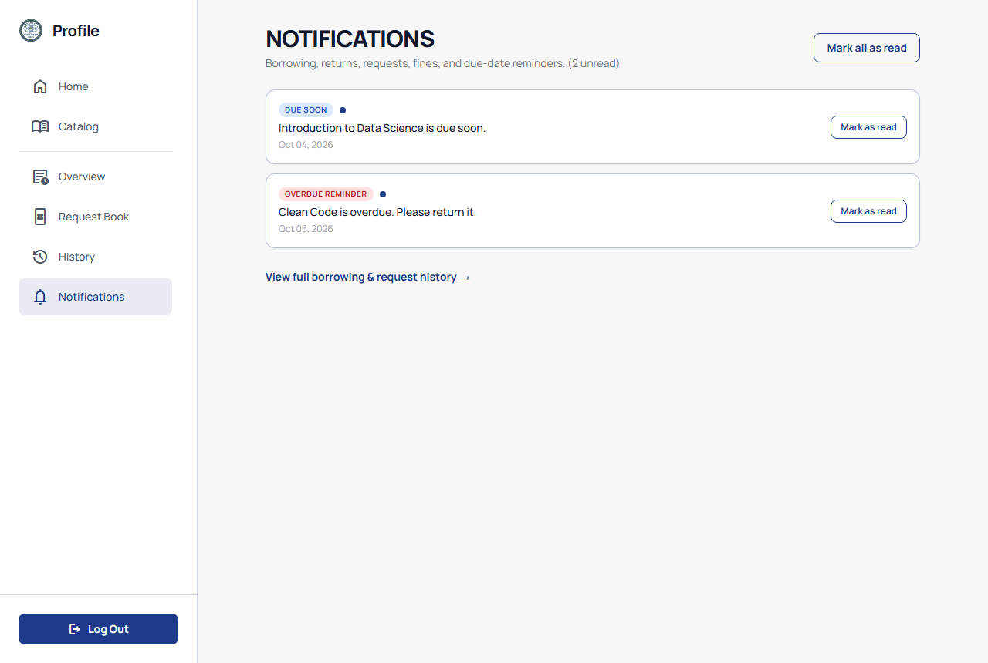
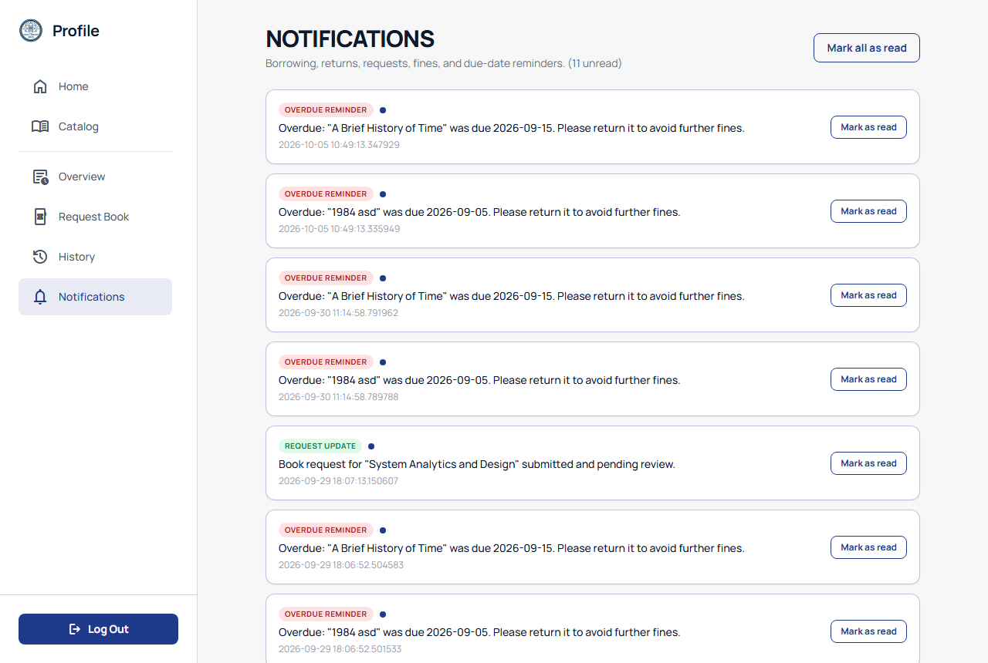
FEATURES
Reservations and Notifications
• Reservation queue per title when a book is unavailable.
• FIFO queue - first reservation served first, in one system.
• 2-hour claim window for unclaimed reserved copies.
• In-system notifications: reservation-ready, overdue warnings, request-status updates.
Reservation queue
Notification badges
User notifications
MCST Library Management System - Research Colloquium
11
Notes:
Reservations consolidate into the same platform with a first-come, first-served queue and a two-hour claim window. Notifications warn of due dates and tell users when reserved books are ready - no more manual follow-ups.

Slide 12
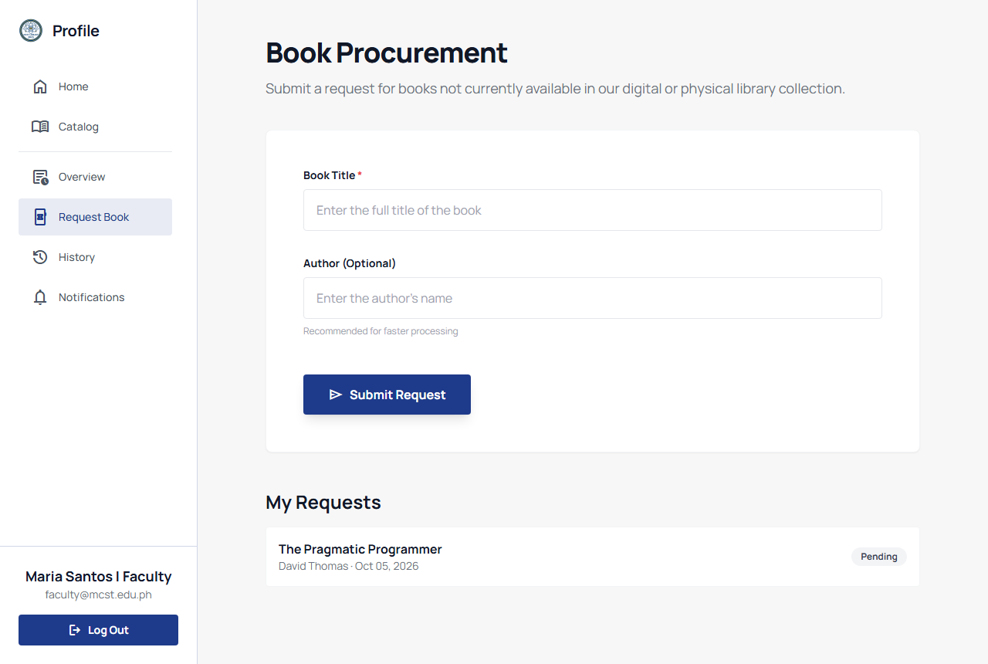
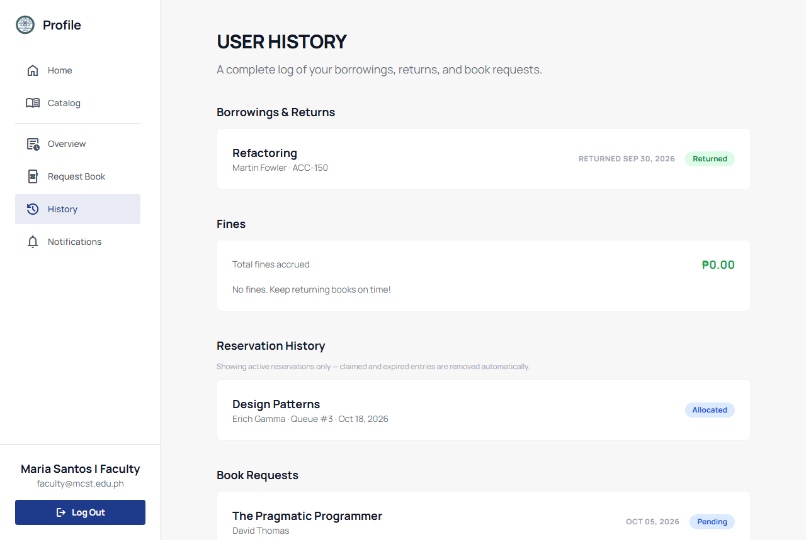
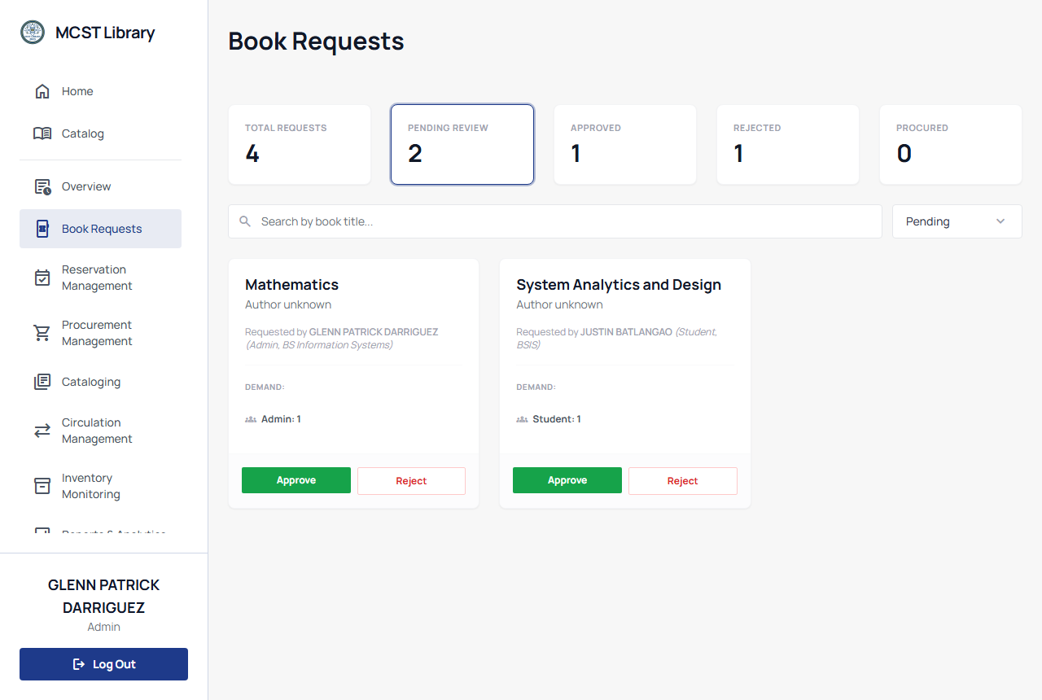
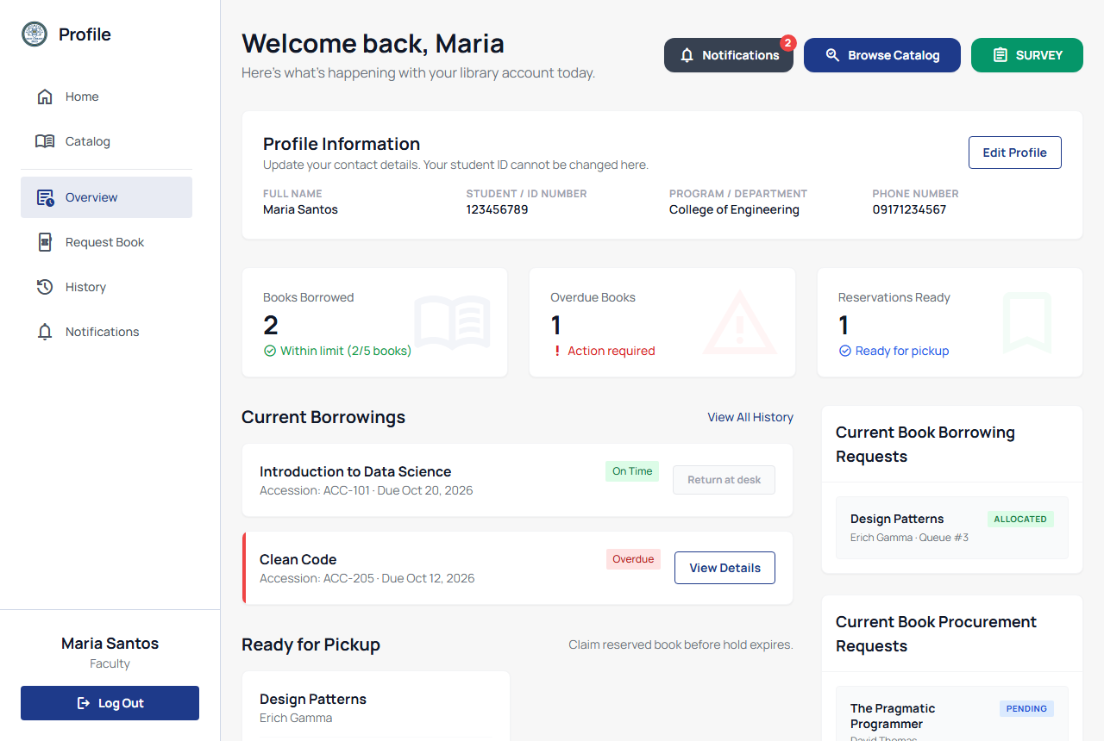
FEATURES
Requests, Profile, and Borrowing History
• Request a book the library does not carry yet; track its status live.
• Profile: name, ID, department, phone; live counts of borrowed, overdue, and reservations-ready.
• Borrowing history: past borrows, reservations, requests, and fines in one page.
• Encourages self-service instead of manual follow-ups.
Book request form
History
Librarian request view
Profile overview
MCST Library Management System - Research Colloquium
12
Notes:
Users can request titles the library lacks; requests are tracked to approval. The profile page gives live counts of what you have borrowed and what is overdue, and history consolidates everything. Faculty reported this as the clearest reduction in manual follow-up.

Slide 13
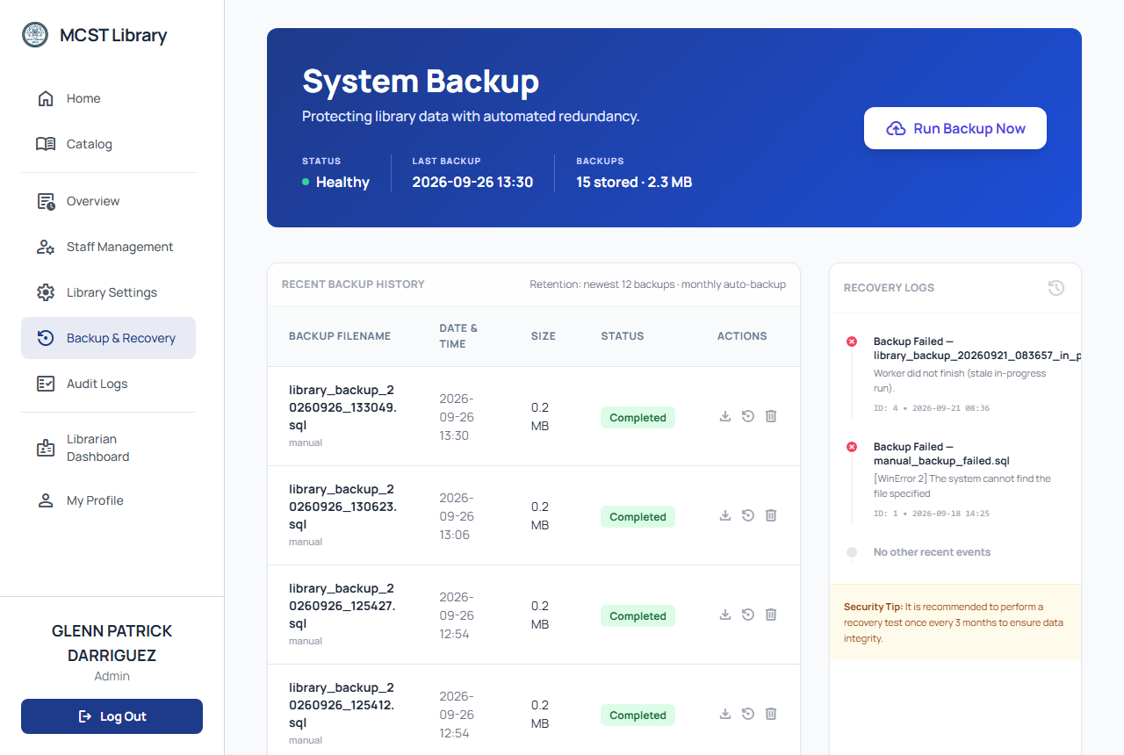
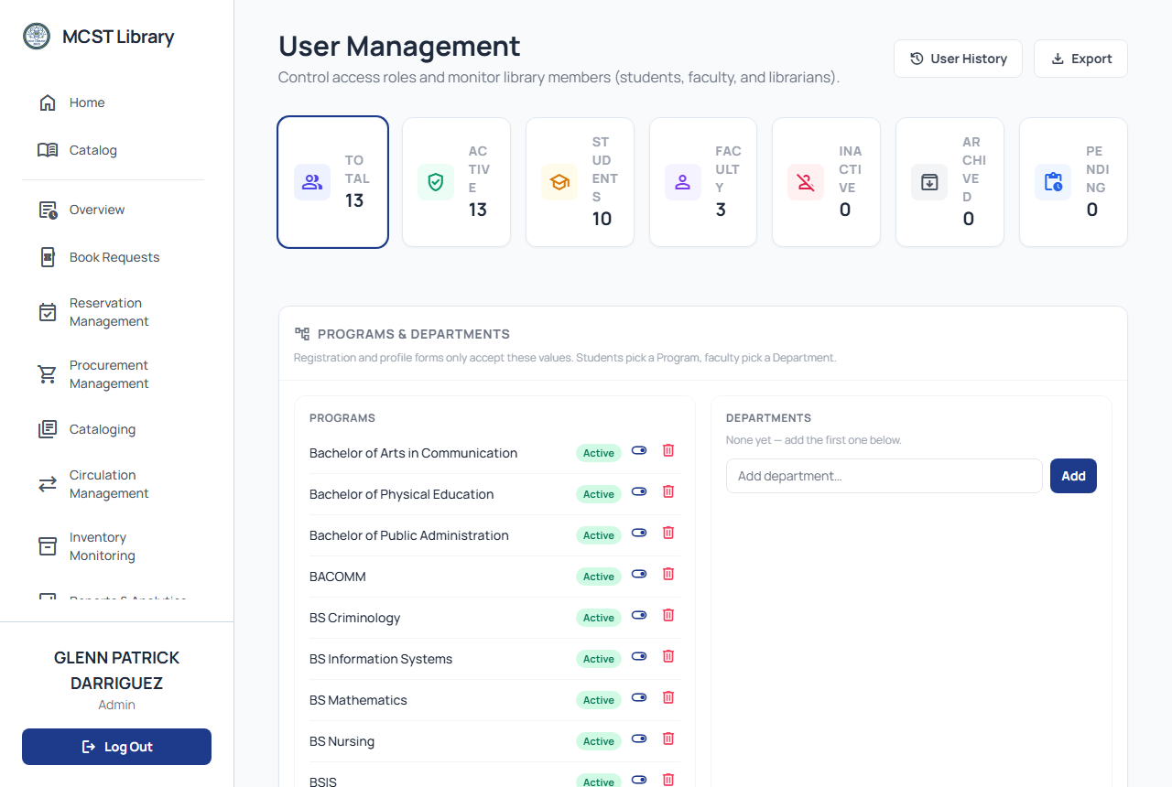
FEATURES
Security, User Administration, and Backup
• User management: approve, disable, archive/restore, change role; hard delete only for archived.
• Audit analytics: sign-ins, access denials, errors - by category and role.
• Backup: timestamped SQL dumps + managed point-in-time recovery (Neon).
• Data Privacy Act 2012-aligned: encrypted sessions + role-based control.
Backup module
User management
Audit trail
MCST Library Management System - Research Colloquium
13
Notes:
Administration covers accounts, statuses, and roles - with archived-first deletion. Administrators review the audit trail to see who did what. Backups are automatic dumps plus managed point-in-time recovery. All 7 security tests passed in evaluation.

Slide 14
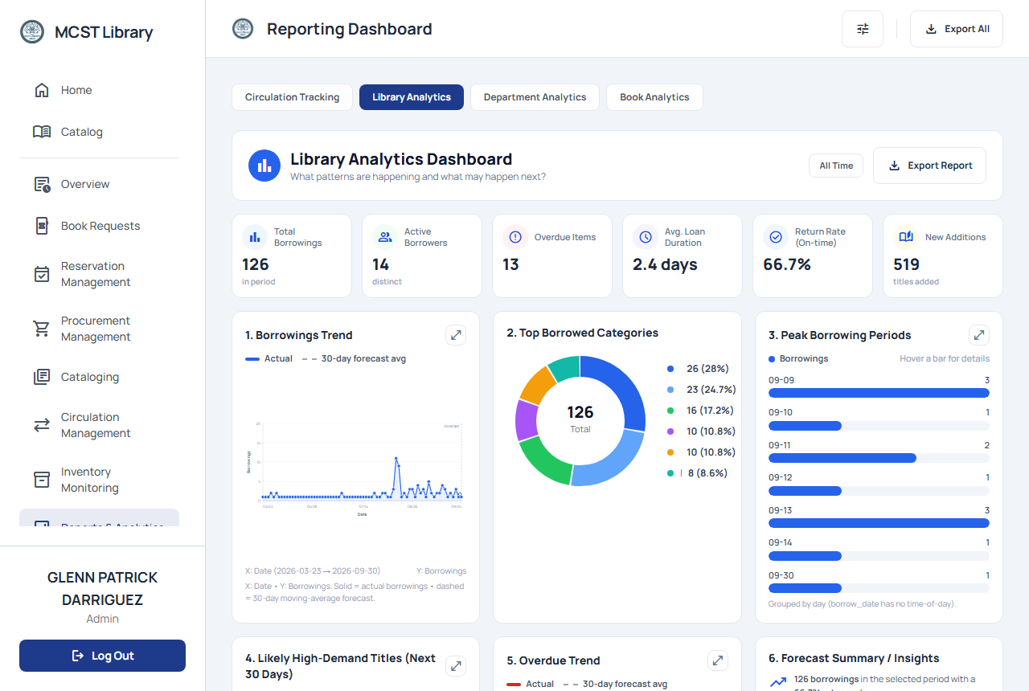
BUSINESS INTELLIGENCE
Business Intelligence - The Reporting Dashboard
• The analytics KOHA never had - built into the same platform that holds the records.
• One Reporting Dashboard, four tabs - each answering a different question:
  – Circulation Tracking - where does every book and copy stand right now?
  – Library Analytics - what patterns are happening, and what may happen next?
  – Department Analytics - how do programs compare in library usage?
  – Resource Analytics - what is the traffic story of one specific book?
• Descriptive analytics + rule-based insights; KPI accuracy checked against manual computation.
• Exportable reports (CSV), with snapshots saved for the budget defense trail.
Reporting Dashboard - four tabs
MCST Library Management System - Research Colloquium
14
Notes:
This is the answer to 'KOHA has no integrated BI'. The Reporting Dashboard has four tabs, and each gets its own slide next. Circulation Tracking answers 'where does every book and copy stand right now'; Library Analytics answers 'what patterns are happening and what may happen next'; Department Analytics compares programs; Resource Analytics drills into one book. All KPIs were checked against manual computation before evaluation.

Slide 15
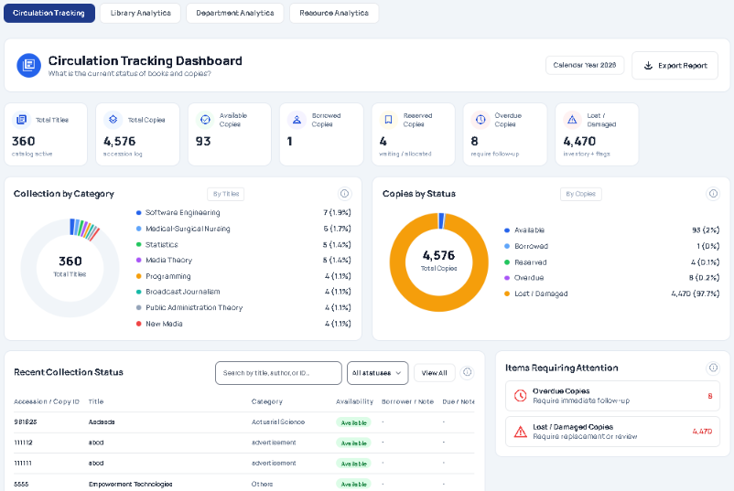
BUSINESS INTELLIGENCE
BI Tab 1 - Circulation Tracking
• Answers: 'Where does every book and copy stand right now?'
• KPIs on current stock and activity.
• Donut charts by category and by status (available / borrowed / reserved / etc.).
• Live recent-copies table - the freshest copy movements as they happen.
• The librarian's daily situational view - no more manual inventory tallies.
MCST Library Management System - Research Colloquium
15
Notes:
First tab: Circulation Tracking. It shows the current status of all books and copies - KPI cards, donut breakdowns by category and status, and a live table of recent copies. This is the librarian's situational dashboard: at a glance, what is where, without walking the shelves.

Slide 16
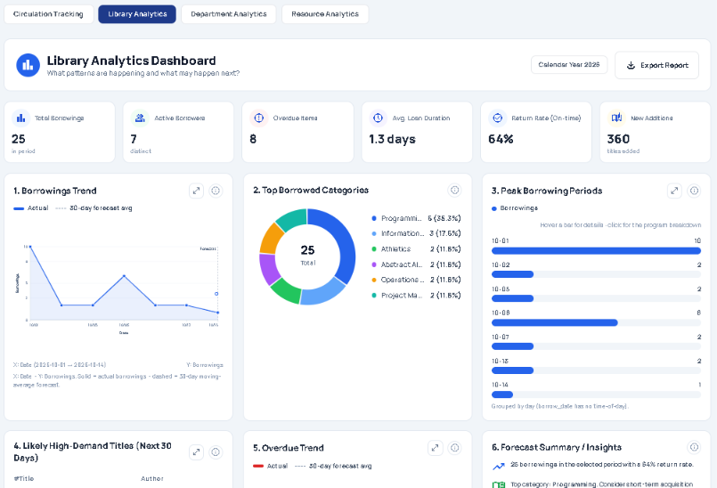
BUSINESS INTELLIGENCE
BI Tab 2 - Library Analytics
• Answers: 'What patterns are happening - and what may happen next?'
• Borrowing trends with a 30-day moving-average forecast line.
• Top borrowed titles, categories, fines, and requests.
• Per-program borrowing breakdowns.
• Rule-based insights: demand spikes surfaced early, while decisions stay with the librarian.
Reporting Dashboard - Library Analytics tab
MCST Library Management System - Research Colloquium
16
Notes:
Second tab: Library Analytics, shown in the screenshot. Borrowing patterns by day with a 30-day moving-average forecast, top categories, peak periods, and forecast summaries. The rule-based insight is important: 'what may happen next' is a moving average, not machine learning - final decisions remain with the librarian.

Slide 17
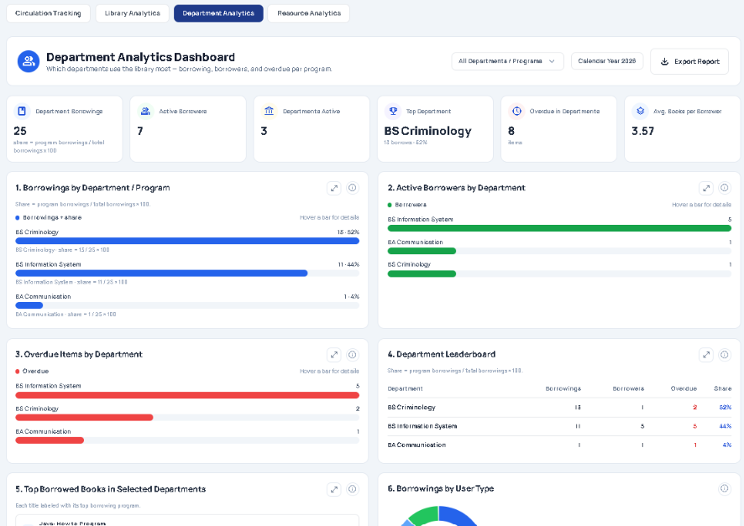
BUSINESS INTELLIGENCE
BI Tab 3 - Department Analytics
• Answers: 'How do programs compare in library usage?'
• Borrowings, borrowers, and overdues - compared across programs/departments.
• Direct evidence for program chairs and deans when aligning collections with curricula.
• Supports fair, transparent budget allocation between departments.
MCST Library Management System - Research Colloquium
17
Notes:
Third tab: Department Analytics. Usage compared across programs and departments - borrowings, borrowers, overdues. This is the direct answer to the old problem that program chairs and deans had no evidence: now the comparison is a screen, not a manual tally.

Slide 18
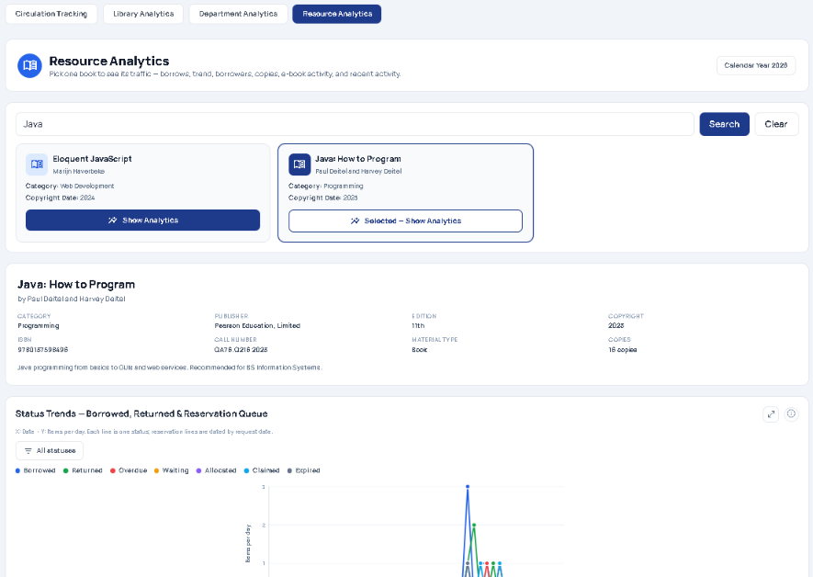
BUSINESS INTELLIGENCE
BI Tab 4 - Resource Analytics (Book Analytics)
• Answers: 'What is the traffic story of one specific book?'
• Drills into a single book: borrow counts, borrow trend, its borrowers, its copies, and e-book activity.
• Tells demand at copy level - which edition is hot, which copies sit idle.
• Feeds copy-count decisions: where to add copies, where to stop re-buying.
MCST Library Management System - Research Colloquium
18
Notes:
Fourth tab - labeled 'Book Analytics' in the interface, Resource Analytics in scope: it drills into a single book's traffic - borrows, trend, borrowers, copies, and e-book activity. This is copy-level demand intelligence: does this title deserve another copy, or is one copy enough?

Slide 19
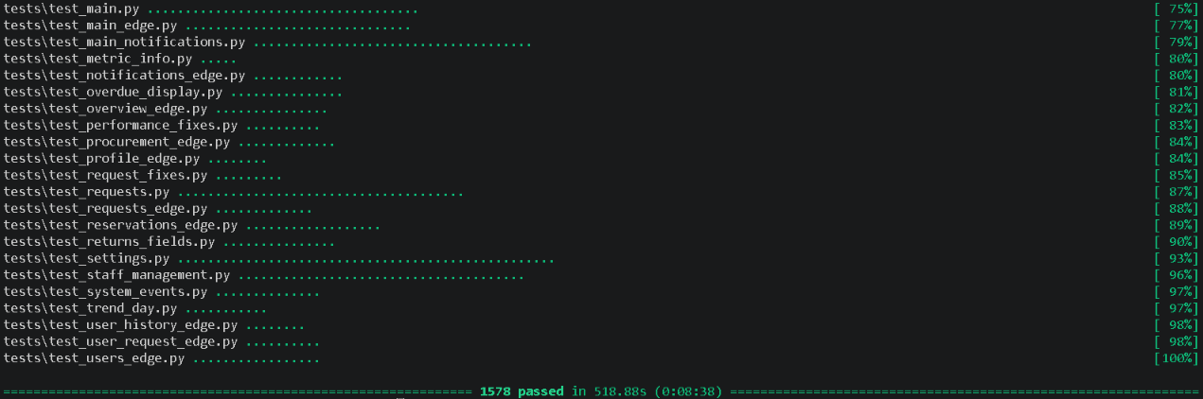
EVALUATION
Testing Journey
UNIT TESTING
Module logic, DB reads/writes, and route behavior checked individually during development.
ALPHA
Internal testing by the development team; functional defects and edge cases all resolved.
BETA
Limited release to the librarian and selected faculty under real-use conditions; workflow gaps fixed.
ISO / IEC 25010
Formal quality evaluation by 4 IT experts + the librarian across 8 characteristics.
UAT
User Acceptance Testing with 87 users (71 students, 15 faculty, 1 librarian).
Response-time checks on key operations (catalog search, borrow/return, report generation) all PASSED - within acceptable range, by Python timing.
MCST Library Management System - Research Colloquium
19
Notes:
Testing moved through five phases: unit tests during development; alpha by the team; beta with the librarian and selected faculty; the formal ISO 25010 evaluation; then UAT with 87 users. Key operations were also timed with Python functions and all completed within acceptable range.

Slide 20
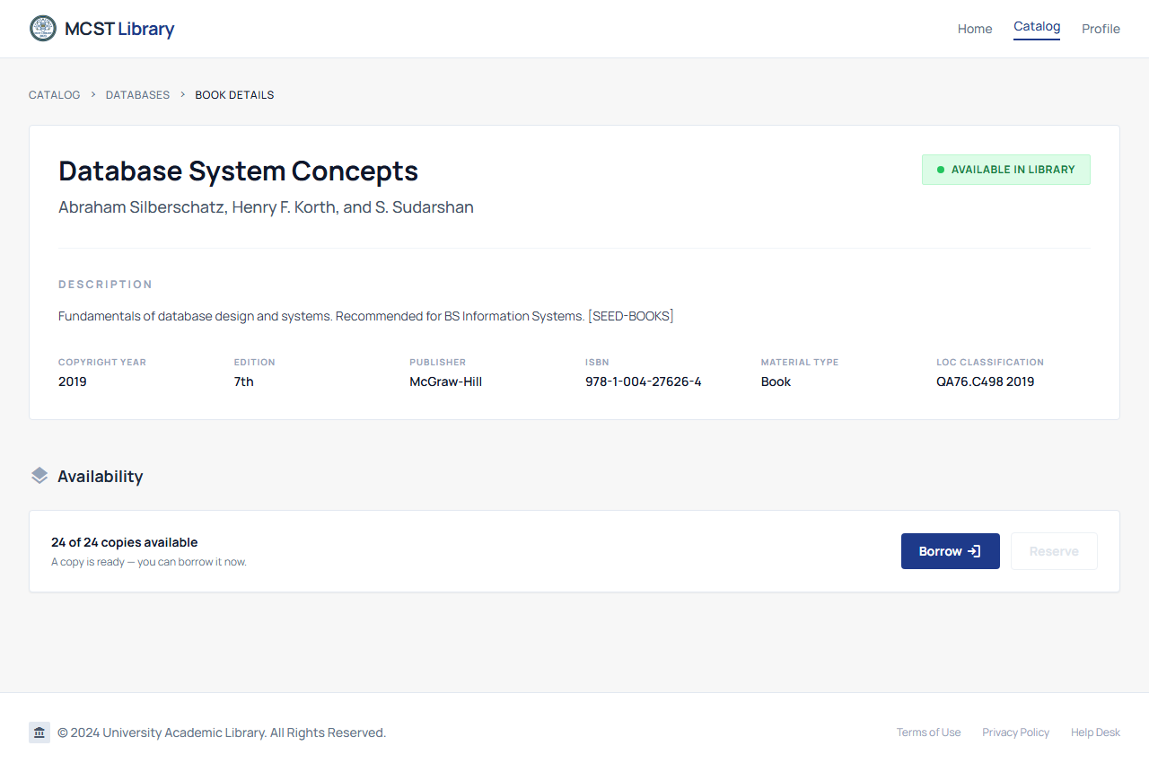
EVALUATION
Results Overview - What the Tests Showed, Per Module
• Remote access - 5 / 5 off-campus tasks passed through a browser (login, cataloging, circulation, reports, search/request).
• Interface usability - users rated 3.38 (UAT), 3.92 (ISO Usability): workable without manual logs.
• Workflow integration - 4 / 4 end-to-end cases passed as one connected chain.
• Analytics - all 5 checked KPIs matched manual computation.
• Security - 7 / 7 security tests passed; audit verified (UAT 3.31, ISO Security 3.88).
• Every section mean fell in the 'Highly Acceptable' range.
Circulation (off-campus)
Book details
MCST Library Management System - Research Colloquium
20
Notes:
Present results as a module overview rather than per problem - per the adviser's guidance. Remote access: all five tasks passed. Integration: the whole chain worked end-to-end. Analytics: KPIs matched. Security: all seven tests passed. Keep the summary of findings descriptive - stating what the figures show, in plain language.

Slide 21
EVALUATION
ISO/IEC 25010:2011 Evaluation Results
Characteristic | Mean | Verbal Interpretation
Functional Suitability | 3.92 | Highly Acceptable
Performance Efficiency | 3.76 | Highly Acceptable
Compatibility | 3.92 | Highly Acceptable
Usability | 3.92 | Highly Acceptable
Reliability (lowest) | 3.60 | Highly Acceptable
Security | 3.88 | Highly Acceptable
Maintainability | 3.72 | Highly Acceptable
Portability | 3.76 | Highly Acceptable
OVERALL (grand mean) | 3.81 | Highly Acceptable
• Evaluated by 4 IT experts + 1 librarian (n = 5).
• Highest: Functional Suitability, Compatibility, Usability (3.92 each).
• Lowest: Reliability (3.60) - stability and error recovery flagged as future priorities, not failures.
• Backup/PITR and institution-grade hosting are tied to this lowest score in the recommendations.
MCST Library Management System - Research Colloquium
21
Notes:
The ISO evaluation by 4 IT experts and the librarian gave an overall mean of 3.81 - Highly Acceptable across all eight characteristics. The strongest: functional suitability, compatibility, and usability. The lowest: reliability at 3.60 - still Highly Acceptable, but the area where future work starts. Scale: 3.26-4.00 = Highly Acceptable.

Slide 22
EVALUATION
User Acceptance Testing - Summary of Findings
UAT Section | Mean (n = 87) | Verbal Interpretation
A. Accessibility & Functionality (Q1-3) | 3.41 | Highly Acceptable
B. Usability (Q4-6) | 3.38 | Highly Acceptable
C. Integration (Q7-9) | 3.31 | Highly Acceptable
D. Analytics (Q10-12) | 3.30 | Highly Acceptable
E. Security (Q13-15) | 3.31 | Highly Acceptable
F. Overall Acceptability (Q16-18) | 3.43 | Highly Acceptable
Grand mean | 3.36 | Highly Acceptable
• Respondents: 71 students, 15 faculty, 1 librarian.
• Overall system acceptability: 3.43 - performs reliably (3.41), improves efficiency (3.43), beneficial for planning (3.46).
• Presented descriptively: every section mean falls in the Highly Acceptable range (3.26-4.00).
MCST Library Management System - Research Colloquium
22
Notes:
The UAT summary of findings, presented descriptively: all six section means are Highly Acceptable, with overall acceptability at 3.43 and a grand mean of 3.36. The strongest single answer overall: the system is beneficial for academic resource planning (3.46) - which is exactly the BI purpose of the system.

Slide 23
CLOSING
Future Recommendations
• Reliability first: stability and error recovery (ISO 3.60) is the main improvement area.
• Access permissions: a permissions model / role matrix beyond roles alone.
• Institutionally managed, paid hosting as usage grows beyond what was tested.
• Channel integration (e.g., KOHA) and a full disaster-recovery plan.
• Better trend visualization and report customization (trend rating was the lowest UAT item).
• Orientation, user guides, and staff training on roles and backups.
• Future research: larger samples, longer deployment, scalability beyond tested limits, predictive forecasting (outside current descriptive scope).
MCST Library Management System - Research Colloquium
23
Notes:
Recommendations are organized by stakeholder in Chapter 5; these seven capture all of them in speaker-friendly form. Lead with reliability since it is the lowest ISO score, and note that access permissions and trend identification tied in the low 3.20s among UAT items.

Slide 24
CLOSING
Benefits of the Solution
Librarian & Staff - Automated cataloging and circulation, accurate reports, less manual encoding - service quality with lower effort.
Students & Faculty - Web-based catalog and request submission from anywhere; self-service tracking of borrows, fines, and request status.
Program Chairs & Deans - Borrowing statistics, request trends, and usage reports - transparent evidence for acquisition and budget decisions.
MCST Institution - Data-driven resource planning, DPA-compliant records, and a documented quality baseline (ISO 3.81).
Future Researchers - A real-world reference for integrating descriptive BI into operational systems in small/mid-sized institutions.
MCST Library Management System - Research Colloquium
24
Notes:
Close with who benefits: the librarian gains automation; students and faculty gain access and transparency; chairs and deans gain evidence for budget decisions; the institution gains a quality-baseline and DPA-aligned records; and future researchers gain a working reference.

Slide 25
Thank You.
Questions and feedback are welcome.
MCST Library Management System - Research Colloquium
25
Notes:
Thank the panel and open the floor for questions. Anticipate: how fines are computed, why analytics stop at rule-based forecasts, and reliability improvements.

