Slide 1

A Business Intelligence-Enabled Web-Based Library Management System for Academic Resource Planning
RESEARCH COLLOQUIUM
Mandaluyong College of Science and Technology
Bachelor of Science in Information Systems | Capstone Research Team
Presenters: Justin
Adviser: [Insert name]
October 2026
Notes:
HIDDEN SCRIPT - Presenter View only, projector shows slides only. Approx. 30-45 sec.
Opening: "Good day, ladies and gentlemen. We are the 404_NOT_FOUND, capstone research team of BSIS, Mandaluyong College of Science and Technology. Our study is titled: Business Intelligence-Enabled Web-Based Library Management System for Academic Resource Planning."
Introduce the presenters and what each will cover, then move quickly - panels remember strong openings.
Do NOT read the title slide. Wave at it while introducing.

Slide 2




Background of the Study
01 | BACKGROUND
1
2
3
From automation to analytics
Access beyond library walls
The small and mid-sized institution gap
Academic libraries are shifting from record-keeping to analytics-based resource management, converting everyday transactions into evidence for collection decisions (Roy, 2025; Sukula et al., 2023; Wan Abas & Mustapha, 2025).
Web-based systems extend services to remote and self-service use and simplify operations (Chavan & Hase, 2025).
Limited technology infrastructure and data capability make this shift hardest where it is needed most. MCST continues to grow in enrollment, borrowing activity, and collection volume.
RESEARCH RESPONSE
SUSTAINABLE DEVELOPMENT GOALS
A web-based Library Management System with Business Intelligence embedded in daily operations.
SDG 4 Quality Education
SDG 9 Industry, Innovation and Infrastructure
Notes:
HIDDEN SCRIPT - Presenter View only. Approx. 1.5-2 min. Background section.
Three beats to hit:
1. "Libraries worldwide are moving from record-keeping to analytics-driven resource management" - cite Roy 2025, Sukula et al. 2023, Wan Abas & Mustapha 2025.
2. "Web-based systems push service beyond library walls" - Chavan & Hase 2025.
3. "But small and mid-sized institutions feel this shift is hardest - limited infrastructure and data capability." Point at MCST: growing enrollment, borrowing, and collection volume.
LAND THE RESPONSE LINE: "Our research response: a web-based LMS with Business Intelligence embedded in daily operations."
Close by touching SDG 4 (Quality Education) and SDG 9 (Innovation and Infrastructure) briefly.

Slide 3





Current System: KOHA and Paper Log Sheets
02 | CURRENT SYSTEM
1
2
3
4
Student borrows
Paper log sheet
Re-encoded into KOHA
Manual tallies and reports
in-library / overnight
book + program + name
at a later time
Observed limitations
IMAGE PLACEHOLDER
1
KOHA stores records but does not analyze them; no integrated BI.
Photo: paper borrowing log sheet
2
The paper record is the effective system of record; KOHA lags behind real activity.
Insert a clear, de-identified photograph of the actual paper log sheet used at the MCST library (blur or crop student names).
3
Program-level demand, borrowing trends, and utilization exist as data, yet no tool reads them.
4
Collection decisions therefore rely on intuition rather than evidence.
Figure 1. Paper borrowing log used for in-library and overnight transactions.
Notes:
HIDDEN SCRIPT - Presenter View only. Approx. 1.5 min. Current system section.
Walk the 4-step flow like a story: "A student borrows a book - a paper log sheet records title, program, and name by hand - it is re-encoded into KOHA later - and reports are made through manual tallies."
Then the limitation that matters most: "KOHA stores records, but it does not analyze them. There is no integrated BI."
Punch line: "The PAPER is effectively the system of record - KOHA is always lagging behind real activity. And the data to answer program-level demand exists, but no tool reads it. Decisions rely on intuition, not evidence."
If asked about the image: it is the actual MCST paper log, de-identified.

Slide 4



Issues That Arise from the Current System
03 | PROBLEM
Complex KOHA interface
Paper log sheets, re-encoded later
1
WHAT HAPPENS DAILY
2
WHAT HAPPENS DAILY
The librarian finds KOHA too difficult to use for daily work.
Book, program, and name are written by hand, then keyed into KOHA at a later time.
THE RESULTING PROBLEM
THE RESULTING PROBLEM
Staff fall back on manual processing, a "Serious to Very Serious" issue (Padilla, 2022).
KOHA lags behind real activity; paper becomes the real record and data is scattered.
No integrated BI
Weak authentication and access control
3
WHAT HAPPENS DAILY
4
WHAT HAPPENS DAILY
KOHA stores records but never analyzes them.
There is no audit trail of who did what.
THE RESULTING PROBLEM
THE RESULTING PROBLEM
No view of borrowing trends, program-level usage, or demand; decisions rely on intuition and librarian lack concrete evidence.
Accountability and data security are at risk.
NET RESULT A fragmented process with no analytics: the gap this study addresses. Most systems automate records; few turn them into insight (Ch. 2).
Notes:
HIDDEN SCRIPT - Presenter View only. Approx. 2 min. Problem section - this is where the panel judges whether the problem is real. Slow down.
Walk each of the 4 issues in WHAT HAPPENS -> RESULTING PROBLEM pairs:
1. KOHA is too complex for daily work -> staff fall back to manual processing (Padilla 2022 rates this "Serious to Very Serious").
2. Handwritten logs re-encoded later -> KOHA lags, data is scattered.
3. No integrated BI -> no trend/usage/demand view; chairs and deans have no evidence.
4. No audit trail -> accountability and data security risk.
END with the net result: "A fragmented process with no analytics. Most systems automate records; few turn them into insight. That is the gap this study addresses." Transition to the proposed system.

Slide 5




Proposed System: Mapping Solutions to Identified Issues
04 | PROPOSED SYSTEM
Issue identified
Proposed system response
1
Complex KOHA interface
Simplified, consistent interface usable with minimal training
2
Paper log sheets and re-encoding
Borrowing and returns processed in-system, on or off campus, with automatic due dates and fines; one platform for requests, cataloging, circulation, inventory, reservations, and reporting
3
No integrated BI
Reporting Dashboard with four analytics tabs on the same platform
4
Weak access control
Google OAuth (@mcst.edu.ph), four-role access control, HTTPS sessions, audit trail
Evaluated against ISO/IEC 25010:2011 and UAT with 87 users.
Analytics are descriptive with rule-based insights; machine learning is outside the study scope.
Notes:
HIDDEN SCRIPT - Presenter View only. Approx. 1.5-2 min. Proposed system section.
Frame it as one-to-one responses: "For every issue we identified, the proposed system has a direct answer."
1. Complex interface -> simplified, consistent UI with minimal training.
2. Paper + re-encoding -> borrowing/returns processed in-system, on or off campus, automatic due dates and fines; one platform for everything.
3. No BI -> Reporting Dashboard with four analytics tabs on the same platform.
4. Weak access control -> Google OAuth restricted to @mcst.edu.ph, four roles, HTTPS, full audit trail.
Mention: evaluated against ISO/IEC 25010:2011 and UAT with 87 users. If asked about AI: "Analytics are descriptive with rule-based insights; machine learning is outside the scope." - say it proactively.

Slide 6




System Architecture
05 | SYSTEM ARCHITECTURE
Figure 2. Three-tier system architecture
Library Users
Students, Faculty, Librarian, Admin
Flask Web App
Jinja2 + Tailwind + Gunicorn on Render
Authentication Module
Core Modules
Data and Services
Google OAuth 2.0 login
Flask-Login sessions
Role-based access (RBAC)
Cataloging
Circulation
Reports
reportlab PDF, openpyxl Excel, CSV bulk import
Backup Job
APScheduler + pg_dump
Audit Trail / Role Checks
Requests
Procurement
Inventory
Analytics
Backup
Settings
PostgreSQL
Hosted on NEON
Google school-account sign-in only (@mcst.edu.ph); every action runs over HTTPS, is role-checked, and is written to the audit trail.
Notes:
The system was built using three layers architecture.
First we have the library user layer. These includes the four types of users: Students, Faculty, Librarian, and Admin, pwede nilang i-access it through web-Browsers.
Second we have the application layer: dito pinaprocess yung mga core functions ng system na ginawa namin. We developed the application using flask and then dineploy namin siya sa render. Itong layer na’to yung nag hahandle ng different modules, tulad ng cataloging, circulation, requests, procurement, inventory, analytics, backup, and settings. It also support report generations in PDF, Excel, and CSV format.
Lastly we have the database layer, gumamit kami ng PostgreSQL and nakahost siya sa neon, dito iniistore at minamanage yung data ng system, including book records, information ng users, borrowing transactions, reservations, and requests.
Para naman sa authentication, si user kelangan mag sign in using official accounts which is the @mcst.edu.ph. inimplement din naming yung RBAC or yung role based acces control, so that si user ang maaccess niya lang na features is yung permitted para sa naka assigned sa role niya. In addition may audit trail din kami so that the user’s action is recorded for accountability.
Now that we know how the system works behind the scene proceed na tayo sa actual features.

Slide 7









System Features: Main Highlight
06 | FEATURES
01
02
03
04
Access and Roles
Cataloging
Public Catalog
Circulation
Google sign-in, four roles, approval flow, audit trail
Records, accessioning, CSV bulk import up to 1,000 rows
Scholar-style search, filters, availability badges
Browser-based borrow and return, due dates, fines
05
06
07
08
Reservations
Notifications
Requests and History
Administration
FIFO queue with a 2-hour claim window
Ready, overdue, and request-status alerts
Book requests, profile, borrowing history
User management, audit analytics, backup and recovery
Plus: the Reporting Dashboard with four Business Intelligence tabs (next section).
Notes:
Our system has 8 main functional areas: these are the Access and Roles, Cataloging, the Public Catalog, Circulation, Reservations, Notifications, Requests and History, and Administration. On top of these features is the Reporting Dashboard which contains our business intelligence and analytics functions.
For now, mag focus muna tayo sa system’s operational features, umpisahan naten on how users access the platform.

Slide 8

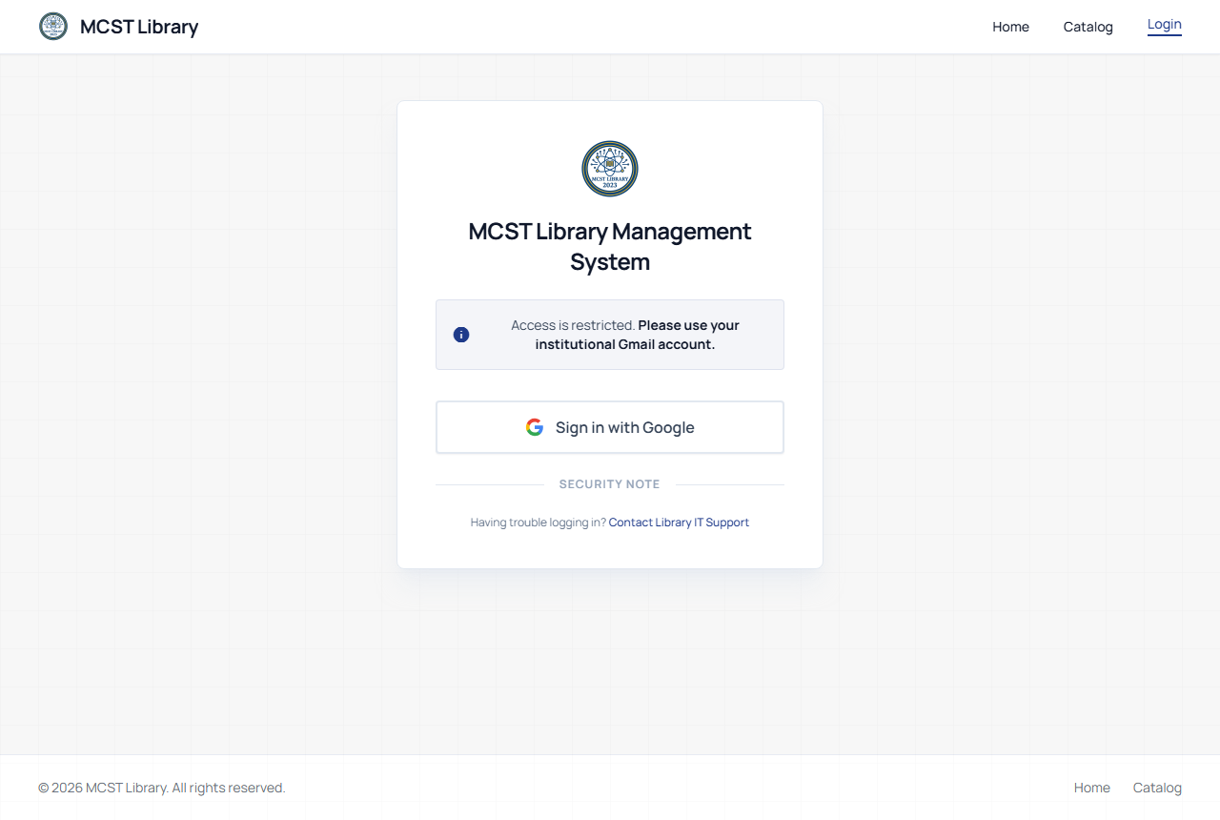
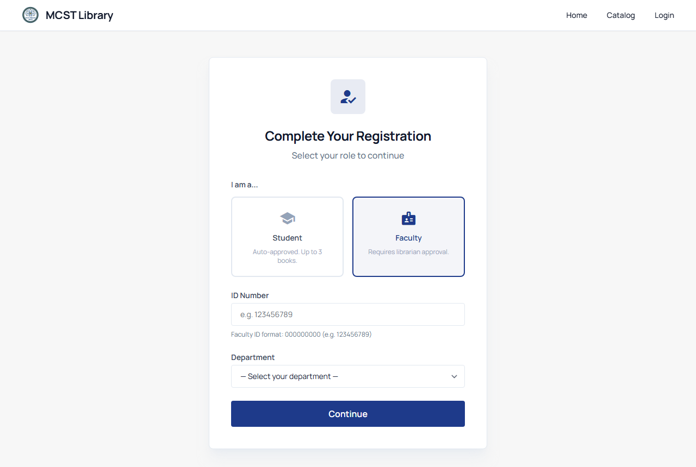
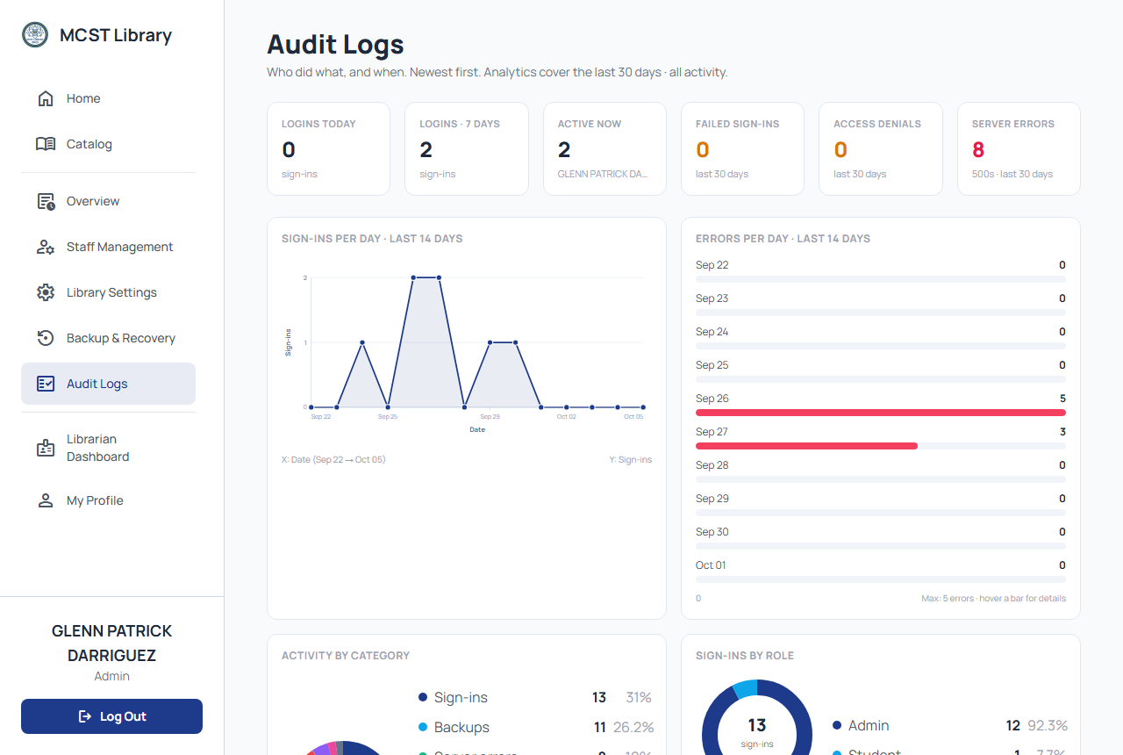

Access, Roles, and Accountability
06 | FEATURES
Sign-in with Google restricted to @mcst.edu.ph accounts.
Students and faculty choose a role, give ID or department, then await approval.
Four roles: Admin, Librarian, Faculty, Student; each sees only what the role permits.
Audit trail records every write action.
Institutional sign-in
Role selection
4
RESEARCH LINK
roles, one rule
Addresses the weak access control and missing audit trail.
Admin · Librarian · Faculty · Student
Audit trail
Notes:
For the system access, We restricted sign-in to official MCST accounts using the @mcst.edu.ph domain.
After they sign in with their official accounts, Next the user will pick a role and iinput niya yung ID niya and kung anong departpent siya. For the faculty naman after they signed in mag hihintay muna sila for approval ng librarian bago sila makapasok sa site. After ma-approve mag rere-login sila to officially access the site.
May 4 roles kami the admin, librarian, faculty and students. Each of them has a specific module na sila lang yung makakaaccess. Ito yung Role Based Access Control
We also implemented an audit trail, dito nakarecord yung mga actions or activities na ginagawa ng mga users. And this is our answer to the weak access control problem.
Soooo Once secure na yung access ni users, ang next naman is the collection itself.

Slide 9
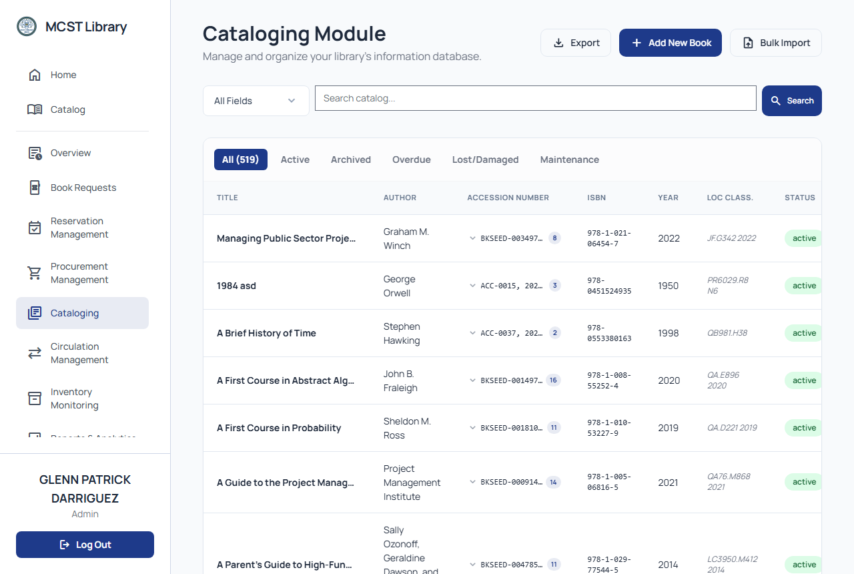
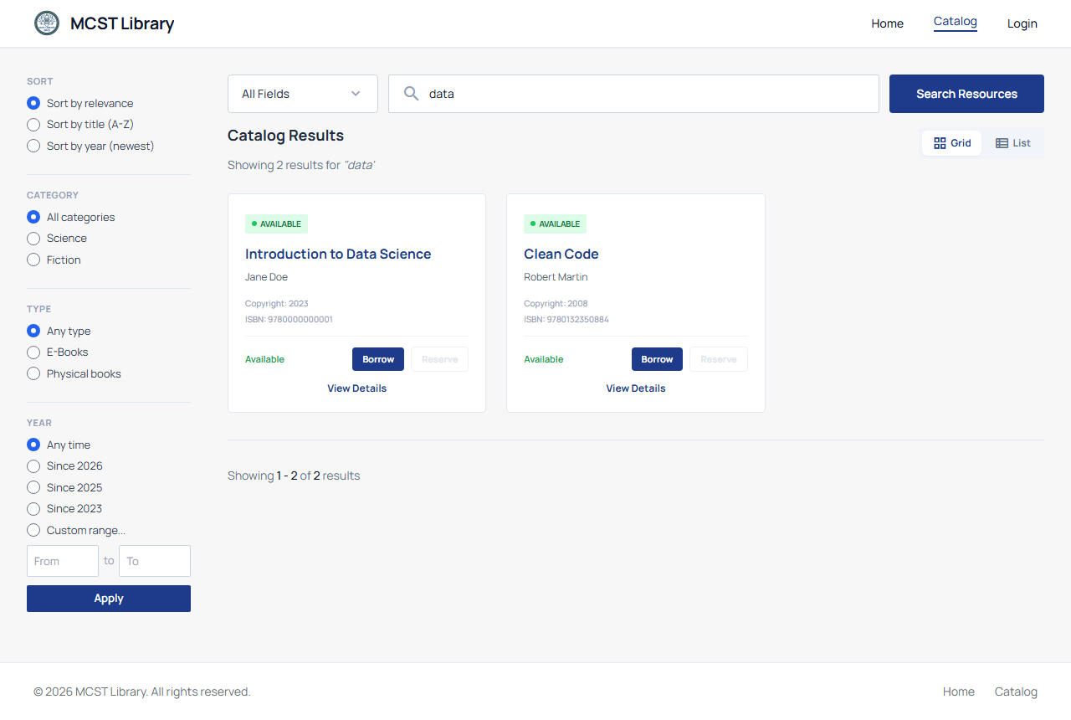
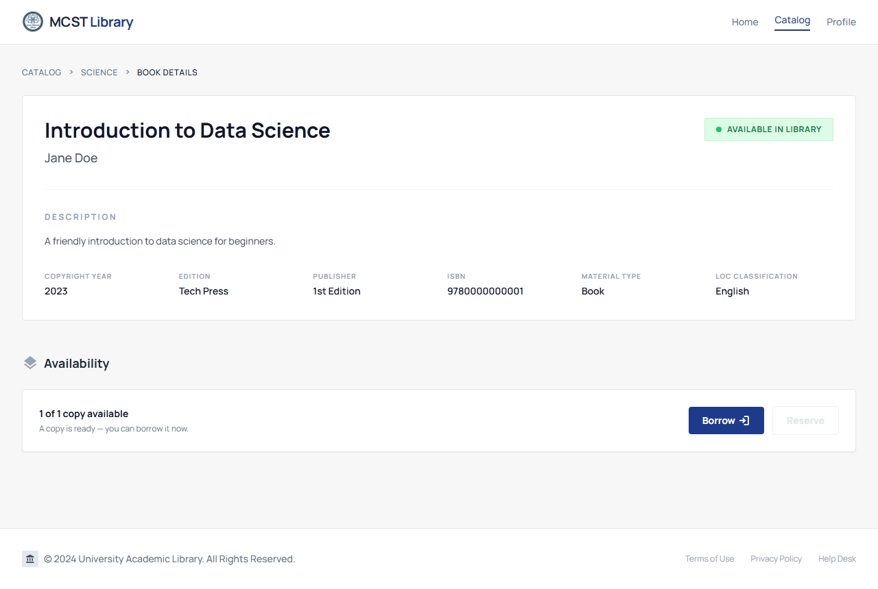
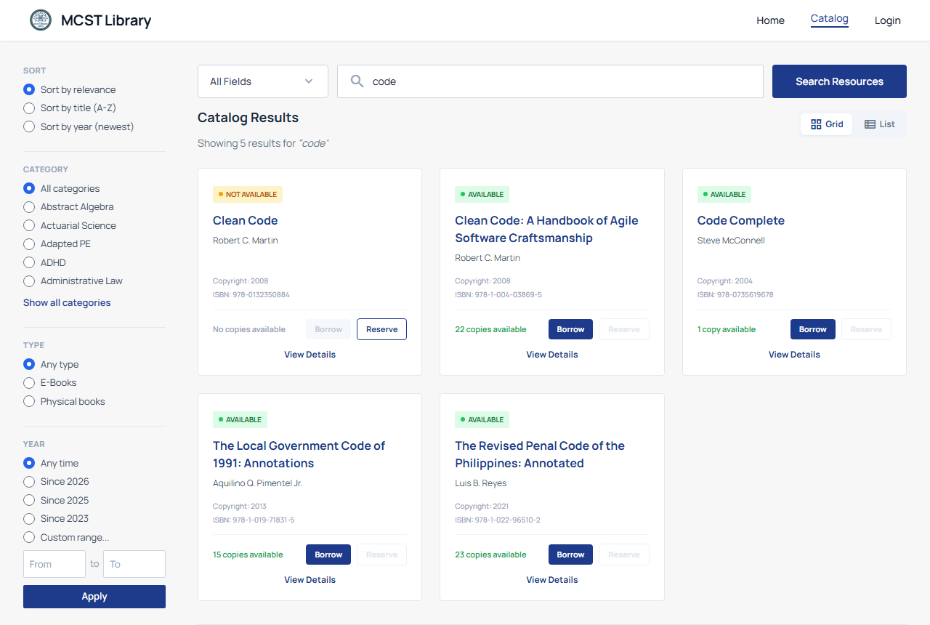
Cataloging, Accessioning, and Public Catalog
06 | FEATURES
Add, edit, and archive records with full bibliographic details.
Automatic accession control numbers and copy numbering.
Bulk CSV import (up to 1,000 records) with per-row validation.
Search by title, author, ISBN, or category; filter chips and availability badges.
Cataloging (remote)
Catalog search
Archive-then-delete policy protects active records.
RESEARCH LINK
Addresses the fragmented workflow: one integrated record, cataloged remotely.
Book details
Filters and badges
Notes:
Si librarian pwede na siya mag catalog remotely or at any place and anytime, with automatic accession numbers, and bulk import up to 1,000 records by CSV. Para naman sa users tulad ng faculty or students we have a public catalog kung saan pwede sila mag search by title, ISBM, or category, makikita rin nila agad dito yung badge kung available ba yung book or not.
Pero hindi parin nito nafifix yung paper-based borrowing kahit na may complete catalog na so…

Slide 10
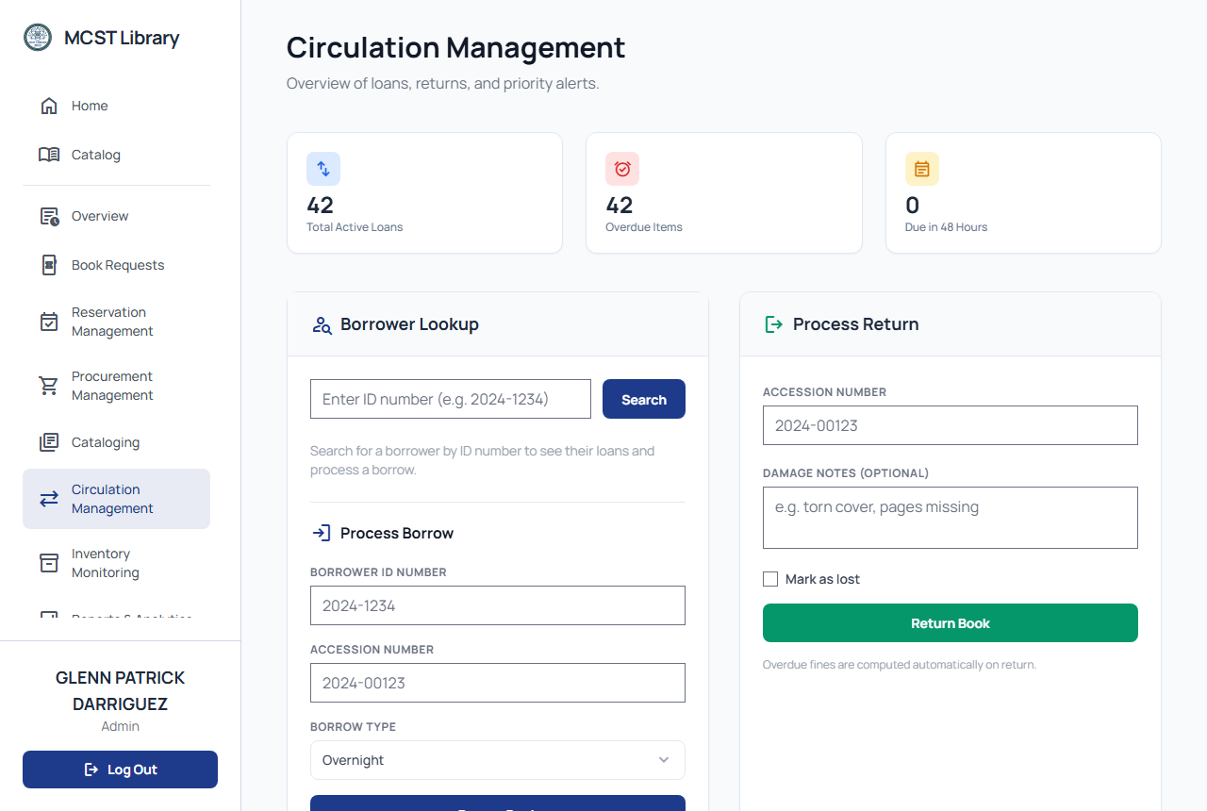
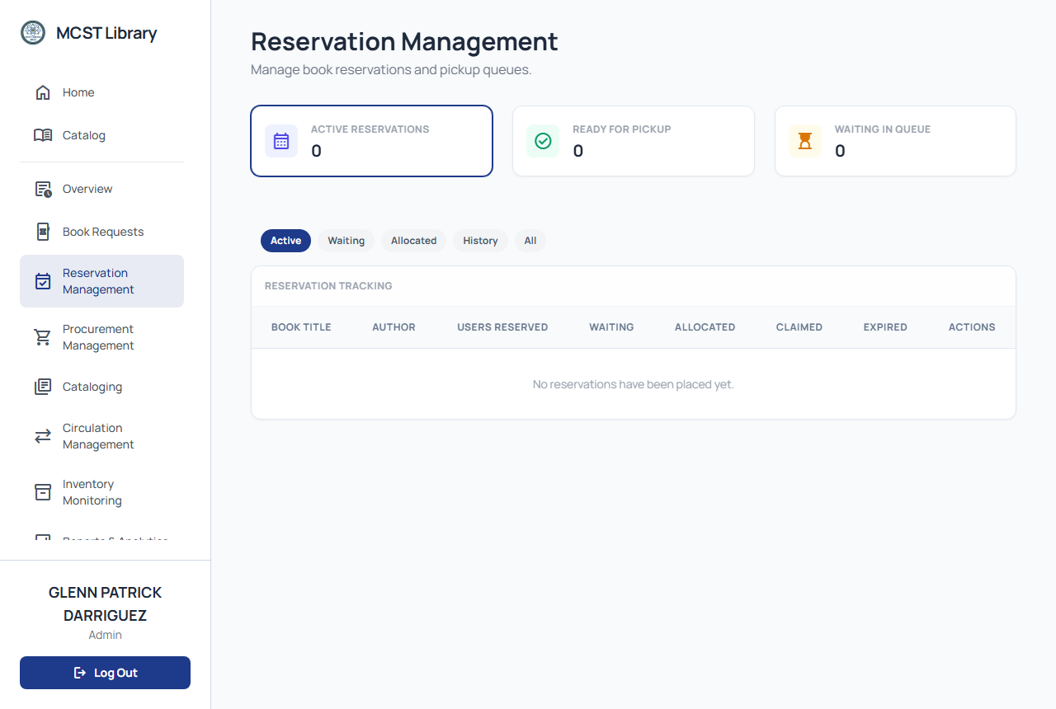
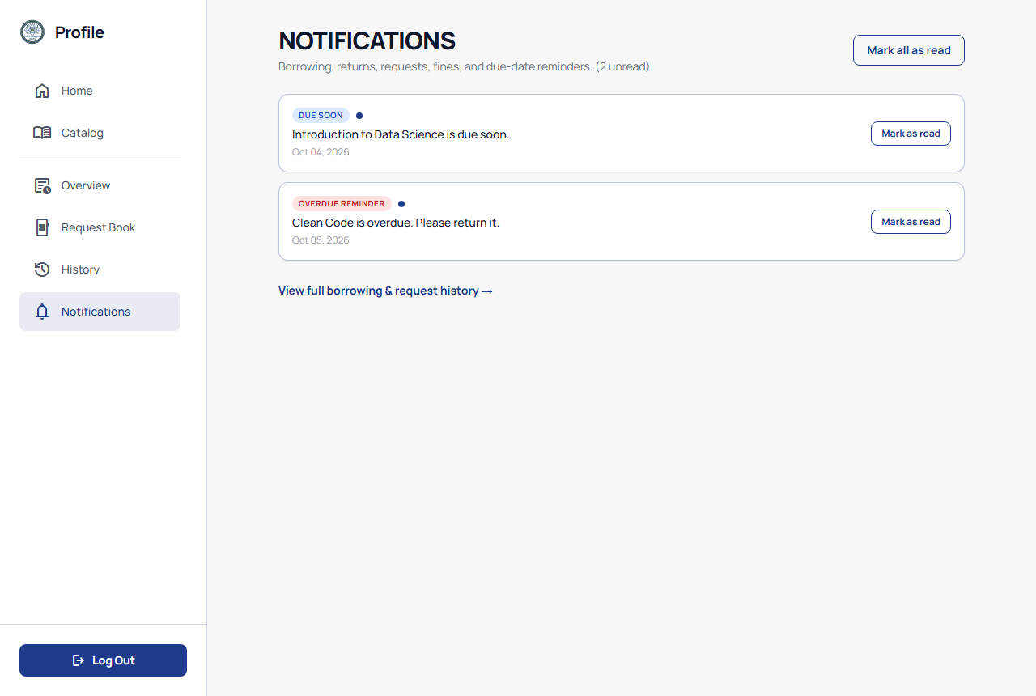
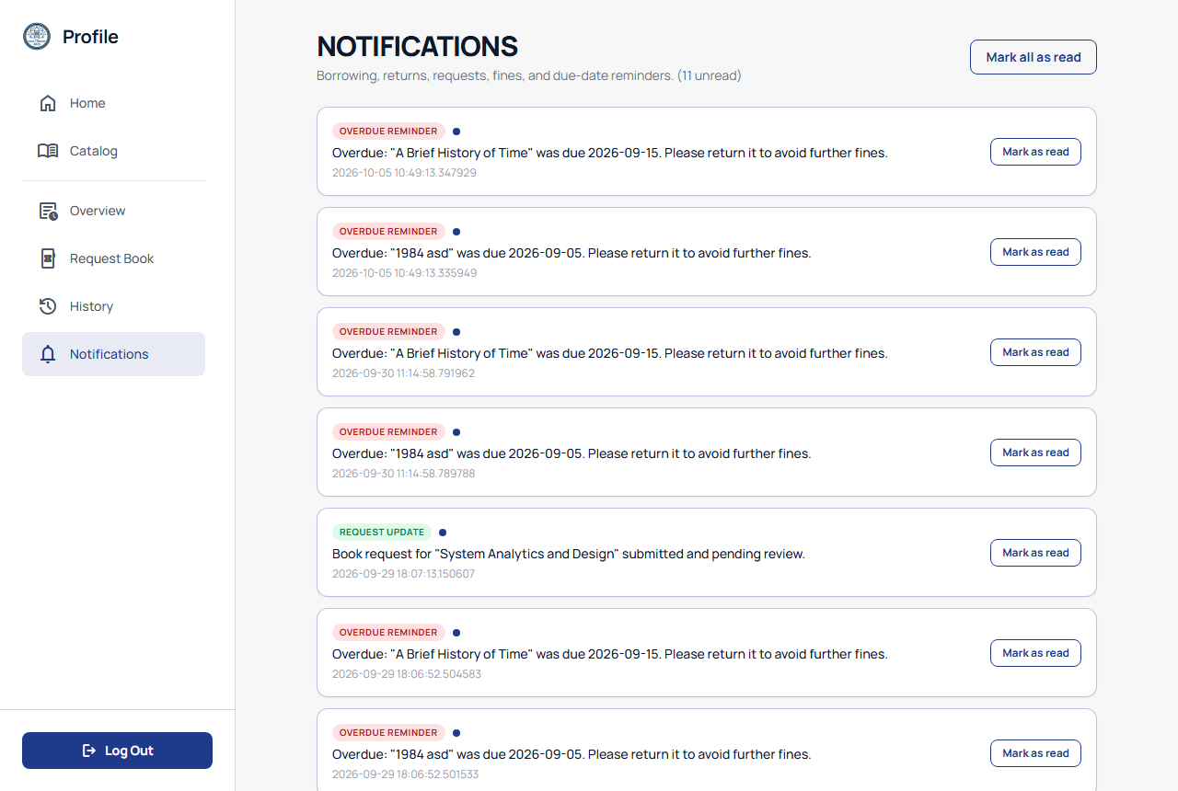
Circulation, Reservations, and Notifications
06 | FEATURES
Borrow and return in the browser, on or off campus; replaces the paper log.
Due dates follow policy and role; fines computed automatically.
FIFO reservation queue per title; 2-hour claim window.
In-system alerts: reservation ready, overdue, request status.
Circulation (remote)
Reservation queue
RESEARCH LINK
Addresses the paper log sheets: the system record is the real record.
Notifications
Notification badges
Notes:
Dito na namin papalitan yung paper log. Borrowing and returning pwede na magawa sa browser, with automatic due dates and fines.
What if hindi available ang book? Dito na papasok si FIFO or the first in first out reservation queue na may 2 hrs claim window, once natapos na yung 2hrs pwde na ito ma-allocate for the next user. Of course meron din kaming notifications, dito manonotify c user kung ang reservation niya is ready na, or ang book is overdue na, or yung request is updated. So yung system record is now a real record.
Pero…. Paano kung yung book is hindi available sa library?

Slide 11
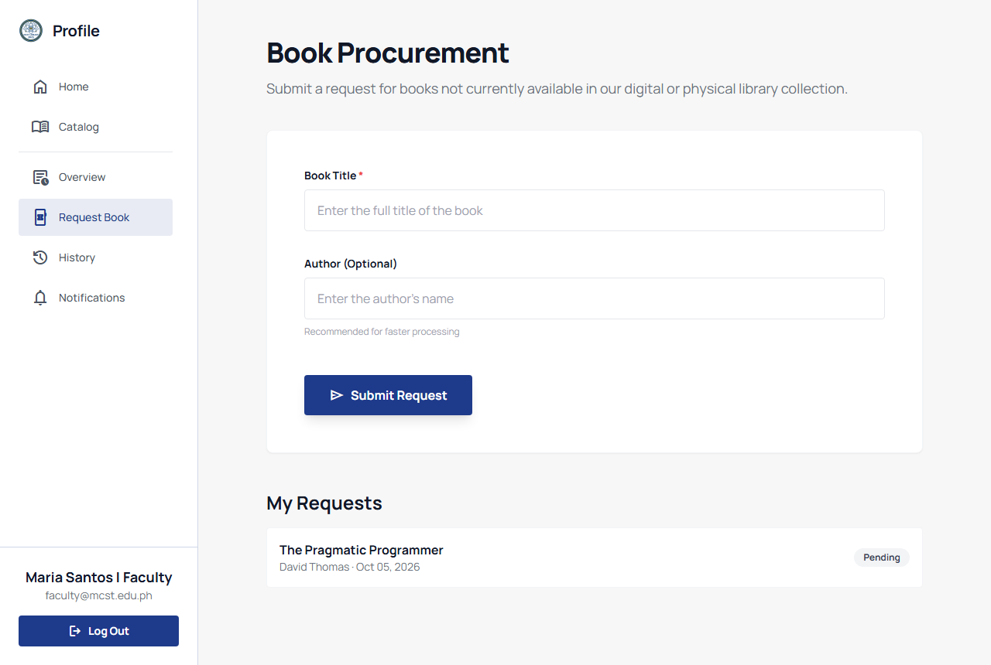
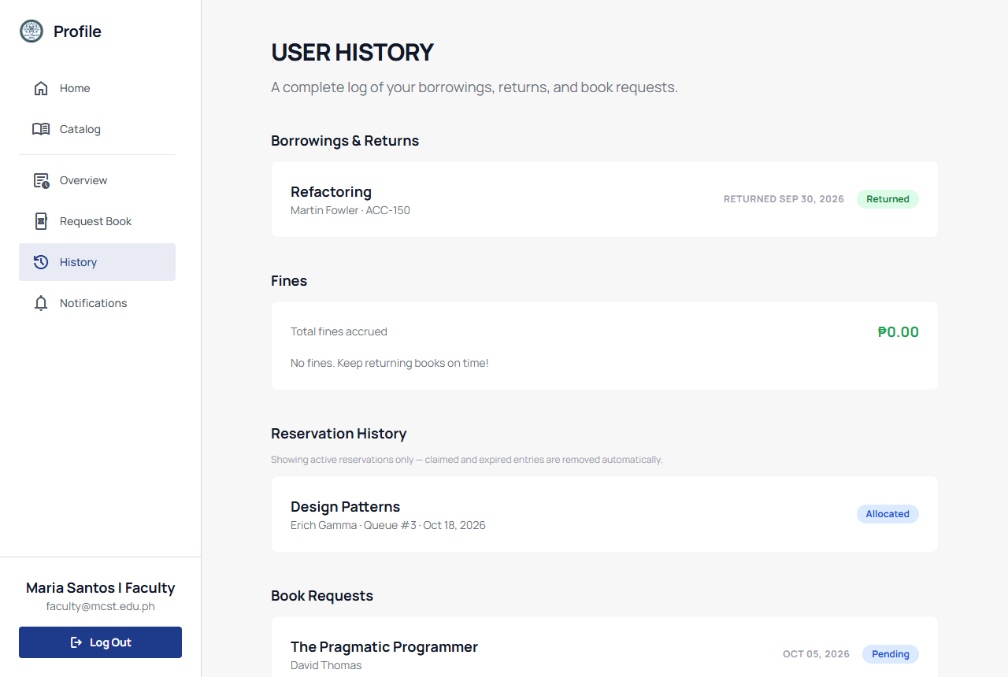
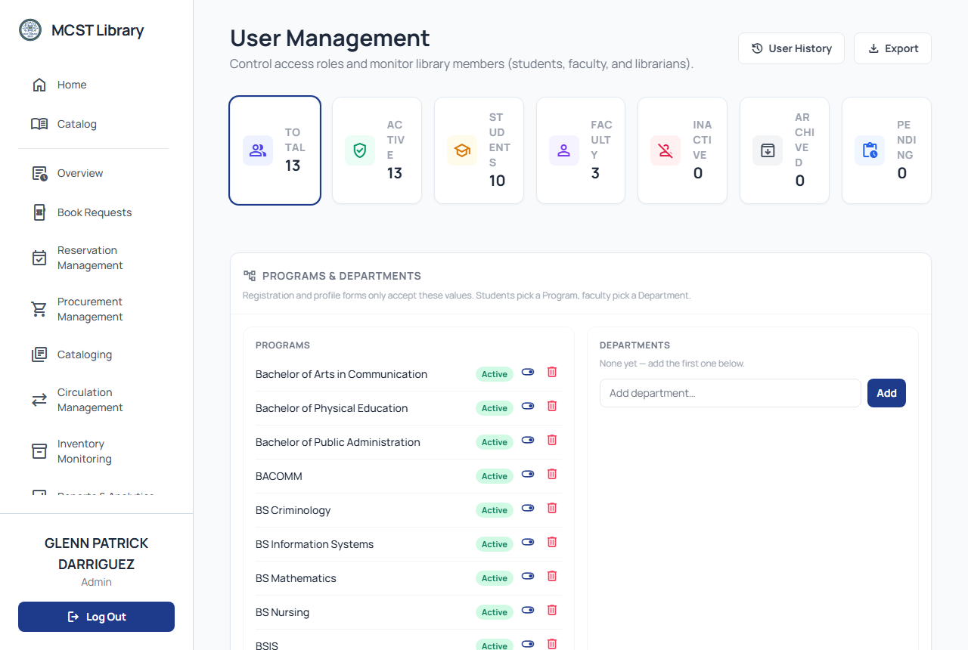
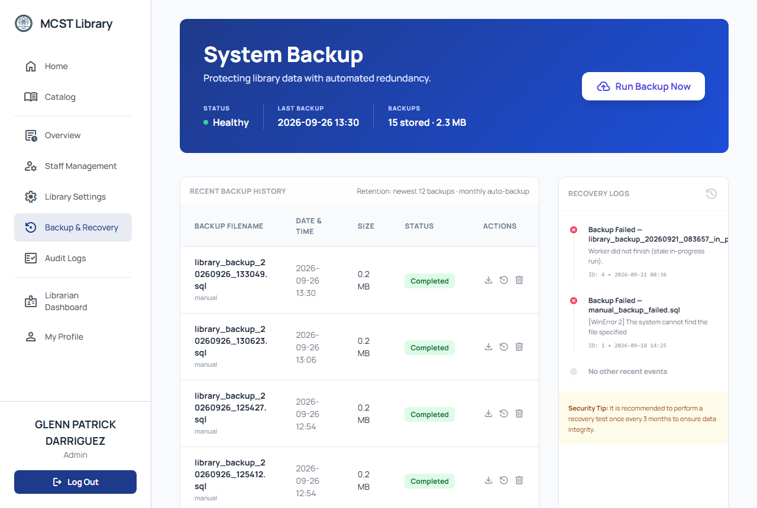
Requests, History, and Administration
06 | FEATURES
Request missing titles and track status live; profile shows borrowed, overdue, and ready counts.
Borrowing history consolidates borrows, reservations, requests, and fines.
User management: approve, disable, archive or restore, change role.
Backup: timestamped SQL dumps plus managed point-in-time recovery; Data Privacy Act 2012-aligned controls.
Book request form
Borrowing history
RESEARCH LINK
Supports self-service and governance.
User management
Backup module
Notes:
Dito na papasok si book request module, dito pwede mag request si users for new titles and pwede rin nilang ma track yung status ng request nila through notification kung yung request ba nila is napproved or na reject. And meron din kaming History ng borrowing makikita dito yung pinagsamang borrows, reservations, requests, and fines sa iisang place lang. As for admins, admins can manage users and yung roles nila, and pwede rin siyang mag run ng backups with timestamped SQL dumps, na aligned sa data privacy act of 2012.
So may system na tayong kayang mag run ng buong library operation. Pero ang real goal naten is further pa, which is turning this daily data into insights. Ito yung reporting dashboard.

Slide 12
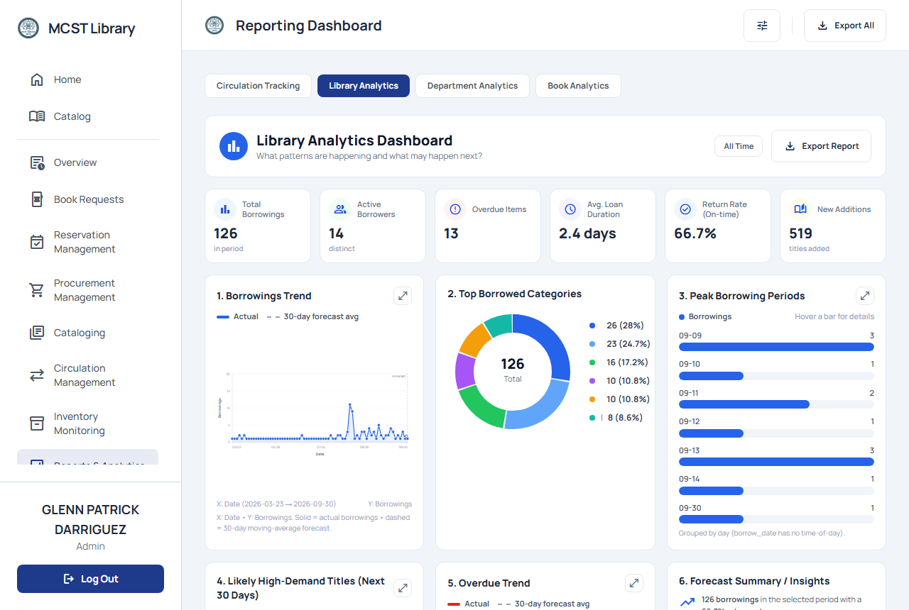

The Reporting Dashboard: Four Analytics Tabs
07 | BUSINESS INTELLIGENCE
Tab 1 Circulation Tracking
1
Where does every book and copy stand now?
Tab 2 Library Analytics
2
What patterns are happening, and what may happen next?
Tab 3 Department Analytics
3
How do programs compare in library usage?
Tab 4 Resource Analytics
4
What is the traffic story of one specific book?
Descriptive analytics with rule-based insights; CSV export and saved snapshots support the budget-defense trail.
Figure 3. Reporting Dashboard overview
Notes:
HIDDEN SCRIPT - Presenter View only. Approx. 1 min. BI overview - the heart of the study. Slow down, this is the differentiator.
"One platform, four analytics tabs, four guiding questions."
Tab 1 - Circulation Tracking: "Where does every book and copy stand RIGHT NOW?"
Tab 2 - Library Analytics: "What patterns are happening, and what may happen NEXT?"
Tab 3 - Department Analytics: "How do programs compare in library usage?"
Tab 4 - Resource Analytics: "What is the traffic story of ONE specific book?"
Close: "All analytics are descriptive with rule-based insights, with CSV export and saved snapshots - that is your budget-defense paper trail." Transition: "Let me show you each tab."

Slide 13
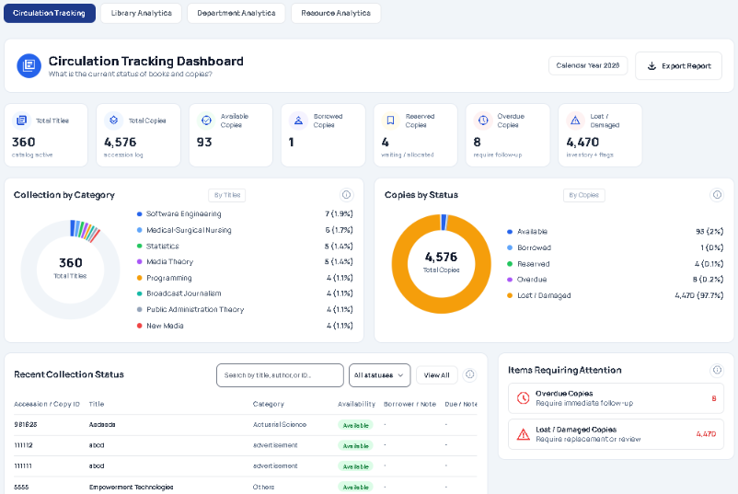
BI Tab 1: Circulation Tracking
07 | BUSINESS INTELLIGENCE
GUIDING QUESTION
Where does every book and copy stand right now?
KPI cards on current stock and activity.
Donut charts by category and by status.
Live table of recent copy movements.
DECISION SUPPORTED
Daily situational view; replaces manual inventory tallies.
Figure 4. Circulation Tracking tab
Notes:
HIDDEN SCRIPT - Presenter View only. Approx. 45 sec. BI Tab 1.
"Tab 1 answers: where does every book and copy stand right now?"
Point at the KPI cards (current stock and activity), the donut charts by category and by status, and the live table of recent copy movements.
DECISION SUPPORTED - say this phrase, panels love it: "This is the daily situational view. It replaces manual inventory tallies."

Slide 14
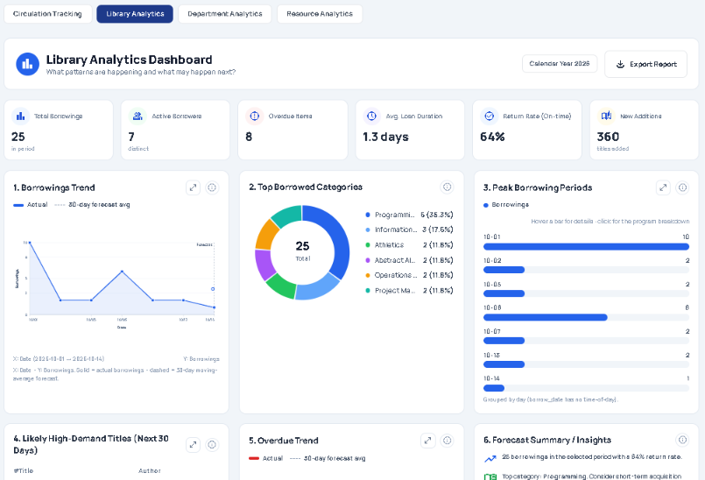
BI Tab 2: Library Analytics
07 | BUSINESS INTELLIGENCE
GUIDING QUESTION
What patterns are happening, and what may happen next?
Borrowing trend with a 30-day moving-average forecast.
Top titles, categories, fines, and requests.
Per-program breakdowns; rule-based insights flag demand spikes.
DECISION SUPPORTED
Early demand signals; final decisions remain with the librarian.
Figure 5. Library Analytics tab
Notes:
HIDDEN SCRIPT - Presenter View only. Approx. 45-60 sec. BI Tab 2.
"Tab 2 answers: what patterns are happening, and what may happen next?"
Highlight the 30-day moving-average forecast on the borrowing trend. Also mention top titles, categories, fines, requests, and per-program breakdowns.
"Rule-based insights flag demand spikes automatically."
Honest framing (panels respect this): "The system surfaces early demand signals - the final acquisition decision remains with the librarian."

Slide 15
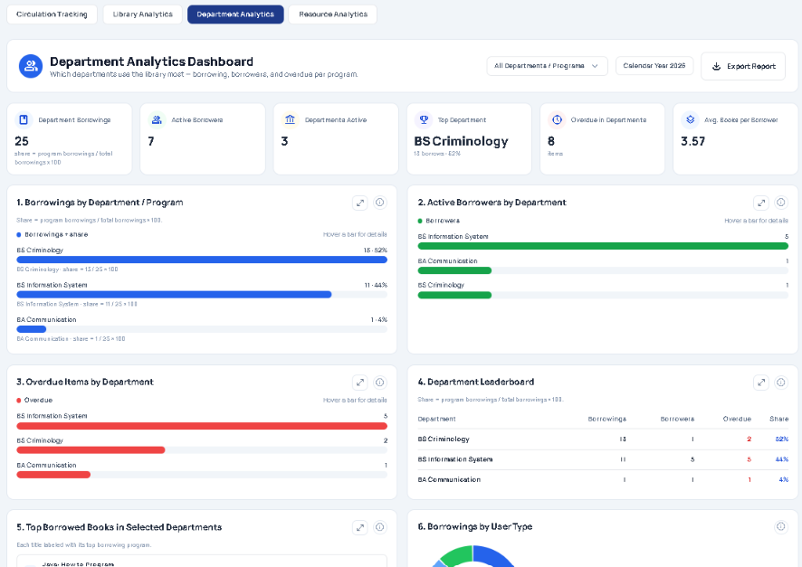
BI Tab 3: Department Analytics
07 | BUSINESS INTELLIGENCE
GUIDING QUESTION
How do programs compare in library usage?
Borrowings, borrowers, and overdues by program.
Direct evidence for program chairs and deans.
Aligns collection with curricula.
DECISION SUPPORTED
Transparent, evidence-based budget allocation between departments.
Figure 6. Department Analytics tab
Notes:
HIDDEN SCRIPT - Presenter View only. Approx. 45 sec. BI Tab 3.
"Tab 3 answers: how do programs compare in library usage?"
"See borrowings, borrowers, and overdues by program - this is direct evidence for program chairs and deans, something they never had before."
Outcome: "It aligns the collection with the curricula, and it supports transparent, evidence-based budget allocation between departments."
If panel asks for an example: e.g., "If two programs both borrow the same titles heavily, budget can follow the evidence."

Slide 16
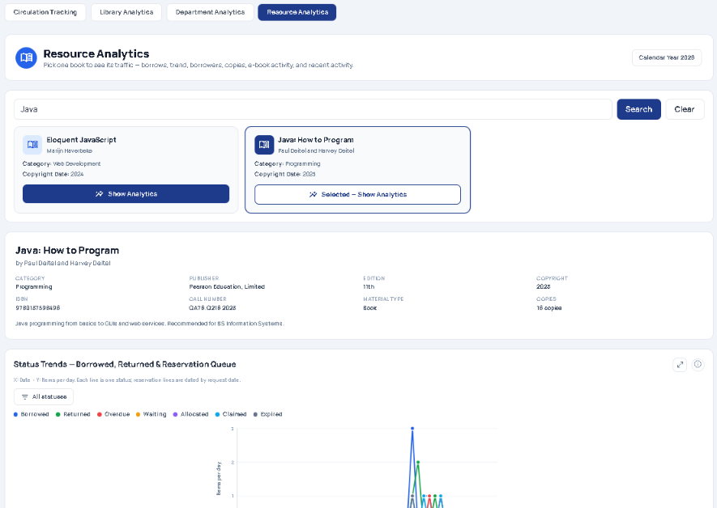
BI Tab 4: Resource Analytics
07 | BUSINESS INTELLIGENCE
GUIDING QUESTION
What is the traffic story of one specific book?
Borrow counts, trend, borrowers, and copies per title.
E-book activity included.
Shows which edition is hot and which copies sit idle.
DECISION SUPPORTED
Copy-count decisions: where to add copies, where to stop re-buying.
Figure 7. Resource Analytics tab
Notes:
HIDDEN SCRIPT - Presenter View only. Approx. 45 sec. BI Tab 4.
"Tab 4 answers: what is the traffic story of ONE specific book?"
"Borrow counts, trend, borrowers, and copies per title - e-book activity included."
The practical punch: "It shows which edition is hot and which copies just sit idle on the shelf."
DECISION SUPPORTED: "Copy-count decisions - where to ADD copies, and where to STOP re-buying. That is how the system pays for itself in avoided dead stock."

Slide 17






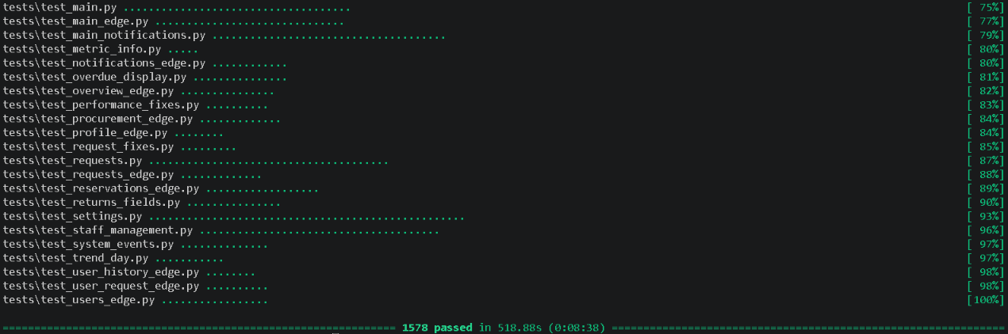
Testing and Evaluation Methodology
08 | TESTING
1
2
3
4
5
Unit Testing
Alpha
Beta
ISO/IEC 25010
UAT
Module logic, database reads and writes, and route behavior checked individually.
Internal testing by the development team; functional defects and edge cases resolved.
Limited release to the librarian and selected faculty under real use; workflow gaps fixed.
Quality evaluation by 4 IT experts and the librarian (n = 5) across 8 characteristics.
User Acceptance Testing with 87 users: 71 students, 15 faculty, 1 librarian.
IMAGE PLACEHOLDER
Photo: UAT / evaluation session
Insert a photo of respondents or experts evaluating the system (faces blurred or with consent).
Figure 9. User Acceptance Testing session.
Figure 8. The actual unit testing of the system.
Notes:
HIDDEN SCRIPT - Presenter View only. Approx. 1.5 min. Testing section - show rigor. Be precise with numbers.
Five stages, in order:
1. Unit testing - module logic, DB reads/writes, routes checked individually.
2. Alpha - internal testing by our dev team; defects and edge cases resolved.
3. Beta - limited release to the librarian and selected faculty under REAL use.
4. ISO/IEC 25010 - 5 evaluators: 4 IT experts plus the librarian, across 8 quality characteristics.
5. UAT - 87 users: 71 students, 15 faculty, 1 librarian.
Mention response-time checks passed for search, borrow/return, and reports (Python timing).
If a photo placeholder is still empty, skip it smoothly - do not apologize.

Slide 18
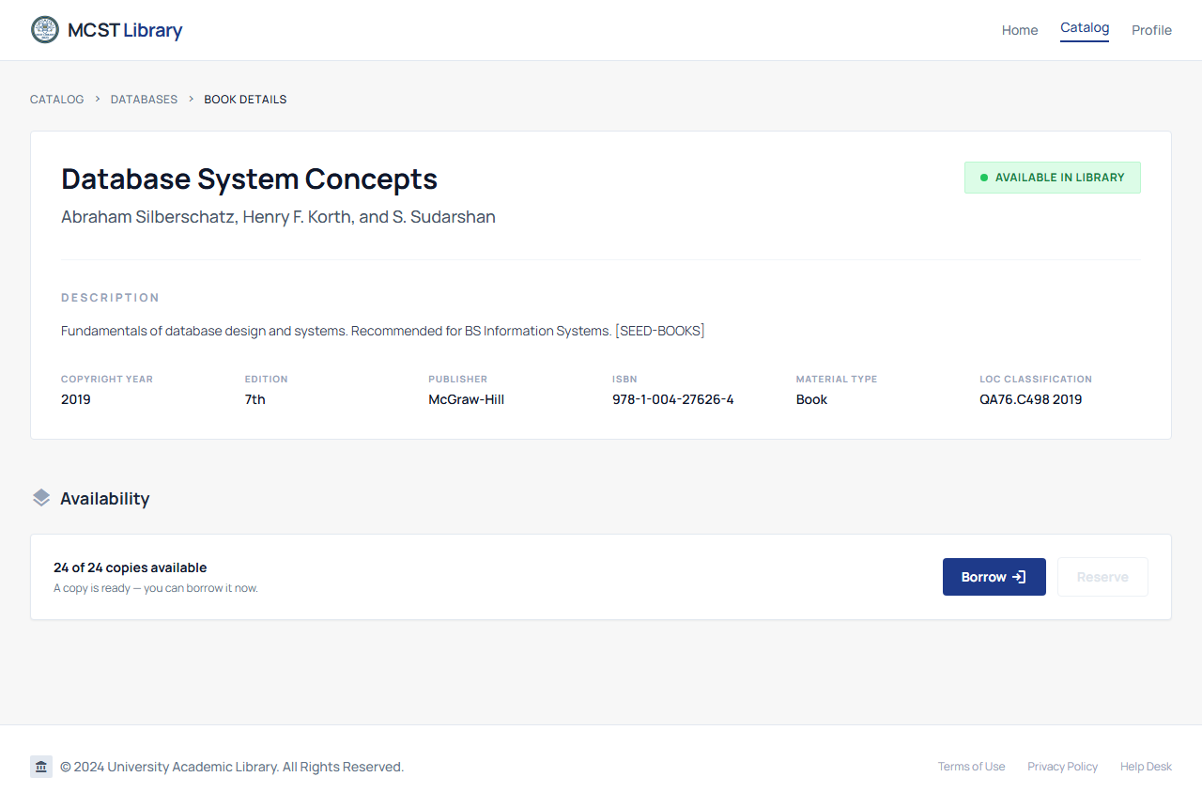




Results Overview: Module-Level Findings
09 | RESULTS
5 / 5
4 / 4
5 / 5
7 / 7
Off-campus tasks passed (login, cataloging, circulation, reports, search)
End-to-end integration cases passed
Analytics KPIs matched manual computation
Security tests passed; audit verified
Usability: UAT 3.38 and ISO 3.92, workable without manual logs.
Security: UAT 3.31 and ISO 3.88.
Performance: search, borrow/return, and report generation within acceptable response time.
Every section mean falls within “Highly Acceptable” (3.26 to 4.00).
Evidence: book details, off-campus test
Notes:
HIDDEN SCRIPT - Presenter View only. Approx. 1.5 min. Results - know these numbers cold. Anticipated panel questions live here.
Lead with passing scores: 5/5 off-campus modules, 4/4 end-to-end integration cases, 5/5 analytics KPIs matched manual computation, 7/7 security tests passed with the audit trail verified.
Then the acceptance numbers: "Usability: UAT 3.38, ISO 3.92 - workable without manual logs. Security: UAT 3.31, ISO 3.88. Performance: acceptable response times across search, circulation, and reports."
LAND IT: "Every section mean falls within Highly Acceptable - that is 3.26 to 4.00."

Slide 19



ISO/IEC 25010:2011 Evaluation Results
09 | RESULTS
3.81
Grand mean: Highly Acceptable (n = 5)
Highest: Functional Suitability, Compatibility, Usability (3.92 each).
Lowest: Reliability (3.60); stability and error recovery are future priorities, not failures.
Scale: 3.26 to 4.00 = Highly Acceptable.
Highest
Lowest
Other
Notes:
HIDDEN SCRIPT - Presenter View only. Approx. 1 min. ISO results.
"Grand mean 3.81 on a five-evaluator panel - Highly Acceptable."
"Highest scores: Functional Suitability, Compatibility, and Usability - 3.92 each."
"On the lowest, Reliability at 3.60 - frame it proactively before they ask: 'stability and error recovery are identified as future priorities, not failures. They are already addressed in our recommendations.'"
Remind the scale: 3.26-4.00 is Highly Acceptable.

Slide 20

User Acceptance Testing: Summary of Findings
09 | RESULTS
3.36
Grand mean: Highly Acceptable (n = 87)
Respondents: 71 students, 15 faculty, 1 librarian.
Overall acceptability 3.43: performs reliably (3.41), improves efficiency (3.43), beneficial for planning (3.46).
All section means fall within 3.26 to 4.00.
Highest
Lowest
Other
Notes:
HIDDEN SCRIPT - Presenter View only. Approx. 1 min. UAT results.
"Grand mean 3.36 with n = 87: 71 students, 15 faculty, 1 librarian."
"Beyond that, overall acceptability is 3.43: users rate it reliable at 3.41, efficient at 3.43, and - the one I want to highlight - beneficial for PLANNING at 3.46."
"That planning number is the study thesis showing up in the data: the system is not just easier - it helps users make decisions."
"All section means fall within the Highly Acceptable range, 3.26 to 4.00."

Slide 21

Recommendations
10 | RECOMMENDATIONS
Full Implementation
Adoption
User Training
1
1
2
2
3
3
Deploy on institutionally managed hosting as usage grows beyond the tested load.
Strengthen stability and error recovery (ISO Reliability 3.60, the lowest score).
Add a permissions model beyond roles, and a full disaster-recovery plan.
Integrate with KOHA for continuity with existing records.
Phase out paper log sheets so the system record becomes the only record.
Name librarian and faculty champions to lead the rollout.
Use the Reporting Dashboard in acquisition and budget meetings.
Refine trend visualization and report customization from user feedback.
Orientation sessions for students and faculty.
User guides for each role: Admin, Librarian, Faculty, Student.
Staff training on role management, audit trail, and backup procedures.
Refresher sessions as features are added.
FUTURE RESEARCH Larger samples, longer deployment, scalability beyond tested limits, and predictive forecasting.
Notes:
For our recommendations, we have three main priorities.
First, Full Implementation. We recommend na gumamit ng institutionally managed hosting para mas maging stable ang system. We also suggest improving error recovery, strengthening permissions, preparing a disaster recovery plan, and considering integration with KOHA.
Second, Adoption. We recommend na unti-unting alisin ang paper log sheets at gamitin na ang system for daily transactions. We also encourage using the Reporting Dashboard during budget discussions para mas maging data-driven ang decision-making.
Third, User Training. Mahalaga ang proper orientation and user guides para mas maintindihan ng bawat user kung paano gamitin ang system.
For future researchers, we recommend testing the system for a longer period and exploring predictive forecasting kapag mas marami nang historical data.

Slide 22



With Our System, Everyone Gains
10 | RECOMMENDATIONS
Librarians can
Faculty can
Students can
Process borrowing and returns in the system, with no paper log.
Catalog from anywhere and bulk-import up to 1,000 records.
See stock, demand, and program usage in four BI tabs.
Search the catalog and request new titles from anywhere.
Track request status and borrowing history in one place.
Reserve unavailable titles through a fair queue.
Search with live availability and filters.
Get notified when a reserved book is ready.
Track borrows, fines, and requests in one profile.
SDG ALIGNMENT
SDG 4
Quality Education
SDG 9
Industry, Innovation and Infrastructure
Structured, accessible learning materials for students and faculty through a digital library.
A technology solution that strengthens information management and innovation at MCST.
Notes:
Sa pamamagitan ng system namin, bawat user ay may kanya-kanyang benefit.
For librarians, mas mapapadali ang pag-manage ng books and transactions, at magkakaroon sila ng dashboard para makita ang library trends.
For faculty, mas madali nang mag-search, mag-request, at mag-reserve ng books kahit hindi nasa library.
For students, they can check book availability, receive notifications, and view their borrowing records and requests in one place.
Our system also supports SDG 4, or Quality Education, by making learning resources more accessible, and SDG 9, or Industry, Innovation, and Infrastructure, by using technology to improve library operations.
Ultimately, hindi lang namin gustong mapadali ang library transactions. Gusto rin naming makatulong sa paggawa ng better decisions through organized data and useful insights.

Slide 23




From Managing Books to Making Better Decisions
11 | CLOSING
A modern library should do more than manage resources.
IT SHOULD…
1
2
3
Understand demand
Connect people to knowledge
Turn everyday transactions into insights for better decisions
Information is a source of learning. But unless it is organized, processed, and available to the right people in a format for decision making, it is a burden, not a benefit.
— C. William Pollard, The Soul of the Firm (2000).
Notes:
HIDDEN SCRIPT - Presenter View only. Approx. 1 min. Closing.
Slow down here; this is the takeaway they must remember.
"A modern library should do more than manage resources. It should understand demand. Connect people to knowledge. And turn everyday transactions into insights for better decisions."
Read or paraphrase the Pollard quote naturally - do not rush it.
Then: "From managing books... to making better decisions. That is our study."

Slide 24
Thank you.
11 | CLOSING
Every Borrow Tells a Story.
Every Data Point Can Guide a Decision.
The goal is no longer just to know what books we have. It is to understand what our academic community needs.
Mandaluyong College of Science and Technology
That is the library we are building.
BSIS 404 Not Found
Notes:
HIDDEN SCRIPT - Presenter View only. Final slide. Approx. 30 sec + Q&A readiness.
Final lines, delivered with confidence:
"Every borrow tells a story. Every data point can guide a decision."
"The goal is no longer just to know what books we have - it is to understand what our academic community needs. That is the library we are building."
"Thank you. We are happy to take your questions."
LIKELY PANEL QUESTIONS - review before the defense:
- Why not extend KOHA instead of building new? (Answer: integrated BI + simpler UX; KOHA integration is in recommendations.)
- Where is machine learning? (Out of scope; descriptive + rule-based - say it again.)
- Data privacy handling? (DPA 2012-aligned controls, timestamped backups, role-based access.)
- Scalability? (Tested load stated; institutional hosting is recommendation #1.)
- Cost/hosting? (Have a one-line answer ready.)

