Slide 1
SU 2024 IOT102t Bluetooth-controlled traffic light
Group 05 – Class SE1826
SE182869 – Pham Minh Tuan 25%
SE182916 – Nguyen Ngoc Trai 25%
SE182958 – Huynh Quoc Khang 25%
SE182892 – Hoang Trung Tin 25%
Supervisor Dang Ngoc Minh Duc

Slide 2
INTRODUCTION Objective
Bluetooth-controlled traffic light uses Bluetooth technology to manage traffic signal systems, helping to reduce time for traffic participants and increasing circulation efficiency at junctions.

Slide 3
INTRODUCTION Requirement
This system is researched and designed by us with feature:
-Use a Bluetooth module to communicate with the central controller and mobile application.
-Alter green, red, and yellow light times using mobile app.

Slide 4
INTRODUCTION Components
Title: Bluetooth-controlled traffic light
Description:
Red, yellow and green LEDs:
Button:
7- segment display:
Led- Control 8x8:
Mobile Phone (Android) and Module
Bluetooth HC05:

Slide 5
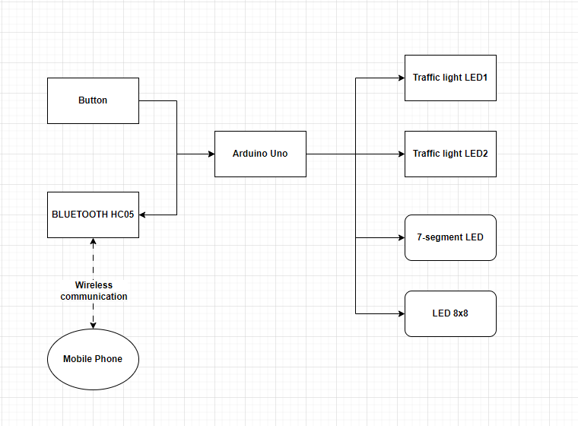
BLOCK DIAGRAM

Slide 6
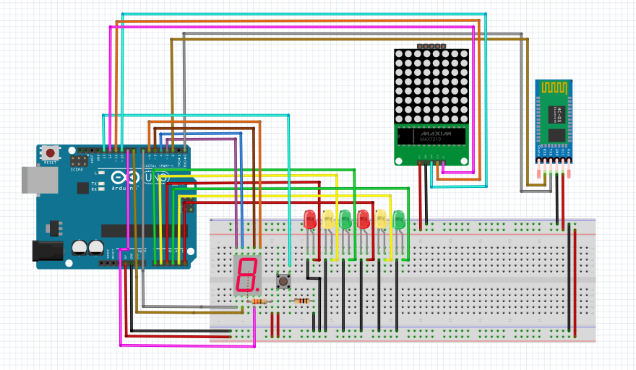
CIRCUIT SCHEMATIC

Slide 7
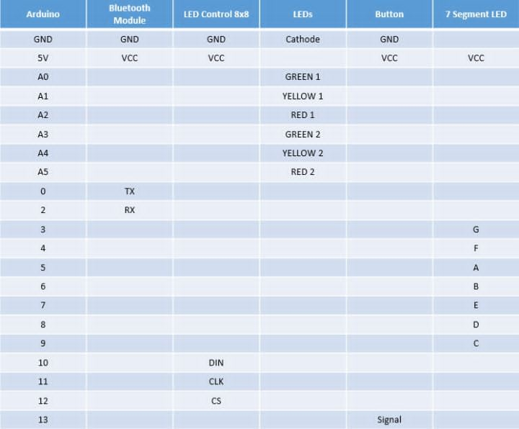
HARDWARE INTERFACING

Slide 8
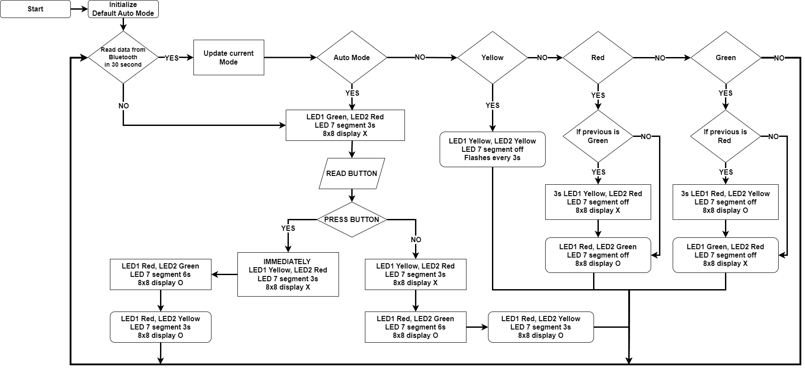
FLOW CHART

Slide 9
OUTCOME
Value:
Developing a traffic light system that can be remotely managed by users.

Slide 10
OUTCOME
Challenge:
+ The wire is not plugged correctly
(Incorrect Pin)
+ Having problems comprehending how to handle the standard traffic light system.
Future Plans:
+ Improve security for the traffic signal system.
+ Collect Data about traffic conditions.

Slide 11
THANK YOU

