Slide 1

SoK: Understanding the State of IoT-specific Vulnerabilities via CVE Characterization with LLIoT
Tina Rezaei
Suzan Bayhan
Andrea Continella
Jeroen van der Ham-de Vos
Roland van RijsWijk-Deij

Slide 2
Motivation
IoT attacks usually use known vulnerabilities for exploitation.
  A 2019 study (Feng et al., CCS): 96% of attack scripts captured by IoT honeypots matched publicly available vulnerability reports.
Known IoT vulnerabilities can inform improved or targeted mitigation.
Problem​
NVD is the most reach source of vulnerabilities since 1999, but no metadata about IoT. ​
Hard to find IoT CVEs among hundreds of thousands of records.​
Feng et al., “Understanding and securing device vulnerabilities through automated bug report analysis”, USENIX Security, 2019​
1

Slide 3
What prior work has done
IoT CVE distinction
  Reliance on weak heuristics such as keyword filtering or metadata (e.g., CPE) followed by human review
    high false positives & low coverage
    limited scalability.
  Underspecified IoT definitions.
IoT taxonomy
  Prior IoT taxonomies vary in granularity and perspective
2

Slide 4
What we do
LLIoT: An LLM-assisted approach to systematically distinguish IoT CVEs at large scale
Phase 1: Ground-truth & validation
Phase 2: Large scale classification
Phase 3: Characterization
Define IoT taxonomy
Create keyword dictionaries
Filter CVEs
Manual review
Validate LLMs and human
Apply best-performing LLM
Classify all 225k CVEs
Consistency analysis
Comparison with prior datasets
Manual verification
Temporal trends
Severity analysis
Weakness families
Actionable recommendations
3

Slide 5
IoT Taxonomy & Classification Rules
4-layer IoT taxonomy:
Device
Communication
Application
Cloud backend
Constrained hardware, firmware, embedded OS
Low-power protocols and their stacks
Companion apps and orchestration
IoT-specific cloud endpoints
AWS IoT, Azure IoT, Google Cloud IoT
IP camera, thermostat, FreeRTOS, smart lock
ZigBee, BLE, 6LoWPAN, LoRaWAN, MQTT, CoAP
Home Assistant, SmartThings, IFTTT, OpenHAB
Typical flaws: misconfig, insecure APIs/tokens
Typical flaws: firmware, hardware, embedded OS bugs
Typical flaws: protocol design, stack bugs
Typical flaws: design and logic flaws
4

Slide 6
IoT Taxonomy & Classification Rules
4-layer IoT taxonomy:
Device
Communication
Application
Cloud backend
Constrained hardware, firmware, embedded OS
Low-power protocols and their stacks
Companion apps and orchestration
IoT-specific cloud endpoints
AWS IoT, Azure IoT, Google Cloud IoT
IP camera, thermostat, FreeRTOS, smart lock
ZigBee, BLE, 6LoWPAN, LoRaWAN, MQTT, CoAP
Home Assistant, SmartThings, IFTTT, OpenHAB
Typical flaws: misconfig, insecure APIs/tokens
Typical flaws: firmware, hardware, embedded OS bugs
Typical flaws: protocol design, stack bugs
Typical flaws: design and logic flaws
Classification rules:
IoT-specific = technology purpose-built for IoT + deployed in IoT context + is an active element of an IoT system
Non-IoT = Vulnerabilities not fit in IoT + smartphones/laptops/PCs + Network infrastructures (routers, modems)
4

Slide 7
Building the Ground-Truth Dataset
Ground-truth sample selection
Ground-truth labeling
4 IoT Keyword dictionaries (one per layer)
851 potential IoT CVEs filtered
150 potential IoT CVEs randomly samples
150 potential non-IoT CVEs randomly samples
Total 300 CVEs for expert review
9 reviewers (Security professor, Security exert, PhDs in IoT & cybersecurity, Internet measurement, Quantum crypto for IoT, Web privacy)
Divided in 3 groups of 3 reviewers
100 CVEs per group, each CVE reviewed by 3 people
CVE label set by majority voting
5

Slide 8
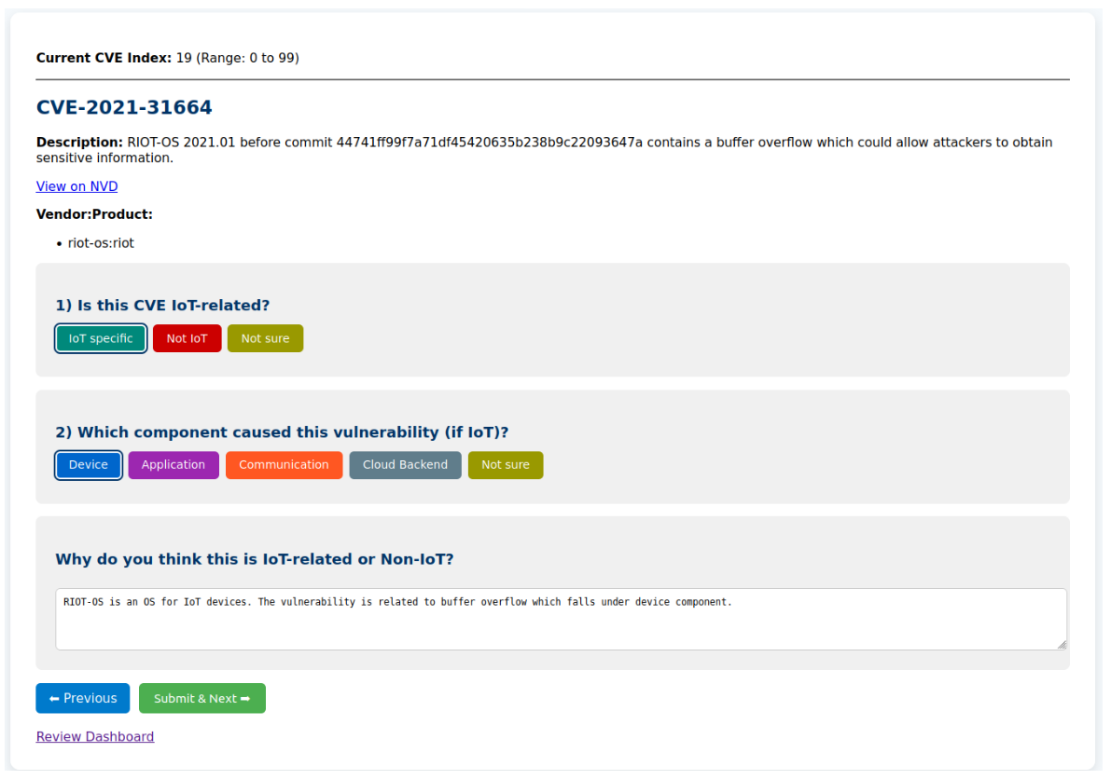
Building the Ground-Truth Dataset​
Affected vendor & product
Description
IoT/Non-IoT label?
Layer-level label?
Reasoning?
6

Slide 9
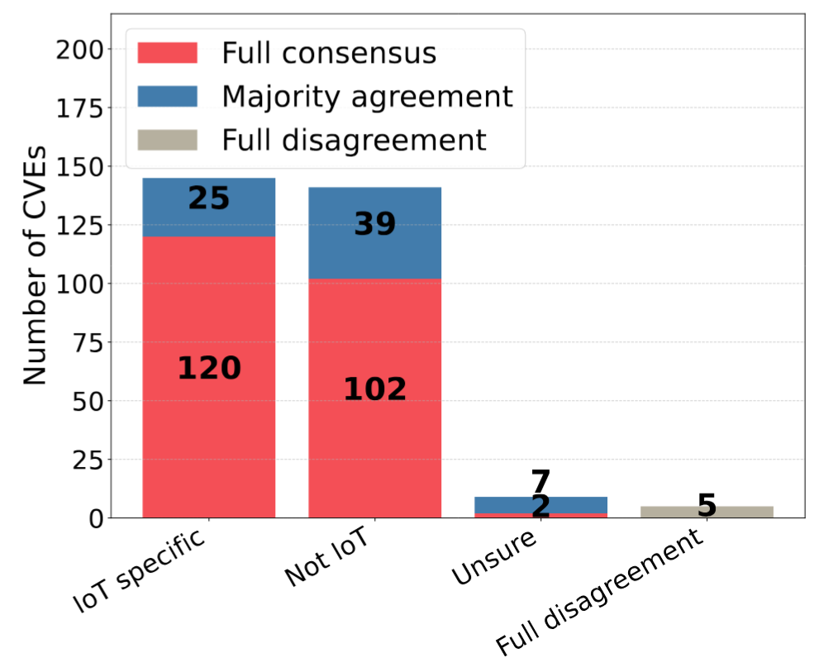
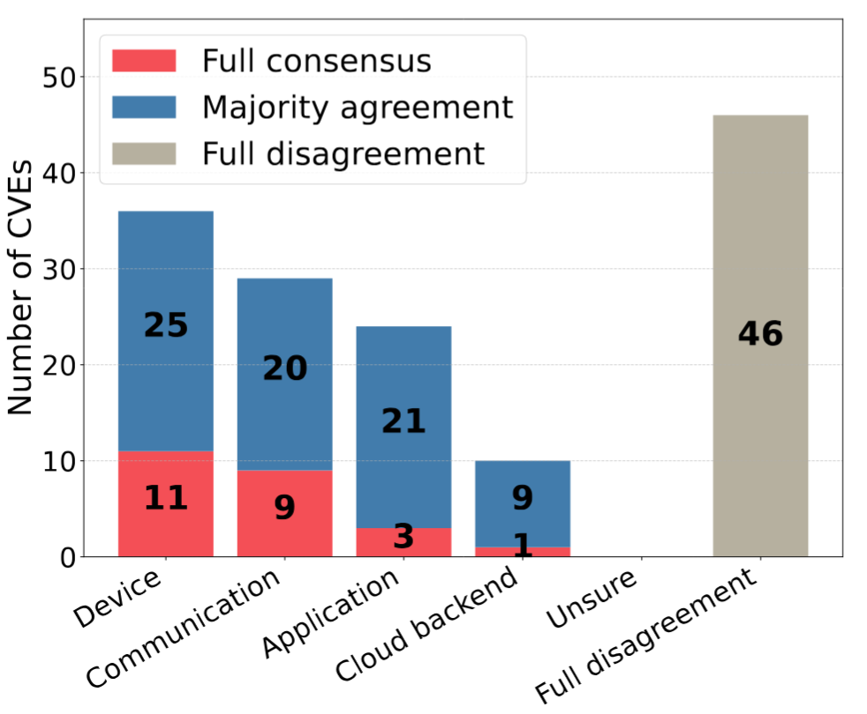
Manual labeling outcomes
IoT/Non-IoT Classification
Layer-level classification
Krippendorff α = 0.80
Krippendorff α = 0.28
Satisfactory agreement
Poor agreement
CVE descriptions lack technical detail
Reviewer expertise gaps
Some vulnerabilities span multiple layers
Tie breaker
148 IoT & 152 non-IoT
7

Slide 10
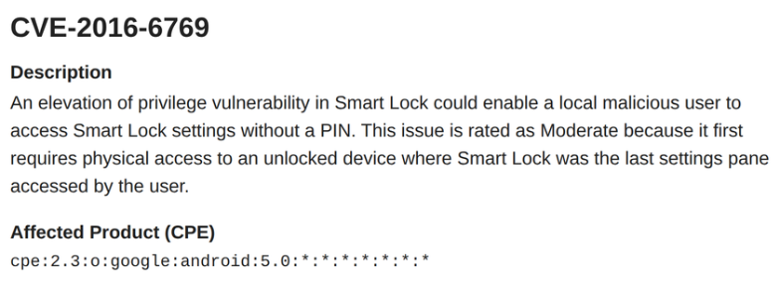
LLM Performance on the Ground-Truth Dataset​
Model | Accuracy | Precision | Recall | F1 score
O3 | 94.67 | 93.96 | 95.24 | 94.59
GPT-4O | 95.33 | 94.04 | 96.60 | 95.30
DeepSeek-r1-70B | 92.67 | 89.81 | 95.92 | 92.76
Llama4-scout | 89.33 | 83.63 | 97.28 | 89.94
LLM vs human reasoning
Human errors:
Cognitive error -> "smart lock" misread as IoT device while Android feature (CVE-2016-6769)
Limited domain-knowledge -> "modem" misunderstood as cable modem
(CVE-2022-33211)
Unsure labels for poorly documented technologies (CVE-2024-25507)
LLM errors:
Borderline technologies (Busy box, WolfSSL)
8

Slide 11
LLM Performance on the Ground-Truth Dataset​
Model | Accuracy | Precision | Recall | F1 score
O3 | 94.67 | 93.96 | 95.24 | 94.59
GPT-4O | 95.33 | 94.04 | 96.60 | 95.30
DeepSeek-r1-70B | 92.67 | 89.81 | 95.92 | 92.76
Llama4-scout | 89.33 | 83.63 | 97.28 | 89.94
LLM vs human reasoning
Human errors:
Cognitive error -> "smart lock" misread as IoT device while Android feature (CVE-2016-6769)
Limited domain-knowledge -> "modem" misunderstood as cable modem
(CVE-2022-33211)
Unsure labels for poorly documented technologies (CVE-2024-25507)
LLM errors:
Borderline technologies (Busy box, WolfSSL)
Model | Accuracy | Precision | Recall | F1 score
Human reviewers | 97.58 | 98.6 | 97.24 | 97.92
O3 | 99.31 | 100 | 99.31 | 99.65
GPT-4O | 97.58 | 97.28 | 98.62 | 97.95
DeepSeek-r1-70B | 96.19 | 94.7 | 98.62 | 96.62
Llama4-scout | 92.39 | 87.8 | 99.31 | 93.2
8

Slide 12
Phase 2: Large scale classification
Phase 1: Ground-truth & validation
Phase 2: Large scale classification
Define IoT taxonomy
Create keyword dictionaries
Filter CVEs
Manual review
Validate LLMs and human
Apply best-performing LLM
Classify all 225k CVEs
Consistency analysis
Comparison with prior datasets
Manual verification
9

Slide 13
Large Scale Classification & Consistency
Applying O3 to all CVEs from 2013 to 2024 (225,262) 15,066 IoT CVEs
Consistency analysis
10 classification iterations on 1000 randomly selected CVEs (500 IoT & 500 Non-IoT)
Unanimity (U): Measures how often the exact same label is assigned to a CVE across all runs
Maximum class agreement(C): Measures consistency per CVE, the fraction of most frequent assigned label
 | U | 95% bootstrap CI | C | 95% bootstrap CI | n
Overall | 0.92 | [0.90, 0.94] | 0.98 | [0.97, 0.98] | 1000
IoT | 0.86 | [0.83, 0.88] | 0.96 | [0.95, 0.97] | 500
Non-IoT | 0.98 | [0.97, 0.99] | 0.99 | [0.995, 0.999] | 500
10

Slide 14
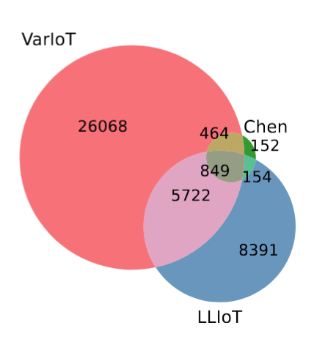
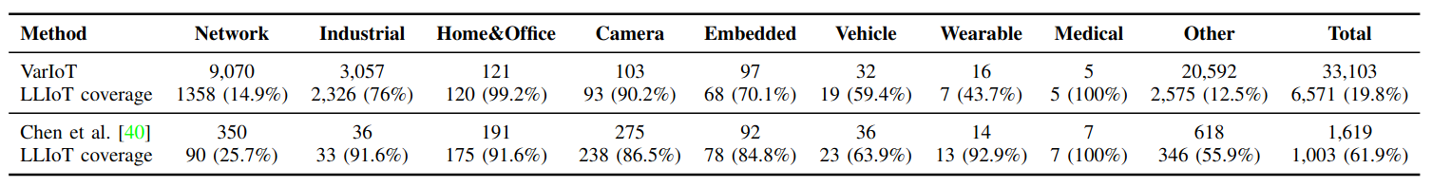
Dataset Comparison and Quality Validation​
Dataset | # IoT CVEs | Methodology
VarIoT | 33,103 | Keyword filtering (multi-level)
Chen et al. | 1,619 | Keyword filtering + manual review
LLIoT | 15,066 | LLM assisted
Why is VarIoT so large?
Janiszewski et al., "Automatic actionable information processing and trust management towards safer Internet of Things", Sensors, 2021
Chen et al., "An empirical study of high-risk vulnerabilities in IoT systems", IEEE Internet of Things Journal, 2024
11

Slide 15
Dataset Comparison and Quality Validation​
Dataset | # IoT CVEs | Methodology
VarIoT | 33,103 | Keyword filtering (multi-level)
Chen et al. | 1,619 | Keyword filtering + manual review
LLIoT | 15,066 | LLM assisted
Why is VarIoT so large?
Janiszewski et al., "Automatic actionable information processing and trust management towards safer Internet of Things", Sensors, 2021
Chen et al., "An empirical study of high-risk vulnerabilities in IoT systems", IEEE Internet of Things Journal, 2024
11

Slide 16
Dataset Comparison and Quality Validation​
Manual verification of 100 samples per dataset
VarIoT
Chen et al.
LLIoT
43 network devices
21 chipsets and OSes (iOS, macOS, tvOS)
36 Non-IoT (Google Chrome, WordPress plugins, Perl, Adobe Flash Player, Safari )
Keyword search: 671 Adobe Flash. 801 Safari. 62 WordPress
13 network devices
59 chipsets and various Android and Linux drivers
28 Non-IoT (Windows, wired speakers, desktop and non-IoT web apps )
22 IoT consumer devices (cameras, infusion pump, smart lock, printer, drone, smartTV, wearable)
9 chipsets and 64 (EV charging station, building automations, industrial controller, IoT SDK, communication stack)
4 Non-IoT (PLC engineering software, robotics simulation software, and web management software)
12

Slide 17
Phase 3: IoT vs non-IoT characterization
Phase 1: Ground-truth & validation
Phase 2: Large scale classification
Phase 3: Characterization
Define IoT taxonomy
Create keyword dictionaries
Filter CVEs
Manual review
Validate LLMs and human
Apply best-performing LLM
Classify all 225k CVEs
Consistency analysis
Comparison with prior datasets
Manual verification
Temporal trends
Severity analysis
Weakness families
Actionable recommendations
13

Slide 18
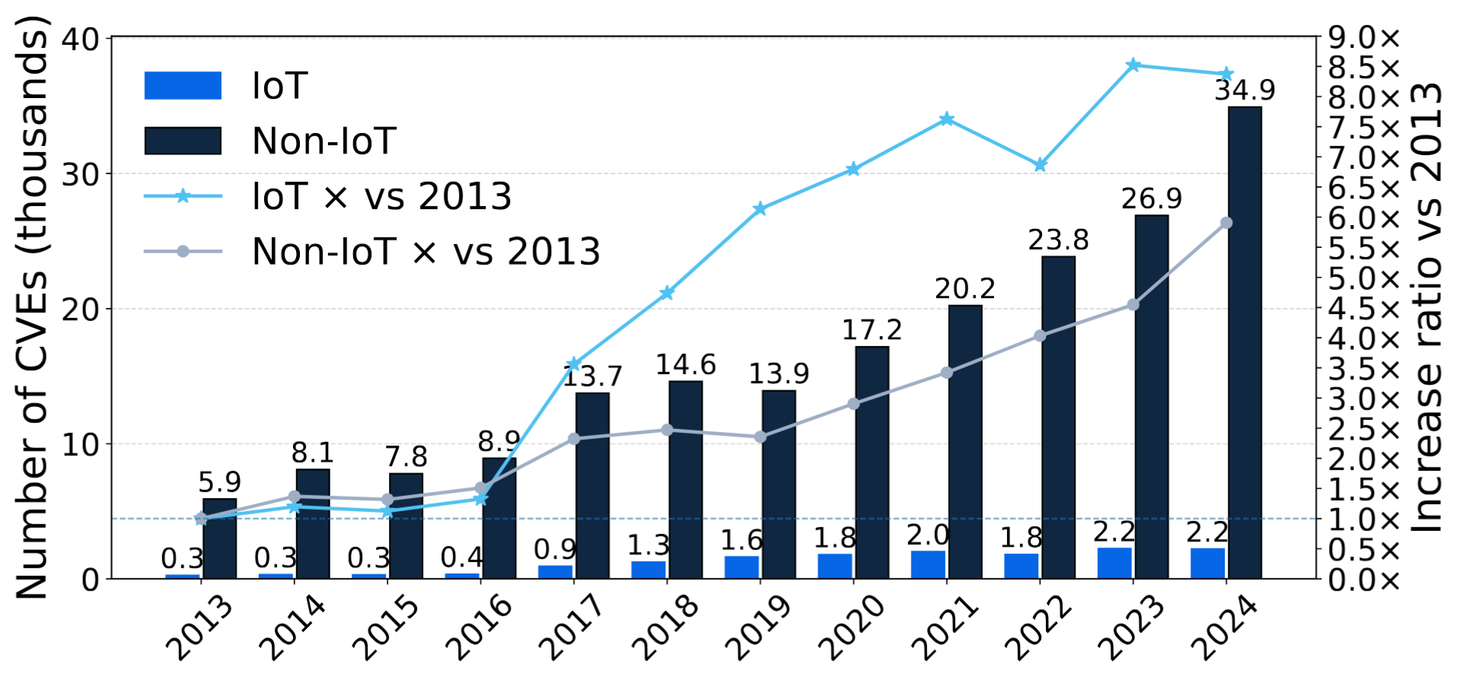
IoT CVE Temporal Trends
35k
8.5× IoT growth vs 2013
6× Non-IoT growth vs 2013
Steep rise in IoT 2016 -> 2017
Mirai botnet in 2016
CNA program expansion in 2016
5900
2200
300
14

Slide 19
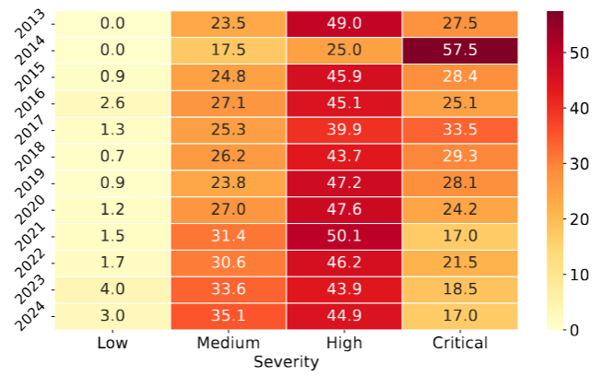
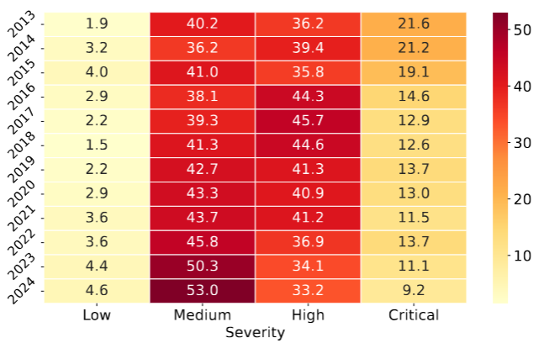
Severity Analysis
IoT
Non-IoT
IoT holding higher severity than Non-IoT
Non-IoT shifting from high and critical towards medium level
IoT vulnerabilities follow the same trend, but still far behind
15

Slide 20
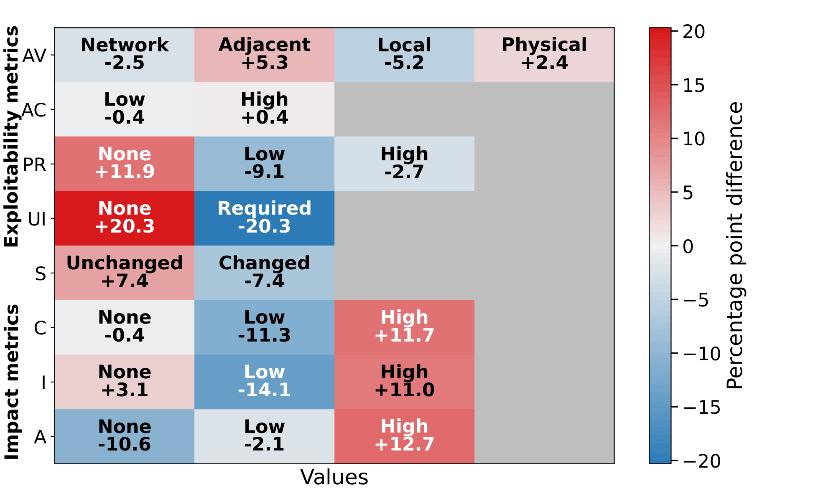
Severity Analysis
IoT vs non-IoT (pp)
+20.3
UI: None
No user interaction needed: autonomous, remotely triggerable
+11.9
PR: None
No privileges needed: missing or single-role auth
+11 to 13
C / I / A: High
Few internal boundaries: one bug, whole device
IoT vulnerabilities: lower-effort (no user interaction, no privilege), higher impact -> higher severity score
209 IoT CVEs in VulnCheck KEV
16

Slide 21
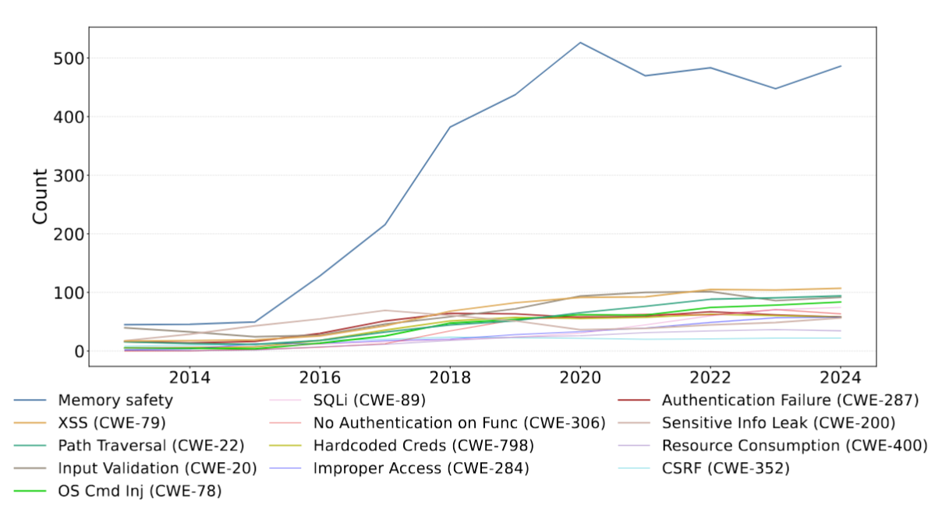
Weakness Family Analysis – CWE comparison
IoT
1. Memory safety
C language, poor memory protection in firmware
2. Web-centric weaknesses increasing in recent years (Input Validation, XSS, Path Traversal , SQLi, CSRF)
Growing use of web-based interfaces in IoT devices
to provide user interaction and remote management
3. Authentication issue (#9 improper authentication, #7 no authentication on
critical functions, and improper access control).
Resource constraints and neglecting security practices
Memory safety issues: OOB write (CWE-787), OOB read (CWE-125), Stack-based buffer overflow (CWE-121), Use after free (CWE-416),
Integer overflow (CWE-190), NULL dereference (CWE-476),
Buffer copy without checking size of input (CWE-120),
Memory-bound (CWE-119)
17

Slide 22
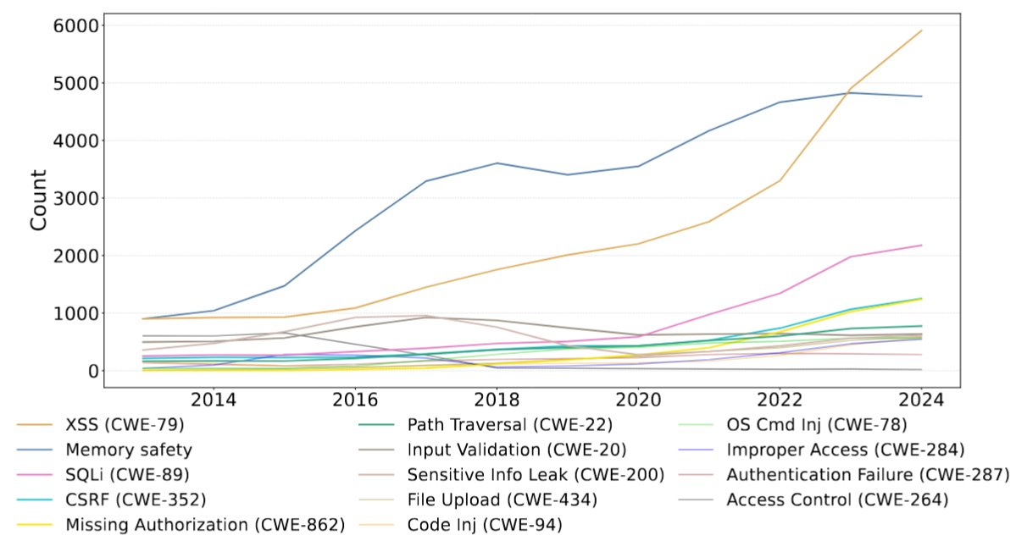
Weakness Family Analysis – CWE comparison
Non-IoT
1. Web-centric weaknesses (XSS, SQLi, CSRF and Path Traversal,)
The ubiquity of web applications and the impact of large-scale automated discovery
2. Memory safety
3. Authorization issue
Multi-tenant architectures and access control mechanisms
18

Slide 23
Actionable Recommendations
Kill the low hanging-fruit vulnerability
Eliminate memory-safety issues
Hard-coded credentials
Generate device-specific credentials during manufacturing.
Enforce mandatory credential change at first setup.
Provide secure physical reset mechanism.
Adopt memory-safe languages: Rust, Ada, MicroPython.
Case study: Android → 76% memory bugs in 2019 → 24% in 2024.
Prevent web-based vulnerabilities
Legislation and enforcement
Block web management interfaces from WAN access.
Firewall rules for inbound traffic.
Use cloud-based remote management with strong authentication.
EU Cyber Resilience Act (CRA), adopted Dec 2024, full force 2027.
Mandates security-by-design at every lifecycle stage.
Radio Equipment Directive (RED) for wireless IoT devices.
19

Slide 24
Limitations and Future Work
Borderline technologies
  Future: Multi-label classification + post analysis
Data source limitations
  Rely solely on CVE description + CPE metadata, which can be incomplete.
  Future: merge security advisories & vendor bulletins, or references for richer context
20

Slide 25
Conclusion
  Distinguishing IoT vulnerabilities requires a unified architectural abstraction that covers all contributing components.
Using LLMs and the four-layer IoT taxonomy, we could overcome the limitations of previous works (scalability, high false positives).
15,066 IoT CVEs (8,391 new) that could be used for further research.
IoT vs Non-IoT characterization: IoT = higher severity, lower attacker effort, memory-safety + growing web weaknesses
21

Slide 26

Thanks for your attention!
Questions?
Find the code and dataset here!

