Slide 1
Project Overview
Purpose: Analyze global job postings, salary, AI involvement, and automation risk across countries, cities, and companies.
Database: PostgreSQL, schema analytics.
Tables: job_postings, companies, cities, countries, time_dim.

Slide 2
Design Decisions
Schema choice: Star schema centered on job_postings.
Normalization logic:
  countries and cities separated → avoids duplication of country/region info.
  companies separate → avoids repeating company details per job.
  time_dim separate → allows analysis across months/years efficiently.
Join strategy:
  All joins via primary/foreign keys (job_postings.company_id → companies.company_id, etc.).
  Ensures referential integrity and avoids Cartesian joins.

Slide 3
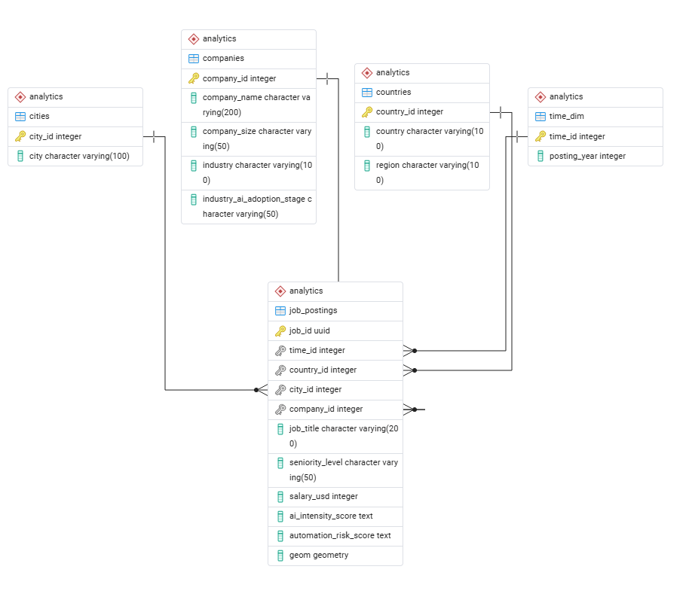
ERD (Entity Relationship Diagram)

Slide 4
Analytical Tables
Distribution of jobs by region (Question 1).
Top 5 countries with the highest average salary (Question 2).
Job distribution by region, company, title (Question 3).
Job postings over years (Question 4).
Average automation risk by region (Question 5).
Automation risk by seniority (Question 6).
AI intensity and salary overview (Question 7).

Slide 5
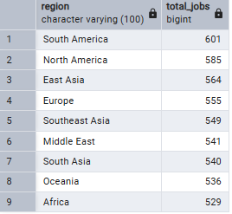
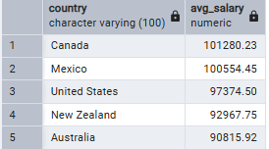
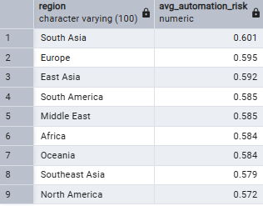
Visuals
Distribution of jobs by regions (Regions)
Average salary analysis by country:
Average automation risk level by region

Slide 6
Data Dictionary
data_dictionary.md - Shows column definitions, data types, descriptions, constraints.
https://github.com/Tina856/final_sql_project/blob/main/docs/dictionary.md

Slide 7
Analytical Findings / Business Insights
Job postings are concentrated in AI/engineering roles.
Job postings per year are stable (~300/year).
Automation risk is slightly higher in South Asia and Europe.
Junior vs senior automation risk shows executives have unexpectedly high risk scores.
AI-intensive roles correlate with slightly higher salaries (~$63k average).

