Slide 2
Welcome – Ice Breaker
Tell us a little about yourself:
What is your name?
Favorite Country you have visited, or a country you really want to visit?
My answer:
My Name: Tina Brownfield
Favorite Country – France
My Name: Katelyn McCarty
Favorite Country- Vietnam
Notes:
Hello Everyone! Welcome to Introduction to SQL!
A little bit about myself.
Now we are going to do a quick icebreaker… We are going to have everyone give us their name, and a favorite country. My TA’s will write down the countries and we can see how many of you enjoy the same countries... ☺

Slide 3
Background Basics
Things to know before we Play

Slide 4
What is SQL
SQL (pronounced "ess-que-el” or “see-quill”) stands for Structured Query Language.
SQL is used to communicate with a database. Used for creation and modification
SQL is considered the standard language for RDBMS (Relational Database Management Systems).
SQL statements are used to perform tasks such as retrieving data stored in a database, updating data, deleting data and more.
Most RDBMS’s use SQL, but use their particular ’flavor’ of it. Common Flavors are
Oracle -SQLite - Postgres -MSQL (Microsoft) -MySQL - Microsoft Access
Standard SQL commands (such as Select, Insert, Update, etc.) can be used across SQL types.
Notes:
So – now to the reason we are all here today… SQL!
SQL (pronounced "ess-que-el” or “see-quill”) stands for Structured Query Language.
How is SQL used: For the creation, modification and … querying of relational databases and schema.
How I think of it - SQL is the translation of a business question into a query that is framed in a precise language that a database can read… and respond back with an answer.
For Reference
RDMS: Some common relational database management systems that use SQL are: Oracle, Sybase, Microsoft SQL Server, Access, Ingres, etc. Although most database systems use SQL, most of them also have their own additional proprietary extensions that are usually only used on their system. However, the standard SQL commands such as "Select", "Insert", "Update", "Delete", "Create", and "Drop" can be used to accomplish almost everything that one needs to do with a database.

Slide 5
What is a Database
The technical definition: A structured set of data held in a computer, especially one that is accessible in various ways.
User Friendly: A database at its core – is a set of related information.
A real world example: A Restaurant menu- it is a listing of all items, their prices, their descriptions, broken down into sections.
Notes:
If SQL is used to communicate with databases… so what is a database?
A Database has tables. Tables have columns.
Databases with tables and columns are known as relational databases.
As I mention here it’s a set of related information. Think of a restaurant menu… How its organized – Broken down by specific sections like Appetizers, Drinks, Full course etc, then think of each of those sections – The appetizers lists the names of the items, the ingredients, the price etc....
Also think of how for restaraunts have multiple menus – like a lunch, dinner and happy hour versions.
Extra Reference:
A relational database system contains one or more objects called tables. The data or information for the database are stored in these tables. Tables are uniquely identified by their names and are comprised of columns and rows. Columns contain the column name, data type, and any other attributes for the column. Rows contain the records or data for the columns.

Slide 6
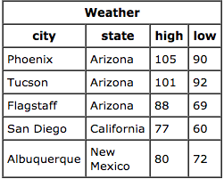
What is a Table
Technical Definition: In relational databases and flat file databases, a table is a set of data elements (values) using a model of vertical columns (identifiable by name) and horizontal rows, the cell being the unit where a row and column intersect. A table has a specified number of columns, but can have any number of rows.
User Friendly: A table is a collection of related data entries and it consists of columns and rows.
Real World Example: City Weather Highs and Lows
Notes:
As I said before – a database is made up of tables – so what is a table?
Tables are like spreadsheets organized around a single topic.
Every row record or row refers to a single piece of data.
Lets take a real world example – everyday we check out our weather, see the highs and lows and where our predicted weather aligns with it. The image here is a great example of a table. It is data related to weather – the city and state and the highs and lows for those cities.

Slide 7
What is a Column
Technical Definition: In the context of a relational database table, a column is a set of data values of a particular simple type, one for each row of the table. The columns provide the structure according to which the rows are composed.
User Friendly: An individual piece of data.
Also known as an attribute of field
Real World Example: In our Weather table:
City, State, High, and Low are all columns.
They refer to a specific dimension in our table.
Notes:
Columns store specific dimensions (properties or attributes) for each row of data.
Columns have predefined types such as dates, or integers, or text, or varchar.
Each row has the same columns.
It is the data in the columns that we can extract, manipulate or calculate on.

Slide 8
What is a Row
Technical Definition: In the context of a relational database, a row—also called a record or tuple—represents a single, implicitly structured data item in a table. In simple terms, a database table can be thought of as consisting of rows and columns or fields
User Friendly: A data set representing a single item.
Real World Example: In our Weather table:
Phoenix Arizona 105 90 is a single record.
Each row has the same columns.
Notes:
A row is a single entry within the table.
So in terms of our weather table- Phoenix arizona with a high of 105 and a low of 90.

Slide 9
SQL stands for Structured Query Language… and what is a query??
It’s a Question!
We all know how to ask questions!
Notes:
We all ask questions everyday...

Slide 10
SQL Syntax
select [columns]
from [tablename]
where [condition]
group by [column]
having [condition]
order by [column]
limit [number];
SQL syntax is the framework into which we build (or phrase) our questions into a query to send to the database.
SQL queries will always be written with this framework in the order shown.
Not all options listed are required to run a query
The minimum requirements for a query to run against any database is SELECT and FROM.
Notes:
Now don’t get intimidated by the framework listed here… We wont be hitting everything listed here, but I wanted you all to get familiarity with all of the framework
**ONCLICK**
What we we be discussing to day is the SELECT, FROM, WHERE and LIMIT clauses.

Slide 11
Learning To Think in SQL
Step One – The Business question/ask
Step Two – Rephrase the question using the SQL syntax
Step Three – Trim to only the SQL syntax
Example:
Who won the academy award for best actor in 1997?
SELECT actor name FROM the best actor academy award WHERE the year is 1997
SELECT actor_name
FROM Best_Actor_Award
WHERE Year = 1997
SELECT – What do you want to know? What is the answer you are looking to return?
These will be the column names listed
FROM – The name of the location where this information will be coming from.
This will be the table or tables where the data is stored.
WHERE – Is used to extract only those records that fulfill a specified criterion.
This is a filter for the data you want returned
Notes:
Remember how I said SQL is just asking a question… and putting it in the right way to be read by the database?
Think of it in this way – Everyone here has used google correct?
We are simply ‘googling’ our database… phrasing our ask into a way that will return the answer or answers we need.
I find breaking it down into three steps makes tackling this language so much easier.
Step ONE – The business question – Identify what you are being asked.
Step TWO – Rephrase the question using the correct syntax – identify the what/where from/ filters etc
Step THREE – Trim the question into ONLY the SQL Syntax is left.
****CLICK*****
So lets work through one. We want to know who won the academy award for best actor in 1997
To rephrase this question using SQL syntax… we need to understand that framework better
****CLICK*****
****CLICK*****
****CLICK*****
So from our question – what do we know - what do we want returned?
****CLICK*****
And for this for this particular instance we are going to assume that we have a table named Best_Actor_Award that has all winners of Best Actor awards
And our filter – it’s the year from our question – 1997
****CLICK*****
Don’t worry if that was a little fast – we will go through more in depth examples next.

Slide 12
Hands on Activities
Now for the fun!

Slide 13
Our Sandbox
Environments where users can play without breaking anything are often referred to as sandboxes. They are usually personal spaces where an analyst or developer can experiment with code without affecting a production environment.
The sandbox environment we will be using is the w3 schools SQL editor:
http://bit.ly/1foSkgu
Notes:
Today we are going to be using a sandbox environment provided by the W3 schools. A Sandbox environment is a great environment for people to use people to ‘play with the data’ without ruining a production.
Http://www.w3schools.com/sql/trysql.asp?filename=trysql_select_all
So everyone please go to the following location – TA’s will assist while I continue on.
TA and for reference
If no tables are listed on the right hand side have them click the restore database option.
**Give disclaimer that in normal instances of SQL the ‘viewing’ of available tables is not normally as easily seen or restored as this environment is.

Slide 14
Time to play in the Sandbox!
We are all going into business together!
We are all now part owners of the SheCodesNow Online Store.
This is an online store where our people can browse through our selection of Products offered from various Suppliers all organized neatly by Category.
Once our Customers check out, our Employees go over the OrderDetails to prep and ship the Orders using one of preapproved list of Shippers.
Notes:
**Read PowerPoint**
Now that you know what we do… Let look at the tables we have listed in our database... Would you look at that – products, suppliers, customers – it looks like the naming conventions of our tables alligns with our description of our business. ☺
This matches what we have listed in our SQL editor:
Customers, Categories, Employees, OrderDetails, Orders, Products, Shippers and Suppliers.

Slide 15
Our first query
Business Question/Ask:
We need a detailed list of information on all of our customers.
Rephrase - Using the framework we saw earlier :
We want to SELECT all the rows FROM the Customers table.
Trim: Then we trim it –
SELECT all FROM Customers
Extra step – change ‘all’ to ‘*’
SELECT * FROM Customers
Type into the ‘SQL Statement’ Box:
SELECT * FROM Customers
Notes:
Tina
**Every business owner should know a little bit about their Customers. It looks like we have a table in our database called Customers.
Lets Dig into our data
Things to remember – Our SQL is not case sensitive. So whether you write SELECT or select or Select all will be read by the database the same.
**Work from PowerPoint**
**Extra step – the database sees ‘all’ as the name of a column, so we need to change it to something the database reads as ‘all’. SQL has a symbol for this very instance the asterisk or star ‘*”
**Disclaimer about running select all queries***
That was good. Now you have everything from this table. But this is not the best to do when you have a very large table.
For TA reference-
The trim step will fail ... the select all needs to be change to select *

Slide 16
LIMIT-ing returns
The LIMIT statement is used to retrieve records from one or more tables in a database and limit the number of records returned based on a limit value.
SELECT *
FROM Customers
LIMIT 10
For Reference
Some flavors of SQL – like Oracle – don’t support the limit syntax/clause.
For Oracle the equivalent syntax is:
SELECT column_name(s) FROM table_name WHERE ROWNUM <= number
Notes:
Katelyn
This allows the user to view all available columns in the table without using too many resources.
What you do is give a numerical number of records to return.
Using limits is a great way to explore a data set without taxing the database with huge returns.
Lets try this for all of our tables… just to get an idea of whats in them.

Slide 17
Commenting SQL
Single Line Comments
Single line comments start with --.
Any text between -- and the end of the line will be ignored (will not be executed).
Multi-line Comments
Multi-line comments start with /* and end with */.
Any text between /* and */ will be ignored.
--SELECT * FROM Customers;
SELECT * FROM Products;
/*Select all the columns
of all the records
in the Customers table:*/
SELECT * FROM Customers;
Notes:
Tina

Slide 18
Selecting Specifics
Business Question/Ask:
Instead of a list of all customer data, we only want a list of customer names and customer IDs
Rephrase:
I want to SELECT Customer Name and Customer ID FROM the Customers table
Trim:
SELECT CustomerID, CustomerName FROM Customers
Type into the ‘SQL Statement’ Box:
SELECT CustomerID, CustomerName
FROM Customers
Notes:
Tina
Alright next steps – learning how to return specific data from a table
So we previously returned a list of all customers. What if I only wanted to see a Customers Name and ID. I dont need anything more than that...
Select CustomerID, CustomerName from Customers

Slide 19
Selecting Specifics
Business Question/Ask:
What are the name of the categories we have on our site?
Rephrase:
SELECT the name of the categories (categoryname) FROM the Categories table
Trim:
SELECT CategoryName FROM Categories
Type into the ‘SQL Statement’ Box:
SELECT CategoryName
FROM Categories
Notes:
Tina
Now that we have the hang of this… lets try another

Slide 20
Where clause – Our Filters
Business Question/Ask:
What are the names and addresses of the customers we have that live in my favorite country?
Rephrase:
SELECT Customer Name and address, city, country FROM the Customers table who have addresses WHERE the country is France
Trim:
SELECT CustomerName, Address, City, Country FROM Customers WHERE Country = France
Type into the ‘SQL Statement’ Box:
SELECT CustomerName, Address, City, PostalCode, Country
FROM Customers
WHERE Country = ‘France’
Notes:
Katelyn
So far we have only used Select and From from our framework.
But what happens when we only want the names of Customers from a specific country? Perhaps we only want to send advertisements to people in this country.
Lets make this a little more fun. Lets look for customers who live in our favorite country.
Make sure that when you type a text or string term in the where clause that you put quotations around it. Otherwise the database won’t know be able to recognize that you are looking for a string/text term.

Slide 21
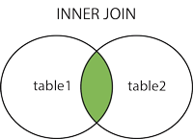
Joining Tables
A SQL JOIN clause is used to combine rows from two or more tables, based on a common field between them.
The most common type of join is: INNER JOIN. An INNER JOIN returns all rows from multiple tables where the join condition is met.
Notes:
I've listed the different types of joins here for reference after this class. The only join we will be using/focusing on in this class will be INNER JOINS.

Slide 22
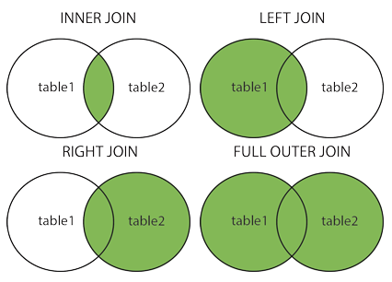
Different Types of Joins
LEFT (OUTER) JOIN: Return all rows from the left table, and the matched rows from the right table
RIGHT (OUTER) JOIN: Return all rows from the right table, and the matched rows from the left table
FULL (OUTER) JOIN: Return all rows when there is a match in ONE of the tables

Slide 23
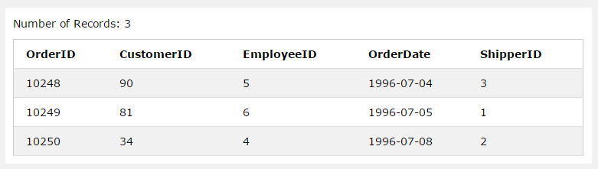
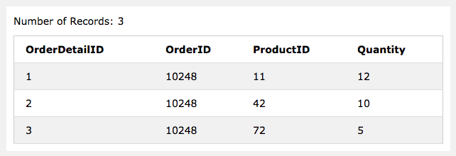
Joining Tables - Practice
SELECT *
FROM Orders
LIMIT 3
SELECT *
FROM OrderDetails
LIMIT 3
Notice that the column OrderID is in both tables. The common column doesn’t have to be in the same location in each table.
Since OrderID in the OrderDetails table refers to OrderID in orders – we can use this relationship to link the tables.
Notes:
Lets practice a Inner Join
We are going to start from the beginning-
Lets run a limited query on Orders
Ok, did everyone get the same results?
Great! Now lets run a limited query on OrderDetails
Did this same table appear?
Does anyone notice a similar column between the two tables?
Yep! OrderID

Slide 24
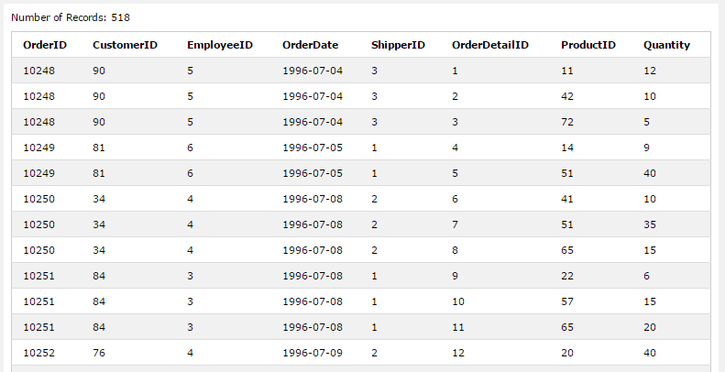
Using Inner Join
Syntax for writing a join:
INNER JOIN table_name
ON table_name.column = table_name.column
So in this instance:
SELECT *
FROM Orders
INNER JOIN OrderDetails
ON Orders.OrderID=OrderDetails.OrderID
Notes:
Ok now that we have identified how to blend these two tables lets walk through the query-
Here is the syntax- this is added on to the SELECT FROM statement we were working on earlier
Does anyone want to take a stab at it?
Here is what the query looks like, it returns a bleneded table with all information from BOTH tables.

Slide 25
Things to remember
The SQL database we are using is not case sensitive. So whether you write SELECT or select or Select all will be read by the database the same.
Using Select * From table is very useful in specific cases (like when tables are small or you really need to return every row from a table) - But is normally not recommended for use without a limiter added: Select * From table limit 10
In the Where Clause: SQL requires single quotes around text values (most database systems will also allow double quotes). Numeric fields should not be enclosed in quotes
Where column = #/ ’string’ - is not the only comparison operator that can be used: Less than, Greater than, Less than or equal to , Great than or equal to, Does not equal [ <,>,<=,>=, != ] can also be used.
Dates need to be in quotations to be read by the database i.e. ‘YYYY-MM-DD’

Slide 26
Classroom Exercises
1. What are the names of all of our shippers
2. Human Relations needs a list of all Employee Names and birthdays for their records.
3. Provide a list of Customers, addresses and point of contact who are in London for the sales team to offer special offers
4. Our Web Admins need a list of all the products we have.
5. The Web Admins need more than just Product Names now, they also need unit and pricing information for each product.
6. List all products and their prices where the price is GREATER THAN 20
7. Our warehouse manager needs a list of all the orders placed on July 8 1996.
7. Our warehouse manager needs a list of all the orders placed on July 8 1996.
8. Our Warehouse manager needs a list of all of the order details where the number product was ordered 12 times in a single order.
9. Provide a list of all products in the Beverages Category
10. The Sales department needs a detailed list of products provided by Shelley Burke of New Orleans Cajun Delights.
11. The Shipping Department found and error and needs a list of all the shipments that went out via United Package.
12. HR wants to track the performance of Michael Suyama and need a list of the orders he has completed.
13. HR loves the report you made, they now want to know who Michael’s customers are.
Notes:
Now for the true fun… Digging into the data. I have a list of questions for you all to play with. I will work through the first one with you, then you all can work on these on your own. The TA’s and myself will be walking around to assist you with this. And please don’t worry if you get stuck... Asking for assistance from others it one of the best ways to learn. Collaboration often spawns the best results.

Slide 27
Terminology
Entity | Entity – Something of interest to the database user community. Examples include customers, parts, geographic locations etc.
Column | In the context of a relational database table, a column is a set of data values of a particular simple type, one for each row of the table. The columns provide the structure according to which the rows are composed.
Row | Set of columns that together completely describe an entity or some action on an entity. Also called a ‘record’
Table | In relational databases and flat file databases, a table is a set of data elements (values) using a model of vertical columns (identifiable by name) and horizontal rows, the cell being the unit where a row and column intersect. A table has a specified number of columns, but can have any number of rows.
Primary Key | One or more columns that can be used as a unique identifier for each row in a table.
Foreign Key | One or more columns that can be used together to identify a single row in another table.

Slide 28
Terminology cont.
Join | A SQL join clause combines columns from one or more tables in a relational database. It creates a set that can be saved as a table or used as it is. A JOIN is a means for combining columns from one (self-table) or more tables by using values common to each.
SQL Clause | The commands in the SQL sytnax framework : SELECT, INSERT, UPDATE, DELETE, WHERE, JOIN, DISTINCT, ORDER BY, GROUP BY, HAVING, and UNION
Alias | You can rename a table or a column temporarily by giving another name known as an alias. The use of table aliases means to rename a table in a particular SQL statement. ... The column aliases are used to rename a table's columns for the purpose of a particular SQL query.
LIMIT | The SQL SELECT LIMIT statement is used to retrieve records from one or more tables in a database and limit the number of records returned based on a limit value.
WHERE Clause | The SQL WHERE clause is used to specify a condition while fetching the data from single table or joining with multiple tables. If the given condition is satisfied then only it returns specific value from the table. You would use WHERE clause to filter the records and fetching only necessary records.

Slide 29
Suggested Study Material
Books
SQL for Dummies
Oreily Learning SQL
O’Reily books are available at Seattle Libraries
SQL in 10 Minutes, Sams Teach Yourself
Online Resources:
W3schools.com : http://www.w3schools.com/sql/default.asp
Code Acedemy:
https://www.codecademy.com/
Notes:
SQL for Dummies Link - https://www.amazon.com/All-One-Dummies-Allen-Taylor/dp/0470929960/ref=sr_1_1?s=books&ie=UTF8&qid=1487113294&sr=1-1&keywords=SQL+for+Dummies
Oreily – Learning SQL - https://www.amazon.com/Learning-SQL-Master-Fundamentals/dp/0596520832/ref=sr_1_1?s=books&ie=UTF8&qid=1487113242&sr=1-1&keywords=oreilly+learning+sql
SQL in 10 Minutes, Sams Teach Yourself - https://www.amazon.com/SQL-Minutes-Sams-Teach-Yourself/dp/0672336073

Slide 30
References
https://en.wikipedia.org/wiki/Row_(database)
https://en.wikipedia.org/wiki/Relational_database
http://www.w3schools.com/sql/default.asp

