Slide 1
INVESTMENT ASSIGNMENT SUBMISSION
Name: TINA GHOSH
Msc in Machine Learning and AI Program
Batch Start : 30th December 2019
Mail_id : ghosh.tina90@gmail.com

Slide 2
Project Description and Objectives :
Project Brief :
You work for Spark Funds, an asset management company. Spark Funds wants to make investments in a few companies. The CEO of Spark Funds wants to understand the global trends in investments so that she can take the investment decisions effectively.
Business and Data Understanding :
Spark Funds has two minor constraints for investments:
1)It wants to invest between 5 to 15 million USD per round of investment.
2) It wants to invest only in English-speaking countries because of the ease of communication with the companies it would invest in.
• Business objectives :
The objective is to identify the best sectors, countries, and a suitable investment type for making investments. The overall strategy is to invest where others are investing, implying that the 'best' sectors and countries are the ones 'where most investors are investing'.

Slide 3
Problem solving methodology :
Company.csv
Convert Permalink in lower case
Prepare Company Dataset
Data Filtering in master_frame datset based on Investment Type = Venture and invest between 5 to 15 million USD per investment round and Status Should not be ‘Closed’
Prepare Master_frame
Dataset
Finding Investment Type
(Ex: Venture)
(Based on invest between 5 to 15 million USD per investment round)
Get the Country wise total investment on the filtered Dataset.
Prepare Rounds2 Dataset
Rounds2.csv
Convert Permalink in lower case
Get the Country_List where English is the official Language from Link :
https://en.wikipedia.org/wiki/List_of_territorial_entities_where_English_is_an_official_language
Find main_Sector from main_sector dataset and Append the Data to main_frame dataset
Find Primary Sector and Append the Data to main_frame dataset
Generating dataset where funding_round_type='venture' and Status ='Closed' and raised_amount_used
# between 5 to 15 million USD per investment round and countries are USA,GBR ,CAN
Get the top 9 Country who are investing more in Funding Type ‘Venture ’ and also English is the official Language for those contries.
Find Complete dataset for country USA and Funding Type ‘Venture’ and Company Status not Closed and invest between 5 to 15 million USD per investment round
Find Complete dataset for country GBR and Funding Type ‘Venture’ and Company Status not Closed and invest between 5 to 15 million USD per investment round
Find Complete dataset for country CAN and Funding Type ‘Venture’ and Company Status not Closed and invest between 5 to 15 million USD per investment round
Prepare Mapping file Dataset called as main_sector Dataset
Get the top 3 Country who are investing more in Funding Type ‘Venture ’ and also English is the official Language for those contries.
As USA, GBR, CAN
Find Top 3 Companies in USA to invest
Find Top 3 Companies in GBR to invest
Find Top 3 Companies in CAN to invest

Slide 4
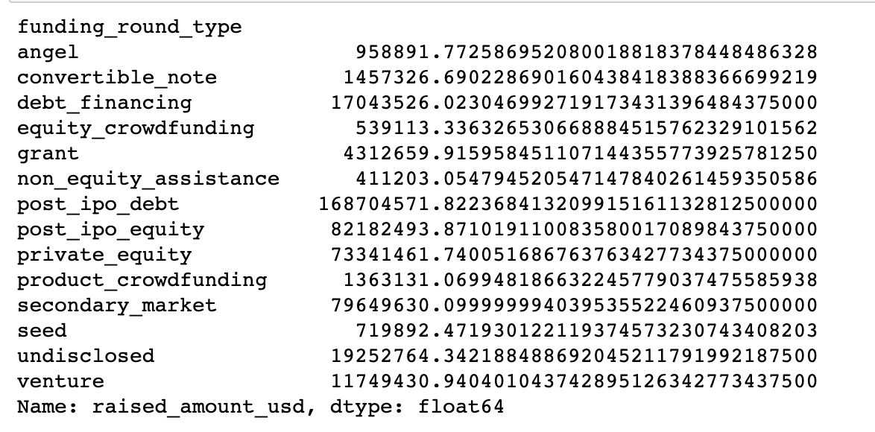
Investment type analysis : Venture
Here Only Venture Investment Type is falling under the Condition :
Spark Funds wants to invest between 5 to 15 million USD per round of investment .

Slide 5
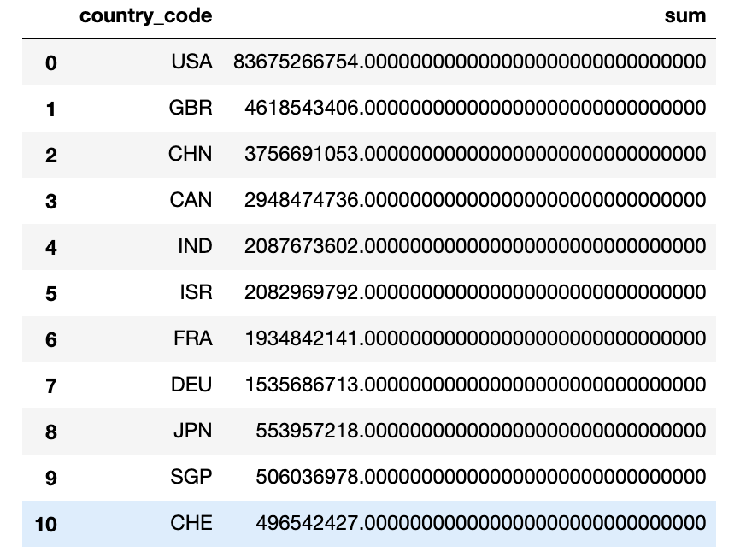
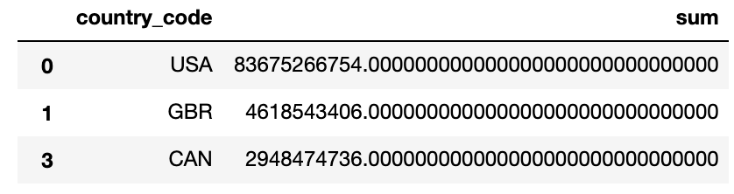
Country analysis : USA , GBR , CAN
Top 3 Countries where each countries received maximum investment on Funding Type Venture and also english is one of the official languages in that country.
Top 10 Countries where each countries received maximum investment on Funding Type Venture .

Slide 6
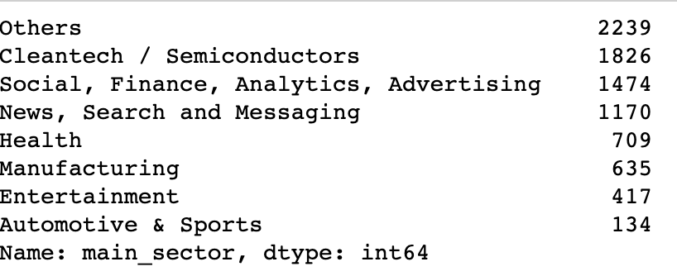
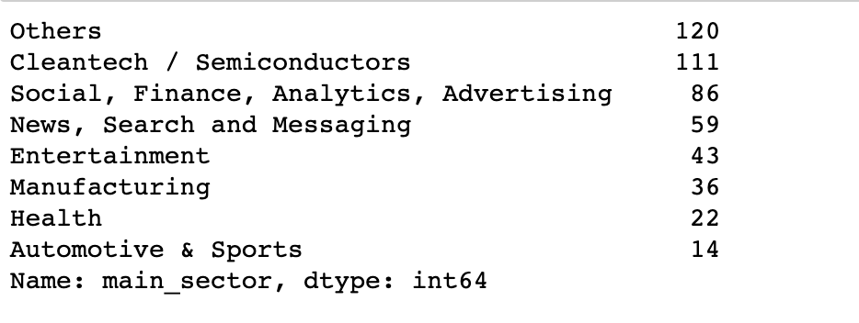
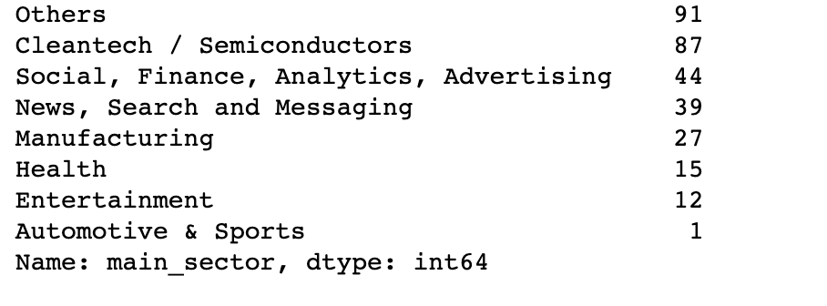
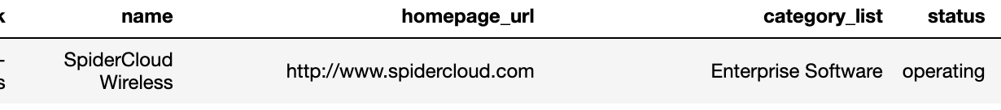
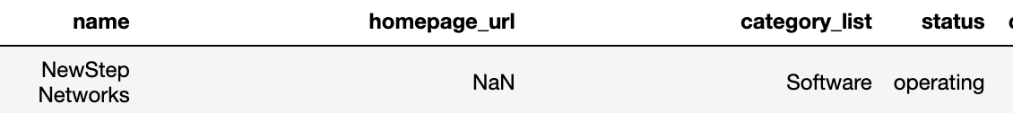
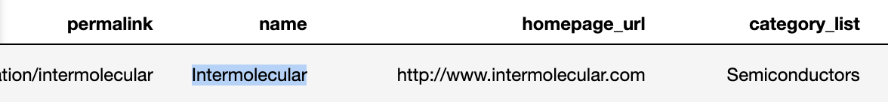
Sector analysis : Top 3 sectors for each top 3 Countries (USA , GBR , CAN)
For USA
For GBR
For CAN
Others Sector :
Others Sector :
Others Sector :
Cleantech / Semiconductors :
Cleantech / Semiconductors :
Cleantech / Semiconductors :

Slide 7
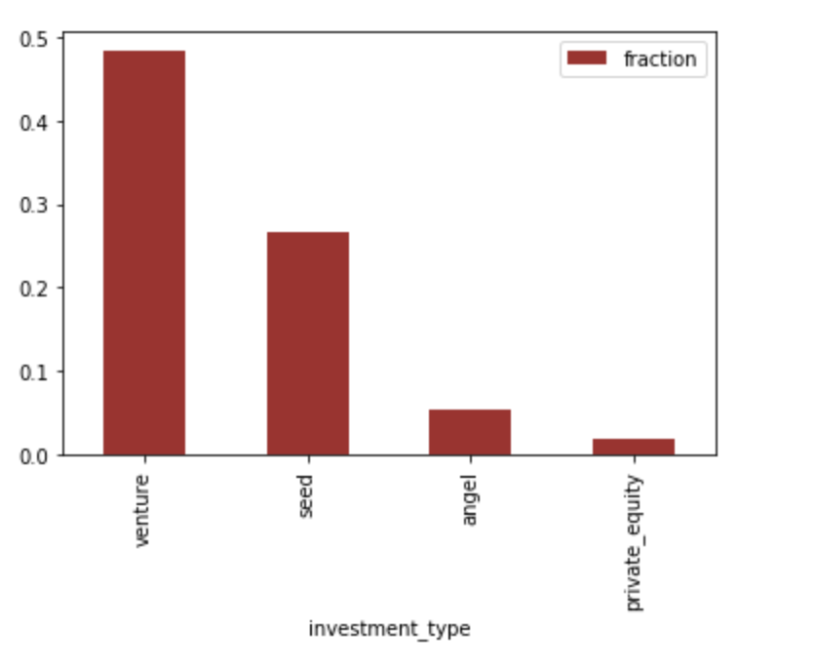
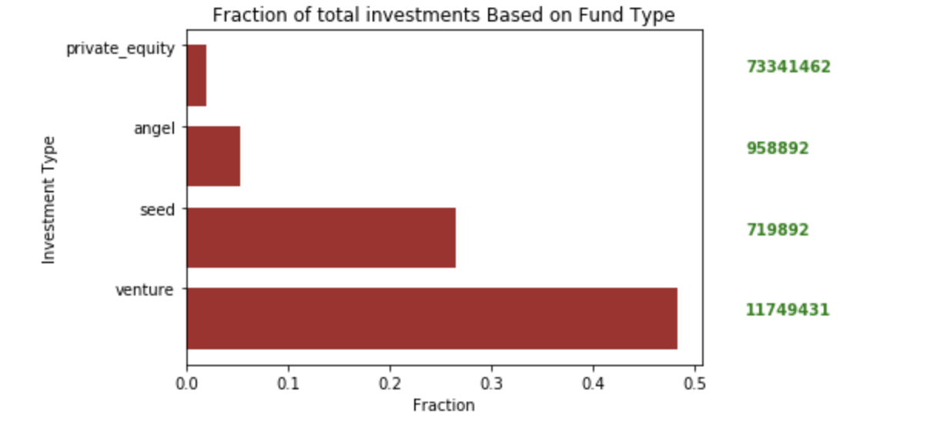
<Results>
Plot 1 : A plot showing the fraction of total investments (globally) in angel, venture, seed, and private equity, and the average amount of investment in each funding type. This chart should make it clear that a certain funding type Venture is best suited for Spark Funds.

Slide 8
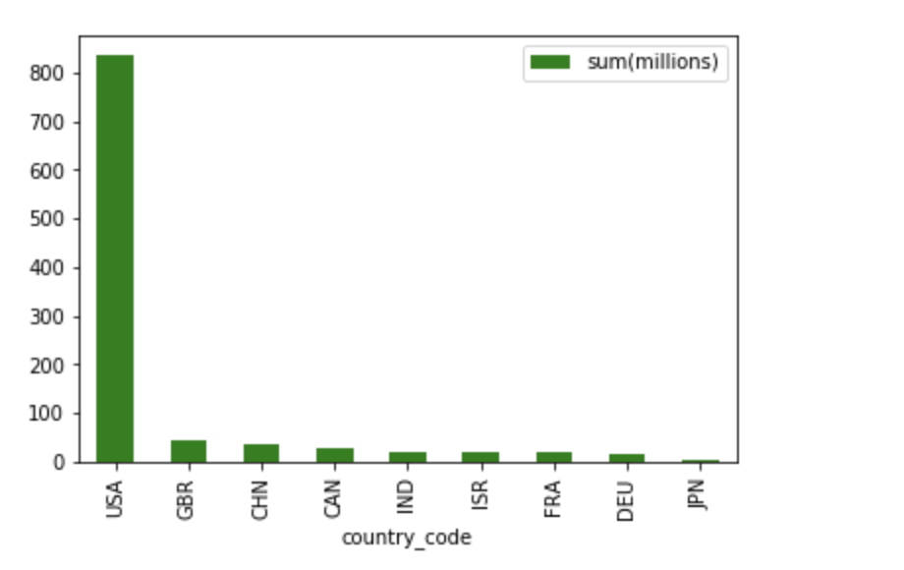
<Results>
Plot 2 : Plot showing the top 9 countries against the total amount of investments of funding type Venture. This should make the top 3 countries (Country 1, Country 2, and Country 3) very clear.
1.Country 1: USA
2.Country 2: GBR
3.Country 3: CAN
Note : As For CHN English is not official Language.

Slide 9
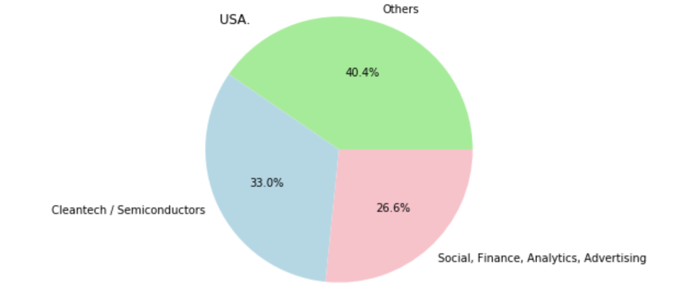
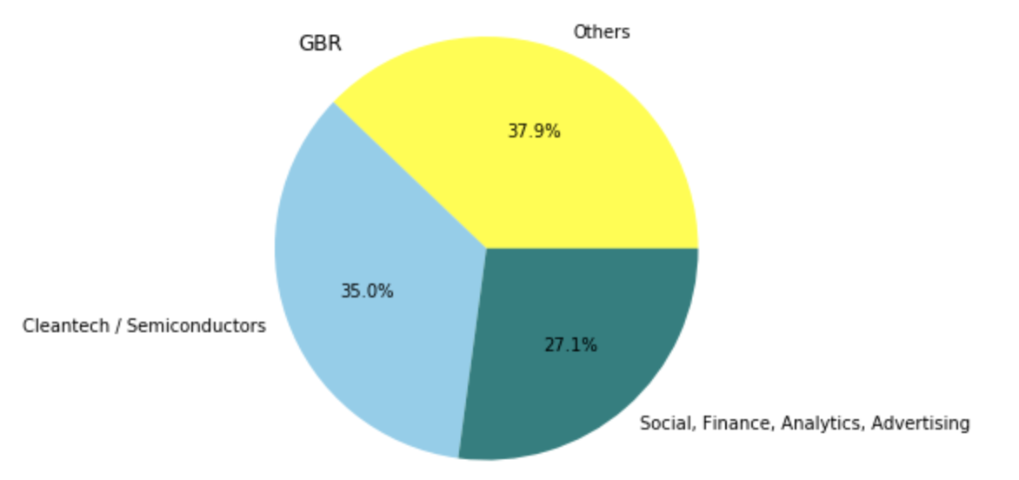
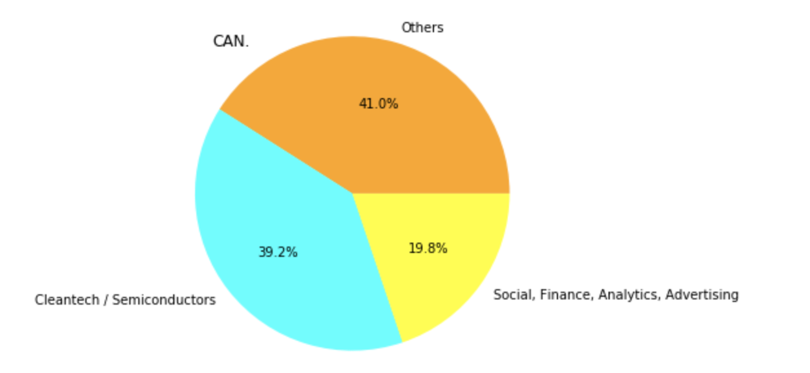
<Results>
Plot 3 :A plot showing the number of investments
in the top 3 sectors of the top 3 countries
on one chart (for the chosen investment type Venture).
Top 3 Countries and Top 3 Sectors in each Country:
USA
Others
Cleantech/Semiconductors
Social, Finance, Analytics, Advertising
GBR
Others
Cleantech/Semiconductors
Social, Finance, Analytics, Advertising
CAN
Others
Cleantech/Semiconductors
Social, Finance, Analytics, Advertising

Slide 10
Conclusion :
Best Companies to invest :
Top 1st Country : USA
In USA Top 2 Companies to invest :
SpiderCloud Wireless (Sector : Others )
Intermolecular (Sector : Cleantech/Semiconductors)
Top 2nd Country : GBR
In GBR Top 2 Companies to invest :
MyOptique Group (Sector : Others )
Onyvax (Sector : Cleantech/Semiconductors)
Top 3rd Country : CAN
In CAN Top 2 Companies to invest :
NewStep Networks (Sector : Others )
Fresco Microchip (Sector : Cleantech/Semiconductors)

