Slide 1
Master of Data Science
Twitter Sentiment Analysis on DogeCoin Stock Performance
Group Member:
Yufeng (Adam) Xing
Xinming Wang
Nancy Ruan
Tina Liu
Summer Zhang
Course Name: Distributed Data System (MSDS697)

Slide 2
Table of Content
Description of data and data collection process
Analytical goal
Models included in the analysis
Preprocessing algorithm & Time Efficiency
Findings (one slide for each objective and model)
Conclusion
.

Slide 3
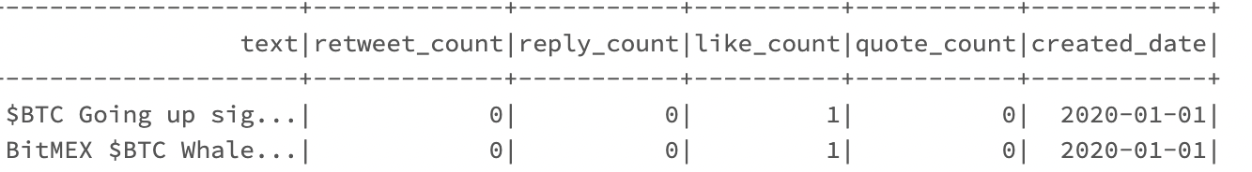
Description of Data and Data Collection
Data Size : 24036
Date Range: 2020-01-01 – 2020-05-09
Data Collection:
Pull Tweets related to DogeCoin
Pull DogeCoin Stock Price
Merge two dataframe
.

Slide 4
Analytical Goal
Predict the daily stock price given the number of tweets on a given date (tweets volume)
Add retweet, reply, comment, like counts as features and predict price (y = daily stock price)
Add text sentiment score into the model and predict the daily stock price

Slide 5

Possible Models
Since the target variable is the stock price, our problem is a regression question, thus following models are chosen for the evaluation:
Linear Regression
RandomForest
H2O autoML

Slide 6
Data Preprocessing, Model - Time Efficiency
Analytical Goals | Model | Model Run Time | Data Preprocessing | Person Responsible
Objective 1 - Tweet Count | Linear Regression | 74.8 ms | <6s | Tina
Objective 1 - Tweet Count | Random Forest | 25.75 m | <6s | Tina
Objective 2 - Multi-features | Linear Regression | 1.82 s | 23.99s(data cleaning) + 849 ms+(standardization) | Adam
Objective 2 - Multi-features | Random Forest | 4.31 s | 23.99s(data cleaning) | Xinming
Objective 3 - Sentiment | H2O | 2 min 2s | 2 min 43s (data cleaning) + 5 min 10s(toH2OFrame) | Nancy
Objective 3 - Sentiment | RandomForestRegressor | 3 min 50s | 2 min 43s (data cleaning) + 14 min 19s (Log/FV/Normalize) | Summer

Slide 7
Objective 1 Findings
Analytical Goal: Predict the daily stock price given the number of tweets on a given date (tweets volume)
Findings: Both the R^2 of test set of and Linear Regression and Random Forest < 0.1 - Tweets Counts and DogeCoin stock price are not significantly correlated. (R2_RF : -0.11 ; R2_LR : 0.06)
Possible Explanation:
The data we collected is not enough to generate some results
The fluctuation of stock price depends on so many factors - and tweets count is not important enough to explain this fluctuation.
The model runs on a cluster of 30.5 GB Memory, 4 Cores for both driver and workers, with # worker of 8

Slide 8
Objective 2 Findings
Analytical Goal: use retweet count, reply count, like count, quote count as features to predict close price of stock
Data preprocessing:
Enlarge close price 1000x (avoid underflow & float accuracy problem) - 18.1 s
Take the average of counts per day as features - 5.89 s
Standardized the features with standardScaler
Linear regression model
R2 score: 0.5115
MSE: 0.05533
The model runs on a cluster of 30.5 GB Memory, 4 Cores for both driver and workers, with # worker of 8

Slide 9
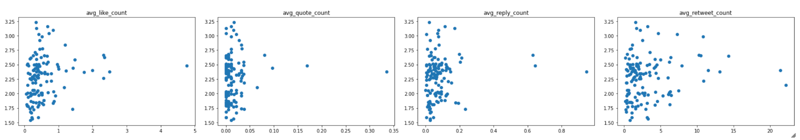
Objective 2 Findings
Data Exploration
By looking at the distribution of features and the scatter plots, we find that our data was right skewed, which may lead to poor prediction result.
Feature Engineering
We trained four random forest models to predict the stock price. The naive one without feature transformation got an extremely high R^2, which is counter-intuition. After taking the log, R^2 becomes negative.
Possible explanation
It’s hard to tell why our data is right skewed. if it’s due to the rare market shock, then the high metric value from original model makes sense; if it’s due to outliers, the truncate one makes sense; if it’s due to lack of data, then the metric is not reliable anymore.
Features | Model | Time | R^2 | MSE
Avg counts per day | Random Forest | 4.31 s | 0.931 | 0.0094
Avg counts per day | Random Forest with cv=5 | 3min4s | 0.939 | 0.0094
Log (avg counts per day) | Random Forest | 36.6 s | -0.160 | 0.1155
Truncate 95% (avg counts per day) | Random Forest | 25.1 | 0.925 | 0.0074

Slide 10
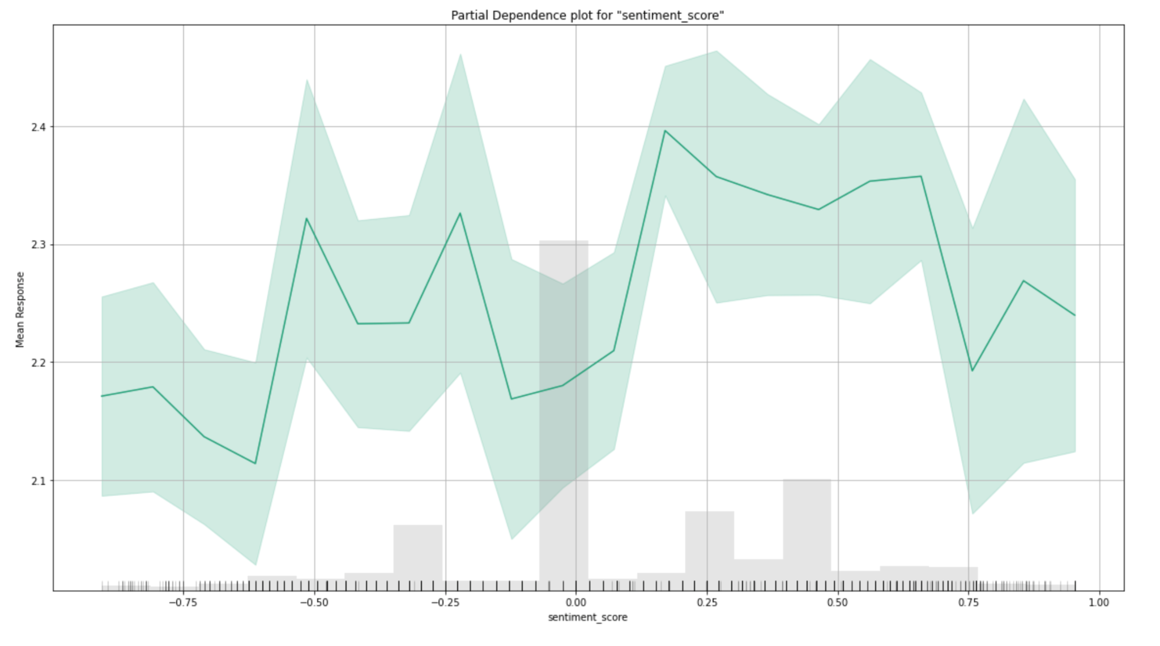
Objective 3 Findings
Objective: add sentiment score into the model and predict the daily stock price (see how closely the sentiment is related to the stock performance)
Sentiment Score Conversion Package:
We used SentimentIntensityAnalyzer to convert cleaned text to a score
converted score to a number between -1 and 1 (negative and positive)
RandomForestRegressor
RMSE: 0.3640
MSE: ~0.1325
R2: ~-0.0271
H2O:
Best Model: StackedEnsemble_AllModels_4_AutoML_3_20220309_13719
MSE: ~0.1165
R2: ~0.1608
Partial Dependence Plot: with many neutral sentiments, we still see negative sentiment tweets would yield to low stock closing price, vice versa.
The model runs on a cluster of 30.5 GB Memory, 4 Cores for both driver and workers, with # worker of 8

Slide 11
Lessons Learned + Conclusion
Different models could be used to explore different analytical goals; when we have more features, more time is required to do data cleaning and model fitting.
Tweets Counts and DogeCoin stock price are not significantly correlated. (R2_RF : -0.11 ; R2_LR : 0.06)
We notice some extremely validation metrics results when we add more features (reply count, like count, quote count) to the model. Some of the possible reasons have been discussed before.
When we take tweet sentiment into considerations, with the H2O model, only 16.1% of the variation was explained. The sentiment score is making some influences on the stock price prediction, though limited. H2O would more likely to select the best model comparing to we individually implement one single model, as it could ensemble good models together.
There might be many possible limitations in our dataset, e.g. right skewed data, limited amount, etc. Further investigations are required to build a better model. For future steps, we would like to gather more data and also include other possible features should be introduced.

