Slide 1
Collaboration  ICT  Mind-mapping
John Ralston  Deirdre Cook
The Open University
Notes:
Presentation to show:
Enjoyment
Energy
Sense of fun
Care taken to create the map as they wanted it to be
Creative way that solutions were arrived at
How do we explore then maps in an analytic sense?
Maps: dynamic, exciting and colourfull

Slide 2
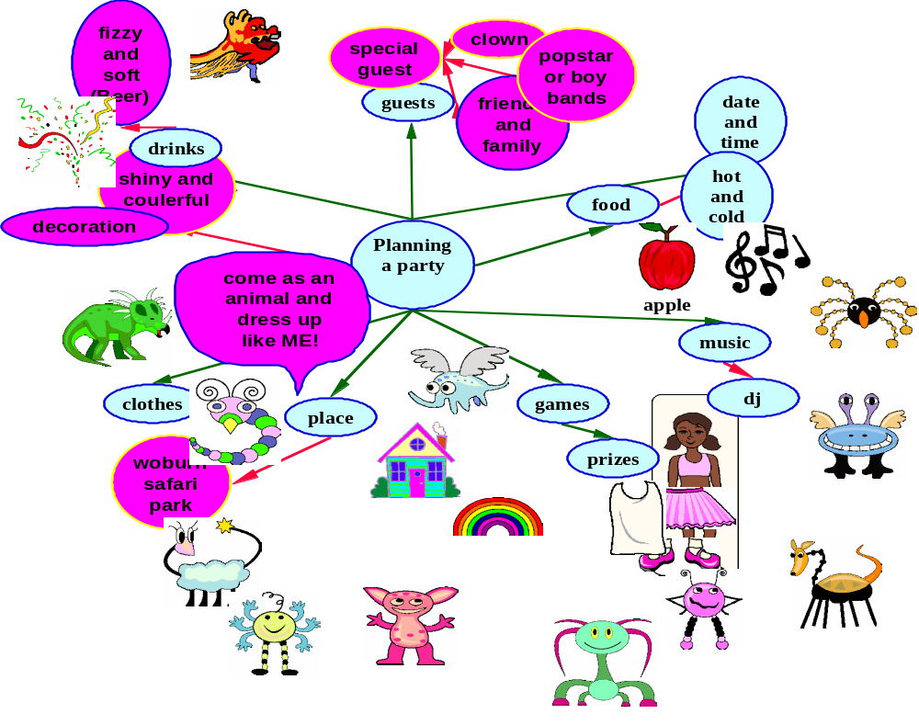
Developing a consensual map
Notes:
Terms:
Mindmapping, concept map, graphic organisers, advanced organizers, story webs, cognitive organizers, semantic maps….
…mostly used for very specific purposes:
Illustrating propositions and interrelationships
Assessing conceptual understanding
Identifying gaps in understanding
As research tools
Our work with the children did not fit into these categories- so
The children were working together to produce a single representation of their joint activity-
Hence consensual map- agreed views

Slide 3
Outline
Questions for the research
Context of the study
Influential ideas from research
Analysing the maps
Spoken language
Some useful outcomes
Notes:
Theory- in paper
Representation
-different forms
-including talk, group behaviour but here: Visual Representation
Bruner
-difficult to discuss being aware of yourself as a thinker
one of a number of approaches
Software
What is the software offering?
Learning as a communal activity
-dominant elements in the maps: icon symbol text

Slide 4
Questions
What are the ways in which multi-modal mapping software can support children’s exploration and investigation of ideas?
How can the children’s maps be analysed?
Using samples of children’s talk is there evidence of collaboration?

Slide 5
House Rules
Remember
  Listening, sharing, taking turns
Additional
  Use two clip art images only with each thought bubble
  Make the map as clear as possible
    Can you explain the map to others?
  Put a title on the map
Notes:
Children working as they normally did
In the party planning clip art was endlessly fascinating
Limited time

Slide 6
Influential ideas from research
Thinking

Slide 7
'Thinking about thinking' has to be a principal ingredient of any empowering practice of education
Bruner, J (1996) The Culture of Education (p.19)

Slide 8
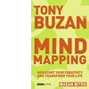


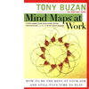
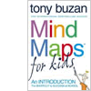







Buzan and de Bono

Slide 9
Role of ICT in teaching thinking skills
McGuinness, C. (1999) From Thinking Skills to Thinking Classrooms: a review and evaluation of approaches for developing pupils' thinking London: DFEE Research Report RR115.
Wegerif, R. and Scrimshaw, P. (Eds.) (1997) Computers and talk in the primary classroom
  Well constructed software can encourage problem solving and help in the development of childrens’ reasoning capabilities
Wegerif, R. (2002) Thinking skills, technology and learning: a review of the literature
  ICT ‘provides ‘mindtools’ as a support for learning conversations’

Slide 10
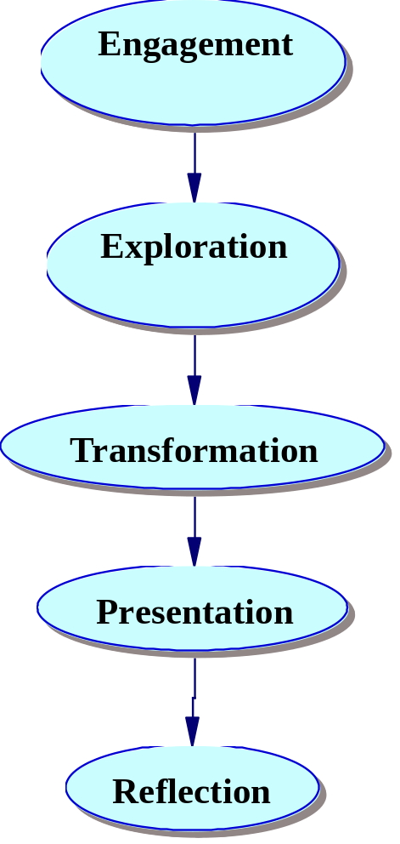
Perspective on Group Work and Collaboration
Collaboration
‘the ways children communicate as members of a group with joint goals’. (Wegerif and Mercer)
Reid, J., Forrestal, P. and Cook, J. (1989) Small group learning in the classroom
  Development of interactions with groups

Slide 11
Why ICT?
  ICT and children
    as a motivator
    encourages interactivity
    presenting information in ways appropriate to different audiences
  Screen focus enabling pupils to:
    organize their thoughts
    use colour and imagery to present information clearly and attractively
    facilitate talk

Slide 12
The software helps…..
Organise information;
Express ideas quickly (and communicate these effectively to others);
Generate new ideas and links between ideas;
Represent ideas spatially involving text, images, colour and symbols;
Show new connections and general overviews clearly;
Encourage collaborative problem solving;
Help clarify misunderstandings or misconceptions;
Stimulate interactive learning.

Slide 13
Reviewing
‘Concept mapping’ software
Inspiration
Kidspiration
Visual Mind
Mind Manager
Open Mind
Personal Brain
Map-It
Decision Explorer
VisiMap
MindGenius
BubbleMaps
MindPad
SoftNeuron
Mindmapper Jnr
ConceptDraw MindMap

Slide 14
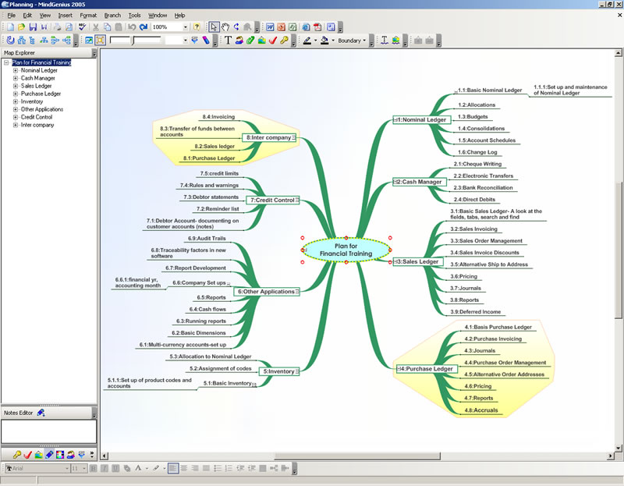
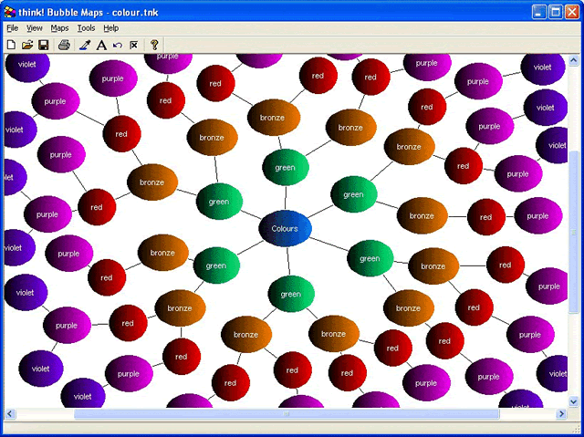
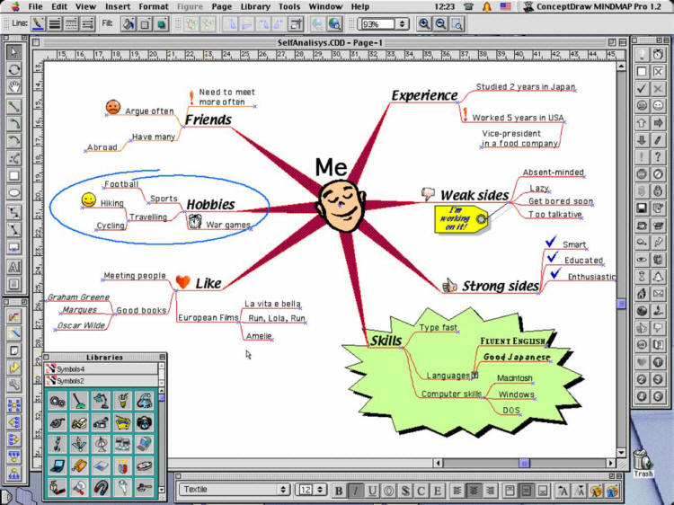
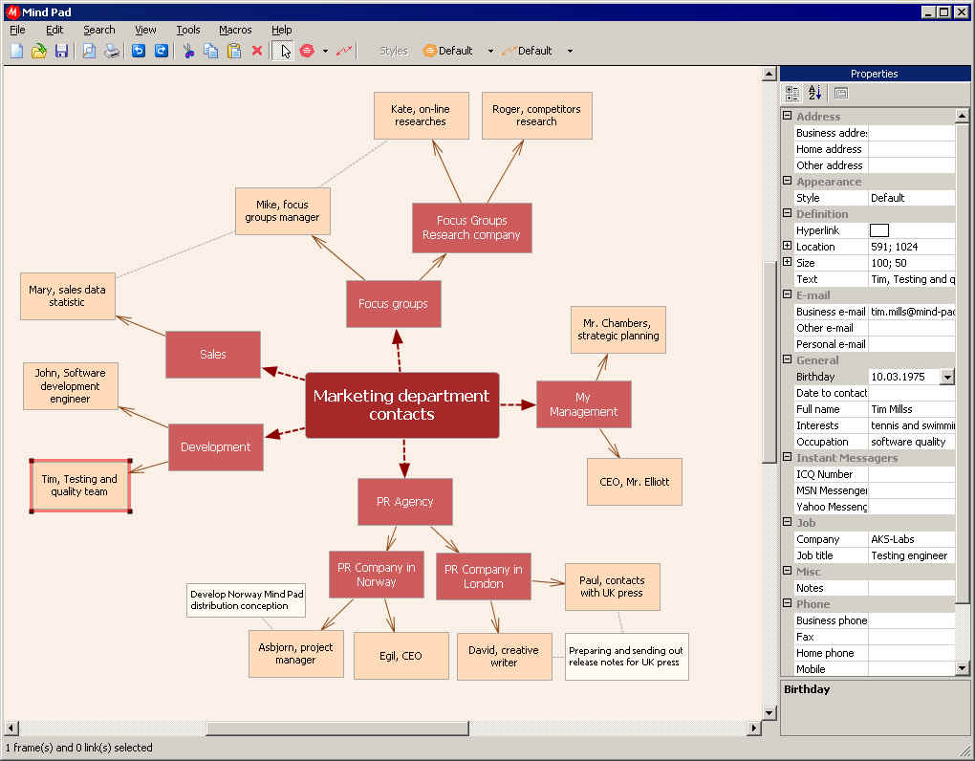
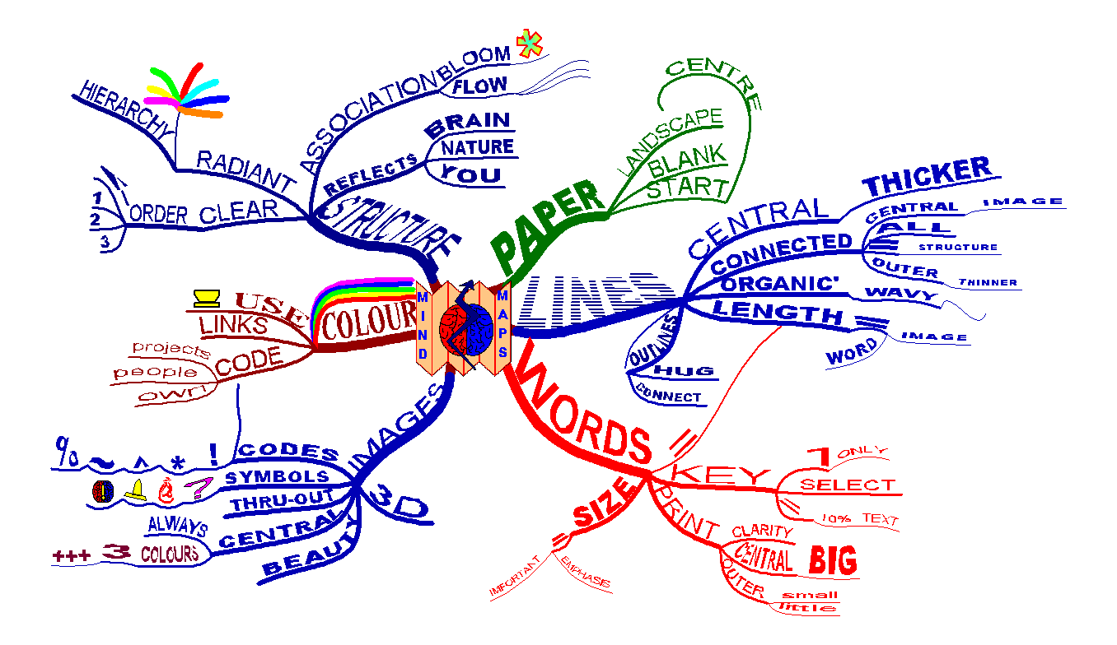
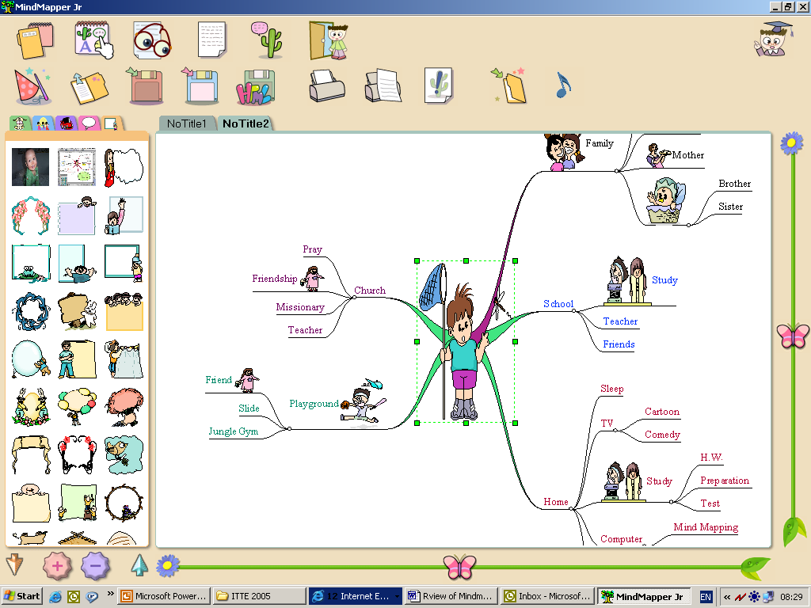
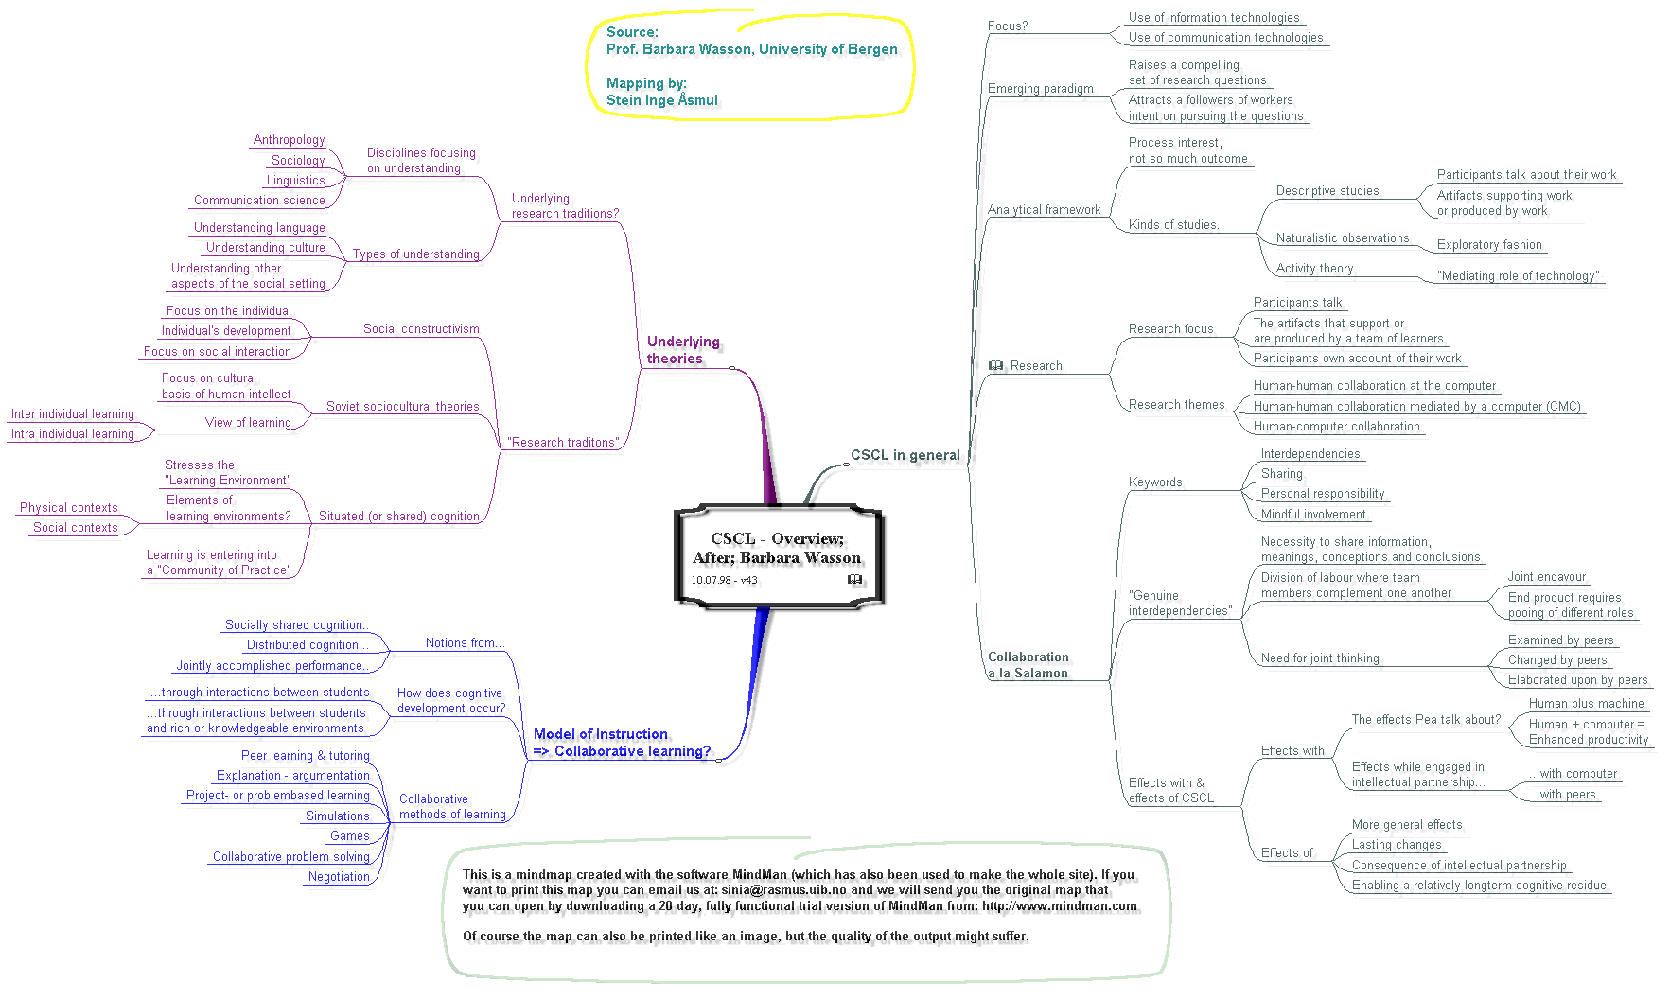
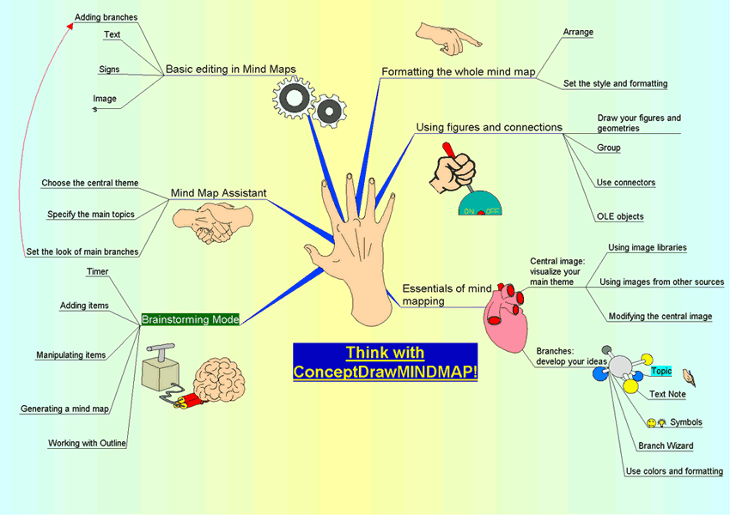


Slide 15
Developing consensual maps
  Terminology
    Story maps
    Graphic organizers
    Semantic maps
    Story webs
    Mind maps
    Advance organizers

Slide 16
Consensual maps
  Modes through which understandings of the world are built by exploiting iconic and symbolic systems
  Can provide a visual representation about a task which can be both efficient and succinct
  Providing insights into what happens in group activity

Slide 17
Analyzing the maps

Slide 18
Analytic Features
Recognizing organizing principles
  Identify laws, methods, rules that arrange in a systematic whole
Organizing elements and relations
  Arrange parts, connections between things into a systematic whole
Illustrating elements and relations
  Make clear by examples the parts, connections between things
Modifying elements and relations
  Change, alter, or qualify the parts, connections between things
Donald (2002), p 218
Notes:
Framework for reporting- helpful analysis
IFIP paper

Slide 19
Analyzing the maps
  Need for qualitative and quantitative approaches
    Two independently generated approaches used and maps scored and compared:
      According to features: colour, text types
      According to nodal structure
Notes:
Software
Continuity
Easy to continue from week to week- record of progress maintained
Helped
Explain

Slide 20
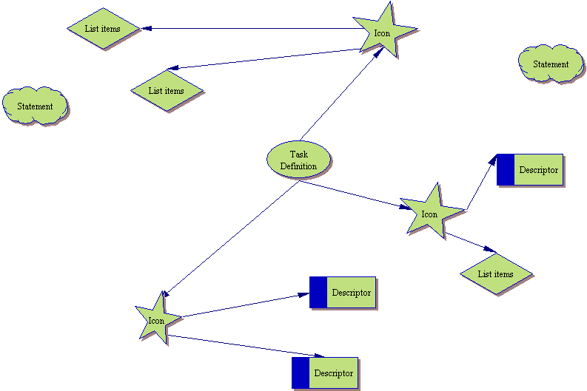
Analysing the maps
Notes:
STRATEGY 1
-based on the differing features of the eight maps which could be clearly seen such as
the use of free and attached icons
label descriptors
list of items
qualifying statements or questions
different types of nodes and links
illustrative or analytic use of colour.
The maps were then codified so that each different feature was identified in a specific and stylised way, that is by using a different icon for each text type.
RESULTS
This revealed much more clearly the systematic way the children had taken to creating their map and also made it possible to compare maps in each task group and across both tasks in a more realistic manner. By giving each identified feature a nominal score of ‘1’ it became possible to rank the maps in a way that reflected their complexity. Although it was clear that colour was sometimes being used to discriminate between categories rather than for aesthetic purposes so far we haven’t found a way to include this in a numerical way.
RESERVATION
While the stylised representation of the maps made them comparable it still does not seem to fully capture in an adequate measure the overall intricacy of the children’s efforts.

Slide 21
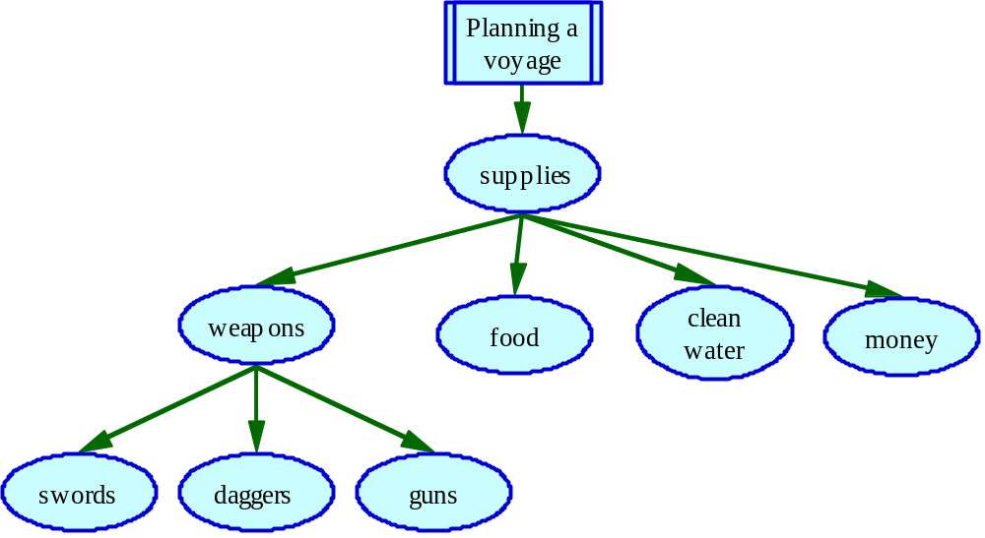
Analysing the maps
Notes:
STRATEGY 2
We analysed the ‘nodes’ of the maps, identifying the ‘busiest’, the ones with most connections or links to other nodes
The ‘supplies’ node is a 5-node, having five ‘connectors’ to other nodes; ‘weapons’ would be defined as a ‘4-node’. The discussion about ‘supplies’ shown in the map was clearly an important one in this example. Nodes were categorised in all the maps from a 1- node, with one link to another node, up to 11-nodes, with many connectors

Slide 22
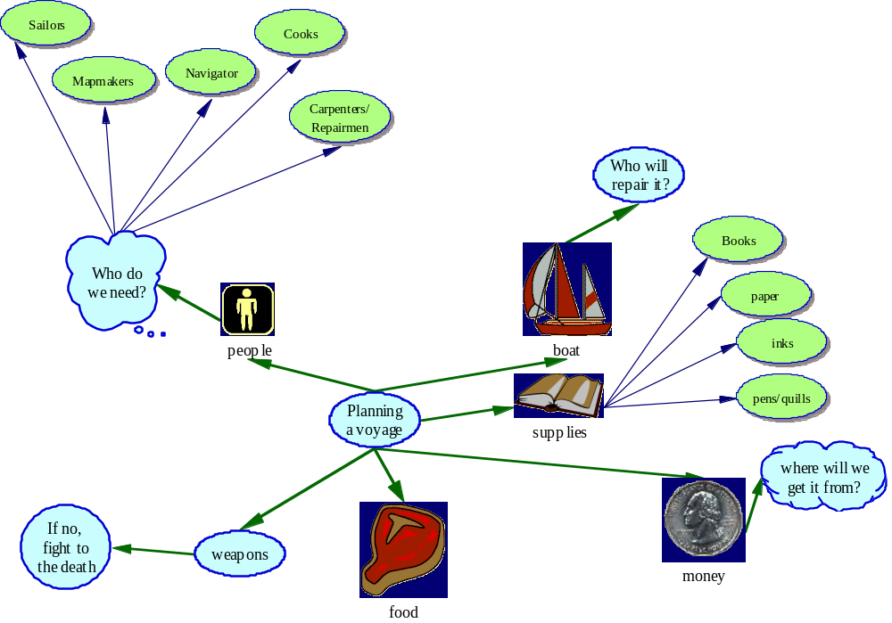
Analysing the maps
Notes:
Using Inspiration software, (a more advanced version of Kidspiration), maps were rearranged with the busiest node(s) at the top and subsidiary nodes lower down. (in Figure 2, ‘Weapons’ would be a subsidiary node)

Slide 23
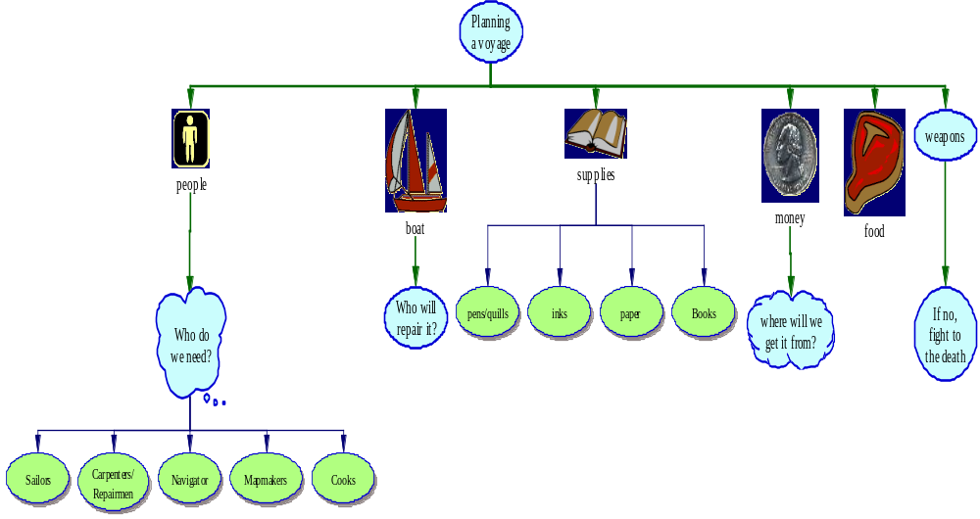
Analysing the maps
Notes:
This rearrangement helps the analysis by showing quite clearly the different ‘levels’ or stages of each map’s ‘development.’
Each level of this hierarchy of nodes was then identified and scored, giving one point of the first level node, two points for a second level node and more points for subsidiary nodes, providing a higher score for more ‘fully developed’ nodes. A numerical sum could then be obtained for each map and a comparison made between the maps.
As with all scoring methods, there is clearly a degree of arbitrariness in the way that values are allocated to the nodes in this technique. However, both these approaches to map analysis did help obtain a sense of the complexity of the structure of each map.
To do justice to the thinking behind each map we needed to look more carefully at what the pupils had to say, to give additional insights into how the maps were created and how they helped the children organise and express their ideas.

Slide 24
Some reflections
    Value of Futzing (experimental interactions with ICT)
    Opportunity to explore and investigate
      With colour changes or structure
      Exploring different images and customising
      Effectiveness of light touch
    Encourages own solutions
    Time pressure resolution
Notes:
Software
Continuity
Easy to continue from week to week- record of progress maintained
Helped
Explain

Slide 25
Some reflections on group work
An ‘integrated’ approach
  - Shared targets, considered by whole group, one or two dominant individuals
  Working ‘through’ the screen
  Importance of working towards a shared presentation
  Role changing + control of input devices
  Discussion about ideas and how to represent them
  Technical issues dominated discussions
  Tasks and the level of challenge

Slide 26
Some Reflections
Talk
  Presentation important in generating a different kind of talk from the process talk
  Every child made a contribution
  Process talk
    Made suggestions, accepted advice, helped with spelling, screen navigation
  Critical comment was mostly practical or social
    Re-arranging map features
Notes:
Some examples but not analysed

Slide 27
Reflections: maps and collaboration
What helped?
  Reshaping of information
  Having to use the different kinds of talk
  Software in terms of visualisation, continuity and recall
  Time pressures and focus
  Being able to make changes easily
Nature of task
Group composition

Slide 28
Some reflections
Software
  Provided a bridge between
    individual thought and the development of group consensus
    Collaborative activity and group presentation
  Bridging helps children make their thinking more explicit

Slide 29
Collaboration  ICT  Mind-mapping
John Ralston  Deirdre Cook
The Open University
Notes:
Presentation to show:
Enjoyment
Energy
Sense of fun
Care taken to create the map as they wanted it to be
Creative way that solutions were arrived at
How do we explore then maps in an analytic sense?
Maps: dynamic, exciting and colourfull

