Slide 1

ICT CPD programme design
What does the research say?
Is Naace agreed on ICT CPD policy?
What does the Naace community
advise on ICT CPD strategy
institutionally, regionally and nationally ?

Slide 2
New Brooms
Leitch 14-19 Reforms
Every Child Matters
Workforce reforms
Harnessing Technology
Personalised Learning
Increased need for effective ICT CPD
Reduction in the numbers of
LA Strategic ICT advisers!

Slide 3
E-enabled schools?
80% - 85% of schools have not integrated ICT into the system in an effort to make personalisation a reality for every child?
Becta (2007) Price Waterhouse (2004)
Is the school also providing social learning opportunities face to face and online, or is this just solitary learning?
How does the support of communities of practice like Naace help to support the teachers who need to make changes?

Slide 4
Motivational factors
NAACE, ITTE, MirandaNet
2000
The Internet fired imagination
E-Communities of Practice (MN)
The large majority had 1-2 days ICT CPD or less
in their professional life time
Preston. Cox et al. (2000) Teachers as Innovators:
an evaluation of what motivates teachers to use ICT. TTA, Compaq and Oracle.

Slide 5
Evaluation of NOF
1,000 teachers in the study
The vision and culture in the school was vital in success
Much was learnt and the quality improved significantly
Lack of accreditation meant it was difficult to know what had been achieved and rigour was in doubt
In 47 programme only 2 which were very successful were practice- based and had portfolios but not web-published
ICT access for teachers was still poor
Key problem - lack of basic computer skills?
No ICT CPD for trainers
The most commented on factor was the trainers, whether negative or positive
Preston 2004. Learning to use ICT in Classrooms: teachers' and trainers' perspectives :
an evaluation of the English NOF ICT teacher training programme 1999-2003.
London, MirandaNet and the Teacher Training Agency

Slide 6
A high level of agreement between the teachers and the quality assessors
Evaluation of NOF programmes based on
Guskey’s levels of engagement
participants’ reactions;
participants’ learning;
organizational support and change;
participants’ use of new knowledge and skills;
students’ learning outcomes.
Davis, Preston al. (2007). "ICT teacher training impacts multiple ecologies: evidence from a national initiative."

Slide 7
Comparison of NOF programme features
Focused on appropriate systemic change in school | Centralised online directional model to teachers from ATP
Took account of the ecology of the system | System disruption
E-CoPs for the trainers as an ICT CPD programme | Online training for the teachers not the trainers
Work based approach to making changes in the system | Information transmission models
Successful | Rewritten more than once
Davis and Preston et al. (2007). "ICT teacher training impacts multiple ecologies: evidence from a national initiative."

Slide 8
NAACE research into ICT CPD
Large number of IT and ICT qualifications
largely skills and knowledge based, providing little evidence of the professional’s broader practice, let alone their values and attitudes
examined through written exams and projects
only vocational qualifications use significant evidence drawn from the workplace
very few schemes that even remotely give an indication of a professional’s e-maturity.
Workforce e-maturity : characteristics and development.
Davies and Adams 2007 Naace

Slide 9
The Perspectives of Professional Educators on ICT CPD:
Past, Present, Future.
250 members of Naace, ITTE and MirandaNet
Preston and Cuthell (2007).
London, Naace, MirandaNet Fellowship, WLE, Institute of Education, University of London.

Slide 10
Tell us your story…
Critical incidents in the professional lives of the teachers of teachers in ICT

Slide 11
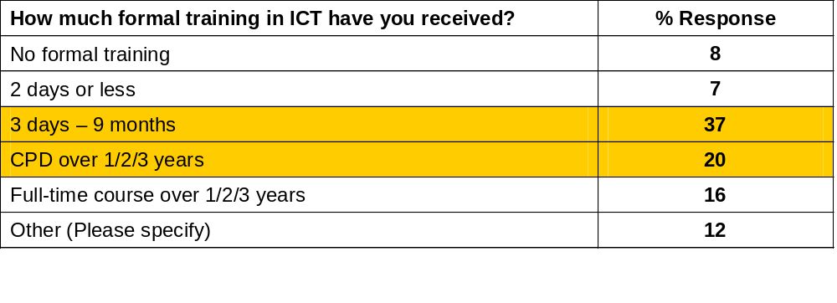
Professional Development in Leading-Edge Communities

Slide 12
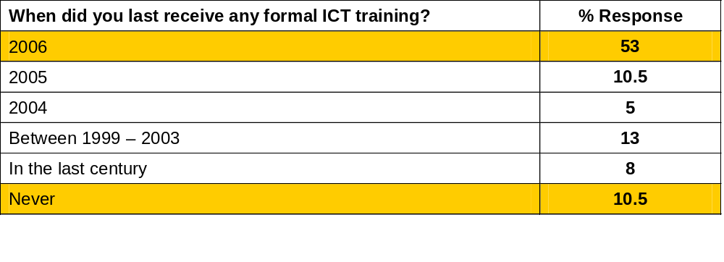
Last formal ICT training

Slide 13
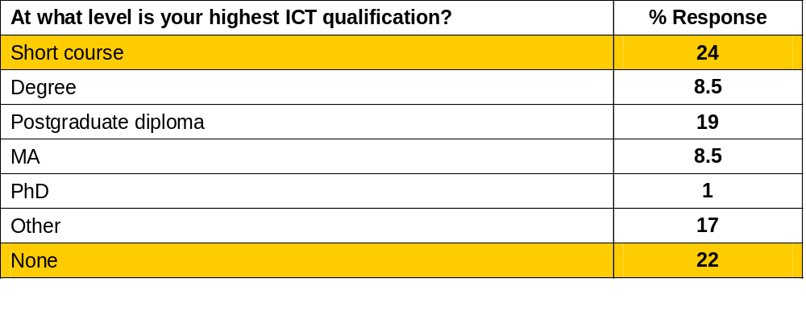
Types of ICT CPD
‘Other’ = CLAIT, ECDL, ICDL, RSA DipIT and the RSA Teacher/Trainer Diploma in ICT

Slide 14
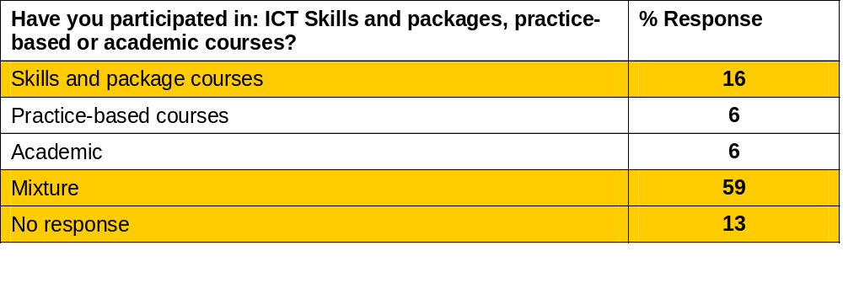
Type of course undertaken

Slide 15
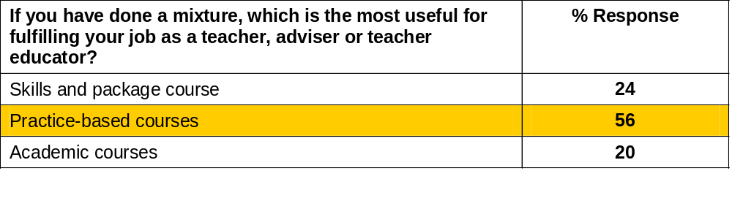
Impact of CPD

Slide 16
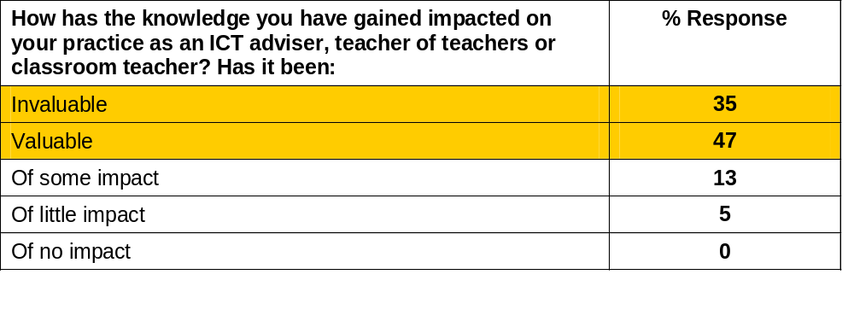
Impact of CPD on current practice

Slide 17
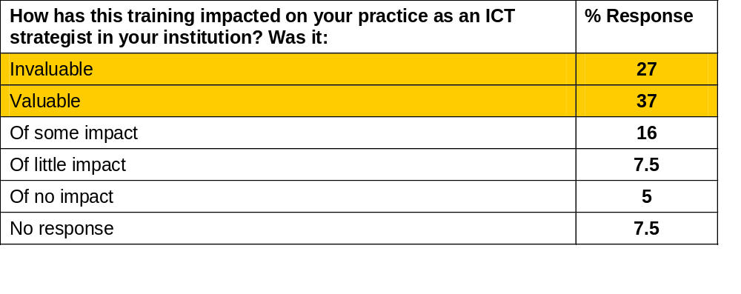
Impact on practice (2)

Slide 18
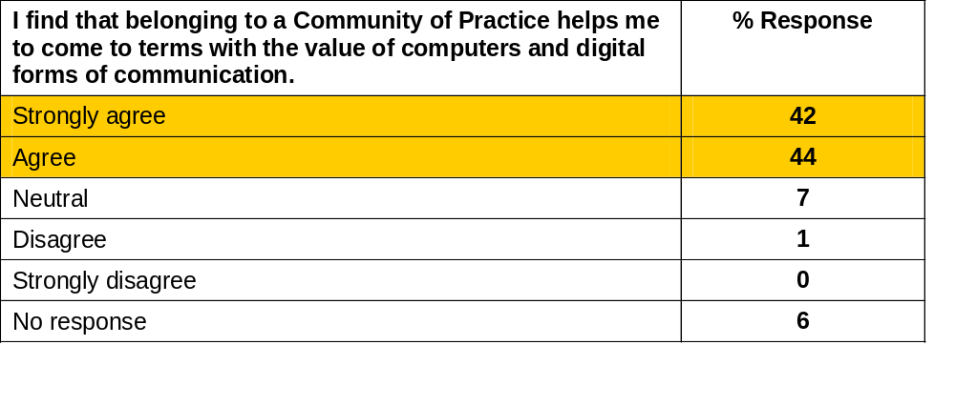
Membership of a Community of Practice

Slide 19
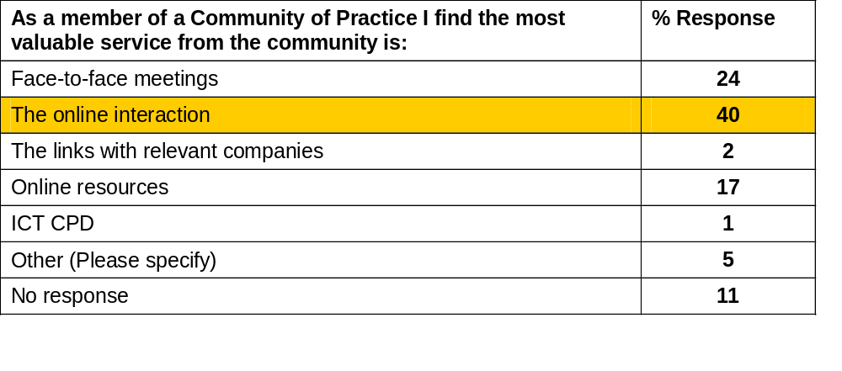
Benefits of a CoP

Slide 20
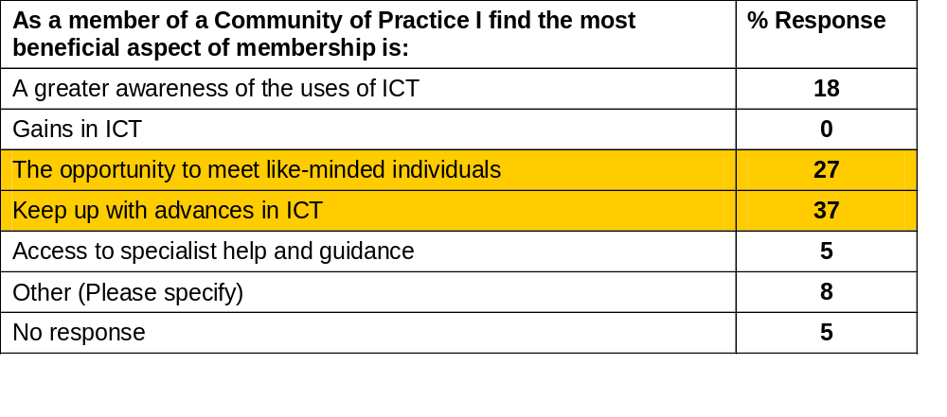
Benefits of a CoP (2)

Slide 21
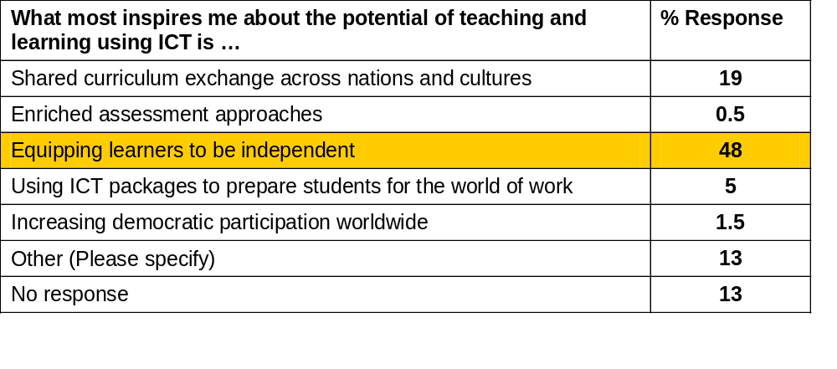
Impact of ICT on teaching and learning

Slide 22
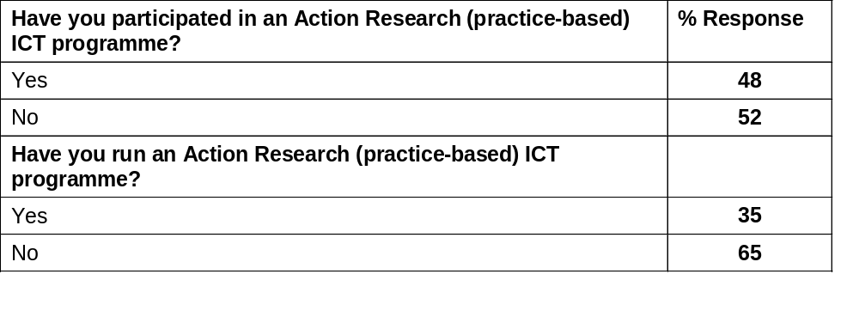
Practice(work)-based research

Slide 23
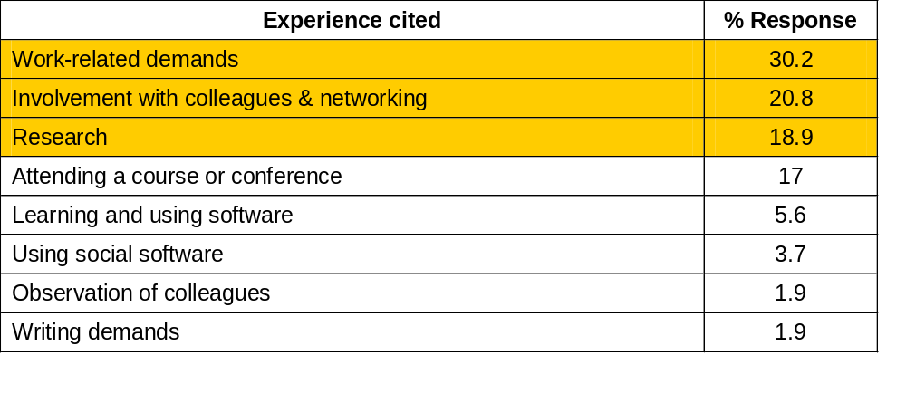
Motivating factors for professional development

Slide 24
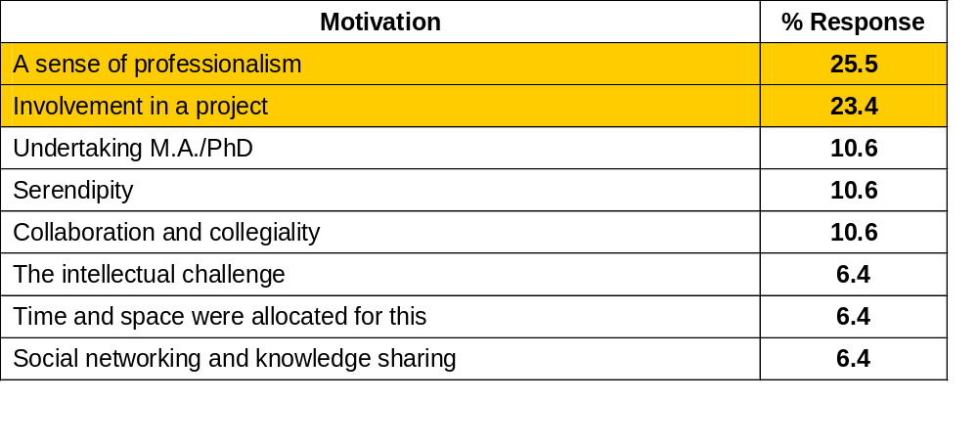
Finding the time; making the effort

Slide 25
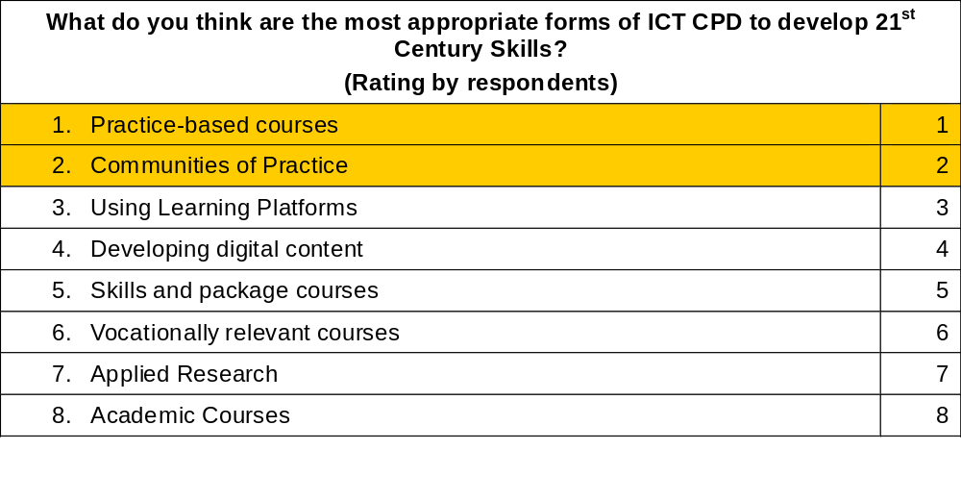
Developing C21 skills

Slide 26
The core question
To leverage ICT as an innovative (or disruptive)
force requires courage and motivation…
The question then is not
What needs to be learnt,
but,
Why would a teacher want to put so much
cognitive energy into ICT to make the change happen?
On-going research into the process of teachers leading Innovative change by the use of ICT
Teacher Knowledge and Teacher Learning
2007 Law, Cox and Somekh. Symposium at BERA

Slide 27
Key question for Naace strategists
What should be the principles of ICT CPD programmes design?
How much does belonging to a community of practice like Naace count in making change happen?
How can we impact on ICT CPD policy?

Slide 28
The research can be found on:
Publications page www.mirandanet.ac.uk/pubs

