Slide 1

Professional learning in e-communities of practice –
an extension of tradition or an innovation?
Lessons from the MirandaNet Fellowship
Dr Christina Preston
Professor of Education Innovation
christina@mirandanet.ac.uk
www.mirandanet.ac.uk
www.mirandanet.ac.uk

Slide 2

Learning online in MOOCs and SPOCs
can be a lonely process
Massive Open Online Course
Specialist Personal Open Online Course
5
Development
4
Knowledge Construction
3
Information Exchange
2
Online Socialisation
1
Access & Motivation
5 Step Theory (Salmon, 2000, 2002, revising 2012)
Looking at the development stage

Slide 3

Beyond Salmon’s
five steps
We Prefer COOCs
Community Open Online Courses
Notes:
International Conference in Portland, Oregan

Slide 4
Founded in 1992: approximately 800 members in 80 countries
‘MirandaNet follows the tradition of a medieval guild for educators’ Wenger 1998
Our Heritage since 1992
Spans national, cultural, commercial and political divides
A forum for professional educators in industry, research, policy
Partnership with the profession, industry and government
Individual learning patterns are celebrated through action research strategies and peer e-mentoring.
Dissemination and publication central to the Fellowship process.
Oh brave new world that hath such people in IT’
Miranda, The Tempest, Shakespeare
JPC

Slide 5
‘One day courses in computers are waste of time’.
Founded in 1992 with x 5 members with Toshiba Laptops. Took 3 months to connect them online;
Website and member profiles in 1994 like Face Book;
Approximately 800 members in 80 countries who are international policy makers, teachers, teacher educators, researchers and commercial developers;
Free to join but members become Fellows by writing an article of 2,000 words or multimodal equivalent
Non-profit making: funded by international associate companies, international governments, charities and other funding bodies
http://www.mirandanet.ac.uk/

Slide 6
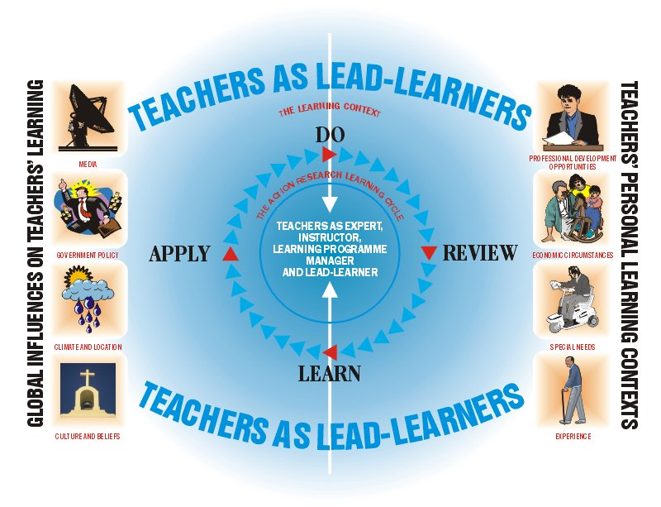
What is an online teacher community?
How does learning work in an informal community of practice in contrast to a formal course ?
Notes:
Diagrams begin to be curved and circular

Slide 7
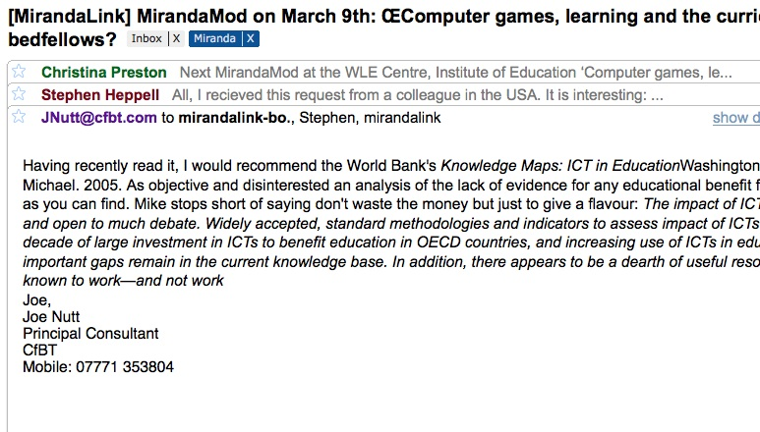


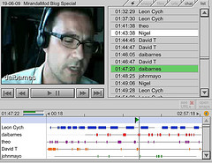
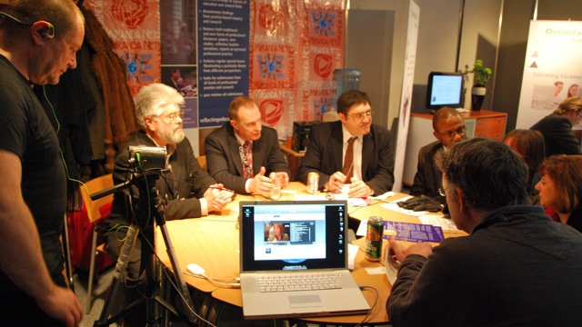
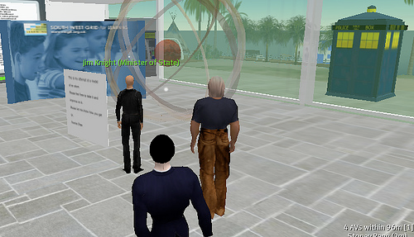
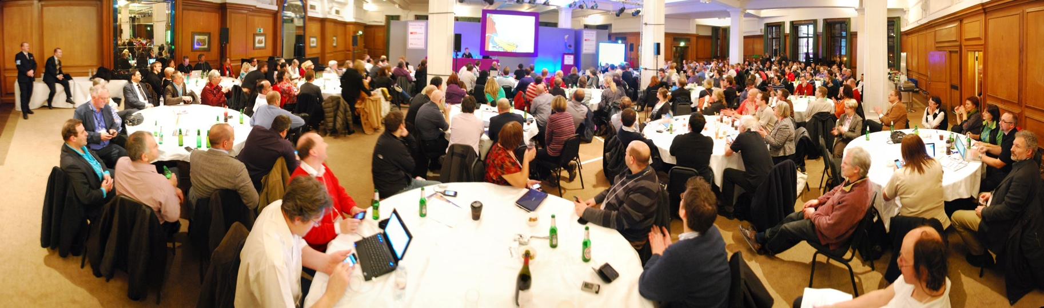
Informal learning spaces

Slide 8
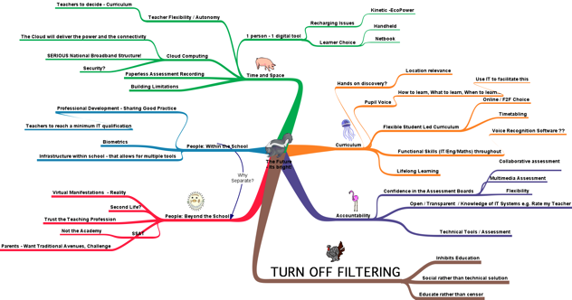
Collaborative knowledge construction and dissemination
Remotely authored multidimensional concept maps

Slide 9

The learning space has diversified, become more democratic and capable of absorbing global voices:
wikis;
video streaming;
Google hang-outs; video conferencing;
concept mapping;
Twitter stream back channel.
www.mirandanet.ac.uk/mirandamods/

Slide 10
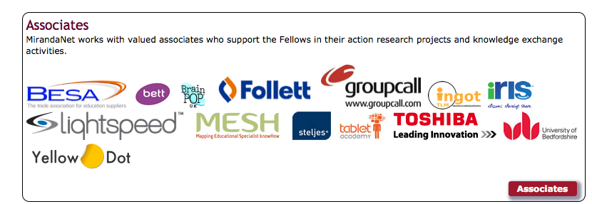
Funding, research and dissemination partners
Current research projects with associates:
Gaming in learning: Brain Pop, Yellow Dot
Web based video in CPD; IRIS Connect
Using mobile devices in enriching personal and collaborative learning; Tablet Academy
Sharing experience with young people establishing careers; iCould
Developing a community of practice for teachers from overseas; Engage
Developing digital support for those with learning challenges; Fit2Learn
Establishing effective collaborative learning; LightSpeed
Parental Engagement through mobile devices: GroupCall
Accreditation of action research: Ingots

Slide 11
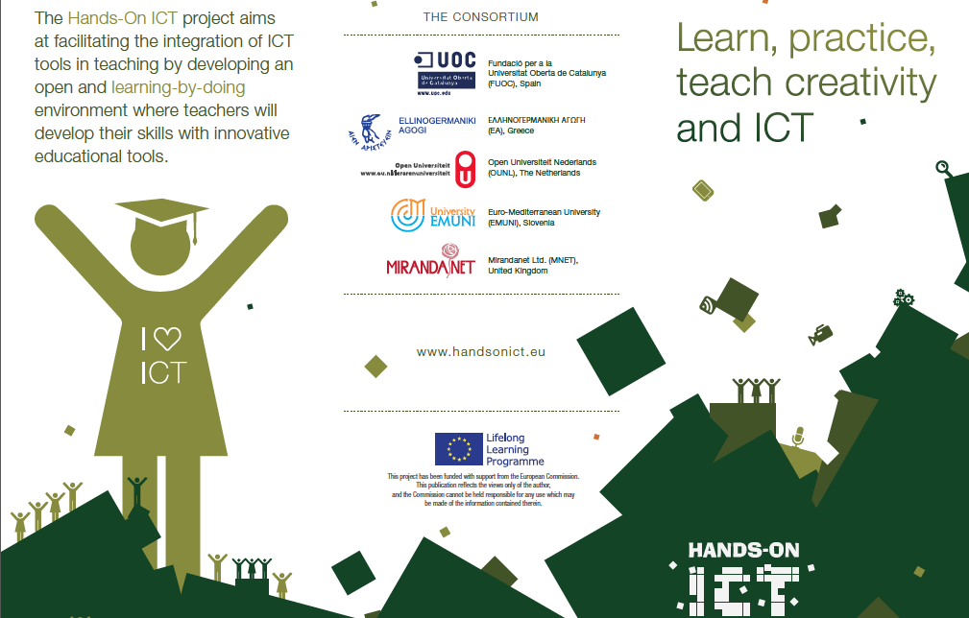
Experts in online learning: EU Partners

Slide 12
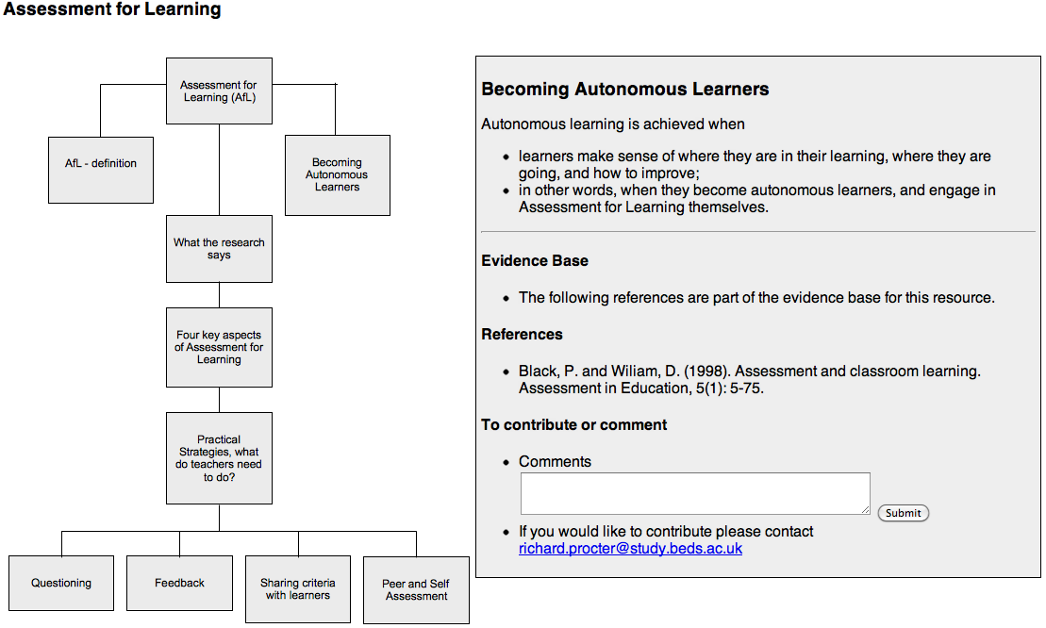
Global publication partners
MESH – mapping education specialist knowhow
MirandaNet Partners
Notes:
Assessment for learning developed into and online pathway
Demonstrator

Slide 13
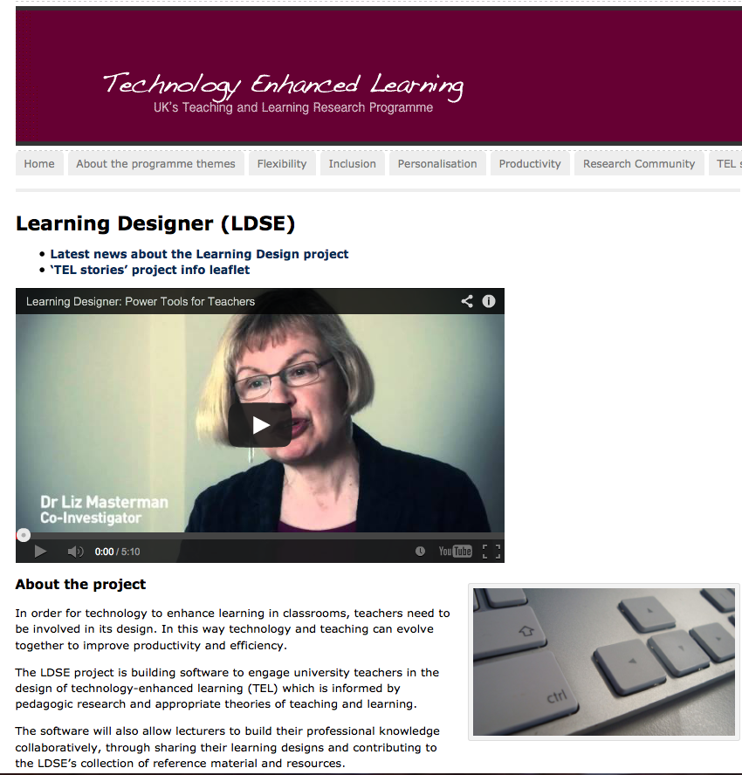
Teachers’ voice Partners
Professor Diana Laurillard
London Knowledge Lab
Institute of Education
University of London

Slide 14

Benefits to Associates: Web stats
High visibility through outstanding webstats; 5 out of 10 on the Google scores;
More than 750,000 visitors a year;
6,000 unique visitors a month who often return;
high user engagement: 11 pages viewed per user;
consistent traffic day by day, month by month, year on year;
global traffic; members in 80 countries but overall the visitors are from:
Europe 490,000 49%; (UK 300,00 30%);
China 170,000 17%;
USA 160,000 16%;

Slide 15
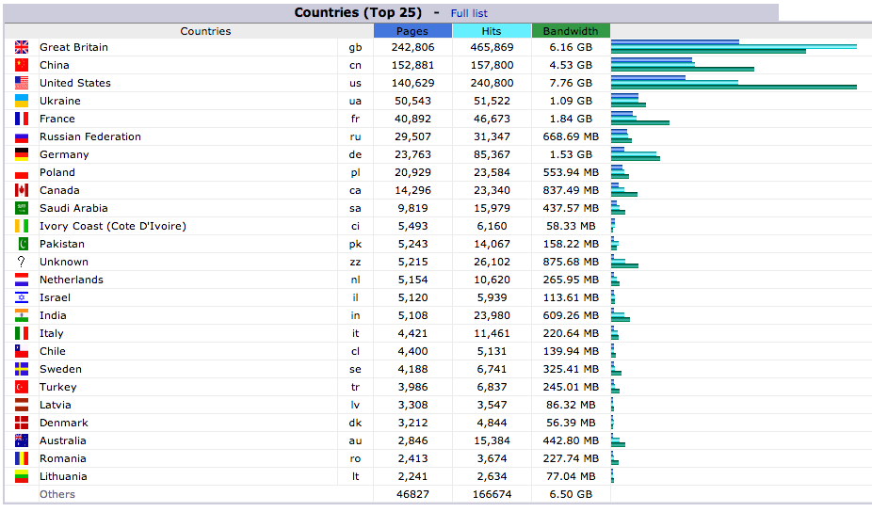
Stats for pages viewed

Slide 16
Benefits to Associates
Networking with teachers, senior managers, policy makers, researchers, teacher educators, education software and services providers;
Presence at international events e.g. IFIT, Postdam July 2014: the MirandaNet lounge at BETT- now to be for all BETT newcomers in 2015;
Busy MirandaMod programme in associate subjects;
Opportunities for effective and affordable research and development with MirandaNet members; literature search, articles, reports, case studies, questionnaires, focus groups, co-researcher study groups, concept mapping for collaborative knowledge capture: crowd sourcing techniques;
Accredited research and development studies involved for educators and company representatives; press releases, articles, reports endorsing associates in a range of media.

Slide 17
Benefits to Associates
Current initiatives
Redesign for website as a showcase for Associates;
Improved associate webpage linking to your site
Publicity in trending articles and members blogs;
Increase in social networking;
Opportunities to be partners in new project bidding, meetings 18th April and 12th May: JISC, ESRC, EEF, EU….

Slide 18
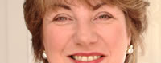
Want to be involved?
Dr Christina Preston
Professor of Education Innovation
christina@mirandanet.ac.uk
www.mirandanet.ac.uk

