Slide 1
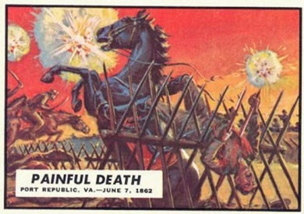
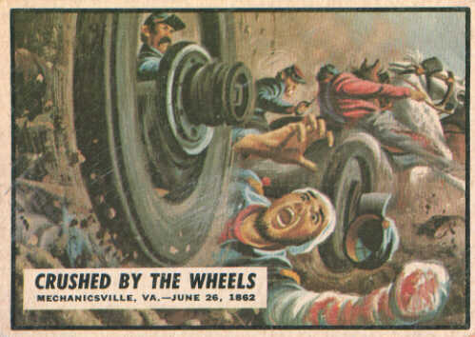
Civil War Bubblegum Cards
“I used to read comics with
images as bad as those as a kid
in the early 60's - there were
also sets of bubble gum cards like
these on sale and in every school
Playground..”
I was 8 years old in 1960 and
passionate collector of bubblegum
cards…I never saw anything like
this.
In fact these cards were highly
controversial at the time.
Notes:
Civil War News was a successful, if controversial, trading card series that first appeared in 1962 during the Civil War centennial celebrations. There were 88 cards in the set, in addition to facsimile Confederate dollars inserted one to a pack.
The front of each card features a piece of color artwork rendered by artist Norman Saunders. The back is a fashioned after a period newspaper page, with a headline and text. Many of the incidents recounted on Civil War News cardbacks were fabricated.
Widely collected and valued among collectors (aside from some bulk warehouse finds of cards in mint condition), the Civil War News cards were originally rejected by parents for their portrayals of violence (despite the cards' perceived educational value).

Slide 2
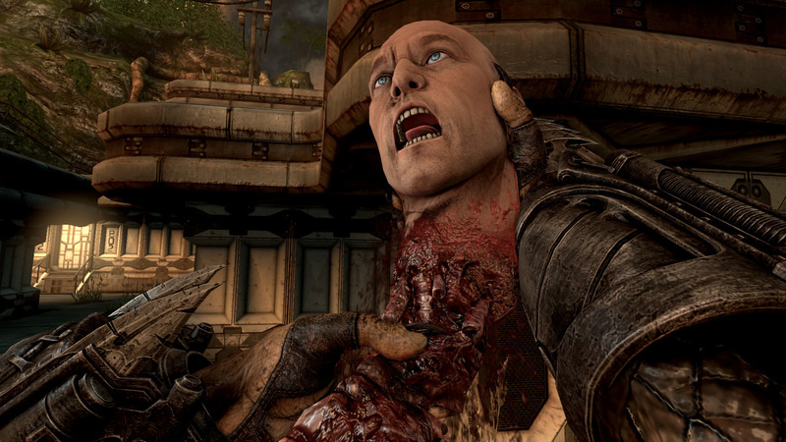

Slide 3
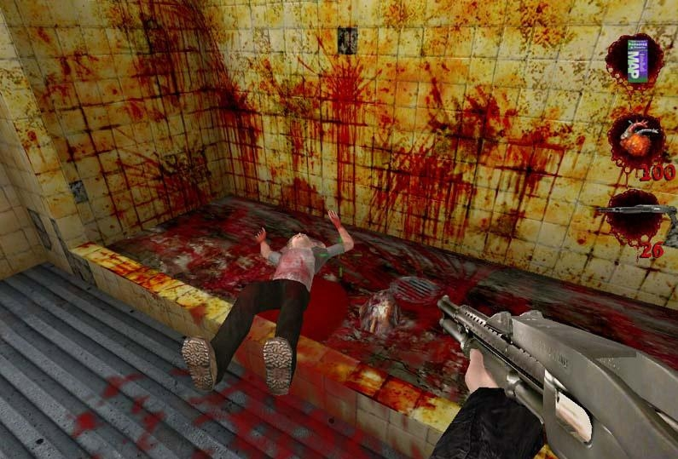

Slide 4
