Slide 1
Achievement for All
Laura Cunningham
Assistant Director, Special Education Needs and Disability
Department for Education

Slide 2
Why do we need Achievement for All?
….because the current system is failing too many children
The achievement gap between 20% of pupils with SEN and disabilities and those without is wide at each key stage and is not closing.
Moral purpose – too many children are not fulfilling their potential and are unhappy at school
Lamb Inquiry- exposed failures in the system, parents’ frustrations and too great a focus on processes rather than outcomes
Future jobs market, independence and fulfilling adulthood

Slide 3
Achievement for All
Achievement for All is a school improvement framework that increases the access, aspiration and achievement of children with SEND. It grew out of Lamb Inquiry (2009) and focuses on outcomes rather than process.
Achievement for All is a 2 year pilot running from Sept 2009- July 2011
There are 450 schools in 10 LAs involved and approx 28,000 pupils
The pilot includes all SEND children (statemented, SAP and SA) in years 1,5,7,10
Achievement for All is mainly in mainstream primary and secondary schools and some special and PRU schools
There is an independent evaluation by University of Manchester. Interim report is expected in Spring 2011 with full report in Summer 2011

Slide 4
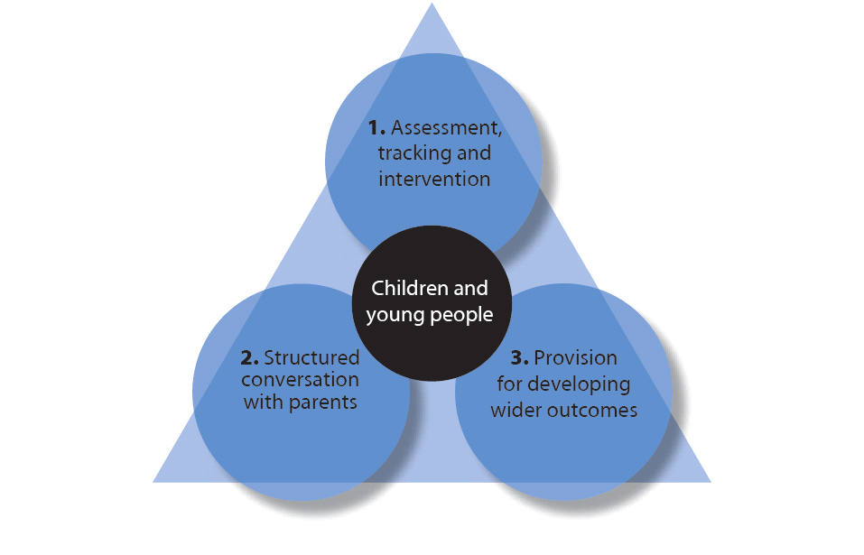
AfA : Improving access, aspiration and achievement
There are 3 strands that work together to provide a flexible framework
  1. Assessment; tracking and intervention
  2. Improved engagement with parents of children and young people through termly conversations
  Increased provision for wider outcomes such as reduction in bullying, increased attendance and improving social interaction

Slide 5
Key Elements
We know that there are key elements to the success of Achievement for All
Leadership- We know that where Achievement for All has been successful, head teachers have been strongly involved in Achievement for All in their schools and have driven Achievement for All as a school improvement strategy.
Parent conversations- These detailed conversations are integral to the success of Achievement for All, and one teacher described these as “eye opening”.
Responsibility- Through Achievement for All the responsibility for children with SEND has shifted from the SENCo to the class teacher. Achievement for All has been described by one teacher as “putting SEND back in the classroom”.
Use of information and data to drive improvement at pupil, school and local authority level
Creativity in removing barriers to learning

Slide 6
Flexibility within a structure
AFA head teacher said
It’s the first initiative that said “right … what are you going to do? We’d like these outcomes but you get on with it’ …’We’d like to see parents fully engaged and we’d like to see the children improve, but how you do it is totally and utterly up to you. Here are the people you can call into help if you want’.. And that’s what’s made it exciting, you are totally in control again. So its down to schools …to take it and to go all out … because if you go all out with one thing everything else pulls together.

Slide 7
Impact and outcomes – closing the gap
Initial evidence shows that Achievement for All is significantly increasing the achievement of children with SEND, both in attainment and wider outcomes
AFA pupils in year 5 and Year 10 made significantly better progress in English and Maths than pupils with and without SEND nationally in the first year (University of Manchester 2011)
Taking all children in the project, the average progress is the first year was 1.5 sub-level gains just under national expectation for all pupils (University of Manchester 2011).
90% of AfA schools achieved average gains of 2 sub levels, primary ( reading, writing and maths) secondary ( English and Maths) in the first 2 terms.
The averages mask some exceptional progress. In one local authority over 45% of year 10s, made at least 3 sub level gains in English and 36% in Maths in 4 terms. 18% made at least 6 sub level gains in English and 15 % in Maths in the same period. In another, 80% of Year 5s have made progress in each area and 10% have made at least 6 sub level gains.

Slide 8
Impact and outcomes – working with parents
The structured conversation continues to be one of the resounding successes of AfA for schools and parents alike.
One school said “it has been the most powerful part of the project” and “an absolute roaring success”.
Huge cultural shift in parental engagement and, for some, the first time a genuine partnership between home and school.
Parents feel more included and empowered.
Change in dynamic of the contact with parents – no longer a conversation about being in trouble but uses termly data on achievement to focus on learning
Schools saying they have an excellent relationship with parents has grown from 12%-46% in first year of project

Slide 9
Impact and outcomes- wider outcomes
Initial evidence shows that Achievement for All is significantly increasing the achievement of children with SEND, both in attainment and wider outcomes
Improving the wider outcomes eg peers relationships and attendance is having an impact on learning and attitudes to school
One secondary school reduced persistent absenteeism from 12%to 3.5%.
Prior to Achievement for All, attendance in wider outcomes and school clubs was 20% . This has now increased to 70%.
Creative strategies being deployed to improve behaviour – this is having a significant impact on achievement

Slide 10
Support and aspiration: SEND Green paper
A radically different system that:
The Green Paper proposes:
a new approach to identifying SEN
supports better life outcomes for young people
a single assessment process and ‘Education, Health and Care Plan’
a local offer of all services available
gives parents more confidence by giving them control
parents to have the option of a personal budget by 2014
giving parents a real choice of school
transfers power to front-line professionals and to local communities
greater independence to the assessment of children's needs

Slide 11
Achievement for All and SEND Green Paper
Builds on the learning from the AfA pilot eg importance of leadership, good teaching and learning, early identification, parental engagement and support
Addresses over identification of SEN with a new single early years-setting and school based SEN category
Sharper accountability on progress for lowest attainers introducing a new measure into school performance tables
Commitment to roll out Achievement for All

Slide 12
Further Information
For more information about Achievement for All please see:
http://www.nationalcollege.org.uk/index/about-us/national-college-initiatives/primary-leadership/primaryleadership-achievementforall.htm
For more information about Support and aspiration: a new approach to special educational needs and disability
www.education.gov.uk/consultations/
www.education.gov.uk/

