Slide 1

Global Warming:
a salutary tale
by
Hannah Rogers
Year 7

Slide 2
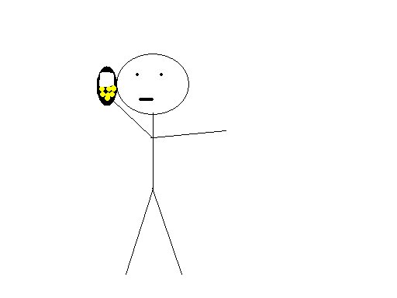

Slide 3
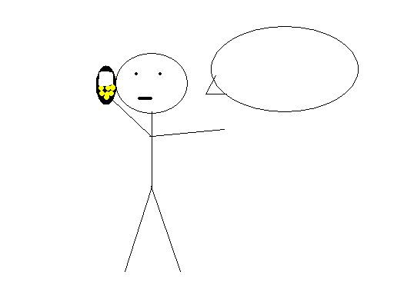
Sorry I’m late, sir!

Slide 5
What was that, sir?

Slide 6
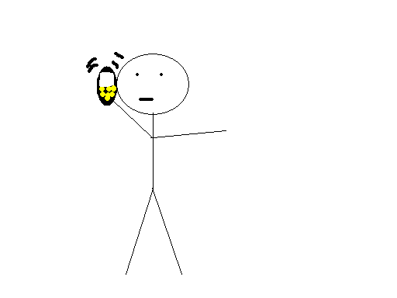
Get here, quickly,
or you’re fired!

Slide 7
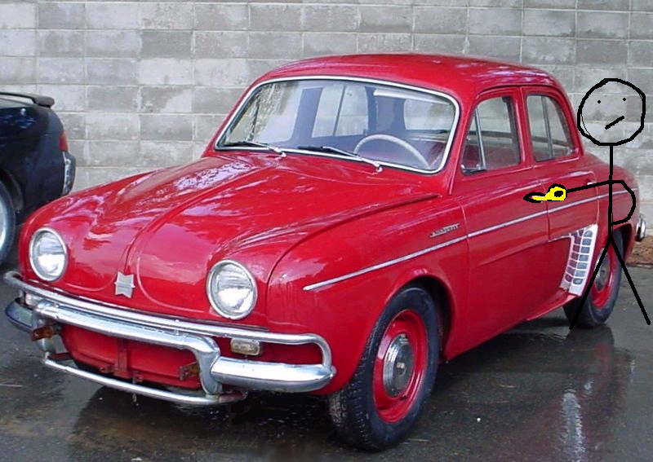

Slide 8
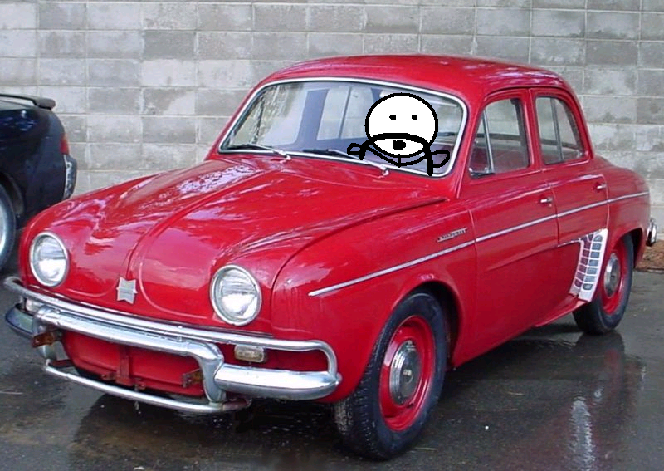

Slide 10
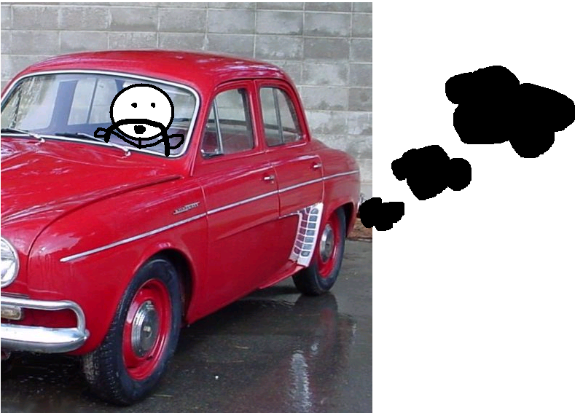

Slide 11

Filthy carbon monoxide!

Slide 12



Slide 13


Slide 14
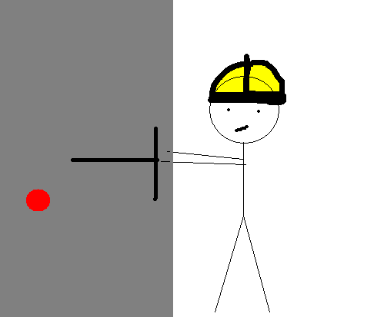

Slide 15
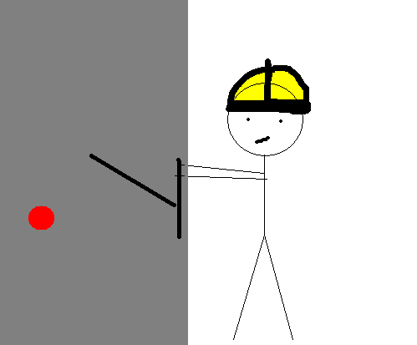

Slide 18
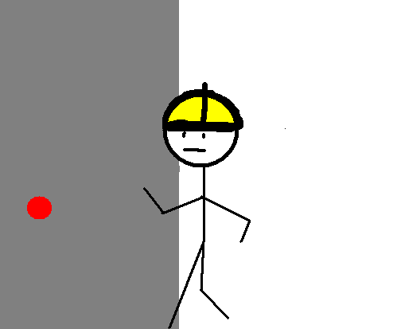

Slide 19
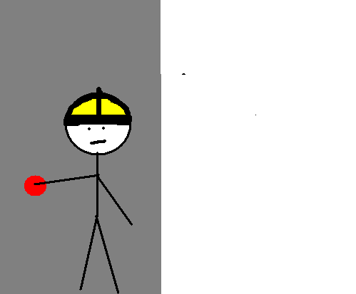

Slide 20


Slide 21
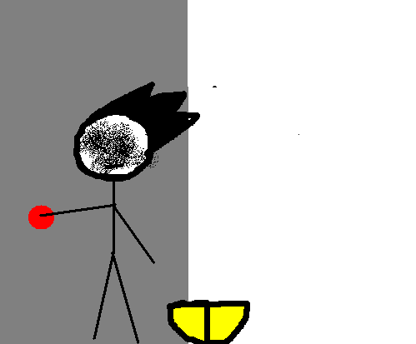

Slide 22
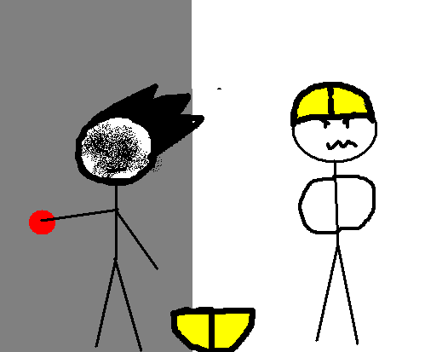
The boss!

Slide 23
STICKY,
YOU’RE FIRED!

Slide 24


Slide 25


Slide 26
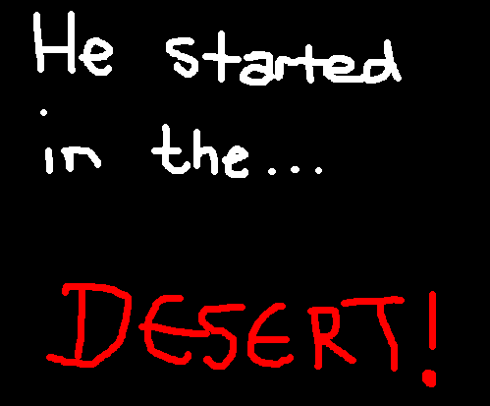

Slide 27
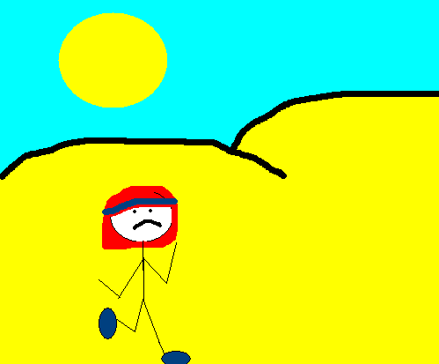

Slide 28


Slide 29
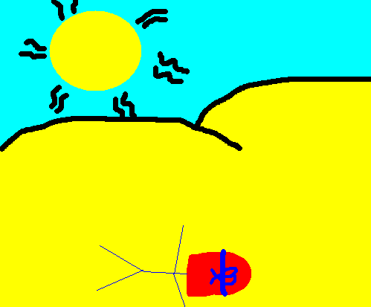

Slide 30
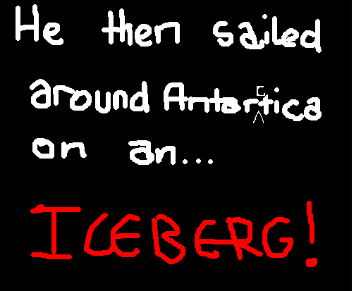

Slide 31
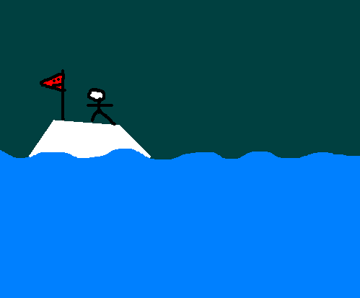

Slide 32
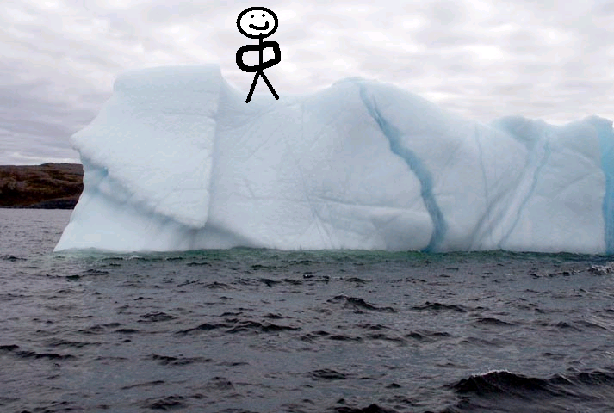
The next day…

Slide 33

….he met a friend along
the way.

Slide 34


Slide 38
Hello, and welcome to Antarctica!
I’m your safety adviser, and I advise that you get off that iceberg before it melts!

Slide 39
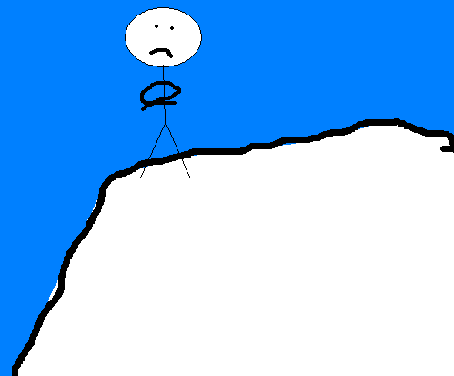
It won’t melt!

Slide 40
It will!

Slide 41
It won’t!

Slide 42
It will!

Slide 43
This guy doesn’t know anything about global warming. I’d better tell him now before he drowns!

Slide 44
Sir, you obviously don’t know anything about global warming…
So I’ll tell you about it. The sun’s rays heat up the Earth. This causes all the ice here to melt!

Slide 45
He is just pulling my leg. This iceberg won’t melt!
It is a solid lump of ice.
Impossible to break!

Slide 46
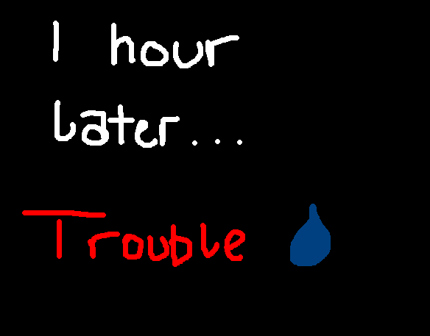

Slide 47

HELP!
ANYBODY!

Slide 48
I guess the little guy was right.
The ice has melted.
I shouldn’t have been so stupid.
I HATE GLOBAL WARMING!

Slide 49
Hang on!
I cause pollution!
Pollution helps speed up global warming!
The smoke from my car
The smoke from the factory chimneys
The explosion I caused
The sun didn’t help, either.
It melted my iceberg, and now I’m stuck!

Slide 50
Oh, well.
I guess I deserve this!
HELP!
The end…..

