Slide 1
As a baby boomer the first critical incident was in 1955 when I saw my first mainframe at a Christmas party at an American bank in London where my father was data-processing manager. Donning plastic hats and shoes to enter the computer laboratory gave the computer a mysterious attraction from which I have never quite recovered. In addition my father often had to answer a summons in the middle of the night to ensure that millions of dollars lost ‘by the US computer’ were found before customers woke up in the UK morning.
As part of programmed learning my father also tested out the theory of ‘time and motion’ in family activities like the washing up. Although this was fun it also reinforced my impression that computer enthusiasts thought that all life could be easily coded, sequenced and flow-charted. I resolved to have nothing to do with computers (Preston 1994).
Over the next year I became an under-trained IT teacher, learning on the job. However, the understanding of computers as a key tool in the teaching portfolio was important when I accepted an invitation to join a major collaboration between the Educational Computing Unit (ECU), King’s College, University of London and the BT Education Service developing educational software.
Although my group of six cross-curricula teachers from Croydon had no formal computer science training, we designed a game about investigative journalist called Scoop in partnership with a professional programmer; the first educational adventure to include location graphics. The international newsroom simulation which followed, called Newsnet, linked three databases, desktop publishing, electronic mail, word processing and a networked wire service like Reuters. My teaching skills were enhanced by the opportunity to trial the programme I had authored in schools as well as presenting to teachers and writing articles.
(Preston 1994).
Figure 2 :
The mystery of computers
Figure 3 :
Authoring resources

Slide 2
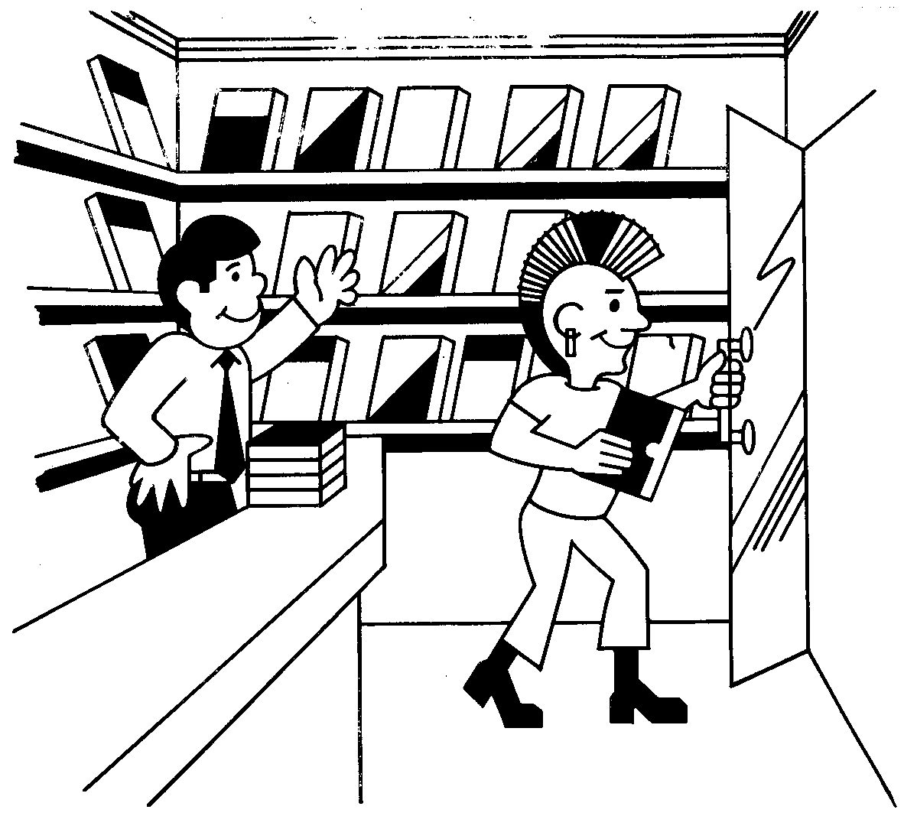
Scoop
an educational adventure game
A partnership between BT - Kings College, London University
The record shop 1987
Figure 4

Slide 3
The original project with which I was involved happened in 1994. MirandaNet and Toshiba got together to see what would happen if you gave teachers laptops. At the time this was a very radical idea indeed. Toshiba provided the laptops, paid the cost of an online training course for the scholars (as we were called) and also paid for some conference time. A lot of people were interested in the findings and it is probably no surprise that NCET, as was then, sponsored a larger scale project based on the MirandaNet findings
Franklin 1997
Figure 5 :
Working with developers
The spin-offs for the scholars were numerous. We had suddenly been plunged into a very different world from the narrow horizons of our individual schools. We found that we actually knew more than some of the experts. We were even asked to write chapters for books. Now anything seemed possible - eight years on and everyone involved in that original project is now a significant figure, to a greater or lesser extent, in the world of ICT. It comes as a pleasurable shock to be told you are regarded as an expert in your given field!
Franklin 1997
Figure 6 :
Teachers as Experts

Slide 4
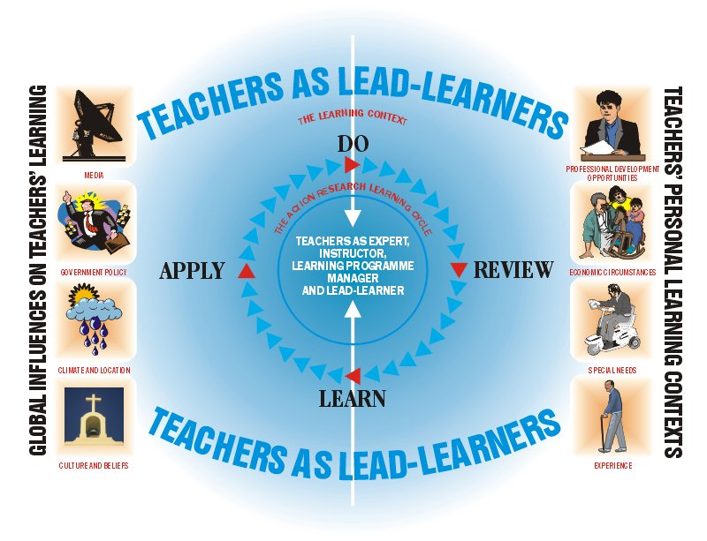

The teacher as a human being: roles, processes, context
Figure 7 : The first MirandaNet self-assessment tool

Slide 5
Many of us were very keen to develop the use of a learning platform as a means of encouraging staff to discuss teaching and learning in a meaningful matter. At the same time there was a growing emphasis on the quality of the learning experience for our students.
However, the drive to develop teaching and learning did not have a coherent context in terms of the operation of the whole school. The school had been persuaded to invest in a network which did
not work reliably for two years. There was no broadband access. The staff were, therefore, very suspicious the time it might take to master any technology. Many of them could use think.com from home or on their laptops. However, after an initial flurry of activity from the learning and teaching group it became clear that the time required to master the software was difficult to justify when the advantages were not clear. The staff also had problems with the interface which was really designed for young children. Again the programmers were changing the versions too often for us to keep up. At one point all the pupils work was wiped over a summer holiday when their class teacher was not in school to see the warning.
There were difficulties for the students too. Many of them had no internet access at home but were keen to use a number of public access points that had been set up in the area. Unfortunately the form based nature of Think.com meant that they could not use these. Most of the public machines were set up to prevent the use of forms ! This reflected the fears council officers and others about the nature of the internet and its use.
There were other difficulties. Slow access in school proved frustrating and lack of structure in some subjects led to periods of inactivity. They stopped using Think.com for a period and then began to regroup, taking more control of the communities, emphasising the fact that continuous activity is not the only measure of success where students are concerned.
Learning is not represented by a simple ascending curve, but motivation has to outweigh the difficulties associated with piloting these new learning platforms which require a multimodal literacy which staff find difficult to achieve. For the school, the experience represented a step back which would make the introduction of a learning platform harder to achieve.
Figure 8 : David Litchfield’s account of a think.com pilot

Slide 6
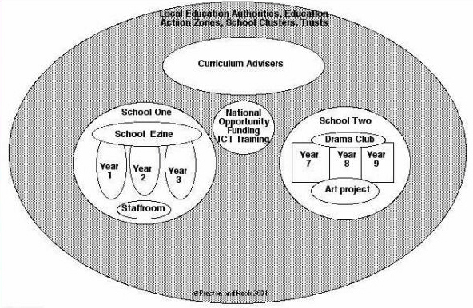
Growing a VLE Community: Phase One
Figure Nine : the second MirandaNet self assessment tool (stage one)

Slide 7
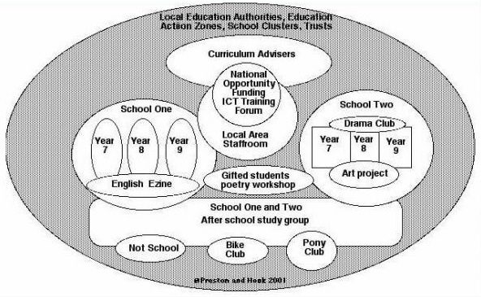
Growing a VLE Community: Phase Two
Figure Ten : the second MirandaNet self assessment tool (stage two)

Slide 8
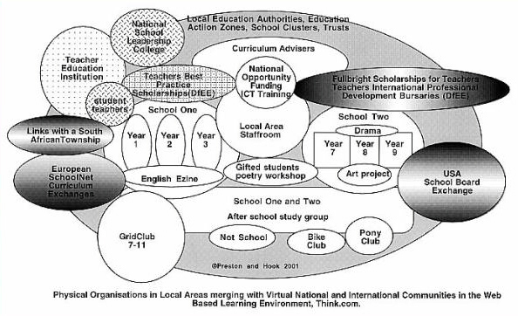
Growing a VLE Community: Phase Three
Figure eleven : the second MirandaNet self assessment tool (Stage Three)

Slide 9
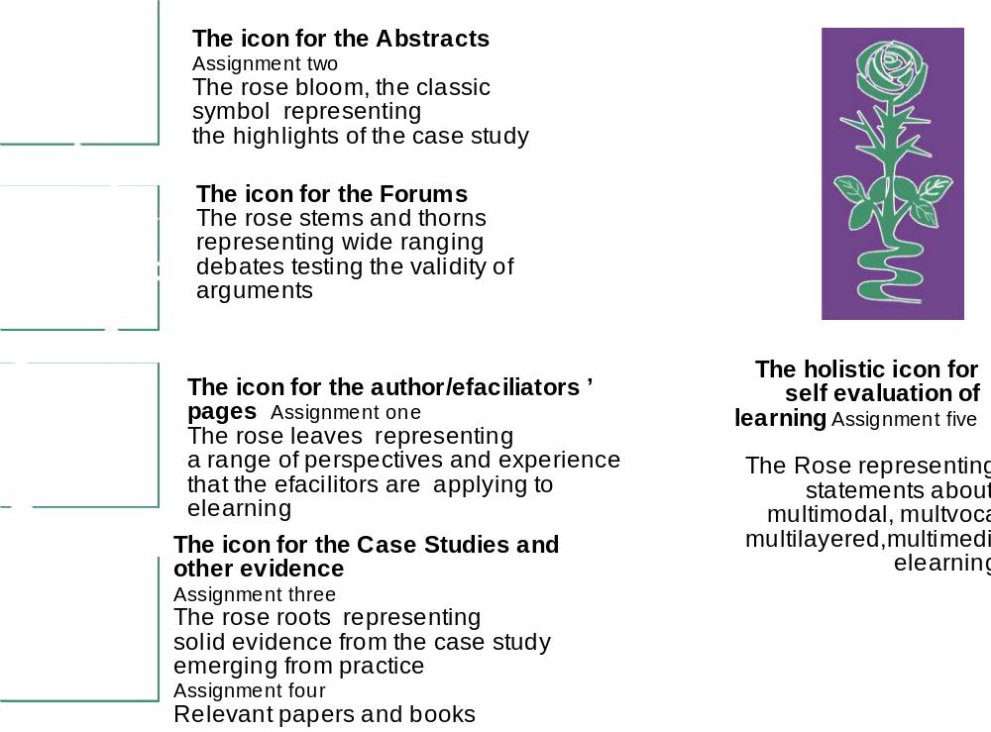
Figure 12

Slide 10

The braided learning image
the weaving together of
individual evidence to make
professional pedagogy and policy
Figure thirteen : The braided learning metaphor

Slide 11
I found your discussion points very helpful. Thank you and thanks to our support network - I have now happily completed my code of conduct! Like you I am very busy and get tied up, yet I have found that using this method of support can speed things up!! I can't believe it. Usually a task like this would take me ages, whereas with group support I have completed it to my satisfaction! Now I feel motivated, perhaps I should consult the model and discover what is happening? (KT)
“Adults tend to be less prepared to be engaged in failure. Children with their 'don't care attitudes' are strategically placed to take advantage of learning in the information age? Is this a fear statement to be making at this point? What do you think? What is paramount though is that perfectionists would have a real difficult time coping, based on the fact that they are more concerned with getting things right, preferably at their first attempt.” (ER)
“It's interesting to see how we have all adapted to the skills and gained confidence. It seemed like a daunting task at first but I think that throwing us in there on the first day and successfully logging us in so we could interact between us was a well structured part of the process. Imagine if we had been given a lecture on it and sent off to try it for ourselves. Like kids, we need to experience to understand. Hope you're well, hello to everyone.” (SC)
Figure fourteen: a sequence sharing professional responses to braided e-learning online (Cuthell 2005).

Slide 12
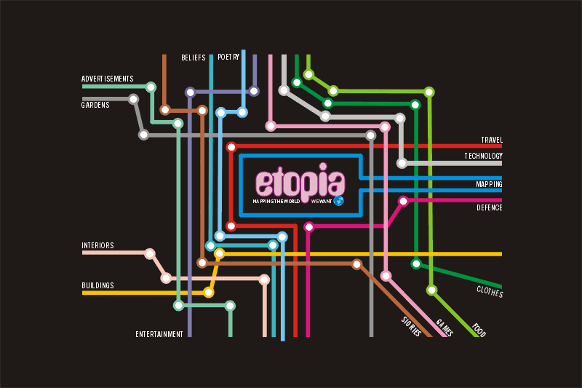
Figure 15 : A map of Etopia, the design for a website being developed by students at Westminster Academy, London, in partnership with LogicaCMG developers for World Ecitizens’ project participants

Slide 13
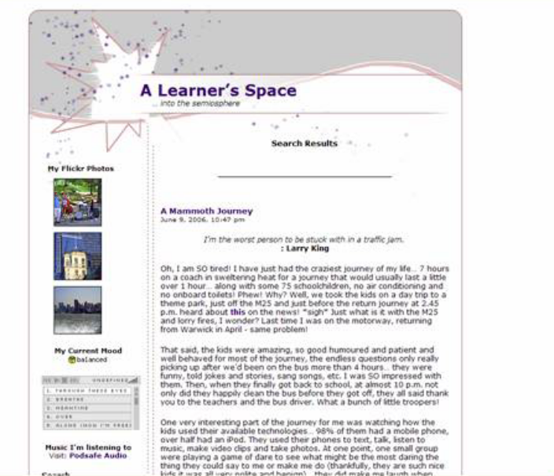
A learner’s space in the semiosphere
A mammoth journey
I’m the worst person to be stuck with in a traffic jam.: Larry King
Oh, I am SO tired! I have just had the craziest journey of my life… 7 hours on a coach in sweltering heat for a journey that would usually last a little over 1 hour… along with some 75 schoolchildren, no air conditioning and no onboard toilets! Phew! Why? Well, we took the kids on a day trip to a theme park, just off the M25 and just before the return journey at 2.45 p.m. heard about this on the news! *sigh* Just what is it with the M25 and lorry fires, I wonder? Last time I was on the motorway, returning from Warwick in April - same problem!
That said, the kids were amazing, so good humoured and patient and well behaved for most of the journey, the endless questions only really picking up after we’d been on the bus more than 4 hours… they were funny, told jokes and stories, sang songs, etc. I was SO impressed with them. Then, when they finally got back to school, at almost 10 p.m. not only did they happily clean the bus before they got off, they all said thank you to the teachers and the bus driver. What a bunch of little troopers!
One very interesting part of the journey for me was watching how the kids used their available technologies… 98% of them had a mobile phone, over half had an iPod. They used their phones to text, talk, listen to music, make video clips and take photos. At one point, one small group were playing a game of dare to see what might be the most daring the thing they could say to me or make me do (thankfully, they are such nice kids it was all very polite and benign)… they did make me laugh when they whooped with laughter after I made a funny face at one of them who promptly caught it on camera… amid some mention of Bebo… I wasn’t too worried - the photo was funny but not too grotesque! That’ll teach me to think twice before I grimace in future. *laughing* Anyway, it was quite fascinating to see this emerging communications network, which only increased as the journey grew longer - as they communicated with friends in the coach in front, with family and friends at home and even with their friends downstairs or even at opposite ends of the bus (they had to remain seat-belted and couldn’t walk up and down).
Others used their iPods to listen to the radio - some to follow news reports on the accident on the M25, others to catch up on the latest gossip from the docusoap “Big Brother” (these students were initially on the back row of the bus in front and they began using a notepad and pencil to relate news back to the girls in the front row of the bus behind). *grin*
[Aside]: Searching for the Big Brother link, I found another, amusing one - a parody you might say… all about fish in a fish tank!
It was funny (and immensely interesting) to see such a visual representation of my students’ communications methods and contents. When one of the other teachers came up top to amuse them for a bit (as their spirits were flagging around the 5 hour stage)… several immediately snapped some video clips as he sent them off into an action-based music song, imitating all the instruments - piano, trombone, etc. *smile*
You know what, actually, being around them all for that length of time really reminded me of what it’s like to be young and, for a while there, my 13-year-old self was very much with me - although the only portable technology I would have had back then was a walkman.
The actual theme park trip itself was fun and the kids really enjoyed themselves. I didn’t dare to go on anything too adventurous (like the newest ride, Stealth, for example) but I did enjoy the water rides, Tidal Wave (got VERY wet) and Loggers Leap (screamed like a banshee).
An interesting day - but, well, I’m just looking forward to some good sleep now.
Wilma Clarks blog http://www.itbubble.com/?p=440
Figure 16 : a teachers’ blog

Slide 14
very interesting this should arise now, my technology literate 13 yr
old daughter has just joined it, I knew she was because she asked me
how to convert a .tiff to a .jpeg and I asked her why - of course I
wasn't supposed to see the images, but my eyesight is not that bad.
Then one of my colleagues told me he'd received an invite to join her
Facebox online friends - ah, not so tech savvy - she'd just invited
everyone in her address book, forgetting that it contained the
addresses of old fogies like me and him and her gran (!) so off I went.
seems she's 17 and looking for love (the provocative poses in the
pictures also make that clear), also belongs to a single parent family
- her dad and I - did wonder which one of us she was planning to bump
off - ah but then her worst experience was a 5 hr car journey with me
and her favourite make of car is his - hmm clearer now.
she sensibly did not use her full real name, but did say which town she
lived in and where she went to school (thinly diguised) - her listed
friends, also school mates, have given full real names and the name of
the school. (maybe someone will think it odd that this sexy 17 yr old
seems to list a lot of 13 yr old boys in her friend's list?). She's
already had comments on the images from a 19 yr old in Belfast and a 20
yr old in Doncaster. She put the site up on Sunday night.
my tactic so far - monitoring and a bit of testing her responses by
putting an entry in her guest book from me as a 17 yr old boy... I need
to know if she has really taken to heart *any* of my lectures on safety
- and they wonder why I won't let them have internet access in their
bedrooms!
The 15 yr old has a Bebo site I found (they are not creative in their
use of aliases) but she clearly prefers the real life dangers of going
out on the town with her mates.
At some point I will also talk to the school about how they tackle the
issue..... but it is, of course, much much wider than a school issue.
Figure 17 - a critical incident for a mother and a teacher

Slide 15
Ó Murchú
Fact...Schools that use IT exclusively fail to understand the enhanced, soulful, meaningful and responsible potential of collaborative, invisible technology which OUGHT to permeate every area of the curriculum as an ALLY ,not as a leader. Technology alone will never change the RESULTS.. re. Clarke and Russel et al, 'Theory of No Significant Difference' research etc. … The academy must recognise the exceptionality in EVERYONE.. from the lowest common denominator (academically) to the greatest academic mind... and EVERY multiple intelligenced individual therein... and prepares the appropriate TESTS and ASSESSMENTS for same then the REAL answer will emerge. Technology enhanced learning environments which soulfully, meaningfully and responsibly recognise the exceptional genius of all will show RESULTS beyond the traditional.....
Nutt
Now ask yourself what putting such technologies thoughtlessly (literally not pejoratively) and ubiquitously in front of children (not adults) might result in. The difficult issue for me is not whether technology can enhance and enrich a teachers' or a child’s experience of schooling,but that when that technology is proffered inside a politically correct wrapper, creativity all too often turns out to be something substantially less rewarding or valuable for all concerned. As a teacher I was only ever interested in the very best my pupils could do, whatever their natural ability, wit or social circumstance, and being free to criticise, frankly and fairly, was a crucial aspect of that teacher/pupil exchange. I wish I felt confident that the often rash adoption of technology by many teachers and schools, sweetened by politically correctness, hadn't seriously undermined that quintessentially human interaction
Brosnan
What a great discussion! I agree with so many of the contributors. From the point of view of an ICT coordinator in an inner city school struggling for money I can say that ICT reaches the parts that other forms of education can’t. I have children on my Gifted and Talented ICT list who have no achievements in any other subjects. They are motivated to work independently and are happier children as a result of this.
Figure 18 : A sequence of mirandalink messages promoting the use of a wiki on the history of learning platforms to be used to fight Blackboards efforts to establish a patent.

Slide 16
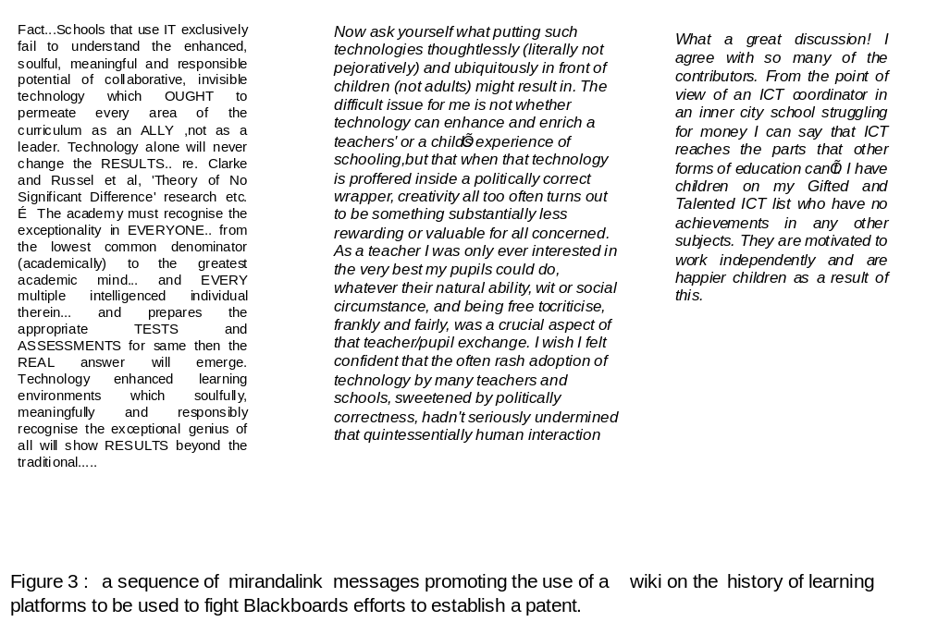
Figure 19

Slide 17
Teacher One: Learning from others – somewhat intimidated by technical skills of others but impressed and enriched by range of skills and knowledge. I found the course constantly stimulated and challenging. My peer group, from all key stages and backgrounds, provided an ideal forum for learning.
Teacher Two: It introduced me to practitioner research, it has provided an outlet for research interests and I now know something about e-facilitation through the experiences we have been involved with. MirandaNet provides an on going research community for further ideas.
Teacher Three: High levels of intellectual challenge – stimulating; cutting edge stuff! I thought the open-endedness of the elearning project especially good – allows scholars to enter at their own level and fits with MirandaNet’s philosophy.
Teacher Four: I was working with a really interesting group of people. My learning journey during the past year took me to educational landscapes I had never previously explored, since until the onset of the research scholarship, I had not previously joined in an online discussion. Now, a year later, I participate in other national online discussions with confidence and am in a new post, working as an e-learning facilitator for a national college and managing several online communities of practice.
Figure 20: Learning gains from the Teachers as Researchers course
(Earle 2004)

Slide 18
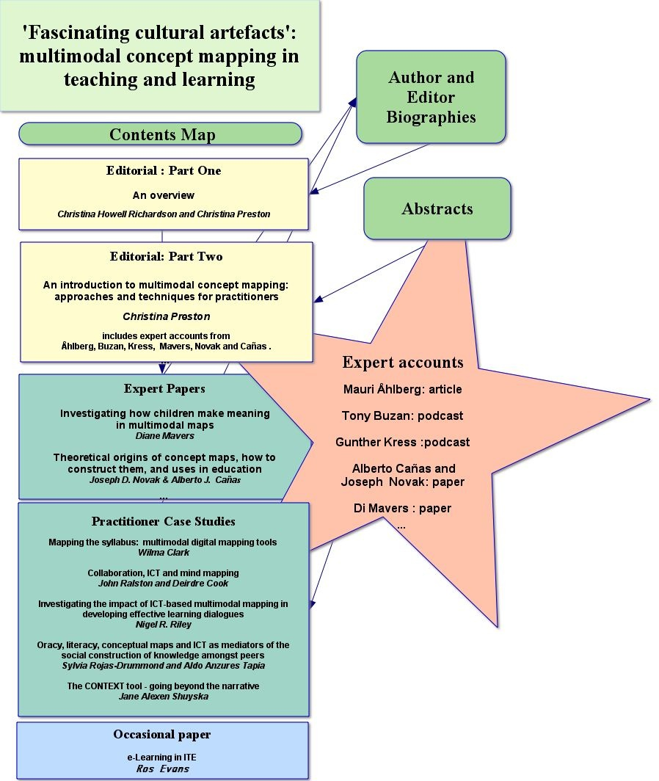
The concept map index used for the second MirandaNet volume of
Reflecting Education
Vol 3, No 1-2 (2007)
Figure 21

