Slide 1

The MirandaNet Fellowship:
a community of practice developing a self-regulating
learning environment
Christina Preston, Director,
MirandaNet International Research Centre,
School of Education, Southampton University,
Lisbon - September 2005

Slide 2

Giving teachers a professional voice……
• a self regulating VLE established in 1992
• practice-based (action) research principles
• intended to increase teachers’ sense of ownership and professionalism
Based on the work of Somekh and Davis (1997), Wenger (1998) and Sachs (2003)
The MirandaNet Fellowship
www.mirandanet.ac.uk

Slide 3
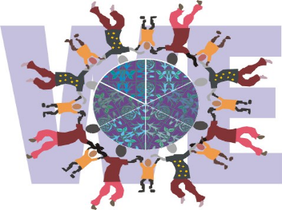
A gallery, VLE and e-journal
for self-regulated learning
Sharing cultural diversity
Giving young people a voice
Peer support for community leaders
World Ecitizens
www.worldecitizens.net

Slide 4
Chickens and Eggs…
Theory and Practice….

Slide 5
Research into professionalism in business
Lave and Wenger 1991
Learning is a process of increasingly
central participation in communities of practice
‘Newcomers’ become ‘old timers’
The mutual constitution of ‘agent’, ‘activity’ and ‘world context’ means that professional identity is negotiated in the course of professional interaction

Slide 6
Building a community of practice
Wenger’s 4 perspectives 1998
    MEANING
    a way of talking about our changing ability, individually and collectively, to experience our life and the world as meaningful;
PRACTICE
a way of talking about the shared historical and social resources, frameworks, and perspectives that can sustain mutual engagement in action

Slide 7
Building a community of practice
Wenger’s 4 perspectives
    COMMUNITY
    a way of talking about the social configurations in which our enterprises are defined as worth pursuing and our participation is recognisable as competence
    IDENTITY
  a way of talking about how learning changes who we are and creates personal histories of becoming in the context of our communities

Slide 8
What motivates teachers to use ICT?
The Internet seems to be the application that fires teachers’ intellect and imagination
Teachers are motivated by belonging to a professional community of practice
Preston, Cox and Cox 2000
Teachers as Innovators: what motivates teachers to use ICT

Slide 9
Bronwyn Stuckey 2002
    Develop an active and passionate core
    Invite different levels of participation
    Celebrate rituals of community life
    Provide news and events that are constantly changing
    Actively generate content
    Develop both public and private spaces
    Harness the power of the personal connection

Slide 10
Develop an active and passionate core
    Teachers, senior managers, advisers,
    teacher educators, education researchers,
    company partners, policy makers
    Everyone starts as a scholar
    Practice Based Research - Action Research
    Work based research - Reflective Practitioners
    A holistic approach to systemic change

Slide 11
Develop an active and passionate core
The MirandaNet Fellowship spans national, social,
cultural, commercial and political divides. Together
members create an inclusive forum to develop
innovative continuing professional development
programmes for educational change.

Slide 12
Develop an active and passionate core
Individual learning patterns and varied experience are celebrated through peer mentoring and practice-based research strategies. Dissemination and web publication are central to the Fellows learning process.

Slide 13
Develop an active and passionate core
Through this shared knowledge base Fellows across the world are sharing emergent trends in the use of new media and technology to promote education and citizenship.

Slide 14
Invite different levels of participation
Partnership with the education industry and with policy makers is at the heart of these activities.
TTA, DFES, BECTA - UK
BRAZIL, CHINA, CHILE, SOUTH AFRICA
BESA, INSPIRATION, ORACLE, MICROSOFT,
PROMETHEAN.

Slide 15
Celebrate rituals of community life
Tina Time!
Newsletters ebb and flow
Winter Solstice
Miranda Rose for a good website
10 year anniversary
Annual workshop which is a dialogue as well as a building of new projects

Slide 16
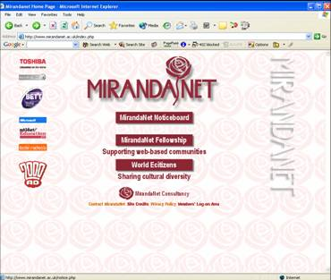
    Provide news and events that are constantly changing

Slide 17
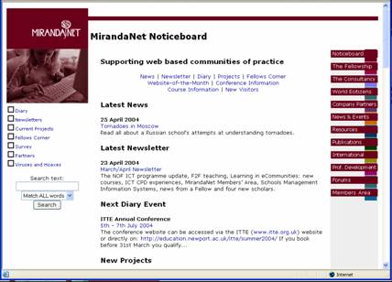
    Provide news and events that are constantly changing

Slide 18
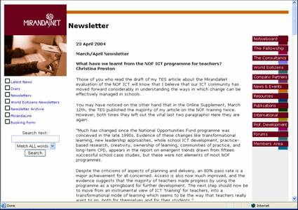
    Provide news and events that are constantly changing

Slide 19
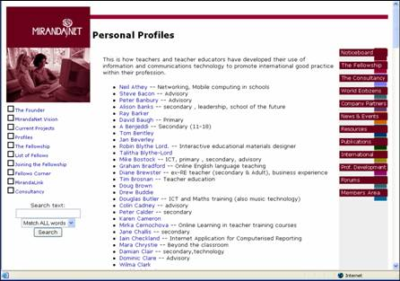
    Actively generate content

Slide 20
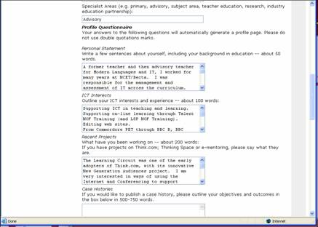
    Actively generate content

Slide 21
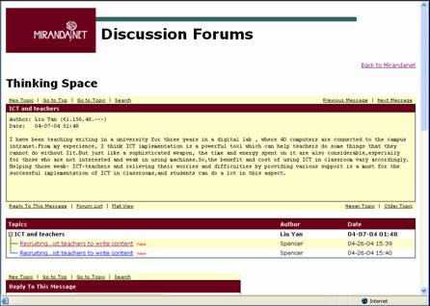
    Actively generate content

Slide 22
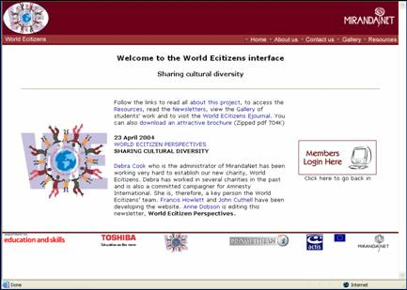
    Actively generate content

Slide 23
Develop both public and private spaces
Public space :
WE gallery, teachers’ case studies, seminars, teachers on platforms
Private space
Mirandalink, annual workshop, Winter Solstice,
Ejournals, WE VLE.

Slide 24

Develop both public and private spaces
This is the ejournal home page

Slide 25
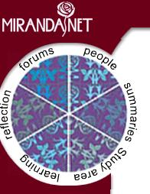
The Kaleidoscope
Navigation Tool
Develop both public and private spaces

Slide 26

Develop both public and private spaces
The summaries
are represented by the rose head

Slide 27

The Forums are represented by the branches and thorns
Develop both public and private spaces

Slide 28

The people generating the evidence are represented by the leaves
Develop both public and private spaces

Slide 29

The case study evidence is represented by the roots
Develop both public and private spaces

Slide 30

The self evaluation of learning image draws the personal learning elements together
Develop both public and private spaces

Slide 31
Harness the power of
the personal connection
“Miranda believes that one day ICT courses
are a waste of time.”
John Potter, MirandaNet Fellow, Prague, 1996
Return to Prague - 2006

Slide 32
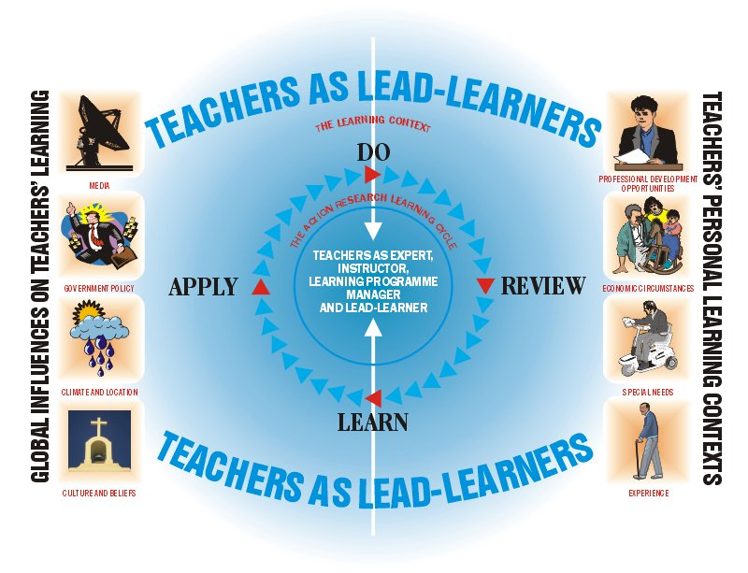
Harness the power of
the personal connection

Slide 33
The key MirandaNet model features post-Stuckey
Partnership
Empowerment
Publication
Braided Learning
Notes:
International Conference in Portland, Oregan

Slide 34
The key MirandaNet model features post-Stuckey
Partnership
Notes:
International Conference in Portland, Oregan

Slide 35
Partnership of equals
I found your discussion points very helpful.
Thank you and thanks to our support network
I have now happily completed my code of conduct!
Like you I am very busy and get tied up, yet I have found that using this method of support can speed things up!!
I can't believe it. Usually a task like this would take me ages, whereas with group support I have completed it to my satisfaction!
Now I feel motivated to learn more….
Learners, educators, policy makers, companies….
Cross phase, cross boundaries….

Slide 36
Partnership of equals
Teacher One: I was learning from others. My peer group, from all key stages and backgrounds, provided an ideal forum for learning.
Teacher Two: High levels of intellectual challenge - stimulating; cutting edge stuff! I thought the open-endedness of the elearning project especially good - allows scholars to enter at their own level and fits with MirandaNet’s philosophy.
Learning from others: a participative community.

Slide 37
Partnership of equals
Teacher Three : I was working with a really interesting group of people. My learning journey during the past year took me to educational landscapes I had never previously explored, since until the onset of the research scholarship, I had not previously joined in an online discussion. Now, a year later, I participate in other national online discussions with confidence and am in a new post, working as an e-learning facilitator for a national college and managing several online communities of practice.
Learning from others: a participative community.

Slide 38
Partnership of equals
Learners, educators, policy makers, companies….
Cross phase, cross boundaries….
Inspiration
Promethean ACTIVboard project

Slide 39
The key MirandaNet model features post-Stuckey
Empowerment
Notes:
International Conference in Portland, Oregan

Slide 40
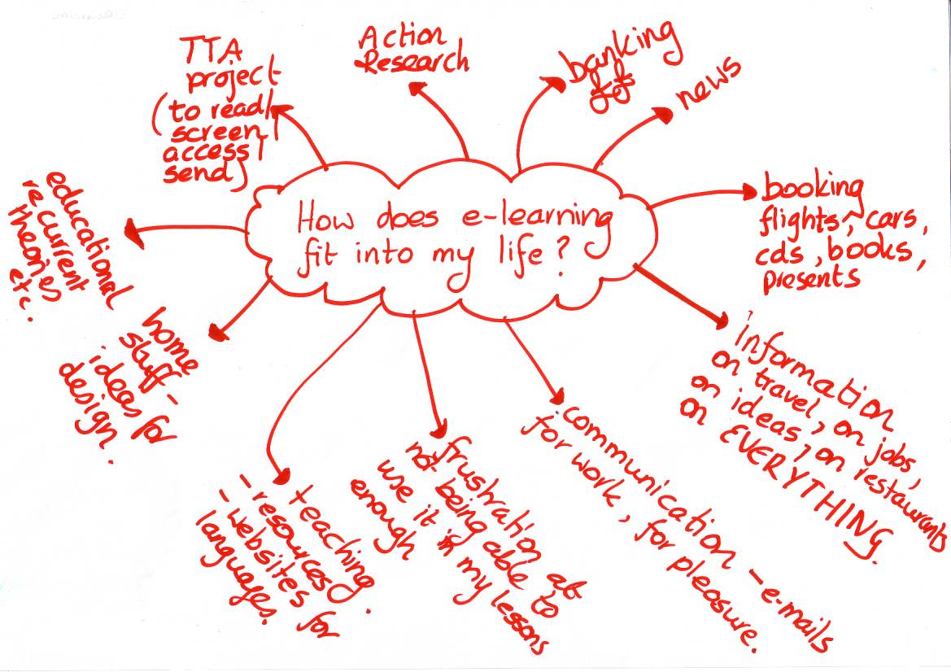
Empowerment
How computers impact on my professional and personal life:
pre-course concept map.

Slide 41
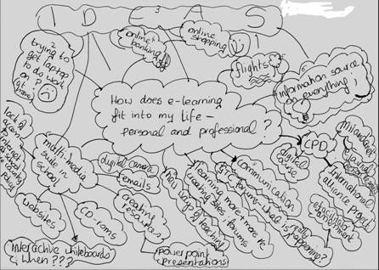
Empowerment
How computers impact on my professional and personal life:
post-course concept map.

Slide 42
Empowerment
Teacher One: Right well one of the immediate things I see of mine is that last time there were I think concerns and question marks as to what’s going to happen in the future, seem to figure more ...certainly in space on my diagram now er...the diagram is much bigger its got more things on it, er...I seem to have developed more ideas on what Elearning might be. They’re questions still but they’re not necessarily concerns.
Identifying personal and group learning progress

Slide 43
Empowerment
Teacher Two: I see a mess in the first one. Er...what’s different in this second one is that I’ve discussed more about what I do in school, and how that’s affecting and changing my outlook in school
Teacher Three: Actually, my second one is completely different from my previous one because I thought in words, so how do you draw qualitative material, and in fact I think the second drawing is more accurate about how Elearning fits in to my life, the first one I was just doing the exercise but I was not as clear in my mind....
Identifying personal and group learning progress

Slide 44
Empowerment
Teacher Four: Well I think everyone looks busier...definitely everybody has more on their second sheet.
Teacher Five: I think what you said about the concerns, yes we did have an issue with concerns but now I think its been replaced by another set of concerns, you know to me I think its similar to what you were saying, where do we go from here, at the beginning of this is what am I going to do? Now It’s what can I do with what I already know, how I can build on it?
Teacher Four: That’s sort of a happier question isn’t it?
Teacher Five: Oh yeah it’s a comfortable question.
Identifying personal and group learning progress

Slide 45
The key MirandaNet model features post-Stuckey
Publication
Notes:
International Conference in Portland, Oregan

Slide 46
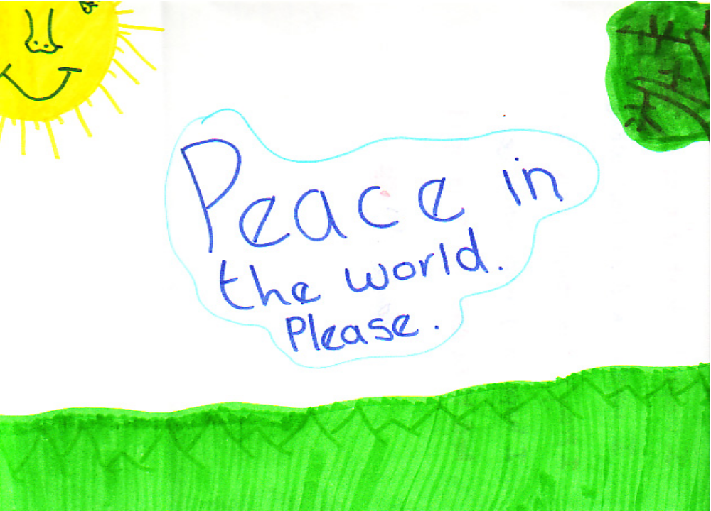
Publication

Slide 47
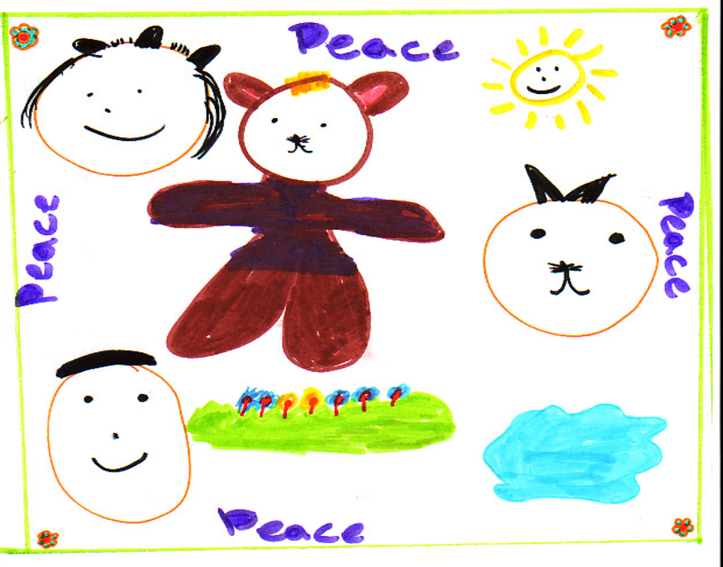
Publication

Slide 48
The key MirandaNet model features post-Stuckey
Braided Learning
Notes:
International Conference in Portland, Oregan

Slide 49
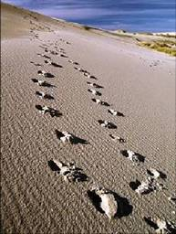
Braided learning
Creating a web environment where students leave their imprint on the community, and the field, as an integral part of their learning.
The doctoral challenge

Slide 50

Braided learning
Inclusive voices

Slide 51

The braided learning image the weaving together of individual evidence to make professional pedagogy and policy
Braided learning

Slide 52
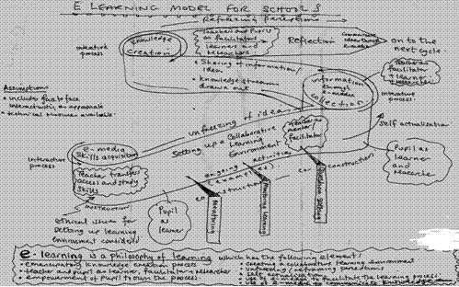
Braided learning
Semiotic challenge to accrediting bodies
Creating Theory - contributing to policy

Slide 53
“Collaborating on the boundaries
of the possible” Workshop
July 26th - 28th 2006
Prague, Czech Republic
www.mirandanet.ac.uk
www.worldecitizens.net

Slide 54
The MirandaNet Fellowship:
a community of practice developing a self-regulating
learning environment
Christina Preston, Director,
MirandaNet International Research Centre,
School of Education, Southampton University,
Lisbon - September 2005

