Slide 1
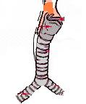
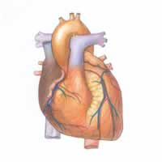
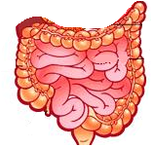
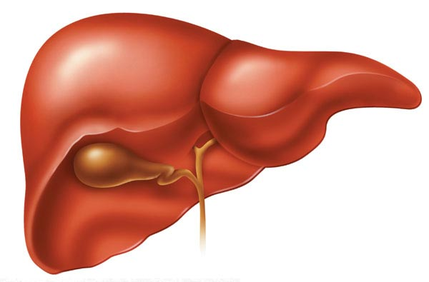

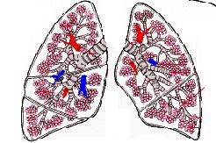
Breathing system - Organs

Slide 2
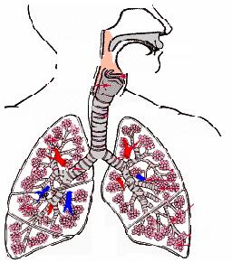
Breathing system

Slide 3
Nasal cavity
?
?
Blood vessels
… are keeping the dust and the other dirtiness from the air
?
back

Slide 4
Description
Function
back

Slide 5
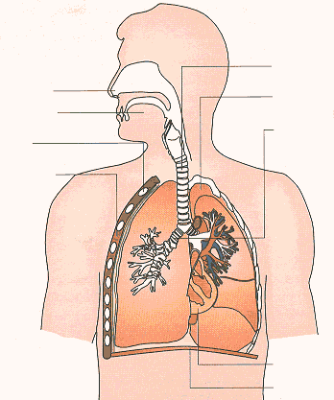
LUNGS
two ….
placed in your
and they are built from
back

Slide 6
1. Taking air in the lungs;
2. Red liquid inside your body;
3. Organ you use for smelling and breathing;
4. The mixture of gases which we breathe
5. Your lungs are inside your...
 |  |  |  |  |  |  |  | 5
 |  |  | 2 |  |  | 4
 |  | 1
 | 3
1. breathing, 2. blood, 3. nose, 4. air, 5. chest

