Slide 1
Language: Grammatical exercise
Revision and exercises

Slide 2
Lena went for a walk in the wood.
  Sentence:
  narrative, questioning or exclamation
  simply or complex sentence

Slide 3
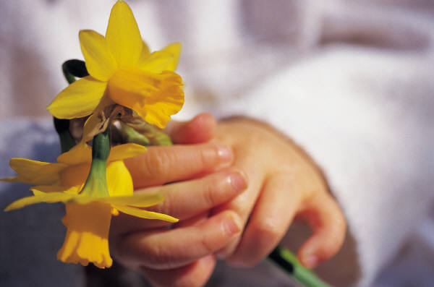
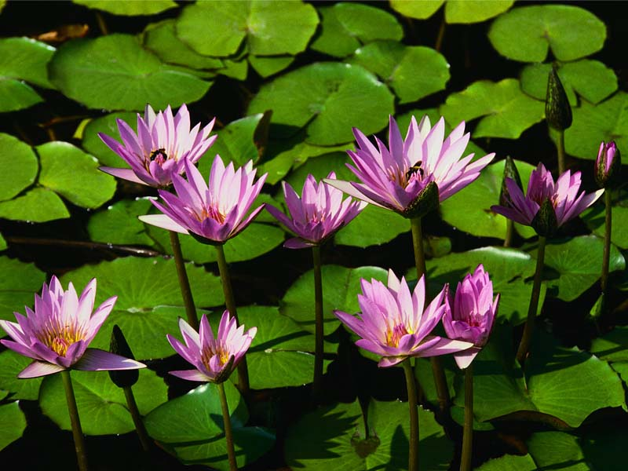
She picked many-colored meadow flowers.
Words
Pronoun
Numbers
Noun
Adjecives
Verbs

Slide 4

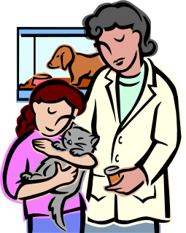
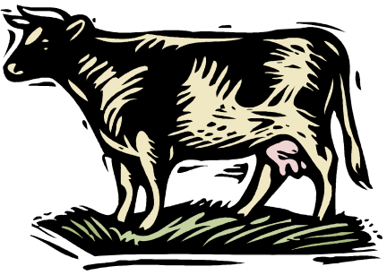
Write complex sentence for each picture.

Slide 5
Mark with an arrow the gender of the nouns.
squirrel
grass
masculine
tree
bird
hill
female
brook
branch
flower

Slide 6
Add the missing adjectives in the poem:
The ________watters of the river
roaring In the ___________spring.
The Sun is sowing
__________ beams.
__________ necklace
arrange the branch.
Playful, __________
flock is bleating.
early
troubled
golden
flowery
tamely

Slide 7
Underline adjectives in the sentences.
Lena is breathing in the clean air and listening the cheerful song of the birds.
She is rolling on the wonderful green covering of grass and flowers.

Slide 8
Write the singular/plural form of the noun:
singular | plural
leaf
tree
hill
 | brooks
 | flowers
branch
squirrel

Slide 9
Write sentences in past time with the verbs: play,run, pick.

Slide 10
Horizontal: 1. The first Macedonian tsar;
2. a very young cat
3. the surface on earth
4. long strip of ground which people walk along
5. damage of some part of the body
6. something that is not restricted
Vertical: 1. The capital of Macedonia
 |  | 1
 |  | 2
3
 |  | 4
5
6

