Slide 1
Investigating the impact of ICT- based multimodal mapping in developing effective learning dialogues.
Project Report 02.07.07
Institute of Education
N.R.Riley
Knowle Primary School,
Plymouth
Notes:
Good afternoon.
My name is Nigel Riley.

Slide 2
Investigating the impact of ICT- based multimodal mapping in developing effective learning dialogues
Framing learning
Background
Objectives
Research design
Results
Findings
Concluding thoughts
Notes:
My study was

Slide 3
Framing learning
Language is described as a tool that provides a system for ‘thinking collectively’
Language in education is recognised as being ‘an integral part of most learning and oral language in particular has a key role in classroom teaching and learning’ (DfES, 2003)
Notes:
classroom observations indicate a reluctance of children to talk effectively in ways that generate solutions to challenges that particular writing task activities produce. I consider compositional drafting as a learning space where individuals engage with challenges that require solutions to be thought through, revised and refined and finally presented.

Slide 4
Framing learning
Basis for using small group discussions in my class practice to generate ideas
An identified need for a tool to structure discussions whilst at the same time allow flexibility for revision and refinement of ideas.
ICT can produce talk of a type that has educational significance when children work in small groups at computers
Notes:
It is recognised that ICT can produce talk of a type that has educational significance when children work in small groups at computers (Fisher, 1997:81; Wegerif, Littleton and Jones, 2005). Development of ideas in talk is also dependent on the ability of participants to reflect on the content of ideas and to develop or rework them. This includes a social dimension as well as a cognitive dimension to such learning dialogues that I am attempting to facilitate. Both dimensions exert constraints to compositional thinking. Social constraints involve such factors as competitiveness, disagreement, disengagement from the task and lack of interpersonal communication ability. Cognitive constraints involve inability to memorise previous contributions, lack of reflection time, a lack of internal representation of the discussion topic. Such constraints reduce and limit learning dialogues reducing their impact on collaborative and individual learning. The problems faced in my mixed class of 10-11 year olds are a combination of these social and cognitive dimensions.

Slide 5
Background
Using ICT-based collaborative
multimodal mapping
considered as a visual method of tracking a
discussion
provides a visual anchor
children can think of, record and reflect on
ideas to help them generate and develop
ideas for writing (affordances of ICT)
Notes:
Can MMM reduce cognitive constraints in the compositional process?
Can MMM reduce social constraints in a collaborative compositional processes?

Slide 6
Background
Using ICT-based collaborative
multimodal mapping
creates conceptual patterns similar to nominalized writing
aligns more with expository drafting
could be used to plan writing into sentences and paragraphs thus providing a scaffold as a writing frame
could mediate in the transfer of ideation from learning dialogues into writing
Notes:
Multimodal mapping produces both narrative and conceptual patterns (Kress and van Leeuwen, 1996, p56) needed to structure ideas in a proto-propositional manner, similar in fact to notes. Narrative patterns are similar to flow charts, are linear in terms of chronology or sequence of events and use temporal connectives in their labels. Conceptual patterns are non-linear, representing meaning or structure, and are ‘classificatory, analytical or symbolic’ utilising causal connectives (Kress and van Leeuwen, 1996, p56). Conceptual patterns, similar to schema, are important in language processing in that they contain the ‘knowledge that is used to facilitate understanding of what we perceive’ (Bransford and Johnson, 1972). Therefore multimodal mapping may be used in a flexible manner that could represent the ideas being generated in talk and structure them in a way that lends itself to easy text drafting.
Conceptual patterns in multimodal mapping are similar to nominalized writing in that meaning is emphasized in nouns rather than verbs (Kress and Van Leeuwen,1996, p59) and this aligns more with expository drafting rather than narrative drafting. Thus employing conceptual pattern generating mapping techniques using ICT-based multimodal mapping software could be used to plan writing into sentences and paragraphs using nominalized conceptual patterns providing a scaffold as a writing frame. Theoretically ICT-based multimodal mapping software could mediate in the transfer of ideation from learning dialogues into writing using the technique of concept mapping.

Slide 7
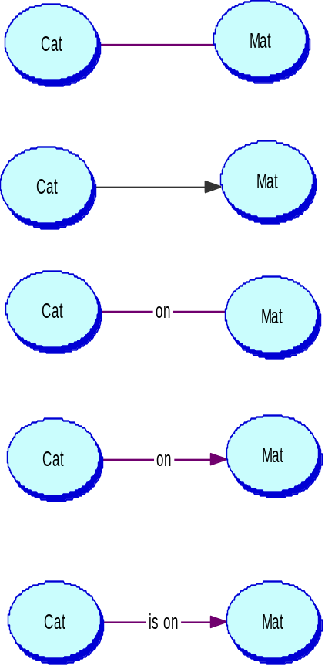
Background
Concept mapping compositionality | Interpretations from concept mapping | Interaction between the visual and linguistic elements.
A | could mean; The cat ate the mat. The cat went to the mat. The cat walked over the mat. The mat belongs to the cat. The mat is near the cat. | The number of possible interactions and types of different relations between the cat and mat are many and diverse.
B | could mean; The cat went to the mat. The cat saw the mat. The cat likes the mat. | The directionality given by the vector is explicit although the definition of the relationship is unclear. It gives a structure to the possible linguistic interpretations in terms of subject/object order.
C | could mean; The cat ate on the mat. The cat ran on the mat. The cat sleeps on the mat. The mat is on the cat. | Although the relationship has been given more clarity in terms of relation by naming the link, the interaction is still lacking clarity in terms of the order of relationship.
D | could mean; The cat went on the mat. The cat is on the mat. | The combination of vector and naming of the link reduces the number of possibilities in interpretation. The relationship achieves more definition and the whole representation becomes more meaningful.
E | could only mean; The cat is on the mat. | The inclusion of a more constrained label to the vector achieves an accurate and meaningful proposition in terms of objects and their relations.
Multimodal mapping:
represents different levels of meaning
discloses levels of understanding or misrepresentation
Notes:
Concept mapping involves the relational connection of two object concepts both linguistically and visually that may have the compositional forms that I have categorised in Table 1. I have exemplified how the increasing combination of both visual and linguistic notation in concept mapping composition develops a closer definition of the concept being represented reducing the number of possible interpretations. The inclusion of vectors in examples B and D (Table 1) create analogical ‘propositions’ (Kress and Van Leeuwen, 1996:57), enhancing the connections and relational interpretation between concepts, making the relationship more meaningful in terms of action and transactional structure (Unsworth, 2000:73). The inclusion of labelled links in examples C and D (Table 1) have a similar impact propositionally, making explicit the specific relations between the concepts, in terms of subject/ object relations. The combination of both graphic and linguistic notation in such external representations more closely defines the concept being represented and reduces the possible number of interpretations as I have shown in the second column (Table 1).
As connectivity between concepts in a concept map increases, changes in the analogical and propositional composition reflect changes in the thinking processes engaged during concept mapping (Somekh et al, 2000; Åhlberg, 1997). The study uses analysis of concept mapping composition and connectivity to represent changes in order of thinking during the mapping process and these methods are described later in the section describing methodology.

Slide 8
Objectives
Research questions
Does using ICT-based multimodal mapping improve the quality of learning dialogues during the compositional process?
This question scrutinises whether the data shows that using ICT based multimodal mapping increases the social modes of thinking in the compositional process and increases the quality of thinking in group talk.

Slide 9
Objectives
Does using ICT-based multimodal mapping increase concept and propositional transfer from learning dialogues into writing?
This question analyses whether using ICT-based multimodal mapping increases the complexity of concept mapping and increases concept and propositional transfer from talk into writing.

Slide 10
Research design
small case study approach
sample is a group of 22 students aged 10-11 years old within a large urban primary school in the United Kingdom (UK). The students have a wide range of academic attainment and social backgrounds
illuminative research designed to extract data from the sample at pre- and post-intervention points (no control)
Notes:
Questions about attributing effects!!

Slide 11
Research design
Data is collected from:
● Full transcription of discussions (5 groups)
● Group ICT-based multimodal mapping (5)
● Tracking of concepts from talk into ICT-
based multimodal mapping and individual
written texts (22).
Notes:
Do these frameworks measure what I am hoping?
Questions about how we measure impact of multi modal forms of expression?
I used speech and language.
Images would create a greater problem in that they cannot be free drawn and choices of digital objects provide contraints.
Data collection and analysis are described according to data type; discussion data, multimodal mapping data and text data.
a) Propositions and concepts recorded in discussions were tracked across
transcripts of talk, resultant ICT-based concept mapping and individual
writing based on the discussed topics. Key words and phrases are extracted
from talk and verified in concept mapping and text. Tracking concepts and
propositions formed in speech provides evidence of validity of the quality of
learning dialogues.
b) Multimodal mapping was analysed for complexity and componential content in
accordance to procedures taken from the Impact2 study (Somekh et al, 2000):
1. nodes (each object counted as one)
2. links (links emanating from each node counted and totalled)
3. connectivity (number of links divided number of nodes).
The frequencies of concepts, labelled links, unlabelled links and propositions
were recorded to provide observation of increased complexity of mapping.
) Dialogue transcripts are analysed according to Wegerif & Mercer’s dialogical
framework for the social modes of thinking. The framework maintains three talk
types labelled as; Disputational talk (D), Cumulative talk (C),Exploratory talk (E).
These three talk types have a set of criteria in which judgements of talk type
are referenced qualitatively (Wegerif and Mercer, 1997, p54).

Slide 12
Research design
Data is analysed:
● transcribed discussions of groups while concept
mapping using
- a dialogical framework for social modes of thinking
(Wegerif and Mercer, 1997) and
- higher order thinking skills using Bloom’s taxonomy;
● analysis of ICT-based multimodal mapping:
nodes, links, propositions (Impact2 study, Somekh et al,
2000);
● tracking the transfer of lexical concepts across the
three modalities (talk, visual mapping, writing)
Notes:
Do these frameworks measure what I am hoping?
Questions about how we measure impact of multi modal forms of expression?
I used speech and language.
Images would create a greater problem in that they cannot be free drawn and choices of digital objects provide contraints.
Data collection and analysis are described according to data type; discussion data, multimodal mapping data and text data.
a) Propositions and concepts recorded in discussions were tracked across
transcripts of talk, resultant ICT-based concept mapping and individual
writing based on the discussed topics. Key words and phrases are extracted
from talk and verified in concept mapping and text. Tracking concepts and
propositions formed in speech provides evidence of validity of the quality of
learning dialogues.
b) Multimodal mapping was analysed for complexity and componential content in
accordance to procedures taken from the Impact2 study (Somekh et al, 2000):
1. nodes (each object counted as one)
2. links (links emanating from each node counted and totalled)
3. connectivity (number of links divided number of nodes).
The frequencies of concepts, labelled links, unlabelled links and propositions
were recorded to provide observation of increased complexity of mapping.
) Dialogue transcripts are analysed according to Wegerif & Mercer’s dialogical
framework for the social modes of thinking. The framework maintains three talk
types labelled as; Disputational talk (D), Cumulative talk (C),Exploratory talk (E).
These three talk types have a set of criteria in which judgements of talk type
are referenced qualitatively (Wegerif and Mercer, 1997, p54).

Slide 13
Research design
Intervention: three phases
Introduction - modelling, guided and directed activities to help students become accustomed to the interface and functions followed by a pre-test expository report (A Newcomers Guide)
Development - use of multimodal mapping across several blocks of work and genres of writing
Consolidation – acceptance of multimodal mapping as a recognised planning tool and the post-test expository report (Book Review)
Notes:
Report writing activities were chosen as this is a familiar and continually practised genre in writing across the curriculum as well as in literacy. The subject specific content of the reports assumes a secondary role since compositionality through concepts and proposition formation are being compared. In this instance I am using concepts and propositions as meta components of report writing for quanlitative analysis.

Slide 14
Results
Proposition and concept tracking
Concepts and proposition formed in talk
When they first met they didn’t like each other.
When they first met, Kensuke helped him.
They met when Kensuke dragged him out of the water because he did.
He felt sorry for him so he left him food.
Yeah, but he might have liked him at the beginning because he didn’t know anything about it.
He (K) was intrigued by him.
He didn’t know who he was.
He didn’t like him because he destroyed his fire.
He pulled him out of the sea.
He was in the sea and then he woke up on the beach.
He thought that he had drowned, and he was holding onto the football and he thought that he had died.
First Kensuke didn’t like Michael.
Michael was grateful of Kensuke because Kensuke gave him food and Michael was grateful.
Michael lit a fire.
Michael wanted to know everything about Kensuke.
He liked all Kensuke’s stories.
He is supposed to be secret.
His kingdom is supposed to be secret.
Michael is on his kingdom so he’s telling Michael.
He don’t want no visitors.
The relationship changed during the story.
They got off the ship right, went on Kensuke’s Kingdom.
He tells Michael his stories.
There’s Orang-utans there.
They can listen to Kensuke.
Notes:
Proposition and concept frequencies increase in talk, multimodal mapping and writing from the introduction phase to the consolidation phase. The range of propositions and concepts in writing as a percentage of their frequency in talk also shows an increase. Proposition and concept frequency in talk increases in the consolidation phase writing activity. All the mean frequency scores increase in the consolidation phase. The mean frequency scores remain static from talk to writing in the introduction but increase in consolidation. These frequencies also increase in consolidation multimodal mapping and comparison indicates that multimodal mapping maintains higher means in both introduction and consolidation phases.
These results suggest there is some small increase in ideation generated in talk and multimodal mapping that transfers into writing. This is supported by the increase in the range of ideas generated in talk and multimodal mapping being used in consolidation phase writing.

Slide 15
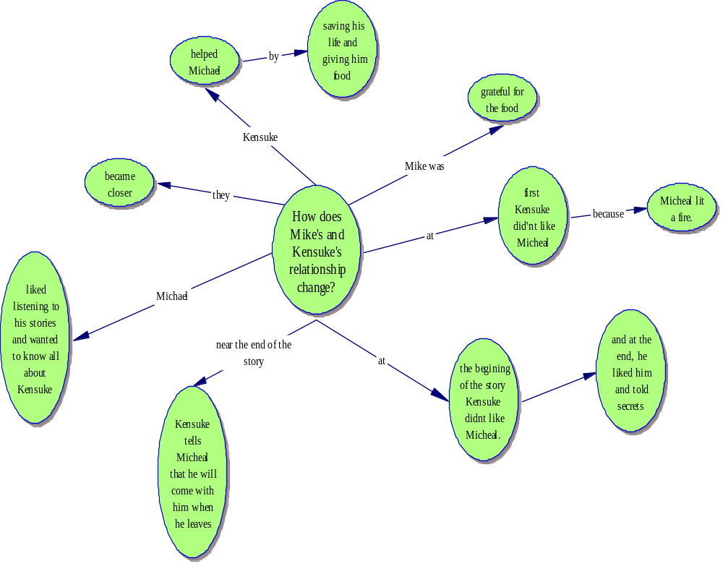
Results
Proposition and concept tracking
Map formed during group post-test discussion.
Notes:
Proposition and concept frequencies increase in talk, multimodal mapping and writing from the introduction phase to the consolidation phase. The range of propositions and concepts in writing as a percentage of their frequency in talk also shows an increase. Proposition and concept frequency in talk increases in the consolidation phase writing activity. All the mean frequency scores increase in the consolidation phase. The mean frequency scores remain static from talk to writing in the introduction but increase in consolidation. These frequencies also increase in consolidation multimodal mapping and comparison indicates that multimodal mapping maintains higher means in both introduction and consolidation phases.
These results suggest there is some small increase in ideation generated in talk and multimodal mapping that transfers into writing. This is supported by the increase in the range of ideas generated in talk and multimodal mapping being used in consolidation phase writing.

Slide 16
Results
Proposition and concept tracking
How does Mike’s and Kensuke’s relationship change?
By Natasha.
At the beginning of the story (or the part where Michael meets Kensuke) Kensuke doesn’t like Michael because Michael lit a fire. Kensuke then told Michael the rules that he had to follow. When Kensuke catches Michael making another fire he smashes the piece of glass that Michael was using to make the fire. Michael then becomes angry with Kensuke and breaks the rules that Kensuke had told him to follow.
From then onwards Michael and Kensuke become more friendly until Kensuke tells Michael about his life and shows Michael the turtles.
After a while their relationship becomes even better and Kensuke tells Michael that when Michael leaves the island Kensuke will come with him. I think that this is a true act of friendship.
Example of text formed from group post-test map
Notes:
Proposition and concept frequencies increase in talk, multimodal mapping and writing from the introduction phase to the consolidation phase. The range of propositions and concepts in writing as a percentage of their frequency in talk also shows an increase. Proposition and concept frequency in talk increases in the consolidation phase writing activity. All the mean frequency scores increase in the consolidation phase. The mean frequency scores remain static from talk to writing in the introduction but increase in consolidation. These frequencies also increase in consolidation multimodal mapping and comparison indicates that multimodal mapping maintains higher means in both introduction and consolidation phases.
These results suggest there is some small increase in ideation generated in talk and multimodal mapping that transfers into writing. This is supported by the increase in the range of ideas generated in talk and multimodal mapping being used in consolidation phase writing.

Slide 17
Results
Proposition and concept tracking
 | Proposition and concept frequencies in TALK (mean) N=22 | Proposition and concept frequencies in MULTIMODAL MAPPING (mean) N=5 | Proposition and concept frequency in WRITING (mean) N=22 | Range of propositions and concepts used in WRITING (as % of talk frequency) N= 22
PRE-TEST | 80 (3.6) | 23 (4.6) | 70 (3.2) | 30 (37%)
POST-TEST | 95 (4.3) | 37 (7.4) | 132 (6) | 41 (43%)
Notes:
Proposition and concept frequencies increase in talk, multimodal mapping and writing from the introduction phase to the consolidation phase. The range of propositions and concepts in writing as a percentage of their frequency in talk also shows an increase. Proposition and concept frequency in talk increases in the consolidation phase writing activity. All the mean frequency scores increase in the consolidation phase. The mean frequency scores remain static from talk to writing in the introduction but increase in consolidation. These frequencies also increase in consolidation multimodal mapping and comparison indicates that multimodal mapping maintains higher means in both introduction and consolidation phases.
These results suggest there is some small increase in ideation generated in talk and multimodal mapping that transfers into writing. This is supported by the increase in the range of ideas generated in talk and multimodal mapping being used in consolidation phase writing.

Slide 18
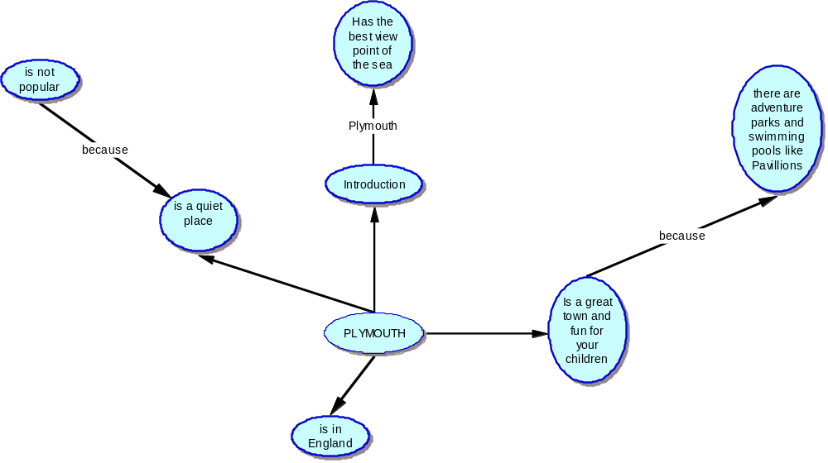
Results
Multimodal mapping analysis
Example of introduction phase ICT-based multimodal mapping

Slide 19
Results
Multimodal mapping analysis
Example of consolidation phase ICT-based multimodal mapping
Notes:
When we compare the examples of multimodal mapping (Fig. 2 and 3) by the same group we notice immediately how the pattern of mapping has increased in concepts formed and labelled links used to join them in propositional in the consolidation phase.
The organisation of ideas is more developed in the consolidation phase and this would be more conducive to more organised drafting.

Slide 20
Results
Multimodal mapping analysis
 | NODES | LINKS | CONNECTIVITY | LABELLED LINKS | PROPOSITIONS
PRE-TEST | 40 | 35 | 0.875 | 19 | 14
POST-TEST | 41 | 38 | 0.927 | 23 | 15
Notes:
Multimodal mapping component frequencies maintained a similar order in the introduction and consolidation phases. There is some increase in connectivity that suggest a small increase in proposition formation in mapping in the consolidation phase that may be an indicator of higher-order thinking (Åhlberg, 1997). Figure 2 is an example of the level of composition of multimodal mapping in the introduction phase and Figure 3 is an example of multimodal mapping in the consolidation phase.

Slide 21
Results
Talk analysis for the framework for the social modes of thinking
6. How does Mike’s and Kensuke’s relationship change? [Exploratory talk]
7. Well, when they first met each other… [Cumulative talk]
8. They didn’t like each other. That’s what I wrote last time. [Cumulative talk]
9. No, when they first met, Kensuke helped him, didn’t he? [Exploratory talk]
10. No, he didn’t like him. [Cumulative talk]
11. Yeah, but he left him food, didn’t he? [Cumulative talk]
12. Just write, ‘They found… ‘ [Disputational talk]
13. ‘They met.’ [Disputational talk]
14. They met in Kensuke’s… I know. They met [Exploratory talk] when Kensuke dragged him out of the water
because he felt sorry for him.
Extract from post-test transcript indicating the social modes of
thinking.
Notes:
In this extract exploratory talk is displayed through participants proactively developing the discussion by introducing new concepts, questioning, and with reasoning statements using ‘because’ an identifier of exploratory talk (Mercer, 2000, p154). Cumulative talk is more open with suggestions being offered and follow-ups made to previous contributions. Disputational talk is shown as individualised and oppositional

Slide 22
Results
Talk analysis for the framework for the social modes of thinking
PHASE | TOTAL CONTRIBUTIONS | Frequency (%) identified contributions for the social modes of thinking in each test
 |  | DISPUTATIONAL | CUMULATIVE | EXPLORATORY
INTRODUCTION | 1094 (42%) | 110 (10%) | 194 (18%) | 73 (7%)
CONSOLIDATION | 1514 (58%) | 30 (2%) | 266 (18%) | 67 (4%)
TOTAL | 2608
Frequency and percentage analysis for the social modes thinking.
Notes:
The total contributions represent the total talk frequencies for the task while the percentages represent the percentages of task talk. The social mode of thinking is represented as frequencies and percentages of talk in the introduction and consolidation phase task. Not all talk equated to the criteria for the social modes of thinking as is shown by the lower percentage scores. Total contributions increased in the consolidation phase indicating more talk.
The percentage frequencies of disputational talk decreased throughout the tests from 10% to 2%. Cumulative talk remained static at 18%. Exploratory talk decreased from 7% to 4%.
When examining the raw frequencies there was a reduction of disputational talk, an increase in cumulative talk and similar frequencies of exploratory talk. Sequence 1 shows an example of disputational, cumulative and exploratory talk.

Slide 23
Results
Talk analysis data for the cognitive thinking skills framework
64. What style do you reckon it’s written in? [5. Evaluate - 5.1 Checking]
65. It don’t have a sort of style… [2. Understand - 2.1 Interpreting]
66. Yeah..it does… [2. Understand - 2.1 Interpreting]
67. It means it’s written in paragraphs [2. Understand - 2.2 Exemplifying]
and sentences.
68. It isn’t…
69. It is…
70. Come on Kirst write it or something.
71. Like.., in the poem… [3. Apply – 3.1 Executing]
72. Yeah…
73. It is written in… [4. Analyze – 4.2 Organizing]
74. Not in the same way… [2. Understand - 2.1 Interpreting]
75. It is written with… [4. Analyze – 4.2 Organizing]
76. ...repeated lines… [6. Create- 6.1 Generating]
Example of thinking skills analysis according to the Bloom’s thinking skills framework
Notes:
In sequence 2 the discussion starts a new thread and opens with a request for an evaluation. There is no consensus on a suggestion and a participant is asked to start writing in the multimodal mapping programme. This generates organizing and parsing activity which results in the generation of ideas relating to the opening request. The contributions are rated according to the ability of the researcher to align contributions with the descriptors and identifiers in the cognitive thinking skills framework.

Slide 24
Results
Talk analysis data for the cognitive thinking skills framework
Analysis of thinking skills in introduction and consolidation task talk contributions
Thinking Skills | Introduction | Consolidation
Lower order (% frequency of the total contributions for the task) | 177 (60%) | 139 (48%)
Higher order (% frequency of the total contributions for the task) | 116 (40%) | 147 (52%)
Totals | 293 | 286
Notes:
The lower order thinking skills decreased in numerical frequency while higher order thinking skills increased in numerical frequency from the introduction to the consolidation phase tasks.
The small scale of the study has implications for the validity of the methodologies used. Multi method triangulation was used to attempt to offset the single-case design in terms of reliability and construct validity. However there is no control group against which to contrast the findings and thus the reader must draw their own conclusions.

Slide 25
Findings
Does using ICT-based multimodal mapping improve the quality of learning dialogues during the compositional process?
Notes:
The concept mapping component analysis suggests a small increase in proposition formation in mapping, an indicator of higher-order thinking. Together with thinking skills data of an increase in use of higher-order thinking skills this provides evidence that the quality of talk using ICT-based multimodal mapping is improved.
Findings from the social modes of thinking analysis show a similar frequency of exploratory talk, a decrease in disputational talk and an increase in cumulative talk frequency in the consolidation phase, suggesting there are some limited positive effects.
That there is a concomitant increase in concept and propositional transfer from talk into writing and an increase in the connectivity of concept mapping suggests that using ICT-based multimodal mapping enhances the quality of thinking of compositional ideas in group talk.
The social modes of thinking data does indicate some increase in agreement in talk but this may also reflect passivity to the task not indicated in the transcripts, a form of Hawthorn effect. The discrepancies between thinking skill scores and social modes of thinking scores in expository writing tasks suggests that task variables such as inherent ‘cognitive load’ (Sweller,1994) may have a larger role in framing the learning dialogues and preparation for such tasks has been shown to have an important impact (Wegerif,1996; Mercer et al., 2004).
The findings suggests that using ICT-based multimodal mapping in compositional activities increases the incidence of higher-order thinking during the compositional process and triangulates with concept mapping connectivity data. However, attributing the impact of using ICT-based multimodal mapping may be described as weak, since differences were of a small magnitude and did not indicate a significant social development during the learning dialogues.

Slide 26
Findings
Does using ICT-based multimodal mapping increase concept and propositional transfer from learning dialogues into writing?
Notes:
The data shows that ideation in talk is reciprocated in concept mapping and in writing and increases in the consolidation phase. There is the transfer of similar ideas from talk and concept mapping into writing and an example of this is appended. The mean proposition and concept frequency is higher in the consolidation phase in writing and an increase in talk-generated ideas supports the suggestion that learning dialogues with ICT-based multimodal mapping enhances transfer of ideation into writing.
The findings show that using ICT-based multimodal mapping in compositional activities increases concept and propositional transfer from talk into writing and tentatively suggests that the dynamic interactions between the group talk and resulting concept mapping enhances propositional transfer from talk to concept mapping and into writing.
The issue of attributing effects to the use of ICT-based multimodal mapping is still difficult due to other effects that may be active within the classroom setting. One observation I feel is important to describe, and is evident in the transcripts, is the sequential repetition of certain sentences obviously intended for written text. This suggests that the mapping of compositional ideas is generating ‘oral rehearsal’ of compositional ideas. It may well be that the graphic modelling of ideas stimulating ‘oral rehearsal’ rather than critical learning dialogue may be affecting transfer of ideas from talk into text.
Overall the research suggests that using ICT-based multimodal mapping has no negative effects in improving the quality of learning dialogues in expository writing tasks.

Slide 27
Findings
Issues in this study
- causality of effects and validity
  No control – is that an issue?
  Does tracking prove that transfer is mediated
  by MMMapping?
  Is analysis for thinking skills an indicator of
  quality dialogue?
  Is the writing task appropriately designed?

Slide 28
Concluding thoughts
Teacher research is hard!
Complexity in designing and analysing multi-modal practices
Time constraints for background research and analysis.
Reasearch methodologies and
academic writing – proving arguments
Notes:
In conclusion the study provides supporting evidence that e-learning is a valid and valuable learning tool and that it provides positive experiences for pupils.

