Slide 1
Using online environments and collaborative
e-learning with primary pupils.
Project Report 04.12.03
Institute of Education
By N.R.Riley, Knowle Primary School, Plymouth.

Slide 2
Using online environments and collaborative e-learning with primary pupils.
Objectives
Framing learning
Context
Research design
Summary of results
Summary of findings
Conclusions

Slide 3
Objectives
Does critical learning take place as a result of e-learning?
Does key skill development take place as a result of e-learning?
What attitudes do pupils have towards e-learning?

Slide 4
Framing learning
Dialogical learning
- dialogical framework of talk types (Wegerif and Mercer,1997)
- disputational, cumulative, exploratory talk.
• E- learning and Online Learning
- Salmon’s five-stage model (2002)
- Access and Motivation, Online socialisation, Information
exchange, Knowledge construction, Development.
• Key Skills
- meta-cognitive or thinking skills, socio-cognitive, intra-personal and
inter-personal communication skills and creativity skills
(Scottish CCC, 2000; C. Law, R.A. Knuth, and S. Bergman, 1992).

Slide 5
Context
A social situation of learning that develops cumulative and exploratory talk.
Community of enquiry (Haynes, 2002) offers established practices.
May include concepts as globalisation, sustainability, identity and community.
Can be embedded into the current curriculum.
Demands the development of the key skills of creativity, critical thinking and interpersonal skills.
Online discussion forum provides a location.

Slide 6
Research design
A class of 29 Y6 pupils within a large city primary school developed and defined the concept of ‘global citizenship’.
Involves research using the Internet, searching and retrieving data to saved files and discussing the project using an online discussion to produce WWW publishable content via www.mirandanet.ac.uk/wecitizens/gallery.htm.

Slide 7
Research design
Data includes:
- Recorded and saved discussions from online
forum.
- Pre-test and post test concept mapping using
Inspiration® software.
- Questionnaire responses about pupils
attitudes using items formed from Aizen’s
‘Analysis of Intentions, Attitudes and
Perceived Behavioural Control’.
An example is available at;
http://www-unix.oit.umass.edu/~aizen/.

Slide 8
Summary of results
Analysis of contributions from the discussion forum.
- Data shows that disputational talk is equal with cumulative talk in the start phase but this decreases through the middle and end phases. Incidences of exploratory talk arise in middle and end phases.
Contribution Number | Disputational talk frequencies | Cumulative talk frequencies | Exploratory talk frequencies | Teacher contributions
Start (1-68) | 33 | 31 | 0 | 4
Middle (69-136) | 4 | 49 | 14 | 1
End (137-204) | 1 | 56 | 8 | 3

Slide 9
Summary of results
Sequence 3. An example of cumulative-exploratory talk. (E) k.m : Tue Jul 1 08:32:24 2003 I found something that says, a world citizen is someone who has developed a love for what is good and true and beautiful, who upholds a value system that is universal in it's relevance, who is rooted in self confidence, equiped with tangible skills and understands how to communicate, encourage and live harmoniously with those of different viewpoints and perspectives. (E) cassie : Tue Jul 1 08:33:23 2003 I think global citizenship means friend ship, world, people, war, trade, life. what do you think ?(D) sophie b : Tue Jul 1 11:10:02 2003 K.m I agree with you truly (C) N.H : Tue Jul 1 11:11:51 2003 Kirsty you found a great piece of writing there. (C) vm : Tue Jul 1 11:12:15 2003 I think so. (C) sophie b : Tue Jul 1 11:15:06 2003 V.m thats right to encourage people. I think we should encourage people to learn different languages (E) a.o : Tue Jul 1 11:15:11 2003 Valerie what do you think? (E)
Analysis of forum contributions show that pupils develop from stage 1 to stage 4 (Knowledge construction) of Salmon’s 5-Stage Model.

Slide 10
Summary of results
Content analysis of global citizenship key word incidence in concept mapping.
- Comparison of key words used in pre- and post test concept mapping shows a 42% increase in frequency of keywords post-test, an increase in the range of keywords used and an increase to 89% in keywords used as a percentage of total nodes in post test concept mapping. This indicates there is large transfer of knowledge and understanding from the group discussion forum into individual thinking for the defining of global citizenship.
23 KEY WORDS from forum using MS WORD AutoSummarize at 25% | Incidences in pre-test concept mapping | Incidences in post test concept mapping
respect | 0 | 1
world-wide | 1 | 3
world | 25 | 31
people | 27 | 31
money | 2 | 6
global citizenship | 6 | 15
communication | 2 | 7
different countries | 3 | 1
cooperation | 0 | 0
care | 0 | 0
friendship | 4 | 6
destinations | 0 | 0
trade | 4 | 14
starvation | 0 | 0
fair trade | 0 | 9
money | 0 | 9
food | 4 | 11
poverty | 0 | 3
responsibility | 0 | 1
decisions | 1 | 0
different viewpoints | 0 | 0
war | 12 | 6
life | 0 | 4
Range of keywords used (%) | 12 (52%) | 17 (74%)
TOTALS | 91 | 158
Keywords used in mapping (%) | 58% | 89%

Slide 11
Summary of results
Analysis of concept maps
- In post test increase in all components of concept mapping. The largest increases occur in the number of labelled links and propositions. The large propositional increase that suggests thinking about global citizenship has become more critical, as proposition formation is an indicator of higher level thinking (Åhlberg, 1991, 1997).
Raw score totals | Links | Nodes | Connectivity | Labelled links | Propositions
Pre-test concept mapping | 140 | 157 | 17.6364 | 60 | 47
Post- test concept mapping | 159 | 177 | 18.6520 | 126 | 97

Slide 12
Summary of results
Analysis of concept maps
- The T-test shows that post test connectivity has achieved significance at the 0.01 level (df 20; sig. 0.303, 2-tailed). This indicates a significant increase in complexity of concept mapping throughout the whole group.
Connectivity Test | N | Means | T-test
Pretest | 21 | 0.8398 | df 20 Sig. (2-tailed) 0.303 (Significant at 1% level)
Post-test | 21 | 0.8882

Slide 13
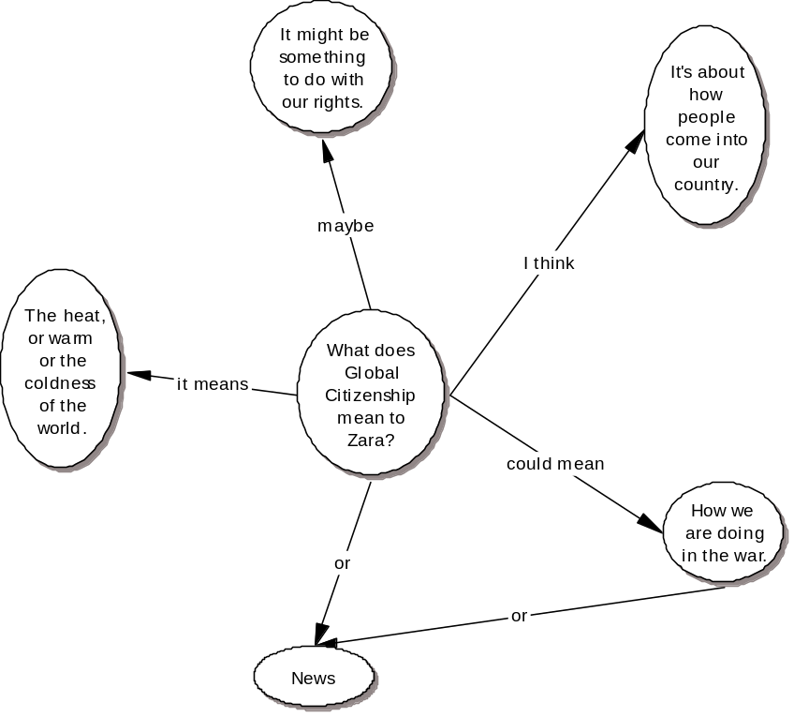
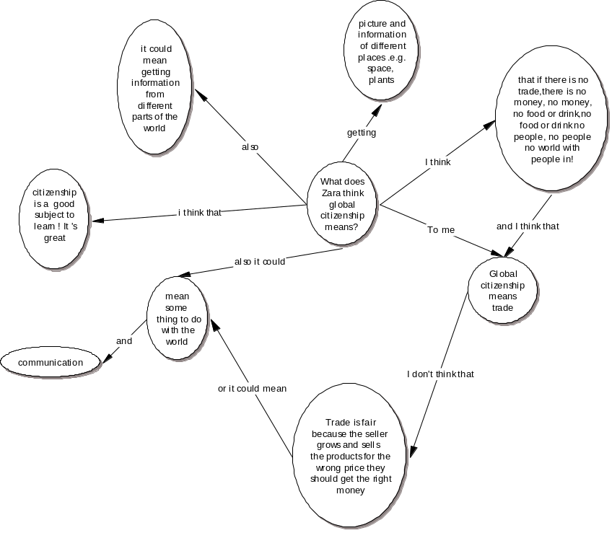
Summary of results
Figure 1. Example of pre-test concept mapping by Zara.
Figure 2. Example of post test concept mapping by Zara.

Slide 14
Summary of findings
Does critical learning take place as a result of e-learning?
- Concept mapping indicates transfer of new knowledge and concepts from the online discussion forum into individually produced concept mapping.
- Qualitative talk type evidence from the discussion forum indicates that pupils moved from initial stages of online learning to the more advanced stages of information exchange and knowledge construction.

Slide 15
Summary of findings
• Does key skill development take place as a result of
e-learning?
- Concept mapping indicates that higher order thinking skills have been used to forge links between concepts that increase propositions formation. This suggests that thinking has increased and that critical thinking and reasoning have been used.
- qualitative talk type data shows some increase in exploratory talk through the discussion period although this did not supersede cumulative talk. Exploratory talk requires interpersonal skills.
- evidence shows that key skills can be developed and online discussion forum may promote the development of key skills.

Slide 16
Summary of findings
What attitudes do pupils have towards
e-learning?
- The analysis of intentions and attitudes shows that pupils have positive attitudes towards e-learning and strong intentions to use e-learning activities. There are high social expectations to use e-learning and positive perceptions about the ability to undertake e-learning activities.

Slide 17
Conclusion
This study provides supporting evidence of the effectiveness of e-learning in online discussion environments to provide opportunities for collaboration and high-quality learning, promoting critical thinking for extending primary pupils concepts about global citizenship. The study establishes that primary pupils consider e-learning a valid and valuable learning tool.

